Slide 1

Joe Kaeser, President and CEO – Ralf P. Thomas, CFO
Q4 – Solid close to Fiscal 2013
Q4 FY 2013, Analyst Conference
London, November 7, 2013
Restricted © Siemens AG 2013. All rights reserved.

Slide 2
Safe Harbour Statement
This document contains statements related to our future business and financial performance and future events or developments involving Siemens that may
constitute forward-looking statements. These statements may be identified by words such as “expects,” “looks forward to,” “anticipates,” “intends,” “plans,”
“believes,” “seeks,” “estimates,” “will,” “project” or words of similar meaning. We may also make forward-looking statements in other reports, in presentations, in
material delivered to shareholders and in press releases. In addition, our representatives may from time to time make oral forward-looking statements. Such
statements are based on the current expectations and certain assumptions of Siemens’ management, and are, therefore, subject to certain risks and uncertainties.
A variety of factors, many of which are beyond Siemens’ control, affect Siemens’ operations, performance, business strategy and results and could cause the
actual results, performance or achievements of Siemens to be materially different from any future results, performance or achievements that may be expressed or
implied by such forward-looking statements or anticipated on the basis of historical trends. These factors include in particular, but are not limited to, the matters
described in Item 3: Key information—Risk factors of our most recent annual report on Form 20-F filed with the SEC, in the chapter “Risks” of our most recent
annual report prepared in accordance with the German Commercial Code, and in the chapter “Report on risks and opportunities” of our most recent interim report.
Further information about risks and uncertainties affecting Siemens is included throughout our most recent annual and interim reports, as well as our most recent
earnings release, which are available on the Siemens website, www.siemens.com, and throughout our most recent annual report on Form 20-F and in our other
filings with the SEC, which are available on the Siemens website, www.siemens.com, and on the SEC’s website, www.sec.gov. Should one or more of these risks
or uncertainties materialize, or should underlying assumptions prove incorrect, actual results, performance or achievements of Siemens may vary materially from
those described in the relevant forward-looking statement as being expected, anticipated, intended, planned, believed, sought, estimated or projected. Siemens
neither intends, nor assumes any obligation, to update or revise these forward-looking statements in light of developments which differ from those anticipated.
All underlying margins are calculated by adjusting margins for the effects reported for the respective businesses in the relevant period. These effects are provided
to assist in the analysis of the businesses' results year-over-year and may vary from period to period. Underlying margins are not necessarily indicative of future
performance. Other companies may calculate similar measures differently.
Due to rounding, numbers presented throughout this and other documents may not add up precisely to the totals provided and percentages may not precisely
reflect the absolute figures.
Restricted © Siemens AG 2013. All rights reserved.
Page 2
London, November 7, 2013
Q4 FY 2013, Analyst Conference

Slide 3
Our agenda for today
Key Financials Q4 Fiscal 2013
Ongoing portfolio matters
Shareholder return
Priorities for Fiscal 2014
Outlook 2014 and beyond
Restricted © Siemens AG 2013. All rights reserved.
Page 3
London, November 7, 2013
Q4 FY 2013, Analyst Conference

Slide 4
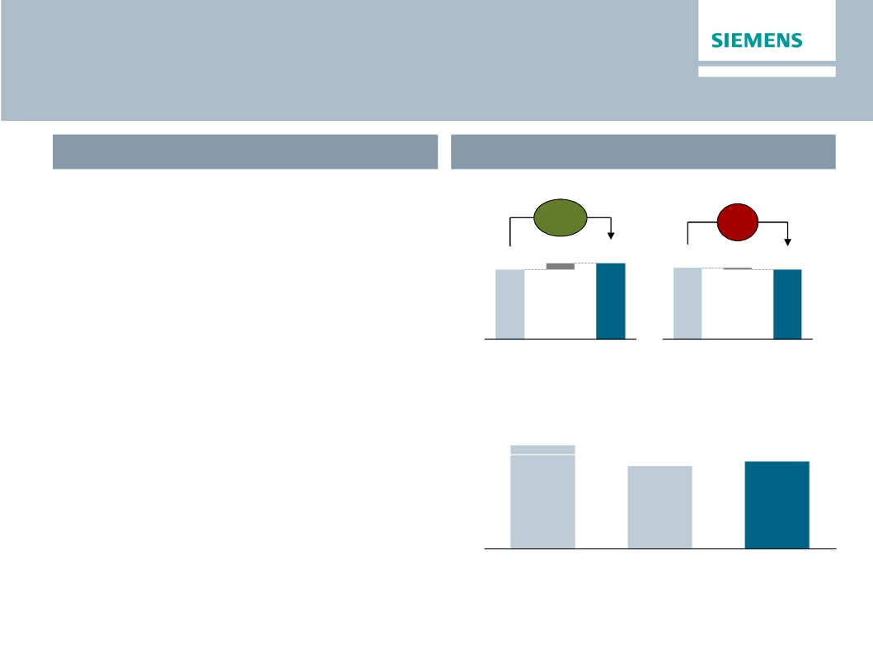
Despite higher transformation efforts we achieved
our revised Fiscal 2013 guidance
FY 2013 Outlook (as of Q3/2013)
FY 2013 Actual Performance
Orders (€bn)
Revenue (€bn)
· For Fiscal 2013, we expect clear order
growth and a moderate decline in revenue
compared to the prior year, both on an
organic basis.
· Charges associated with the 'Siemens 2014'
program in the Sectors are expected to total
comp.
+10%
6.4
comp.
-1%
1.5
76.0
FY
2012
82.4
FY
2013
77.4
FY
2012
75.9
FY
2013
approximately €1.0bn for the full fiscal year.
Income continuing operations (€bn)
· Given these developments and financial
results for the first nine months, we expect
income from continuing operations of
€4.0bn in Fiscal 2013 including the solar
business and NSN.
Restricted © Siemens AG 2013. All rights reserved.
4.5 - 5.0
Outlook as
of Nov. 2012
4.0
Revised as
of July 2013
4.2
FY 2013
Page 4
London, November 7, 2013
Q4 FY 2013, Analyst Conference

Slide 5
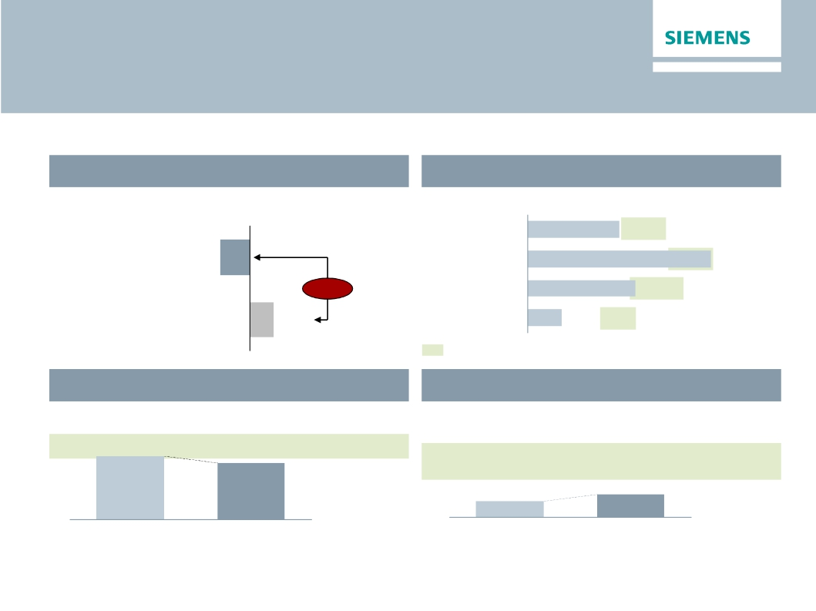
One Siemens cockpit – FY 2013
Call for focus on profitability & capital efficiency in FY 2014
Financial target system
Growth1)
Revenue growth (rolling 4 quarters FY 13)
Margins compared to industry benchmarks
EBITDA Margins (FY 2013)
Energy
9.9%
10-15%
Siemens
-2.0%
Healthcare
19.8%
15-20%
-3.6%
Industry
11.6%
11-17%
Competitors
1.6%
Infrastr. & Cities
3.7%
8-12%
EBITDA margins of respective markets throughout business cycles
Capital structure
Adjusted industrial net debt/EBITDA
Capital efficiency
ROCE adjusted (continuing operations)
15.5%
13.8%
15-20%
0.5-1.0x
0.2x
FY 2012
0.3x
FY 2013
FY 2012
1) As reported
FY 2013
Restricted © Siemens AG 2013. All rights reserved.
Page 5
London, November 7, 2013
Q4 FY 2013, Analyst Conference

Slide 6
Growth is driven by emerging markets
Regional business split
Key developments
Q4 FY 13 Order growth y-o-y1)
· Europe – Lower volume of large orders
Europe/C.I.S./Africa/ME
-10%
· Americas – Sharp recovery of U.S. Wind
(therein Germany)
+5%
business and large Fossil orders
Americas
(therein U.S.)
Asia/Australia
+18%
+26%
+14%
· China – Strength in Healthcare and
Transportation & Logistics
· Emerging markets up 21% and accounting for
(therein China)
Q4 FY 13 Revenue growth y-o-y1)
Europe/C.I.S./Africa/ME
(therein Germany)
+6%
-1%
37% of order volume
· Softness in industrial short-cycle business
· Continued weakness in Southern Europe
compensated by Northern Europe and Africa
4%
Americas
(therein U.S.)
0%
· U.S. – Down on tough comps (Wind at peak
in 2012)
-9%
Asia/Australia
(therein China)
3%
2%
· Emerging markets up 8% and accounting for
36% of revenue
· China – Healthcare compensates for lower
1) Change is adjusted for currency translation and portfolio effects
Restricted © Siemens AG 2013. All rights reserved.
Energy revenues
Page 6
London, November 7, 2013
Q4 FY 2013, Analyst Conference

Slide 7
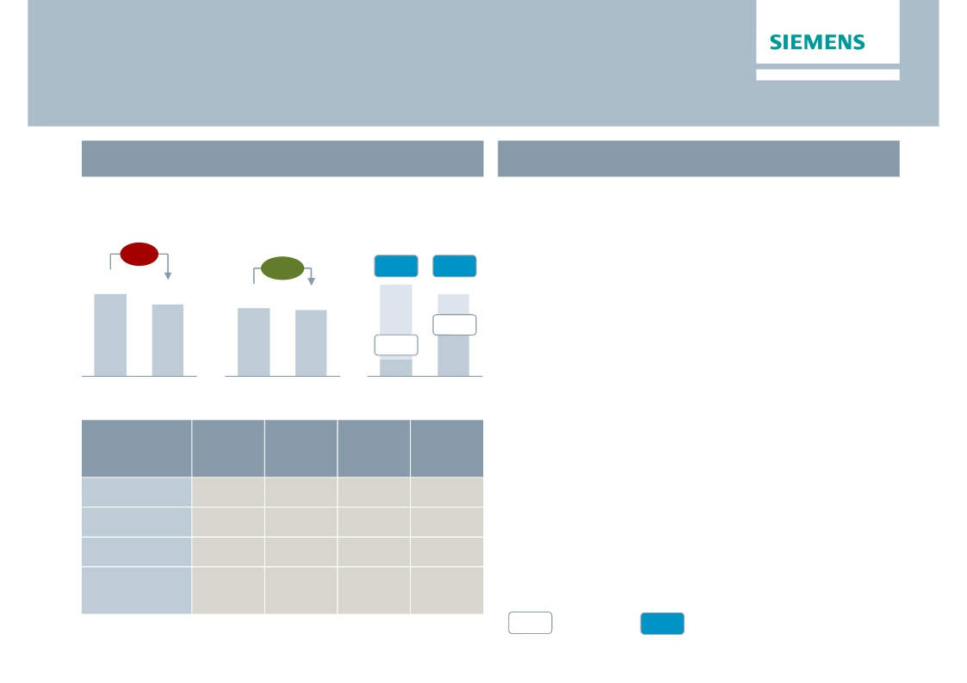
Energy – Solid Sector performance
Challenges in Transmission remain
Key Figures Energy
Main developments in Q4
€bn
Orders 1)
€m
Profit 2)
· Solid book-to-bill at 1.02 on lower volume of
major orders in Europe and Middle East
Revenue 1)
-7%
· Fossil – Solid profit impacted by lower products
& solutions revenue
· Wind – Higher offshore share drives profit
· Oil & Gas – Volume drives profit conversion
· Transmission – Turnaround program ongoing
+2%
11.1%
2.1%
163
10.6%
7.6%
564
8.7
7.6
7.6
7.4
Q4 12
Q4 13
Q4 12
Q4 13
Q4 12
Q4 13
· €151m transformation charges 'Siemens 2014'
Orders
y-o-y 1)
-7%
-33%
21%
5%
Revenue
y-o-y 1)
-3%
15%
16%
-8%
Profit
margin
13.9%
11.1%
11.3%
-2.4%
Underl.
profit
margin
16.1%
11.2%
12.1%
4.1%
Division
Fossil Power
Wind Power
Oil & Gas
Power
Transmission
· Legacy projects (e.g. grid access offshore,
Olkiluoto) continue to pose challenges
· FY 2014: Combination of Fossil and Oil & Gas
in a single Power Generation Division due to
changing customer demand
1) Comparable, i.e. adjusted for currency translation and portfolio effects
%
Profit margin
%
Underlying Profit margin
Restricted © Siemens AG 2013. All rights reserved.
2) for underlying margin calculation please refer to Flashlight document
Page 7
London, November 7, 2013
Q4 FY 2013, Analyst Conference

Slide 8
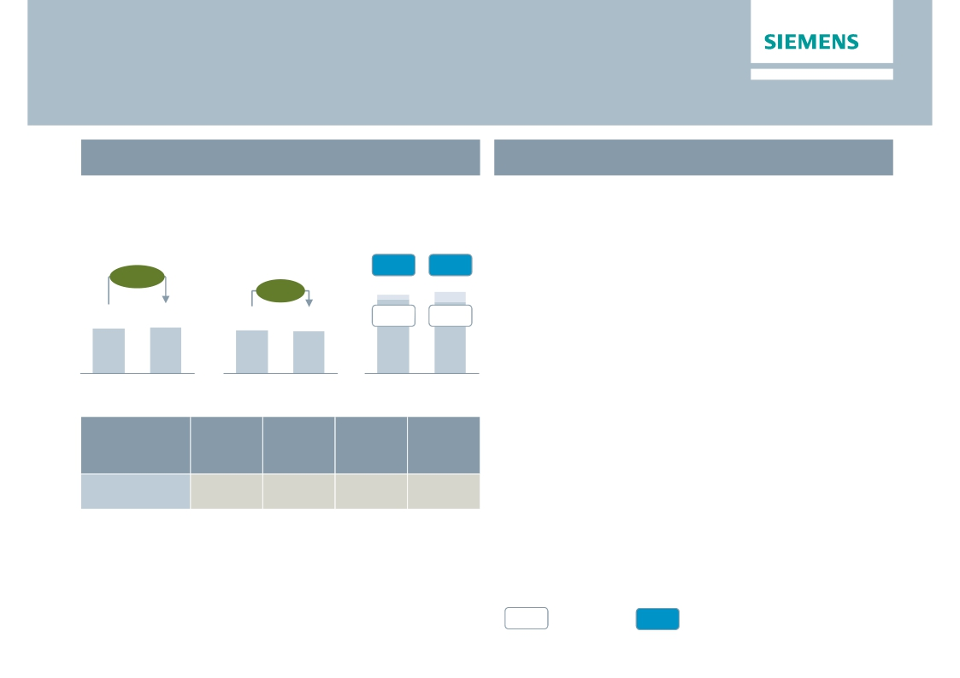
Healthcare – Strong performance continues
Key Figures Healthcare
Main developments in Q4
€bn
Orders 1)
+10%
€m
Profit 2)
17.6%
· Successful completion of 'Agenda 2013'
followed by 'Healthcare operating model'
· Order growth fueled by strong equipment and
service orders, and a major contract in the U.S.
Revenue 1)
+5%
18.6%
4.0
Q4 12
4.1
Q4 13
3.8
Q4 12
3.7
Q4 13
16.7%
631
Q4 12
16.1%
601
Q4 13
· Strong underlying margin expansion of
100 bps despite impact of U.S. medical device
tax
Underl.
profit
margin
14.1%
· Diagnostics – Asia drives growth, tight opex
control drives profit recovery
· €49m transformation charges 'Siemens 2014'
Division
Diagnostics
Orders
y-o-y 1)
4%
Revenue
y-o-y 1)
4%
Profit
margin
8.0%
1) Comparable, i.e. adjusted for currency translation and portfolio effects
%
Profit margin
%
Underlying Profit margin
Restricted © Siemens AG 2013. All rights reserved.
2) for underlying margin calculation please refer to Flashlight document
Page 8
London, November 7, 2013
Q4 FY 2013, Analyst Conference

Slide 9
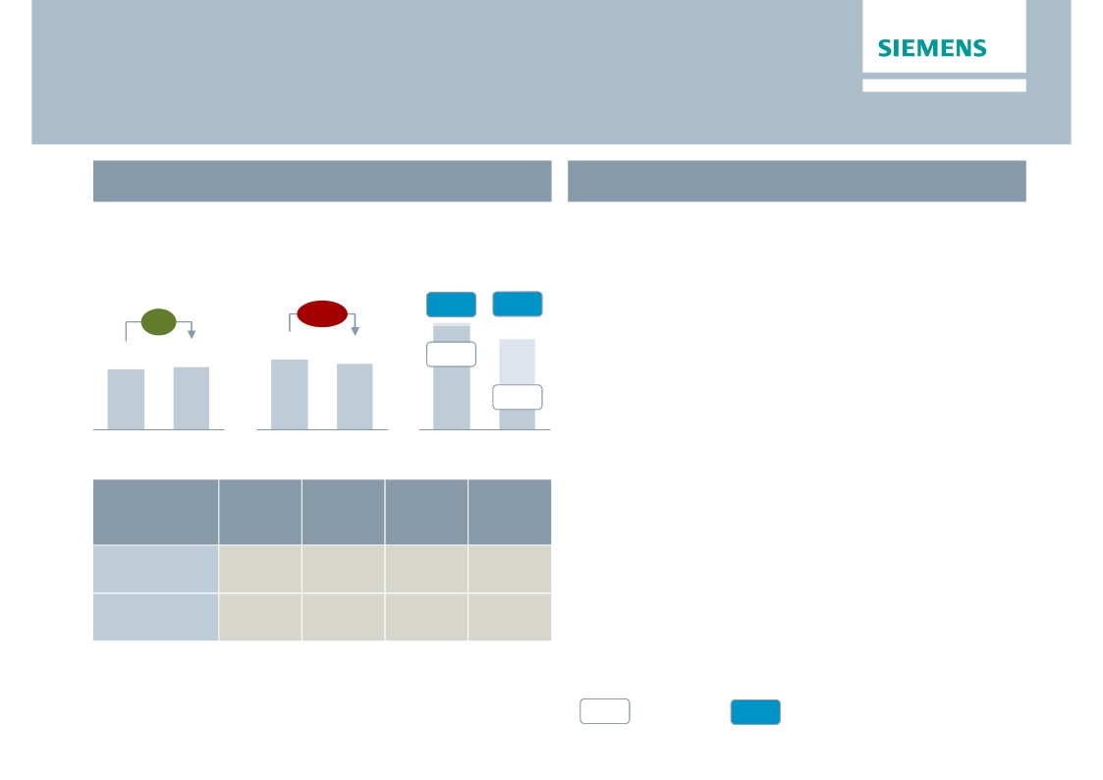
Industry – Timely completion of transformation efforts
Profit impacted by substantial transformation charges
Key Figures Industry
€m
Main developments in Q4
· Market bottoming – no reasons for
€bn
Orders 1)
Revenue 1)
Profit 2)
overexcitement on recovery
-2%
14.0%
13.5%
721
12.5%
5.5%
278
· Industry Automation – Revenue decline
impacts margin development; discrete
automation still behind in short-cycle recovery
· Drive Technologies – Pick up of large orders in
8%
4.6
4.8
5.3
5.0
long-cycle business; less favourable revenue mix
held back profit
Q4 12
Q4 13
Q4 12
Q4 13
Q4 12
Q4 13
Orders
y-o-y 1)
0%
7%
Revenue
y-o-y 1)
-4%
2%
Profit
margin
13.2%
3.3%
Underl.
profit
margin
17.9%
9.3%
Division
Industry
Automation
Drive
Technologies
· Metals business – Impacted by €52m charges,
needs tighter focus and reorientation
· €232m transformation charges 'Siemens 2014'
1) Comparable, i.e. adjusted for currency translation and portfolio effects
%
Profit margin
%
Underlying Profit margin
Restricted © Siemens AG 2013. All rights reserved.
2) for underlying margin calculation please refer to Flashlight document
Page 9
London, November 7, 2013
Q4 FY 2013, Analyst Conference

Slide 10
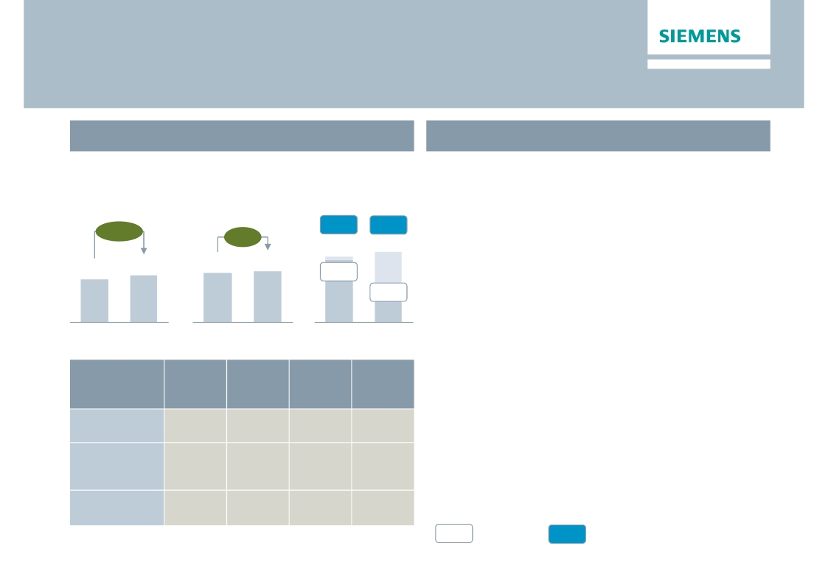
Infrastructure & Cities – While top-line grows, focus is
on improving cost efficiency and project execution
Key Figures Infrastructure & Cities
€m
Main developments in Q4
· Orders – Rolling stock drives growth; while
€bn
Orders 1)
+10%
Revenue 1)
+5%
Profit 2)
8.8%
margins on orders are decent, proper execution
is key
8.9%
5.0
5.2
· Transportation & Logistics – Focus on
restructuring and Invensys integration; €46m
4.4
4.8
8.3%
416
Q4 12
3.2%
166
Q4 13
impairment on Postal & Baggage Handling
· Power Grid Solutions & Products – €30m
Q4 12
Q4 13
Q4 12
Q4 13
Underl.
profit
margin
5.9%
10.2%
12.3%
impairment impacts decent profits
· Building Technologies – Structural cost
improvements show their benefits
· €255m transformation charges 'Siemens 2014'
(incl. impairments)
Division
Transportation
& Logistics
Power Grid
Solutions
& Products
Building
Technologies
Orders
y-o-y 1)
29%
6%
0%
Revenue
y-o-y 1)
8%
3%
3%
Profit
margin
-4.0%
6.0%
10.5%
1) Comparable, i.e. adjusted for currency translation and portfolio effects
%
Profit margin
%
Underlying Profit margin
Restricted © Siemens AG 2013. All rights reserved.
2) for underlying margin calculation please refer to Flashlight document
Page 10
London, November 7, 2013
Q4 FY 2013, Analyst Conference

Slide 11
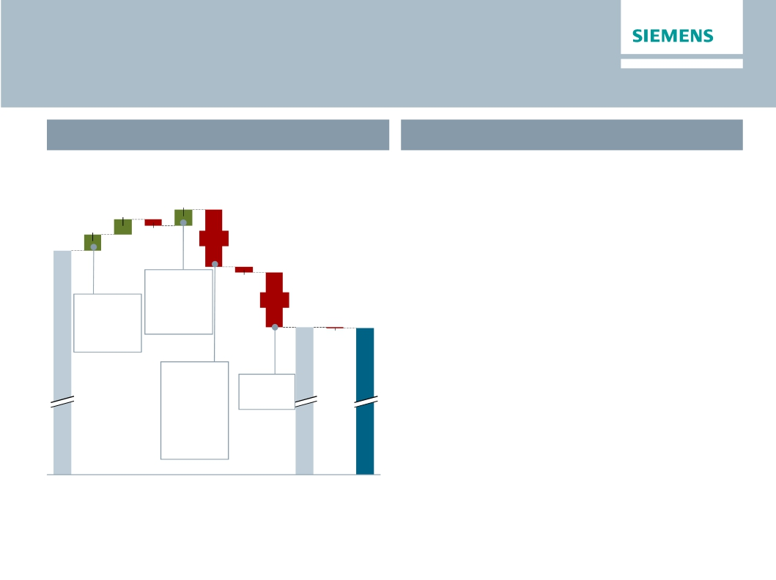
Below Total Sectors
FY 2014 – lower volatility in Equity Investments expected
Q4 FY 2013 'Below Total Sectors'
What to expect in FY 2014
€m
· Equity Investments
107
112
· Lower volatility through NSN exit
110
· Expect ~€100m contribution for FY 2014
· SFS & CMPA in line with FY 2013
1,609
-47
-396
Significant
disposal
-39
Therein:
-381
· SRE dependent on disposal gains
€76m gain
gains
1,075
1,068
on sale of
NSN stake
-7
· Corporate Items & Pensions
· Run rate of approx. -€250m per quarter
Therein:
-€101m
Pensions
- €295m
Corp. Items
Tax rate
@26%
· H2 typically higher than H1
· Corp. Treasury and other interest expense –
run rate of approx. -€50m per quarter is safe
· Disc. Ops – expect approx. -€100m impact
Total
Equity
SFS
CMPA
SRE
Corp.
Corp.
Tax
Inc.
Disc.
Net
Sectors
Inv.
Items
Tre.,
cont.
Ops.Income
Profit
&
Pen.
other
Ops
all in
Restricted © Siemens AG 2013. All rights reserved.
Page 11
London, November 7, 2013
Q4 FY 2013, Analyst Conference

Slide 12
Further progress in strengthening core activities by
active portfolio management
Solar ramp down ongoing
Energy
Healthcare
Industry
Infrastructure
& Cities
Below Total
Sectors
Turbocare JV Wood Group (49%)
TLT Turbo sold
Radiation Oncology ramp down
Partnership with Varian
Water Treatment
Low synergies, sold to AEA (Signed)
Postal & Baggage Handling
Limited synergies, niche business
Nokia Siemens Networks
Non-core, 50% share divested
Osram
Business model transition, spin-off
Q4 FY 2013, Analyst Conference
LMS International
Expansion of PLM portfolio
Invensys Rail
Strengthen Rail Automation
Restricted © Siemens AG 2013. All rights reserved.
Page 12
London, November 7, 2013

Slide 13
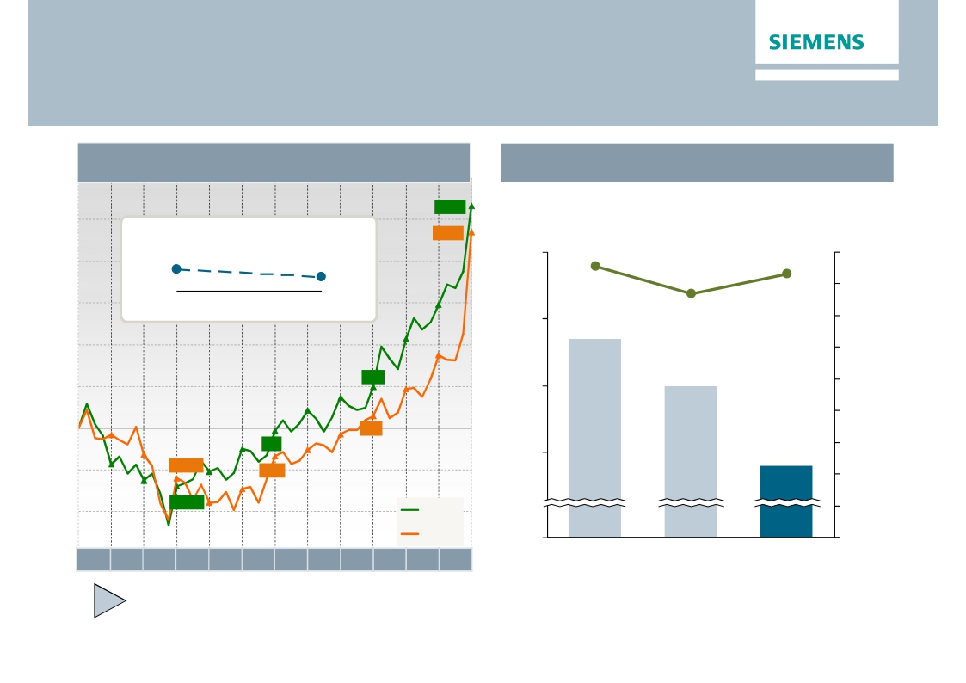
Free cash flow
Seasonal strong finish in Fiscal Q4
Free cash flow development ("all-in")
Advance payments / Billings in Excess
€m
Total Sectors
Advance payments & BiE
€bn
85.416
76.8
15
14.7
14.0
14
13
0
5,328
4,700
FY 2013
FY 2012
Orders
€bn
90
80
70
60
50
40
30
20
10
0
Operating Working Capital (OWC) turns
Total Sector
7.7
FY 2012
FY 2013
992
291
-61
-1,204
-676
-1,395
9.0
83.1
12.8
Oct Nov Dec Jan Feb Mar Apr May Jun Jul Aug Sep
FY 2011
FY 2012
FY 2013
Operating working capital mainly impacted by change in customer payment behavior
Restricted © Siemens AG 2013. All rights reserved.
Page 13
London, November 7, 2013
Q4 FY 2013, Analyst Conference

Slide 14
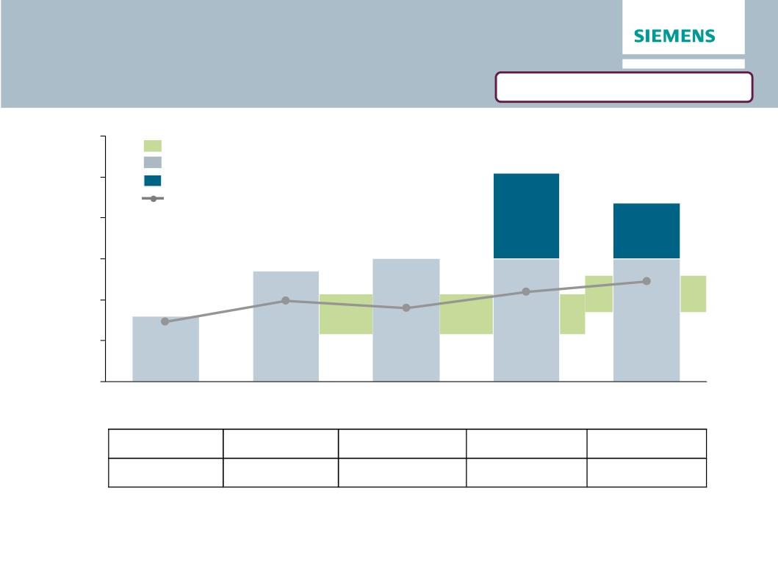
Attractive shareholder return driven by
stable dividend & share buyback
Corrected version from Nov 12, 2013
€
6.00
Payout ratio policy
Dividend per share
€ 5.10
5.00
Share buyback (SBB) effect per share
Dividend payout ratio3)
€ 4.37
4.00
3.00
2.00
SBB
51%
SBB
57%
46%
60%
40%
42%
1.00
34%
€ 1.60
€ 2.70
€ 3.00
€ 3.00
€ 3.00
0.00
2009
1,388
2.4%
2010
2,349
2.9%
2011
2,629
3.9%
2012
incl. SBB
4,294
6.1%
2013
incl. SBB
3,6861)
4.9%
Shareholder
return in €m
Yield2)
1)
2)
3)
Shares outstanding assumption of 845m (at AGM on January 28th 2014)
Calculation based on share price at AGM; for 2013 on closing share price of €89.06 on Sep. 30, 2013
Net Income all-in adjusted for exceptional non-cash items: Impairments at NSN (2009) & DX (2010), Impairments at Solar and NSN Restructuring (2012)
Note: 2012 comparable to 2013 (incl. IAS 19R), 2009-2011 as reported (excl. IAS 19R)
Restricted © Siemens AG 2013. All rights reserved.
Page 14
London, November 7, 2013
Q4 FY 2013, Analyst Conference

Slide 15

Further optimization of capital structure through
share buyback
Optimize capital structure ...
Adjusted industrial net debt/EBITDA
0.5-1.0x
Cash position
(FY 2013): €9.2bn
up to €4bn
... via share buyback – key facts
· Scope
· Planned buyback volume up to
€4bn
· Execution period up to 2 years
· Reasons
0.3x
up to 2 years
· Focus on continued shareholder
0.2x
return
· Following capital structure target
of One Siemens Framework
FY 2012
FY 2013
Potential
for share
buyback
Restricted © Siemens AG 2013. All rights reserved.
Page 15
London, November 7, 2013
Q4 FY 2013, Analyst Conference

Slide 16
Outlook Fiscal 2014
Basic earnings per share (Net income)
In €
·
We expect our markets to remain
challenging in Fiscal 2014.
At least 15%
growth
·
Our short-cycle businesses are not
anticipating a recovery until late in the fiscal
year.
6.55
5.08
·
·
·
·
We expect orders to exceed revenue, for a
book-to-bill ratio above 1.
Assuming that revenue on an organic basis
remains level year-over-year, we expect
basic earnings per share (Net Income) for
Fiscal 2014 to grow by at least 15% from
€5.08 in Fiscal 2013.
This outlook is based on shares outstanding
of 843 million as of September 30, 2013.
Furthermore it excludes impacts related to
4.74
FY 2011
FY 2012
FY 2013
FY 2014e
legal and regulatory matters.
Restricted © Siemens AG 2013. All rights reserved.
Page 16
London, November 7, 2013
Q4 FY 2013, Analyst Conference

Slide 17
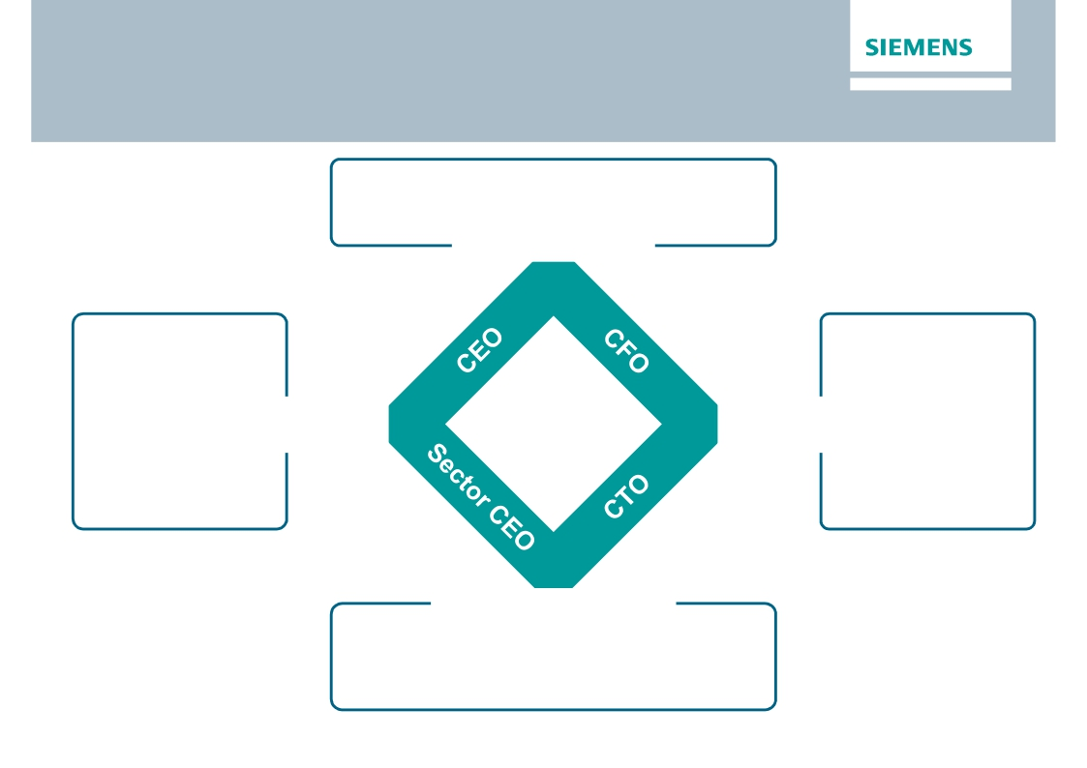
Operational priorities, clear roles & responsibilities
and value culture set the stage for review of strategy
'Siemens beyond 2014'
· Resource allocation
· Accountability
· Corporate Core
· Corporate Memory
Management Model
· Lead country
concept
· Localization
· Net Promoter
Score (NPS)
Metric for key
accounts
· Risk
management
· Capital efficiency
· Process
optimization
· Benchmarking
· Productivity
Customer
Proximity
Ownership-
Culture
Innovation Management
Operational
Excellence
· SW Architecture
· Innovation Board
· Partner models (VCs, …)
· Operational execution in Sector business
Restricted © Siemens AG 2013. All rights reserved.
Page 17
London, November 7, 2013
Q4 FY 2013, Analyst Conference

Slide 18
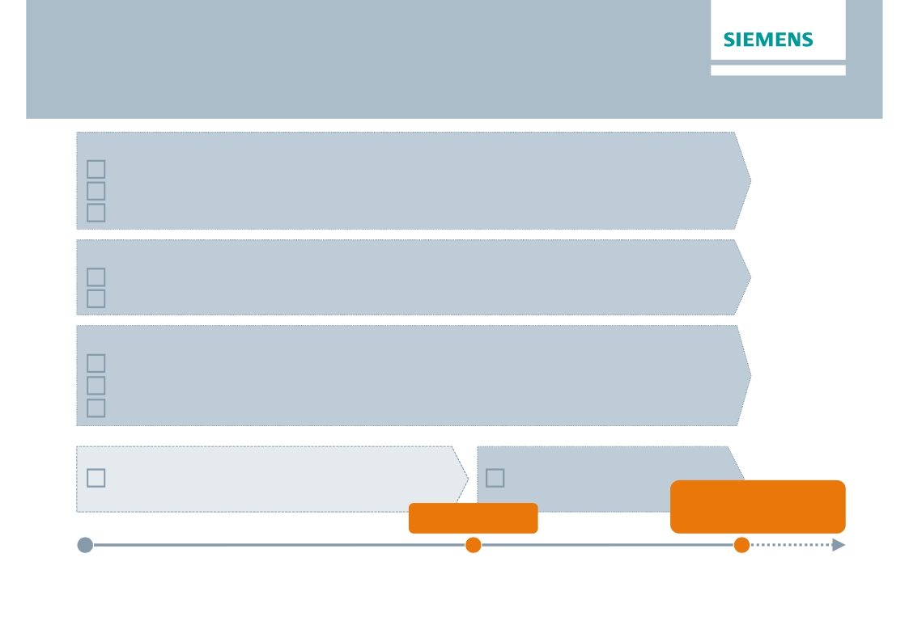
Our roadmap to shape 'Siemens beyond 2014'
Managing Board
Combine Sector and Region responsibility
Streamline Management Board
Foster accountability and alignment through individual incentive model
Regional organization – Secure and optimize customer interface
Set-up and implement lead country concept
Further bundle support office function in the regions
Corporate priorities
Monitor stringent delivery on productivity program Siemens 2014
Optimize corporate core
Evaluate process industries opportunities
Strategic concept 'Siemens beyond 2014'
October 2013
Restricted © Siemens AG 2013. All rights reserved.
Page 18
London, November 7, 2013
Implementation
'Siemens beyond 2014'
Announcement
May 2014
'Siemens beyond 2014'
in operation
October 2014
Q4 FY 2013, Analyst Conference

Slide 19
Appendix
Restricted © Siemens AG 2013. All rights reserved.
Page 19
London, November 7, 2013
Q4 FY 2013, Analyst Conference

Slide 20
Q4 FY 2013 – Key figures
Siemens (continuing operations), €m
Orders
Revenue
Book-to-bill ratio
Total Sectors profit
Income from continuing operations
Basic earnings per share (in €)
Free cash flow
1) Change is adjusted for portfolio and currency translation effects
Restricted © Siemens AG 2013. All rights reserved.
Q4 FY 12
21,251
21,444
0.99x
1,932
1,230
1.35
4,328
Q4 FY 13
21,011
21,168
0.99x
1,609
1,075
1.20
4,357
Change
3%1)
3%1)
-17%
-13%
-11%
1%
Page 20
London, November 7, 2013
Q4 FY 2013, Analyst Conference

Slide 21
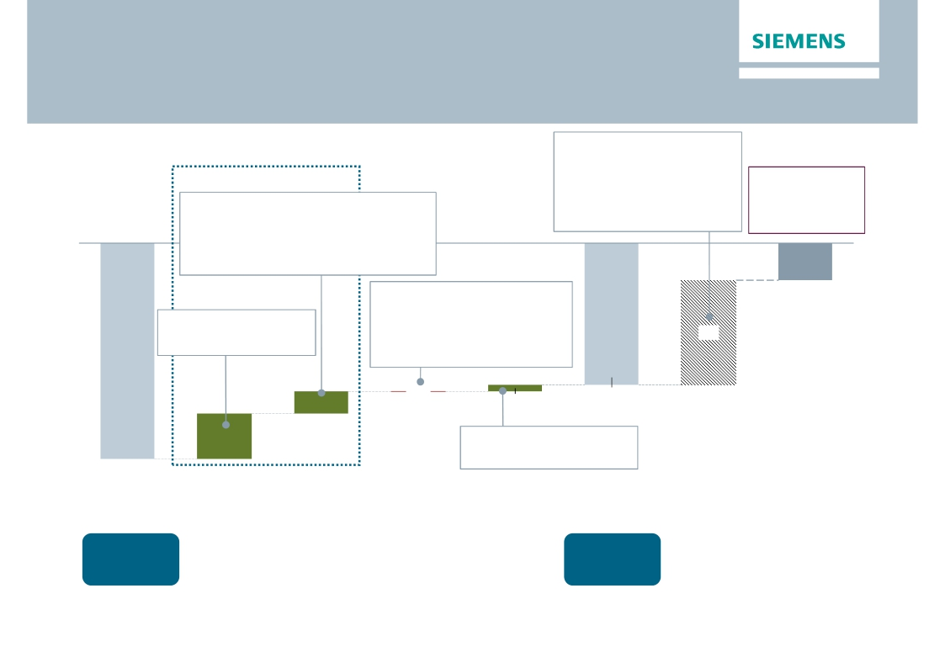
Net Debt Bridge as of Q4 FY13
€bn
Q4 Q3
· SFS Debt
· Pensions
· Credit guarantees
· Hybrid adjustments
· Fair value adj.
(hedge accounting)
+15.6
-9.3
-0.6
+0.9
+1.2
+0.6
+0.1
-0.0
+0.0
-0.1
Operating Activities
therein:
· Inventories net of advanced payments +0.7
· Trade and other receivables +0.6
· Trade payables
+0.7
· Billings in excess
-0.4
therein a.o.:
Adj. ind. Net Debt/
EBITDA
0.32x
(Q3 FY13: 1.22x)
-2.8
· CAPEX
-0.7
therein a.o.:
· Income (C/O)
· Proceeds from sale of
NSN (at Equity)
+1.7
+1.5
7.9
· D&A & Impairments +0.9
· Change in receivables from
financing activities (SFS)
-1.0
1.7
-0.0
0.5
-10.7
3.4
therein a.o.:
· Financing discontinued
-16.2
Net Debt
Q3 2013
Cash &
cash equiv.
€6.6bn2)
operations
Financing
topics
+0.3
Net Debt
Q4 2013
Cash &
cash equiv.
€9.8bn2)
Profitability/
other
operating
activities
Working
Capital1)
Net cash from
investing
activities
Net Debt adj.
Adj. ind.
Net Debt
Q4 2013
1) Includes net cash used in inventories less advanced payments received, net cash provided by trade and other receivables, net cash provided by trade payables and
flow in change in other assets and liabilities)
Restricted © Siemens AG 2013. All rights reserved.
net cash used in billings in excess of cost and in estimated earnings on uncompleted contracts and related advances (included in the consolidated statements of cash
2)
Including available-for-sale financial assets
Page 21
London, November 7, 2013
Q4 FY 2013, Analyst Conference

Slide 22
One Siemens financial framework
sets the aspiration
One Siemens
Financial target system
Siemens
Outperforming
revenue growth
Growth (nominal) >
most relevant competitors
M&A hurdle rates
1) EVA accretive within 3 years after integration
2) 15 percent cash return within 5 years
after closing3)
Capital efficiency
ROCE (cont. ops.)1)
15 - 20%
SFS ROE 2)
15 - 20%
Capital structure
Adjusted industrial net debt /
EBITDA
0.5 - 1.0x
Payout ratio
(Dividend + Share buyback)
40 - 60% 4)
Sectors
Top EBITDA margins of respective markets throughout business cycles
Energy 10 – 15%
Healthcare 15 – 20%
Industry 11 – 17%
Infrastructure
& Cities
8 – 12%
Continuous improvement relative to market / competitors
1) After tax, adjusted primarily for SFS debt, pension plans and similar commitments, hedge accounting of bonds 2) After tax
3) Cash return: Free cash flow divided by average capital employed
Restricted © Siemens AG 2013. All rights reserved.
4) Of net income excluding exceptional non-cash items
Page 22
London, November 7, 2013
Q4 FY 2013, Analyst Conference

Slide 23
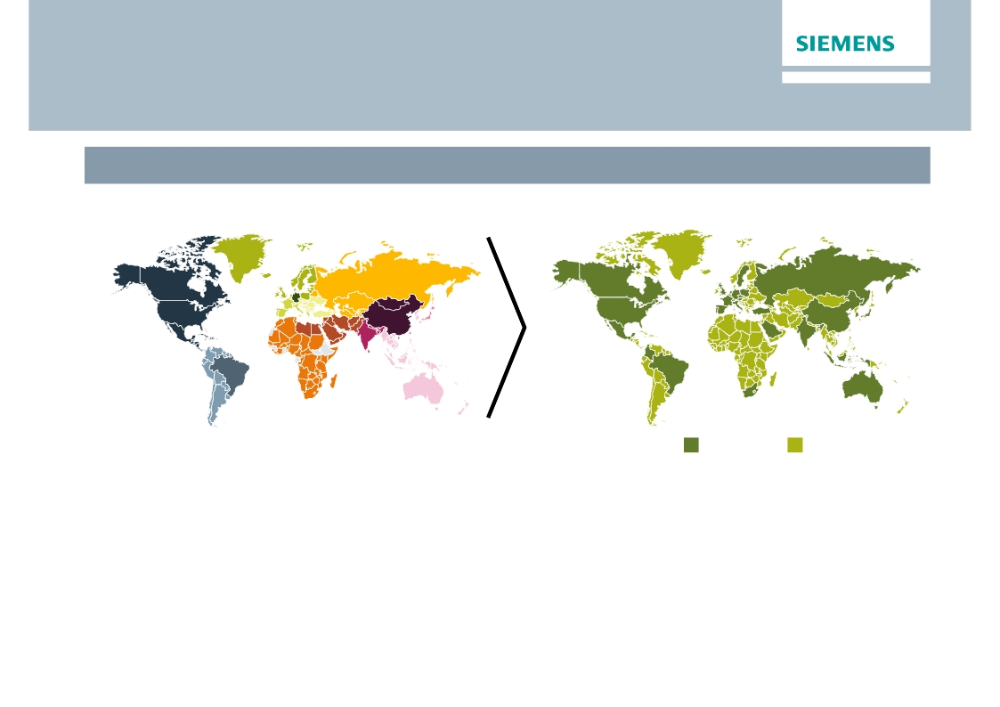
Improve customer proximity through simplified
regional organization
Simplified regional set-up as of Nov. 1, 2013
Old set-up: 14 Regional Clusters
· Elimination of one organizational level (Clusters)
New set-up: 30 Lead Countries
Lead Countries
Assigned Countries
· 30 Lead Countries, covering > 85% of Siemens’ business; other Countries are assigned to Lead
Countries; Lead Countries report to Managing Board
› Strengthened countries and increased customer proximity to increase regional business
› Direct interaction between Lead Countries and global headquarters to speed up decision making
› Optimization of support functions to improve productivity
Restricted © Siemens AG 2013. All rights reserved.
Page 23
London, November 7, 2013
Q4 FY 2013, Analyst Conference

Slide 24
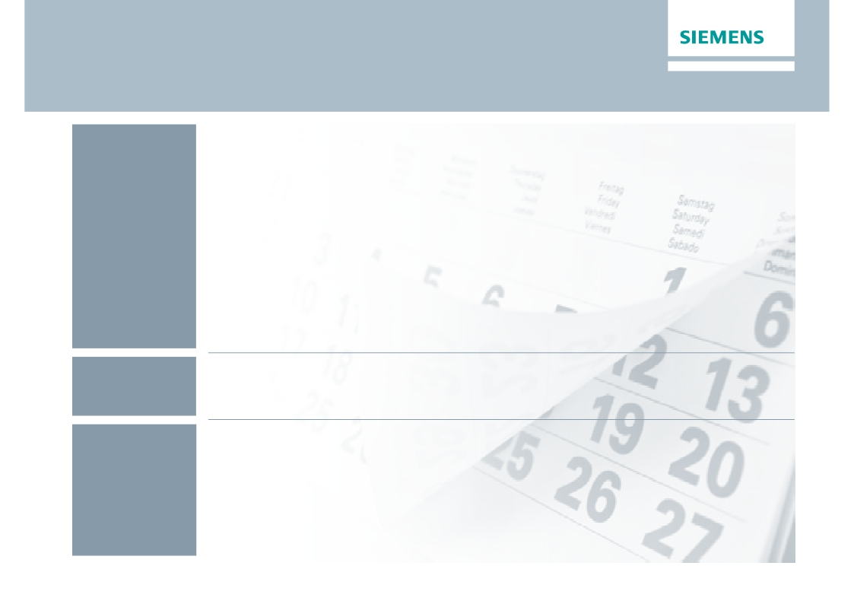
Financial calendar
November
December
January
November 7 - 8, 2013
Q4 Earnings Release / Analyst Conference, Roadshow UK (London)
November 12, 2013
Roadshow France (Paris)
November 13, 2013
Roadshow Germany (Frankfurt)
November 18 - 19, 2013
Roadshow U.S. (Boston, New York)
December 4 - 5, 2013
Capital Market Day Infrastructure & Cities (London)
January 13, 2014
Commerzbank German Investment Seminar (New York)
January 28, 2014
Q1 Earnings Release; Annual General Meeting
Restricted © Siemens AG 2013. All rights reserved.
Page 24
London, November 7, 2013
Q4 FY 2013, Analyst Conference

Slide 25

Siemens Investor Relations contact data
Mariel von Drathen
Munich Office
Fax:
Internet:
+49-89-636-33780
+49-89-636-32474
+49-89-636-32830
http://www.siemens.com/investorrelations
Email: investorrelations@siemens.com
Restricted © Siemens AG 2013. All rights reserved.
Page 25
London, November 7, 2013
Q4 FY 2013, Analyst Conference

Slide 26
Reconciliation and Definitions for
Non-GAAP Measures
This document includes supplemental financial measures that are or may be non-GAAP financial measures.
Orders and order backlog; adjusted or organic growth rates of revenue and orders; book-to-bill ratio; Total Sectors profit; return on equity (after tax), or ROE (after
tax); return on capital employed (adjusted), or ROCE (adjusted); Free cash flow, or FCF; adjusted EBITDA; adjusted EBIT; adjusted EBITDA margins, earnings
effects from purchase price allocation, or PPA effects; net debt and adjusted industrial net debt are or may be such non-GAAP financial measures.
These supplemental financial measures should not be viewed in isolation as alternatives to measures of Siemens’ financial condition, results of operations or cash
flows as presented in accordance with IFRS in its Consolidated Financial Statements. Other companies that report or describe similarly titled financial measures
may calculate them differently.
Definitions of these supplemental financial measures, a discussion of the most directly comparable IFRS financial measures, information regarding the usefulness
of Siemens’ supplemental financial measures, the limitations associated with these measures and reconciliations to the most comparable IFRS financial measures
are available on Siemens’ Investor Relations website at www.siemens.com/nonGAAP. For additional information, see supplemental financial measures and the
related discussion in Siemens’ most recent annual report on Form 20-F, which can be found on our Investor Relations website or via the EDGAR system on the
website of the United States Securities and Exchange Commission.
Revenue growth - Performance against competition
To illustrate management’s perspective on the Company’s performance against competition, Siemens compares its own revenue growth rate with the weighted
average revenue growth rate of its Sectors’ most relevant competitors, including, among others, ABB, GE, Philips, Rockwell and Schneider. Revenue growth for
Siemens and its competitors is calculated as the actual growth rate over a rolling four quarter period compared to the same period a year earlier. Siemens
competitors revenue growth is derived as the weighted average growth rate of dedicated competitor baskets defined for each Siemens Sector. Each Sector
basket's growth rate is based upon the most recent reported competitor revenues publicly available at the time of calculation. The Sector competitor baskets
revenue growth rates are weighted by the revenue of the respective Siemens Sector.
This measure may provide useful information to investors with respect to management’s view on Siemens’ growth compared to competitor growth. However, we
caution investors, that this measure is subject to certain limitations, which include the following: The metric is defined by Siemens and, as such, is not based on a
generally accepted framework that is also relevant for other companies; accordingly, other companies may define a similarly titled measure differently. In
calculating this measure, Siemens relies on data published by its competitors for which Siemens assumes no responsibility. In addition, the data may not be
directly comparable as a result of differing presentation currencies and reporting standards being used by our competitors in the data’s presentation. Furthermore,
subject to limited exceptions, no adjustments are made for currency translation effects, portfolio changes and changes in reporting structure for either the Siemens
or the competitor data. Because the public availability of relevant competitors’ data at the time of calculation may not coincide with the availability of Siemens’ data,
some competitor data used may relate to a different time period than the Siemens data.
Restricted © Siemens AG 2013. All rights reserved.
Page 26
London, November 7, 2013
Q4 FY 2013, Analyst Conference

