Slide 1

Joe Kaeser, President and CEO
Siemens – Vision 2020
JP Morgan Pan-European Capital Goods CEO Conference
June 12, 2014
© Siemens AG 2014. All rights reserved.

Slide 2
Safe Harbour Statement
This document contains statements related to our future business and financial performance and future events or developments involving Siemens that may
constitute forward-looking statements. These statements may be identified by words such as “expect,” “look forward to,” “anticipate,” “intend,” “plan,” “believe,”
“seek,” “estimate,” “will,” “project” or words of similar meaning. We may also make forward-looking statements in other reports, in presentations, in material
delivered to shareholders and in press releases. In addition, our representatives may from time to time make oral forward-looking statements. Such statements
are based on the current expectations and certain assumptions of Siemens’ management, and are, therefore, subject to certain risks and uncertainties. A variety
of factors, many of which are beyond Siemens’ control, affect Siemens’ operations, performance, business strategy and results and could cause the actual results,
performance or achievements of Siemens to be materially different from any future results, performance or achievements that may be expressed or implied by
such forward-looking statements or anticipated on the basis of historical trends. These factors include in particular, but are not limited to, the matters described in
Item 3: Key information—Risk factors of our most recent annual report on Form 20-F filed with the SEC, in the chapter C.9.3 Risks of our most recent annual
report prepared in accordance with the German Commercial Code, and in the chapter C.7 Risks and opportunities of our most recent interim report.
Further information about risks and uncertainties affecting Siemens is included throughout our most recent annual and interim reports, as well as our most recent
earnings release, which are available on the Siemens website, www.siemens.com, and throughout our most recent annual report on Form 20-F and in our other
filings with the SEC, which are available on the Siemens website, www.siemens.com, and on the SEC’s website, www.sec.gov. Should one or more of these risks
or uncertainties materialize, or should underlying assumptions prove incorrect, actual results, performance or achievements of Siemens may vary materially from
those described in the relevant forward-looking statement as being expected, anticipated, intended, planned, believed, sought, estimated or projected. Siemens
neither intends, nor assumes any obligation, to update or revise these forward-looking statements in light of developments which differ from those anticipated.
All underlying margins are calculated by adjusting margins for the effects reported for the respective businesses in the relevant period. These effects are provided
to assist in the analysis of the businesses' results year-over-year and may vary from period to period. Underlying margins are not necessarily indicative of future
performance. Other companies may calculate similar measures differently.
Due to rounding, numbers presented throughout this and other documents may not add up precisely to the totals provided and percentages may not precisely
reflect the absolute figures.
The financial measures identified in this document are in part transitional figures attained by comparison, classification, appreciation and rounding of historical
financial measures; these financial measures and their transitional basis must be regarded as preliminary.
© Siemens AG 2014. All rights reserved.
Page 2
London, June 12, 2014 JP Morgan Conference

Slide 3
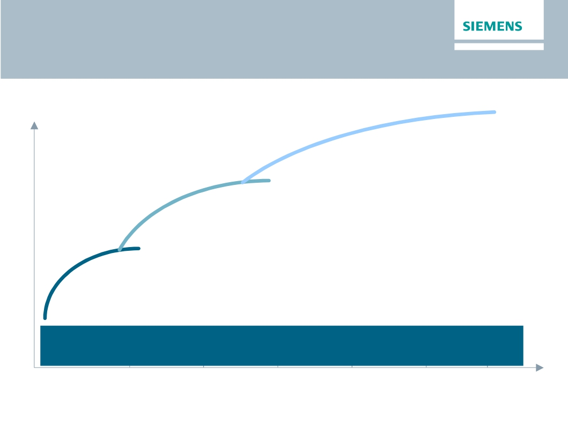
Siemens – Vision 2020: Strategic focus
"Siemens – Vision 2020"
Value
Scale up
e.g. growth in attractive fields
Strengthen core
e.g. portfolio along strategic imperatives
Drive performance
e.g. cost reduction and business excellence
Foster ownership culture and
leadership based on common values
2015
© Siemens AG 2014. All rights reserved.
2016
2017
2018
2019
2020
Page 3
London, June 12, 2014 JP Morgan Conference

Slide 4
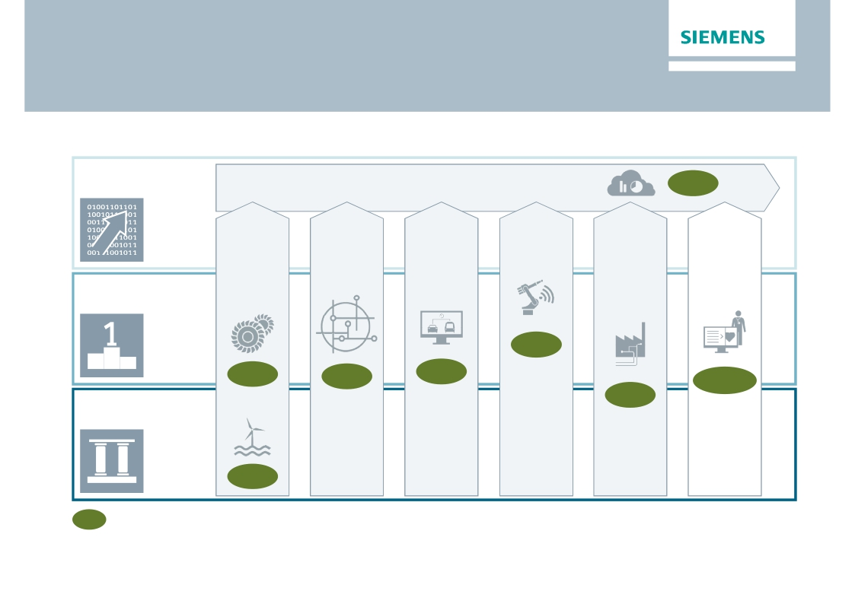
Stringent resource allocation for growth fields in
Electrification, Automation and Digitalization
Selected growth fields
Digitalization
Business Analytics & Data-driven Services
Software & IT solutions
8%
'Digital twin'
Software
7%
Image
guided
Therapy,
Molecular
Diagnostics,
etc.
8-10%
Distribution
Grid
Automation
& Software
7%
Road & City
Mobility,
tolling
6%
Key
Verticals
e.g.
O&G, F&B
6%
Automation
Electrification
Flexible &
Small GT
8%
Offshore
18%
x%
Est. market growth
2013-2020 (CAGR)
Power to
last
Drive energy
management
Efficient
urban
mobility
Shape
Industrie
4.0
Grow in
Process
Industries
Next
Generation
Healthcare
© Siemens AG 2014. All rights reserved.
Page 4
London, June 12, 2014 JP Morgan Conference

Slide 5
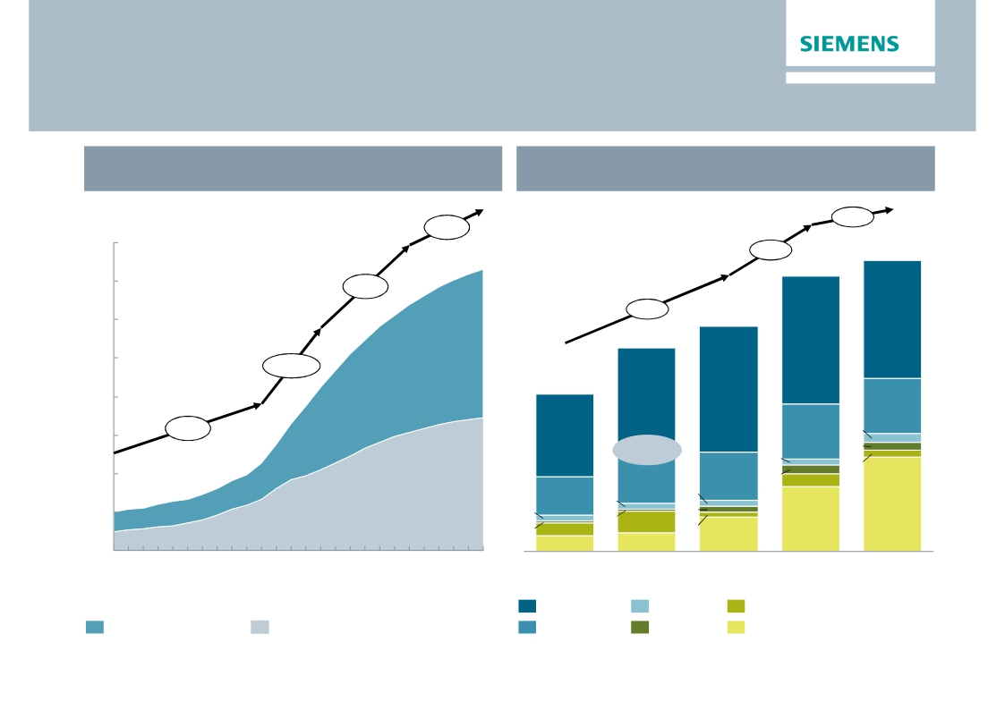
Unconventional Oil & Gas opportunities remain very
attractive
Global unconventional O&G supply development
Production, in Mbbl/d
Regional capex split for unconventionals,
top 5 countries in 2025, USD billion
+3%
1.1%
40
4.1%
272
257
35
+7%
30
9.3%
210
110
190
119
25
+17%
20
147
118
99
51
15
+9%
78
52
8
7
7
75%
5
10
46
45
8
13
36
12
15
6
2
6
5
5
88
5
0
5
2
20
17
60
32
2000
2005
2010
2015
2020
2025
2011
United States
2013
China
2015
2020
Australia
2025
Unconventional liquids
Source: Rystad Ucube 2014
Unconventional gas
Canada
Venezuela
Sum Others
© Siemens AG 2014. All rights reserved.
Page 5
London, June 12, 2014 JP Morgan Conference

Slide 6

Acquisition of Rolls-Royce's Aero Derivative Gas
Turbine business offers great value
Transaction scope
Transaction rationale 3)
·
·
Acquisition of 100% of Rolls-Royce's aero-derivative gas
turbine (ADGT) and compressor business including
related services business
Only part of Rolls-Royce's Energy Business
ADGT's are an attractive power
supply option e.g. for offshore
oil & gas and for decentralized
power generation
1
2
3
4
5
Excellent fit – complementary technologies
Strengthens focus area Oil & Gas and
Decentralized Power
Innovation leader with ''best in breed'' gas turbines
supported by access to aero-technology
World-class global service platform
Significant synergies and enabling business
Transaction facts
Selected Rolls-Royce ADGT business financials
(2013)
·
·
·
·
·
Purchase price of £785m 1)
Additional £200m for 25 years exclusive access to future
Rolls-Royce aero-technology developments and
preferred access to supply and engineering services
Ramp up to £50m+ annual gross cost synergies until
FY2017 2) (~2/3 of long-term run-rate gross cost synergies)
EVA accretive in FY2020
Closing expected by end of December 2014 subject to
regulatory approvals
·
·
·
·
Sales:
Installed fleet:
EBIT:
Employees:
£871m, thereof ~60% service
~2,500 ADGT
£72m (~8.3% EBIT margin)
~2,400
Portfolio completion with key aero-derivative gas turbine technology for growth
in the oil & gas industry and in decentralized power supply
1) On a cash-and-debt-free basis; 2) Pre integration & transformation cost 3) Transaction rationale details – see slides in appendix
© Siemens AG 2014. All rights reserved.
Page 6
London, June 12, 2014 JP Morgan Conference

Slide 7
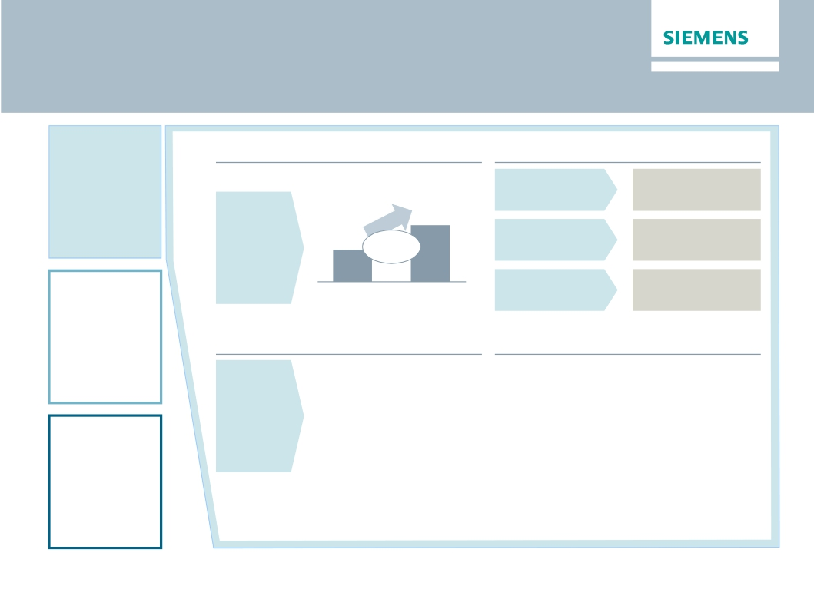
Digitalization: From data to business
Digitalization
Attractive market in Siemens verticals
Market (€bn)1
Substantial profit margins achievable
IT enhanced
>30%
Services
Software
&
Vertical IT
100
56
CAGR
+8%
Software
products
>20%
Automation
Solutions
Combined SW
& HW solutions
2012
2020
>15%
Innovative business models
· Meter data management
Key enablers
· Cloud strategy
in the cloud
· Data Analytics enriched
plant control
· Siemens remote service
platform across divisions
· Data analytics platform
· Applications on top of platforms
· Strong partnerships
Business
model
innovation
Electrification
1) Source internal: Siemens market for vertical IT
© Siemens AG 2014. All rights reserved.
Page 7
London, June 12, 2014 JP Morgan Conference

Slide 8
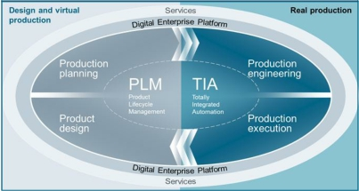
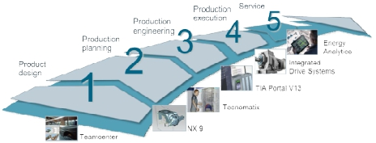
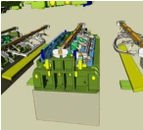


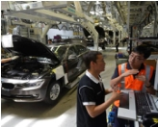

Digital Factory:
Shaping the future of manufacturing with Industrie 4.0
Merging the virtual and real worlds
End-to-end view of product development
and production process
Improving competitiveness
through
Shortened time-to-market
-20%
development
time
Increased efficiency
-40% energy
+14% output
© Siemens AG 2014. All rights reserved.
Enhanced flexibility
Shenyang:
3 models
on 1 line
Page 8
London, June 12, 2014 JP Morgan Conference

Slide 9
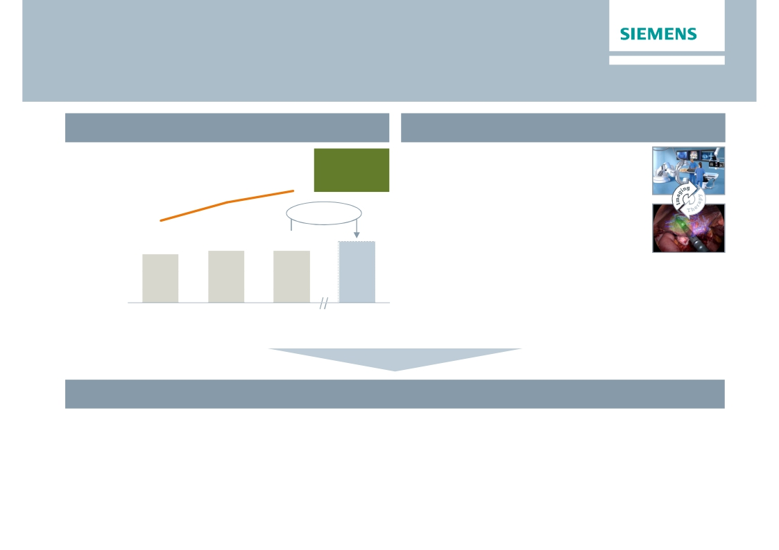
Healthcare with higher entrepreneurial flexibility –
separately managed under the Siemens umbrella
Strong position, resilient performance
Distinct trends at work
Margin
range
15-19%
· Customer & market structures in tran-
sition (e.g. value-based reimbursement,
convergence of diagnosis & therapy)
Profit
excl. ppa
16.3%
14.6%
in % of
revenue
12.0%
3-5% p.a.
· Long-term paradigm shifts:
· Potential disruptive technological
12.5
13.6
13.6
changes (e.g. Big data analytics,
knowledge based HC, molecular DX)
Revenue
in €bn
· Point of Care/Mobile HC
FY 2011
FY 2012
FY 2013
FY 2020e
Healthcare with individual set-up to succeed in changing environment
· Focus flexibly on market requirements
· Invest in growth opportunities to respond to paradigm shifts in the system
· Focus resource allocation to address distinct Healthcare industry characteristics
· Going public of Audiology
© Siemens AG 2014. All rights reserved.
Page 9
London, June 12, 2014 JP Morgan Conference

Slide 10

Flat and market driven organization along the value
chain will capture growth opportunities
Go-to-market
Americas
Middle
East, CIS1)
Europe,
Africa
Asia,
Australia
Global
Healthcare
Market
Separately
managed
Healthcare
Power
and Gas
PG
Wind
Power and
Renewables
WP
Energy
Manage-
ment
Building
Techno-
logies
Mobility
Digital
Factory
Process
Industries
and Drives
Financial
Services
Divisions (Global P&L)
Power Generation
Services
PS
EM
BT
ManagingBoard
MO
DF
PD
HC
SFS
Corporate Services
1) Commonwealth of Independent States
© Siemens AG 2014. All rights reserved.
Corporate Core
Page 10
London, June 12, 2014 JP Morgan Conference

Slide 11
One Siemens Financial Framework
sets the aspiration
One Siemens
Financial Framework
Siemens
Capital efficiency
Capital structure
Growth:
Siemens > most
relevant competitors1)
(Comparable revenue growth)
(ROCE2))
15-20%
Total cost productivity3)
3-5% p.a.
(Industrial net debt/EBITDA)
up to 1.0x
Dividend payout ratio
40-60%4)
Profit Margin ranges of businesses (excl. PPA)5)
PG
11-15%
WP
5-8%
EM
7-10%
BT
8-11%
MO
6-9%
DF
14-20%
PD
8-12%
HC
15-19%
SFS6)
15-20%
1) ABB, ALSTOM, GE, Rockwell and Schneider, weighted 2) Based on continuing and discontinued operations 3) Productivity measures divided by functional costs (cost of sales,
R&D-, SG&A-expenses) of the group 4) Of net income excluding exceptional non-cash items 5) excl. acquisition related amortization on intangibles
6) SFS based on Return on equity after tax
© Siemens AG 2014. All rights reserved.
Page 11
London, June 12, 2014 JP Morgan Conference

Slide 12
Foster ownership culture through equity ownership
and leadership based on shared values
Foster equity ownership
Employees owning shares from Siemens Share plans
(in thousand)
Leadership based
on shared values
“It is not the
strategy which
52%
>50%
140
makes the
92
FY 2009
difference, but the
culture of a
company, its
values and what it
stands for"
Ownership
culture
FY 2013
Target
· >3% of shares are held by current employees
· ~107k employees participated in share matching
plan 2014, up 5% from 2013
Broad implementation of a Siemens Profit Sharing
Pool (share based) planned
© Siemens AG 2014. All rights reserved.
"Always act as
if it were your
own company"
Page 12
London, June 12, 2014 JP Morgan Conference

Slide 13
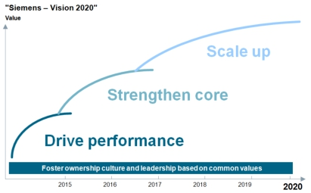
Siemens – Vision 2020
Value creation & Cultural change
Siemens – Vision 2020
1. Stringent company governance with effective
support functions (cost reduction ~€1bn)
2. 'Underperforming' businesses fixed
3. Solid execution of our financial target system
· Capital efficiency: ROCE 15-20%
· Growth > most relevant competitors
4. Global and decentralized management
structures: more than 30% of Division and BU
management outside Germany
5. Partner of choice for customers (NPS up ≥20%)
6. Employer of choice (Siemens Engagement
Survey: Employee Engagement Index,
Leadership and Diversity Index: >75%)
7. Ownership culture: Increase number of
employee shareholders by at least 50%
Innovating the electrical world
NPS: Net Promoter Score
© Siemens AG 2014. All rights reserved.
Page 13
London, June 12, 2014 JP Morgan Conference

Slide 14
Appendix
© Siemens AG 2014. All rights reserved.
Page 14
London, June 12, 2014 JP Morgan Conference

Slide 15
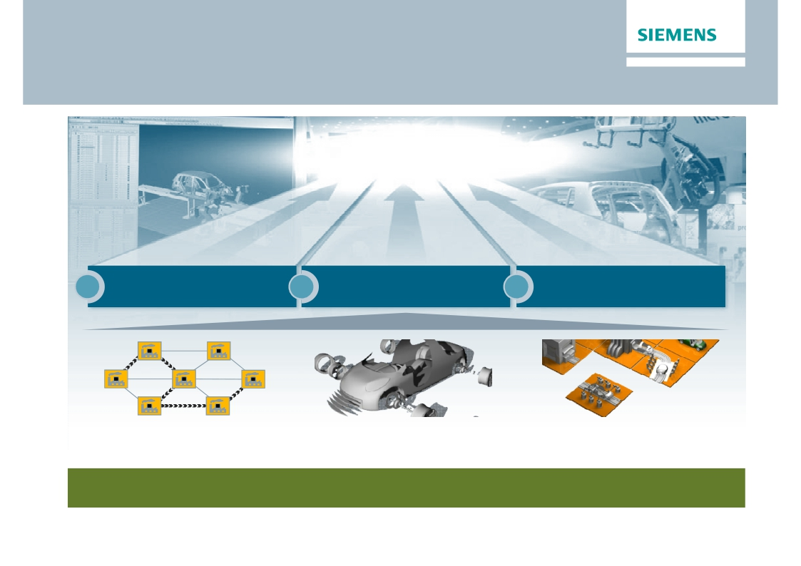
Digital Factory
Shaping the future of manufacturing with Industrie 4.0
Increasing
competitiveness
1
Increase efficiency
Production network
2
Shorten
time-to-market
Integration of virtual
and real world
3
Enhance flexibility
Cyber-physical systems
Key elements of Industrie 4.0
© Siemens AG 2014. All rights reserved.
Page 15
London, June 12, 2014 JP Morgan Conference

Slide 16
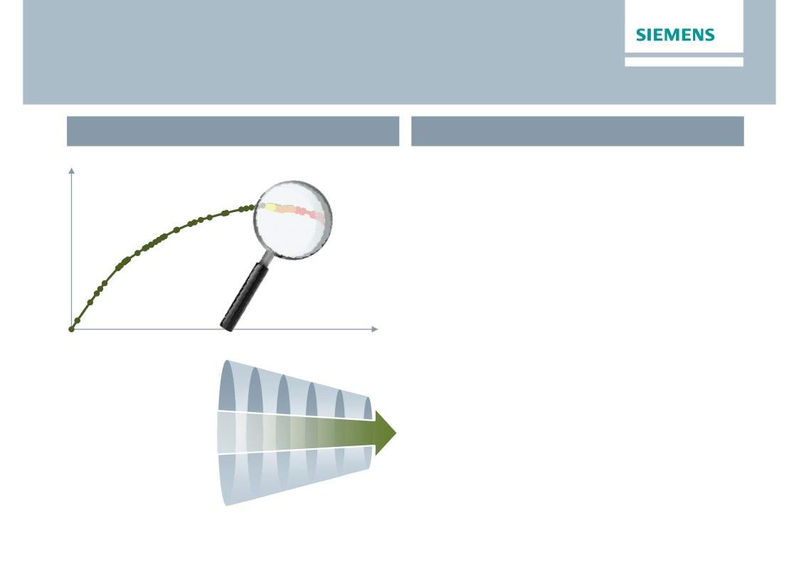
In depth analysis of businesses
has led to specific conclusions
Portfolio analysis
Conclusions
Cumulated
Profit
1. Areas of growth?
2. Potential profit pool?
3. Why Siemens?
4. Synergetic value?
5. Paradigm shifts in
technology/markets?
Focus
Cumulated
Revenue
'Siemens – Vision 2020'
· Fix underperforming businesses
starting with 'bottom 10' businesses
· Decide along the Strategic Imperatives
· Organic structural realignment
· Strategic partnerships
· Divestment (best owner concept)
· Stringent resource allocation supported by
performance culture and One Siemens
framework
© Siemens AG 2014. All rights reserved.
Page 16
London, June 12, 2014 JP Morgan Conference

Slide 17
Simplification leads to reduction
of overhead and support function cost by ~€1bn
Target
Functional cost reduction
~€1bn
FY 2014e
Target
© Siemens AG 2014. All rights reserved.
Key actions
· Remove additional layers (Cluster, Sectors)
· Combine certain Divisions and Businesses
· Stringent management governance through
all levels of the organization (Corporate Core)
· Optimization of Corporate Services on
highest possible level
· Full savings to mainly materialize in FY 2016
Page 17
London, June 12, 2014 JP Morgan Conference

Slide 18
Q2 FY 2014 – Key figures
Siemens (continuing operations, in €m)
Orders
Revenue
Book-to-bill ratio
Total Sectors profit
Net income
Basic earnings per share net income (in €)
Free cash flow
1) Change is adjusted for portfolio and currency translation effects
© Siemens AG 2014. All rights reserved.
Q2 FY 13
21,235
17,779
1.19x
1,348
1,030
1.20
1,360
Q2 FY 14
18,430
17,449
1.06x
1,566
1,153
1.33
1,390
Change
-10%1)
1%1)
16%
12%
11%
2%
Page 18
London, June 12, 2014 JP Morgan Conference

Slide 19
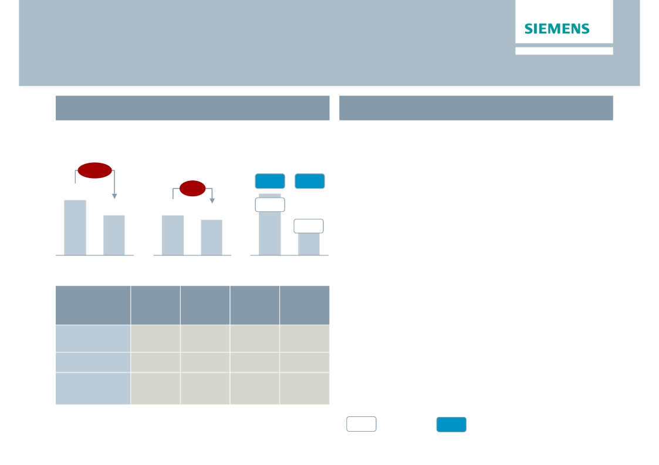
Energy – Performance held back by lower revenues and
execution challenges
Key Figures Energy
€bn
Main developments in Q2
· Book-to-bill at 1.09 despite sharp order decline
€m
Orders 1)
Revenue 1)
Profit 2)
in Europe/CAME region
-23%
8.5
6.1
· Market environment remains challenging
· Power Generation – Positive gains
overcompensate lower contribution due to
decreasing revenue mainly from gas turbine
business
-6%
10.5%
8.8%
551
8.6%
4.6%
255
6.3
5.6
Q2 13
Q2 14
Q2 13
Q2 14
Q2 13
Q2 14
· Wind – Significantly lower contribution from
offshore business and charges related to
Orders
y-o-y 1)
-14%
-46%
7%
Revenue
y-o-y 1)
-8%
13%
-14%
Profit
margin
18.4%
-4.3%
-24.2%
Underl.
profit
margin
14.4%
-0.2%
1.1%
defective components
· Transmission – Substantial execution
challenges at two Canadian turnkey projects
result in charges of €287m; further low margin
projects
Division
Power
Generation
Wind Power
Power
Transmission
1) Comparable, i.e. adjusted for currency translation and portfolio effects
%
Profit margin
%
Underlying Profit margin
© Siemens AG 2014. All rights reserved.
2) for underlying margin calculation please refer to Flashlight document
Page 19
London, June 12, 2014 JP Morgan Conference

Slide 20
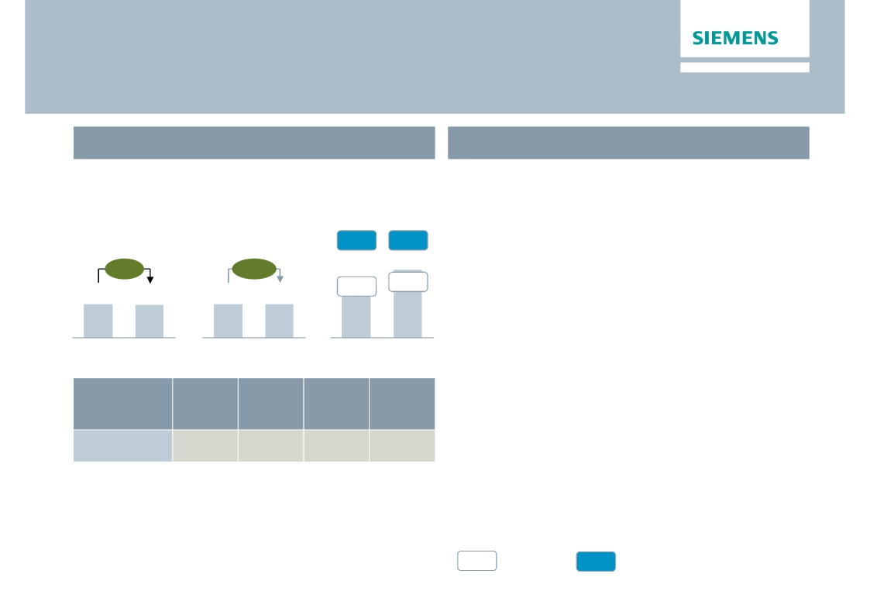
Healthcare – Continued excellent performance on high
level despite currency headwinds
Key Figures Healthcare
€bn
Main developments in Q2
· Order growth supported by strong service
€m
Orders 1)
Revenue 1)
Profit 2)
business and improvement in Europe while
revenue growth is broad based
15.3%
15.5%
· Strong profit margin – €66m gain from
+1%
+5%
expected sale of particle therapy installation
13.6%
445
Q2 13
16.3%
531
Q2 14
compensates for strongly adverse FX effects
· Diagnostics – Solid growth and profit
development
3.3
Q2 13
3.2
Q2 14
3.3
Q2 13
3.3
Q2 14
Orders
y-o-y 1)
3%
Revenue
y-o-y 1)
3%
Profit
margin
10.8%
Underl.
profit
margin
15.2%
Division
Diagnostics
1) Comparable, i.e. adjusted for currency translation and portfolio effects
%
Profit margin
%
Underlying Profit margin
© Siemens AG 2014. All rights reserved.
2) for underlying margin calculation please refer to Flashlight document
Page 20
London, June 12, 2014 JP Morgan Conference

Slide 21
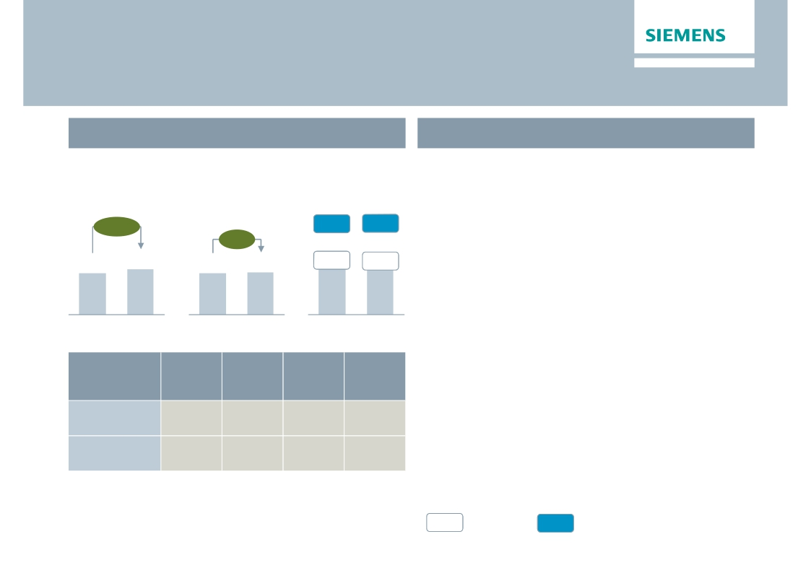
Industry – Profit climbs as short cycle businesses
continue stabilizing
Key Figures Industry
€bn
Main developments in Q2
· Short cycle markets show continuing
€m
Orders 1)
Revenue 1)
Profit 2)
stabilization, with positive order growth
particularly in Germany and China
+12%
4.8
10.5%
7.9%
345
13.2%
10.3%
456
· Industry Automation – Margin improvement
due to higher capacity utilization
· Drive Technologies – Improved cost position
and volume growth support gross margins
+5%
4.4
4.4
4.4
Q2 13
Q2 14
Q2 13
Q2 14
Q2 13
Q2 14
· Metals Technologies burdened by a project in
the US; Joint venture with Mitsubishi-Hitachi
Orders
y-o-y 1)
11%
14%
Revenue
y-o-y 1)
6%
5%
Profit
margin
15.8%
9.5%
Underl.
profit
margin
18.1%
9.9%
Heavy Machinery signed
Division
Industry
Automation
Drive
Technologies
1) Comparable, i.e. adjusted for currency translation and portfolio effects
%
Profit margin
%
Underlying Profit margin
© Siemens AG 2014. All rights reserved.
2) for underlying margin calculation please refer to Flashlight document
Page 21
London, June 12, 2014 JP Morgan Conference

Slide 22
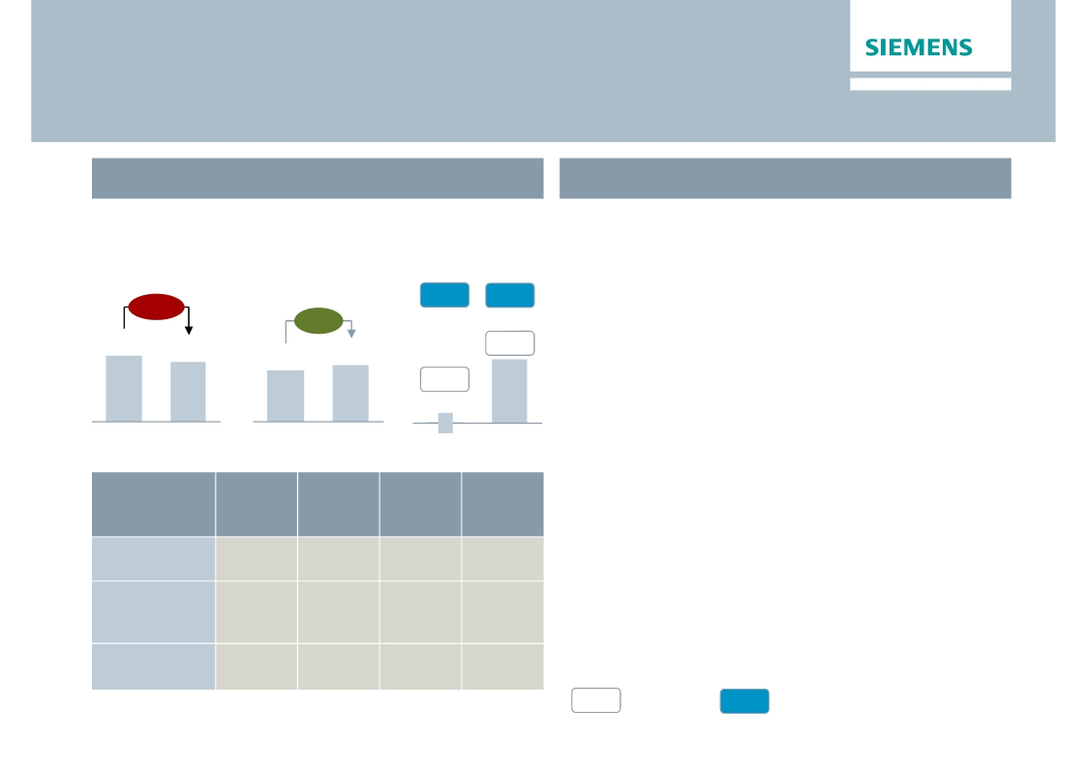
Infrastructure & Cities – Higher profit on improvements
in execution, mix and productivity
Key Figures Infrastructure & Cities
Main developments in Q2
€bn
Orders 1)
-12%
€m
Profit 2)
4.7%
· Positive book-to-bill of 1.05 on tough comps
due to major rail orders
· Transportation & Logistics – Improved project
execution of large rolling stock orders
Revenue 1)
+7%
7.2%
5.2
4.7
4.1
4.4
7.3%
· Power Grid Solutions & Products – Mainly
0.2%
6
Q2 13
benefitting from favourable mix and ‘Siemens
2014’ related productivity improvements
· Building Technologies – Continued
improvement from successful implementation
325
Q2 14
Q2 13
Q2 14
Q2 13
Q2 14
Orders
y-o-y 1)
-29%
9%
-6%
Revenue
y-o-y 1)
21%
1%
-1%
Profit
margin
7.0%
8.2%
6.9%
Underl.
profit
margin
8.3%
8.2%
6.9%
of 'Siemens 2014' measures
Division
Transportation
& Logistics
Power Grid
Solutions
& Products
Building
Technologies
1) Comparable, i.e. adjusted for currency translation and portfolio effects
%
Profit margin
%
Underlying Profit margin
© Siemens AG 2014. All rights reserved.
2) for underlying margin calculation please refer to Flashlight document
Page 22
London, June 12, 2014 JP Morgan Conference

Slide 23
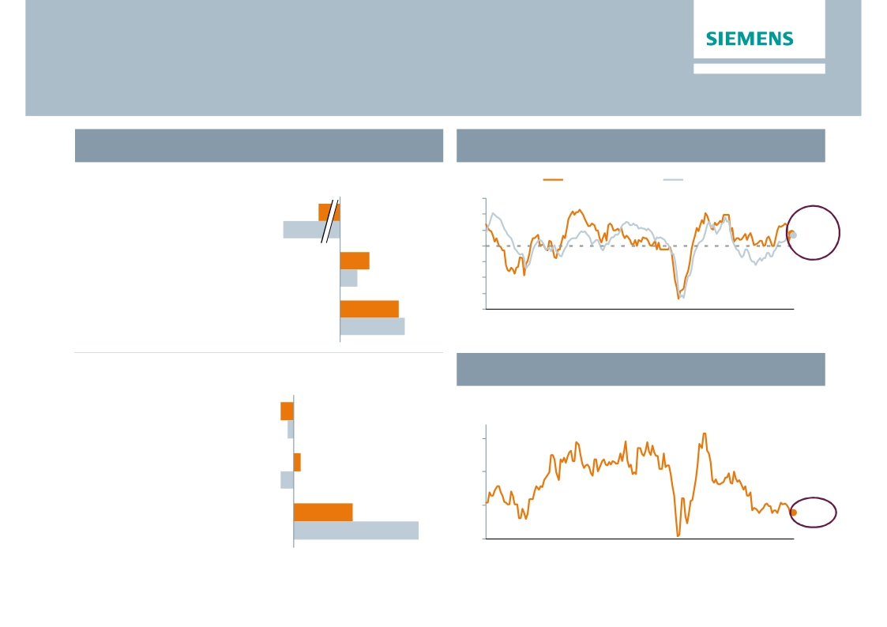
Lower volume from large orders in Europe while
China shows strength
Regional business split
Purchasing Managers Index
Q2 FY 14 Order growth y-o-y1)
Index
US ISM Mfg PMI
Eurozone Mfg PMI
65
60
Expanding economy
Europe/C.I.S./Africa/ME
-26%
(therein Germany)
-38%
55
50
53.72)
53.3
Americas
(therein USA)
Asia/Australia
+10%
+6%
+20%
45
40
35
30
Contracting economy
(therein China)
+22%
00
01
02
03
04
05
06
07
08
09
10
11
12
13
14
(Apr)
2) US as of March; flash reading for EZ in April
China Industry Value Added
Q2 FY 14 Revenue growth y-o-y1)
Europe/C.I.S./Africa/ME
(therein Germany)
Americas
(therein USA)
-2%
-1%
-2%
In %
20
15
1%
Asia/Australia
9%
10
8.8%
(therein China)
19%
5
00
01
02
03
04
05
06
07
08
09
10
11
12
13
14
(Mar)
1) Change is adjusted for currency translation and portfolio effects
© Siemens AG 2014. All rights reserved.
Page 23
London, June 12, 2014 JP Morgan Conference

Slide 24
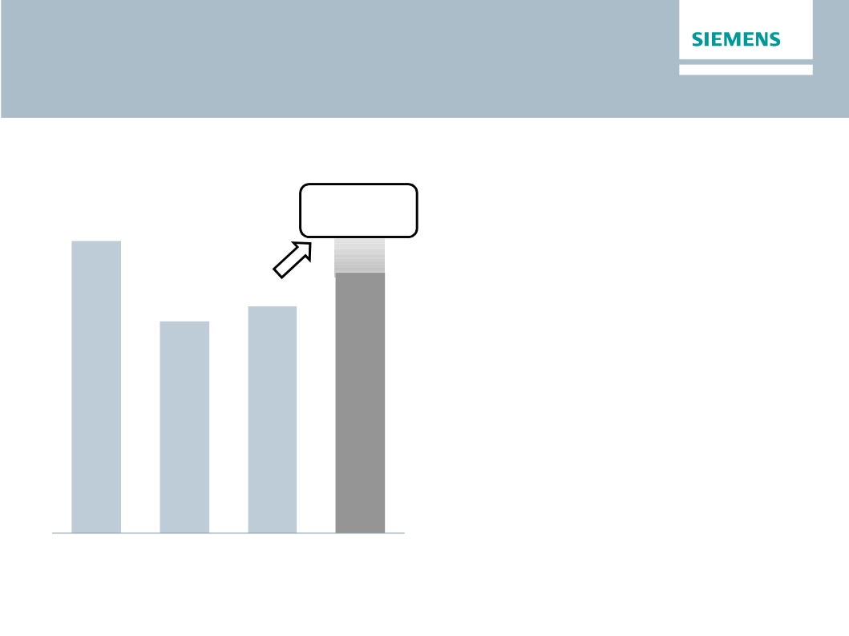
Outlook Fiscal 2014
Basic earnings per share (Net income)
In €
At least 15%
growth
6.55
·
·
·
We expect our markets to remain
challenging in Fiscal 2014
Our short cycle businesses are not
anticipating a sustainable recovery until
late in the fiscal year
We expect orders to exceed revenue,
5.08
for a book-to-bill ratio above 1
Assuming that revenue on an organic basis
remains level year-over-year, we expect
basic earnings per share (Net Income) for
Fiscal 2014 to grow by at least 15% from
€5.08 in Fiscal 2013
This outlook is based on shares outstanding
of 843 million as of September 30, 2013
Furthermore it excludes impacts related
to legal and regulatory matters
4.74
·
·
·
FY 2011
FY 2012
FY 2013
FY 2014e
© Siemens AG 2014. All rights reserved.
Page 24
London, June 12, 2014 JP Morgan Conference

Slide 25
Reconciliation and Definitions for
Non-GAAP Measures
This document includes supplemental financial measures that are or may be non-GAAP financial measures.
Orders and order backlog; adjusted or organic growth rates of revenue and orders; book-to-bill ratio; Total Sectors profit; return on equity (after tax), or ROE (after
tax); return on capital employed (adjusted), or ROCE (adjusted); Free cash flow, or FCF; adjusted EBITDA; adjusted EBIT; adjusted EBITDA margins, earnings
effects from purchase price allocation, or PPA effects; net debt and adjusted industrial net debt are or may be such non-GAAP financial measures.
These supplemental financial measures should not be viewed in isolation or as alternatives to measures of Siemens’ net assets and financial positions or results of
operations as presented in accordance with IFRS in its Consolidated Financial Statements. Other companies that report or describe similarly titled financial
measures may calculate them differently.
Definitions of these supplemental financial measures, a discussion of the most directly comparable IFRS financial measures, information regarding the usefulness
of Siemens’ supplemental financial measures, the limitations associated with these measures and reconciliations to the most comparable IFRS financial measures
are available on Siemens’ Investor Relations website at www.siemens.com/nonGAAP. For additional information, see supplemental financial measures and the
related discussion in Siemens’ most recent annual report on Form 20-F, which can be found on our Investor Relations website or via the EDGAR system on the
website of the United States Securities and Exchange Commission.
Revenue growth - Performance against competition (Fiscal 2014)
To illustrate management’s perspective on the Company’s performance against competition, Siemens compares its own revenue growth rate with the weighted
average revenue growth rate of its Sectors’ most relevant competitors, including, among others, ABB, GE, Philips, Rockwell and Schneider. Revenue growth for
Siemens and its competitors is calculated as the actual growth rate over a rolling four quarter period compared to the same period a year earlier. Siemens
competitors revenue growth is derived as the weighted average growth rate of dedicated competitor baskets defined for each Siemens Sector. Each Sector
basket's growth rate is based upon the most recent reported competitor revenues publicly available at the time of calculation. The Sector competitor baskets
revenue growth rates are weighted by the revenue of the respective Siemens Sector.
This measure may provide useful information to investors with respect to management’s view on Siemens’ growth compared to competitor growth. However, we
caution investors, that this measure is subject to certain limitations, which include the following: The metric is defined by Siemens and, as such, is not based on a
generally accepted framework that is also relevant for other companies; accordingly, other companies may define a similarly titled measure differently. In
calculating this measure, Siemens relies on data published by its competitors for which Siemens assumes no responsibility. In addition, the data may not be
directly comparable as a result of differing presentation currencies and reporting standards being used by our competitors in the data’s presentation. Furthermore,
subject to limited exceptions, no adjustments are made for currency translation effects, portfolio changes and changes in reporting structure for either the Siemens
or the competitor data. Because the public availability of relevant competitors’ data at the time of calculation may not coincide with the availability of Siemens’ data,
some competitor data used may relate to a different time period than the Siemens data.
© Siemens AG 2014. All rights reserved.
Page 25
London, June 12, 2014 JP Morgan Conference

