Slide 1

Financial Results for the Fiscal Year
Ended March 31, 2014
and
Financial Forecasts for the Fiscal Year
Ending March 31, 2015
May 13, 2014

Slide 2


The forward-looking statements and projected figures concerning the future performance of NTT
and its subsidiaries and affiliates contained or referred to herein are based on a series of
assumptions, projections, estimates, judgments and beliefs of the management of NTT in light of
information currently available to it regarding NTT and its subsidiaries and affiliates, the economy
and telecommunications industry in Japan and overseas, and other factors. These projections
and estimates may be affected by the future business operations of NTT and its subsidiaries and
affiliates, the state of the economy in Japan and abroad, possible fluctuations in the securities
markets, the pricing of services, the effects of competition, the performance of new products,
services and new businesses, changes to laws and regulations affecting the telecommunications
industry in Japan and elsewhere, other changes in circumstances that could cause actual results
to differ materially from the forecasts contained or referred to herein, as well as other risks
included in NTT’s most recent Annual Report on Form 20-F and other filings and submissions
with the United States Securities and Exchange Commission.
* “E” in this material represents that the figure is a plan or projection for operation.
** “FY” in this material indicates the fiscal year ending March 31 of the succeeding year.
Financial Results for the Fiscal Year Ended March 31, 2014
and Financial Forecasts for the Fiscal Year Ending March 31, 2015
－1－
Copyright (c) 2014 Nippon Telegraph and Telephone Corporation

Slide 3
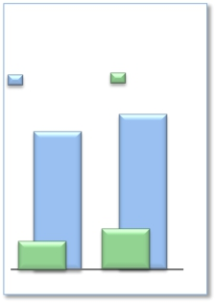
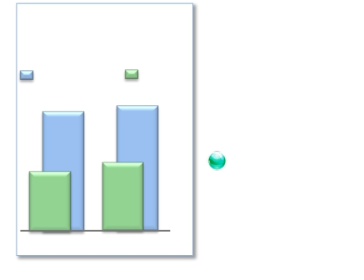
FY2013 Highlights
Operating Revenues &
Overseas Sales
(Billions of yen)
FY2013 saw an increase in Operating Revenues and Operating
Income. Operating Revenues increased for the fourth
Operating Income
10,700.7
Overseas sales
10,925.2
consecutive year, and Net Income reached a six-year peak.
Earnings Per Share (EPS) increased to 509 yen (increase of 18%
year-on-year)
Expansion of global cloud services
➢Overseas sales increased to 1,196.0 billion yen (increase of 241.9
billion yen year-on-year)
954.1
FY2012
1,196.0
FY2013
Enhanced competitiveness of network services
➢Expansion of NTT’s user base
・13.78 million smartphone sales and 21.97 million Xi subscribers (net increase of 10.40
Operating Income &
Net Income
(Billions of yen)
million subscribers)
・18.05 million FLET’S Hikari subscribers (net increase of 0.75 million subscribers)
・Number of subscribers to Hikari TV and FLET’S TV : 3.98 million
Number of “d video” subscribers: 4.41 million
Operating Income
1,202.0
Net Income
1,213.7
・The number of Wi-Fi area owners increased to three times the FY2012 amount
➢Cost reductions
・Cost reductions related to fixed-line and mobile access services: NTT reached approx.
80% of its medium-term target of a 500 billion yen reduction by the end of FY2014
Increased shareholder returns
521.9
FY2012
585.5
FY2013
➢Completed 156.5 billion yen of stock repurchases, mainly from the Japanese government in
March, for a total of 406.5 billion yen in stock repurchases in FY2013.
➢Increased year-end dividend by 10 yen per share compared to FY2012. Distributed
dividends of 170 yen per share for the year.
Financial Results for the Fiscal Year Ended March 31, 2014
and Financial Forecasts for the Fiscal Year Ending March 31, 2015
－2－
Copyright (c) 2014 Nippon Telegraph and Telephone Corporation

Slide 4

Consolidated Results and Forecasts (U.S. GAAP)
NTT as a group made up for the decrease in Operating Income of its mobile communications and data communications
businesses and as a result, Operating Revenues and Operating Income both increased. Net Income reached a six-year peak.
Both Operating Revenues and Operating Income fell short of FY2013 forecasts due to the decrease in Operating Income in
the mobile communications business.
Achieved EPS of 509.21 yen, an increase of 18% year-on-year.
(Billions of yen)
FY2013 Highlights
FY2013
Change
year-on-year
+224.4
+212.7
+11.7
FY2013
Forecasts
11,000.0
9,770.0
1,230.0
FY2012
10,700.7
9,498.8
1,202.0
Change from the
Revised
Forecasts
(74.8)
(58.5)
(16.3)
[%]
+2.1%
+2.2%
+1.0%
Operating
Revenues
Operating
Expenses
Operating
Income
10,925.2
9,711.5
1,213.7
Net Income
※
EPS
※
585.5
509.21
+63.5
+78.53
+12.2%
+18.2%
+0.5
+5.99
521.9
430.68
585.0
503.22
(yen)
※Net Income represents net income attributable to NTT, excluding noncontrolling interests.
※Net Income for FY2012 has been revised to reflect the retroactive application of the equity method of accounting for Philippine Long Distance Telephone
Company.
Financial Results for the Fiscal Year Ended March 31, 2014
and Financial Forecasts for the Fiscal Year Ending March 31, 2015
－3－
Copyright (c) 2014 Nippon Telegraph and Telephone Corporation

Slide 5
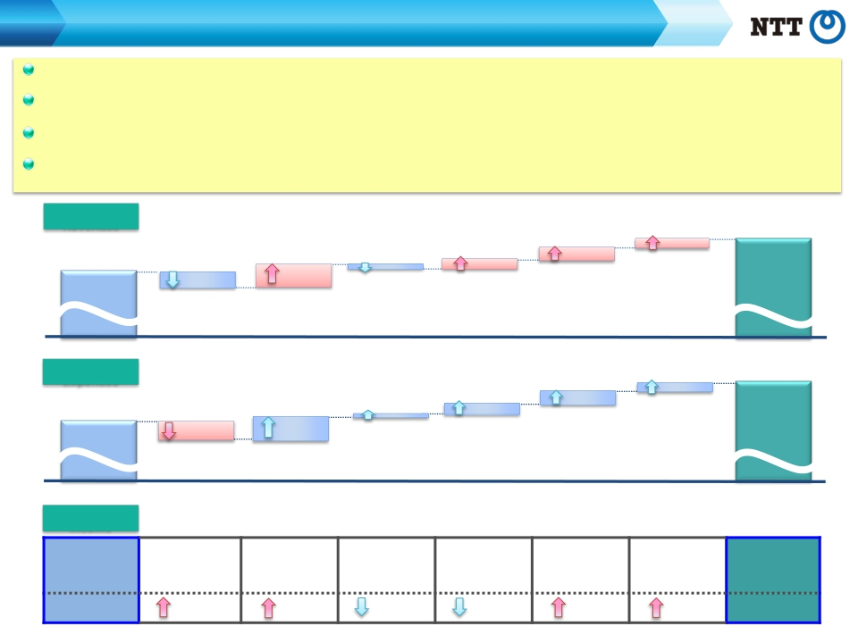
Consolidated Results and Forecasts (U.S. GAAP)
FY2013 Contributing Factors by Segment
Regional communications business: Operating Income increased due to, among other things, efforts to limit Hikari subscription
cancellations, improvements in business efficiency, and a decrease in pension costs.
Long-distance and international communications business: Operating Income increased due to growth in NTT’s overseas business and
improvements in cost efficiency.
Mobile communications business: Although strong iPhone sales mitigated mobile number portability (MNP) losses to an extent, Operating
Income decreased due to, among other things, “Monthly Support” discount programs.
Data communications business: Despite the effect of unprofitable business deals, the decline in profit margins slowed due to cost
reductions in the latter half of the year.
Operating
[year-on-year：+224.4]
(Billions of yen)
10,925.2
FY2013
Revenues
10,700.7
FY2012
Long distance and
international
communications
business
152.0
Mobile
communications
business
8.9
Data
communications
business
40.3
76.7
Other
business
51.9
Elimination of
intersegment/Others
87.5
Regional
communications
business
Operating
Expenses
9,498.8
FY2012
Operating
Income
FY2012
[year-on-year：+212.7]
Long-distance and
internationalRegional
communicationscommunications
businessbusiness
145.8121.8
[year-on-year：+11.7]
Regional
Long-distance and
international
communications
communications
business
business
Data
communications
business
58.2
Data
communications
business
Mobile
communications
business
10.3
Mobile
communications
business
46.4
Elimination of
intersegment/Others
Elimination of
intersegment/
Others
73.8
Other
business
Other business
9,711.5
FY2013
FY2013
1,202.0
34.3
6.2
19.2
17.9
2.8
5.5
1,213.7
Financial Results for the Fiscal Year Ended March 31, 2014
and Financial Forecasts for the Fiscal Year Ending March 31, 2015
－4－
Copyright (c) 2014 Nippon Telegraph and Telephone Corporation

Slide 6

Consolidated Results and Forecasts (U.S. GAAP)
FY2014 Forecast Summary
Operating Revenues increased for the fifth consecutive year, reaching a record 11,200.0 billion yen.
Operating Income remained relatively unchanged from the previous fiscal year at 1,215.0 billion
yen.
Achieved EPS of 536 yen, a 5% increase year-on-year.
(Billions of yen)
FY2014 Forecasts
FY2013
Change
year-on-year
[%]
Operating
Revenues
Operating
Expenses
Operating
Income
Net Income
※
EPS
(yen)
10,925.2
9,711.5
1,213.7
585.5
509.21
11,200.0
9,985.0
1,215.0
586.0
536.00
+274.8
+273.5
+1.3
+0.5
+26.79
+2.5%
+2.8%
+0.1%
+0.1%
+5.3%
※Net income represents net income attributable to NTT, excluding noncontrolling interests.
Financial Results for the Fiscal Year Ended March 31, 2014
and Financial Forecasts for the Fiscal Year Ending March 31, 2015
－5－
Copyright (c) 2014 Nippon Telegraph and Telephone Corporation

Slide 7

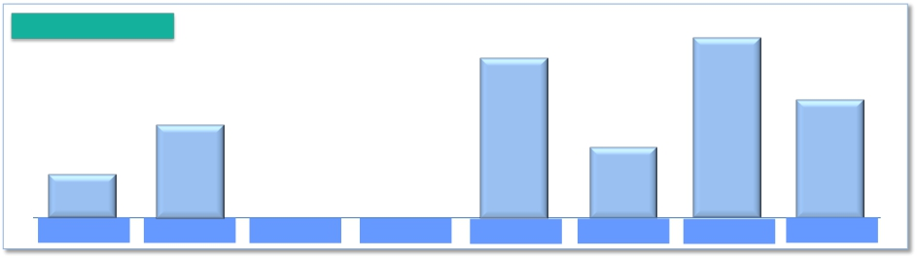
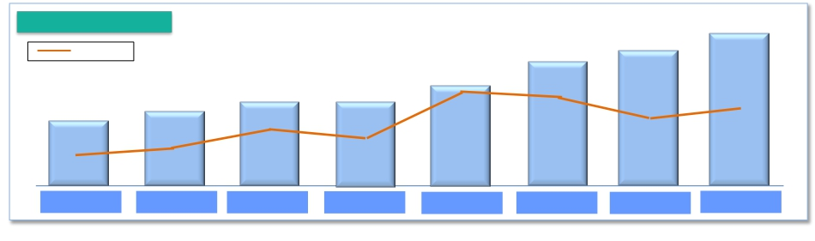
Shareholder Returns
Share repurchases:
Dividends:
250.0 billion yen repurchase from the Japanese government planned for FY2014
Dividends of 180 yen per share planned for FY2014
Share repurchases
406.5
(Billions of yen)
Up to 250.0
381.7
200.0
150.0
94.4
FY 2007
FY 2008
FY 2009
FY 2010
FY 2011
FY 2012
FY 2013
FY 2014E
Dividends per share
180
(yen)
160
●
37.2%
FY 2012
170
●
33.4%
FY 2013
● Pay-out ratio
90
●
19.5%
FY 2007
140
●
38.2%
FY 2011
120
●
32.3%
FY 2009
120
●
31.2%
FY 2010
110
●
27.5%
FY 2008
●
33.6%
FY 2014E
Financial Results for the Fiscal Year Ended March 31, 2014
and Financial Forecasts for the Fiscal Year Ending March 31, 2015
－6－
Copyright (c) 2014 Nippon Telegraph and Telephone Corporation

Slide 8


Progress of the Medium-Term Strategy
“Towards the Next Stage”

Slide 9
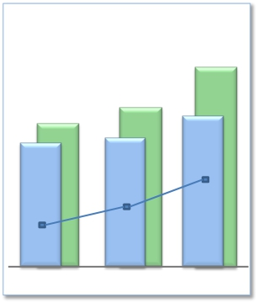

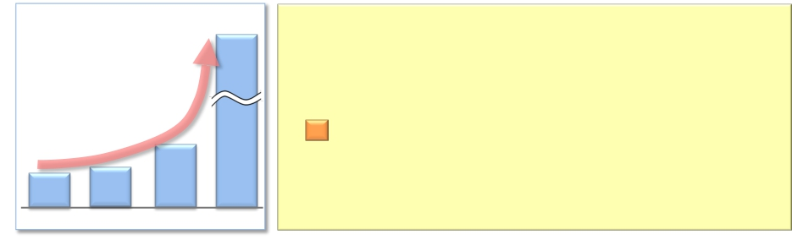
Progress of the Medium-Term Strategy “Towards the Next Stage”
Expansion of Global Cloud Services
Overseas Sales
¥1,530.0
Billion
Overseas Sales:
Proportion of corporate sales
represented by overseas sales:
$20.0 billion by FY2016
50% or more by FY2016
¥954.1 ¥1,196.0Billion
Billion
$15.0$12.2 Billion
$12.0 Billion 43.1%
Billion
31.8% 36.6%Proportion of corporate sales
represented by overseas sales
FY2012 FY2014EFY2013
Order Volume from
Cross-Selling
$700
Million
“Overseas Sales are leading NTT Group’s top-line (growth)”
FY2013
Overseas Sales: $12.2 billion (¥1,196.0 billion)
Proportion of corporate sales
represented by overseas sales: 37%
FY2014 Targets
Overseas Sales: $15.0 billion (¥1,530.0 billion)
Proportion of corporate sales
represented by overseas sales: 43%
Note: Exchange rate used for FY2013: $1 dollar = ¥97.73
Exchange rate used for FY2014: $1 dollar = ¥102 (estimate)
“Order volume from cross-selling for the latter half of the year:
$200 million”
FY2013
$700 million
$85
Million
FY2011
$143
Million
FY2012
$62
Million
FY2010
FY2013
Financial Results for the Fiscal Year Ended March 31, 2014
and Financial Forecasts for the Fiscal Year Ending March 31, 2015
－7－
Copyright (c) 2014 Nippon Telegraph and Telephone Corporation

Slide 10
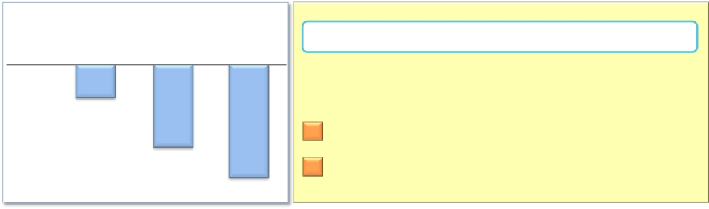
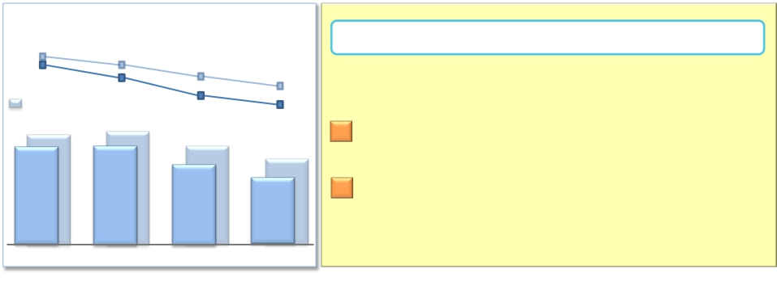
Progress of the Medium-Term Strategy “Towards the Next Stage”
Strengthening the Competitiveness of Network Services
Access Network Cost Reductions
(billions of yen)
FY2014E
(600.0)
Access Network Cost Reduction: Targeting decrease
of 500.0 billion yen by FY2014
“Revision of cost reduction target
to ¥600.0 billion”
¥410.0 billion decrease in FY2013*1
¥600.0 billion decrease in FY2014*1
*1 Compared to FY2011
FY2011
FY2012
(120.0)
FY2013
(410.0)
Capex to Sales
Capital Investment
18.5%*2
Amounts
17.3%*2
(billions of yen)
Capex to Sales Ratio: Target of 15％％ by FY2015
18.4%*2
18.4%
Includes amount
related to real estate
16.5%*2
15.9%
1,850.0
“Enhance efficiency in capital investment, and
reach a ratio in the 15% range this year”
Target of ¥1,795.7 billion by FY2013 (¥111.8 billion decrease
from previous year), resulting in a 16.7% Capex to Sales ratio
18.1%
16.7%
1,892.8
1,946.6
1,970.0
1,906.5
FY2011
1,907.5
FY2012
Target of ¥1,750.0 billion by FY2014 (¥45.7 billion decrease
from previous year), resulting in a 15.9% Capex to Sales ratio
*2 Amounts include sales and investments related to real estate and solar
power generation operations
1,795.7
FY2013
1,750.0
FY2014E
Financial Results for the Fiscal Year Ended March 31, 2014
and Financial Forecasts for the Fiscal Year Ending March 31, 2015
－8－
Copyright (c) 2014 Nippon Telegraph and Telephone Corporation

Slide 11
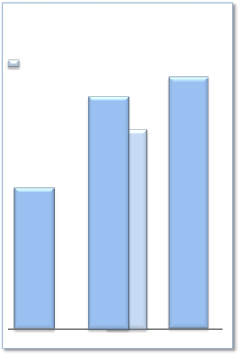

Progress of the Medium-Term Strategy “Towards the Next Stage”
Earnings Per Share
EPS Growth
(EPS)
Excludes special factors
509
＋39%*
477
＋30%*
431
＋17%*
(yen/share)
536
＋46%*
EPS: Targeting growth of 60% or more
by FY2015
“Expand steadily toward achieving the target”
FY2013: 509 yen (39% increase*)
FY2014: 536 yen (46% increase*)
FY2012
FY2013
FY2014E
* Compared to FY2011
Financial Results for the Fiscal Year Ended March 31, 2014
and Financial Forecasts for the Fiscal Year Ending March 31, 2015
－9－
Copyright (c) 2014 Nippon Telegraph and Telephone Corporation

Slide 12
Progress of Broadband Services

Slide 13
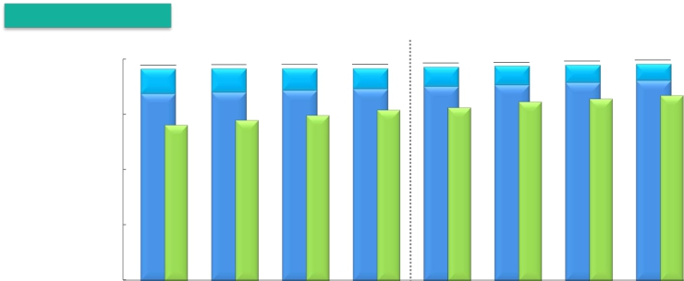


Progress of Broadband Services
Number of Subscribers for Fixed Broadband Services
Number of subscribers
(Thousands)
20,000
15,000
10,000
5,000
0
FLET’S ADSL
FLET’S Hikari
Hikari Denwa
19,954
1,203
18,750
17,106
2015.3E
19,078
2,206
16,872
14,252
2012.6
19,118
2,098
17,020
14,557
2012.9
19,130
1,968
17,162
14,852
2012.12
19,148
1,848
17,300
15,169
2013.3
19,271
1,751
17,521
15,412
2013.6
19,335
1,663
17,672
15,664
2013.9
19,444
1,572
17,873
15,950
2013.12
19,534
1,483
18,050
16,256
2014.3
Changes from the preceding quarter
(Thousands)
FY2014E
FY2012
10-12
FY2013
10-12
FY2013
4-6
7-9
1-3
4-6
7-9
1-3
FLET’S Hikari
※1
307
148
143
138
220
152
200
178
750
700
Number of
982
762
750
848
870
707
743
811
3,131
3,000
opened
※2
connections
FLET’S ADSL
(115)
(108)
(131)
(119)
(98)
(88)
(91)
(89)
(365)
(280)
Hikari Denwa
※3
351
305
295
318
242
252
287
305
1,087
850
※1 Number of FLET’S Hikari subscribers includes B FLET’S, FLET’S Hikari Next, FLET’S Hikari Light and FLET’S Hikari WiFi Access provided by NTT East and B FLET’S, FLET’S Hikari Premium,
FLET’S Hikari Mytown, FLET’S Hikari Next, FLET’S Hikari Light and FLET’S Hikari WiFi Access provided by NTT West.
※2 Number of opened connections excludes openings due to relocations.
※3 Number of Hikari Denwa subscribers is presented in thousands of channels.
Financial Results for the Fiscal Year Ended March 31, 2014
and Financial Forecasts for the Fiscal Year Ending March 31, 2015
－10－
Copyright (c) 2014 Nippon Telegraph and Telephone Corporation

Slide 14


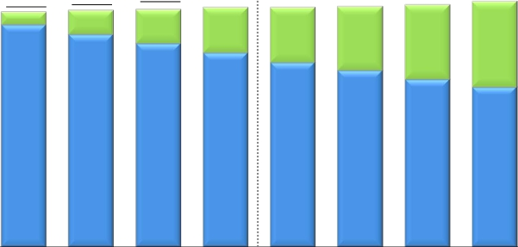

Progress of Broadband Services
Number of Subscribers for Mobile Broadband Services
Number of subscribers※
(Thousands)
70,000
60,000
50,000
40,000
30,000
20,000
10,000
0
Xi
FOMA
66,800
29,800
37,000
2015.3 E
60,787
6,198
54,588
2012.9
60,988
8,678
52,310
2012.12
61,536
11,566
49,970
2013.3
61,623
14,198
47,425
2013.6
61,772
16,398
45,374
2013.9
62,182
19,021
43,160
2013.12
63,105
21,965
41,140
2014.3
60,396
3,317
57,079
2012.6
Changes from the preceding quarter
FY2012
10-12
FY2013
10-12
(Thousands)
FY2014E
4-6
7-9
1-3
4-6
7-9
1-3
FY2013
FOMA+Xi
266
391
201
548
87
149
410
924
1,569
3,700
※ The number of FOMA subscribers includes communications module service subscribers
Financial Results for the Fiscal Year Ended March 31, 2014
and Financial Forecasts for the Fiscal Year Ending March 31, 2015
－11－
Copyright (c) 2014 Nippon Telegraph and Telephone Corporation

Slide 15


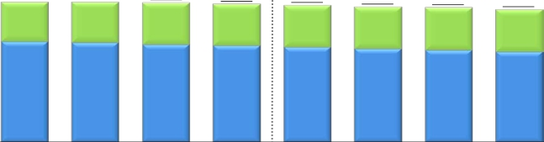



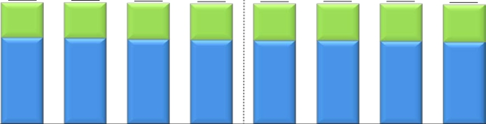
Progress of Broadband Services
ARPU of Fixed Broadband Services (FLET’S Hikari)
※
NTT East
(Yen)
Optional Service
Basic Monthly Charges
6,000
4,000
2,000
0
5,890
1,670
4,220
5,880
1,690
4,190
5,860
1,760
4,100
5,800
1,740
4,060
5,750
1,760
3,990
5,680
1,760
3,920
5,650
1,790
3,860
5,570
1,770
3,800
5,660
1,770
3,890
5,500
1,800
3,700
FY2012
FY2013
FY2013
FY2014 E
4-6
7-9
10-12
1-3
4-6
7-9
10-12
1-3
NTT West
(Yen)
6,000
4,000
2,000
0
5,910
1,700
4,210
5,900
1,720
4,180
5,870
1,750
4,120
5,840
1,740
4,100
5,840
1,770
4,070
5,850
1,790
4,060
5,850
1,820
4,030
5,800
1,810
3,990
5,830
1,800
4,030
5,740
1,840
3,900
FY2012
FY2013
FY2013
FY2014 E
4-6
7-9
10-12
1-3
4-6
7-9
10-12
1-3
※ FLET’S Hikari includes B FLET’S, FLET’S Hikari Next, FLET’S Hikari Light and FLET’S Hikari WiFi Access provided by NTT East and B FLET’S, FLET’S Hikari Premium, FLET’S Hikari Mytown, FLET’S Hikari Next,
FLET’S Hikari Light and FLET’S Hikari WiFi Access provided by NTT West. Commencing in the fiscal year ended March 31, 2014, NTT East and NTT West began including in their respective FLET’S Hikari ARPU
calculations revenues from NTT East’s and NTT West‘s “FLET’S VPN WIDE” virtual private network option. NTT East‘s and NTT West’s FLET’S Hikari ARPU for the three months ended June 30, 2012, September 30,
2012, December 31, 2012 and March 31, 2013 have been revised to include revenues from “FLET’S VPN WIDE.” Please see page 29 regarding the calculation of ARPU.
Financial Results for the Fiscal Year Ended March 31, 2014
and Financial Forecasts for the Fiscal Year Ending March 31, 2015
－12－
Copyright (c) 2014 Nippon Telegraph and Telephone Corporation

Slide 16
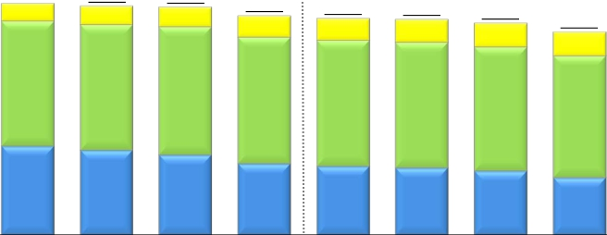

Progress of Broadband Services
ARPU of Mobile Broadband Services (FOMA, Xi)
※
(Yen)
6,000
5,000
4,000
3,000
2,000
1,000
0
Smart ARPU
Packet ARPU
Voice ARPU
4,390
530
2,620
1,240
4,930
370
2,660
1,900
4,870
390
2,670
1,810
4,850
420
2,720
1,710
4,670
460
2,690
1,520
4,610
460
2,680
1,470
4,590
490
2,670
1,430
4,510
500
2,640
1,370
4,500
490
2,640
1,370
4,320
500
2,600
1,220
FY2012
10-12
FY2013
10-12
FY2013
FY2014 E
4-6
7-9
1-3
4-6
7-9
1-3
※ The calculation of mobile broadband services ARPU does not include communications module service subscribers and the revenues therefrom.
Please see page 29 regarding the calculation of ARPU.
Financial Results for the Fiscal Year Ended March 31, 2014
and Financial Forecasts for the Fiscal Year Ending March 31, 2015
－13－
Copyright (c) 2014 Nippon Telegraph and Telephone Corporation

Slide 17

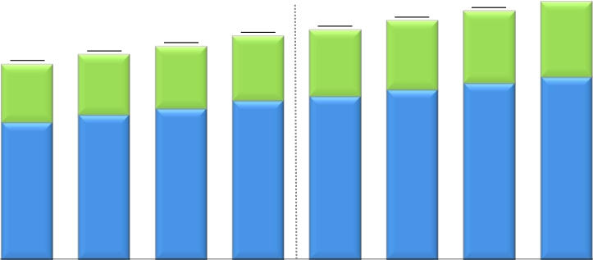
Progress of Broadband Services
Number of Subscribers for Video Services
FLET'S TV
Hikari TV
※
(Thousands)
4,500
4,000
3,500
3,000
2,500
2,000
1,500
1,000
500
0
4,546
1,346
3,200
FY2014 E
3,841
1,113
2,727
2013.12
3,984
1,161
2,823
2014.3
3,552
1,032
2,520
2013.6
3,692
1,067
2,625
2013.9
3,297
967
2,330
2012.12
3,457
1,003
2,453
2013.3
3,020
898
2,122
2012.6
3,168
933
2,235
2012.9
※“FLET’S TV” requires a subscription to “FLET’S TV Transmission Service,” provided by NTT East and NTT West, and a subscription to Opticast Inc.’s “Opticast Facility Use
Services” broadcast service.
Financial Results for the Fiscal Year Ended March 31, 2014
and Financial Forecasts for the Fiscal Year Ending March 31, 2015
－14－
Copyright (c) 2014 Nippon Telegraph and Telephone Corporation

Slide 18
Financial Information

Slide 19










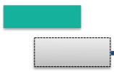




Subsidiaries’ Results (JPN GAAP Non-Consolidated)
NTT East Financial Results
Operating
Revenues
1,831.7
FY2012
Operating
Expenses
57.9
(3.2)%
Voice Transmission Services (60.8)
IP Services +5.4
Others
(2.5)
59.6
(3.4)%
(Billions of yen)
1,771.0
FY2014E
Change from
2.8
(0.2)%
Voice Transmission Services (54.3)
IP Services (1.3)
Others
+52.8
26.0
(1.5)%
revised forecast:
+1.8
1,773.8
FY2013
revised forecast:
+5.0
Change from
1,766.7
Personnel expenses
Expenses for purchase of goods
(2.0)
1,707.0
Personnel expenses
Expenses for purchase of goods
(4.9)
1,681.0
and services and other expenses (45.5)
Depreciation expenses and loss
and services and other expenses (24.2)
Depreciation expenses and loss
on disposal of assets
(12.0)
on disposal of assets
+3.1
FY2012
FY2013
FY2014E
Operating
Income
65.0
Change from
1.6
+2.5%
revised forecast:
(3.2)
66.7
23.2
+34.9%
90.0
Financial Results for the Fiscal Year Ended March 31, 2014
and Financial Forecasts for the Fiscal Year Ending March 31, 2015
－15－
Copyright (c) 2014 Nippon Telegraph and Telephone Corporation

Slide 20








Subsidiaries’ Results (JPN GAAP Non-Consolidated)
NTT West Financial Results
Operating
Revenues
1,627.9
FY2012
Operating
Expenses
38.3
(2.4)%
Voice Transmission Services (56.5)
IP Services +10.7
Others
+7.4
35.5
(2.2)%
(Billions of yen)
1,582.0
FY2014E
Change from
7.6
(0.5)%
Voice Transmission Services (50.3)
IP Services +13.3
Others
+29.3
26.2
(1.7)%
revised forecast:
+8.6
1,589.6
FY2013
revised forecast:
+12.2
Change from
1,608.7
Personnel expenses
Expenses for purchase of goods
(6.9)
1,573.2
Personnel expenses
Expenses for purchase of goods
+0.5
1,547.0
and services and other expenses (11.3)
Depreciation expenses and loss
and services and other expenses (27.8)
Depreciation expenses and loss
on disposal of assets
(17.2)
on disposal of assets
+1.1
FY2012
FY2013
FY2014E
Operating
Income
19.2
Change from
2.8
(14.7)%
revised forecast:
(3.6)
16.3
18.6
+113.7%
35.0
Financial Results for the Fiscal Year Ended March 31, 2014
and Financial Forecasts for the Fiscal Year Ending March 31, 2015
－16－
Copyright (c) 2014 Nippon Telegraph and Telephone Corporation

Slide 21












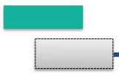




Subsidiaries’ Results (JPN GAAP Non-Consolidated)
NTT Communications Financial Results
Operating
Revenues
944.8
FY2012
Operating
Expenses
0.7
(0.1)%
Cloud Computing Platforms +10.9
Data Networks (12.1)
Voice Communications (21.6)
Solution Services +23.1
Others
(1.0)
3.8
+0.5%
Change from
(Billions of yen)
910.0
FY2014E
revised forecast:
+19.0
944.0
FY2013
revised forecast:
+17.5
34.0
(3.6)%
Cloud Computing Platforms +13.0
Data Networks (8.5)
Voice Communications (20.4)
Solution Services (20.6)
Others
+2.4
23.5
(2.8)%
Change from
826.6
Personnel expenses
Expenses for purchase of goods
(6.1)
830.5
Personnel expenses
Expenses for purchase of goods
+0.6
807.0
and services and other expenses +16.0
Depreciation expenses and loss
and services and other expenses (30.2)
Depreciation expenses and loss
on disposal of assets
(6.0)
on disposal of assets
+6.0
FY2012
FY2013
FY2014E
Operating
Income
118.1
Change from
4.6
(4.0)%
revised forecast:
+1.4
113.4
10.4
(9.2)%
103.0
Financial Results for the Fiscal Year Ended March 31, 2014
and Financial Forecasts for the Fiscal Year Ending March 31, 2015
－17－
Copyright (c) 2014 Nippon Telegraph and Telephone Corporation

Slide 22












Subsidiaries’ Results (JPN GAAP Consolidated)
NTT DATA Financial Results
116.2
+8.6%
93.8
+7.3%
22.4
+35.8%
(Billions of yen)
1,460.0
FY2014E
1,375.0
FY2014E
85.0
Operating
Revenues
1,301.9
FY2012
Operating
Expenses
1,216.2
FY2012
Operating
Income
85.6
41.8
+3.2%
64.9
+5.3%
23.1
(27.0)%
Change from
revised forecast:
+13.7
1,343.7
FY2013
revised forecast:
+11.1
1,281.1
FY2013
revised forecast:
+2.5
62.5
Change from
Change from
Financial Results for the Fiscal Year Ended March 31, 2014
and Financial Forecasts for the Fiscal Year Ending March 31, 2015
－18－
Copyright (c) 2014 Nippon Telegraph and Telephone Corporation

Slide 23











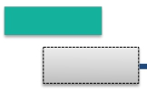



Subsidiaries’ Results (U.S. GAAP Consolidated)
NTT DOCOMO Financial Results
Operating
Revenues
8.9
revised forecast:
(0.2)%
(178.8)
4,470.1
4,461.2
FY2013
FY2012
Operating
Expenses
9.1
revised forecast:
128.8
+2.9%
198.0
+5.4%
(Billions of yen)
4,590.0
FY2014E
Change from
Change from
+0.2%
(158.0)
3,642.0
FY2013
3,840.0
FY2014E
3,632.9
FY2012
Operating
Income
837.2
Change from
18.0
(2.1)%
revised forecast:
(20.8)
819.2
69.2
(8.4)%
750.0
Financial Results for the Fiscal Year Ended March 31, 2014
and Financial Forecasts for the Fiscal Year Ending March 31, 2015
－19－
Copyright (c) 2014 Nippon Telegraph and Telephone Corporation

Slide 24
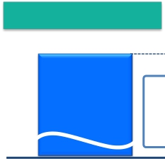



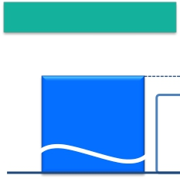



Details of Difference Between Consolidated Operating Income and Total Operating Income of
5 Major Subsidiaries
(Billions of yen)
FY2012
8.2
84.9
・NTT (Holding Company): (4.0)
・NTT URBAN DEVELOPMENT (Consolidated): 27.4
・NTT COMWARE: 3.4
・NTT FINANCE (Consolidated): 19.4
・Outsourcing companies (East): 5.0
・Outsourcing companies (West): 3.0
・Other companies: 30.6
Total operating income of subsidiaries other than
the 5 major ones (excluding the effect of
dividends received by NTT (Holding Company))
113.3
・NTT (Holding Company): (4.6)
・NTT URBAN DEVELOPMENT (Consolidated): 30.4
・NTT COMWARE: 0.2
・NTT FINANCE (Consolidated): 18.2
・Outsourcing companies (East): 9.2
・Outsourcing companies (West): (0.9)
・Other companies: 60.7
Total operating income of subsidiaries other than
the 5 major subsidiaries (excluding the effect of
dividends received by NTT (Holding Company))
・Pension (actuarial difference, etc): (4.8)
・Depreciation of engineering facilities: (28.4)
・Adjustments between operating and non-operating
items, including eliminations, etc.
Elimination and
U.S. GAAP
adjustments
22.0
・Pension (actuarial difference, etc.): 26.1
・Depreciation of engineering facilities: (24.4)
・Adjustments between operating and non-operating
items, including eliminations, etc.
Elimination and
U.S. GAAP
adjustments
1,202.0
Consolidated operating
income
(U.S. GAAP)
1,213.7
Consolidated operating
income
(U.S. GAAP)
1,125.3
Total operating income
of 5 major subsidiaries
(JPN GAAP)
FY2013
1,078.3
Total operating income
of 5 major subsidiaries
(JPN GAAP)
Financial Results for the Fiscal Year Ended March 31, 2014
and Financial Forecasts for the Fiscal Year Ending March 31, 2015
－20－
Copyright (c) 2014 Nippon Telegraph and Telephone Corporation

Slide 25




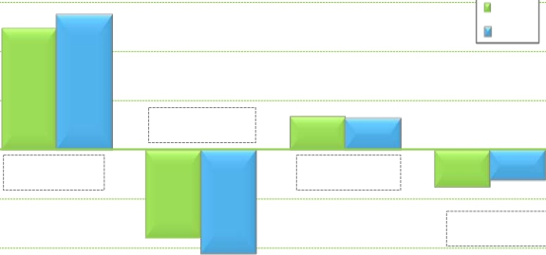

Details of Consolidated Cash Flows
Cash flows from
operating
activities
(A)
Cash flows from
investing
activities
(B)
FCF
(A) + (B)
Cash flows from
financing
activities
Interest-bearing debt
（Billions of yen）
4,500.0
3,000
2,727.9
FY2012
FY2013
4,300.0
2,453.7
4,200.0
2,000
4,036.0
4,000.0
1,000
677.4
621.1
(330.6)
0
+274.2
(56.3)
3,500.0
(1,000)
(745.2)
(622.4)
+122.7
(2,000)
(1,776.3)
(2,106.8)
3,000.0
(3,000)
2013.3
2014.3
2015.3E
Increase/Decrease from the same period of the previous fiscal year
Financial Results for the Fiscal Year Ended March 31, 2014
and Financial Forecasts for the Fiscal Year Ending March 31, 2015
－21－
Copyright (c) 2014 Nippon Telegraph and Telephone Corporation

Slide 26









Capital Investment
Capital Investment
(Billions of yen)
1,907.5
168.6
122.1
108.2
358.4
396.5
753.7
FY2012
Capex to Sales Ratio
1,970.0
111.8
(5.9)%
1,892.8
1,795.7
112.4
147.7
141.8
339.4
351.3
703.1
FY2013
Includes consolidated
capital investments real
estate-related amounts
Other
NTT DATA (Consolidated)
NTT Communications
NTT West
NTT East
NTT DOCOMO (Consolidated)
45.7
(2.5)%
1,850.0
1,750.0
160.0
140.0
120.0
320.0
320.0
690.0
FY2014E
18.1%
16.7%
17.3%
15.9%
16.5%
* Amounts include sales and
investments related to real estate and
solar power generation operations
Capex to Sales
* (includes real estate-related amounts)
18.4%
Financial Results for the Fiscal Year Ended March 31, 2014
and Financial Forecasts for the Fiscal Year Ending March 31, 2015
－22－
Copyright (c) 2014 Nippon Telegraph and Telephone Corporation

Slide 27
Appendices

Slide 28

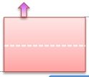










Appendices
FY2013 Details of Financial Results (Per Item)
Operating
Revenues
Fixed IP/packet: +1.7
Mobile IP/packet: (3.3)
(Billions of yen)
[year-on-year：+224.4]
Fixed voice: (133.9)
Mobile voice: (204.9)
10,700.7
Other: +0.7
SI revenues and sales
of telecommunications
equipment
389.9
Systems Integration
Telecommunications
IP/packet
communications
services revenues
0.9
Other revenues
174.3
Voice-related
services revenues
338.8
Fixed voice
Mobile voice
10,925.2
equipment
Systems Integration:
+265.1
Telecommunications equipment (Fixed-line): + 8.3
Telecommunications equipment (Mobile): +116.4
FY2012
FY2013
Operating
Expenses
[year-on-year：+212.7]
Depreciation
expenses and loss on
disposal of assets
25.9
27.8
Personnel expenses
22.6
Other expenses
233.4
Expenses for purchase
of goods and services
and other expenses
9,498.8
FY2012
9,711.5
FY2013
* Beginning with FY2013, NTT Group revised a portion of its breakdown of Operating Revenue components. As a result, each of the components of Operating Revenues for
FY2012 has been adjusted to reflect this change.
Financial Results for the Fiscal Year Ended March 31, 2014
and Financial Forecasts for the Fiscal Year Ending March 31, 2015
－23－
Copyright (c) 2014 Nippon Telegraph and Telephone Corporation

Slide 29





Appendices
Details of Consolidated Balance Sheet
March 31, 2013
(Billions of yen)
19,549.1
March 31, 2014
20,284.9
Liabilities
9,027.1
Interest-Bearing
Debt
4,036.0
Liability for Employees’
Retirement Benefits
1,505.6
Equity
10,522.0
Treasury Stock
(568.5)
Assets
20,284.9
[+735.9]
Depreciable Assets
(property, plant and
equipment)
8,241.9
[(60.8)]
Deferred Tax Assets
(non-current)
661.5
[(91.3)]
Liabilities
9,334.2
[+307.2]
Interest-Bearing
Debt
4,200.0
[+164.0]
Liability for Employees’
Retirement Benefits
1,327.9
[(177.7)]
Other
25.9 [+25.9]
Equity
10,924.8
[+402.8]
Treasury Stock
(156.9)
[+411.5]
Assets
19,549.1
Depreciable Assets
(property, plant and
equipment)
8,302.7
Deferred Tax
Assets
(non-current)
752.8
* Figures for March 31, 2013 have been revised to reflect the retroactive application of the equity method of accounting for Philippine Long Distance Telephone Company.
Financial Results for the Fiscal Year Ended March 31, 2014
and Financial Forecasts for the Fiscal Year Ending March 31, 2015
－24－
Copyright (c) 2014 Nippon Telegraph and Telephone Corporation

Slide 30
Appendices
Consolidated and Main Subsidiaries’ Financial Results for FY2013
(Billions of yen)
NTT DOCOMO
Consolidated
(U.S. GAAP)
4,461.2
(8.9)
(0.2)%
4,640.0
96.1%
3,642.0
9.1
0.2%
3,800.0
95.8%
819.2
(18.0)
(2.1)%
840.0
97.5%
(1)
NTT
Consolidated
(U.S. GAAP)
10,925.2
224.4
2.1%
11,000.0
99.3%
9,711.5
212.7
2.2%
9,770.0
99.4%
1,213.7
11.7
1.0%
1,230.0
98.7%
NTT
(Holding Company)
Non-Consolidated
(JPN GAAP)
430.8
(1.9)
(0.4)%
431.0
100.0%
147.3
(6.8)
(4.5)%
147.0
100.2%
283.5
4.9
1.8%
284.0
99.8%
NTT East
Non-Consolidated
(JPN GAAP)
1,773.8
(57.9)
(3.2)%
1,772.0
100.1%
1,707.0
(59.6)
(3.4)%
1,702.0
100.3%
66.7
1.6
2.5%
70.0
95.3%
NTT West
Non-Consolidated
(JPN GAAP)
1,589.6
(38.3)
(2.4)%
1,581.0
100.5%
1,573.2
(35.5)
(2.2)%
1,561.0
100.8%
16.3
(2.8)
(14.7)%
20.0
81.9%
NTT Com
Non-Consolidated
(JPN GAAP)
944.0
(0.7)
(0.1)%
925.0
102.1%
830.5
3.8
0.5%
813.0
102.2%
113.4
(4.6)
(4.0)%
112.0
101.3%
NTT DATA
Consolidated
(JPN GAAP)
1,343.7
41.8
3.2%
1,330.0
101.0%
1,281.1
64.9
5.3%
1,270.0
100.9%
62.5
(23.1)
(27.0)%
60.0
104.3%
Operating Revenues
Change year-on-year
(% change)
Forecasts for FY2013
(% progress)
Operating Expenses
Change year-on-year
(% change)
Forecasts for FY2013
(% progress)
Operating Income
Change year-on-year
(% change)
Forecasts for FY2013
(% progress)
Income Before
Income Taxes
(2)
1,294.2
277.3
91.7
26.0
132.5
62.1
833.0
Change year-on-year
(% change)
Forecasts for FY2013
(% progress)
Net Income
Change year-on-year
(% change)
Forecasts for FY2013
(% progress)
96.5(5)
8.1%
1,280.0
101.1%
585.5
63.5(5)
12.2%
585.0
100.1%
2.8
1.1%
278.0
99.8%
279.2
7.6
2.8%
280.0
99.7%
2.8
3.2%
90.0
101.9%
53.9
1.1
2.1%
52.0
103.8%
(2.3)
(8.2)%
28.0
93.1%
18.7
(2.2)
(10.7)%
19.0
98.5%
2.8
2.2%
122.0
108.7%
88.9
23.6
36.2%
84.0
105.9%
(19.7)
(24.1)%
49.0
126.8%
23.2
(20.2)
(46.5)%
23.0
101.2%
(0.3)
(0.0)%
842.0
98.9%
464.7
(26.3)
(5.4)%
510.0
91.1%
(5)
(5)
(3)
(4)
(1) NTT has 946 consolidated subsidiaries and accounts for 123 companies under the equity method.
(2) “Income Before Income Taxes” for NTT (Holding Company), NTT East, NTT West, NTT Communications and NTT DATA represent their recurring profits.
(3) “Net Income” for NTT Consolidated represents “Net income attributable to NTT, excluding noncontrolling interests.”
(4) “Net Income” for NTT DOCOMO represents “Net income attributable to NTT DOCOMO, excluding noncontrolling interests.”
(5) “Change year-on-year (% change)” of “Net Income” and “Income Before Income Taxes” for NTT Consolidated and NTT DOCOMO reflect the retroactive application of the equity method of
accounting for Philippine Long Distance Telephone Company.
Financial Results for the Fiscal Year Ended March 31, 2014
and Financial Forecasts for the Fiscal Year Ending March 31, 2015
－25－
Copyright (c) 2014 Nippon Telegraph and Telephone Corporation

Slide 31
Appendices
Consolidated and Main Subsidiaries’ Financial Forecasts for FY2014
(Billions of yen)
NTT DOCOMO
Consolidated
(U.S. GAAP)
4,590.0
128.8
2.9%
3,840.0
198.0
5.4%
750.0
(69.2)
(8.4)%
NTT
Consolidated
(U.S. GAAP)
11,200.0
274.8
2.5%
9,985.0
273.5
2.8%
1,215.0
1.3
0.1%
NTT
(Holding Company)
Non-Consolidated
(JPN GAAP)
422.0
(8.8)
(2.1)%
145.0
(2.3)
(1.6)%
277.0
(6.5)
(2.3)%
NTT East
Non-Consolidated
(JPN GAAP)
1,771.0
(2.8)
(0.2)%
1,681.0
(26.0)
(1.5)%
90.0
23.2
34.9%
NTT West
Non-Consolidated
(JPN GAAP)
1,582.0
(7.6)
(0.5)%
1,547.0
(26.2)
(1.7)%
35.0
18.6
113.7%
NTT Com
Non-Consolidated
(JPN GAAP)
910.0
(34.0)
(3.6)%
807.0
(23.5)
(2.8)%
103.0
(10.4)
(9.2)%
NTT DATA
Consolidated
(JPN GAAP)
1,460.0
116.2
8.6%
1,375.0
93.8
7.3%
85.0
22.4
35.8%
Operating Revenues
Change year-on-year
(% change)
Operating Expenses
Change year-on-year
(% change)
Operating Income
Change year-on-year
(% change)
Income Before
Income Taxes
(1)
1,195.0
272.0
90.0
28.0
113.0
75.0
758.0
※2
Change year-on-year
(% change)
Net Income
Change year-on-year
(% change)
(99.2)
(7.7)%
586.0
0.5
0.1%
(5.3)
(1.9)%
274.0
(5.2)
(1.9)%
(1.7)
(1.9)%
58.0
4.0
7.5%
1.9
7.4%
25.0
6.2
33.6%
(19.5)
(14.8)%
72.0
(16.9)
(19.1)%
12.8
20.7%
37.0
13.7
58.9%
(75.0)
(9.0)%
480.0
15.3
3.3%
(2)
(3)
(1) “Income Before Income Taxes” for NTT (Holding Company), NTT East, NTT West, NTT Communications and NTT DATA represent their recurring profits.
(2) “Net Income” for NTT Consolidated represents “Net income attributable to NTT, excluding noncontrolling interests.”
(3) “Net Income” for NTT DOCOMO represents “Net income attributable to NTT DOCOMO, excluding noncontrolling interests.”
Financial Results for the Fiscal Year Ended March 31, 2014
and Financial Forecasts for the Fiscal Year Ending March 31, 2015
－26－
Copyright (c) 2014 Nippon Telegraph and Telephone Corporation

Slide 32
Appendices
Financial Indices
FY2012
3,207.4 billion yen
30.0%
1,237.5 billion yen
FY2013
3,192.3 billion yen
29.2%
1,299.5 billion yen
FY2014E
3,207.0 billion yen
28.6%
1,357.0 billion yen
EBITDA
EBITDA Margin
Operating Free
Cash Flow
※2
ROCE
EPS
6.1%
431 yen
6.0%
509 yen
6.1%
536 yen
1. EBITDA = Operating Income + Depreciation, Amortization and Loss on Disposal of Property, Plant and Equipment
2. EBITDA Margin = (Operating Income + Depreciation, Amortization and Loss on Disposal of Property, Plant and Equipment)/Operating Revenues
3. Operating Free Cash Flow = Operating Income + Depreciation, Amortization and Loss on Disposal of Property, Plant and Equipment – Capital Investments
4. ROCE = Operating Income×(1 – Normal Statutory Tax Rate)/Operating Capital Employed
[Note] Please see next page for reconciliation of financial indices.
Financial Results for the Fiscal Year Ended March 31, 2014
and Financial Forecasts for the Fiscal Year Ending March 31, 2015
－27－
Copyright (c) 2014 Nippon Telegraph and Telephone Corporation

Slide 33
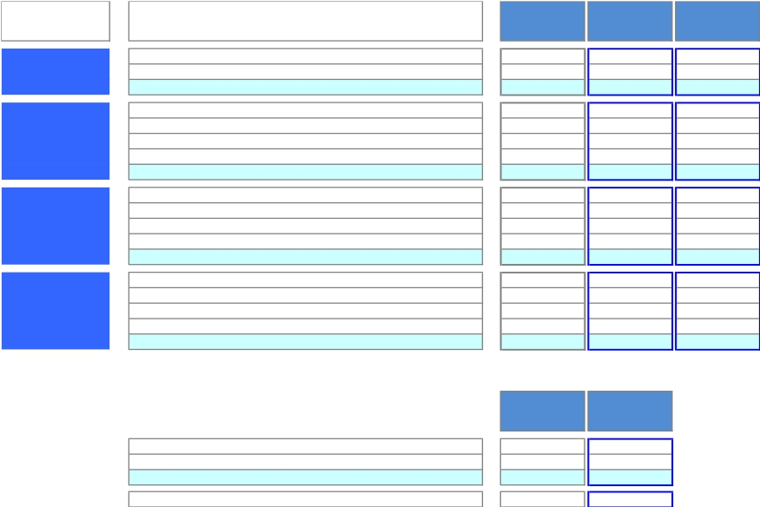
Appendices
Reconciliation of Financial Indices
(Billions of yen)
Items
FY2012
FY2013
FY2014E
EBITDA
EBITDA
Margin
Operating Free
Cash Flow
ROCE
(1) Operating Income
(2) Depreciation, Amortization, and Loss on Disposal of Property, Plant and Equipment
EBITDA [ (1)+(2) ]
(1) Operating Income
(2) Depreciation, Amortization, and Loss on Disposal of Property, Plant and Equipment
(3) EBITDA [ (1)+(2) ]
(4) Operating Revenues
EBITDA Margin [ (3)/(4)×100 ]
(1) Operating Income
(2) Depreciation, Amortization, and Loss on Disposal of Property, Plant and Equipment
(3) EBITDA [ (1)+(2) ]
(4) Capital Investment *
Operating Free Cash Flow [ (3)-(4) ]
(1) Operating Income
Normal Statutory Tax Rate
(2) Operating Income×(1-Normal Statutory Tax Rate)
(3) Operating Capital Employed
ROCE [ (2)/(3)×100 ]
1,202.0
2,005.5
3,207.4
1,202.0
2,005.5
3,207.4
10,700.7
30.0%
1,202.0
2,005.5
3,207.4
1,970.0
1,237.5
1,202.0
38%
742.1
12,212.0
6.1%
1,213.7
1,978.6
3,192.3
1,213.7
1,978.6
3,192.3
10,925.2
29.2%
1,213.7
1,978.6
3,192.3
1,892.8
1,299.5
1,213.7
38%
749.3
12,489.4
6.0%
1,215.0
1,992.0
3,207.0
1,215.0
1,992.0
3,207.0
11,200.0
28.6%
1,215.0
1,992.0
3,207.0
1,850.0
1,357.0
1,215.0
36%
778.8
12,831.5
6.1%
* “Capital investment” is the accrual-based amount required for any acquisition of property, plant and equipment or intangibles. The differences from the
amounts of “Payments for property, plant and equipment” and “Payments for intangibles” in the consolidated statements of cash flows are as follows:
FY2012
1,538.1
446.6
1,984.7
14.7
FY2013
1,486.7
416.6
1,903.2
10.5
Payments for Property, Plant and Equipment
Payments for Intangibles
Total
Difference from Capital Investment
Financial Results for the Fiscal Year Ended March 31, 2014
and Financial Forecasts for the Fiscal Year Ending March 31, 2015
－28－
Copyright (c) 2014 Nippon Telegraph and Telephone Corporation

Slide 34

Appendices
Calculation of ARPU
Average monthly revenue per unit, or ARPU, is used to measure average monthly operating revenues attributable to each designated service on a per user basis. In the case of NTT Group’s fixed-line business, ARPU is calculated by dividing revenue
items included in the operating revenues of NTT Group’s regional communications business segment, that is, telephone subscriber lines, "INS-NET" and "FLET'S Hikari," by the number of Active Subscribers to the relevant services.
In the case of NTT Group’s mobile communications business, ARPU is calculated by dividing revenue items included in operating revenues from its mobile communications business segment, such as revenues from FOMA mobile phone services and
Xi mobile phone services, that are incurred consistently each month (i.e., basic monthly charges and voice/packet transmission charges), by the number of Active Subscribers to the relevant services. The calculation of these figures excludes revenues
that are not representative of monthly average usage, such as telecommunications equipment sales, activation fees and universal service charges.
NTT believes that its ARPU figures calculated in this way provide useful information regarding the monthly average usage of its subscribers. The revenue items included in the numerators of NTT Group’s ARPU figures are based on its financial results
comprising its U.S. GAAP results of operations.
Notes
(1)We compute the following four categories of ARPU for business conducted by each of NTT East and NTT West.
・Aggregate Fixed Line ARPU (Telephone Subscriber Lines + INS-NET Subscriber Lines): Calculated based on revenues from monthly charges and call charges for Telephone Subscriber Lines and INS-NET Subscriber Lines, which are
included in operating revenues from Voice Transmission Services (excluding IP Services), and revenues from "FLET'S ADSL" and "FLET'S ISDN," which are included in operating revenues from IP Services.
・Telephone Subscriber Lines ARPU: Calculated based on revenues from monthly charges and call charges for Telephone Subscriber Lines and revenues from "FLET'S ADSL."
・INS-NET Subscriber Lines ARPU: Calculated based on revenues from monthly charges and call charges for "INS-NET" Subscriber Lines and revenues from "FLET'S ISDN."
・FLET’S Hikari ARPU: Calculated based on revenues from "FLET’S Hikari" (including "FLET’S Hikari" optional services), which are included in operating revenues from IP Services, revenues from monthly charges, call charges and connection
device charges for "Hikari Denwa," and revenues from "FLET’S Hikari" optional services, which are included in Supplementary Business revenues.
－"FLET'S Hikari" includes "B FLET'S," "FLET'S Hikari Next," "FLET'S Hikari Light" and "FLET'S Hikari WiFi Access" provided by NTT East, and "B FLET'S," "FLET'S Hikari Premium," "FLET'S Hikari Mytown," "FLET'S Hikari Next," "FLET'S
Hikari Light" and "FLET'S Hikari WiFi Access" provided by NTT West.
－Commencing in the fiscal year ended March 31, 2014, NTT East and NTT West began including in their respective FLET'S Hikari ARPU calculations revenues from NTT East's and NTT West's “FLET'S VPN WIDE” virtual private network
option. These revenues are part of NTT East's and NTT West's operating revenues from IP services. As a result of this new calculation methodology, NTT East's and NTT West's FLET'S Hikari ARPU for the fiscal year ended March 31,
2013 include revenues of 20 yen for NTT East and NTT West from “FLET'S VPN WIDE.”
(2)Revenues from interconnection charges are excluded from the calculation of Aggregate Fixed Line ARPU (Telephone Subscriber Lines + INS-NET Subscriber Lines), Telephone Subscriber Lines ARPU, INS-NET Subscriber Lines ARPU, and
FLET'S Hikari ARPU.
(3)For purposes of calculating Aggregate Fixed Line ARPU (Telephone Subscriber Lines + INS-NET Subscriber Lines), Telephone Subscriber Lines ARPU and INS-NET Subscriber Lines ARPU, the number of subscribers is determined based on the
number of subscriptions for each service.
(4)In terms of number of channels, transmission rate, and line use rate (base rate), INS-Net 1500 is in all cases roughly ten times greater than INS-Net 64. For this reason, for the purpose of calculating Aggregate Fixed Line ARPU (Telephone
Subscriber Lines + INS-NET Subscriber Lines) and INS-NET Subscriber Lines ARPU, one INS-Net 1500 subscription is calculated as ten INS-Net 64 subscriptions.
(5)For purposes of calculating FLET'S Hikari ARPU, number of subscribers is determined based on the number of "FLET'S Hikari" subscribers, including subscribers to "B FLET'S," "FLET'S Hikari Next," "FLET'S Hikari Light" and "FLET'S Hikari WiFi
Access" provided by NTT East, and subscribers to "B FLET'S," "FLET'S Hikari Premium," "FLET'S Hikari Mytown," "FLET'S Hikari Next," "FLET'S Hikari Light" and "FLET'S Hikari WiFi Access" provided by NTT West.
(6)The following is the formula we use to compute ARPU for mobile business conducted by NTT DOCOMO.
Mobile Aggregate ARPU ("FOMA"+"Xi") = Voice ARPU ("FOMA"+"Xi") + Packet ARPU ("FOMA"+"Xi") + Smart ARPU ("FOMA"+"Xi").
－NTT DOCOMO’s Voice ARPU ("FOMA"+"Xi") is based on operating revenues related to voice services, such as basic monthly charges and voice communication charges attributable to our "FOMA" and "Xi" services, and our Packet ARPU
("FOMA"+"Xi") is based on operating revenues related to packet services, such as flat monthly fees and packet communication charges attributable to our "FOMA" and "Xi" services and our Smart ARPU (“FOMA”+”Xi”) is based on operating
revenues from a part of Other Operating Revenues attributable to “FOMA” and “Xi” wireless communications services (revenues from content, collection of charges, mobile phone insurance service, advertising and others).
(7)Communications module service, phone number storage service, mail address storage service and docomo Business Transceiver subscribers and the revenues therefrom are not included in the calculations of Mobile Aggregate ARPU.
(8)Number of active subscribers used in the ARPU calculation of NTT East and NTT West are as below.
1Q Results: Sum of number of active subscribers** for each month from April to June.
2Q Results: Sum of number of active subscribers** for each month from July to September.
3Q Results: Sum of number of active subscribers** for each month from October to December.
4Q Results: Sum of number of active subscribers** for each month from January to March.
FY Results : Sum of number of active subscribers** for each month from April to March.
FY Forecast: Sum of the average expected active number of subscribers during the fiscal year ((number of subscribers at March 31, 2014 + number of expected subscribers at March 31, 2015)/2)x12
(9)Number of active subscribers used in the ARPU calculation of NTT DOCOMO are as below.
1Q Results: Sum of number of active subscribers** for each month from April to June.
2Q Results: Sum of number of active subscribers** for each month from July to September.
3Q Results: Sum of number of active subscribers** for each month from October to December.
4Q Results: Sum of number of active subscribers** for each month from January to March.
FY Results/FY Forecast: Sum of number of active subscribers**/ expected number of active subscribers** for each month from April to March.
**active subscribers = (number of subscribers at end of previous month + number of subscribers at end of the current month)/2
Financial Results for the Fiscal Year Ended March 31, 2014
and Financial Forecasts for the Fiscal Year Ending March 31, 2015
－29－
Copyright (c) 2014 Nippon Telegraph and Telephone Corporation

