Slide 1

“Hikari Collaboration Model”
- Contributing to the Creation of New Value -
May 13, 2014
Copyright (c) 2014 Nippon Telegraph and Telephone Corporation

Slide 2


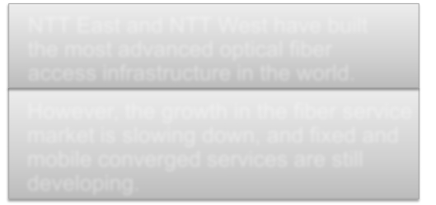


Stimulation of the ICT Market by Creating New Value
NTT East and NTT West have built
Japan faces a variety of issues
such as an aging society and
environmental and energy issues,
while solutions using ICT tend to
lag behind.
the most advanced optical fiber
access infrastructure in the world.
However, the growth in the fiber service
market is slowing down, and fixed and
mobile converged services are still
developing.
NTT East and NTT West start wholesaling fiber access services.
Stimulate the ICT market by supporting a variety of market players to
create new value
Contribute to the resolution of social issues and the enhancement of
the industrial competitiveness of Japan
－1－
Copyright (c) 2014 Nippon Telegraph and Telephone Corporation

Slide 3
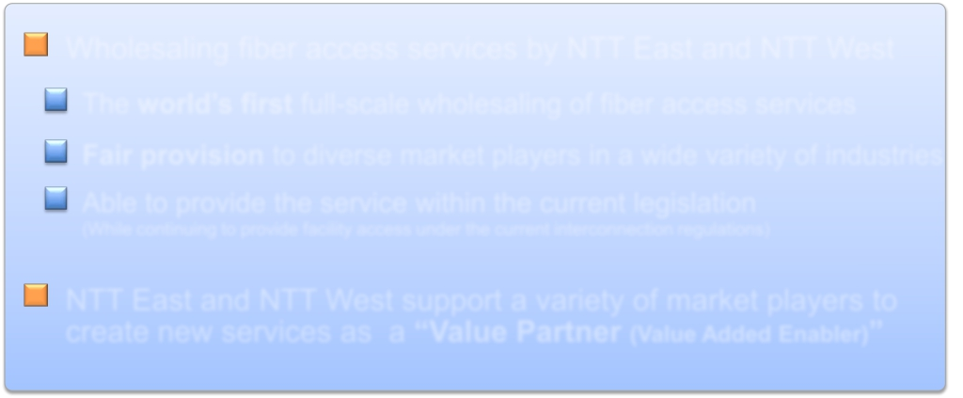

The World’s First Wholesaling of Fiber Access Services
Wholesaling fiber access services by NTT East and NTT West
The world’s first full-scale wholesaling of fiber access services
Fair provision to diverse market players in a wide variety of industries
Able to provide the service within the current legislation
(While continuing to provide facility access under the current interconnection regulations)
NTT East and NTT West support a variety of market players to
create new services as a “Value Partner (Value Added Enabler)”
“Hikari* Collaboration Model”
*Hikari: optical, fiber access
Copyright (c) 2014 Nippon Telegraph and Telephone Corporation
－2－

Slide 4
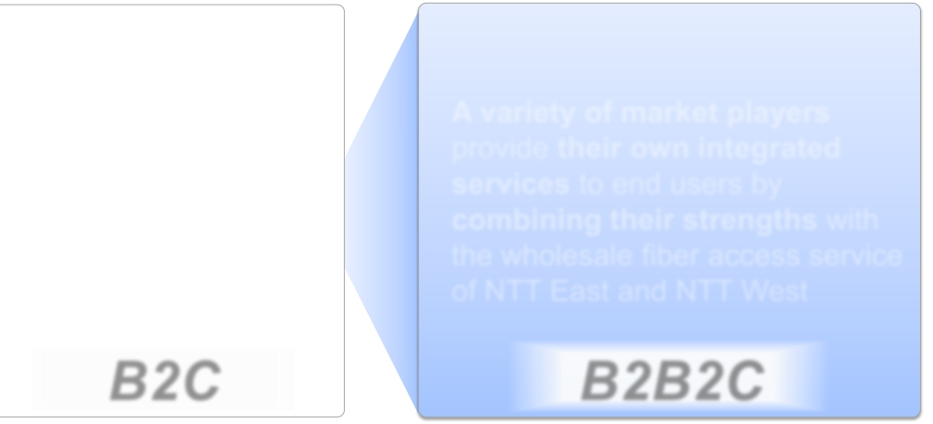
“Hikari Collaboration Model”
Current Model
“Hikari Collaboration Model”
A variety of market players
provide their own integrated
services to end users by
combining their strengths with
the wholesale fiber access service
of NTT East and NTT West
B2B2C
－3－
Copyright (c) 2014 Nippon Telegraph and Telephone Corporation
NTT East and NTT West
directly provide fiber
access services to end
users.
B2C

Slide 5
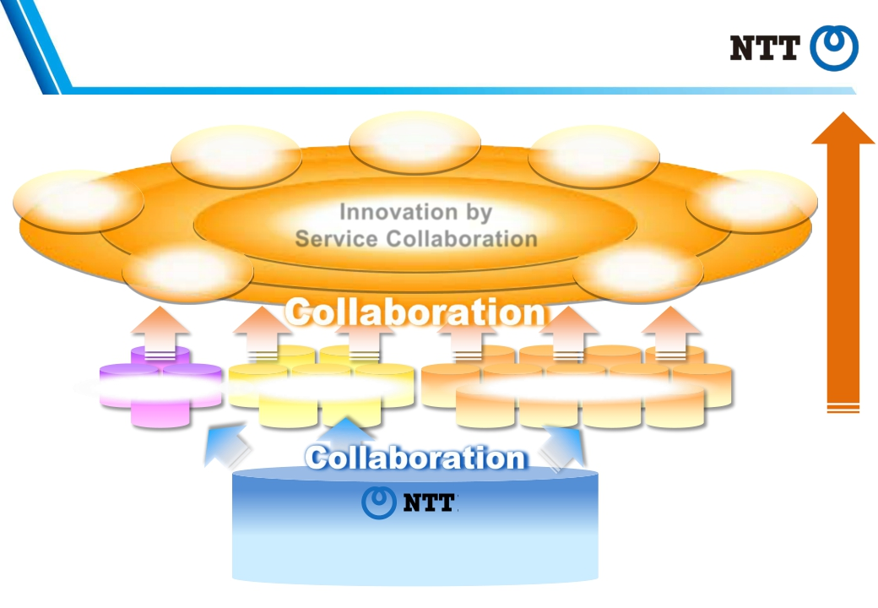
Creation of Value through Collaboration
Health Care
Environment
Distribution
Transportation
Innovation by
Service Collaboration
Manufacturing
Sports/
Entertainment
Companies in other industries
Creation of New Value
Tourism
Carriers
MVNOs, ISPs
(NTT East, NTT West, R&D)
Value Partner
－4－
Copyright (c) 2014 Nippon Telegraph and Telephone Corporation

Slide 6

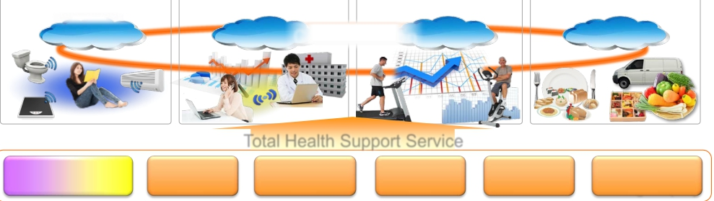

A Sample Case of “Hikari Collaboration Model”
(Example: Health Care)
Communications service providers:
Carriers, MVNOs, ISPs provide services linking fixed and mobile communications.
Players in other industries：
Players in a wide range of industries, such as medical institutions, electronics manufacturers and
residential builders collaborate to provide one-stop services supporting a healthy lifestyle.
Health Monitoring
(Vitals sensor)
Remote diagnosis and
health consultation
Exercise
suggestion
Dietary advice and
food delivery
Cloud
Cloud
Collaboration
Cloud
Cloud
Total Health Support Service
Carrier,
MVNO, ISP
×
Medical
institution
Electronics×
Residential×
×
Fitness
club
Restaurant /×
manufacturer
builder
Catering company
Wholesaling Fiber Access Service
(NTT East, NTT West, R&D)
－5－
Copyright (c) 2014 Nippon Telegraph and Telephone Corporation

Slide 7


Benefits of “Hikari Collaboration Model”
Benefits for service players
Possible to create new services in a variety of industries
combining their real world business with ICT, based
on fixed and mobile converged communications
Benefits for end users
Possible to select innovative services through the
creation of value by a variety of market players
－6－
Copyright (c) 2014 Nippon Telegraph and Telephone Corporation

Slide 8
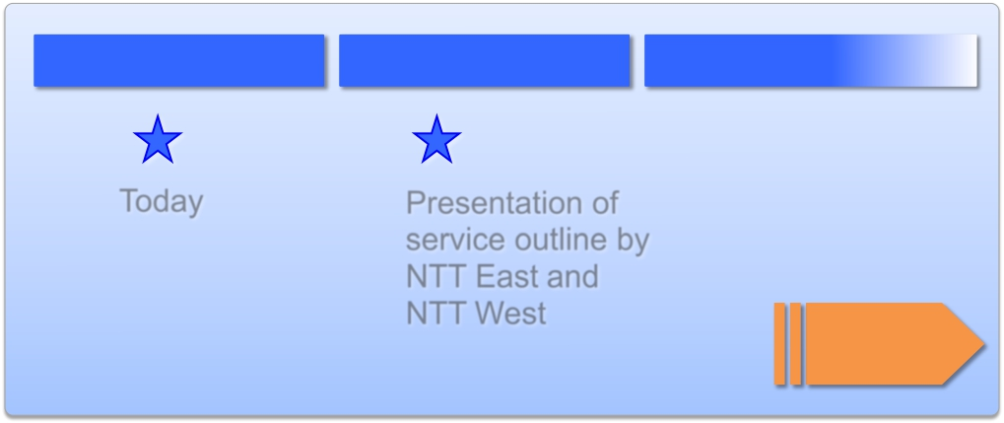
Schedule
FY2014 Q1
Today
Q2
Presentation of
service outline by
NTT East and
NTT West
Q3 and beyond
Service
Launch
Inquiries in advance of presentation of service outline (business inquiries only)
NTT East
New Business Development Headquarters 03-5359-7159 hikari_collabo@ml.east.ntt.co.jp
NTT West
Business Design Department
06-4793-5771 hikari_collabo@ml.hq.west.ntt.co.jp
－7－
Copyright (c) 2014 Nippon Telegraph and Telephone Corporation

Slide 9

Next V alue P artner
T ransformation
T rusted S olutions
andFull-lineICT services
Copyright (c) 2014 Nippon Telegraph and Telephone Corporation
for
of BusinessmodelsandLifestyle
by
ofGlobal,Secure,End-to-end,

