Slide 1

Financial Results for the Three Months
Ended June 30, 2014
August 6, 2014

Slide 2


The forward-looking statements and projected figures concerning the future performance of NTT
and its subsidiaries and affiliates contained or referred to herein are based on a series of
assumptions, projections, estimates, judgments and beliefs of the management of NTT in light of
information currently available to it regarding NTT and its subsidiaries and affiliates, the economy
and telecommunications industry in Japan and overseas, and other factors. These projections
and estimates may be affected by the future business operations of NTT and its subsidiaries and
affiliates, the state of the economy in Japan and abroad, possible fluctuations in the securities
markets, the pricing of services, the effects of competition, the performance of new products,
services and new businesses, changes to laws and regulations affecting the telecommunications
industry in Japan and elsewhere, other changes in circumstances that could cause actual results
to differ materially from the forecasts contained or referred to herein, as well as other risks
included in NTT’s most recent Annual Report on Form 20-F and other filings and submissions
with the United States Securities and Exchange Commission.
* “E” in this material represents that the figure is a plan or projection for operation.
** “FY” in this material indicates the fiscal year ending March 31 of the succeeding year.
*** “1Q” in this material represents the 3-month period beginning on April 1 and ending on June 30.
Financial Results for the Three Months Ended June 30, 2014
－1－
Copyright (c) 2014 Nippon Telegraph and Telephone Corporation

Slide 3
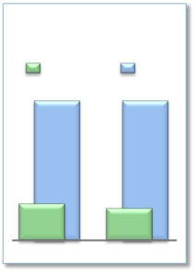
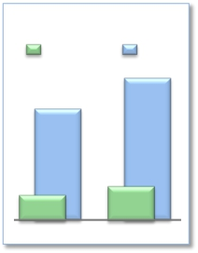
FY2014/1Q Highlights
Operating Revenues increased for the fourth consecutive year
Consolidated
Operating Income
(Billions of yen)
FY
1,215.0
(forecast)
298.0
FY2014
Operating Income decreased but was in line with expectations
Expansion of global cloud services
➢Promoting M&A
· Dimension Data completed acquisition of U.S. ICT solutions provider Nexus IS
➢Cross-selling order volume: approx. $50 million
➢Overseas sales: +96.4 billion yen increase year-on-year; steadily expanding
Enhanced competitiveness of network services
1Q
1,213.7
348.9
FY2013
Global Revenues
➢Expansion of NTT’s user base
(Billions of yen)
FY
1,530.0
(forecast)
363.3
FY2014
· Net increase of 0.46 million mobile phone subscribers from the end of FY2013 (0.37
million increase from FY2013/1Q), 4.67 million new rate plan subscribers
· Number of smartphone users exceeded 25 million; 24.04 million Xi subscribers (net
increase of 2.08 million subscribers from the end of FY2013)
· 18.32 million FLET’S Hikari subscribers (net increase of 0.27 million subscribers from
the end of FY2013) and NTT WEST subscribers exceeded 8 million
· 4.09 million Hikari TV & FLET’S TV subscribers and 4.13 million dvideo subscribers
· Steady growth of the number of Wi-Fi area owners of NTT hotspots (7% increase from
the end of FY2013)
➢Cost reductions
· Steady progress in fixed-line and mobile access cost reductions: NTT achieved cost
reductions of 45 billion yen during FY2014/1Q, out of its annual target of 190 billion yen
1Q
1,196.0
267.0
FY2013
Financial Results for the Three Months Ended June 30, 2014
－2－
Copyright (c) 2014 Nippon Telegraph and Telephone Corporation

Slide 4

Consolidated Results and Forecasts (U.S. GAAP)
FY2014/1Q Highlights
Operating Revenues increased for the fourth consecutive year
Operating Income decreased but was in line with expectations
(Billions of yen)
FY2014
Forecasts
FY2014/1Q
% progress
compared to
FY2014
FY2013/1Q
Change
year-on-year
+31.1
+82.0
(50.9)
(17.8)
[%]
+1.2%
+3.6%
(14.6)%
(10.6)%
Forecasts
23.6%
23.5%
24.5%
25.4%
Operating
Revenues
Operating
Expenses
Operating
Income
Net Income*
2,640.2
2,342.2
298.0
149.0
2,609.1
2,260.2
348.9
166.7
11,200.0
9,985.0
1,215.0
586.0
*
Net income represents net income attributable to NTT, excluding noncontrolling interests.
Financial Results for the Three Months Ended June 30, 2014
－3－
Copyright (c) 2014 Nippon Telegraph and Telephone Corporation

Slide 5
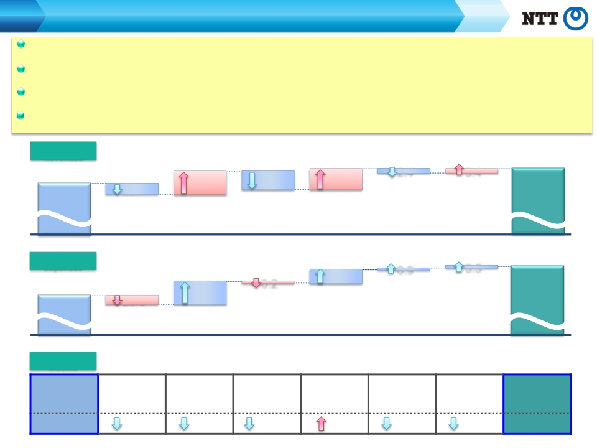
Consolidated Results and Forecasts (U.S. GAAP)
FY2014/1Q Contributing Factors by Segment
Regional communications business: Operating Income remained roughly unchanged from the previous year as a result of continued efforts to
improve operational efficiency, despite the increased impact of FLET'S Hikari discounts.
Long-distance and international communications business: Despite a decrease in Operating Income due to intensifying domestic competition,
there was steady growth in overseas businesses.
Mobile communications business: Despite a decrease in Operating Income mainly due to the increased impact of "Monthly Support" discount
programs, there was a net increase in the number of subscribers due to improvements in mobile number portability (MNP).
Data communications business: Despite the effect of unprofitable business deals, Operating Income remained roughly unchanged from the
previous year, as gross margins improved due to an increase in sales.
Operating
Revenues
[year-on-year：+31.1]
Mobile
communications
business
Data
communications
business
Other
business
(Billions of yen)
42.6
2.4
3.4
Elimination of
intersegment/Others
23.1
Regional
communications
business
48.9
Long distance and
international
communications
business
38.3
2,609.1
2,640.2
FY2013/1Q
Operating
Data
communications
FY2014/1Q
Expenses
2,260.2
FY2013/1Q
[year-on-year：+82.0]
business
41.5
3.5
Elimination of
intersegment/Others
Regional
communications
business
20.3
0.9
Other
business
0.2
56.7
Long distance and
international
communications
business
Mobile
communications
business
2,342.2
FY2014/1Q
Operating
Income
[year-on-year：(50.9)]
Regional
Long distance and
Mobile
Data
Other business
Elimination of
FY2013/1Q
348.9
communications
business
2.8
international
communications
business
7.9
communications
business
38.0
communications
business
1.1
intersegment/
Others
0.1
FY2014/1Q
298.0
3.2
Financial Results for the Three Months Ended June 30, 2014
－4－
Copyright (c) 2014 Nippon Telegraph and Telephone Corporation

Slide 6


Progress of Broadband Services

Slide 7
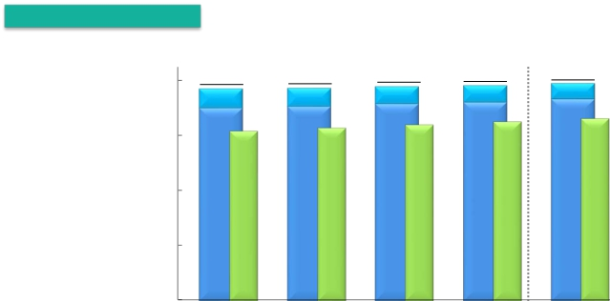



Progress of Broadband Services
Number of Subscribers for Fixed Broadband Services
Number of subscribers
FLET’S ADSL
FLET’S Hikari
(Thousands)
20,000
15,000
10,000
5,000
0
Hikari Denwa
19,954
1,203
18,750
17,106
2015.3E
19,271
1,751
17,521
15,412
2013.6
19,335
1,663
17,672
15,664
2013.9
19,444
1,572
17,873
15,950
2013.12
19,534
1,483
18,050
16,256
2014.3
19,717
1,398
18,319
16,507
2014.6
Changes from the preceding quarter
(Thousands)
FY2014E
FY2013
10-12
FY2014
4-6
FY2013
4-6
7-9
1-3
FLET’S Hikari
*1
220
152
200
178
269
750
700
Number of
opened
*connections 2
FLET’S ADSL
870
(98)
707
(88)
743
(91)
811
(89)
879
(85)
3,131
(365)
3,000
(280)
Hikari Denwa
*3
242
252
287
305
251
1,087
850
*
1 Number of FLET’S Hikari subscribers includes B FLET’S, FLET’S Hikari Next, FLET’S Hikari Light and FLET’S Hikari WiFi Access provided by NTT East and B FLET’S,
FLET’S Hikari Premium, FLET’S Hikari Mytown, FLET’S Hikari Next, FLET’S Hikari Light and FLET’S Hikari WiFi Access provided by NTT West.
* 2 Number of opened connections excludes openings due to relocations.
*
3 Number of Hikari Denwa subscribers is presented in thousands of channels.
Financial Results for the Three Months Ended June 30, 2014
－5－
Copyright (c) 2014 Nippon Telegraph and Telephone Corporation

Slide 8

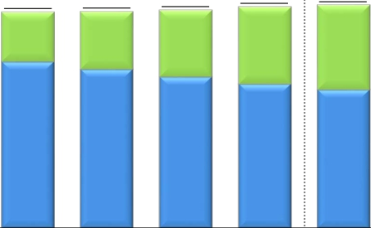


Progress of Broadband Services
Number of Subscribers for Mobile Broadband Services
Number of subscribers
(Thousands)
*
Xi
FOMA
70,000
60,000
50,000
40,000
30,000
20,000
10,000
0
66,800
29,800
37,000
2015.3E
61,623
14,198
47,425
2013.6
61,772
16,398
45,374
2013.9
62,182
19,021
43,160
2013.12
63,105
21,965
41,140
2014.3
63,566
24,043
39,523
2014.6
Changes from the preceding quarter
(Thousands)
FY2014E
FY2013
10-12
FY2014
4-6
FY2013
4-6
7-9
1-3
Xi+FOMA
87
149
410
924
461
1,569
3,700
*
The number of communication module service subscribers is included in FOMA subscribers.
Financial Results for the Three Months Ended June 30, 2014
－6－
Copyright (c) 2014 Nippon Telegraph and Telephone Corporation

Slide 9


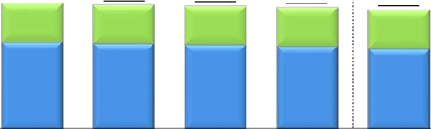

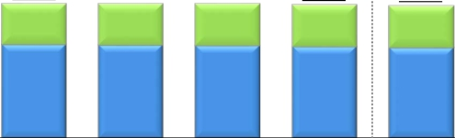

Progress of Broadband Services
*
ARPU of Fixed Broadband Services (FLET’S Hikari)
NTT East
Optional Service
Basic Monthly Charge
(Yen)
6,000
4,000
2,000
0
5,750
1,760
3,990
5,680
1,760
3,920
5,650
1,790
3,860
5,570
1,770
3,800
5,660
1,770
3,890
5,460
1,770
3,690
5,500
1,800
3,700
FY2013
FY2014
4-6
FY2013
FY2014E
4-6
7-9
10-12
1-3
NTT West
(Yen)
6,000
4,000
2,000
0
5,840
1,770
4,070
5,850
1,790
4,060
5,850
1,820
4,030
5,800
1,810
3,990
5,750
1,810
3,940
5,830
1,800
4,030
5,740
1,840
3,900
FY2013
FY2014
4-6
FY2013
FY2014E
4-6
7-9
10-12
1-3
*
FLET’S Hikari includes B FLET’S, FLET’S Hikari Next, FLET’S Hikari Light and FLET’S Hikari WiFi Access provided by NTT East and B FLET’S, FLET’S Hikari Premium,
FLET’S Hikari Mytown, FLET’S Hikari Next, FLET’S Hikari Light and FLET’S Hikari WiFi Access provided by NTT West. Please see page 22 regarding the calculation of ARPU.
Financial Results for the Three Months Ended June 30, 2014
－7－
Copyright (c) 2014 Nippon Telegraph and Telephone Corporation

Slide 10
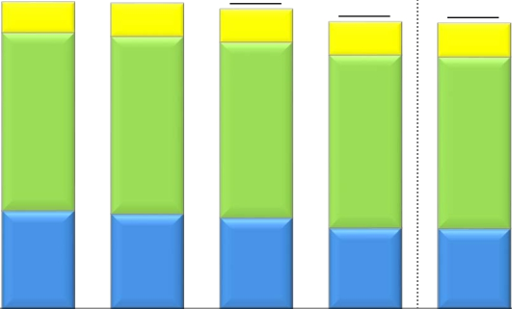

Progress of Broadband Services
ARPU of Mobile Broadband Services (Xi, FOMA)*
Smart ARPU
Packet ARPU
Voice ARPU
(Yen)
5,000
4,000
3,000
2,000
1,000
0
4,610
460
2,680
1,470
4,590
490
2,670
1,430
4,510
500
2,640
1,370
4,500
490
2,640
1,370
4,320
500
2,600
1,220
4,300
510
2,580
1,210
4,390
530
2,620
1,240
FY2013
10-12
FY2014
4-6
FY2013
FY2014E
4-6
7-9
1-3
* The calculation of mobile broadband services ARPU does not include communication module service subscribers and the revenues therefrom.
Please see page 22 regarding the calculation of ARPU.
Financial Results for the Three Months Ended June 30, 2014
－8－
Copyright (c) 2014 Nippon Telegraph and Telephone Corporation

Slide 11


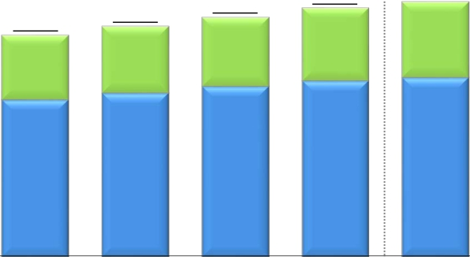
Progress of Broadband Services
Number of Subscribers for Video Services
FLET'S TV
Hikari TV
*
(Thousands)
5,000
4,546
1,346
3,200
FY2014E
3,984
1,161
2,823
2014.3
4,086
1,209
2,877
2014.6
4,000
3,000
2,000
1,000
0
3,692
1,067
2,625
2013.9
3,841
1,113
2,727
2013.12
3,552
1,032
2,520
2013.6
*
“FLET’S TV” requires a subscription to “FLET’S TV Transmission Service,” provided by NTT East and NTT West, and a subscription to Opticast Inc.’s “Opticast Facility Use
Services” broadcast service.
Financial Results for the Three Months Ended June 30, 2014
－9－
Copyright (c) 2014 Nippon Telegraph and Telephone Corporation

Slide 12
Financial Information

Slide 13













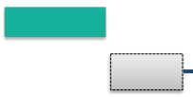



Subsidiaries’ Results (JPN GAAP Non-Consolidated)
NTT East Financial Results
(Billions of yen)
FY2014/1Q
5.4
FY2014E
2.8
(0.2)%
Operating
Revenues
(1.2)%
Progress
24.4%
1,773.8
FY2013
1,771.0
FY2014E
438.4
FY2013/1Q
432.9
FY2014/1Q
Voice Transmission Services
IP Services
Others
(54.3)
(1.3)
+52.8
Voice Transmission Services
IP Services
Others
(12.7)
(2.5)
+9.8
Operating
Expenses
4.9
(1.2)%
26.0
(1.5)%
Progress
24.1%
410.1
FY2013/1Q
Personnel expenses
Expenses for purchase of goods
and services and other expenses
Depreciation expenses and loss
on disposal of assets
(0.8)
(7.6)
+3.5
405.1
FY2014/1Q
1,707.0
FY2013
Personnel expenses
Expenses for purchase of goods
and services and other expenses
Depreciation expenses and loss
on disposal of assets
(4.9)
(24.2)
+3.1
1,681.0
FY2014E
Operating
Income
Progress
0.5
(1.8)%
30.9%
27.7
23.2
+34.9%
28.3
66.7
90.0
Financial Results for the Three Months Ended June 30, 2014
－10－
Copyright (c) 2014 Nippon Telegraph and Telephone Corporation

Slide 14












Subsidiaries’ Results (JPN GAAP Non-Consolidated)
NTT West Financial Results
(Billions of yen)
FY2014/1Q
3.6
FY2014E
7.6
(0.5)%
Operating
Revenues
(0.9)%
Progress
24.3%
1,589.6
FY2013
1,582.0
FY2014E
388.8
FY2013/1Q
385.1
FY2014/1Q
Voice Transmission Services
IP Services
Others
(50.3)
+13.3
+29.3
Voice Transmission Services
IP Services
Others
(12.6)
+2.7
+6.3
Operating
Expenses
0.2
(0.1)%
26.2
(1.7)%
Progress
24.4%
377.3
FY2013/1Q
Personnel expenses
Expenses for purchase of goods
and services and other expenses
Depreciation expenses and loss
on disposal of assets
(0.1)
(0.7)
+0.7
377.0
FY2014/1Q
1,573.2
FY2013
Personnel expenses
Expenses for purchase of goods
and services and other expenses
Depreciation expenses and loss
on disposal of assets
+0.5
(27.8)
+1.1
1,547.0
FY2014E
Operating
Income
Progress
3.4
(29.9)%
23.1%
8.1
18.6
+113.7%
11.5
16.3
35.0
Financial Results for the Three Months Ended June 30, 2014
－11－
Copyright (c) 2014 Nippon Telegraph and Telephone Corporation

Slide 15












Subsidiaries’ Results (JPN GAAP Non-Consolidated)
NTT Communications Financial Results
(Billions of yen)
FY2014/1Q
8.2
FY2014E
34.0
(3.6)%
Operating
Revenues
(3.6)%
Progress
23.9%
944.0
FY2013
910.0
FY2014E
225.4
FY2013/1Q
Cloud Computing Platforms
Data Networks
Voice Communications
Solution Services
Others
+3.4
(6.4)
(5.7)
+0.0
+0.4
217.2
FY2014/1Q
Cloud Computing Platforms
Data Networks
Voice Communications
Solution Services
Others
+13.0
(8.5)
(20.4)
(20.6)
+2.4
Operating
Expenses
23.5
(2.8)%
0.4
(0.2)%
Progress
23.9%
192.9
FY2013/1Q
Personnel expenses (0.4)
and services and other expenses +0.2
Depreciation expenses and loss
(0.2)
on disposal of assets
192.5
FY2014/1Q
830.5
FY2013
Personnel expenses
Expenses for purchase of goods
and services and other expenses
Depreciation expenses and loss
on disposal of assets
+0.6
(30.2)
+6.0
807.0
FY2014E
Expenses for purchase of goods
Operating
Income
Progress
7.8
(24.1)%
23.9%
24.6
10.4
(9.2)%
32.4
113.4
103.0
Financial Results for the Three Months Ended June 30, 2014
－12－
Copyright (c) 2014 Nippon Telegraph and Telephone Corporation

Slide 16

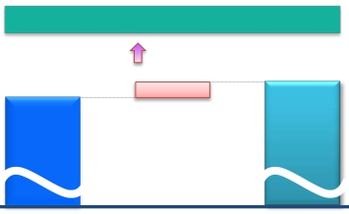






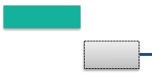


Subsidiaries’ Results (U.S GAAP Consolidated)
NTT DOCOMO Financial Results
(Billions of yen)
FY2014/1Q
38.3
(3.4)%
FY2014E
128.8
+2.9%
Operating
Revenues
Progress
23.4%
4,461.2
4,590.0
1,113.6
FY2013/1Q
1,075.3
FY2014/1Q
FY2013
FY2014E
198.0
+5.4%
Operating
Expenses
0.4
(0.1)%
Progress
22.5%
866.1
FY2013/1Q
865.7
FY2014/1Q
3,642.0
FY2013
3,840.0
FY2014E
Operating
Income
Progress
37.8
(15.3)%
28.0%
209.6
69.2
(8.4)%
247.5
819.2
750.0
Financial Results for the Three Months Ended June 30, 2014
－13－
Copyright (c) 2014 Nippon Telegraph and Telephone Corporation

Slide 17







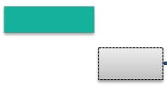
Subsidiaries’ Results (JPN GAAP Consolidated)
NTT DATA Financial Results
(Billions of yen)
FY2014/1Q
41.7
+14.2%
FY2014E
116.2
+8.6%
Operating
Revenues
Progress
23.0%
1,343.7
1,460.0
294.1
FY2013/1Q
335.9
FY2014/1Q
FY2013
FY2014E
93.8
+7.3%
Operating
Expenses
41.3
+14.3%
Progress
24.0%
289.0
FY2013/1Q
330.4
FY2014/1Q
1,281.1
FY2013
1,375.0
FY2014E
Operating
Income
Progress
0.3
+7.7%
6.5%
5.5
22.4
+35.8%
5.1
62.5
85.0
Financial Results for the Three Months Ended June 30, 2014
－14－
Copyright (c) 2014 Nippon Telegraph and Telephone Corporation

Slide 18









Details of Difference Between Consolidated Operating Income and Total Operating Income of
5 Major Subsidiaries
FY2013/1Q
8.0
16.0
(Billions of yen)
324.9
Total operating income
of 5 major subsidiaries
(JPN GAAP)
FY2014/1Q
・NTT (Holding Company): 1.5 ・Pension (actuarial difference, etc.): 4.9・Depreciation of engineering facilities: (6.0)
・NTT URBAN DEVELOPMENT (Consolidated): 10.4 ・Adjustments between operating and non-
・NTT COMWARE: (0.2) operating items, including eliminations, etc.
・NTT FINANCE (Consolidated): 5.9
・Outsourcing companies (East): 1.0
・Outsourcing companies (West): (3.7)
・Other companies: 0.9
Total operating income of subsidiaries other than Elimination and
the 5 major subsidiaries (excluding the effect of U.S. GAAPadjustments
dividends received by NTT (Holding Company))
1.0
21.2
348.9
Consolidated operating
income
(U.S. GAAP)
275.7
Total operating income
of 5 major subsidiaries
(JPN GAAP)
・ Pension (actuarial difference, etc): 4.7
・Depreciation of engineering facilities: (4.9)
・Adjustments between operating and non-operating
items, including eliminations, etc.
Elimination and
U.S. GAAP
adjustments
298.0
Consolidated operating
income
(U.S. GAAP)
・NTT (Holding Company): 1.7
・NTT URBAN DEVELOPMENT (Consolidated): 6.2
・NTT COMWARE: 0.0
・NTT FINANCE (Consolidated): 5.4
・Outsourcing companies (East): 2.7
・Outsourcing companies (West): 1.6
・Other companies: 3.4
Total operating income of subsidiaries other than
the 5 major subsidiaries (excluding the effect of
dividends received by NTT (Holding Company))
Financial Results for the Three Months Ended June 30, 2014
－15－
Copyright (c) 2014 Nippon Telegraph and Telephone Corporation

Slide 19




Details of Consolidated Cash Flows
Cash flows from
operating activities
(A)
Cash flows from
investing activities
(B)
FCF
(A) + (B)
Cash flows from
financing activities
（Billions of yen）
1,000
FY2013/1Q
FY2014/1Q
500
497.6
443.8
247.3
+19.4
(34.4)
0
(48.6)
(48.7)
+295.9
(53.8)
(83.0)
(500)
(546.2)
(526.8)
(1,000)
Increase/Decrease from the same period of the previous fiscal year
Copyright (c) 2014 Nippon Telegraph and Telephone Corporation
Financial Results for the Three Months Ended June 30, 2014
－16－

Slide 20
Appendices

Slide 21
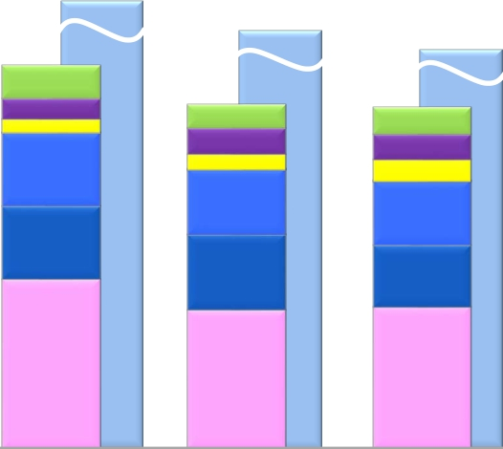
Appendices
Capital Investment
1,907.5
(Billions of yen)
[1,970.0]*
1,795.7
[1,892.8]*
1,750.0
401.1
[405.7]*
33.9
21.8
77.0
76.8
177.4
FY2012/1Q
[1,850.0]*
361.2
[374.8]*
30.3
26.2
23.1
68.3
64.8
148.5
FY2014/1Q
361.6
[377.6]*
24.4
27.1
16.3
69.2
79.2
145.4
FY2013/1Q
Other
NTT DATA (Consolidated)
NTT Communications
NTT West
NTT East
NTT DOCOMO (Consolidated)
14.2
FY2012
FY2013
FY2014E
* Figures in [ ] include investments related to real estate and solar power generation operations.
Financial Results for the Three Months Ended June 30, 2014
－17－
Copyright (c) 2014 Nippon Telegraph and Telephone Corporation

Slide 22
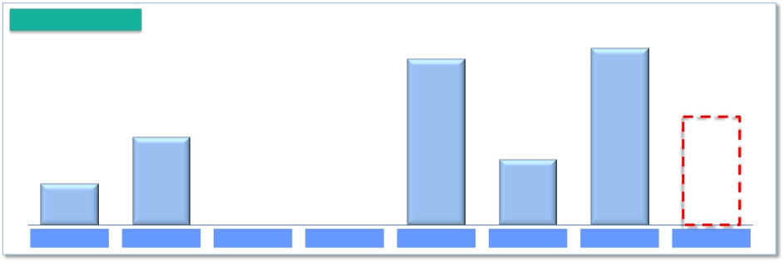
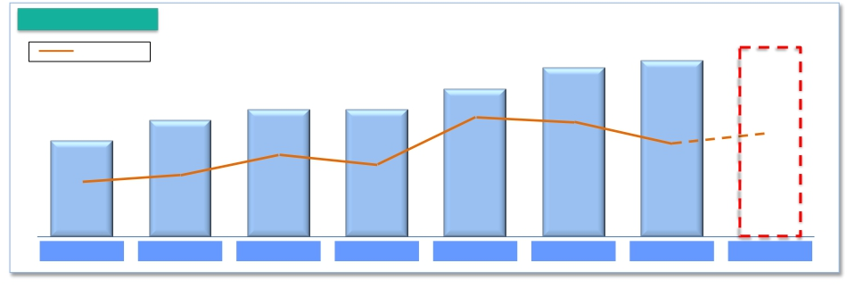
Appendices
Shareholder Returns
Share buy backs
406.5
(Billions of yen)
381.7
Up to
250.0
200.0
150.0
94.4
FY2007
FY2008
FY2009
FY2010
FY2011
FY2012
FY2013
FY2014 E
Dividend
Payout ratio●
180
(yen)
160
170
140
●
38.2%
FY2011
110
●
27.5%
FY2008
120
●
32.3%
FY2009
120
●
31.2%
FY2010
90
●
19.5%
FY2007
●
37.2%
FY2012
●
33.6%
FY2014 E
●
33.4%
FY2013
Financial Results for the Three Months Ended June 30, 2014
－18－
Copyright (c) 2014 Nippon Telegraph and Telephone Corporation

Slide 23













Appendices
FY2014/1Q Details of Financial Results (Per Item)
Fixed IP/packet : (14.7)
Operating
Revenues
Mobile IP/packet : (3.6)
Other : +0.1
SI revenues and sales
IP/packet
(Billions of yen)
[ year-on-year：+31.1]
Voice related
services revenues
68.4
of telecommunications
equipment
communications
services revenues
18.2
Other revenues
22.0
Fixed voice
Mobile voice
X.X
2,609.1
95.7
2,640.2
Fixed voice : (23.5)
Systems Integration
: +100.0
Mobile voice : (45.0)
Telecommunications equipment (Fixed-line) : +1.0
Telecommunications equipment (Mobile) : (5.3)
FY2013/1Q
FY2014/1Q
Operating
Expenses
[year-on-year：+82.0]
19.9
0.0
Other expenses
54.2
Personnel expenses
8.0
Depreciation
expenses and loss on
disposal
of assets
Expenses for purchase
of goods and services
and other expenses
2,260.2
FY2013/1Q
2,342.2
FY2014/1Q
Financial Results for the Three Months Ended June 30, 2014
－19－
Copyright (c) 2014 Nippon Telegraph and Telephone Corporation

Slide 24





Appendices
Details of Consolidated Balance Sheet
March 31, 2014
(Billions of yen)
20,284.9
June 30, 2014
20,207.1
Liabilities
9,334.2
Interest-Bearing
Debt
4,200.0
Liability for Employees’
Retirement Benefits
1,327.9
Other
25.9
Equity
10,924.8
Treasury Stock
(156.9)
Assets
20,284.9
Depreciable Assets
(property, plant and
equipment)
8,241.9
Deferred Tax Assets
(non-current)
661.5
Liabilities
[(94.5)]
Interest-Bearing
Debt
4,588.9
[+388.9]
Liability for Employees’
Retirement Benefits
1,340.3
[+12.4]
Other
25.8 [(0.1)]
Equity
10,941.6
[+16.8]
Treasury Stock
(159.4)
[(2.5)]
Assets
20,207.1
[(77.9)]
Depreciable Assets
(property, plant and
equipment)
8,152.2
[(89.7)]
Deferred Tax
Assets
(non-current)
654.5
[(7.0)]
9,239.7
Financial Results for the Three Months Ended June 30, 2014
－20－
Copyright (c) 2014 Nippon Telegraph and Telephone Corporation

Slide 25
Appendices
Consolidated and Main Subsidiaries’ Financial Results for FY2014/1Q
(Billions of yen)
NTT DATA
Consolidated
(JPN GAAP)
335.9
41.7
14.2%
1,460.0
23.0%
330.4
41.3
14.3%
1,375.0
24.0%
5.5
0.3
7.7%
85.0
6.5%
(1)
NTT
Consolidated
(U.S. GAAP)
2,640.2
31.1
1.2%
11,200.0
23.6%
2,342.2
82.0
3.6%
9,985.0
23.5%
298.0
(50.9)
(14.6)%
1,215.0
24.5%
NTT
(Holding Company)
Non-Consolidated
(JPN GAAP)
221.0
(8.8)
(3.8)%
422.0
52.4%
31.2
(1.9)
(6.0)%
145.0
21.6%
189.7
(6.8)
(3.5)%
277.0
68.5%
NTT East
Non-Consolidated
(JPN GAAP)
432.9
(5.4)
(1.2)%
1,771.0
24.4%
405.1
(4.9)
(1.2)%
1,681.0
24.1%
27.7
(0.5)
(1.8)%
90.0
30.9%
NTT West
Non-Consolidated
(JPN GAAP)
385.1
(3.6)
(0.9)%
1,582.0
24.3%
377.0
(0.2)
(0.1)%
1,547.0
24.4%
8.1
(3.4)
(29.9)%
35.0
23.1%
NTT Com
Non-Consolidated
(JPN GAAP)
217.2
(8.2)
(3.6)%
910.0
23.9%
192.5
(0.4)
(0.2)%
807.0
23.9%
24.6
(7.8)
(24.1)%
103.0
23.9%
NTT DOCOMO
Consolidated
(U.S. GAAP)
1,075.3
(38.3)
(3.4)%
4,590.0
23.4%
865.7
(0.4)
(0.1)%
3,840.0
22.5%
209.6
(37.8)
(15.3)%
750.0
28.0%
Operating Revenues
Change year-on-year
(% change)
Forecasts for FY2014
(% progress)
Operating Expenses
Change year-on-year
(% change)
Forecasts for FY2014
(% progress)
Operating Income
Change year-on-year
(% change)
Forecasts for FY2014
(% progress)
Income Before
Income Taxes
(2)
306.0
189.0
39.7
6.8
33.7
212.5
4.4
Change year-on-year
(% change)
Forecasts for FY2014
(% progress)
Net Income
Change year-on-year
(% change)
Forecasts for FY2014
(% progress)
(50.0)
(14.1)%
1,195.0
25.6%
149.0
(17.8)
(10.6)%
586.0
25.4%
(6.9)
(3.6)%
272.0
69.5%
188.7
(6.8)
(3.5)%
274.0
68.9%
3.6
10.2%
90.0
44.1%
28.2
3.5
14.4%
58.0
48.7%
(8.9)
(56.6)%
28.0
24.5%
6.2
(6.3)
(50.6)%
25.0
24.8%
(6.2)
(15.6)%
113.0
29.8%
22.4
(2.3)
(9.3)%
72.0
31.1%
(40.0)
(15.8)%
758.0
28.0%
136.4(4)
(21.6)
(13.7)%
480.0
28.4%
(1.7)
(28.3)%
75.0
5.9%
0.3
(1.8)
(82.6)%
37.0
1.1%
(3)
(1) NTT has 944 consolidated subsidiaries and accounts for 123 companies under the equity method.
(2) “Income Before Income Taxes” for NTT (Holding Company), NTT East, NTT West, NTT Communications and NTT DATA represent their recurring profits.
(3) “Net Income” for NTT Consolidated represents “Net income attributable to NTT, excluding noncontrolling interests.”
(4) “Net Income” for NTT DOCOMO represents “Net income attributable to NTT DOCOMO, excluding noncontrolling interests.”
Financial Results for the Three Months Ended June 30, 2014
－21－
Copyright (c) 2014 Nippon Telegraph and Telephone Corporation

Slide 26

Appendices
Calculation of ARPU
Average monthly revenue per unit, or ARPU, is used to measure average monthly operating revenues attributable to each designated service on a per user basis. In the case of NTT Group’s fixed-line business, ARPU is calculated by dividing revenue
items included in the operating revenues of NTT Group’s regional communications business segment, that is, telephone subscriber lines, INS-NET and FLET’S Hikari, by the number of Active Subscribers to the relevant services.
In the case of NTT Group’s mobile communications business, ARPU is calculated by dividing revenue items included in operating revenues from its mobile communications business segment, such as revenues from Xi mobile phone services and
FOMA mobile phone services, that are incurred consistently each month (i.e., basic monthly charges and voice/packet transmission charges), by the number of Active Subscribers to the relevant services. The calculation of these figures excludes
revenues that are not representative of monthly average usage, such as telecommunications equipment sales, activation fees and universal service charges.
NTT believes that its ARPU figures calculated in this way provide useful information regarding the monthly average usage of its subscribers. The revenue items included in the numerators of NTT Group’s ARPU figures are based on its financial results
comprising its U.S. GAAP results of operations.
Notes:
(1) We compute the following four categories of ARPU for business conducted by each of NTT East and NTT West.
・Aggregate Fixed Line ARPU (Telephone Subscriber Lines + INS-NET Subscriber Lines): Calculated based on revenues from monthly charges and call charges for Telephone Subscriber Lines and INS-NET Subscriber Lines, which are
included in operating revenues from Voice Transmission Services (excluding IP Services), and revenues from "FLET'S ADSL" and "FLET'S ISDN," which are included in operating revenues from IP Services.
・Telephone Subscriber Lines ARPU: Calculated based on revenues from monthly charges and call charges for Telephone Subscriber Lines and revenues from "FLET'S ADSL.“
・INS-NET Subscriber Lines ARPU: Calculated based on revenues from monthly charges and call charges for "INS-NET" Subscriber Lines and revenues from "FLET'S ISDN.“
・FLET’S Hikari ARPU: Calculated based on revenues from "FLET’S Hikari" (including "FLET’S Hikari" optional services), which are included in operating revenues from IP Services, revenues from monthly charges, call charges and connection
device charges for "Hikari Denwa," and revenues from "FLET’S Hikari" optional services, which are included in Supplementary Business revenues.
- "FLET'S Hikari" includes "B FLET'S," "FLET'S Hikari Next," "FLET'S Hikari Light" and "FLET'S Hikari WiFi Access" provided by NTT East, and "B FLET'S," "FLET'S Hikari Premium," "FLET'S Hikari Mytown," "FLET'S Hikari Next,"
"FLET'S Hikari Light" and "FLET'S Hikari WiFi Access" provided by NTT West.
(2) Revenues from interconnection charges are excluded from the calculation of Aggregate Fixed Line ARPU (Telephone Subscriber Lines + INS-NET Subscriber Lines), Telephone Subscriber Lines ARPU, INS-NET Subscriber Lines ARPU,
and FLET'S Hikari ARPU.
(3) For purposes of calculating Aggregate Fixed Line ARPU (Telephone Subscriber Lines + INS-NET Subscriber Lines), Telephone Subscriber Lines ARPU and INS-NET Subscriber Lines ARPU, the number of subscribers is determined based on the
number of subscriptions for each service.
(4) In terms of number of channels, transmission rate, and line use rate (base rate), INS-Net 1500 is in all cases roughly ten times greater than INS-Net 64. For this reason, for the purpose of calculating Aggregate Fixed Line ARPU (Telephone
Subscriber Lines + INS-NET Subscriber Lines) and INS-NET Subscriber Lines ARPU, one INS-Net 1500 subscription is calculated as ten INS-Net 64 subscriptions.
(5) For purposes of calculating FLET'S Hikari ARPU, number of subscribers is determined based on the number of "FLET'S Hikari" subscribers, including subscribers to "B FLET'S," "FLET'S Hikari Next," "FLET'S Hikari Light" and "FLET'S Hikari WiFi
Access" provided by NTT East, and subscribers to "B FLET'S," "FLET'S Hikari Premium," "FLET'S Hikari Mytown," "FLET'S Hikari Next," "FLET'S Hikari Light" and "FLET'S Hikari WiFi Access" provided by NTT West.
(6) The following is the formula we use to compute ARPU for mobile business conducted by NTT DOCOMO.
・Mobile Aggregate ARPU ("Xi"+"FOMA") = Voice ARPU ("Xi"+"FOMA") + Packet ARPU ("Xi"+"FOMA") + Smart ARPU ("Xi"+"FOMA").
- NTT DOCOMO’s Voice ARPU ("Xi"+"FOMA") is based on operating revenues related to voice services, such as basic monthly charges and voice communication charges attributable to our "Xi"+"FOMA" services, our Packet ARPU
("Xi"+"FOMA") is based on operating revenues related to packet services, such as flat monthly fees and packet communication charges attributable to our "Xi"+"FOMA" services, and our Smart ARPU ("Xi"+"FOMA") is based on
operating revenues from a part of Other Operating Revenues attributable to "Xi"+"FOMA" wireless communications services (revenues from content, collection of charges, mobile phone insurance service, advertising and others).
(7) Communications module service, “Phone Number Storage,” “Mail Address Storage” and “docomo Business Transceiver” subscribers and the revenues therefrom are not included in the calculations of Mobile Aggregate ARPU.
(8) Numbers of active subscribers used in the ARPU calculation of NTT East and NTT West are as below.
- 1Q Results: Sum of number of active subscribers* for each month from April to June
- 2Q Results: Sum of number of active subscribers* for each month from July to September
- 3Q Results: Sum of number of active subscribers* for each month from October to December
- 4Q Results: Sum of number of active subscribers* for each month from January to March
- FY Results : Sum of number of active subscribers* for each month from April to March
- FY Forecast: Sum of the average expected active number of subscribers during the fiscal year ((number of subscribers at March 31, 2014 + number of expected subscribers at March 31, 2015)/2)x12
(9) Numbers of active subscribers used in the ARPU calculation of NTT DOCOMO are as below.
- 1Q Results: Sum of number of active subscribers* for each month from April to June
- 2Q Results: Sum of number of active subscribers* for each month from July to September
- 3Q Results: Sum of number of active subscribers* for each month from October to December
- 4Q Results: Sum of number of active subscribers* for each month from January to March
- FY Results/FY Forecast: Sum of number of active subscribers*/expected number of active subscribers* for each month from April to March.
*active subscribers = (number of subscribers at end of previous month + number of subscribers at end of the current month)/2
Financial Results for the Three Months Ended June 30, 2014
－22－
Copyright (c) 2014 Nippon Telegraph and Telephone Corporation

