Slide 1

Strategies for Wi-Fi Business
Natsuo Minamikawa
President,
NTT Broadband Platform, Inc.
September 26, 2014

Slide 2
The forward-looking statements and projected figures concerning the future performance
of NTT and its subsidiaries and affiliates contained or referred to herein are based on a
series of assumptions, projections, estimates, judgments and beliefs of the management
of NTT in light of information currently available to it regarding NTT and its subsidiaries
and affiliates, the economy and telecommunications industry in Japan and overseas, and
other factors. These projections and estimates may be affected by the future business
operations of NTT and its subsidiaries and affiliates, the state of the economy in Japan
and abroad, possible fluctuations in the securities markets, the pricing of services, the
effects of competition, the performance of new products, services and new businesses,
changes to laws and regulations affecting the telecommunications industry in Japan and
elsewhere, other changes in circumstances that could cause actual results to differ
materially from the forecasts contained or referred to herein, as well as other risks
included in NTT’s most recent Annual Report on Form 20-F and other filings and
submissions with the United States Securities and Exchange Commission.

Slide 3
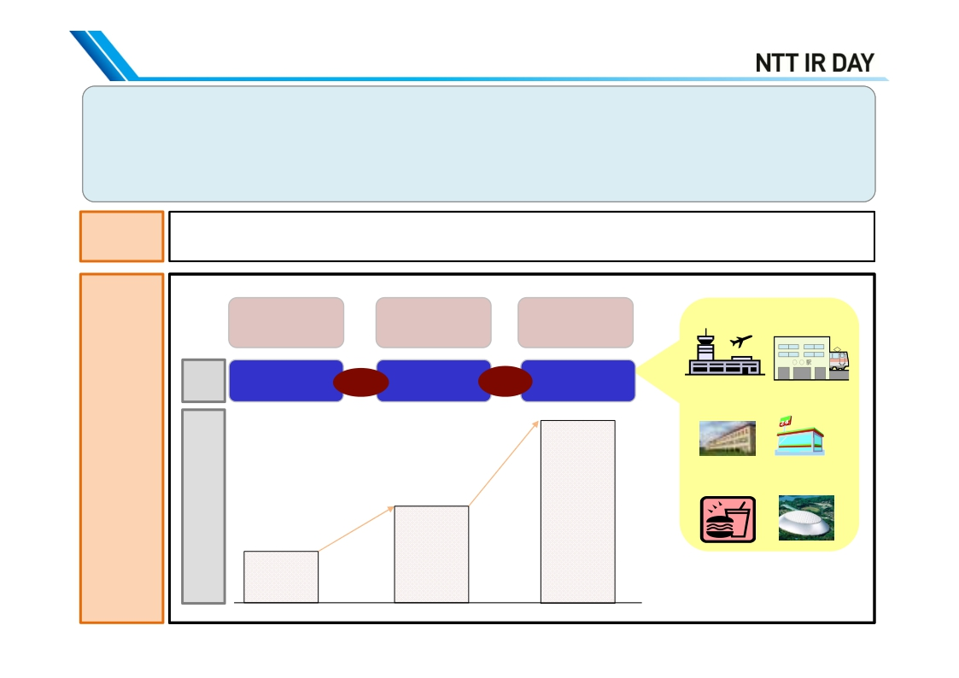
Overview of NTT BP’s Business (1/2)
-NTT BP is an NTT Group company specialized in wireless LAN (Wi-Fi) business
= “the third access” business
-Business model: mainly B2B2B/C; offering 150,000 wireless access points
-Sources of revenue: (1) Wholesale of equipment for telecommunication carriers
(2) Wi-Fi cloud business
Established
July 15, 2002 (13 years since founding)
FY2011
FY2012
FY2013
[Airports, railroads]
AP
10,000
+110,000
120,000
+30,000
150,000
[Municipalities]
[Convenience
Rapid expansion since 2011
on the back of offload demand
stores]
Performancetrend
[Cafés]
[Stadiums]
Sales
¥19.6 billion
¥11.4 billion
¥5.0 billion
*AP=access points:
places accessible to Wi-Fi
1

Slide 4
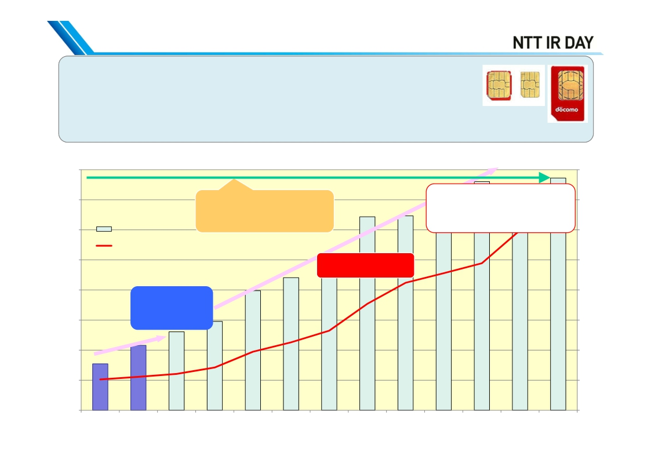
Overview of NTT BP’s Business (2/2)
- Wi-Fi traffic (data volume) has increased 5 times year-on-year
- The number of Wi-Fi association (connection procedure) has
increased about 6 times year-on-year.
- Rate of increase has accelerated since the introduction of SIM*
authentication in October 2013
*IC cards with an ID number to
identify phone number
Traffic: Tbyte
1,600
- Monthly traffic and association trends -
Association: million
800
1,400
1,200
Daily average
-Traffic: about 50TB/day
-Association: 20 million/day
700
600
Traffic: 5 times
Association: 5.8 times
Traffic
Association
1,000
Rapid increase since
SIM authentication
500
800
600
400
200
0
DOCOMO SIM
authentication
starts
400
300
200
100
0
Aug
Sep
Oct
Nov
Dec
Jan
Feb
Mar
Apr
May
Jun
Jul
Aug
2013
2014
2

Slide 5
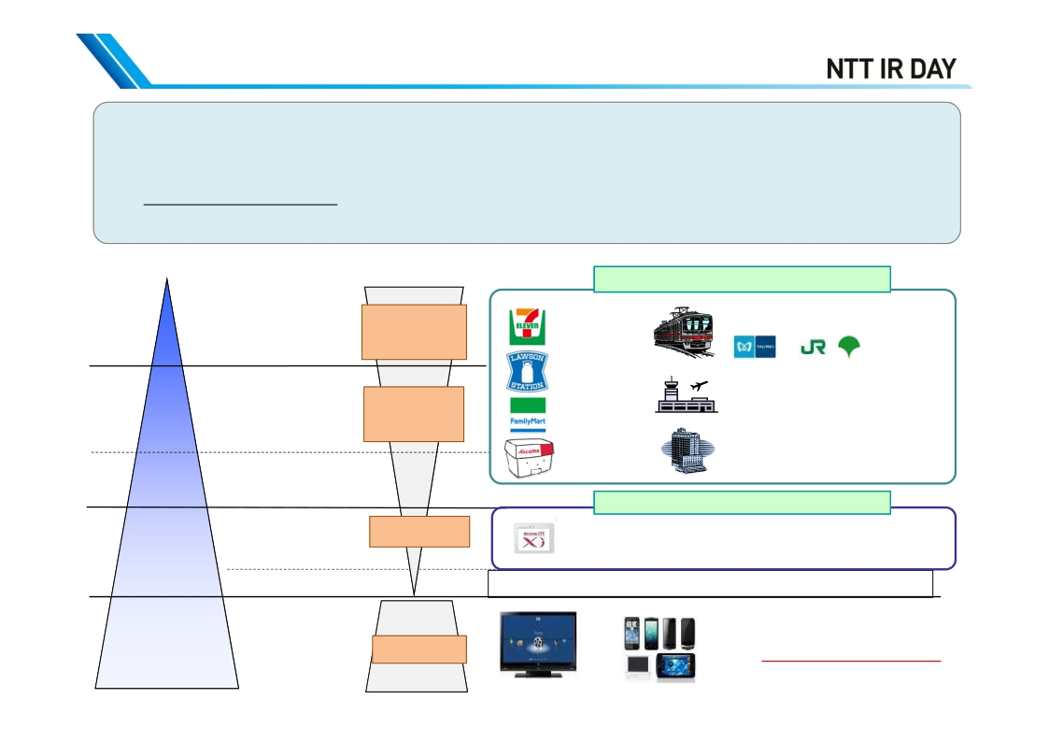
Wi-Fi Installation Policy and Current Status
- NTT BP’s public wireless LAN has about 150,000 AP
(about 200,000 AP including AP of NTT East and West)
- AP have been established with focus on public spots with high traffic in daily life
⇒ One of BP’s strengths
⇒ AP count x Traffic of people = Maximum wireless LAN reach count
[Traffic of people/day]
(estimate by Broadband Platform)
70
million
FTTH area (77,000)
Nationwide 2,000 stations of 47
railroad companies: 13,000 AP
Stations,
airports
19,000 AP
16,000 AP
Convenience stores
Shopping Malls,
cafés, etc.
Small and medium-
Educational facilities
11,000 AP
9,000 AP
2,500 AP
40
million
38 Airports throughout Japan:
700 AP
Cafés, Shopping malls, etc.
Xi area (76,000)
54,000 AP
4,000 AP
sized shops
76,000 AP
48,000 AP
20 million FTTH
subscribers
↓
Switch to Wi-Fi
4 million
44 million
Commercial facilities, restaurants and cafes,
leisure facilities, hotels, etc.
<NTT East , NTT West > Hikari station, Dospot
Total: 200,000 AP
Small shops
Homes,
offices
Smart TV
Home
(As of the end of
Aug2014; AP count)
appliancesSmartphones/tablets
3

Slide 6
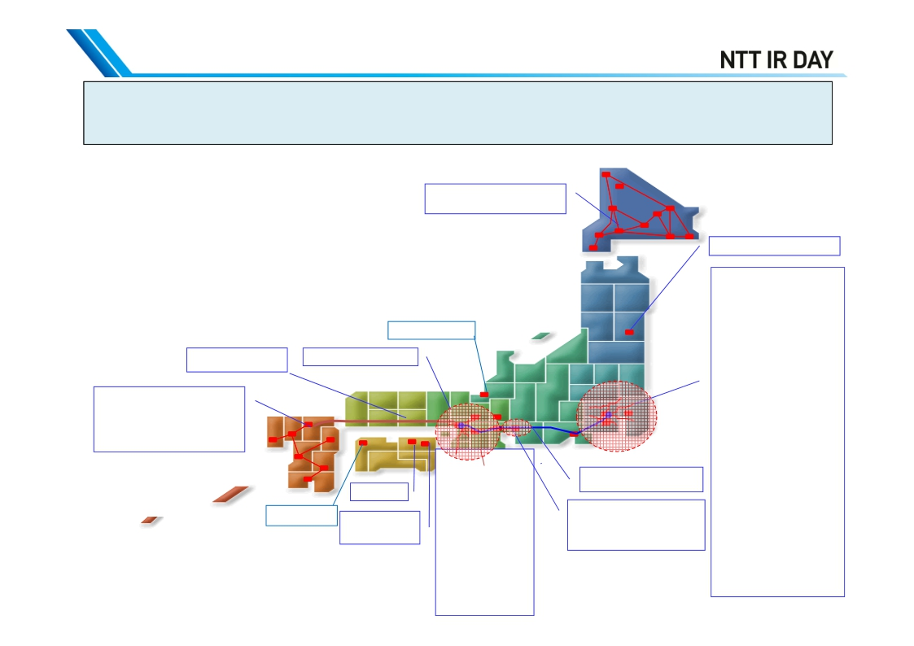
(Reference) Railroad Wi-Fi Operated by NTT BP
12,863 AP at 1,968 stations of 47 railroad companies in Japan
brought under Wi-Fi coverage
-Sapporo Municipal Subway
-JR Hokkaido
Echizen Railway
Kobe Municipal Subway
*As of the end of August 2014
Sendai Municipal Subway
Tokyo Metropolitan area
-Tokyo Metro
-Toei Subway
-Keikyu Line
-Seibu Railway
-Tsukuba Express
-Yurikamome Line
-Tobu Railway
-Keio Railway
-Keisei Electric Railway
-Shin-Keisei Electric
Railway
-Hokuso Railway
-Tama Monorail
Sanyo Shinkansen
line stations
-Fukuoka City Subway
-JR Kyushu (bullet train,
conventional lines)
-Nishi-Nippon Railroad
-Nagasaki Electric Tramway
Kansai area
-Osaka Municipal
Subway
-Nankai Electric
Railway
-Keihan Electric
Railway
-Kintetsu Railway
-JR West
-Hankyu Railway
-Hanshin Electric
Railway
-Kita-Osaka
Kyuko Railway
-Osaka Monorail
-Sagami Railway
-Yokohama Municipal
Subway
-Saitama Railway
-Chiba Urban Monorail
-Tokyo Waterfront Area
Raipd Transit Rinkai Line
-JR East
-Tokyu LIne
-Odakyu Line
-Minatomirai Line
4
Tokaido Shinkansen line
stations
-Nagoya Municipal Subway
-Nagoya Railroad
-JR Central
(conventional lines)
JR Shikoku
Kotohira Electric
Railroad
Iyo Railway

Slide 7
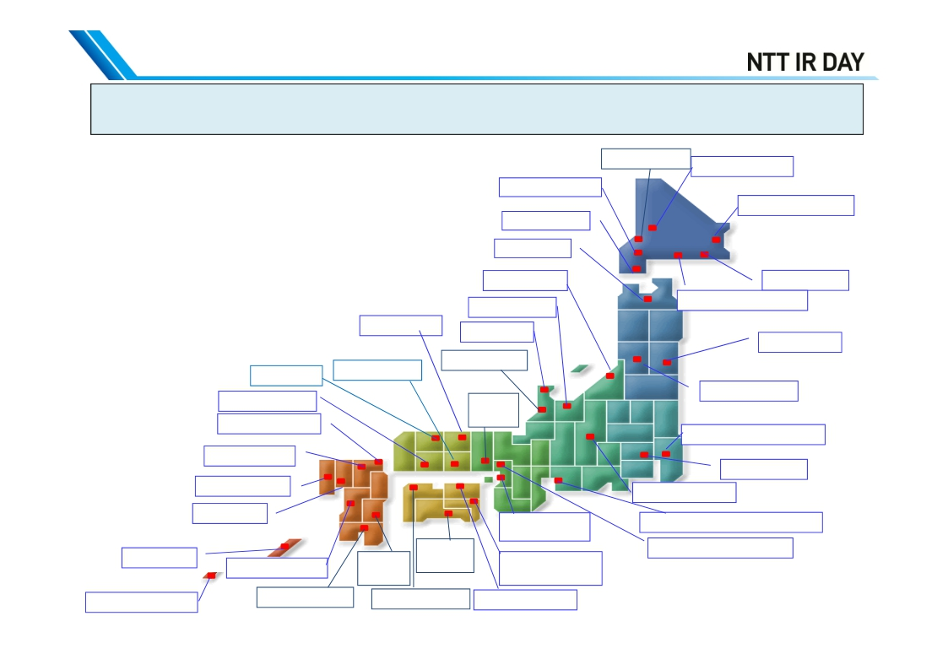
(Reference) Airport Wi-Fi Areas Operated by NTT BP
692 AP at 38 airports in Japan brought under Wi-Fi coverage
*As of the end of August 2014
Okadama Airport
Asahikawa Airport
New Chitose Airport
Nakashibetsu Airport
Hakodate Airport
Aomori Airport
Niigata Airport
Toyama Airport
Kushiro Airport
Tokachi-Obihiro Airport
Tottori Airport
Noto Airport
Sendai Airport
Okayama Airport
Komatsu Airport
Izumo Airport
Hiroshima Airport
Kitakyushu Airport
Kobe
Airport
Yamagata Airport
Narita International Airport
Fukuoka Airport
Haneda Airport
Matsumoto Airport
Nagasaki Airport
Saga Airport
Kansai International
Airport
Central Japan International Airport
Naha Airport
Kochi
Osaka International Airport
Kumamoto Airport
Miyazaki
airport
Airport
Tokushima
Awaodori Airport
New Ishigaki Airport
Kagoshima Airport
Matsuyama Airport
Takamatsu Airport
5

Slide 8
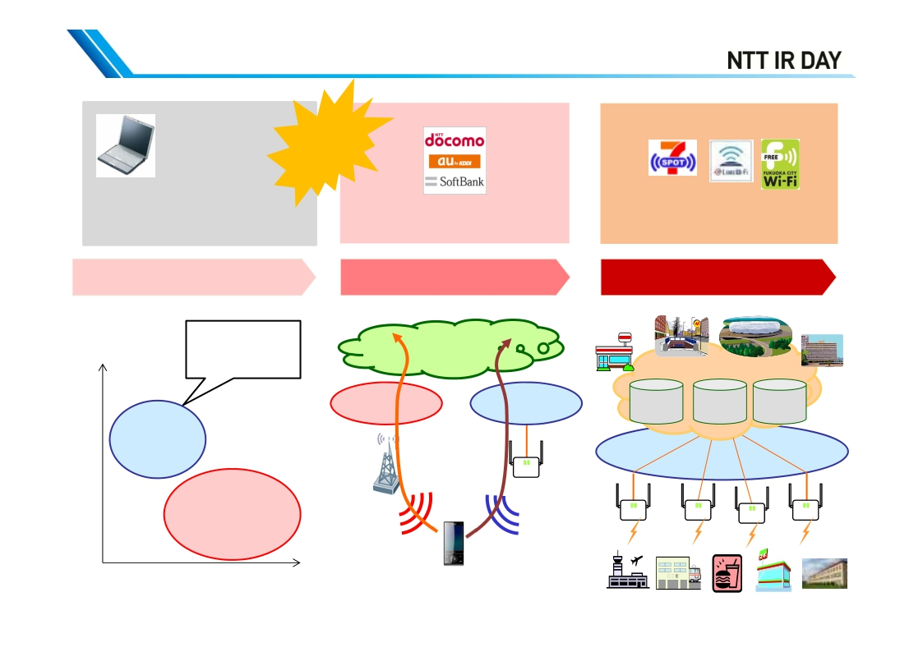
Transition of NTT BP’s Business
- 2011
Explosive spread
of smartphones
and tablets
2012
2013 -
Development of high-speed, high-
capacity Wi-Fi infrastructure at
stations, airports, cafés, etc.
for notebook PCs
1st high-speed wireless
Expansion of information
distribution business targeting
smartphones and tablets
3rd Wi-Fi cloud
Stadium
Subway
Convenience
Municipality
Massive addition of AP led by
carriers, aimed at offload of
traffic
2nd Wi-Fi offload
High
-Specific spots
-High speed
Internet
store
communication
Wi-Fi cloud
Mobile carrier
NW
Wi-Fi
NW
Internet
authentication
Contents
distribution
External
collaboration
GW
Wi-Fi
NW
Mobile carrier
NW
●
POI
NTTBP NW
Communicationspeed
Areacoverage
Low
Wide
Narrow
6

Slide 9
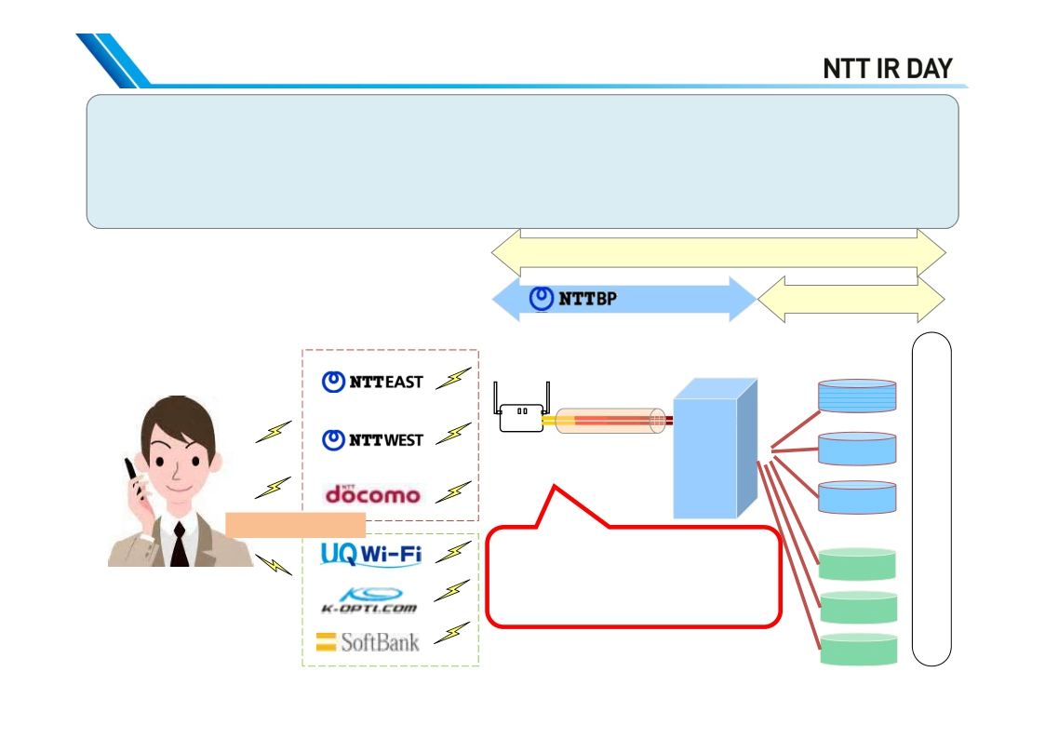
Overview of Facility Wholesale Business for
Telecommunication Carriers
- Offers AP and other infrastructure for telecommunication carriers to realize Wi-Fi services
they are currently offering their customers
- Adopts shared AP, which share necessary cost among telecommunication carriers and make
the offering price lower
- Avoids radio-frequency interference through segregation of radio waves of the shared AP to
achieve stable and high-quality Wi-Fi environment
<Mechanism of shared AP>
Carrier service
infrastructure
Carrier’s NW
[SSID]*
It can offer multiple carriers’ services with
just one physical line/base station
Backhaul is FTTH
NTT East
POI
Shared AP
NTTBP
DC
●
NTT West
DOCOMO
Internet
SIM authentication
Multi SSID (service name)
Multi VLAN (virtual NW)
Multi Radius (authentication, etc.)
*Identifier for access point in wireless LAN
UQ
Kopti
SoftBank
‐Select SSID and connect
‐Communication carriers
start SIM authentication
Multi‐carrier/multi‐device
7

Slide 10
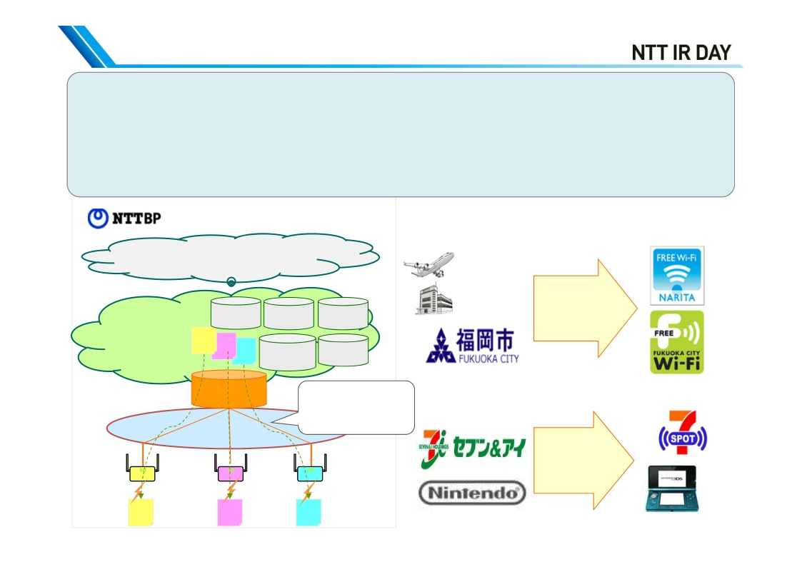
Overview of Wi-Fi Cloud Business
[Background] Demand from companies and municipalities which wish to offer Wi-Fi free of
charge, and distribute information
[Features]
- Open access : Accessible to anyone, including foreigners (carrier free)
- Direct access: After connecting to the Internet, portal website of the venue owner is displayed
- Carries out portal screen creation, collects logs and reports, etc. for each venue owner
<
Wi-Fi cloud basic functions>
Contents, applications of
each company , etc
Companies and municipalities that installed AP
⇒venue owners
Narita
Airport
Haneda
Airport
Municipality
wishes to
offer free Wi-
Fi for tourists
Log
collection
C
Contents
distribution
Internet
authentication
Multilingual
Single
sign-on
Wi-Fi cloud
platform
A
B
GW
NTTBP NW
②
B
Distribute different
information from
each AP
③
C
Companies
wish to distribute
coupons and
contents at
each store
①
A
8

Slide 11
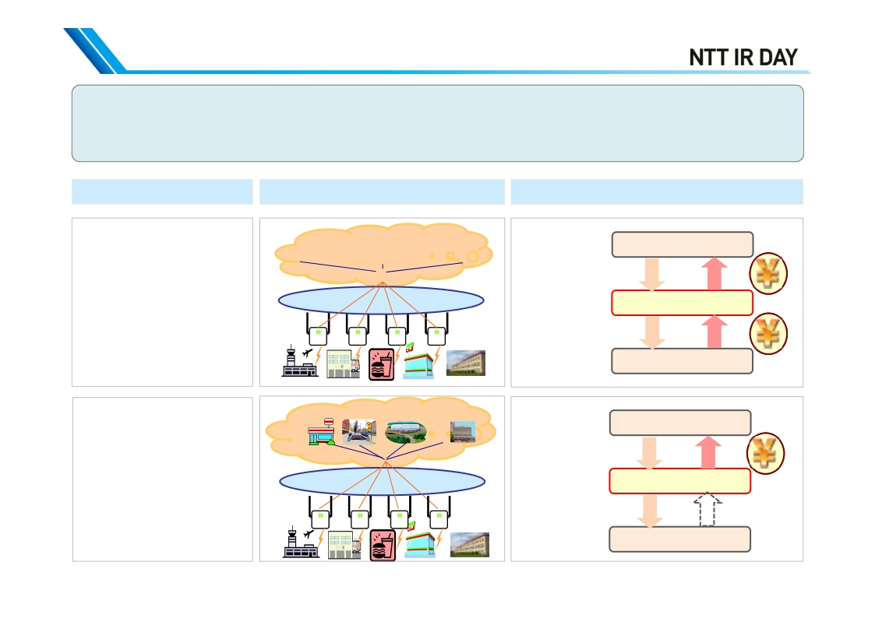
Business Model and Revenue Structure
- Telecommunication carriers: offer offload AP and NW (e.g. DOCOMO: established docomoWi-Fi)
- Companies, municipalities: provide service from the Internet connection to portal screen
⇒ NTT BP’s business: based on revenues from telecommunication carriers and venue owners
Features
Equipment configuration
Business model and revenue structure
[For telecommunication
carriers]
Mobile phone
carrier A
Mobile phone
carrier B
Mobile phone
carrier C
ＢＰ
➢Carrier Wi-Fi
➢Limited to the carrier’s
subscribers, such as
DOCOMO
➢Automatic connection
anywhere in the country
with one registration
●
AP establishment,
SSID transmission
(enables offload)
Wi-Fi offered by
carrier
POI
NTTBP NW
Telecommunication carrier
Customers (subscribers)
[For Companies and
municipalities]
Convenience
store
Subway
Stadium
Municipality
ＢＰ
Offering of
infrastructure and
cloud functions
Wi-Fi offered by
area owner
➢Venue owner Wi-Fi
➢Free of charge for
customers
(terms of use vary)
➢Needs to register for each
venue owner ‘s Wi-Fi
POI●
NTT BP NW, cloud
Venue owner
Customers
Revenue
increase from
attracting
customers and
improvement in
CS
9

Slide 12
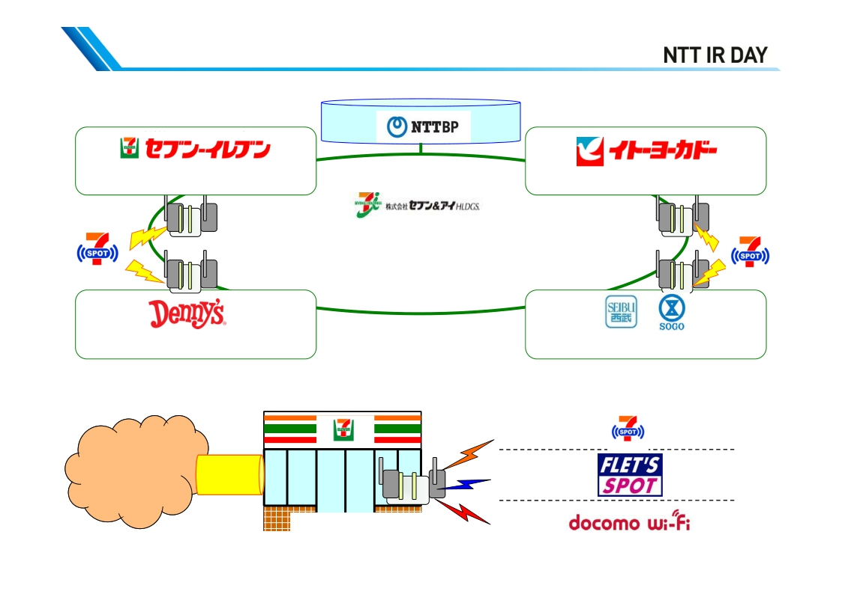
Wi-Fi Cloud Introduction Case (Seven & i)
NTTBP Wi-Fi Cloud Platform
About 16,000 stores
About 17,000 stores
(about 17,000 AP)
*As of the end of August 2014
About 390 stores
Different SSID
About 170 stores
24 stores
Service offered at Seven & i
Seven & i Group stores
(identifier) for
each service
Group stores
7 SPOT
FLETS-
SPOT
7 SPOT
NTT East
FLET’S SPOT
Wi-Fi cloud
FTTH
Wireless LAN access point
docomo
NTT DOCOMO
Docomo Wi-Fi
10

Slide 13
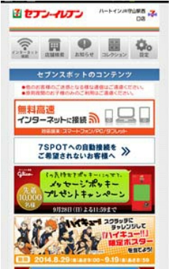
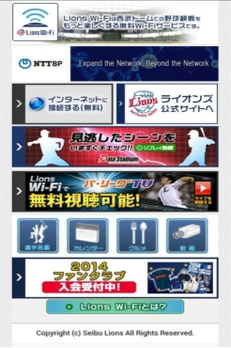
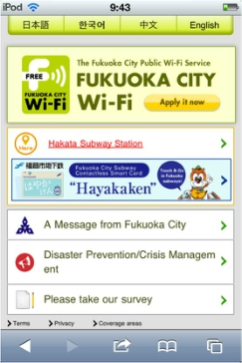
Direct Access Portal Site (Example)
- Connected using open access and displays information on the direct access page
- Multiple languages available (English, Chinese [traditional/simplified], Korean, etc.), and
provides reports of log collection
- Even after service is launched, new functions and information distribution can be added to
meet demands
[Seven & i Holdings]
➢Expand to the entire 7&i Group
➢Business use
➢Collaboration on coupons
with Tokyo Metro
[Seibu Lions]
➢Replay movie
➢Bingo game
➢Multi-angle view
[Fukuoka City]
➢Collaboration on authentication with
New Taipei City
➢Strengthening information
distribution capability with
information distribution bar
➢Collecting series of stamps at
Progress
after
introduction
railway stations, tourist spots, etc.
11

Slide 14
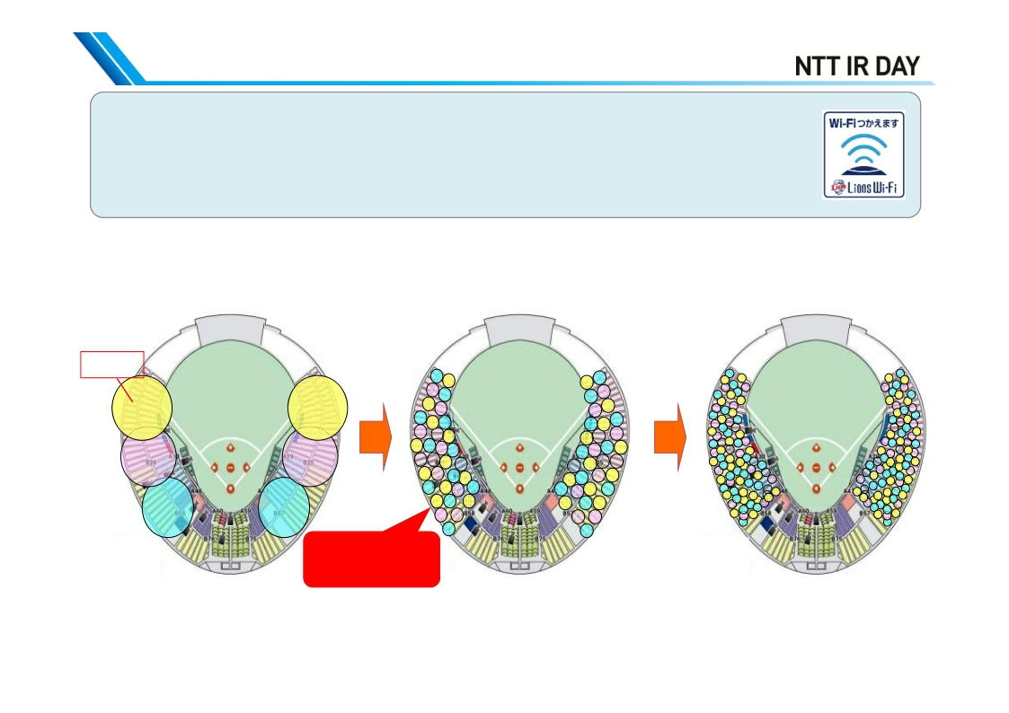
Wi-Fi Cloud Introduction Case (Seibu Lions [1])
◆High-density Wi-Fi solution
Divides the areas covered by each AP into small cells and increase the setting
density to ensure required communication capacity and coverage for several tens
of thousands of users
Conventional area design
AP cell
Highly dense
area design
AP installation
at Seibu Dome
Future area design
(Olympic Games-
related facilities, etc.)
Capacity: 3.4 million people
⇒AP count (Inside and outside the stadium)
More dense
: about 160 AP
12

Slide 15
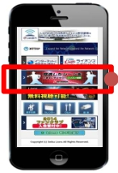
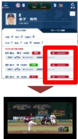
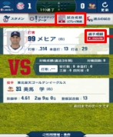
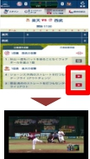
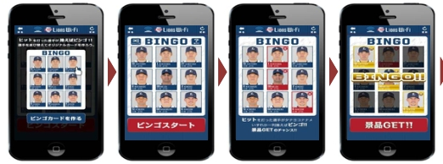
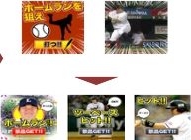



Wi-Fi Cloud Introduction Case (Seibu Lions [2])
- A pioneering case of Wi-Fi high-density solutions at a stadium in Japan
- Started image service such as replay and multi-angle views
◆Replay movie distribution service: users can watch the results of all at bats at their convenience
Player result
Top page of real time game data
Game result
Replay
playback
link
Replay
movie
playback
Replay
playback link
Replay
movie
playback
◆Bingo game: Create a bingo card with player pictures. When a player hits a homerun or a hit, the
player is crossed out and it is Bingo when a vertical, horizontal or diagonal line is formed.
Fancy prizes are given to those chosen by lot
from the winners of the bingo game
[Drawing display (examples)]
[Drawing result display (examples)]
[Prepare a
bingo card]
[Start the
bingo game]
[Play the
game]
[Bingo]
Big hit
(Rare items)
Hit
(Coupons)
Out
(Digital contents)
13

Slide 16




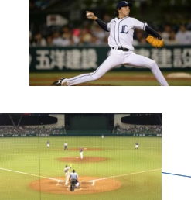
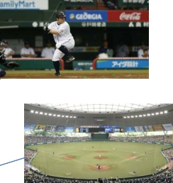




Wi-Fi Cloud Introduction Case (Seibu Lions [3])
◆Multi-view image distribution trial (September 14 and 15, 2014)
*Implemented by Seibu Lions, NTT Plala, NTT and NTT BP
[Features of the service]
Can be enjoyed
from 6 angles
Can be enjoyed while
listening to running
commentary
User can enjoy not
only live image but
also replay
High-quality, less
delay video
Third-base camera
Lower camera behind the plate
Running comment and commentary camera
First-base camera
Upper camera behind the plate
Live telecast
14

Slide 17
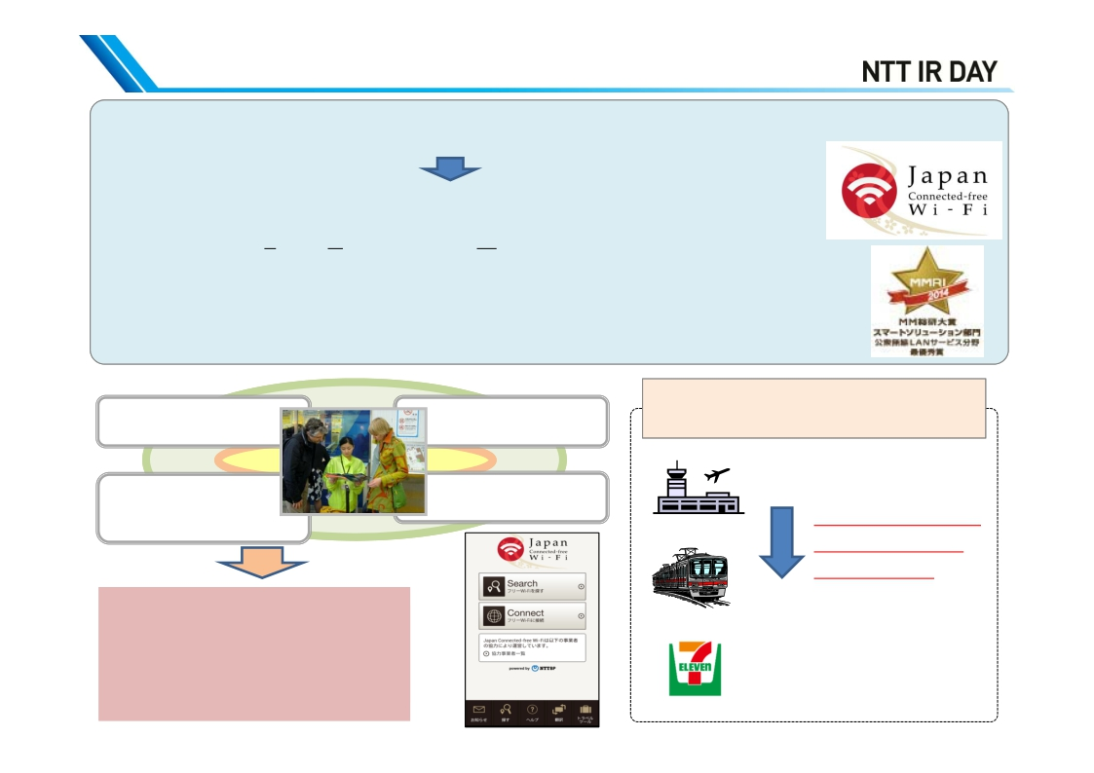
Wi-Fi Cloud Business (Killer Service: JCW)
[Background] Users were bothered by registration with each venue owner’s Wi-Fi
- Collaborated on authentication and enabled single-step sign-on
- Started offering Japan Connected-free Wi-Fi application (Nov 2013),
free of charge, and one-time user registration available in multiple languages
⇒Introduced in the country blogs of Japan Tourism Agency’s Visit Japan
⇒Won MM Research Institute Award 2014 First Prize (July 2014)
⇒Added multilingual translation tool and travel tool (September 2014)
Collaboration with paid W-Fi inside an airplane
Limited area
with free Wi-Fi
Connection procedure
varies from area to
area and it is hard to
figure out
Currently,
single-step sign-on is enabled
at 82,000 AP for free Wi-Fi
(with time limit, unsecured)
Not sure where
Wi-Fi is available
Authentication procedure
varies from area to area
and is troublesome
(Under consideration)
Paid Wi-Fi in an airplane
No change in ID
and Password
after arrival
With JCW, use throughout
Japan becomes more
convenient through
authentication collaboration
(Secured type is also available)
15

Slide 18
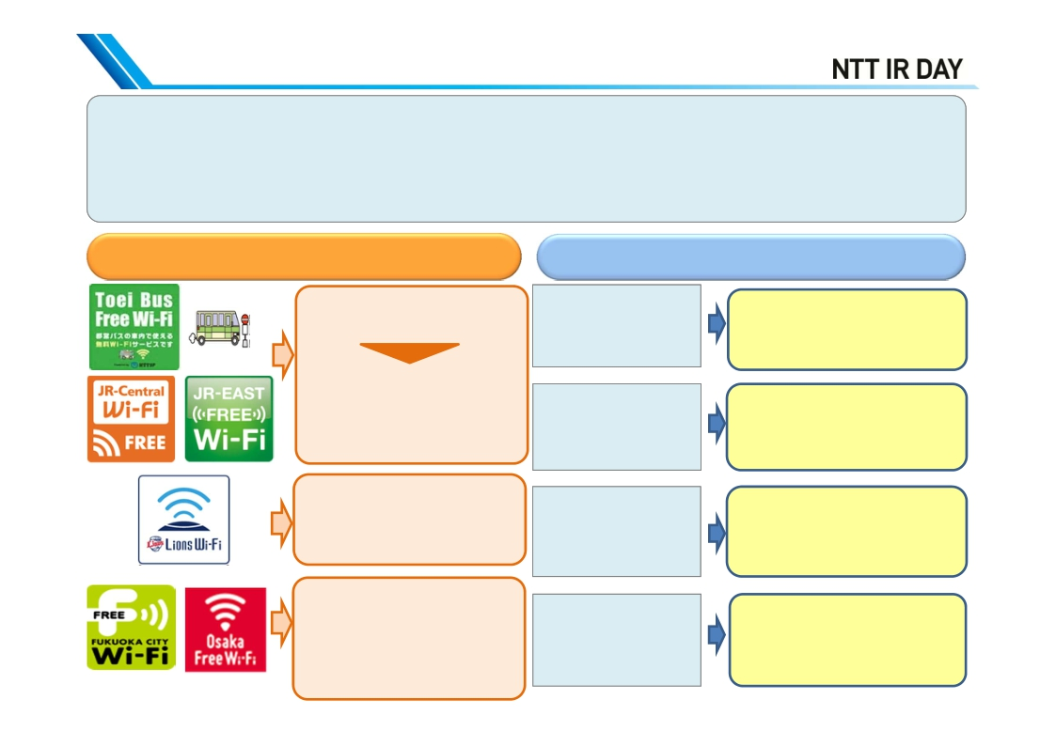
Expansion of Wi-Fi Business and New Practical Demand (2014 - )
(1) - Business expands as the existing venue-owner Wi-Fi model is followed by companies of the similar
category
- As the number of foreigners visiting Japan exceeded 10 million, inquiries from municipalities throughout
Japan have increased, due to the effect of JCW
(2) Practical demand is generated from new Wi-Fi usage (developing into collaboration with companies)
(1) Practical demand following advanced model
(2) New real demand
(promotion of collaboration)
-Intra-vehicle Wi-Fi
-Contents server installed
-Cities and medium- to long-
distance buses
-Expansion into waiting rooms
of hospitals and beauty parlors
-Stadiums in Japan
-J.League
-Wi-Fi for foreigners visiting
Japan
-New real demand including
hospitality tools and tourist
flow analysis, etc
Demand for
Wi-Fi use
Demand for
temporary use
of Wi-Fi
Demand towards
2020 (high density,
ICT, etc.)
-Information distribution
with Push and
information bar
-Flow analysis, etc.
- MVNO business operator
- Wi-Fi international roaming
- Event venues
- Security
- Stadiums, convention
centers
- Information bar, Push ads
- Use of digital signage
system
16

Slide 19
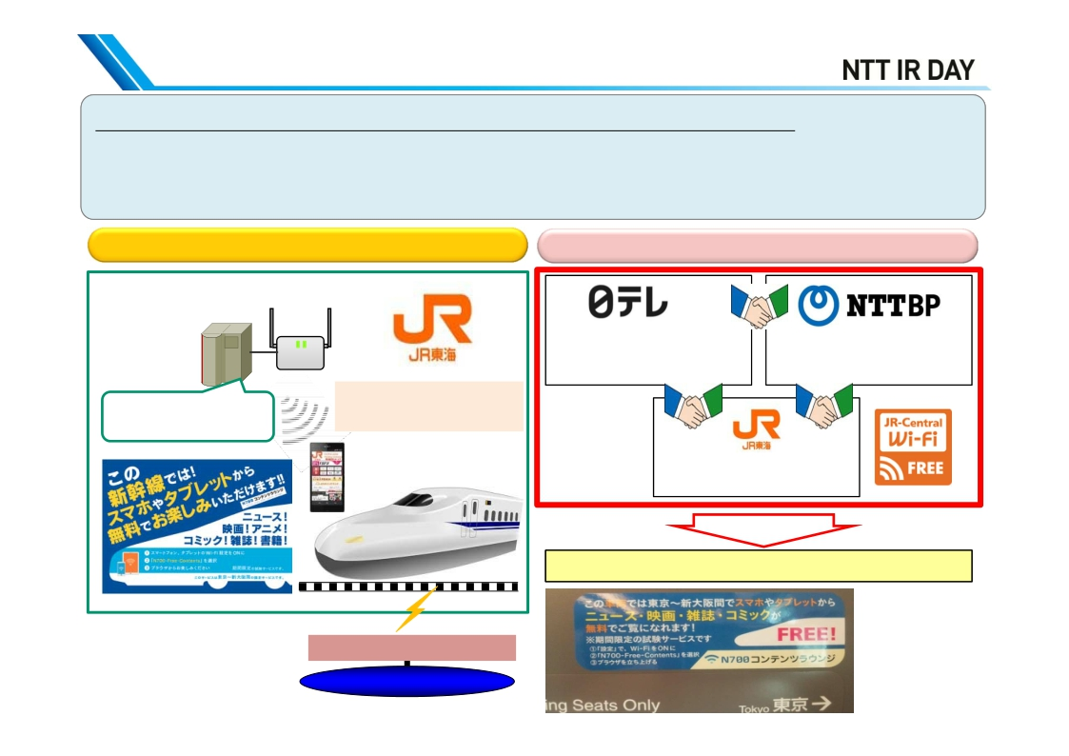
Service Examples
(Tokaido Shinkansen (bullet train) N700 Contents Lounge)
◆Overview of contents distribution demonstration service in bullet train
- To install contents distribution server in a bullet train and offer various contents such as
movies and electronic book for passengers traveling long distances
- Demonstration period: from June to September 2014 (4 months)
Image of service provision
[Inside bullet train]
SSID：：
-Server installed in the train car
N700-Free-Contents
-Distribution of various contents
Leaky coaxial cables
Internet
Implementation structure
(NipponTV)
- Contents provision
- Contents management,
- Portal site
software development
structure/development
- On-board server
- Contents operation (update)
setup/maintenance
- Preparation and provision of
the train cars
- Train car contents update
Service provision
Customers
[Reference]
Sticker on the back
of bullet train seats
17

Slide 20
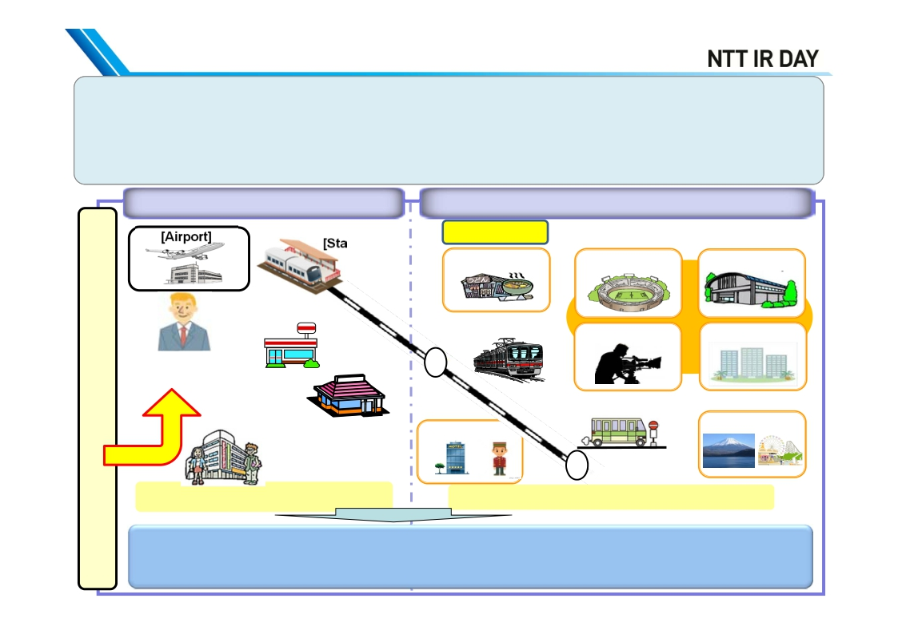
Initiatives for Wi-Fi Expansion towards 2020
➢From “Internet connection using Wi-Fi” to “Hospitality using Wi-Fi”
- Meet the demands generated by Olympic Games, redevelopment, etc.
- Expansion of collaboration with diverse industries and business formats and further expansion of
Wi-Fi devices
➢NTT BP aims to be the “behind the scenes supporter” of Wi-Fi business and a value partner
Access points already developed for
telecommunication carriers
Areas which require development of individual access points
Redevelopment <Olympic Games-related facilities>[Airport]
[Small outlets] [Stadiums]
[Convenience
[Olympicstore]
Athletes, Olympic [Café]
media, audience, etc.
[Large-scale
commercial [Inside buses]
destinations][Hotels, inns]
<Shopping center>Visiting
Japan <Department store>
Currently offering free Wi-Fi at about It is necessary to cover the areas surrounding the
80,000 AP Olympic Games sites
Further simplification and standardization of the utilization method
Hospitality Wi-Fi ⇒⇒ expand location information, maps/navigation, multilingual guidance
[Station]
[Indoor
[Variouscountriesaroundtheworld]
stadiums]
[Inside trains]
[Press centers]
village]
Games officials, mass
facility]
[Tourist
⇒
⇒ expansion of Japan Connected-free Wi-Fi
/translation and security
18

Slide 21
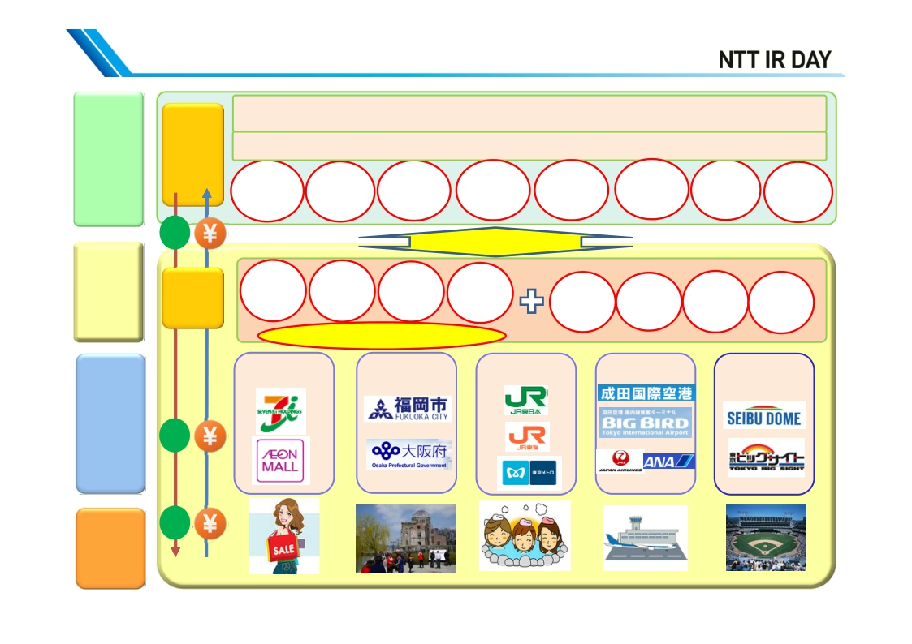
Expansion in Collaboration with Diverse
Service companies: companies owning various information such as
travel-related information/contents, vendors developing application/systems, etc.
Industries and Business Conditions
Hospitality
realization
Wi-Fi
usage
NTT Group (Docomo, East/West, Com, Data, Resonant, Advertising, GEOSPACE, etc.)
platform
(B)
Wi-Fi
platform
(B)
service
Service
BP
provision
function
Push-type
multilingual
information
distribution
Single
Sign-on
Map/
navigation
Automatic
connection
push
distribution
Contents
Multi-
lingual
Hospitality
application
Log
accumulation
Big data
analysis
API linking
Authentication
cooperation
Stadium
solutions
Location
information
O2O
Service
Information/
advertisement
distribution,
introduction
International
roaming
Map
linking
Open access/direct access
Distribution
Municipalities
Railways
Airports
Stadiums
流通
Venue
owners of
diverse
industries
流通
and
business
conditions
(B)
User
(C/B)））
Service
Service
19

Slide 22
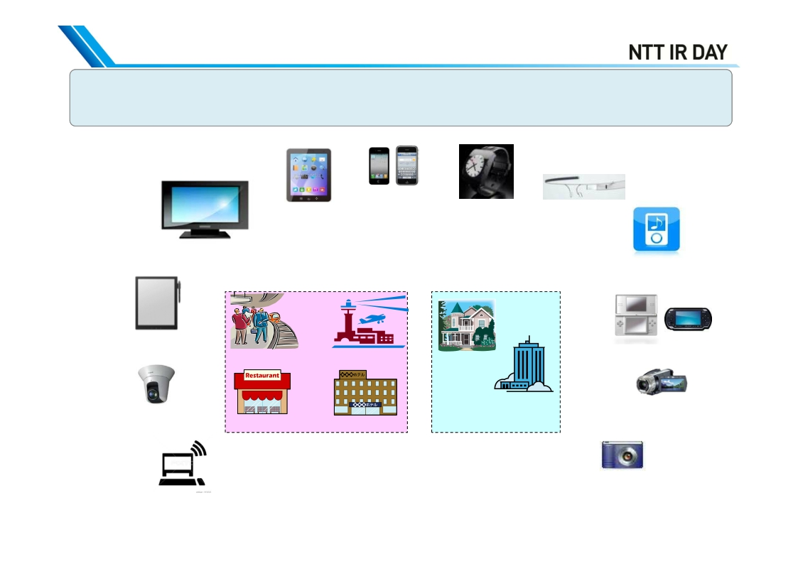
Increased Business from Expansion of Wi-Fi Devices
- As W-Fi is unlicensed, anybody can use it freely and it is installed in various devices
- Expansion in Wi-Fi devices leads to expansion in new usage demand for Wi-Fi
Smartphones
Wearable device
Wearable device
Tablet PC
(Watch)
(Glass)
Television
Paper display
Wi-Fi in ALL
Music players
Railway stations
Shops
Airports
Hotels
Video games
Video cameras
Homes
Offices,
schools, etc.
ゲーム
IP camera
various sensors
Area owner
Home, office
●Anybody can install Wi-Fi in any device
Digital cameras
PC
●Enables building of customer-centered network
20

