Slide 1

Strategies for reducing CAPEX/OPEX
Mitsuyoshi Kobayashi
Executive Vice President,
Senior Vice President of Technology Planning Department
September 26, 2014

Slide 2

The forward-looking statements and projected figures concerning the future performance
of NTT and its subsidiaries and affiliates contained or referred to herein are based on a
series of assumptions, projections, estimates, judgments and beliefs of the management
of NTT in light of information currently available to it regarding NTT and its subsidiaries
and affiliates, the economy and telecommunications industry in Japan and overseas, and
other factors. These projections and estimates may be affected by the future business
operations of NTT and its subsidiaries and affiliates, the state of the economy in Japan
and abroad, possible fluctuations in the securities markets, the pricing of services, the
effects of competition, the performance of new products, services and new businesses,
changes to laws and regulations affecting the telecommunications industry in Japan and
elsewhere, other changes in circumstances that could cause actual results to differ
materially from the forecasts contained or referred to herein, as well as other risks
included in NTT’s most recent Annual Report on Form 20-F and other filings and
submissions with the United States Securities and Exchange Commission.
* “E” in this material represents that the figure is a plan or projection for operation.

Slide 3
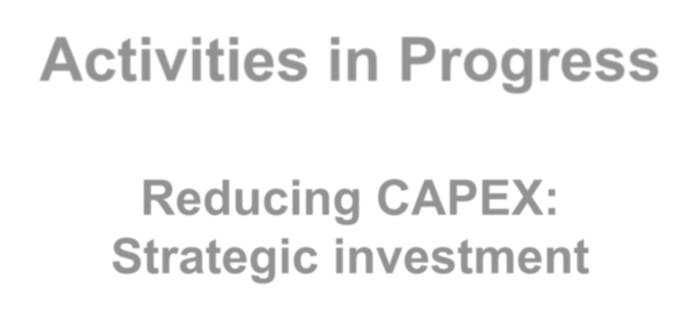
Activities in Progress
Reducing CAPEX:
Strategic investment
Copyright©2014 Nippon Telegraph and Telephone Corporation
1

Slide 4
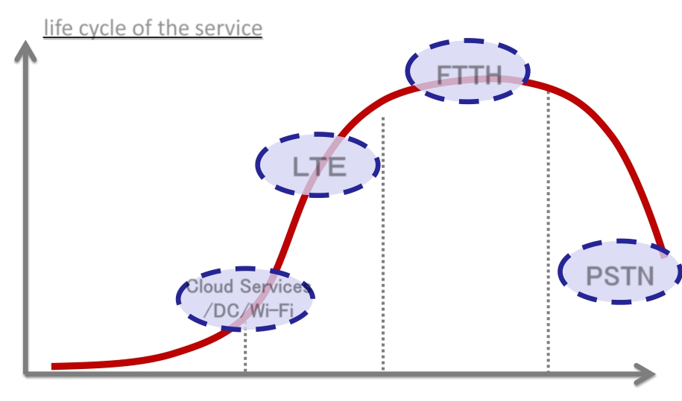
Strategic Investment
Strategic investment based on the
stage of services
life cycle of the service
Rapid Expansion
ＬＴＥ
Aggressive
Investment
Cloud Services
/ DC/Wi- Fi
Efficient Utilization
FTTH
PSTN
Streamlining
introduction
growth
maturity
decline
Copyright©2014 Nippon Telegraph and Telephone Corporation
2

Slide 5
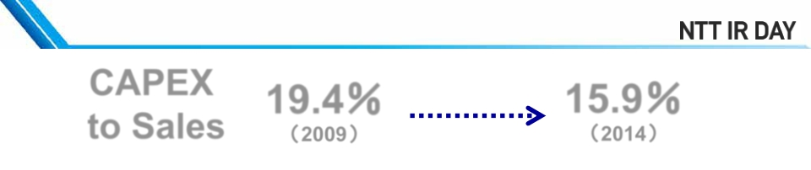
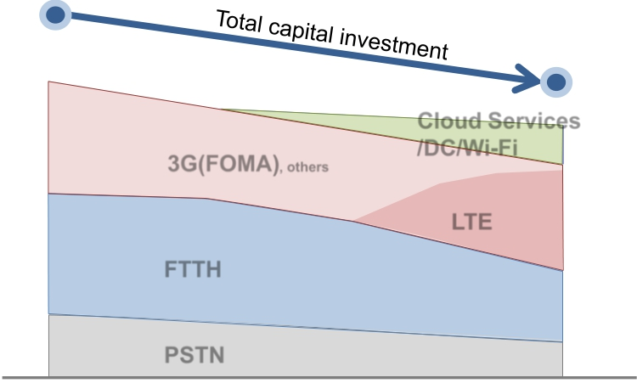
Changes in capital investment
CAPEX
to Sales
19.4％
（2009）
15.9％
（2014）
*
2.2
(Trillions of yen)
In comparison
with FY2005
▲▲ 16％
1.9
Cloud Services
/DC/Wi-Fi
LTE
3G(FOMA), others
FTTH
▲▲ 30％
▲▲ 40％
PSTN
2005
2014E
[Fiscal year]
* Amounts excludes sales and investments related to real estate and solar power generation operation
Copyright©2014 Nippon Telegraph and Telephone Corporation
3

Slide 6
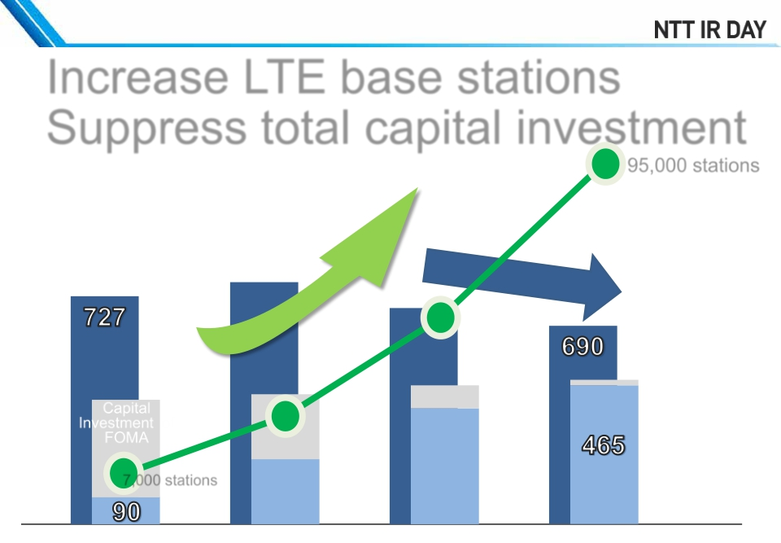
<Growing Field: LTE>
Changes in capital investment
Increase LTE base stations
Suppress total capital investment
95,000 stations
Number of LTE
Base Stations
(Billions of yen)
Total capital
investment of
NTT docomo
Capital
Investment of
FOMA
Capital
investment
*
of LTE
7,000 stations
2011
2012
2013
2014E
[Fiscal year]
* Forecast at the end of FY2013
(New segment reporting structure have been applied from FY2014/1Q)
4
Copyright©2014 Nippon Telegraph and Telephone Corporation

Slide 7
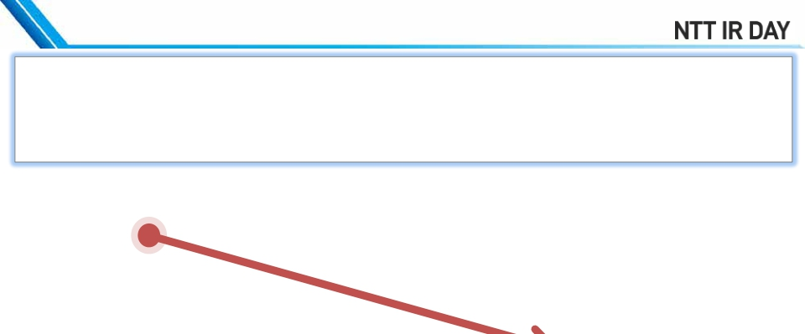
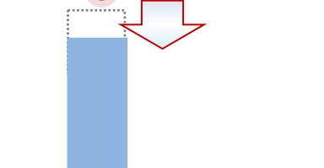
<Growing Field: LTE>
Improving efficiency of installing base stations
ü Reducing goods expenses and improving efficiency of engineering
ü Introducing multi-frequency antenna (maximum 5 frequencies)
⇒reduced to 1/3 compared with FOMA
ü Utilizing the network service of NTT East and NTT West
The unit construction cost
of the LTE base stations
*2
Capital investments for LTE
Efficient
*1
▲▲ 12%
investment
2011
2012
2013
2014E
[Fiscal year]
*1 Cost of antenna for one frequency of a base station
*2 Calculated by dividing LTE investment by the number of the installed base station
Copyright©2014 Nippon Telegraph and Telephone Corporation
5

Slide 8
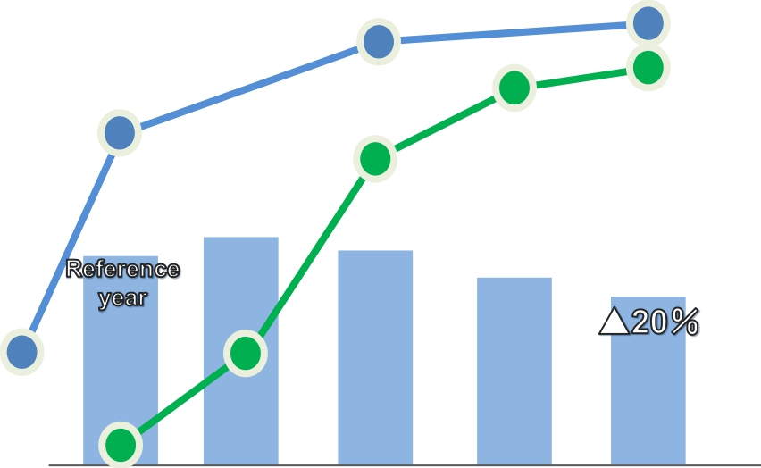
<Maturing Field: FTTH>
Changes in capital investments
94％
Area coverage rate of FTTH
*
18 millions
Number of FTTH subscribers
80％
50％
(FY 2000)
Capital investments for FTTH
1 million
2003
2005
2008
2012
2013
[Fiscal year]
* Ratio of optical fiber deployment in distribution points (NTT East)
Copyright©2014 Nippon Telegraph and Telephone Corporation
6

Slide 9
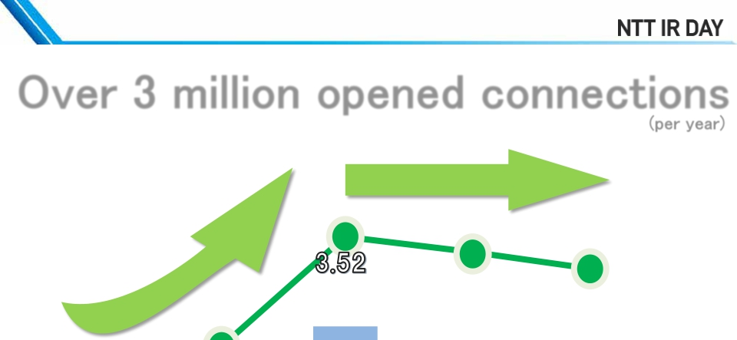
<Maturing Field: FTTH>
Changes in number of opened connections
Over 3 million opened connections
Number of opened connections
(millions)
(per year)
(per year)
2.36
Net increase of subscribers
(millions)
1.75
0.74
2012
0.75
2013
0.65
2003
2005
2008
[Fiscal year]
Copyright©2014 Nippon Telegraph and Telephone Corporation
7

Slide 10
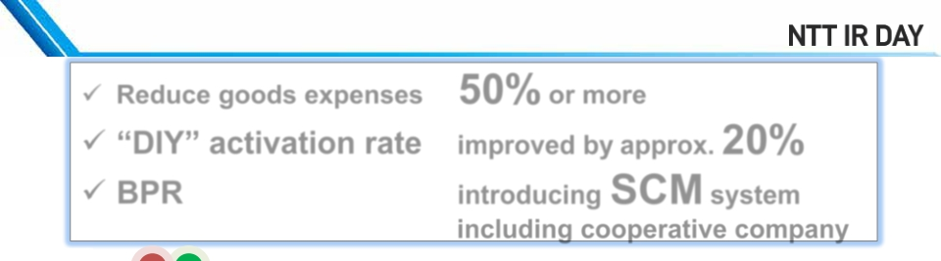
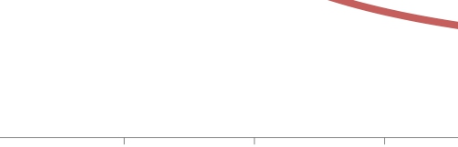
<Maturing Field: FTTH>
Reducing the activation costs
ü Reduce goods expenses 50% or more
ü “DIY” activation rate
ü BPR
improved by approx. 20%
introducing SCM system
*
including cooperative company
Reduced to 1/2
in delivery time
per one FTTH line compared with FY2003
Reduced to 1/3
1
in activation cost
per one FTTH line compared with FY2003
0
2003
2005
2008
2012
2013
[Fiscal year]
* Supply chain management
Copyright©2014 Nippon Telegraph and Telephone Corporation
8

Slide 11
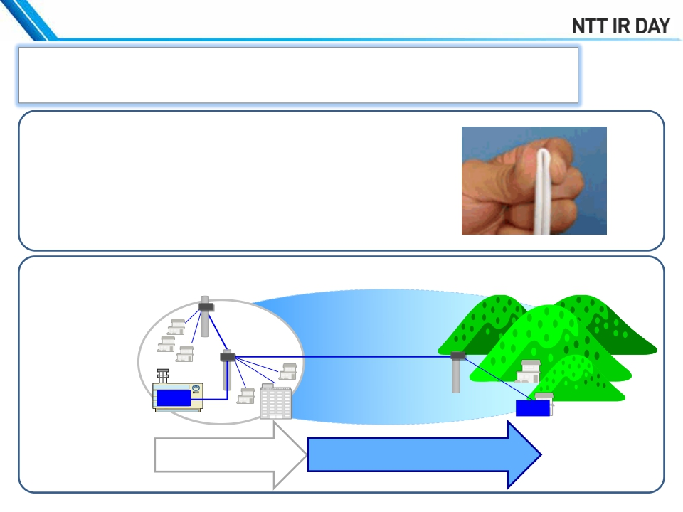
<Maturing field: FTTH>
Measures to facilitate more activations (example)
ü
Applying the fruits of R&D
Significant improvement in work efficiency
by “Free-Bending Optical Fiber Cord”
Extend the transmission distance of the optical signal
OLT
ONU
Previously 7km
Currently 20km or more
Copyright©2014 Nippon Telegraph and Telephone Corporation
9

Slide 12
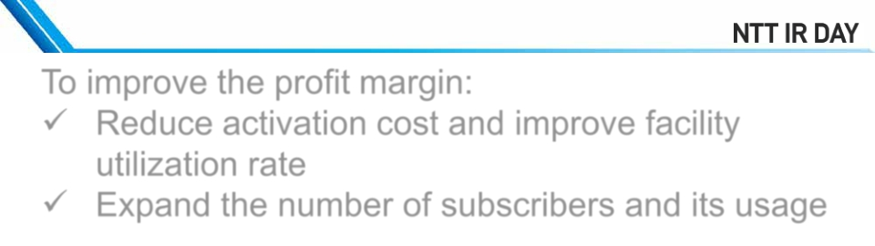


<Maturing Field: FTTH >
Changes in profit margin
To improve the profit margin:
ü
ü
Reduce activation cost and improve facility
utilization rate
Expand the number of subscribers and its usage
(Billions of yen for Operating Income)
100
1,000
15%
Profit margin
(right axes)
Operating Profits
(left axes)
0
0
0%
2009
2010
2011
2012
2013
[Fiscal year]
▲ 15%▲ 100
* Summary of “FTTH Access Services” and “Other” from “Designated Telecommunications Services other than Specified Telecommunications Services”
Copyright©2014 Nippon Telegraph and Telephone Corporation
-1,000
(15%)
10

Slide 13
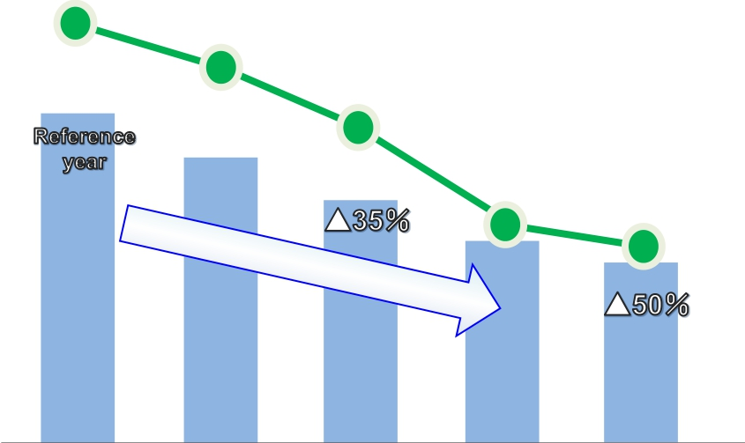
<Declining Field: PSTN >
Changes in asset’s carrying value
60
Number of subscribers
(millions)
Decreased to half
in 10 years
26
▲ 56%
Streamlining the equipments
Asset’s
carrying
value
2003
2005
2008
2012
2013
[Fiscal year]
Copyright©2014 Nippon Telegraph and Telephone Corporation
11

Slide 14
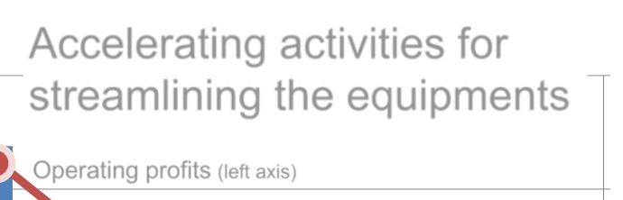

<Declining Field: PSTN >
Changes in profit margin
Accelerating activities for
streamlining the equipments
Operating profits (left axis)
Profit margin
(right axis)
(Billions of yen)
3,000
2,000
1,000
0
300
15%
10%
5%
0%
200
100
2004 2005 2006 2007 2008 2009 2010 2011 2012 2013
[Fiscal year]
-1,000
* Calculated from “Voice Transmission Services” and “Leased Circuit Services”
(5%)
Copyright©2014 Nippon Telegraph and Telephone Corporation
(100)
12

Slide 15
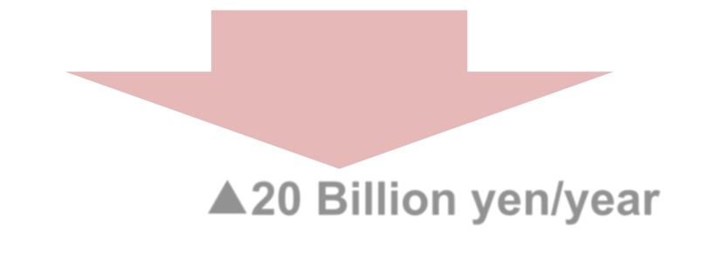
<Declining Field: PSTN >
Measures to streamline the equipments(example)
Replacement of legacy equipments
Transport system : 60 thousand racks
Switch system : 1.8 thousand units
Settlement of lines : 400 thousand lines
(from FY2012 to FY2016)
Significant
asset reduction
OPEX ▲▲ 20 Billion yen/year
(Electricity charges, Maintenance costs, etc.)
Copyright©2014 Nippon Telegraph and Telephone Corporation
13

Slide 16



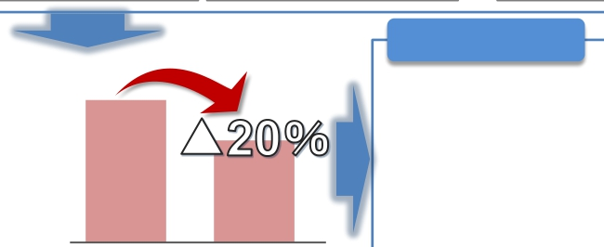
Improving efficiency in procurements
Up to now
ü Cost reduction by introducing new technologies
the variety of goods
üExpansion of the global procurement
ü Extend the common specification and reduce
Procurement price
(example：Aerial optical fiber cable)
Cost of antenna
Promoting competition
by utilizing Dimension Data
Suppliers
Reduced to 1/3
(Compared to 3G)
companiesOperating
(Compared to 2G: 1/10)
Cost of antenna for one
frequency of a base station
2007 2013
3G(FOMA) LTE(Xi)
Vendors
RFP
Price per 1meter
(100 fibers cable)
2003 2013
[Fiscal year]
Dimension
Data
[Fiscal year]
From now on
Promoting the cooperated procurement
strategy for whole NTT group
ü Deployment of visualization and best
practices by the unification of IT systems
ü Improve efficiency including the procurement
of outsourcing services
The amount of procurements
of NTT Group
2003
2013
[Fiscal year]
14
Copyright©2014 Nippon Telegraph and Telephone Corporation

Slide 17
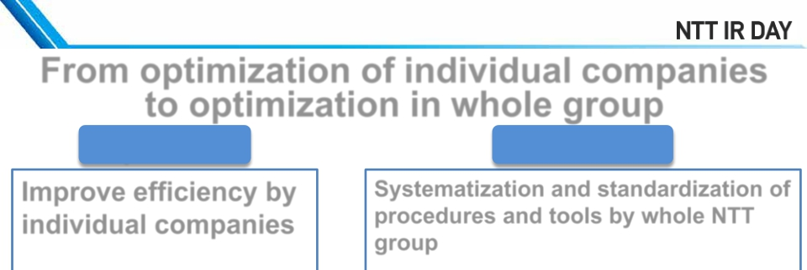

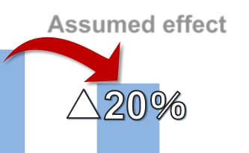
Improving efficiency in software development
From optimization of individual companies
to optimization in whole group
Up to now
Improve efficiency by
individual companies
From now on
Systematization and standardization of
procedures and tools by whole NTT
group
ü Standardization of
development procedure
ü Applying group common frameworks
with open source
*
ü Applying group common tools
(e.g. automated testing, development process
ü Automation of testing
control)
Assumed effect
ü Applying open source
softwares
Cost of new development project
ü Utilizing offshore
2013
2015
[Fiscal year]
* Templates of Applications
Copyright©2014 Nippon Telegraph and Telephone Corporation
15

Slide 18
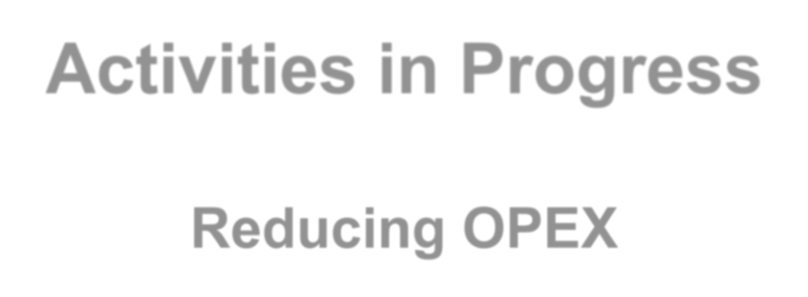
Activities in Progress
Reducing OPEX
Copyright©2014 Nippon Telegraph and Telephone Corporation 16

Slide 19
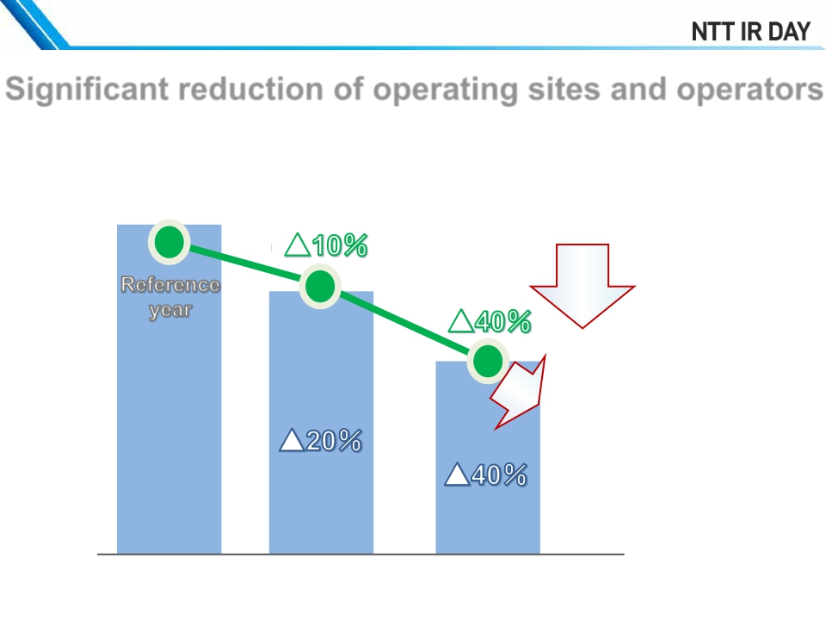
Improving efficiency in operation
Significant reduction of operating sites and operators
Trouble reception centers
of NTT East and NTT West
Operators in
Companies outsourced from
NTT East and NTT West
Applying IT systems
Further
multitasking
2006
2009
2013
[Fiscal year]
Copyright©2014 Nippon Telegraph and Telephone Corporation
17

Slide 20
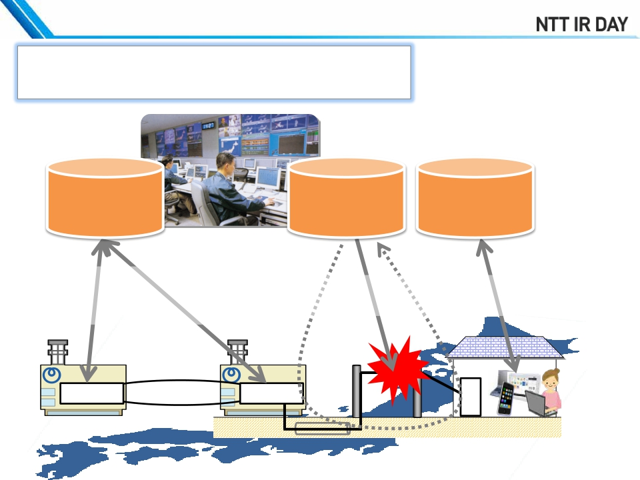
Improving efficiency in operation(Example)
ü Applying IT systems
Monitoring and
control system
Automatic
testing system
Diagnostic and
recovery tools
Traffic control and
troubleshooting from
remote site
equipment
Detecting trouble
point in fiber network
equipment
Trouble diagnosis and
recovery by customer
Ｎ
ＵＯ
Ｕ
Copyright©2014 Nippon Telegraph and Telephone Corporation
18

Slide 21
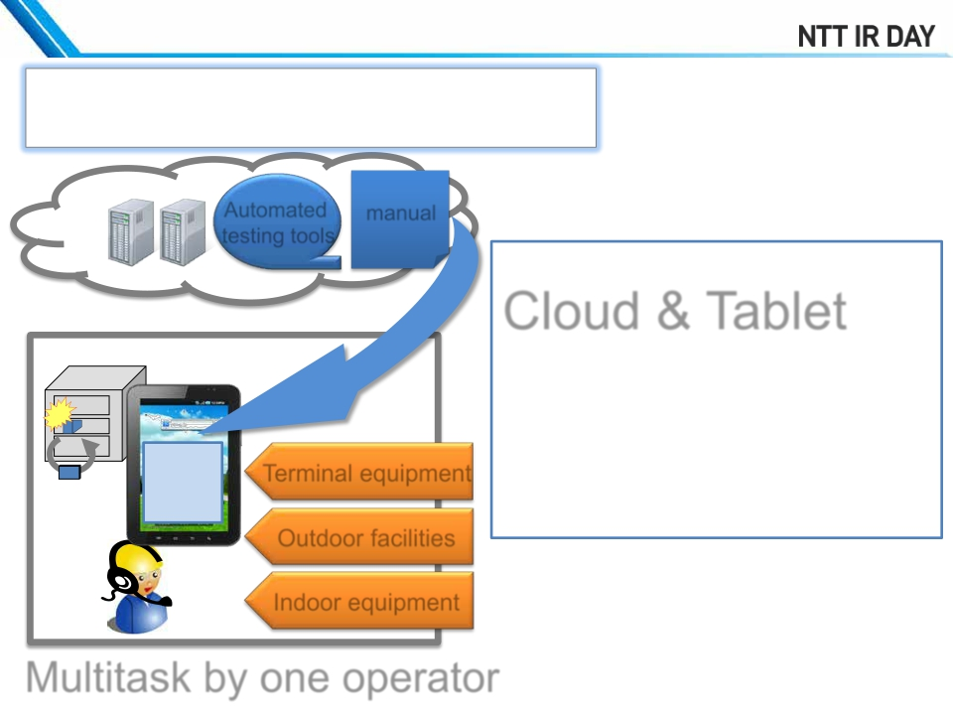
Improving efficiency in operation(Example)
ü Further multitasking
Automated
testing tools
manual
Cloud & Tablet
ü Electronic manuals
ü Automated tools
(e.g. testing tools)
Terminal equipment
Outdoor facilities
Indoor equipment
repair
xx manual
Multitask by one operator
Copyright©2014 Nippon Telegraph and Telephone Corporation
19

Slide 22
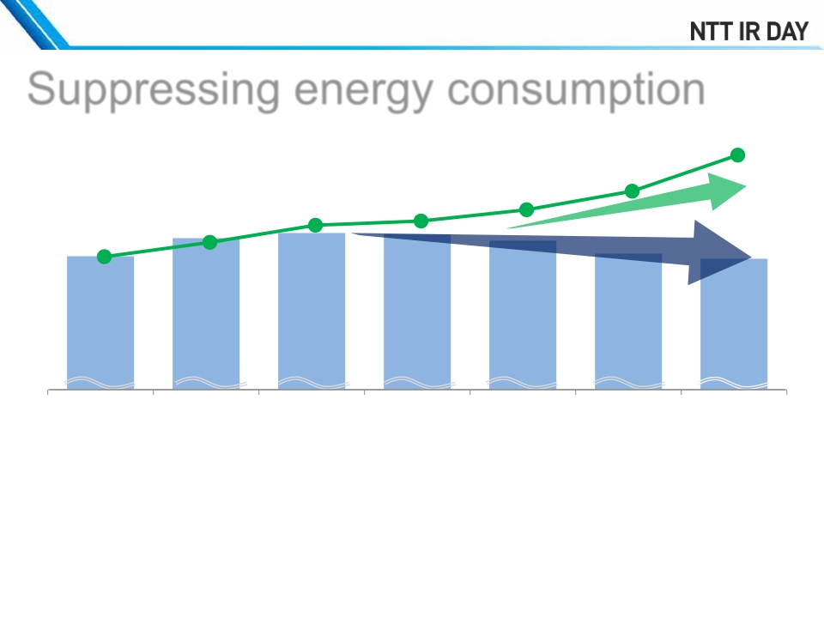
Efficient use of energy
Suppressing energy consumption
by Total Power Revolution (TPR)
1,560Gbps
2,130
Gbps
Internet traffic of NTT
1,090Gbps
1,270Gbps
1,020Gbps
750Gbps
*
520Gbps
8.68
2008
8.72
2009
8.71
2010
8.66
2011
8.54
2007
8.56
2012
8.52
(reference)
2013
(billion kWh)
Electric power
2007
2008
2009
2010
2011
2012
2013
ü Replacing old equipment to energy efficient type
ü Introducing new technologies aggressively
[Fiscal year]
·
·
·
Next-generation power transmission system HVDC (High voltage direct current )
Cooperative control of the NW equipment, AC and electric supply
Outdoor air cooling system
* Predicted by NTT based on the following
“The estimation of the Internet traffic in Japan” (Ministry of Internal Affairs and Communications)
20
Copyright©2014 Nippon Telegraph and Telephone Corporation

Slide 23
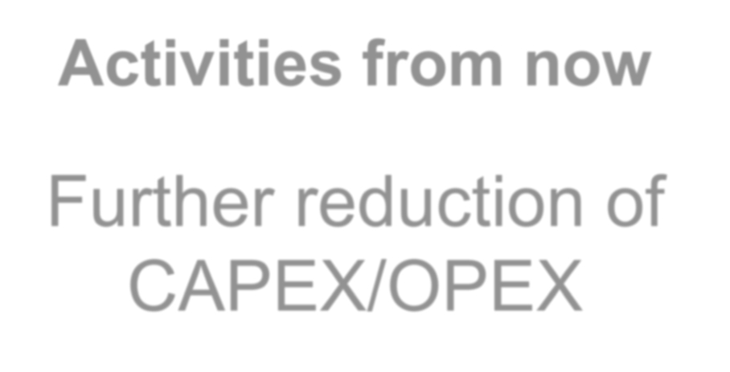
Activities from now
Further reduction of
CAPEX/OPEX
Copyright©2014 Nippon Telegraph and Telephone Corporation
21

Slide 24
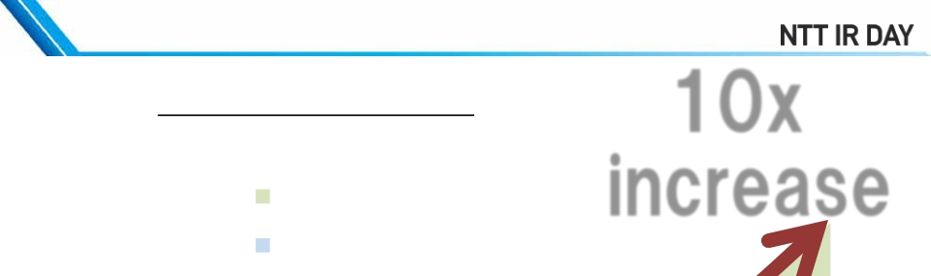
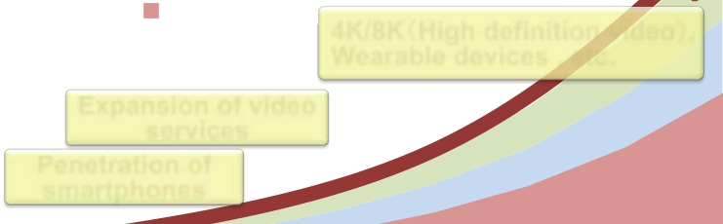
Increase of Internet Traffic
10x
increase
Internet traffic of Japan
ファイル共有
ウェブ
*
File sharing
Web
ビデオ
Expansion of video
services
Penetration of
smartphones
Video
4K/8K（（High definition video）
）,
Wearable devices , etc.
2013
2014
2015
2016
2017
2018
2019
2020
* Predicted by NTT based on the following
“The estimation of the Internet traffic in Japan” (Ministry of Internal Affairs and Communications)
“The present conditions of the mobile communication traffic in Japan” (Ministry of Internal Affairs and Communications)
Cisco Visual Networking Index
Copyright©2014 Nippon Telegraph and Telephone Corporation
22

Slide 25
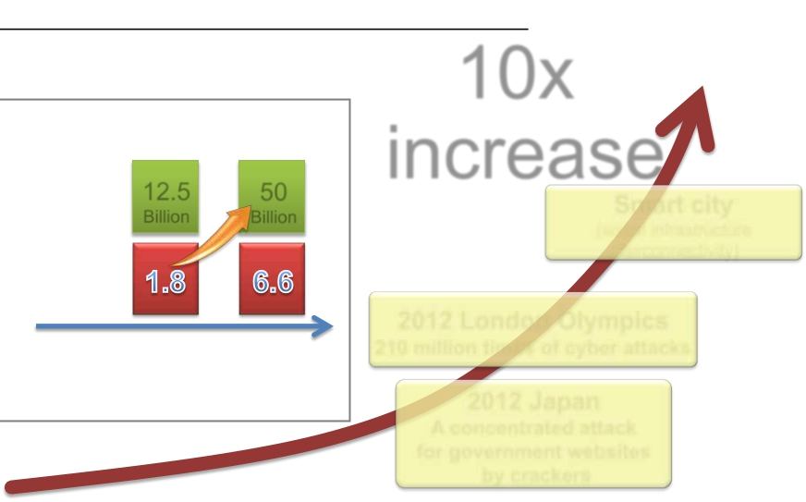
Increase of cyber attacks
Cyber attacks against social infrastructure
10x
Internet of Things
Connected 12.5 50
Billion Billion
Connected
Device/Person
*
increase
Smart city
(social infrastructure
interconnectivity)
2012 London Olympics
Devices
*
2010
2020
210 million times of cyber attacks
Increase of risk by connecting
vulnerable devices
2012 Japan
A concentrated attack
for government websites
by crackers
2000
2010
2020
* Source: Cisco IBSG, April 2011
Copyright©2014 Nippon Telegraph and Telephone Corporation
23

Slide 26
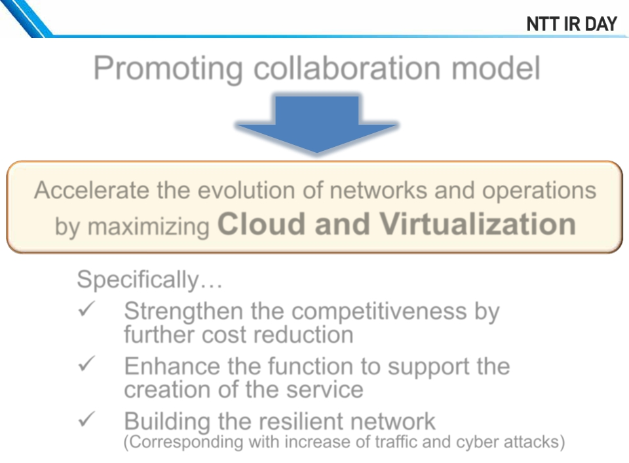
Further evolution of network services
Promoting collaboration model
Accelerate the evolution of networks and operations
by maximizing Cloud and Virtualization
Specifically…
ü
ü
ü
Strengthen the competitiveness by
further cost reduction
Enhance the function to support the
creation of the service
Building the resilient network
(Corresponding with increase of traffic and cyber attacks)
Copyright©2014 Nippon Telegraph and Telephone Corporation
24

Slide 27
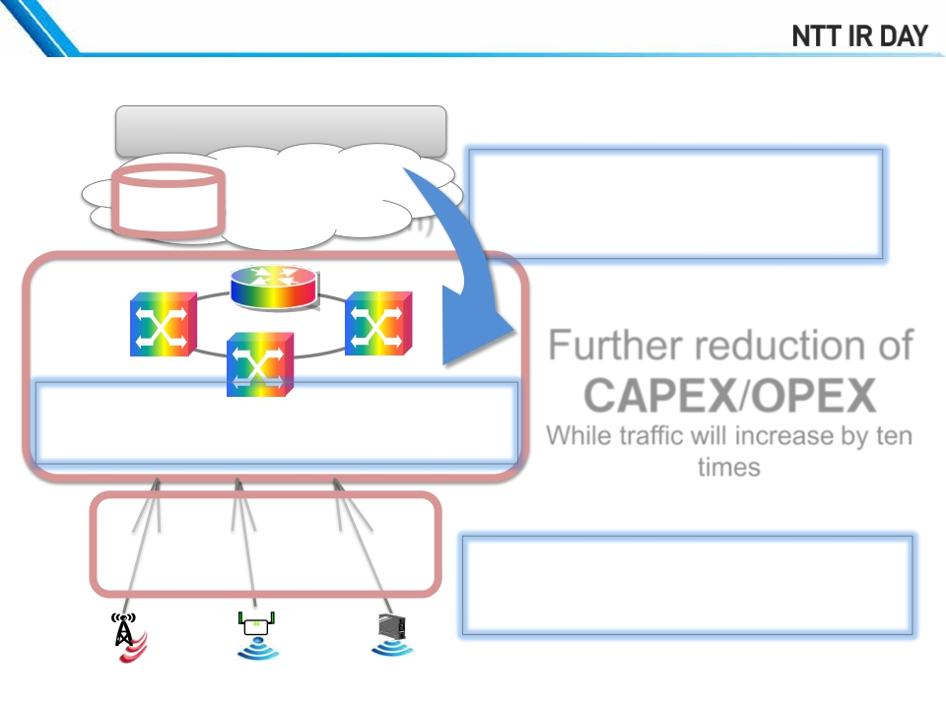
Strengthening the competitiveness
Network as of 2020
The Internet
by Cloud and Virtualization
Cloud
(Virtualization)
1)Control by software
(e.g. SDN)
Further reduction of
OSS/BSS
ＣＡＰＥＸ/ＯＰＥＸ
While traffic will increase by ten
times
2)Large capacity, simplified
Cost reduction using EMS *
Optical fiber base
+ new technologies
(e.g. WDM)
Public Wi-Fi In-houseLTE, 5G
* Electronics manufacturing service
3)Efficient expansion of
wireless access network
Copyright©2014 Nippon Telegraph and Telephone Corporation
Wi-Fi
25

Slide 28
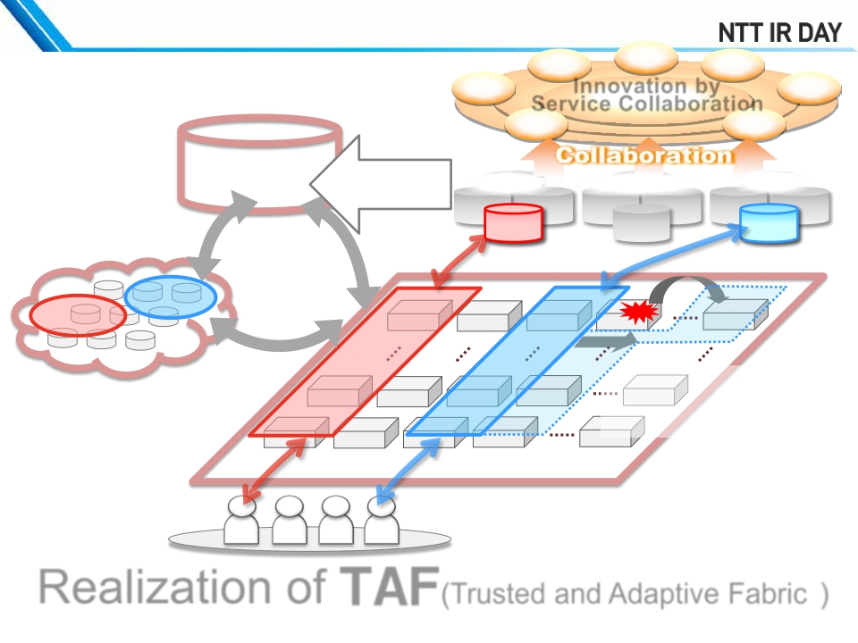
Technology strategies for
strengthening the competitiveness
Environment
Health care
Distribution
Innovation by ManufacturingTransportation
Entertainment
Service Collaboration
Tourism
Sports/
OSS/BSS
On demand
control
Telecomm
carriers
Ａ
MVNO,ISP Other industries
B
Service
Service
Ｂ
Service
NW
Service
NW
Ａ
Ａ
B
Controlling resources
quickly and automatically
depending on the situation
Cloud
General switches
End users
Realization of ＴＡＦ(Trusted and Adaptive Fabric )
*
Copyright©2014 Nippon Telegraph and Telephone Corporation
* The network which has both confidence and flexibility (= tough)
to meet various demands of partners, quickly and precisely
26

Slide 29
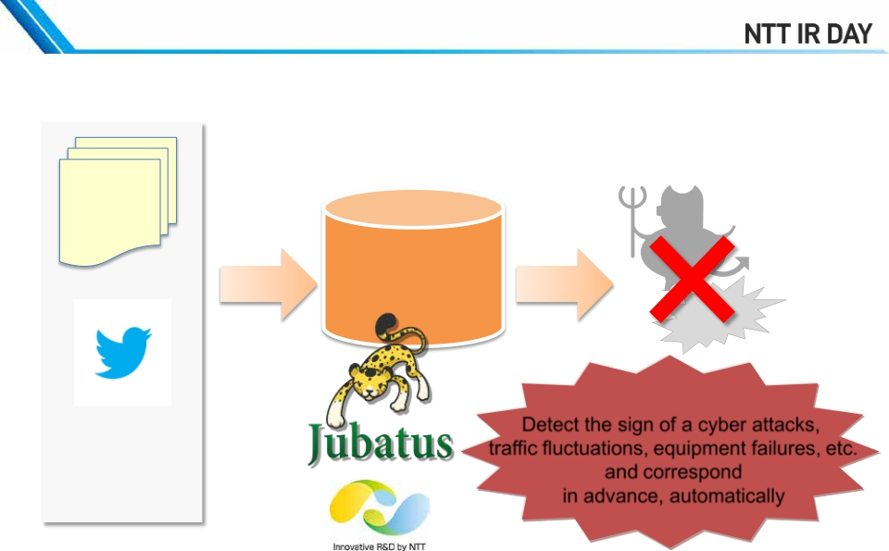
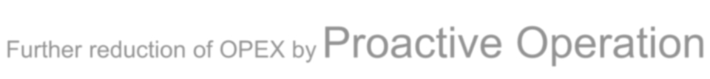
Evolution of operations
Correcting and analyzing vast information
using AI technologies
2013-1-1T01:11:00 msg [100]: STP: VLAN 1 Port
38 STP State -> DISABLED (PortDown)
2013-1-1T01:11:00 msg [101]: System: Interface
ethernet 38, state down
2013-1-1T03:00:00 msg [200] : STP: VLAN 100
Port 22 STP State -> DISABLED (PortDown)
2013-1-1T03:00:00 %NODE%: %HOST%
port %I/F% detected CRC error in %N% flames
2013-1-1T03:00:00 msg [201] : System: Interface
ethernet 22, state down
Big Data
Equipment log
analysis
Social log
(e.g. SNS)
・・・
Detect the sign of a cyber attacks,
traffic fluctuations, equipment failures, etc.
and correspond
in advance, automatically
Further reduction of OPEX by Proactive Operation
Copyright©2014 Nippon Telegraph and Telephone Corporation
27

Slide 30
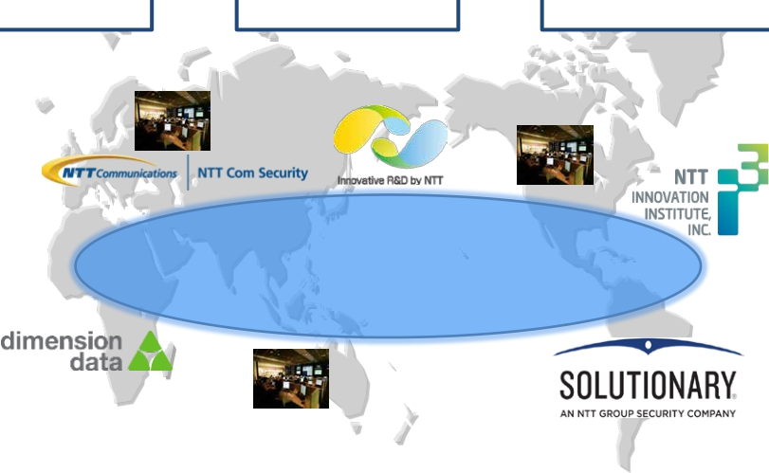
Advanced security management
Global
Broadband Network
★★
Seamless
security monitoring
system
World leading
detecting and analyzing
technique
★★
★
★
with collective strength
★
★
★
★
★
★
Guarding solidly
★
★★
★ security operation center (including locations with security specialists)
Copyright©2014 Nippon Telegraph and Telephone Corporation
28

Slide 31
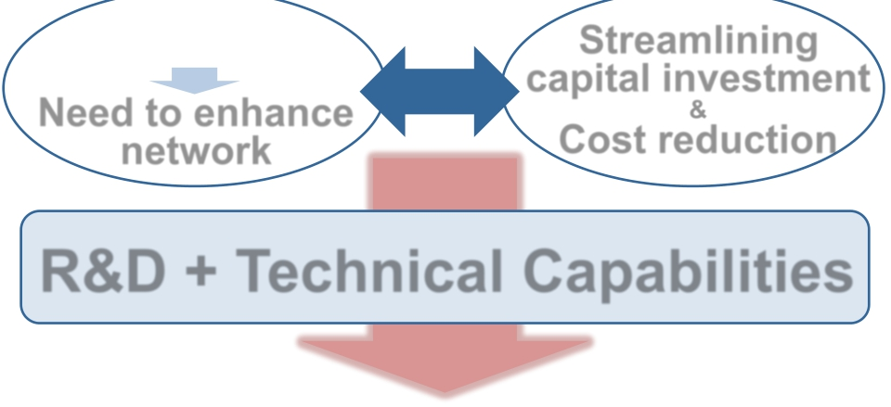
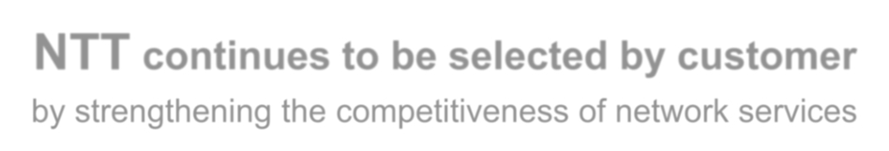
Summary
Increase of traffic
and security risk
Need to enhance
network
Streamlining
capital investment
Cost reduction
contradiction
&
R&D + Technical Capabilities
NTT continues to be selected by customer
by strengthening the competitiveness of network services
Copyright©2014 Nippon Telegraph and Telephone Corporation
29

