Slide 1

Peter Löscher, President and CEO – Joe Kaeser, CFO
Mixed picture, Focus on Execution
Q2 FY 2013, Analyst Conference
London, May 2, 2013
Restricted © Siemens AG 2013. All rights reserved.
siemens.com/answers

Slide 2
Safe Harbour Statement
This document contains statements related to our future business and financial performance and future events or developments
involving Siemens that may constitute forward-looking statements. These statements may be identified by words such as “expects,”
“looks forward to,” “anticipates,” “intends,” “plans,” “believes,” “seeks,” “estimates,” “will,” “project” or words of similar meaning. We
may also make forward-looking statements in other reports, in presentations, in material delivered to stockholders and in press
releases. In addition, our representatives may from time to time make oral forward-looking statements. Such statements are based
on the current expectations and certain assumptions of Siemens’ management, and are, therefore, subject to certain risks and
uncertainties. A variety of factors, many of which are beyond Siemens’ control, affect Siemens’ operations, performance, business
strategy and results and could cause the actual results, performance or achievements of Siemens to be materially different from any
future results, performance or achievements that may be expressed or implied by such forward-looking statements or anticipated on
the basis of historical trends. These factors include in particular, but are not limited to, the matters described in Item 3: Key
information—Risk factors of our most recent annual report on Form 20-F filed with the SEC, in the chapter “Risks” of our most recent
annual report prepared in accordance with the German Commercial Code, and in the chapter “Report on risks and opportunities” of
our most recent interim report.
Further information about risks and uncertainties affecting Siemens is included throughout our most recent annual and interim
reports, as well as our most recent earnings release, which are available on the Siemens website, www.siemens.com, and
throughout our most recent annual report on Form 20-F and in our other filings with the SEC, which are available on the Siemens
website, www.siemens.com, and on the SEC’s website, www.sec.gov. Should one or more of these risks or uncertainties materialize,
or should underlying assumptions prove incorrect, actual results, performance or achievements of Siemens may vary materially from
those described in the relevant forward-looking statement as being expected, anticipated, intended, planned, believed, sought,
estimated or projected. Siemens neither intends, nor assumes any obligation, to update or revise these forward-looking statements in
light of developments which differ from those anticipated.
All underlying margins are calculated by adjusting margins for the effects reported for the respective businesses in the relevant
period. These effects are provided to assist in the analysis of the businesses' results year-over-year and may vary from period to
period. Underlying margins are not necessarily indicative of future performance. Other companies may calculate similar measures
differently.
Due to rounding, numbers presented throughout this and other documents may not add up precisely to the totals provided and
percentages may not precisely reflect the absolute figures.
Restricted © Siemens AG 2013. All rights reserved.
Page 2
London, May 2, 2013
Q2 FY 2013, Analyst Conference

Slide 3
Orders and EPS growth are highlights in an
operationally challenging quarter
Siemens (continuing operations), €m
Orders
Revenue
Book-to-bill
Profit Total Sectors
Income from continuing operations
Basic earnings per share (in €)
Free cash flow
1) Change is adjusted for portfolio and currency translation effects
Restricted © Siemens AG 2013. All rights reserved.
Q2 FY 12
17,880
19,297
0.93x
1,929
979
1.08
532
Q2 FY 13
21,451
18,011
1.19x
1,374
982
1.14
1,375
Change
20%1)
-6%1)
-29%
0%
6%
158%
Page 3
London, May 2, 2013
Q2 FY 2013, Analyst Conference

Slide 4
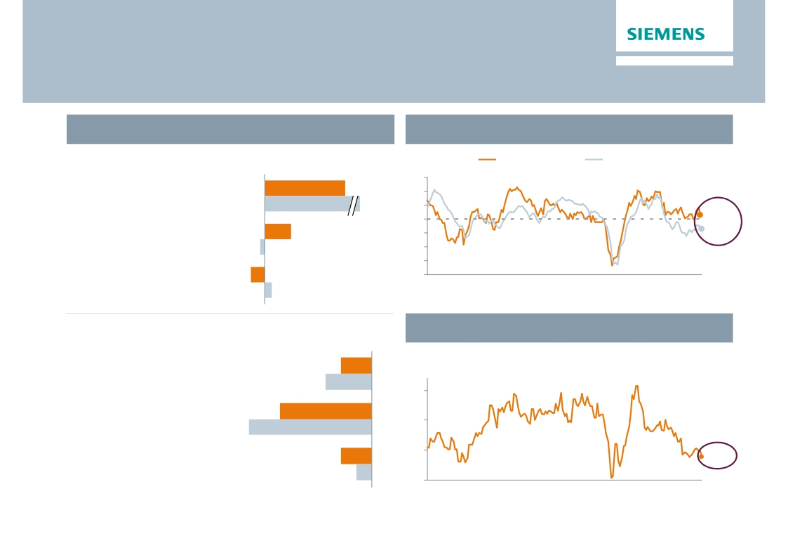
Large project orders boost orders in Europe
Regional business split
Purchasing Managers Index
Q2 FY 13 Order growth y-o-y1)
Index
US ISM Mfg PMI
Eurozone Mfg PMI
Europe/C.I.S./Africa/ME
+34%
65
60
Expanding economy
(therein Germany)
+58%
55
50
51.32)
Americas
+11%
45
46.5
(therein USA)
Asia/Australia
-2%
-6%
40
35
30
Contracting economy
(therein China)
+3%
00
01
02
03
04
05
06
07
08
09
10
11
12
13
(Apr)
2) US as of March; flash reading for EZ in April
China Industry Value Added
In %
20
Q2 FY 13 Revenue growth y-o-y1)
Europe/C.I.S./Africa/ME
(therein Germany)
-4%
-6%
Americas
(therein USA)
-12%
15
-16%
Asia/Australia
(therein China)
-4%
-2%
10
5
8.9%
00
01
02
03
04
05
06
07
08
09
10
11
12
13
(Mar)
1) Change is adjusted for currency translation and portfolio effects
Restricted © Siemens AG 2013. All rights reserved.
Page 4
London, May 2, 2013
Q2 FY 2013, Analyst Conference

Slide 5
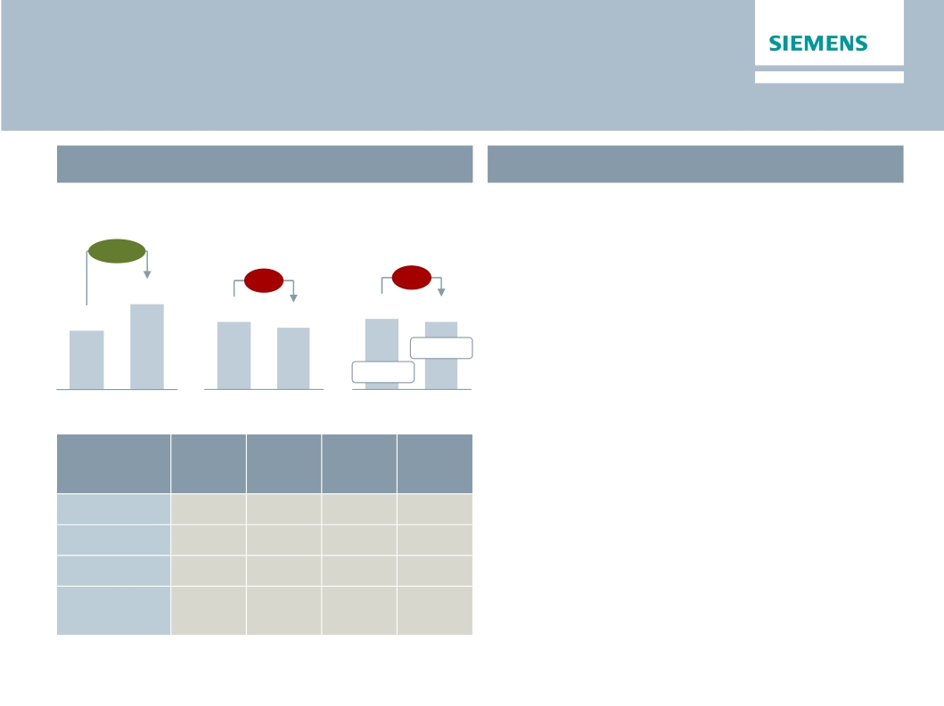
Energy
Continued strong performance backed by Fossil&Service
Key Figures Energy
Main developments in Q2
€bn
Orders 1)
+45%
€m
Profit
· Strong book-to-bill at 1.35; sharp order
growth driven by two large offshore wind
orders in Europe
Revenue 1)
-9%
-4%
· Revenue impacted by less turnkey projects in
8.5
5.8
Q2 12
6.9
Q2 12
6.3
Q2 13
573
8.3% 2)
Q2 12
551
8.8% 2)
Q2 13
Fossil and declining Wind business in the US
· Fossil – Strong service contribution
· Wind – Volume-driven earnings decline on tough
comps
Q2 13
Orders
y-o y 1)
4%
480%
-5%
-8%
Revenue
y-o y 1)
-14%
-18%
-6%
3%
Profit
margin
17.6%
5.1%
9.8%
-3.2%
Underl.
profit
margin
17.6%
5.1%
9.8%
2.3%
· Transmission – Turnaround program on plan;
challenges from offshore grid access projects
continue to affect margins
· Solar – Reclassification to Energy, pre-tax loss
of €21m in Q2
· €20m transformation charges 'Siemens 2014'
Division
Fossil Power
Wind Power
Oil & Gas
Power
Transmission
1) Comparable, i.e. adjusted for currency translation and portfolio effects
Restricted © Siemens AG 2013. All rights reserved.
2) Underlying margin: Q2 12: 11.4%, Q2 13: 10.5%, for underlying margin
calculation please refer to Flashlight document
Page 5
London, May 2, 2013
Q2 FY 2013, Analyst Conference

Slide 6
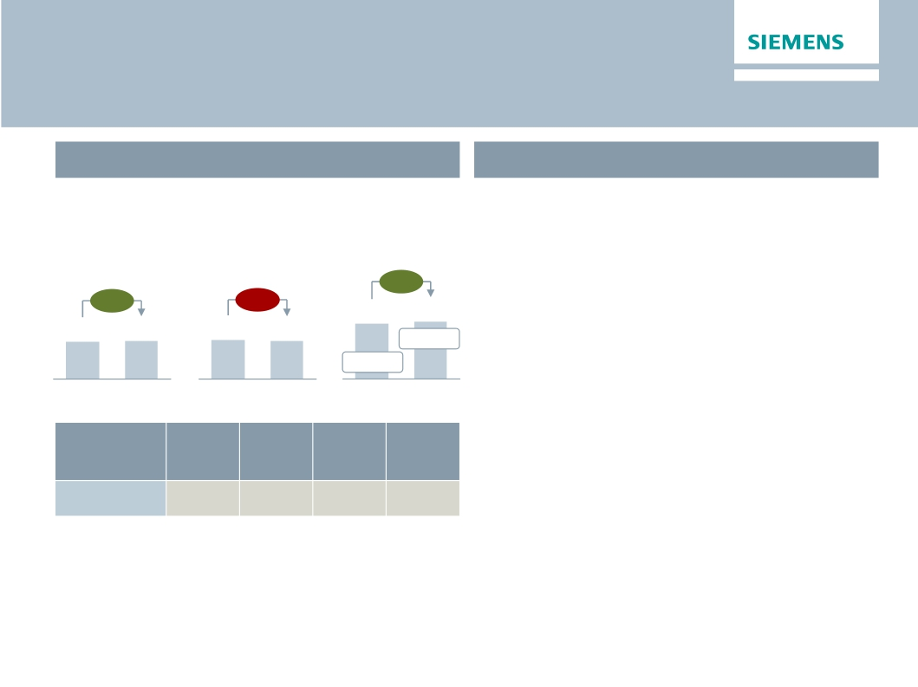
Healthcare
Solid execution of ‘Agenda 2013'
Key Figures Healthcare
Main developments in Q2
€bn
Orders 1)
+4%
3.2
€m
Profit
+5%
445
424
13.6% 2)
12.6% 2)
· Order growth driven by strength in Emerging
markets, especially in China
· Modest revenue decline mainly due to revenue
delays into H2
· Improved profit margin despite negative impact
from medical device tax (-30 bps)
Revenue 1)
-1%
3.4
3.3
3.3
Q2 12
Q2 13
Q2 12
Q2 13
Q2 12
Q2 13
· Diagnostics – Revenue growth in emerging
Underl.
profit
margin
13.9%
markets compensates weaknesses in advanced
markets
· €13m transformation charges 'Siemens 2014'
Division
Diagnostics
Orders
y-o y 1)
0%
Revenue
y-o y 1)
0%
Profit
margin
8.7%
1) Comparable, i.e. adjusted for currency translation and portfolio effects
Restricted © Siemens AG 2013. All rights reserved.
2) Underlying margin: Q2 12: 15.0%, Q2 13: 15.3%, for underlying margin
calculation please refer to Flashlight document
Page 6
London, May 2, 2013
Q2 FY 2013, Analyst Conference

Slide 7
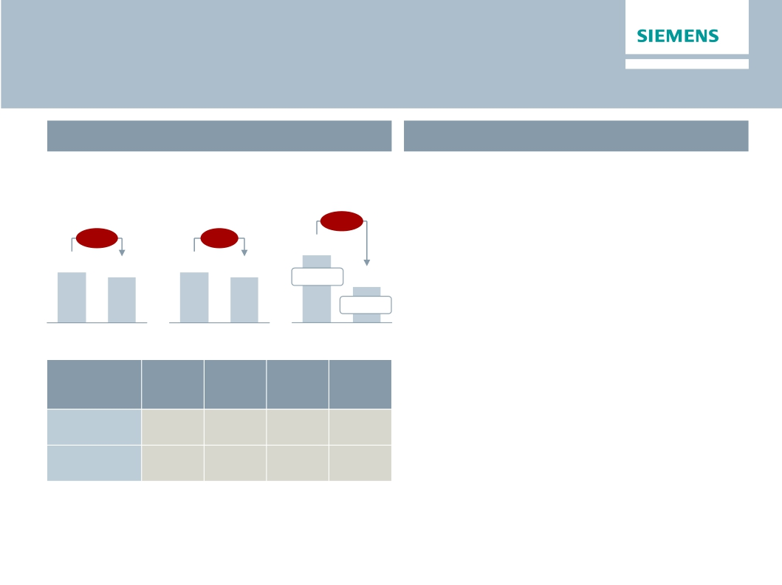
Industry
Weak markets & unfavourable product mix affect margins
Key Figures Industry
€m
Main developments in Q2
· Business volumes in short-cycle businesses
€bn
Orders 1)
Revenue 1)
Profit
affected by more challenging market
-47%
environment (in particular China and Germany)
-11%
-9%
662
13.1% 2)
· Industry Automation – Earnings performance
significantly impacted by volume decline and
significantly less favourable mix from solution
business
5.1
4.6
5.1
4.6
350
7.6% 2)
Q2 12
Q2 13
Q2 12
Q2 13
Q2 12
Q2 13
· Drive Technologies – Weaker market
Orders
y-o y 1)
-9%
-11%
Revenue
y-o y 1)
-7%
-9%
Profit
margin
9.2%
6.7%
Underl.
profit
margin
12.1%
7.1%
conditions impact profit from short-cycle
businesses and renewable offerings
· Metals business severely affected by slow
steel industry volume
· €49m transformation charges 'Siemens 2014'
Division
Industry
Automation
Drive
Technologies
1) Comparable, i.e. adjusted for currency translation and portfolio effects
Restricted © Siemens AG 2013. All rights reserved.
2) Underlying margin: Q2 12: 13.9%, Q2 13: 10.2%, for underlying margin
calculation please refer to Flashlight document
Page 7
London, May 2, 2013
Q2 FY 2013, Analyst Conference

Slide 8
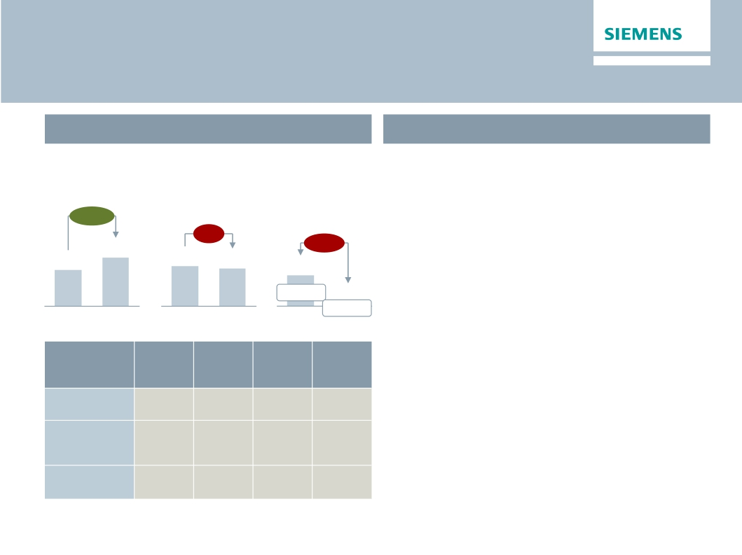
Infrastructure & Cities
Charges for high speed trains severely impact profitability
Key Figures Infrastructure & Cities
€m
Main developments in Q2
· Order intake – Substantial increase driven by
€bn
Orders 1)
+34%
Revenue 1)
Profit
two major rail orders in Europe
· Transportation & Logistics – €161m charges
-4%
-90%
270
6.4% 2)
27
0.7% 2)
primarily related to high-speed trains
· Invensys Rail acquisition passed regulatory
hurdles (close expected on May 2nd, 2013)
5.2
4.3
4.1
3.9
Q2 12
Q2 13
Q2 12
Q2 13
Q2 12
Q2 13
· Power Grid Solutions & Products – higher
Orders
y-o y 1)
148%
-5%
0%
Revenue
y-o y 1)
-6%
0%
-5%
Profit
margin
-11.9%
6.8%
4.3%
Underl.
profit
margin
0.4%
6.8%
4.3%
earnings in Smart Grid solutions compensate for
seasonally weaker development in LMV
· €23m transformation charges 'Siemens 2014'
Division
Transportation
& Logistics
Power Grid
Solutions
& Products
Building
Technologies
1) Comparable, i.e. adjusted for currency translation and portfolio effects
Restricted © Siemens AG 2013. All rights reserved.
2) Underlying margin: Q2 12: 6.4%, Q2 13: 5.2%, for underlying margin
calculation please refer to Flashlight document
Page 8
London, May 2, 2013
Q2 FY 2013, Analyst Conference

Slide 9
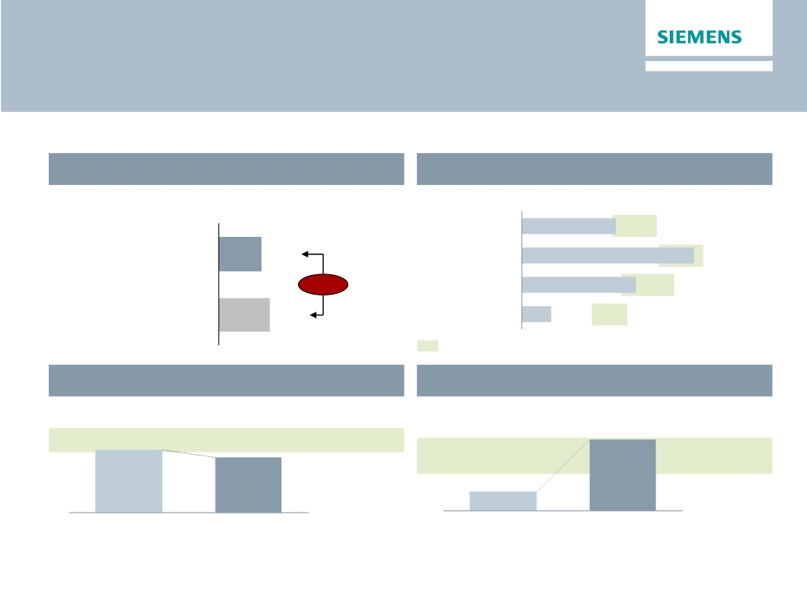
One Siemens cockpit – H1 FY 2013
Deterioration of KPI’s call for solid 'Siemens 2014' execution
Financial target system
Growth1)
Revenue growth (rolling 4 quarters Q2 FY 13)
Margins compared to industry benchmarks
EBITDA Margins (H1 FY 2013)
Energy
10.5%
10-15%
Siemens
2.7%
Healthcare
19.3%
15-20%
-0.5%
Industry
12.8%
11-17%
Competitors
3.2%
Infrastr. & Cities
3.3%
8-12%
EBITDA margins of respective markets throughout business cycles
Capital structure
Adjusted industrial net debt/EBITDA
Capital efficiency
ROCE adjusted (continuing operations)
15.7%
15-20%
1.0x
13.9%
0.5-1.0x
0.3x
Q2 FY 12
H1 FY 12
1) As reported
H1 FY 13
Q2 FY 13
Restricted © Siemens AG 2013. All rights reserved.
Page 9
London, May 2, 2013
Q2 FY 2013, Analyst Conference

Slide 10
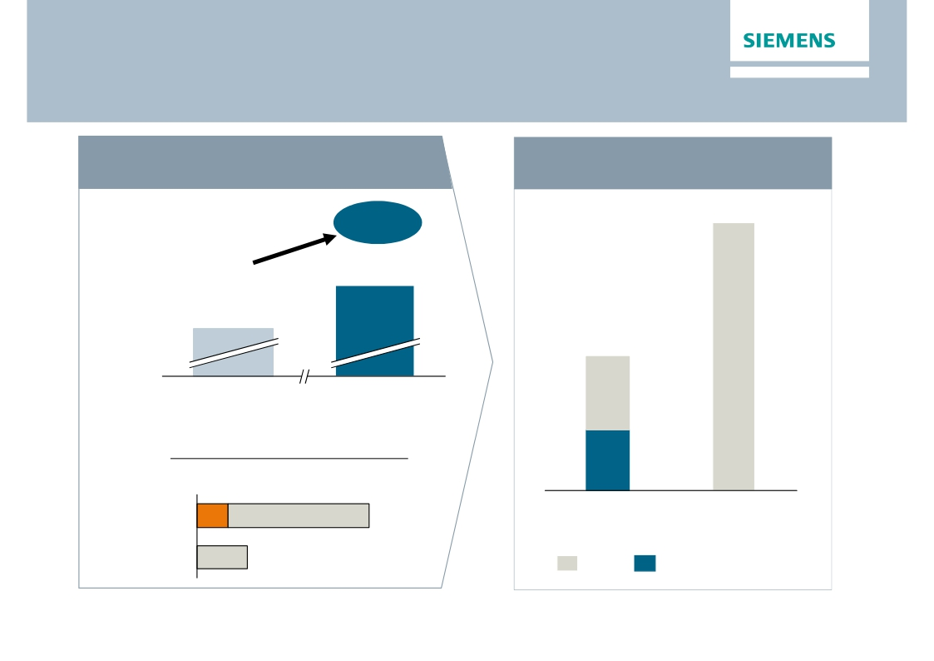
Full commitment to deliver on 'Siemens 2014'
throughout the organisation
Target 'Siemens 2014' confirmed
H1 FY 2013 Productivity Ramp Up
Total Sector
Profit Margin1)
≥ 12%
€bn
~4.0
9.2%
7,284
Total Sector
Profit1)
€m
~2.0
FY 2012
Target FY 2014
Transformation Cost (in €m)2)
H1 FY 2013
~45%
FY 2013e
152
up to 900
FY 2013e
FY 2014e
FY 2014e
1) Incl. Solar 2) w/o Solar
up to 300
Target
Effective in P&L
Restricted © Siemens AG 2013. All rights reserved.
Page 10
London, May 2, 2013
Q2 FY 2013, Analyst Conference

Slide 11
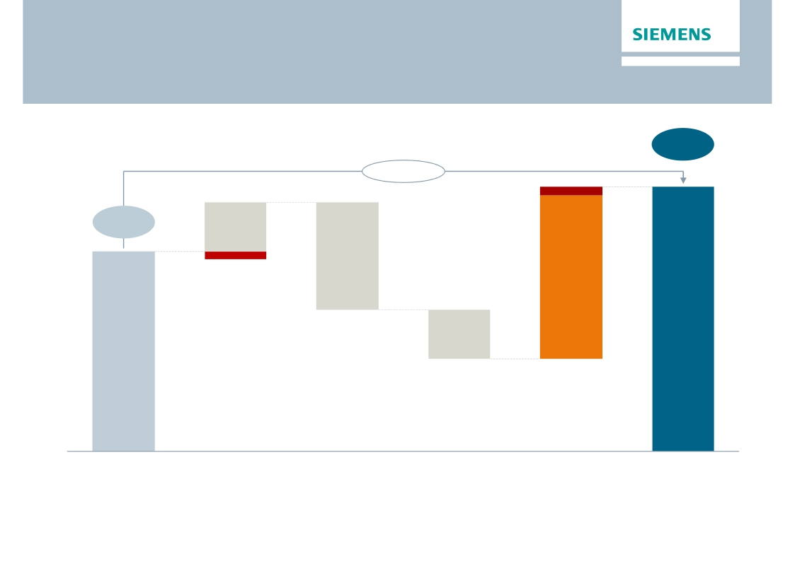
Incremental savings of ~€300m targeted to compensate for
adverse effect from more conservative growth expectation
Total Sector Profit Margin (% revenue)
≥ 12.0%
+280bps
9.2%1)
Profit
2012
1) Incl. reclassification Solar
Modest
growth
Volume/
Degression
2.5 - 3%
p.a.
pricing
pressure
Price
Erosion
Cost
Inflation
Gross
Productivity
Profit Target
2014
Restricted © Siemens AG 2013. All rights reserved.
Page 11
London, May 2, 2013
Q2 FY 2013, Analyst Conference

Slide 12
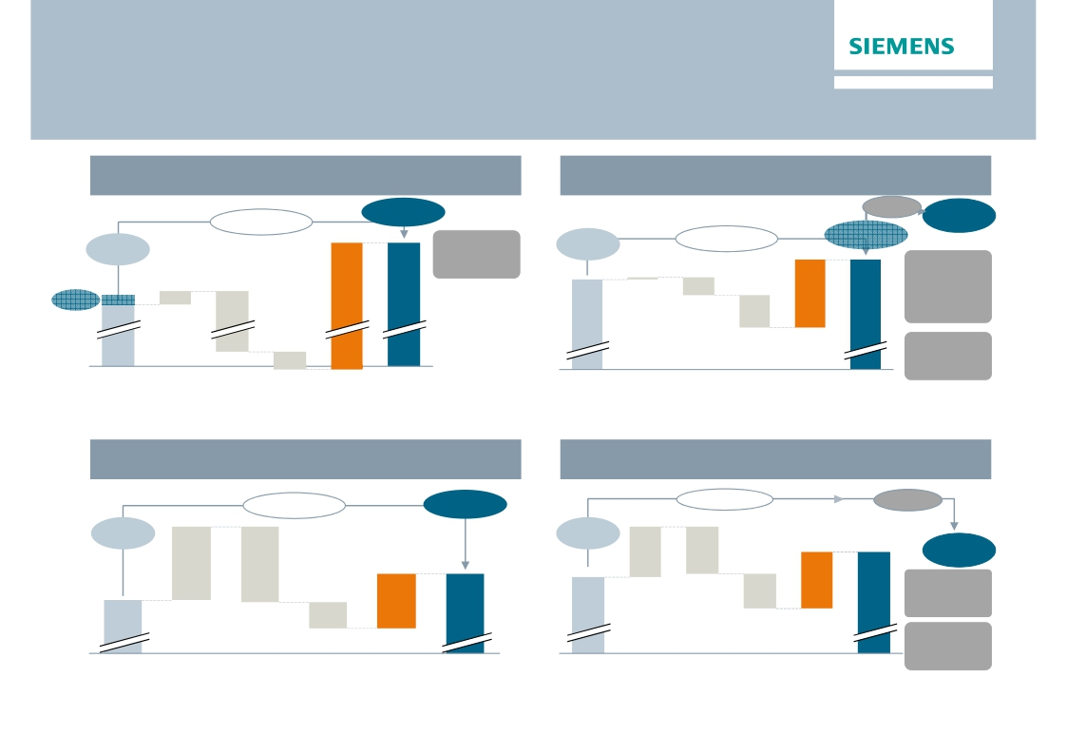
Assumptions and goals for 'Siemens 2014’ are
aligned and cascaded down into the Sectors
Sector Energy
Sector Industry
€bn
6.9%1)
7.8%2)
≥ 12.0%
€bn
12.0%
~50 bps
+510 bps
3 – 3.5% p. a.
≥ 14.0%
≥ 13.5%
Exit Water
Techno-
logies
Integrate
LMS
+150 bps
< 1% p. a.
3.3
Exit Solar
1.1
Profit
2012
Volume/
Degression
Price
Erosion
Cost
Inflation
Productivity
Profit
Target
Profit
2012
Volume/
Degression
Price
Erosion
Cost
Inflation
Productivity
Profit
Target
1) Incl. Solar 2) w/o Solar
Sector Healthcare
2014
2014
Sector Infrastructure & Cities
€bn
13.3%
€bn
6.3%
+160 bps
~ 40 bps
+170 bps
≥ 15.0%
~-40 bps
≥ 7.5%
0.8
0.8
Integrate
Invensys
Exit
3.5 – 4% p. a.
< 2% p. a.
Baggage &
Profit
2012
Volume/
Degression
Price
Erosion
Cost
Inflation
Productivity
Profit
Target
Profit
2012
Volume/
Degression
Price
Erosion
Cost
Inflation
Productivity
Profit
Target
Postal
Restricted © Siemens AG 2013. All rights reserved.
Page 12
London, May 2, 2013
2014
2014
Q2 FY 2013, Analyst Conference

Slide 13
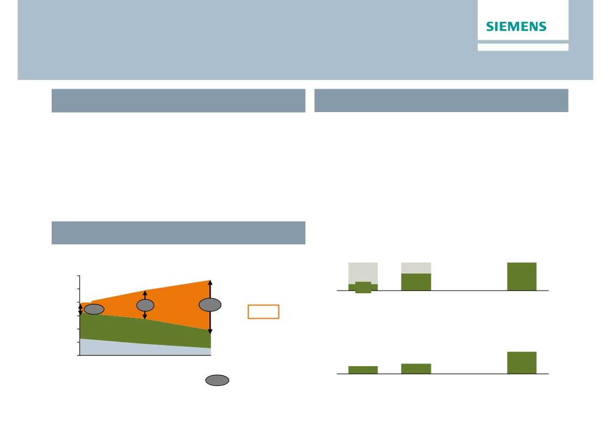
OSRAM
Listing & transformation program well under way
> 8% EBITA margin target from 2015 onwards
Spin-off process
AGM Approval by >98%
Capital Market Day OSRAM
Management Roadshow
OSRAM Listing
Transformation program PUSH on track
· Gross savings of ~€1bn over three years
(FY 13 – FY 15)
· Headcount reduction of 8,000 FTE until FY 14
· Total transformation costs in mid triple-digit €m
range (FY 12 – FY 14)
· Jan 23:
· May 17:
· End of June:
· Early July:
Lighting – a growth market in transition
Cumulative headcount reduction in '000 FTEs
Global lighting market
in €bn
120
100
CAGR
2011 - 2020
4%
> 60%
executed
to date
113
~5.0
8.0
99
1.9
80
60
79
18%
SSL1)
66%
FY 12
Today
FY 14
Target
45%
20%
40 Green2)
Basic2)
0
2011
Reduction of manufacturing footprint
# of sites
5
20
(4)%
(9)%
11
4
2016
2020
1) LED/IR/OLED/Laser-based products
2) Lamps & components only
xx%
SSL penetration rate
FY 12
Today
FY 14
Source: OSRAM estimates based on McKinsey Market Report 2012, OSRAM data
Restricted © Siemens AG 2013. All rights reserved.
Target
Page 13
London, May 2, 2013
Q2 FY 2013, Analyst Conference

Slide 14
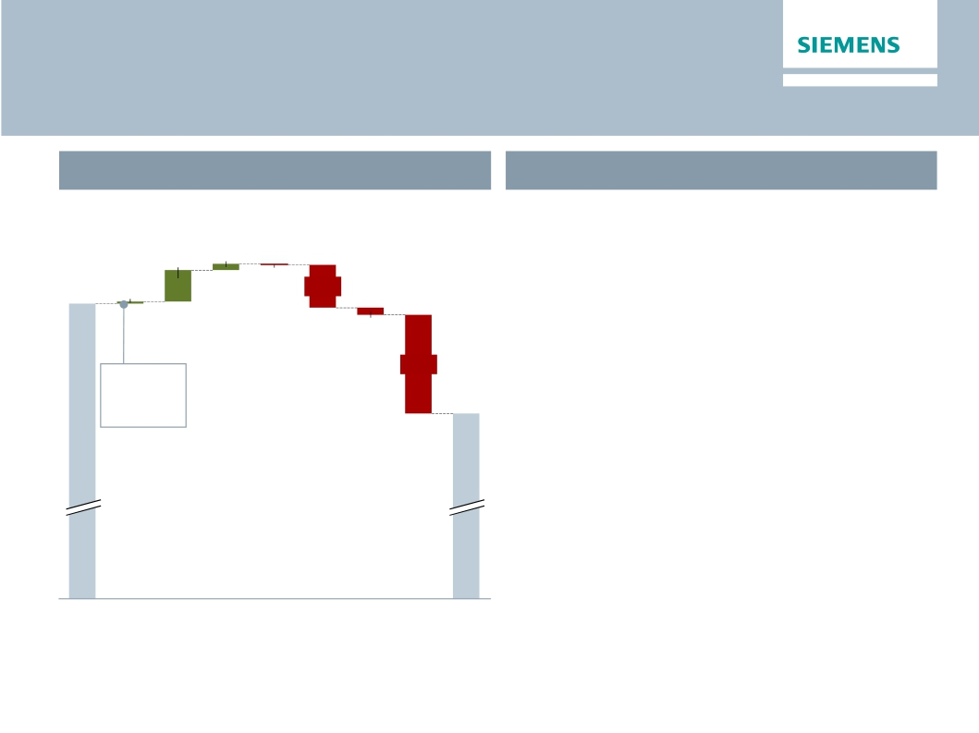
Significant swing in Equity Investments (NSN) boost
'below-the-line' performance
Q2 FY 2013 'Below Total Sectors'
What to expect for H2 FY13
€m
· Equity Investments
· Operational progress in NSN continues, but
113
21
1,374
8
-2
-153
results expected to remain volatile in coming
quarters
-25
· Further transformation charges expected in
-354
H2 FY 13
Therein:
-62m NSN
982
· SFS & CMPA in line with previous quarters
· SRE dependant on disposal gains
· Corporate Items & Pensions
· Run rate of approx. -€250m per quarter
· H2 typically higher than H1
· Corp. Treasury run rate of approx. -€50m per
quarter
Total
Sectors
Equity
Inv.
SFS
CMPA
SRE
Corp.
Items
Corp.
Treasury,
Tax
Income
cont.
Profit
& Pen.
other
Ops
Restricted © Siemens AG 2013. All rights reserved.
Page 14
London, May 2, 2013
Q2 FY 2013, Analyst Conference

Slide 15
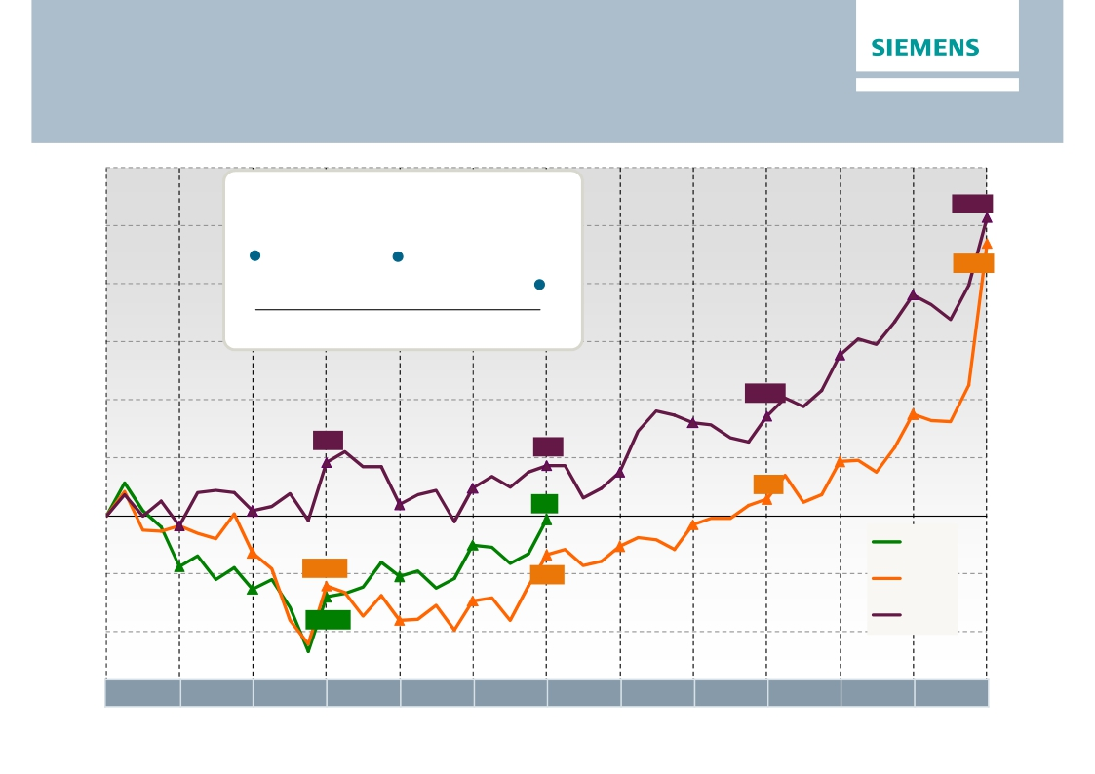
Free Cash Flow
Decent performance in Q2 after a weak start in Q1
€m
Operating Working Capital (OWC) turns
Total Sector
9.0
8.9
7.1
FY 2011
FY 2012
Q2 FY 2013
5,150
4,700
1,727
928
866
291
-61
FY 2013
FY 2012
FY 2011
-1,204
-1,395
-676
Oct
Nov
Dec
Jan
Feb
Mar
Apr
May
Jun
Jul
Aug
Sep
Restricted © Siemens AG 2013. All rights reserved.
Page 15
London, May 2, 2013
Q2 FY 2013, Analyst Conference

Slide 16
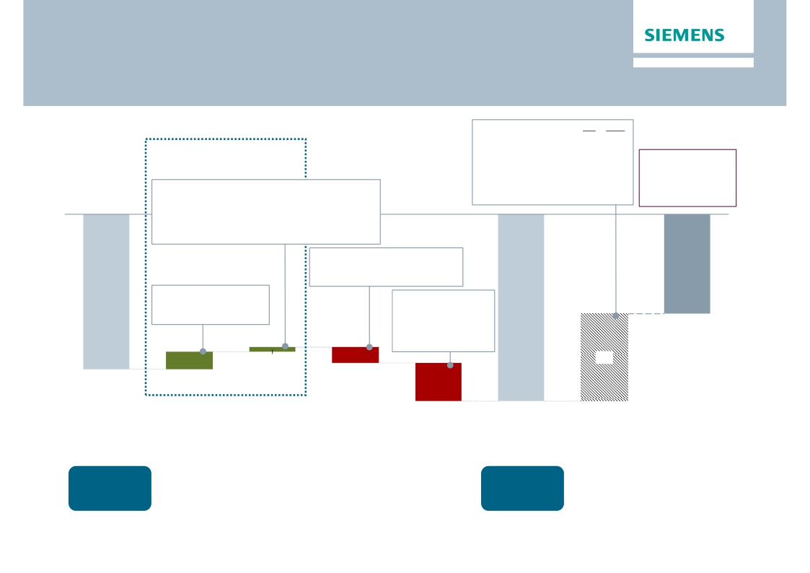
Net debt increase in Q2 mostly due to dividend and
LMS payment
€bn
Q2
∆Q1
Operating Activities
· SFS Debt
· Pensions
· Credit guarantees
· Hybrid adjustments
+14.9
-9.9
-0.6
+0.9
+0.4
-0.0
-0.3
-0.0
Adj. ind. Net Debt/
EBITDA
therein:
· Fair value adjustm. +1.5
-0.1
1.0x
· ∆ Inventories net of advanced payments
· ∆ Trade and other receivables
· ∆ Trade payables
· ∆ Billings in excess
-0.1
+0.7
+0.2
-0.5
(hedge accounting)
(Q1 FY 13: 0.6x)
therein:
· CAPEX
· Acquisition (LMS)
-0.4
-0.7
therein:
· Net Income
· D&A
therein:
· Dividends paid -2.5
· FX effects -0.1
· Purchase of
common stock -0.1
+1.0
+0.7
-7.7
1.3
0.4
1.3
6.8
-12.0
3.0
-14.5
Net Debt
Q2 2013
Cash &
cash equiv.
€8.4bn
Net Debt
Q1 2013
Cash &
cash equiv.
€8.3bn
Profitability/
∆ other
operating
activities
∆ Working
Capital1)
Net cash from
investing
activities
Financing
topics
Net Debt adj.
Adj. ind.
Net Debt
Q2 2013
1) Includes net cash used in inventories less advanced payments received, net cash provided by trade and other receivables, net cash provided by trade payables and
Restricted © Siemens AG 2013. All rights reserved.
net cash used in billings in excess of cost and in estimated earnings on uncompleted contracts and related advances (included in the consolidated statements of cash
flow in change in other assets and liabilities)
Page 16
London, May 2, 2013
Q2 FY 2013, Analyst Conference

Slide 17
Outlook
· In fiscal 2013, Siemens is implementing 'Siemens 2014', a company-wide program supporting our
One Siemens framework for sustainable value creation.
· The goal of the program is to raise our Total Sectors profit margin to at least 12% by fiscal 2014.
· For fiscal 2013, we confirm our expectations of moderate organic order growth.
· With continuing challenges for our businesses whose results react strongly to short-term changes in
the economic environment, we now anticipate a moderate decline in revenue on an organic basis
compared to the prior year.
· Charges associated with the 'Siemens 2014' program in the Sectors are expected to total up to €0.9
billion for the full fiscal year.
· Given these developments and financial results for the first half, we expect income from continuing
operations in fiscal 2013 to approach the low end of our original expectation, €4.5 billion, before
impacts related to legal and regulatory matters and significant portfolio effects which we expect
to burden income by up to €0.5 billion due primarily to the solar business.
Restricted © Siemens AG 2013. All rights reserved.
Page 17
London, May 2, 2013
Q2 FY 2013, Analyst Conference

Slide 18
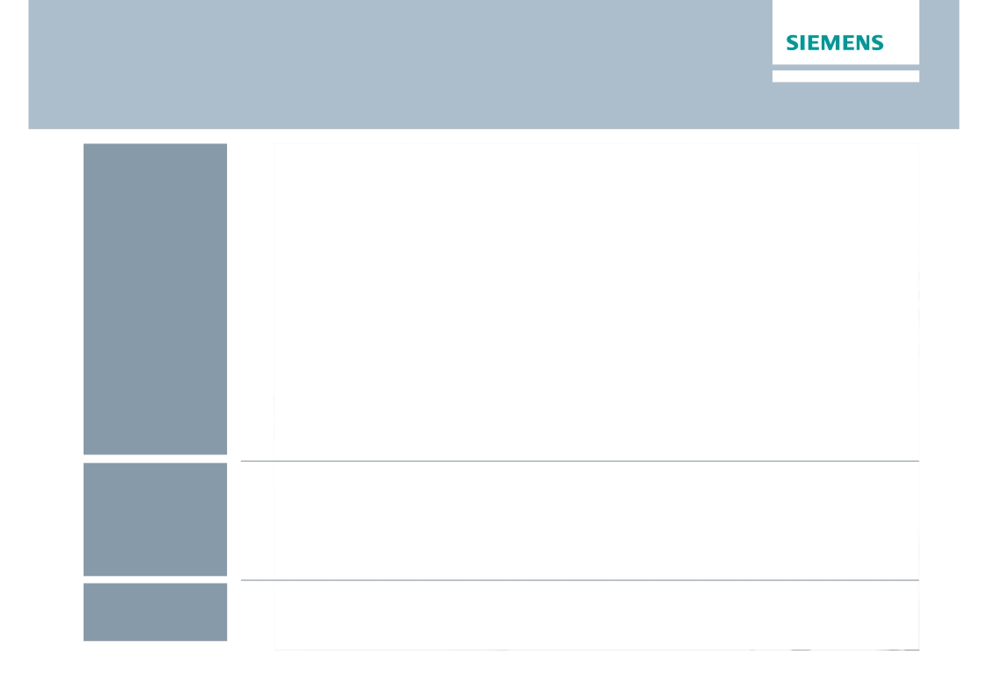
Financial calendar
May
June
July
May 2, 2013
Q2 Earnings Release / Analyst Conference
May 3, 2013
Q2 Roadshow Germany (Frankfurt)
May 15, 2013
Q2 Roadshow US (Boston, New York)
May 17, 2013
Capital Market Day Osram (Munich)
May 27 – 30, 2013
Asia Roadshow, Morgan Stanley China Conference (Beijing)
June 13, 2013
JP Morgan Conference (London)
June 14, 2013
Exane Conference (Paris)
July 2013
Listing Osram
Restricted © Siemens AG 2013. All rights reserved.
Page 18
London, May 2, 2013
Q2 FY 2013, Analyst Conference

Slide 19

Siemens Investor Relations contact data
Mariel von Drathen +49-89-636-33780
Munich Office
Fax:
Internet:
+49-89-636-32474
+49-89-636-32830
http://www.siemens.com/investorrelations
Email: investorrelations@siemens.com
Restricted © Siemens AG 2013. All rights reserved.
Page 19
London, May 2, 2013
Q2 FY 2013, Analyst Conference

Slide 20
Reconciliation and Definitions for
Non-GAAP Measures
This document includes supplemental financial measures that are or may be non-GAAP financial measures.
Orders and order backlog; adjusted or organic growth rates of revenue and orders; book-to-bill ratio; Total Sectors profit; return on equity (after tax), or ROE (after
tax); return on capital employed (adjusted), or ROCE (adjusted); Free cash flow, or FCF; cash conversion rate, or CCR; adjusted EBITDA; adjusted EBIT; adjusted
EBITDA margins, earnings effects from purchase price allocation, or PPA effects; net debt and adjusted industrial net debt are or may be such non-GAAP financial
measures.
These supplemental financial measures should not be viewed in isolation as alternatives to measures of Siemens’ financial condition, results of operations or cash
flows as presented in accordance with IFRS in its Consolidated Financial Statements. Other companies that report or describe similarly titled financial measures
may calculate them differently.
Definitions of these supplemental financial measures, a discussion of the most directly comparable IFRS financial measures, information regarding the usefulness
of Siemens’ supplemental financial measures, the limitations associated with these measures and reconciliations to the most comparable IFRS financial measures
are available on Siemens’ Investor Relations website at www.siemens.com/nonGAAP. For additional information, see supplemental financial measures and the
related discussion in Siemens’ most recent annual report on Form 20-F, which can be found on our Investor Relations website or via the EDGAR system on the
website of the United States Securities and Exchange Commission. Revenue growth - Performance against competition
Revenue growth - Performance against competition
To illustrate management’s perspective on the Company’s performance against competition, Siemens compares its own revenue growth rate with the weighted
average revenue growth rate of its Sectors’ most relevant competitors, including, among others, ABB, GE, Philips, Rockwell and Schneider. Revenue growth for
Siemens and its competitors is calculated as the actual growth rate over a rolling four quarter period compared to the same period a year earlier. Siemens
competitors revenue growth is derived as the weighted average growth rate of dedicated competitor baskets defined for each Siemens Sector. Each Sector
basket's growth rate is based upon the most recent reported competitor revenues publicly available at the time of calculation. The Sector competitor baskets
revenue growth rates are weighted by the revenue of the respective Siemens Sector.
This measure may provide useful information to investors with respect to management’s view on Siemens’ growth compared to competitor growth. However, we
caution investors, that this measure is subject to certain limitations, which include the following: The metric is defined by Siemens and, as such, is not based on a
generally accepted framework that is also relevant for other companies; accordingly, other companies may define a similarly titled measure differently. In
calculating this measure, Siemens relies on data published by its competitors for which Siemens assumes no responsibility. In addition, the data may not be
directly comparable as a result of differing presentation currencies and reporting standards being used by our competitors in the data’s presentation. Furthermore,
subject to limited exceptions, no adjustments are made for currency translation effects, portfolio changes and changes in reporting structure for either the Siemens
or the competitor data. Because the public availability of relevant competitors’ data at the time of calculation may not coincide with the availability of Siemens’ data,
some competitor data used may relate to a different time period than the Siemens data.
Restricted © Siemens AG 2013. All rights reserved.
Page 20
London, May 2, 2013
Q2 FY 2013, Analyst Conference

