Slide 1

Joe Kaeser, President and CEO
Ralf P. Thomas, CFO
Lisa Davis, Member of the Managing Board
Fiscal Year guidance achieved
Execution of Vision 2020 begun
Q4 FY 2014, Analyst Call
Berlin, November 6, 2014
© Siemens AG 2014. All rights reserved.

Slide 2
Notes and Forward Looking Statement
This document contains statements related to our future business and financial performance and future events or developments involving Siemens that may
constitute forward-looking statements. These statements may be identified by words such as “expect,” “look forward to,” “anticipate” “intend,” “plan,” “believe,”
“seek,” “estimate,” “will,” “project” or words of similar meaning. We may also make forward-looking statements in other reports, in presentations, in material
delivered to shareholders and in press releases. In addition, our representatives may from time to time make oral forward-looking statements. Such statements
are based on the current expectations and certain assumptions of Siemens’ management, of which many are beyond Siemens’ control. These are subject to a
number of risks, uncertainties and factors, including, but not limited to those described in disclosures, in particular in the chapter Risks in the Annual Report.
Should one or more of these risks or uncertainties materialize, or should underlying expectations not occur or assumptions prove incorrect, actual results,
performance or achievements of Siemens may (negatively or positively) vary materially from those described explicitly or implicitly in the relevant forward-looking
statement. Siemens neither intends, nor assumes any obligation, to update or revise these forward-looking statements in light of developments which differ from
those anticipated.
This document includes – in IFRS not clearly defined – supplemental financial measures that are or may be non-GAAP financial measures. These supplemental
financial measures should not be viewed in isolation or as alternatives to measures of Siemens’ net assets and financial positions or results of operations as
presented in accordance with IFRS in its Consolidated Financial Statements. Other companies that report or describe similarly titled financial measures may
calculate them differently.
All underlying margins are calculated by adjusting margins for the effects reported for the respective businesses in the relevant period. These effects are provided
to assist in the analysis of the businesses' results year-over-year and may vary from period to period. Underlying margins are not necessarily indicative of future
performance. Other companies may calculate similar measures differently.
Due to rounding, numbers presented throughout this and other documents may not add up precisely to the totals provided and percentages may not precisely
reflect the absolute figures.
Revenue growth - Performance against competition (FY2014)
To illustrate management’s perspective on the Company’s performance against competition, Siemens compares its own revenue growth rate with the weighted
average revenue growth rate of its Sectors’ most relevant competitors, including, among others, ABB, GE, Philips, Rockwell and Schneider. Revenue growth for
Siemens and its competitors is calculated as the actual growth rate over a rolling four quarter period compared to the same period a year earlier. Siemens
competitors revenue growth is derived as the weighted average growth rate of dedicated competitor baskets defined for each Siemens Sector. Each Sector
basket's growth rate is based upon the most recent reported competitor revenues publicly available at the time of calculation. The Sector competitor baskets
revenue growth rates are weighted by the revenue of the respective Siemens Sector.
This measure may provide useful information to investors with respect to management’s view on Siemens growth compared to competitor growth. However, we
caution investors, that this measure is subject to certain limitations, which include the following: The metric is defined by Siemens and, as such, is not based on a
generally accepted framework that is also relevant for other companies; accordingly, other companies may define a similarly titled measure differently. In
calculating this measure, Siemens relies on data published by its competitors for which Siemens assumes no responsibility. In addition, the data may not be
directly comparable as a result of differing presentation currencies and reporting standards being used by our competitors in the data’s presentation. Furthermore,
subject to limited exceptions, no adjustments are made for currency translation effects, portfolio changes and changes in reporting structure for either the Siemens
or the competitor data. Because the public availability of relevant competitors’ data at the time of calculation may not coincide with the availability of Siemens’
data, some competitor data used may relate to a different time period than the Siemens data.
© Siemens AG 2014. All rights reserved.
y g
Page 2
November 6, 2014
Q4 FY 2014, Analyst Call

Slide 3
Our agenda for today
Delivering on targets – key financials Q4 Fiscal 2014
Driving value for shareholders
Execution of “Siemens – Vision 2020” started
Setting clear priorities to achieve targets in Fiscal 2015 and beyond
© Siemens AG 2014. All rights reserved.
Vi i
2020” t
t d
Page 3
November 6, 2014
Q4 FY 2014, Analyst Call

Slide 4
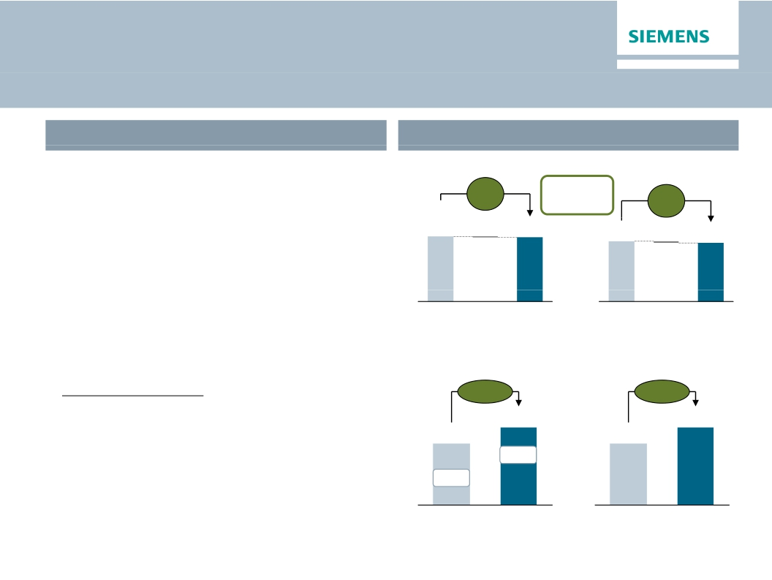
We delivered on our FY 2014 targets
FY 2014 Outlook
FY 2014 Actual Performance
✓✓· We expect revenue on an organic basis to
Orders (€bn)
comp.
+1%
-1.4 78.4
Revenue (€bn)
comp.
+1%
-1.573.4 71.9
Book-to-bill
1.09
remain level year-over-year, and orders to
exceed revenue for a book-to-bill ratio above 1.
· Given these developments and financial results
for the first nine months, we expect basic
79.8
earnings per share (Net Income) for fiscal
2014 to grow by at least 15% from €5.08 in
fiscal 2013.
· Annual Report 2013: We expect a substantial
✓✓
FY FY
2013 2014
Profit Total Sectors (€bn)
+26%
FY FY
2013 2014
Basic Earnings per Share (€)
+25%
increase in Total Sectors profit year-over-year,
and that Total Sectors profit margin will rise
to 9.5% to 10.5%.
This outlook is based on shares outstanding of 843 million as of
September 30, 2013. Furthermore it excludes impacts related to legal
and regulatory matters.
© Siemens AG 2014. All rights reserved.
7.3
10.0%
FY 2014
6.37
FY 2014
✓✓
5.8
7.9%
FY 2013
5.08
FY 2013
Page 4
November 6, 2014
Q4 FY 2014, Analyst Call

Slide 5
One Siemens cockpit – FY 2014
Capital efficiency back in target range
Financial target system
Growth1)
Margins compared to industry benchmarks
Revenue growth (rolling 4 quarters FY 14)
EBITDA Margins (FY 2014)
Energy
8.1%
10-15%
Siemens
-2.1%
Healthcare
20.5%
15-20%
-6.2Pp
Industry
16.4%
11-17%
Competitors basket
4.1%
Infrastr. & Cities
9.4%
8-12%
EBITDA margins of respective markets throughout business cycles
Capital structure
Adjusted industrial net debt/EBITDA
Capital efficiency
ROCE adjusted (continuing operations)
it l ffi i
it l t
17.2%
15-20%
13.7%
0.5-1 0x
0.3x
0.2x
FY 2014
FY 2013
1) As reported
FY 2014
FY 2013
© Siemens AG 2014. All rights reserved.
Page 5
November 6, 2014
Q4 FY 2014, Analyst Call

Slide 6
Large contract wins in the US Rail and European
Wind Power business lift orders
Orders
Q4 FY 14 y-o-y1)
Revenues
Europe/C.I.S./Africa/ME
+11%
-1%
(therein Germany)
+14%
+9%
Americas
-9%
+4%
(therein U.S.)
Asia/Australia
(therein China)
+3%
+2%
+1%
+8%
+5%
+7%
1) Change is adjusted for currency translation and portfolio effects
Key developments
Europe:
- Large offshore wind orders; Export industry drives Germany orders
- Slow recovery in low growth environment impacts revenues
Americas: - Transportation & Logistics in U.S. compensates for lower power orders
- Strong Power Generation and Wind, boost U.S. revs
Transportation & Logistics in U S compensates for lower power orders
Asia /
Australia:
- China shows strength in Infrastructure orders, increasing softness in Healthcare
- Strong Infrastructure revenues growth in Industry and Healthcare in China
Strong Infrastructure revenues, growth in Industry and Healthcare in China
© Siemens AG 2014. All rights reserved.
Page 6
November 6, 2014
Q4 FY 2014, Analyst Call

Slide 7
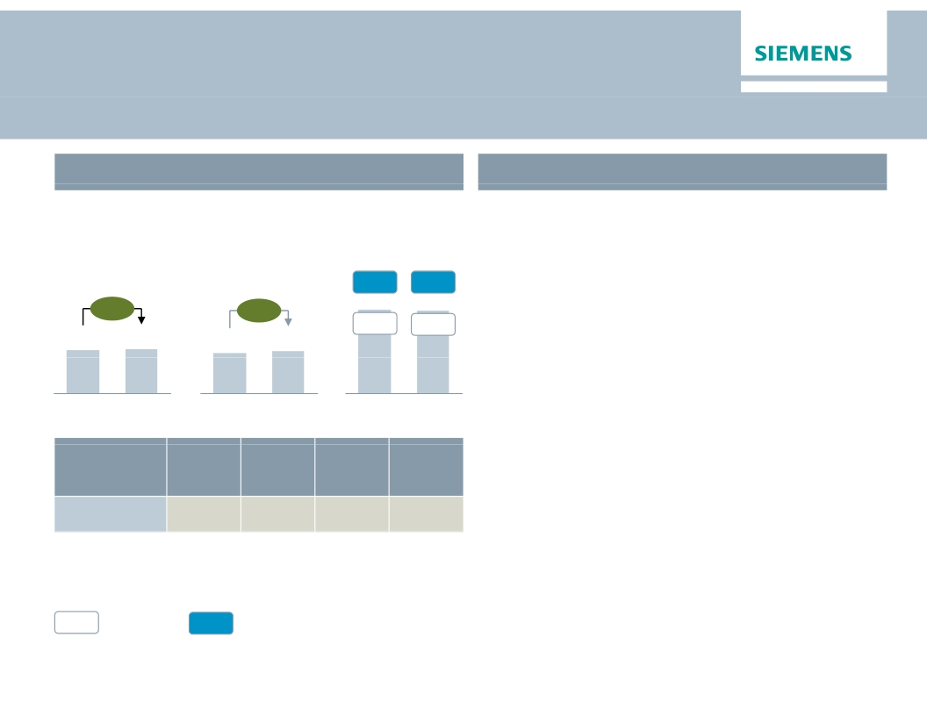
Healthcare – Strong profit contribution continues
Key Figures Healthcare
€bn
Main developments in Q4
· Order growth in Europe/CAME3) and Americas
€m
Orders 1)
Revenue 1)
Profit 2)
offset softness in China
· Slightly lower profit margin on tough
comparables and continued currency effect
· Diagnostics – Solid growth in China; on track
with platform development
· Hospital information system business in
20.2%
17.7%
616
18.2%
17.1%
611
+1%
+3%
3.7
3.8
3.5
3.6
Q4 13
Q4 14
Q4 13
Q4 14
Q4 13
Q4 14
discontinued operations as of Q4 FY 14
Orders
y-o-y 1)
2%
Revenue
y-o-y 1)
2%
Profit
margin
10.6%
Underl.l
profit
margin
14.5%
Division
Diagnostics
1) Comparable, i.e. adjusted for currency translation and portfolio effects
%
Profit margin
%
Underlying Profit margin
2) for underlying margin calculation please refer to Flashlight document
© Siemens AG 2014. All rights reserved.
3) Europe, Commonwealth of Independent States, Africa, Middle East
Page 7
November 6, 2014
Q4 FY 2014, Analyst Call

Slide 8
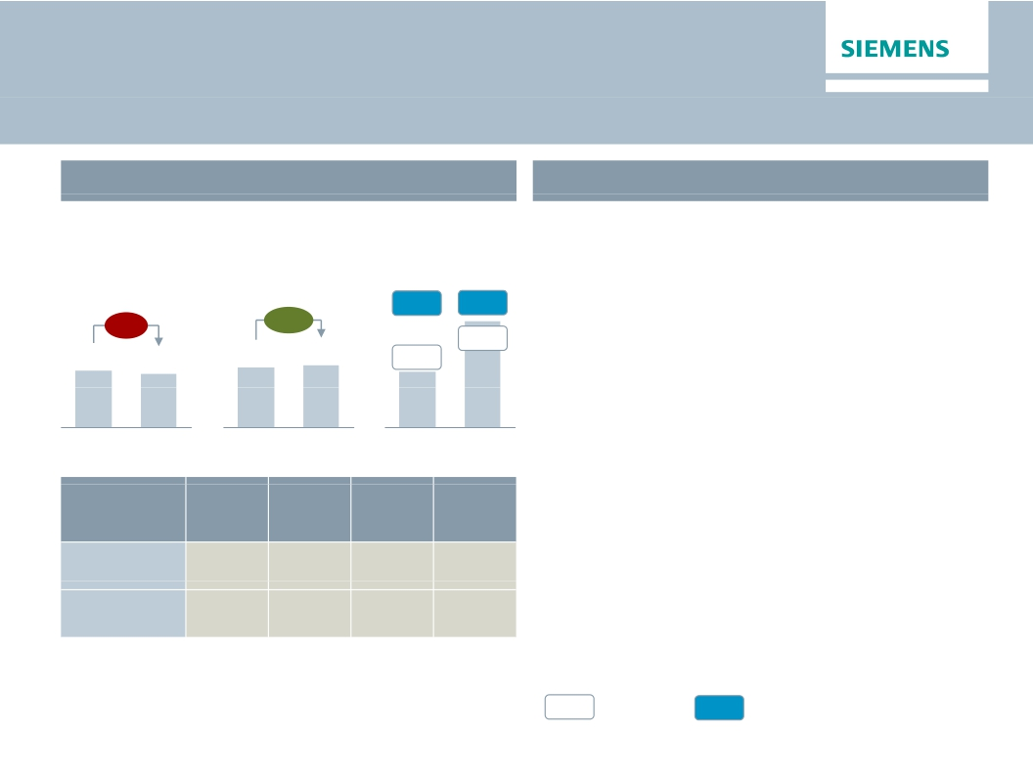
Industry – Better mix and effective growth conversion lift
earnings and margins
Key Figures Industry
€bn
Main developments in Q4
· Lower volume of large orders in long cycle
€m
Orders 1)
Revenue 1)
Profit 2)
business of Drive Technologies; broad based
revenue growth
+4%
13.7%
7.8%
365
15.1%
14.5%
698
· Industry Automation – Growth conversion
drives underlying profit margin
· Drive Technologies – Productivity and higher
margin Motion Control business boost profit
-5%
4.4
4.1
4.7
4.8
Q4 13
Q4 14
Q4 13
Q4 14
Q4 13
Q4 14
Orders
y-o-y 1)
2%
-9%
Revenue
y-o-y 1)
4%
4%
Profit
margin
18.1%
10.7%
Underl.l
profit
margin
18.9%
11.0%
Division
Industry
Automation
Drive
Technologies
1) Comparable, i.e. adjusted for currency translation and portfolio effects
%
Profit margin
%
Underlying Profit margin
© Siemens AG 2014. All rights reserved.
2) for underlying margin calculation please refer to Flashlight document
Page 8
November 6, 2014
Q4 FY 2014, Analyst Call

Slide 9
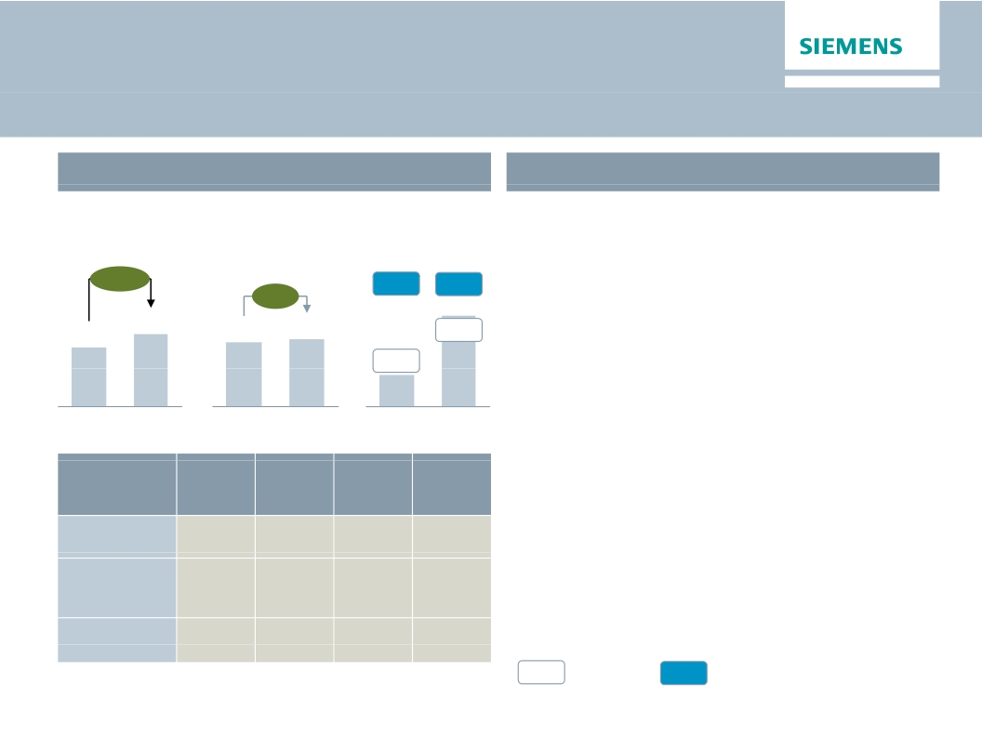
Infrastructure & Cities – Stringent execution drives
excellent profit development
Key Figures Infrastructure & Cities
Main developments in Q4
€bn
Orders 1)
+21%
€m
Profit 2)
9.0%
· Major orders in Transportation & Logistics
(U.S. and UK) drive bookings
· Transportation & Logistics – Profit rises onProfit rises on
higher revenues and stringent project execution
Revenue 1)
+4%
9.1%
4.8
5.9
5.2
5.4
8.9%
· Power Grid Solutions & Products – Higher
3.2%
167
Q4 13
482
Q4 14
productivity and revenue growth lift margins; Low
Voltage products with double-digit margin,
successful launch of new platform
· Building Technologies – Strong profit
Q4 13
Q4 14
Q4 13
Q4 14
Orders
y-o-y 1)
54%
-2%
2%
Revenue
y-o-y 1)
10%
4%
-3%
Profit
margin
4.9%
11.6%
12.4%
Underl.l
profit
margin
5.6%
11.6%
12.4%
performance on lower revenues due to phase
out of lower margin business
Division
Transportation
& Logistics
Power Grid
Solutions
& Products
Building
Technologies
1) Comparable, i.e. adjusted for currency translation and portfolio effects
%
Profit margin
%
Underlying Profit margin
© Siemens AG 2014. All rights reserved.
2) for underlying margin calculation please refer to Flashlight document
Page 9
November 6, 2014
Q4 FY 2014, Analyst Call

Slide 10
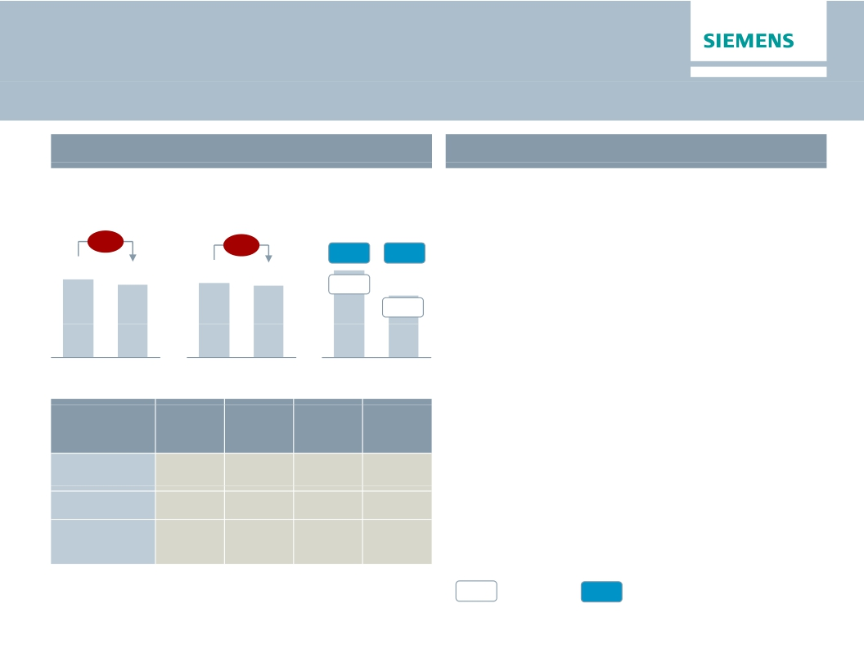
Energy – Pressure on growth and profit
Key Figures Energy
€bn
Main developments in Q4
· Market environment remains competitive in all
€m
Orders 1)
Revenue 1)
Profit 2)
areas
-5%
-2%
10.6%
7.6%
564
9.0%
5.7%
403
· Lower orders driven by a decline in the
Americas
· Power Generation – Strong profit contribution
from service business; challenges in increasingly
competitive large gas turbine markets
7.6
7.1
7.4
7.1
g y
Q4 13
Q4 14
Q4 13
Q4 14
Q4 13
Q4 14
· Wind – €223m charges due to main bearing and
blade erosion issues; €48m gain on equity
Orders
y-o-y 1)
-10%
17%
-14%
Revenue
y-o-y 1)
2%
0%
-11%
Profit
margin
13.0%
-4.0%
-4.3%
Underl.l
profit
margin
13.0%
6.7%
-0.1%
investment
· Transmission – Continuing execution of low
margin solution projects; project charges of
€41m; North Sea offshore grid connection
projects reach several milestones
Division
Power
Generation
Wind Power
Power
Transmission
1) Comparable, i.e. adjusted for currency translation and portfolio effects
%
Profit margin
%
Underlying Profit margin
© Siemens AG 2014. All rights reserved.
2) for underlying margin calculation please refer to Flashlight document
Page 10
November 6, 2014
Q4 FY 2014, Analyst Call

Slide 11
Power Generation: Ensuring competitiveness
Current market environment
Slow demand
Resultant overcapacity
for supply
Consolidation in market
Demand for increased
efficiencies
Greater customer choice
Service model a strong foundation
© Siemens AG 2014. All rights reserved.
Page 11
November 6, 2014
Siemens response
· Increase in R&D investment
· Shift focus to address key growth areas
· Improve time to market and time to
impact
· Use data analytics to increase service
value
· Move closer to the customer
· Broaden commercial offers
· Deeper focus on mega deals
· Leverage Dresser-Rand and Rolls-Royce
ADGT acquisitions
· Reduce current staffing levels
· Further optimize and create flexibility
in manufacturing footprint
· Strengthen operational capabilities
Q4 FY 2014, Analyst Call
Drive
Innovation
Change
Go-to-
Market
Take
Cost Out

Slide 12
Wind Power: Growth and operational excellence
Performance and challenges
· Clear #1 in Offshore – the
strongest growing segment
Current activities
· Focus on Engineering and SCM
processes to drive corrective and
· Cost-out focus driving to grid
parity in Onshore
· Continued positive view on
future wind marketi d k t
· Innovation leadership
· Q4 profit impacted by
provisions for bearing and
blade repairs
· Manufacturing process
inefficiencies result in
underlying profitability below
expectation
Engineering
Changes
& Repairs
Underlying
profitability
preventive actions
· Utilize growing service business to
learn from existing fleet
· Implemented Zero-Defect program to
ensure quality mindset
· Continue focus on Industrialization
and Cost Out
· Program underway to reduce LCoE1) of
Offshore to <10 €ct/kWh by 2020
· New product initiative with significantly
higher performing turbines in market in
2016
· Continue to grow installed base with
increasing share of long-term service
contracts
+
-
Implemented Zero Defect program to
1) LCoE – Levelized Cost of Electricity
© Siemens AG 2014. All rights reserved.
Page 12
November 6, 2014
Q4 FY 2014, Analyst Call

Slide 13
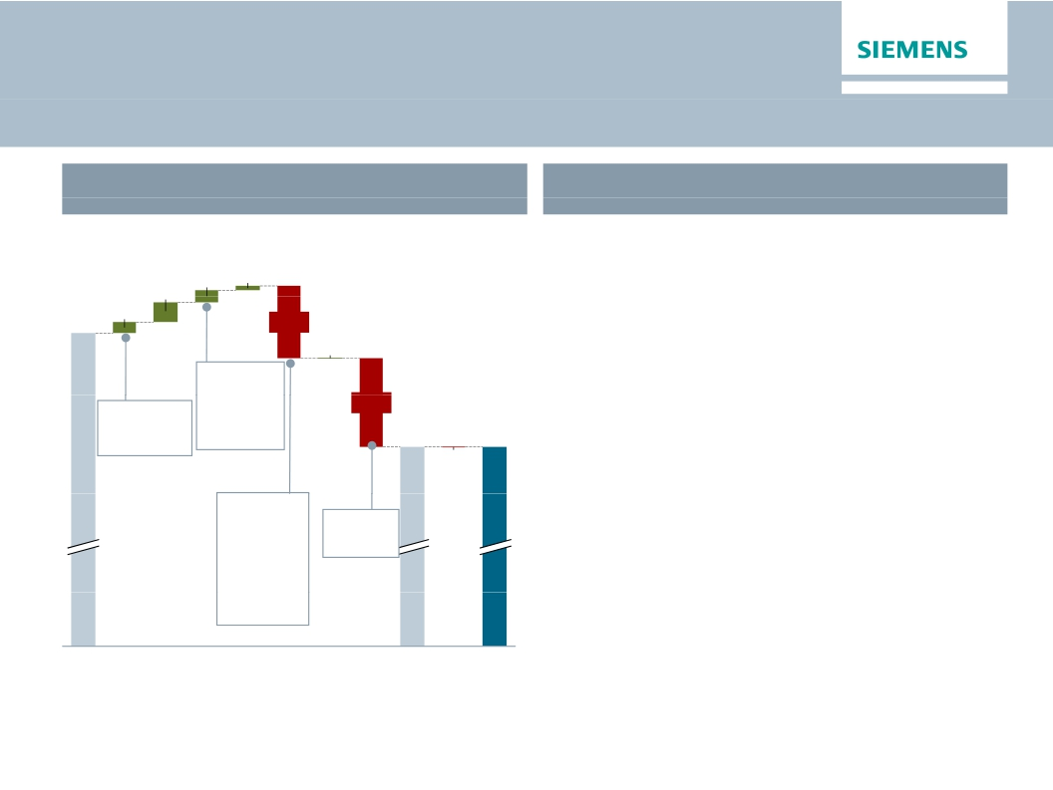
Below Total Sectors
Significant structural changes for FY 2015
Q4 FY 2014 'Below Total Sectors'
What to expect in FY 2015?
€m
Execution of Vision 2020 will have significant
26
positive influence on Net income due to portfolio
optimization; realization and quantification of
120
72
2,195
65
effects depend on negotiations
· SFS: In line with FY 2014
-440
4
· CMPA: Gain from divestment BSH; includes
other portfolio elements (e.g Unify, Osram
Metals, Postal & Baggage Handling as of FY
2015)
· SRE: Lower than PY; dependent on disposal
gains
· Corporate Items: ~€150m per quarter; H2 > H1;
volatility related to warrants, among others
· Pension: ~€125m per quarter
· PPA: In line with FY 2014 ~€500m
Therein:
MT
projects
Therein:
-€96m
Pensions
-€343m
Corp. Items
-539
Tax rate
@26%
Therein:
€61m BSH
1,503
1,498
-4
Pension: €125m per quarter
Total
Equity
SFS
CMPA
SRE
Corp.
Corp.
Tax
Inc.
Disc.
Net
· Disc. Ops: Includes results and gains from HC
Sectors
Inv.
Items
Tre.,
cont.
Ops.Income
IT, Audiology Metals
Profit
&
Pen.
other
Ops
all in
© Siemens AG 2014. All rights reserved.
Page 13
November 6, 2014
Q4 FY 2014, Analyst Call

Slide 14
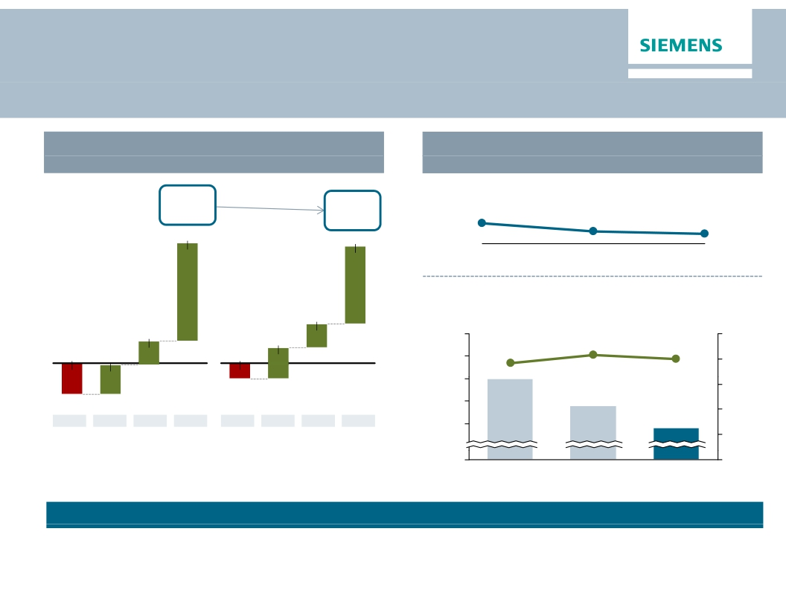
Free cash flow
Seasonal strong finish in Fiscal Q4
Free cash flow development ("all-in )
€m
Key drivers free cash flow
(Total Sectors)
Operating Working Capital turns Total Sector
5,328
4,336
5,201
3,450
9.0
FY 2012
7.6
FY 2013
7.2
FY 2014
Advance payments & BiE
p y
Orders in €bn
1,048
(in €bn
1,053
1,402
16
15
14
83.1
79.6
100
80
60
-1,395
1,335
-699
76.8
14.0
13
12
12.8
11.8
40
20
Q1
Q2
Q3
Q4
Q1
Q2
Q3
Q4
FY 2013
FY 2014
0
0
FY 2012
FY 2013
FY 2014
as reported
Focus on more consistent quarterly cash flow distribution remains
Focus on more even cash flow development over quarters remains
© Siemens AG 2014. All rights reserved.
o e e e cas
de e op e t o e qua te s e a s
Page 14
November 6, 2014
Q4 FY 2014, Analyst Call

Slide 15
Attractive shareholder return driven by stable
dividend policy
€
4,00
3,00
2,00
Payout ratio policy
Dividend per share
Dividend payout ratio3)
46%
48%
49%
60%
42%
57%
1,00
40%
€ 2.70
€ 3.00
€ 3.00
€ 3.00
€ 3.30
0,00
2010
2,356
2.9%
2011
2,629
3.9%
2012
2,528
3.6%
2013
2,533
3.0%
2014
2,7061)
3.5%
Dividend
paid in €m
Yield2)
1)
2)
3)
Shares outstanding assumption of 820m (at AGM 2015)
Calculation based on share price at AGM; for 2014 on closing share price of €94.37 on Sept 30, 2014
Net Income all-in adjusted for exceptional non-cash items: Impairments at DX (2010), Impairments at Solar and NSN Restructuring (2012)
Note: Net income as reported in each relevant year
© Siemens AG 2014. All rights reserved.
Page 15
November 6, 2014
Q4 FY 2014, Analyst Call

Slide 16
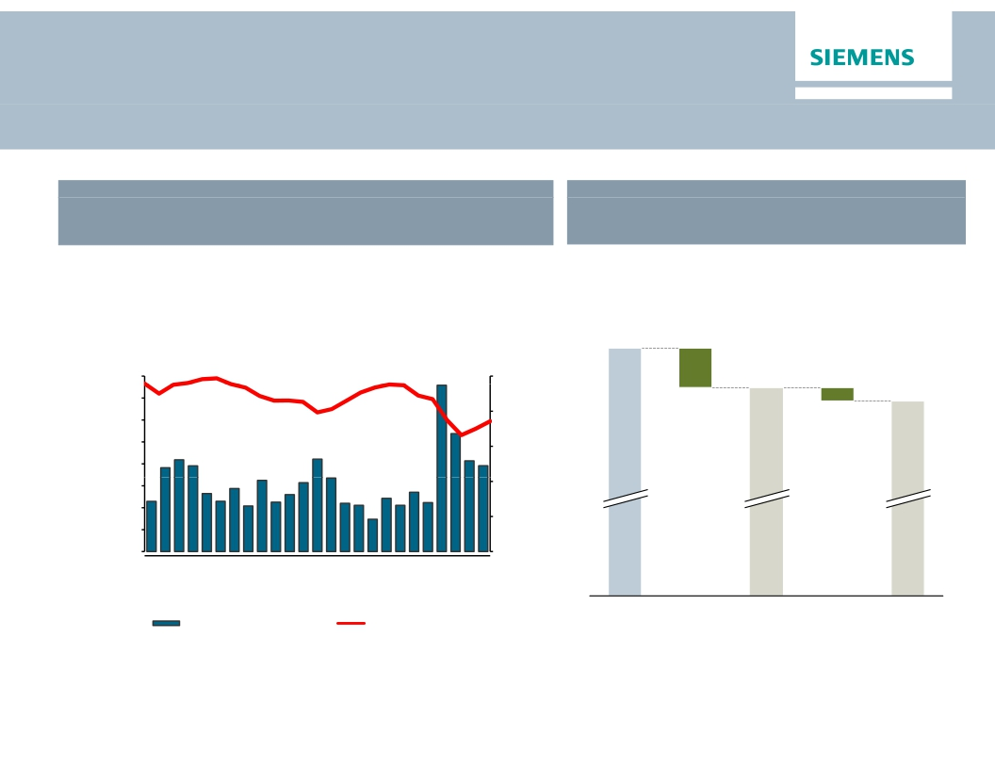
… and through consistent execution of share
buyback
Current status of share buyback
Share price and weekly repurchase volume May 12 – Oct 31, 2014
Average price: €92.71
Shares issued and shares outstanding
Number of shares in million (rounded)
38
881
1.600.000
1.400.000
1.200.000
1.000.000
800.000
600.000
400.000
200.000
0
100
90
80
70
60
50
843
12
Additional
Treasury
shares –
therein share
buyback
(16m as
of Oct 31)
831
Treasury shares
as of 30.09.13
Volume
Share Pric
V
ce (€)
6-
30
13
27
11
25
8-
22
5-
19
2-
17
31
-May-14
0-May-14
3-Jun-14
7-Jun-14
1-Jul-14
5-Jul-14
-Aug-14
2-Aug-14
-Sep-14
9-Sep-14
-Oct-14
7-Oct-14
1-Oct-14
Repurchased Volume
Avg. Price rounded
Shares issued
Shares outstanding
as of Sep 30, 2013
Shares outstanding
as of Oct. 31, 2014
Total buyback volume until Oct. 31: ~€1.5bn
© Siemens AG 2014. All rights reserved.
Page 16
November 6, 2014
Q4 FY 2014, Analyst Call

Slide 17
Siemens – Vision 2020
Clear milestones until 2016
Until
Q4 2014
Q2 2015
Q4 2015
Q4 2016
Execution steps
Execution of ‘Siemens 2014’ measures
Implementation of new organization, start in new structure on Oct 1
Introduction of Incentive System 2015
Sharpening brand message starting in Oct 2014
Update on cost reduction (stringent governance, efficient support functions)
Progress update on portfolio optimization
Update on cost reduction (stringent governance, efficient support functions)
Update on performance in growth fields
Share buy-back executed (up to €4bn)
Update on portfolio optimization and cost reduction
✓✓
✓✓
✓✓
✓✓
og ess update o po t o o opt
at o
© Siemens AG 2014. All rights reserved.
Page 17
November 6, 2014
Q4 FY 2014, Analyst Call

Slide 18
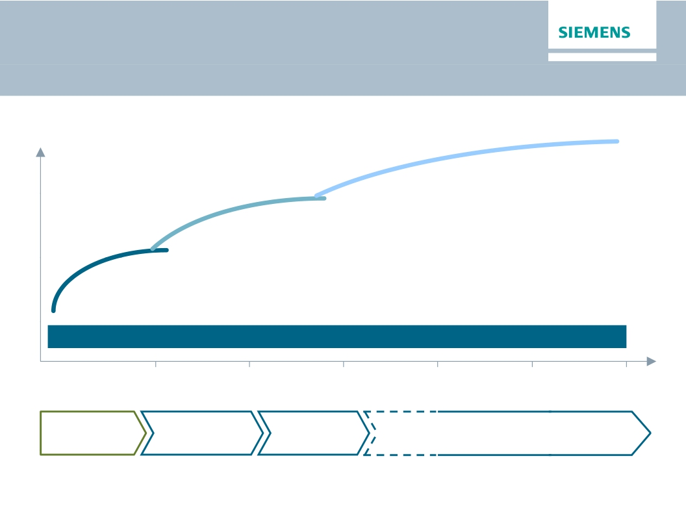
Siemens – Vision 2020
Value creation & Cultural change
"Siemens Vision 2020"
Value
Scale up
Strengthen core
Drive performance
Foster ownership culture and leadership based on common values
2015
2016
2017
2018
2019
2020
Strategic
direction
Operational
consolidation
Optimi-
zation
Accelerated Growth and
Outperformance
© Siemens AG 2014. All rights reserved.
Page 18
November 6, 2014
Q4 FY 2014, Analyst Call

Slide 19

Executing Siemens – Vision 2020
by strengthening the strategic core
Expected closing
t d l
Q1 CY 15
Dec
2014
Healthcare IT
Aero-derivative gas turbines
Divestment to Cerner for US$1.3bn announced
& compressors
· £785m purchase price + £200m exclusive
access to long term aero-technology
developments
Microbiology
Divestment to Beckman Coulter for
US$ ~450m announced
Q1 CY 15
· ~ £50m annual gross cost synergies by
FY17
· EVA accretive in FY2020
Summer
2015
Compressors, turbines and engines
for Oil & Gas
Audiology Solutions Q1 CY 15
Divestment to EQT for €2.15bn announced
Divestment to AEA Partners
Metals Technologies
JV with Mitsubishi–Hitachi Heavy Machinery
✓✓Water Technologies
Q1 CY 15
· US$ 83 per share, total consideration of
US$7.6bn (~€5.8bn)
· ~€150m annual synergies by FY19
B/S/H/
Divestment of 50% share to Bosch planned
Equity value €3.25bn – thereof €3.0bn cash
H1 CY 15
· EPS accretive from year one
© Siemens AG 2014. All rights reserved.
purchase price and €250m dividend & special
dividend
Page 19
November 6, 2014
Q4 FY 2014, Analyst Call

Slide 20
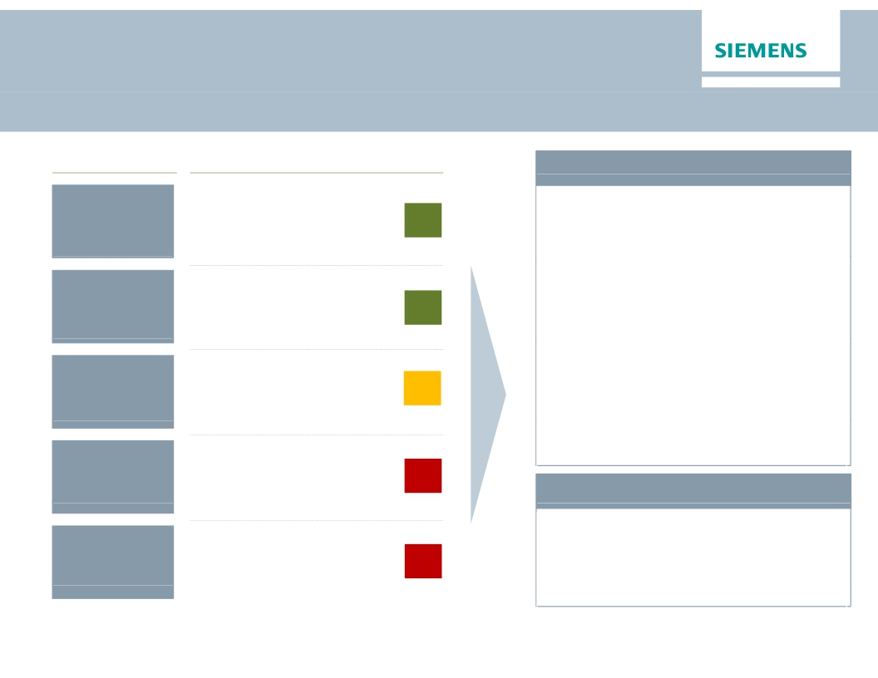
Executing Siemens – Vision 2020
Divestment of Audiology Solutions for €2.15bn
Vision 2020
Area
of growth?
Potential
profit pool?
Why
Siemens?
Synergetic
value?
Paradigm
shift
Strategic rationale
▪ A leading global player;
strong in emerging markets
▪ Market growth ~3-4% p.a.
▪ High margin business
▪ Technological
differentiation possible
▪ Increasingly integrated with
consumer electronics
▪ No significant synergies
in technology nor
distribution channels
▪ Forward integration in
retail chains
▪ Competitor investments in
adjacencies (e.g. implants)
Key transaction facts
▪ Divestment to EQT and family
Struengmann – growth investors
with strong industrial concept
▪ Enterprise value €2.15bn plus
earn-out component
▪ Siemens re-investment of €0.2bn
via preferred equity
▪ Solid financing: ~50% equity
▪ Continued use of Siemens product
brand over the medium term
▪ Expected closing: Q1 CY 2015
subject to regulatory approvals
Audiology key figures (FY2014)
▪ Revenue: €693m
▪ EBITDA: €145m
▪ Employees: ~5,000
✓✓
✓✓


t d l
t )
© Siemens AG 2014. All rights reserved.
Page 20
November 6, 2014
Q4 FY 2014, Analyst Call

Slide 21
Executing Siemens – Vision 2020
Simplified and fully integrated compensation system
Compensation system for Managing Board as of FY 2015
1/3
Fixed
base cash
compensation
1/3
Variable
compensation
(Cash Bonus)
1/3 1/3
Capital
Profit
Individual
efficiency
1/3
Variable stock-basedt k b d
compensation
(Siemens Stock
Awards)
Share price development
compared to competition
+
+
Key imperatives for setting up the system
· Transparency through simplicity
· Performance related incentives based on internal and external benchmarks
· Emphasis on sustainability through share ownership guidelines and long-term stock-
based compensation component
· System is consistent with next management levels
© Siemens AG 2014. All rights reserved.
Page 21
November 6, 2014
Q4 FY 2014, Analyst Call

Slide 22
Leadership priorities 2015
Capture growth opportunities through market driven organization
Simplification of processes and rigorous implementation of
business excellence & risk management
Successful execution of portfolio priorities and integration of
acquisitions
Stringent capital allocation for businesses and investments
Foster ownership culture across all levels
© Siemens AG 2014. All rights reserved.
Page 22
November 6, 2014
Q4 FY 2014, Analyst Call

Slide 23
Assumptions Fiscal 2015
Macroeconomic
environment
Volume andd
pricing
Productivity
Investments
Extraordinary
items
FX
· Complex market conditions impacted by geopolitical developments
· Modest growth for short cycle businesses expected
· Book-to-bill >1 mainly driven by Energy Management and Power & Gas
· Pricing pressure around 2.5% of revenue
· 3 – 4% of cost base
· Investment in organic growth and go-to-market ~€400m (Selling &
Marketing expenses) and innovation ~€400m (R&D expenses)
· Industrial Capex slightly above FY 2014 level
· Significant gains from portfolio divestments cover restructuring charges
and drive EPS-growth
· Limited FX tailwind due to hedging policy
k t
bill 1
i l d i
b E
ti it
4% f
est e ts
et g e pe ses) a d
o at o
€ 00
( &
e pe ses)
© Siemens AG 2014. All rights reserved.
Page 23
November 6, 2014
Q4 FY 2014, Analyst Call

Slide 24

Outlook Fiscal 2015
Basic earnings per share (Net income)
In €
6.55
6.37
5.08
4.74
At least 15%
growth
· We believe that our business environment will
be complex in fiscal 2015, among other things
due to geopolitical tensions.
· We expect revenue on an organic basis to
remain flat year-over-year, and orders to exceed
revenue for a book-to-bill ratio above 1.
· Furthermore, we expect that gains from
divestments will enable us to increase basic
earnings per share (EPS) from net income by
at least 15% from €6.37 in fiscal 2014
· For our Industrial Business, we expect a profit
margin* of 10–11%.
· This outlook excludes impacts from legal and
regulatory matters.
FY 2011
FY 2012
FY 2013
FY 2014
FY 2015e
*Effective with fiscal 2015, our enhanced profit definition excludes
amortization of intangible assets acquired in business combinations.
fit d fi iti
l d
© Siemens AG 2014. All rights reserved.
Page 24
November 6, 2014
Q4 FY 2014, Analyst Call

Slide 25
Appendix
© Siemens AG 2014. All rights reserved.
Page 25
November 6, 2014
Q4 FY 2014, Analyst Call

Slide 26
Q4 FY 2014 – Key figuresKey figures
Siemens (in €m)
Orders
Revenue
Book-to-bill ratio
Total Sectors profit
Net income
Basic earnings per share net income (in €)
Free cash flow (continuing operations)
1) Change is adjusted for portfolio and currency translation effects
© Siemens AG 2014. All rights reserved.
Page 26
November 6, 2014
Q4 FY 13
20,298
20,559
0.99x
1,711
1,068
1.19
4,328
Q4 FY 14
20,733
20,621
1.01x
2,195
1,498
1.72
3,400
Change
2%1)
1%1)
28%
40%
44%
-21%
Q4 FY 2014, Analyst Call

Slide 27
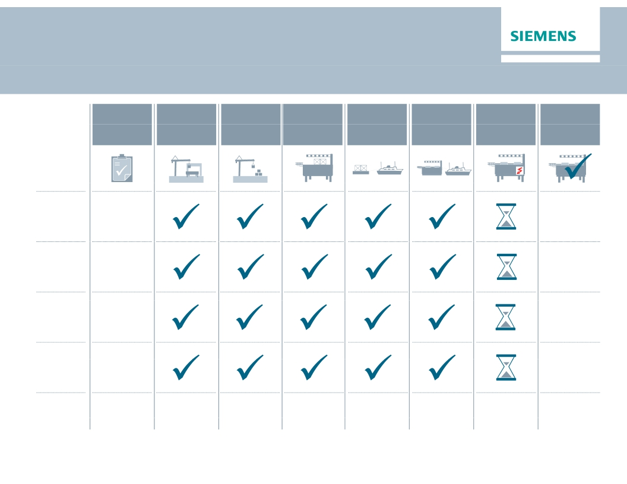
North Sea offshore grid connection projects reach
average percentage of completion >80%
Order
entry
Con-
struction
platform
Construc-
tion land
station
Equipping
platform
Installation
baseframe
Installation
platform
Commis-
sioning
Commer-
cial
operation
HelWin1
BorWin2
SylWin1
HelWin2
BorWin3
2010
2010
2011
2011
2014
2014
2015
2015
2015
2019
© Siemens AG 2014. All rights reserved.
Page 27
November 6, 2014
Q4 FY 2014, Analyst Call

Slide 28
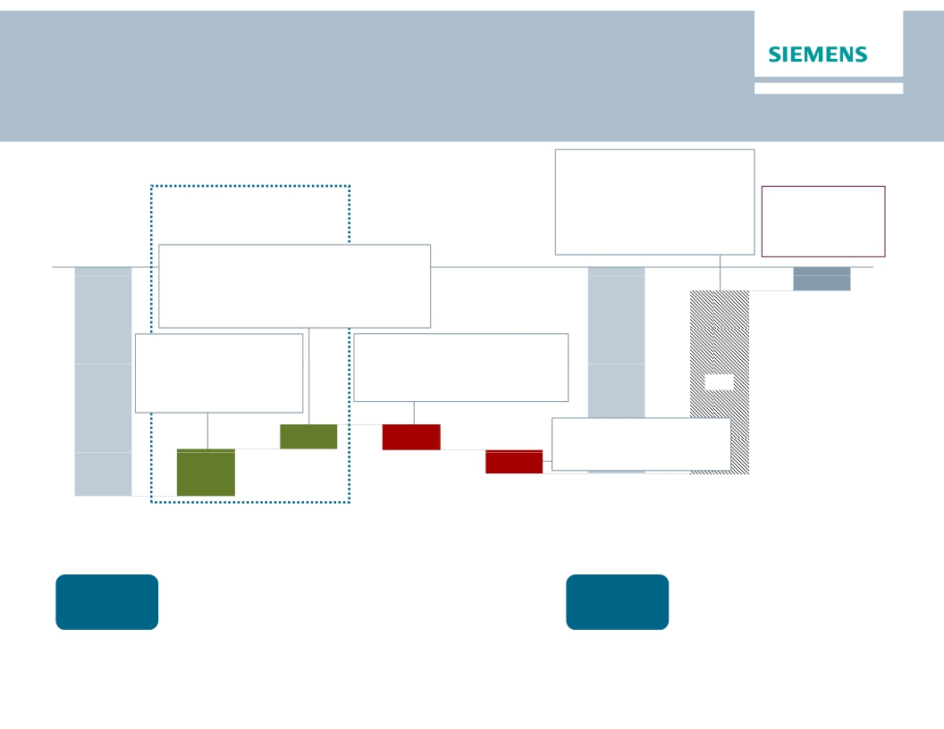
Net Debt Bridge as of Q4 FY14
€bn
Q4 ∆Q3
· SFS Debt
· Pensions
· Credit guarantees
· Hybrid adjustments
· Fair value adj.
(hedge accounting)
+18.7
-9.3
-0.8
+0.9
+1.1
+1.6
+1.1
+0.1
+0.0
+0.0
Operating Activities
therein:
· ∆ Inventories net of advanced payments +1.3
· ∆ Trade and other receivables +0.4
· ∆ Trade payables
+0.7
· ∆ Billings in excess
-1.0
9 3
Adj. ind. Net Debt/
EBITDA
0.15x
(Q3 FY14: 0.63x)
-1.4
p y
therein a.o.:
· Income (C/O) +1 5
· D&A & Impairments +0.6
· Income taxes paid -0.4
therein a.o.:
· CAPEX
· Change in receivables from
financing activities (SFS)
+1.5
-0.7
-0.8
10.6
1.4
-1.4
therein a.o.:
· Interest paid
-0.2
2.7
-1.4
· Share Buyback
-12.0
-0.6
-13.3
Net Debt
Q3 2014
Cash &
cash equiv.
€9.1bn2)
Cash flows from
op. activities
(w/o ∆ working
capital)
∆ Working
Capital1)
Cash flows
from investing
activities
Financing
topics
Net Debt
Q4 2014
Cash &
cash equiv.
€8.9bn2)
Net Debt adj.
Adj. ind.
Net Debt
Q4 2014
1)
2)
Includes cash flows from inventories net of advanced payments received, cash flows provided by trade and other receivables, cash flows provided by trade payables
of cash flow in change in other assets and liabilities)
and cash flows used in billings in excess of cost and in estimated earnings on uncompleted contracts and related advances (included in the consolidated statements
Including available-for-sale financial assets
© Siemens AG 2014. All rights reserved.
Page 28
November 6, 2014
Q4 FY 2014, Analyst Call

Slide 29
One Siemens Financial Framework
sets the aspiration
One Siemens
Financial Framework
Siemens
Capital efficiency
Capital structure
Growth:
Siemens > most
relevant competitors1)
(Comparable revenue growth)
(ROCE2))
15-20%
Total cost productivity3)
3-5% p.a.
(Industrial net debt/EBITDA)
up to 1.0x
Dividend payout ratio
40-60%4)
Profit Margin ranges of businesses (excl. PPA)5)
PG
11-15%
WP
5-8%
EM
7-10%
BT
8-11%
MO
6-9%
DF
14-20%
PD
8-12%
HC
15-19%
SFS6)
15-20%
1) ABB, GE, Rockwell, Schneider and Toshiba, weighted 2) Based on continuing and discontinued operations 3) Productivity measures divided by functional costs (cost of sales,
R&D-, SG&A-expenses) of the group 4) Of net income excluding exceptional non-cash items 5) excl. acquisition related amortization on intangibles
6) SFS based on Return on equity after tax
© Siemens AG 2014. All rights reserved.
Page 29
November 6, 2014
Q4 FY 2014, Analyst Call

Slide 30

Financial calendar
November
December
January
November 6, 2014
Q4 Earnings Release / Analyst Call, Roadshow Germany (Frankfurt)
November 7, 2014
Roadshow UK (London)
November 10, 2014
Roadshow France (Paris)
November 13, 2014
Goldman Sachs Conference, Roadshow U.S. (Boston)
December 8 - 9, 2014
Capital Market Day Vision 2020 (Berlin)
January 12, 2015
Commerzbank German Investment Seminar (New York)
January 27, 2015
Q1 Earnings Release; Annual General Meeting
13 2014
© Siemens AG 2014. All rights reserved.
Page 30
November 6, 2014
Q4 FY 2014, Analyst Call

Slide 31

Siemens Investor Relations contacts
Investor Relations
www.siemens.com/investorrelations
investorrelations@siemens.com
+49 89 636-32474
+49 89 636-32830
Internet:
Email:
IR-
Hotline:
Fax:
© Siemens AG 2014. All rights reserved.
Page 31
November 6, 2014
Q4 FY 2014, Analyst Call

