Slide 1

Joe Kaeser, President and CEO – Ralf P. Thomas, CFO
Good Q3 results – Challenges in Energy Sector
Q3 FY 2014, Analyst and Press Call
July 31, 2014
© Siemens AG 2014. All rights reserved.

Slide 2

Safe Harbour Statement
This document contains statements related to our future business and financial performance and future events or developments involving Siemens that may
constitute forward-looking statements. These statements may be identified by words such as “expect,” “look forward to,” “anticipate,” “intend,” “plan,” “believe,”
“seek,” “estimate,” “will,” “project” or words of similar meaning. We may also make forward-looking statements in other reports, in presentations, in material
delivered to shareholders and in press releases. In addition, our representatives may from time to time make oral forward-looking statements. Such statements
are based on the current expectations and certain assumptions of Siemens’ management, and are, therefore, subject to certain risks and uncertainties. A variety
of factors, many of which are beyond Siemens’ control, affect Siemens’ operations, performance, business strategy and results and could cause the actual results,
performance or achievements of Siemens to be materially different from any future results, performance or achievements that may be expressed or implied by
such forward-looking statements or anticipated on the basis of historical trends. These factors include in particular, but are not limited to, the matters described in
Item 3: Key information—Risk factors of our most recent annual report on Form 20-F filed with the SEC, in the chapter Risks of our most recent annual report
prepared in accordance with the German Commercial Code, and in the chapter Risks and opportunities of our most recent interim report.
Further information about risks and uncertainties affecting Siemens is included throughout our most recent annual and interim reports, as well as our most recent
earnings release, which are available on the Siemens website, www.siemens.com, and throughout our most recent annual report on Form 20-F and in our other
filings with the SEC, which are available on the Siemens website, www.siemens.com, and on the SEC’s website, www.sec.gov. Should one or more of these risks
or uncertainties materialize, or should underlying assumptions prove incorrect, actual results, performance or achievements of Siemens may vary materially from
those described in the relevant forward-looking statement as being expected, anticipated, intended, planned, believed, sought, estimated or projected. Siemens
neither intends, nor assumes any obligation, to update or revise these forward-looking statements in light of developments which differ from those anticipated.
All underlying margins are calculated by adjusting margins for the effects reported for the respective businesses in the relevant period. These effects are provided
to assist in the analysis of the businesses' results year-over-year and may vary from period to period. Underlying margins are not necessarily indicative of future
performance. Other companies may calculate similar measures differently.
Due to rounding, numbers presented throughout this and other documents may not add up precisely to the totals provided and percentages may not precisely
reflect the absolute figures.
© Siemens AG 2014. All rights reserved.
Page 2
July 31, 2014
Q3 FY 2014, Analyst and Press Call

Slide 3
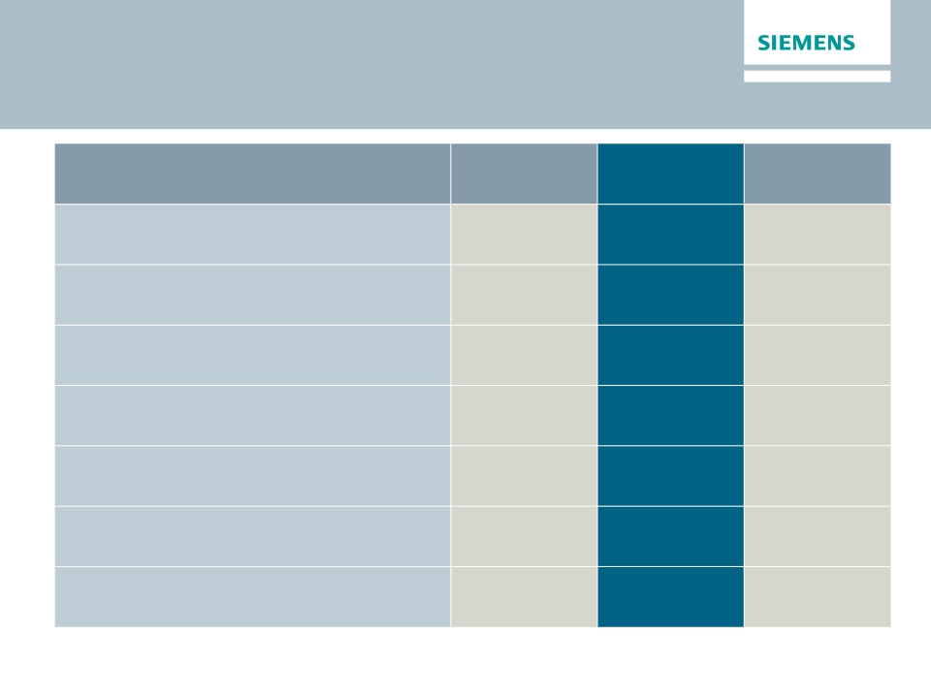
Q3 FY 2014 – Strong bottom line improvements on
flat top line
Siemens (in €m)
Orders
Revenue
Book-to-bill ratio
Total Sectors profit
Net income
Basic earnings per share net income (in €)
Free cash flow (continuing operations)
1) Change is adjusted for portfolio and currency translation effects
© Siemens AG 2014. All rights reserved.
Q3 FY 13
20,113
18,611
1.08x
1,269
1,098
1.27
996
Q3 FY 14
19,411
17,921
1.08x
1,739
1,399
1.62
1,127
Change
0%1)
1%1)
37%
27%
28%
13%
Page 3
July 31, 2014
Q3 FY 2014, Analyst and Press Call

Slide 4
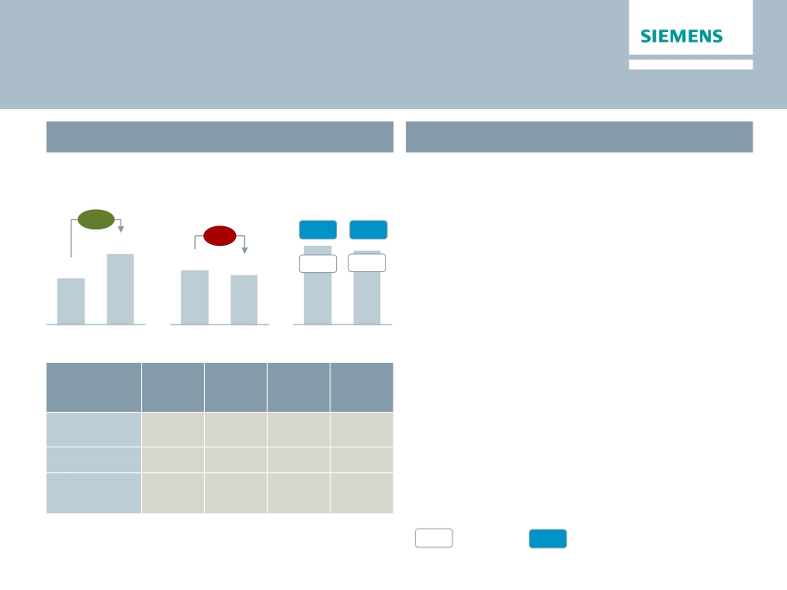
Energy – Strong orders but operational challenges are
continuing
Key Figures Energy
€bn
Main developments in Q3
· Strong book-to-bill of 1.35 due to large orders
€m
Orders 1)
61%
Revenue 1)
-2%
Profit 2)
9.8%
primarily in Europe/CAME region
· Market environment remains competitive in all
areas
8.7%
8.2
5.4
Q3 13
6.6
Q3 13
6.1
Q3 14
6.5%
430
Q3 13
6.6%
405
Q3 14
· Power Generation – Strong profit contribution
from product business; €26m gain on sale of
engineering business
· Wind – Strong order growth; significantly lower
contribution from offshore business call for
Q3 14
Orders
y-o-y 1)
45%
219%
25%
Revenue
y-o-y 1)
1%
7%
-13%
Profit
margin
15.5%
2.7%
-14.8%
Underl.
profit
margin
14.7%
2.7%
-2.6%
higher focus on execution
· Transmission – Broad based, ongoing
challenges remain; offshore grid connection
efforts result in further charges of €128m
Division
Power
Generation
Wind Power
Power
Transmission
1) Comparable, i.e. adjusted for currency translation and portfolio effects
%
Profit margin
%
Underlying Profit margin
© Siemens AG 2014. All rights reserved.
2) for underlying margin calculation please refer to Flashlight document
Page 4
July 31, 2014
Q3 FY 2014, Analyst and Press Call

Slide 5
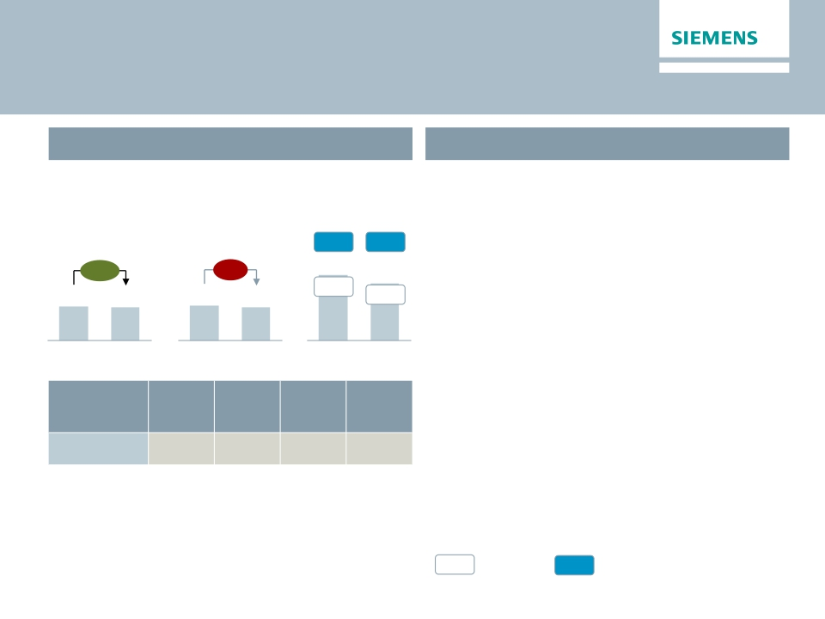
Healthcare – Solid quarter despite adverse currency
effects
Key Figures Healthcare
€bn
Main developments in Q3
· Orders supported by a large particle therapy
€m
Orders 1)
Revenue 1)
Profit 2)
service order in China
· Weaker profit margin on tough comparables
– Mainly impacted by adverse currency effects in
17.5%
14.9%
+2%
-1%
the imaging and therapy systems business
3.3
Q3 13
3.2
Q3 14
3.4
Q3 13
3.2
Q3 14
14.8%
499
Q3 13
13.7%
436
Q3 14
· Diagnostics – Solid growth and profit
development; divestment of non-core
microbiology business to Beckman-Coulter
announced
Orders
y-o-y 1)
1%
Revenue
y-o-y 1)
1%
Profit
margin
11.0%
Underl.
profit
margin
15.4%
Division
Diagnostics
1) Comparable, i.e. adjusted for currency translation and portfolio effects
%
Profit margin
%
Underlying Profit margin
© Siemens AG 2014. All rights reserved.
2) for underlying margin calculation please refer to Flashlight document
Page 5
July 31, 2014
Q3 FY 2014, Analyst and Press Call

Slide 6
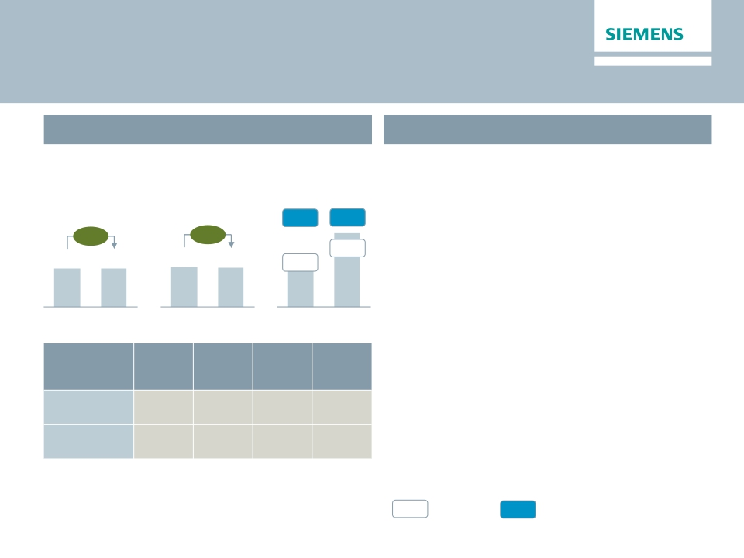
Industry – Improved performance on the back of organic
revenue growth
Key Figures Industry
€bn
Main developments in Q3
· Improved short cycle businesses with
€m
Orders 1)
Revenue 1)
Profit 2)
positive order growth particularly in China
12.9%
8.5%
363
13.8%
12.9%
548
· Industry Automation – Strong profit contribution
due to favorable product mix and sustained
lower PPA related effects from UGS acquisition
· Drive Technologies – Improved cost position
and higher share of Motion Control business
+5%
+3%
4.1
4.1
4.3
4.2
Q3 13
Q3 14
Q3 13
Q3 14
Q3 13
Q3 14
· Metals Technologies in “Discontinued
Operations" as of Q3 FY14
Orders
y-o-y 1)
1%
9%
Revenue
y-o-y 1)
3%
2%
Profit
margin
16.2%
9.4%
Underl.
profit
margin
17.6%
9.7%
Division
Industry
Automation
Drive
Technologies
1) Comparable, i.e. adjusted for currency translation and portfolio effects
%
Profit margin
%
Underlying Profit margin
© Siemens AG 2014. All rights reserved.
2) for underlying margin calculation please refer to Flashlight document
Page 6
July 31, 2014
Q3 FY 2014, Analyst and Press Call

Slide 7
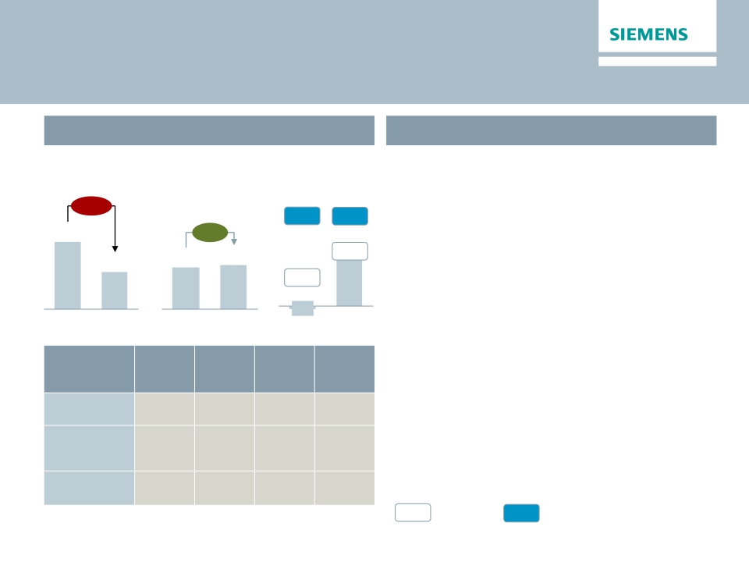
Infrastructure & Cities – Significant profit improvement
continues
Key Figures Infrastructure & Cities
Main developments in Q3
€bn
Orders 1)
€m
Profit 2)
· Order decline on tough comparables (€3bn
rolling stock order in prior year)
Revenue 1)
-43%
7.5
4.2
5.6%
-0.5%
-23
7.1%
7.4%
350
· Transportation & Logistics – Profit surges on
growth conversion and stringent project
execution
· Power Grid Solutions & Products – Solid
execution stabilize margins
+8%
4.5
4.7
Q3 13
Q3 14
Q3 13
Q3 14
· Building Technologies – Optimized go-to-
market concepts bear fruit
Q3 13
Q3 14
Orders
y-o-y 1)
-72%
5%
-3%
Revenue
y-o-y 1)
17%
3%
1%
Profit
margin
6.2%
8.4%
7.6%
Underl.
profit
margin
5.5%
8.4%
7.6%
Division
Transportation
& Logistics
Power Grid
Solutions
& Products
Building
Technologies
1) Comparable, i.e. adjusted for currency translation and portfolio effects
%
Profit margin
%
Underlying Profit margin
© Siemens AG 2014. All rights reserved.
2) for underlying margin calculation please refer to Flashlight document
Page 7
July 31, 2014
Q3 FY 2014, Analyst and Press Call

Slide 8
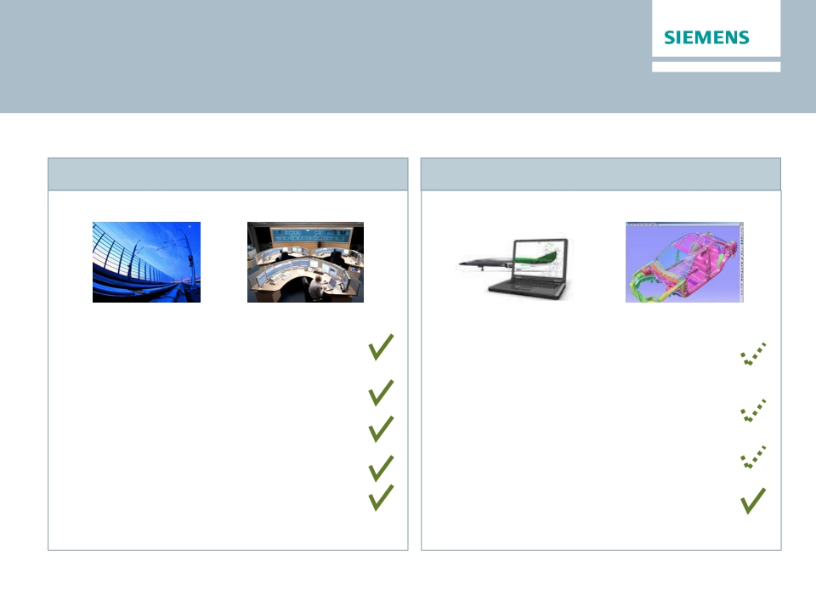
Invensys: Integration on track
LMS: Good progress - but way to go on growth
Invensys Rail1)
· Major strategic goals accomplished,
integration ahead of schedule
· Synergies (€100m) on track, 2/3 to be
achieved until FY 16
· Market leader in Rail Automation
· Large project wins: Metro North, KTCS
Kazakhstan, etc.
· EVA accretive in FY 2018 reconfirmed
1) Invensys Rail consolidated since May 2013
© Siemens AG 2014. All rights reserved.
LMS2)
· Currently low double digit comparable
revenue growth3) due to lower market growth
(mid single digit)
· Revenue synergies: in LMS & PL above plan,
in IA/DT delayed due to longer lead times.
· EBITDA margin: low double digit with
synergy ramp up potential
· Portfolio integration, R&D roadmap and
focused special sales force on track
2) LMS consolidated since January 2013 3) excluding deferred revenue
adjustments from purchase price allocation
Page 8
July 31, 2014
Q3 FY 2014, Analyst and Press Call

Slide 9
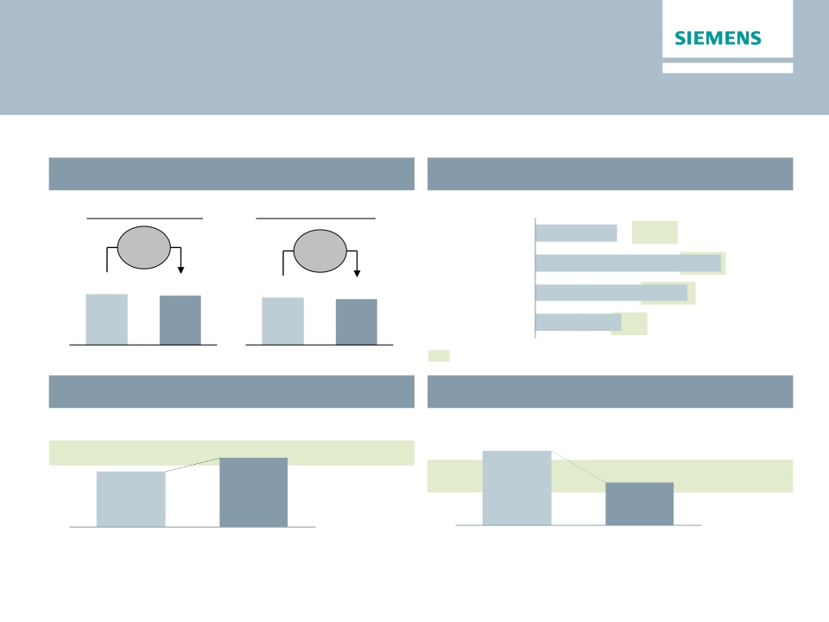
One Siemens cockpit – YTD Q3 2014
Significant improvements in capital efficiency over prior year
Financial target system
Growth1)
Orders
Margins compared to industry benchmarks
EBITDA Margins (YTD FY 2014)
Revenue
-3%
(0%)2)
-3%
(0%)2)
Energy
Healthcare
8.6%
10-15%
15-20%
19.5%
60.1
58.2
53.6
52.0
Industry
16.0%
11-17%
Infrastr. & Cities
9.0%
8-12%
EBITDA margins of respective markets throughout business cycles
YTD FY 13
YTD FY 14
YTD FY 13
YTD FY 14
Capital efficiency
ROCE adjusted (continuing operations)
Capital structure
Adjusted industrial net debt/EBITDA
16.6%
YTD FY 14
1.1x
YTD FY 13
13.3%
YTD FY 13
15-20%
0.6x
YTD FY 14
0.5-1.0x
1) As reported 2) Change is adjusted for portfolio and currency translation effects
© Siemens AG 2014. All rights reserved.
Page 9
July 31, 2014
Q3 FY 2014, Analyst and Press Call

Slide 10
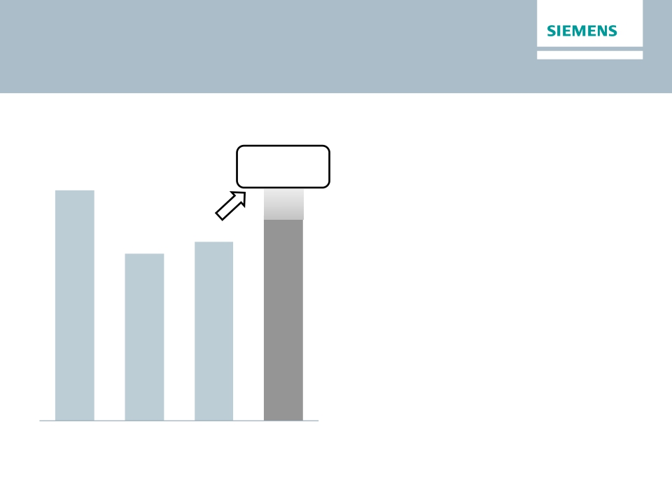
Outlook Fiscal 2014 confirmed
Basic earnings per share (Net income)
In €
At least 15%
· We expect revenue on an organic basis to
6.55
growth
remain level year-over-year, and orders to
exceed revenue for a book-to-bill ratio above 1.
· Given these developments and financial results
5.08
for the first nine months, we expect basic
earnings per share (Net Income) for fiscal
2014 to grow by at least 15% from €5.08 in
fiscal 2013.
· This outlook is based on shares outstanding of
843 million as of September 30, 2013.
· Furthermore, it excludes impacts related to legal
and regulatory matters.
4.74
FY 2011
FY 2012
FY 2013
FY 2014e
© Siemens AG 2014. All rights reserved.
Page 10
July 31, 2014
Q3 FY 2014, Analyst and Press Call

Slide 11
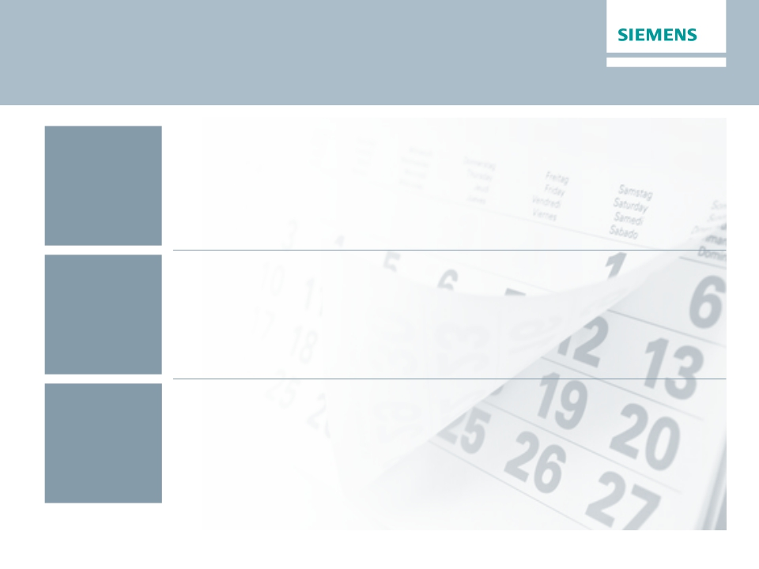
Financial calendar
July
August
September
July 31, 2014
Q3 Earnings Release and Analyst/Press Call
August 4 - 6, 2014
Q3 US Roadshow (Chicago, San Francisco, Los Angeles)
September 16, 2014
Switzerland Roadshow (Zürich)
© Siemens AG 2014. All rights reserved.
Page 11
July 31, 2014
Q3 FY 2014, Analyst and Press Call

Slide 12
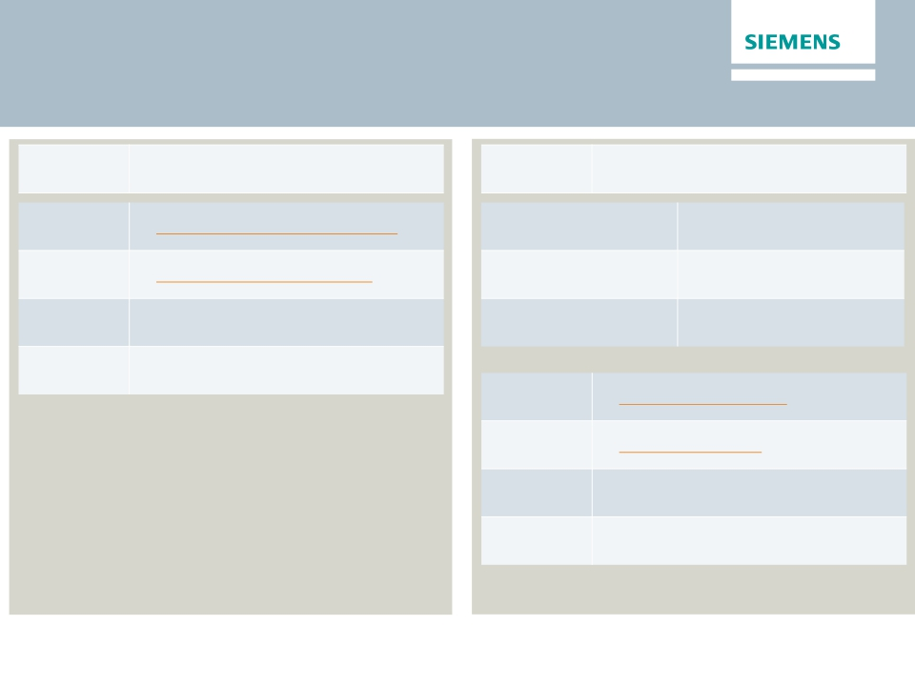
Siemens Communication contacts
Investor Relations
Press
Internet:
Email:
IR-Hotline:
Fax:
www.siemens.com/investorrelations
investorrelations@siemens.com
+49 89 636-32474
+49 89 636-32830
Marc Langendorf
Alexander Becker
Wolfram Trost
+49 89 636-41360
+49 89 636-36558
+49 89 636-34794
Internet:
Email:
Phone:
Fax:
www.siemens.com/press
press@siemens.com
+49 89 636-33443
+49 89 636-35260
© Siemens AG 2014. All rights reserved.
Page 12
July 31, 2014
Q3 FY 2014, Analyst and Press Call

Slide 13

Reconciliation and Definitions for
Non-GAAP Measures
This document includes supplemental financial measures that are or may be non-GAAP financial measures.
Orders and order backlog; adjusted or organic growth rates of revenue and orders; book-to-bill ratio; Total Sectors profit; return on equity (after tax), or ROE (after
tax); return on capital employed (adjusted), or ROCE (adjusted); Free cash flow, or FCF; adjusted EBITDA; adjusted EBIT; adjusted EBITDA margins, earnings
effects from purchase price allocation, or PPA effects; net debt and adjusted industrial net debt are or may be such non-GAAP financial measures.
These supplemental financial measures should not be viewed in isolation or as alternatives to measures of Siemens’ net assets and financial positions or results of
operations as presented in accordance with IFRS in its Consolidated Financial Statements. Other companies that report or describe similarly titled financial
measures may calculate them differently.
Definitions of these supplemental financial measures, a discussion of the most directly comparable IFRS financial measures, information regarding the usefulness
of Siemens’ supplemental financial measures, the limitations associated with these measures and reconciliations to the most comparable IFRS financial measures
are available on Siemens’ Investor Relations website at www.siemens.com/nonGAAP. For additional information, see supplemental financial measures and the
related discussion in Siemens’ most recent annual report on Form 20-F, which can be found on our Investor Relations website or via the EDGAR system on the
website of the United States Securities and Exchange Commission.
© Siemens AG 2014. All rights reserved.
Page 13
July 31, 2014
Q3 FY 2014, Analyst and Press Call

