Slide 1

Joe Kaeser, President and CEO
Ralf P. Thomas, CFO
Q2 – Portfolio gains drive income
Q2 FY 2015, Analyst Conference
London, May 7, 2015
© Siemens AG 2015

Slide 2
Notes and forward-looking statements
This document contains statements related to our future business and financial performance and future events or developments involving Siemens that may
constitute forward-looking statements. These statements may be identified by words such as “expect,” “look forward to,” “anticipate” “intend,” “plan,” “believe,”
“seek,” estimate ” “will,” project” or words of similar meaning. We may also make forward-looking statements in other reports in presentations, in material
delivered to shareholders and in press releases. In addition, our representatives may from time to time make oral forward-looking statements. Such statements
are based on the current expectations and certain assumptions of Siemens’ management, of which many are beyond Siemens’ control. These are subject to a
number of risks, uncertainties and factors, including, but not limited to those described in disclosures, in particular in the chapter Risks in the Annual Report.
Should one or more of these risks or uncertainties materialize, or should underlying expectations not occur or assumptions prove incorrect, actual results,
performance or achievements of Siemens may (negatively or positively) vary materially from those described explicitly or implicitly in the relevant forward-looking
statement. Siemens neither intends, nor assumes any obligation, to update or revise these forward-looking statements in light of developments which differ from
those anticipated.
This document includes – in IFRS not clearly defined – supplemental financial measures that are or may be non-GAAP financial measures. These supplemental
financial measures should not be viewed in isolation or as alternatives to measures of Siemens’ net assets and financial positions or results of operations as
presented in accordance with IFRS in its Consolidated Financial Statements. Other companies that report or describe similarly titled financial measures may
calculate them differently.
Due to rounding, numbers presented throughout this and other documents may not add up precisely to the totals provided and percentages may not precisely
reflect the absolute figures.
© Siemens AG 2015
l t fi
Page 2
London, May 7, 2015
Q2 FY 2015, Analyst Conference

Slide 3
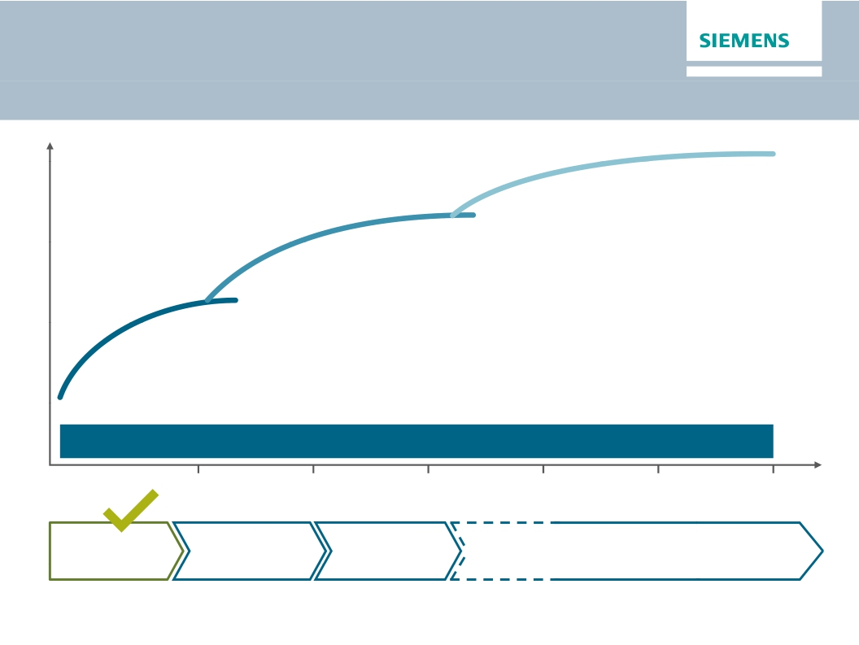
Siemens Vision 2020
Value creation and cultural change
Value
Scale up
Strengthen core
Drive performance
Foster ownership culture and leadership based on common values
2015
2016
2017
2018
2019
2020
Strategic
direction
© Siemens AG 2015
Operational
consolidation
Optimization
Accelerated growth
and outperformance
Page 3
London, May 7, 2015
Q2 FY 2015, Analyst Conference

Slide 4
Siemens Vision 2020 on track
Execution milestones until 2017
Until
Q4 2014
Q2 2015
Q4 2015
Q4 2016
Q4 2017
© Siemens AG 2015
Execution steps
Implementation of new and simplified organization by Oct. 1
Introduction of incentive system 2015
Stringent portfolio optimization - closing of announced divestments
Measures for structural optimization defined (governance & support functions)
Decision on resource allocation for underperforming businesses
Update on cost reduction progress
Update on measures for growth fields and innovation
Share buy-back executed (up to €4bn)
Update on execution of further portfolio optimization
Progress on cost reduction: Major portion of €1bn savings effective
Underperforming business fixed
€1bn cost savings fully effective
✓✓
✓✓
✓✓
✓✓
✓✓
Page 4
London, May 7, 2015
Q2 FY 2015, Analyst Conference

Slide 5
Q2 FY 2015 - Key developments as expected
· Continued complex economic, currency and market environment
· Strong translational tailwind from FX on orders (+9%) & revenue (+8%)
· Clear organic order increase (+7%) driven by large Mobility orders and
rebound in Power & Gas and Healthcare; record backlog of €109bn
· Flat organic revenues - decline in Power & Gas (PG) and Process Industries
& Drives (PD) compensated by growth in other Divisions
· Soft Industrial Business margin of 9.0% as previously indicated due to
adverse mix and weakness in Wind Power; €98m severance charges
· Net Income of €3.9bn and basic EPS of €4.70 driven by disposal gains
(BSH, Audiology, Healthcare IT)
· Weak Free Cash Flow due to net working capital increase and treasury effects
· Strategic assessment of underperforming businesses
© Siemens AG 2015
k t
(+7%) d i
b l
M bilit
Page 5
London, May 7, 2015
Q2 FY 2015, Analyst Conference

Slide 6
Significant order wins in Mobility drive growth in
Europe
Orders
Q2 FY 15 y-o-y1)
Revenues
Europe/C.I.S./Africa/ME
+20%
+1%
(therein Germany)
+65%
+7%
Americas
+3%
+2%
(therein U.S.)
+3%
-2%
Asia/Australia
(therein China)
-20%
-27%
-6%
-3%
1) Change is adjusted for currency translation and portfolio effects
Q2 Key developments
Q2 - Key developments
Europe,
- Large Mobility orders and Power & Gas (PG) drive growth; Healthcare (HC) a positive
MEA, CIS: - Energy Management (EM) with clear revenue growth
Americas: - Soft PG & flat HC orders in US compensated by double digit growth in all other Divisions
- Strong revenue growth in Canada and Colombia
Asia /
China:
- Lower large order volume in the region including China
- HC with double digit revenue growth in China
© Siemens AG 2015
Page 6
London, May 7, 2015
Q2 FY 2015, Analyst Conference

Slide 7
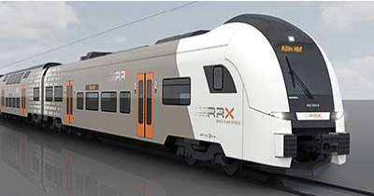
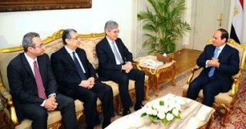
Tailored offerings and customer proximity drive new
business
Megadeals in Egypt
· Beni Suef, Burullus and New Capital
power plants
· Fast track projects for 13.2 GW
· Modular Combined Cycle Power
Plants with H-Frame gas turbines
· Firm agreement for 2 GW onshore wind
power generation capacity
· Build up of rotor blade factory
· Execution from late FY 17 planned
© Siemens AG 2015
Major order in Mobility
· Largest regional rail transport order
ever won by Siemens in Germany
· Customer: Rhine-Ruhr
Metropolitan Region in Germany
· 82 Desiro HC electric multiple units
· Maintenance services over a
period of 32 years
· > €1.7bn total order volume
Page 7
London, May 7, 2015
Q2 FY 2015, Analyst Conference

Slide 8
PG: Accelerating innovation and productivity actions
WP: Continued operational challenges impact margin
Power and Gas (PG)
Wind Power and Renewables (WP)
Orders
Revenue
Orders
Revenue
€bn
€bn
+4%1)
-6%1)
-27%1)
-1%1)
2.7
Q2 FY 14
3.1
Q2 FY 15
2.9
Q2 FY 14
3.0
Q2 FY 15
1.7
Q2 FY 14
1.4
Q2 FY 15
1.2
Q2 FY 14
1.3
Q2 FY 15
Profit & Margin
Profit & Margin
€m
594
20.3%
Q2 FY 14
Target
margin
11-15%
€m
Target
margin
5-8%
392
12.9%
14.7%
Q2 FY 15
-3.5%
-41
Q2 FY 14
-3.5%
-3.4%
-44
Q2 FY 15
· Positive effects by strong project execution
· Higher R&D for innovation push
· Expect operational margins at the lower
end of the corridor
· Sharply lower offshore order volume
· Main bearings still a topic
· Ramping up commercial scale production
of a new turbine ffering
d f th
1) Comparable, i.e. adjusted for currency translation and portfolio effects
© Siemens AG 2015
Page 8
London, May 7, 2015
x.x% Margin as reported
x.x% Margin excl. severance
Q2 FY 2015, Analyst Conference

Slide 9
EM: Progress in execution of legacy projects
BT: Productivity push to mitigate CHF strength
Energy Management (EM)
Building Technologies (BT)
Orders
Revenue
Orders
Revenue
€bn
€bn
+2%1)
+4%1)
+1% )
+1%1)
+1% )
+1%1)
2.8
Q2 FY 14
3.1
Q2 FY 15
2.5
Q2 FY 14
2.8
Q2 FY 15
1.3
Q2 FY 14
1.5
Q2 FY 15
1.3
Q2 FY 14
1.4
Q2 FY 15
Profit & Margin
Profit & Margin
€m
93
Target
margin
€m
93
95
Target
margin
-7.6%
-187
Q2 FY 14
7 6%
3.3%
3.4%
Q2 FY 15
7-10%
7.1%
Q2 FY 14
6.6%
6.8%
Q2 FY 15
8-11%
· Substantial order growth in Americas due
to large HVDC order
· Adverse mix due to large revenue portion
with low margins
· Order growth driven by the U. S.
· Mid-term productivity measures to
compensate for adverse profit impact of
CHF appreciation initiated
1) Comparable, i.e. adjusted for currency translation and portfolio effects
© Siemens AG 2015
Page 9
London, May 7, 2015
x.x% Margin as reported
x.x% Margin excl. severance
Q2 FY 2015, Analyst Conference

Slide 10
DF: Temporarily softer and stronger outlook
PD: Commodity related weakness weighs on margin
Digital Factory (DF)
Process Industries and Drives (PD)
Orders
Revenue
Orders
Revenue
€bn
€bn
+1%1)
+2%1)
-13%1)
-5%1)
2.4
Q2 FY 14
2.6
Q2 FY 15
2.2
Q2 FY 14
2.4
Q2 FY 15
2.7
Q2 FY 14
2.4
Q2 FY 15
2.3
Q2 FY 14
2.3
Q2 FY 15
Profit & Margin
Profit & Margin
€m
408
18.2%
Q2 FY 14
Target
margin
14-20%
€m
3.7%
3.9%
85
Q2 FY 15
Target
margin
8-12%
355
14.7%
15.0%
Q2 FY 15
188
8.2%
Q2 FY 14
· Order growth driven by motion control
and industry software (PLM)
· Lower revenue share from high margin
products and weaker China channels
· Weaker demand in commodity related
industries (O&G, Metals, Mining, Cement)
· Margin impact from operational challenges
in O&G/Marine & Large Drives solutions
1) Comparable, i.e. adjusted for currency translation and portfolio effects
© Siemens AG 2015
Page 10
London, May 7, 2015
x.x% Margin as reported
x.x% Margin excl. severance
Q2 FY 2015, Analyst Conference

Slide 11
MO: Stringent project execution
HC: Higher growth and solid margin
Mobility (MO)
Orders
€bn
+95%1)
Healthcare (HC)
Orders
€bn
+4%1)
Revenue
+2%1)
Revenue
+3%1)
1.8
Q2 FY 14
3.8
Q2 FY 15
1.8
Q2 FY 15
2.8
Q2 FY 14
3.2
Q2 FY 15
2.9
Q2 FY 14
3.2
Q2 FY 15
1.7
Q2 FY 14
Profit & Margin
Profit & Margin
€m
154
9.1%
Q2 FY 14
157
8.6%
8.7%
Q2 FY 15
Target
margin
6-9%
€m
536
18.8%
Q2 FY 14
526
16.4%
16.9%
Q2 FY 15
Target
margin
15-19%
· Revenue growth driven by execution of
turnkey projects & rail infrastructure bus.
· Higher revenue and net positive effects
related to high speed trains foster margin
· Revenue strong in Europe and good in
China, US flat
· Includes €61m gain on sale of Microbiology
business
1) Comparable, i.e. adjusted for currency translation and portfolio effects
© Siemens AG 2015
Page 11
London, May 7, 2015
x.x% Margin as reported
x.x% Margin excl. severance
Q2 FY 2015, Analyst Conference

Slide 12
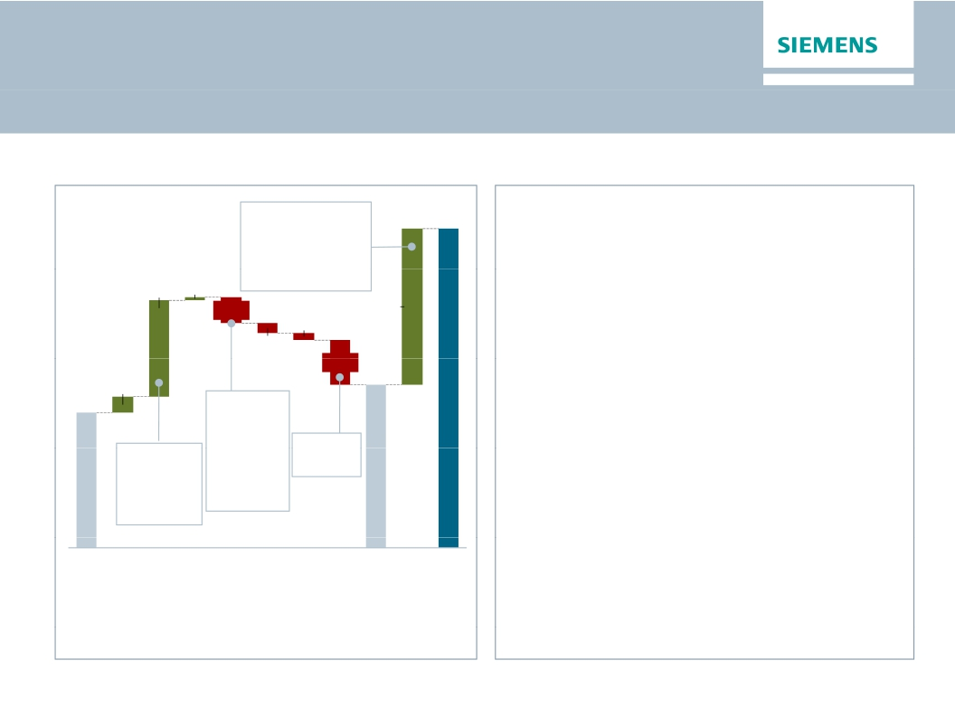
Below Industrial Business materially benefitting from
disposal gains
Below Industrial Business (Q2 FY 2015)
in €m
Therein:
~€1.6bn
Audiology gain
~€0.2bn
3.908
Expectations for H2 FY 2015
· SFS: H2 in line with prior year
· CMPA:
1.172 38
Healthcare IT gain
· B/S/H closed, no further equity income
-308
1.912
· Negative impact from other portfolio
-79
elements (e.g. Unify, Postal & Baggage
Handling, Metals) & M&A related costs
· SRE: Lower than prior year, dependent on
disposal gains
-126
Therein:
-554
1.997
195
1.659
-€119m
Pensions
-€190m
Corp. Items
· Corporate Items: H2 > H1; volatility related
to warrants, among others
· Pension: ~-€125m per quarter
· Treasury: Volatility depending on interest
rates
Therein:
~€1.4bn
B/S/H gain
~-€0.2 Unify
impact
Tax rate
@22%
IB
SFS
CMPA
SRE
Corp.
PPA
Corp.
Tax
Inc.
Disc.
Net
· PPA: Quarterly run-rate to increase by mid-to-
Items
&
Pen.
Elim,
Treas,
Other
Cont.
Ops
IncomeOps.
all in
high double digit €m after Dresser-Rand
closing
· Discont. Operations: Limited impact in H2
© Siemens AG 2015
Page 12
London, May 7, 2015
Q2 FY 2015, Analyst Conference

Slide 13
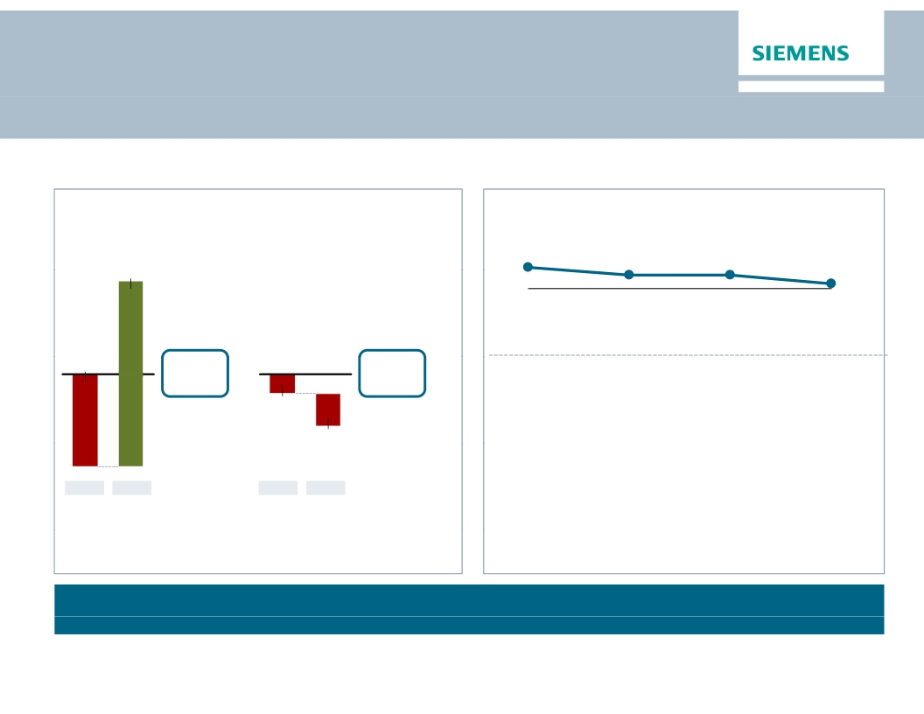
Weak Free Cash Flow in Q2 mainly due to build up of
net operating working capital and treasury effects
Quarterly free cash flow ("all-in")
€m
Key drivers free cash flow
IB – Net Operating Working Capital turns1)
7.8
Q2 FY 2012
7.0
Q2 FY 2013
7.0
Q2 FY 2014
1,402
6.0
Q2 FY 2015
H1
H1
1)
Fiscal 2012 and 2013: Total Sectors
-699
703
-385
· Higher operating working capital, mainly
-144
· Power & Gas (inventories, Rolls-
-241
Q2
FY 2015
Royce integration)
· Wind Power (lower advances and
billings in excess)
· Negative Treasury impact mainly due to
settlements of hedging instruments
Q1
Q2
FY 2014
Q1
Free Cash Flow for Industrial Business with significant improvement over H1 expected
© Siemens AG 2015
Focus on more even cash flow development over quarters remains
ocus o
o e e e cas
de e op e t o e qua te s e a s
Page 13
London, May 7, 2015
Q2 FY 2015, Analyst Conference

Slide 14
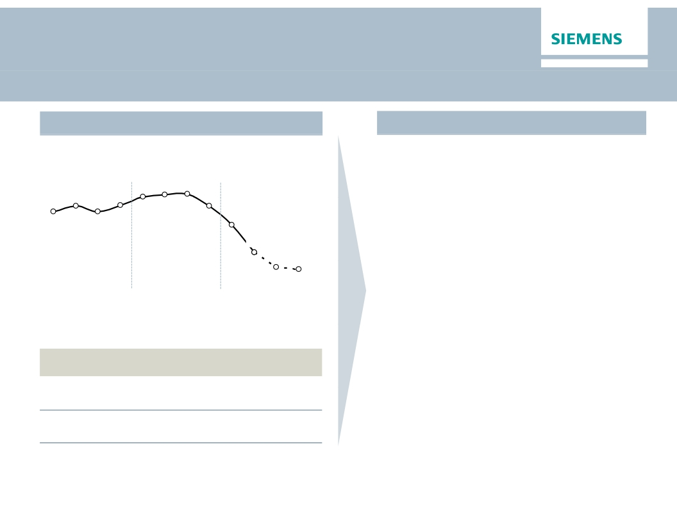
Weaker Euro with limited windfall for H1 profitability,
acceleration expected in H2 FY 2015
FX impact in FY 2015
Quarterly average EUR/USD rates
Hedging strategy and effects
· Limited impact on profitability in H1
due to consistent hedging policy:
1.36
1.37
1.37
· ≥75% of product business exposure
at least three months in advance
1.30
1.32
1.30
1.33
1.32
1.25
1.13
Q2
· Large project businesses fully hedged
at time of order booking
· Margin windfall in H2 as favorable
hedging rates take effect
· Medium term some positive
Q1
Q2
Q3
Q4/13
Q1
Q2
Q3
Q4/14
Q1
Q3e Q4/15e
FX impact
structural effects from weaker Euro
Q2/15
+8%
-10bps
H1/15
+5%
+10bps
H2/15e
high single
digit
~+90bps
against major currencies (USD, CNY,
GBP, INR, among others)
· Strong focus on natural hedging to
mitigate risk from currency volatility
Revenue
Profitability
© Siemens AG 2015
Page 14
London, May 7, 2015
Q2 FY 2015, Analyst Conference

Slide 15
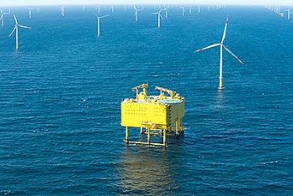
Clear progress in executing legacy projects –
reduced project charges on better backlog quality
Order backlog revenue recognition
in €bn (Industrial Business)
Progress in project execution
· Implementation of “corporate memory”
109
supports improvement in backlog quality
and risk mitigation
€100bn
26
· H1 FY 2015 with stringent project
execution
26
· Three North Sea offshore grid
connection projects in commercial
operation as of April 2015
57
Revenue
recognition
in FY 2017 &
beyond
As of
Mar 31, 2015
Revenue
recognition
in FY 2015
Revenue
recognition
in FY 2016
© Siemens AG 2015
Page 15
London, May 7, 2015
Q2 FY 2015, Analyst Conference

Slide 16
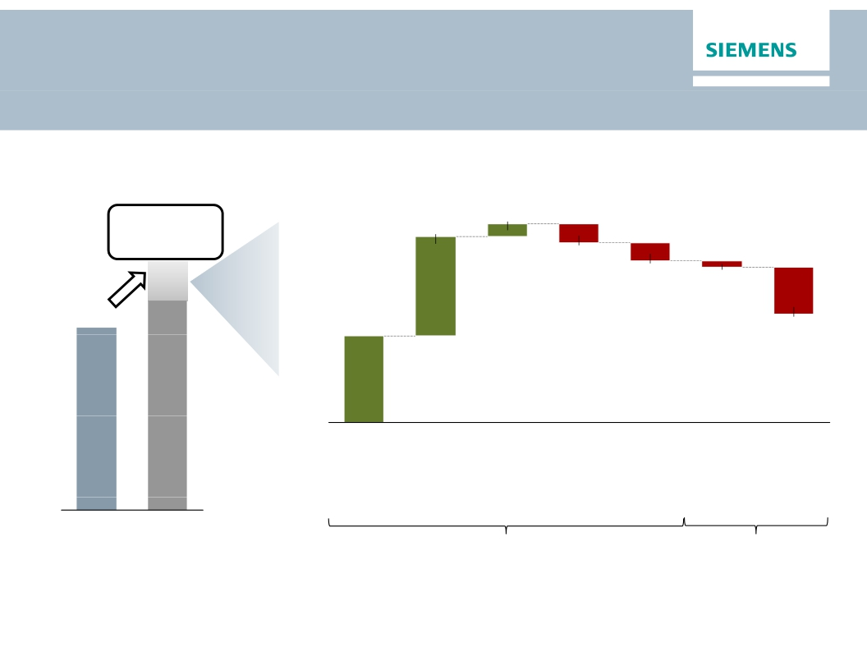
Restructuring and operational consolidation
in FY 2015 is financed by disposal gains
Basic earnings per share (Net income)
In €
In €bn
At least 15%
growth
~1.6
~0.2
~-0.3
0 3
Guidance
includes
~-0.3
~-0.1
6.37
~ 1.4
~-0.75
B/S/H gain
Audiology
gain
HC IT gain
Unify
No more
income
B/S/H
No more
income
Audiology
Restruc-
turing1)
FY 2014
FY 2015e
post tax
pre tax
1)
Midpoint of range of mid to high three digit million Euro assumed
© Siemens AG 2015
Page 16
London, May 7, 2015
Q2 FY 2015, Analyst Conference

Slide 17
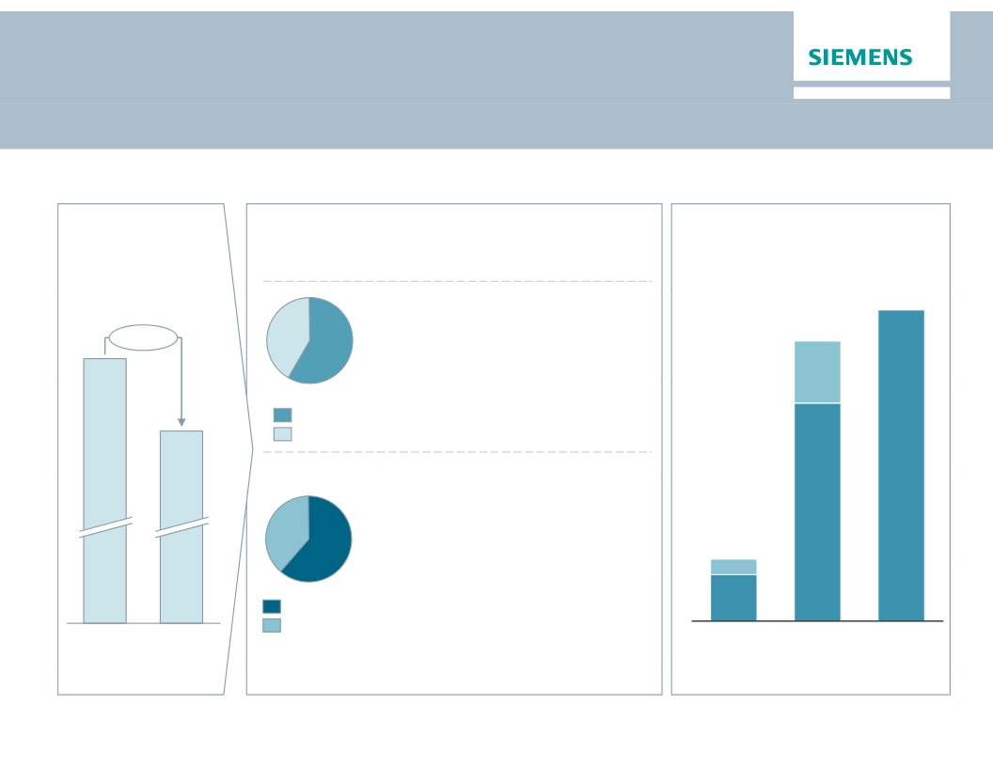
Our target to reduce complexity and achieve
cost reduction of ~€1bn is on track
Current status for functional cost reduction
Target for
functional
Current status
€1bn of saving potential are backed with
Cumulated effects of savings
cost reduction
concrete measures
€1bn
€700m –
· Significant savings to be
€900m
~€1bn
~40%
generated by support functions
(e.g., IT, HR, SCM, Finance)
· Organization streamlined in
Divisions, e.g., by removingb i
~60%
Support functions
Divisions
organizational layers and
combining businesses
· Savings to affect ~7,800 jobs
worldwide, thereof ~3,300 in
Germany
€150m –
€200m
~40%
~60%
Personnel related
Non-personnel
related
· Non-personnel related savings,
e.g.,
· IT: Storage concepts; Cloud
solutions
· SCM: Digitalize purchase to pay
process
FY 2014
Target
FY 2015e
FY 2016e
FY 2017e
© Siemens AG 2015
Page 17
London, May 7, 2015
Q2 FY 2015, Analyst Conference

Slide 18
Fixing remaining underperforming businesses
is key priority – other options remainother options remain
Revenue FY 2013 in €bn
~21
~1.9
Water ~0.9
HC IT ~1.0
~1.8
Extended
Spectrum
Metals
~2.8
LV ~2.0
· Footprint optimization
~15
· Reverse integration
~0.7
Postal
and
Baggage
Handling
· Partnering
· Tight Managing
Board control
Ti ht M
e.g.,
· Compressors
· Transmission
“Bottom10”
~14
· Mechanical
Drives
FY
13
14
15e
17e
20e
Margin
-4%
-3% +1% ~6% >8%
Underperforming
businesses
© Siemens AG 2015
Sell
Partner / JV
Turnaround:
Good
progress
Remaining
underperforming
businesses
Page 18
London, May 7, 2015
Q2 FY 2015, Analyst Conference

Slide 19

Outlook Fiscal 2015 confirmed despite weakening
indicators
Basic earnings per share (Net income)
In €
At least 15%
growth
· We believe that our business environment will
be complex in fiscal 2015, among other things
due to geopolitical tensions.
· We expect revenue on an organic basis to
6.55
6.37
remain flat year-over-year, and orders to
exceed revenue for a book-to-bill ratio above 1.
4.74
FY 2012
5.08
FY 2013
· Furthermore, we expect that gains from
divestments will enable us to increase basic
earnings per share (EPS) from net income by
at least 15% from €6.37 in fiscal 2014.
· For our Industrial Business, we expect a profit
margin* of 10–11%.
· This outlook excludes impacts from legal and
regulatory matters.
*Effective with fiscal 2015, our enhanced profit definition excludes
amortization of intangible assets acquired in business combinations.
l d
t f
FY 2011
FY 2014
FY 2015e
fit d fi iti
l d
© Siemens AG 2015
Page 19
London, May 7, 2015
Q2 FY 2015, Analyst Conference

Slide 20
Appendix
© Siemens AG 2015
Page 20
London, May 7, 2015
Q2 FY 2015, Analyst Conference

Slide 21
One Siemens Financial Framework – Clear
targets to measure success & accountability
One Siemens
Financial Framework
Siemens
Capital efficiency
Capital structure
Growth:
Siemens > most
relevant competitors1)
(Comparable revenue growth)
(ROCE2))
15-20%
Total cost productivity3)
3-5% p.a.
(Industrial net debt/EBITDA)
up to 1.0x
Dividend payout ratio
40-60%4)
Profit Margin ranges of businesses (excl. PPA)5)
PG
11-15%
WP
5-8%
EM
7-10%
BT
8-11%
MO
6-9%
DF
14-20%
PD
8-12%
HC
15-19%
SFS6)
15-20%
1) ABB, GE, Rockwell, Schneider, Toshiba, weighted; 2) Based on continuing and discontinued operations; 3) Productivity measures divided by functional costs (cost of sales,
R&D, SG&A expenses) of the group; 4) Of net income excluding exceptional non-cash items; 5) Excl. acquisition related amortization on intangibles;
6) SFS based on return on equity after tax
© Siemens AG 2015
Page 21
London, May 7, 2015
Q2 FY 2015, Analyst Conference

Slide 22
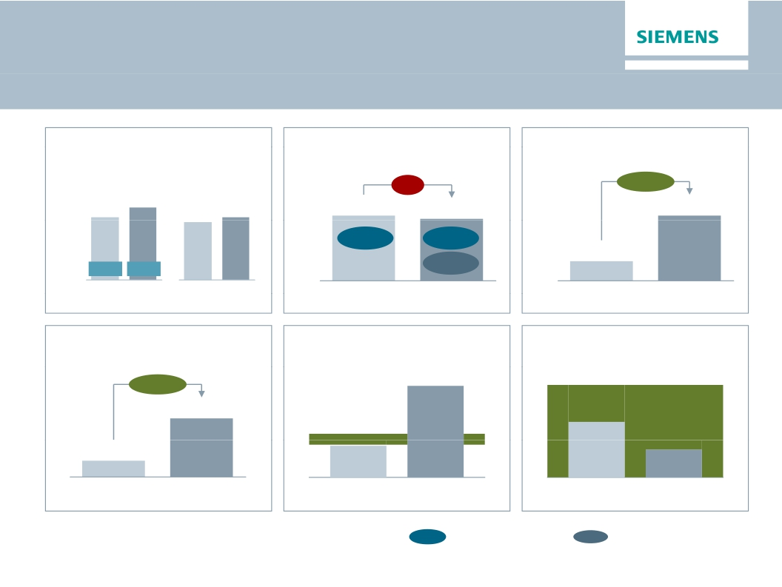
Financial Cockpit
Orders
Revenue
Profit Industrial Business (IB)
Net Income
in €bn
+7%
Comp.
0%
in €bn
in €bn
(+16%)
(nom.)
(+8%)
-5%
+239%
17.9
20.8
18.0
1.7
10.3%
1.7
9.0%
3.9
16.7
Margin
9.6%
1.2
B-t-B
1.07
1.15
Q2 14
Q2 15
Q2 14Q2 15
Q2 FY 14
Q2 FY 15
Q2 FY 14
Q2 FY 15
EPS (“all-in”)
ROCE (“all-in”)
Capital structure
in €
15-20%
≤1
+254%
4.70
42.1%
1.33
Q2 FY 14
14.5%
Q2 FY 14
0.6x
Q2 FY 14
0.3x
Q2 FY 15
Q2 FY 15
Q2 FY 15
x.x% Margin as reported
x.x% Margin excl. severance
© Siemens AG 2015
Page 22
London, May 7, 2015
Q2 FY 2015, Analyst Conference

Slide 23
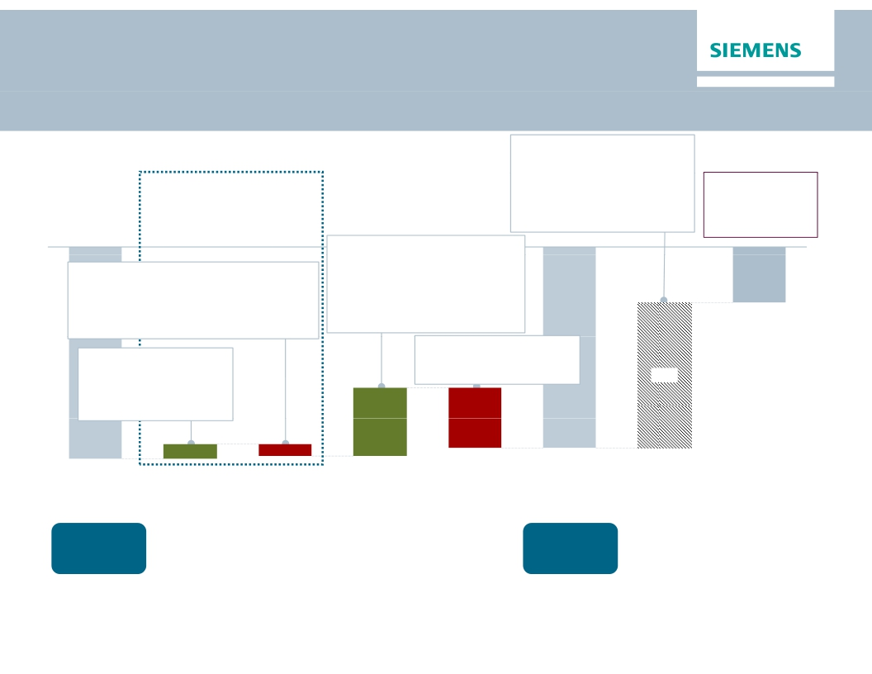
Net Debt Bridge as of Q2 FY 2015
€bn
Q2 ∆Q1
· SFS Debt
+21.4
+2.2
· Post emp. Benefits
Post emp. Benefits 12.1
Operating Activities
-12.1
-1.5
Adj. ind. Net Debt/
EBITDA
0.3x
(Q1 FY15: 0.6x)
· Credit guarantees
· Hybrid bond
· Fair value adj.
(hedge accounting)
-0.8
+1.0
+1.1
+0.0
+0.0
+0.0
therein a.o.:
· CAPEX
-0.4
0 4
therein:
· ∆ Inventories net of advance payments
· Change in receivables from
financing activities (SFS)
-0.7
-0.7
· Disposal of investments,
· ∆ Trade and other receivables +0.1
intangibles and PP&E
· Cash flow from inv. (D/O)
therein a.o.:
+3.0
+3.0
-4.1
· ∆ Trade payables
· ∆ Billings in excess / Adv. pay.
+0.1
-0.4
therein a.o.:
· Income (C/O)
· Share Buyback
· Dividend paid
-0.4
-2.7
+2.0
10.6
· D&A & Impairments +0.6
· Income taxes paid
-0.7
-4.4
5.0
1.1
-0.9
-14.7
-15.4
Net Debt
Q1 2015
Cash &
cash equiv.
€7.8bn1)
Cash flows from
op. activities
(w/o ∆ working
capital)
∆ Working
Capital
Cash flows
from investing
activities
Financing
topics
Net Debt
Q2 2015
Cash &
cash equiv.
€9.9bn1)
Net Debt adj.
Adj. ind.
Net Debt
Q2 2015
1)
Including available-for-sale financial assets
© Siemens AG 2015
Page 23
London, May 7, 2015
Q2 FY 2015, Analyst Conference

Slide 24
SFS Key Figures Q2 FY15
Key Financial Data SFS
· Assets
· Profit before Tax
· Return on Equity after tax
· Operating and Investing Cash Flow
€25.2bn
€195m
28.0%
- €393m
Assets
€bn
Liabilities and Equity
€bn
1.0
1.3
0.2
25.2
25.2
2.4
22.7
21.4
1.3
Accruals
& Other
Liabilities
Leases &
Loans1)
Equity
Investments
Other Assets
& Inventory2)
Cash
Total Assets
Total
Liabilities
& Equity
Allocated
Equity
Total Debt
1) Operating and finance leases, loans, asset-based lending loans, factoring and forfeiting receivables
2) Intercompany receivables, securities, (positive) fair values of derivatives, tax receivables, fixed assets, intangible assets, land and building, prepaid expenses and inventories
© Siemens AG 2015
Page 24
London, May 7, 2015
Q2 FY 2015, Analyst Conference

Slide 25
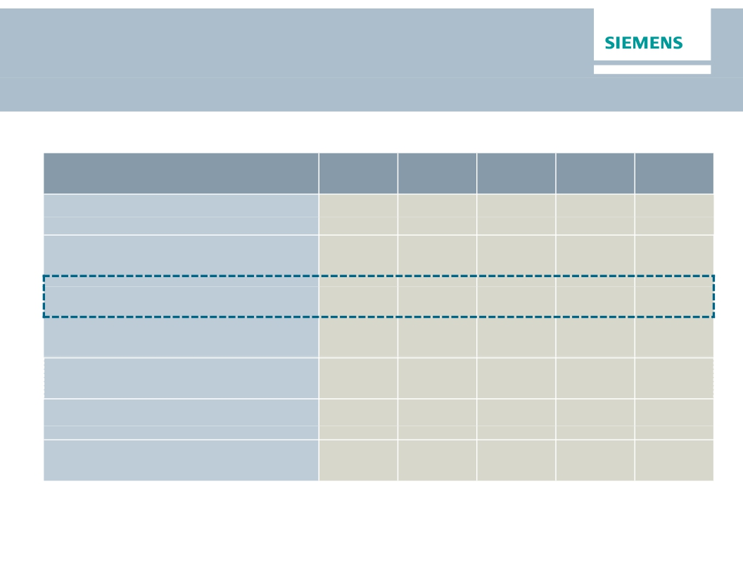
Pension underfunding increased to -€11.0bn in Q2
Deficit for Siemens’ pension plans increased in Q2, mainly due to decreased discount rate assumptions
in €bn1)
Defined benefit obligation (DBO) on
pension benefit plans
Fair value of plan assets
Funded status of pension plans
DBO on other post-employment benefit
plans (mainly unfunded)
Discount rate2)
Interest Income2)
Actual return on plan assets2)
FY 2012
(33.0)
24.1
(8.9)
0.7
3.2%
0.9
3.2
FY 2013
(32.6)
24.1
(8.5)
0.6
3.4%
0.8
1.3
FY 2014
(35.0)
26.5
(8.5)
0.5
3.0%
0.8
2.9
Q1 2015
(36.8)
27.3
(9.6)
0.6
2.6%
0.2
0.8
Q2 2015
(40.8)
29.8
(11.0)
0.6
2.1%
0.2
1.6
1) All figures are reported on a continuing basis and according to IAS 19 (revised 2011).
2) All figures are based on the post-employment benefits in total.
© Siemens AG 2015
Page 25
London, May 7, 2015
Q2 FY 2015, Analyst Conference

Slide 26

Financial calendar
May
June
July
© Siemens AG 2015
May 7, 2015
Q2 Earnings Release and Analyst Conference (London)
May 27, 2015
Bernstein Strategic Decisions Conference (New York)
May 28, 2015
Canada Roadshow (Toronto)
June 10, 2015
Exane European CEO Conference (Paris)
June 11, 2015
JP Morgan European Capital Goods Conference (L don)
June 17, 2015
Deutsche Bank German, Swiss & Austrian Conference (Berlin)
July 30, 2015
Q3 Earnings Release and Analyst Call
10 2015
Page 26
London, May 7, 2015
Q2 FY 2015, Analyst Conference

Slide 27

Siemens Investor Relations contacts
Investor Relations
www.siemens.com/investorrelations
investorrelations@siemens.com
+49 89 636-32474
+49 89 636-32830
Internet:
Email:
IR-
Hotline:
Fax:
© Siemens AG 2015
Page 27
London, May 7, 2015
Q2 FY 2015, Analyst Conference

