Slide 1

ＩＲ Ｐｒｅｓｅｎｔａｔｉｏｎ
December, 2013

Slide 2

The forward-looking statements and projected figures concerning the future performance of NTT
and its subsidiaries and affiliates contained or referred to herein are based on a series of
assumptions, projections, estimates, judgments and beliefs of the management of NTT in light of
information currently available to it regarding NTT and its subsidiaries and affiliates, the economy
and telecommunications industry in Japan and overseas, and other factors. These projections
and estimates may be affected by the future business operations of NTT and its subsidiaries and
affiliates, the state of the economy in Japan and abroad, possible fluctuations in the securities
markets, the pricing of services, the effects of competition, the performance of new products,
services and new businesses, changes to laws and regulations affecting the telecommunications
industry in Japan and elsewhere, other changes in circumstances that could cause actual results
to differ materially from the forecasts contained or referred to herein, as well as other risks
included in NTT’s most recent Annual Report on Form 20-F and other filings and submissions
with the United States Securities and Exchange Commission.
* “E” in this material represents that the figure is a plan or projection for operation.
‐1‐

Slide 3
Medium-term Financial Targets

Slide 4
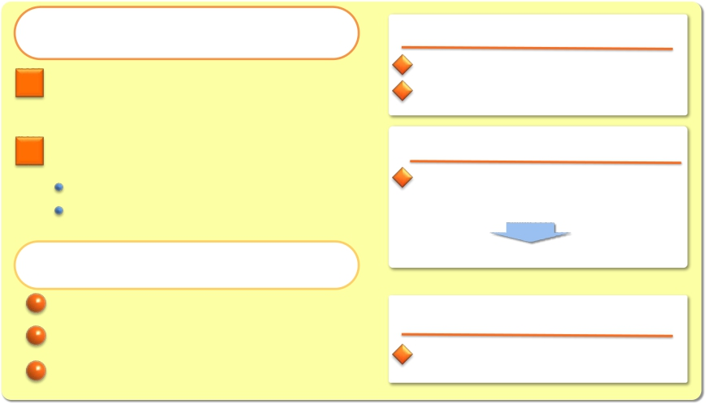

Medium-term Financial Targets
The Path to Profit
Recovery and Growth
“Global Cloud Services” as the
cornerstone of NTT’s business
operations
Comprehensively strengthen
network service competitiveness
Further Improvement of Facility Efficiency
Establishment of Simple and Highly Efficient Business
Operations Tailored to Future Market Changes
Cash Control and its
Effective Utilization
Streamlining capital investment
Increasing M&A with a focus on
Cloud-related businesses
Enhancing shareholder returns
in the medium term
By the fiscal year ending March 31, 2017:
Overseas sales: $20 billion
Proportion of corporate sales represented
by overseas sales: 50% or more
By the fiscal year ending March 31, 2015:
At least 400 billion yen in cost reductions
in fixed-line/mobile access networks
(compared with the fiscal year ended March 31, 2012)
Revised to 500 billion yen in cost reductions
By the fiscal year ending March 31, 2016:
Capex to Sales: 15%
EPS growth of 60% or more by the fiscal year ending
March 31, 2016 (compared with the fiscal year ended March 31, 2012)
IR Presentation (December, 2013)
‐3‐
Copyright©2013 Nippon Telegraph and Telephone Corporation

Slide 5
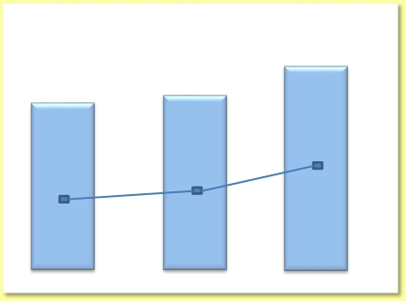
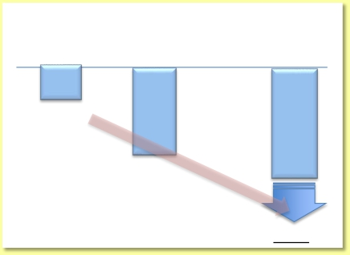
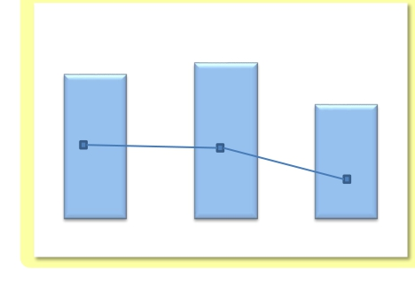
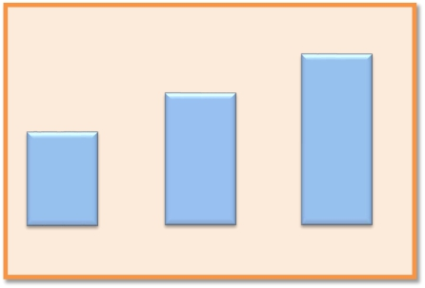
Progress of the Medium-term Financial Targets
Overseas Sales
Cost reductions in
fixed-line/mobile access networks
（Fiscal year
2013/3
ended/ing
March 31）
125
＜approx. 30%＞
2014/3 2Q
275
（Billions of yen）
2015/3 E
400
13.0
Billion USD
37.1%
11.4
Billion USD
12.0
Billion USD
30.6%
31.8%
% in < > shows % progress
＜approx. 70%＞
toward 400 billion yen
Percentage of sales to
overseas corporations
2013/3
（Fiscal year
ended/ing
March 31）
(Note) Amounts are year-on-year figures
as compared to fiscal year ended 2012/3
500
2012/3
2014/3 E
Capital Investment（（Capex to Sales）
（Billions of yen）
1,946.6
EPS
432
（Yen/Share）
503
＋37％
1,970.0
％*
1,870.0
367
＋18％
18.5%
18.4%
Capex to Sales
17.0%
（Fiscal year
2014/3 E2012/3March 31）
※Fiscal year ending 2014/3 EPS is 471 (29% increase) when excluding the effect of
non-operating income relating to the Otemachi 2-chome area redevelopment project.
ended/ing
2013/3
（Fiscal year
ended/ing
March 31）
2012/3
2013/3
2014/3 E
IR Presentation (December, 2013)
‐4‐
Copyright©2013 Nippon Telegraph and Telephone Corporation

Slide 6
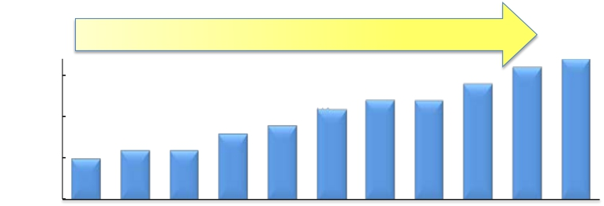
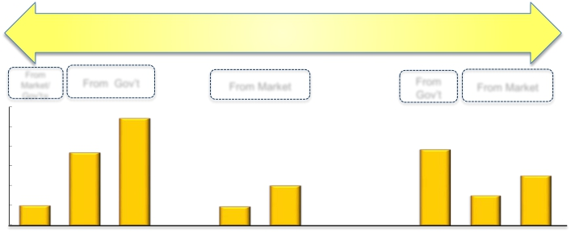

Shareholder Returns
Increased by More Than 3 Times
170
（yen）
Dividend
150
100
50
Dividends per share
50
（Fiscal year0
ended/ing
March 31）
2004/3
2005/3
2006/3
2007/3
2008/3 2009/3 2010/3 2011/3 2012/3 2013/3 2014/3E
More Than 2 Trillion Yen in Buy Backs
ShareBuyBacks
(Billions of yen)
From
Market/
Gov’t※
6,000
5,000
4,000
3,000
1,000
0
ended/ing
March 31）
From Gov’t
539.4
366.5
2005/3 2006/3
From
From Market From Market
381.7
200.0
94.4
2008/3 2009/3 2010/3 2011/3 2012/3 2013/3 2014/3E
600
Gov’t
400
250.0
300
150.0
2,000 100.0
200
100
（Fiscal year
2004/3
2007/3
※Market 61 billion yen, Gov’t 39 billion yen
IR Presentation (December, 2013)
‐5‐
Copyright©2013 Nippon Telegraph and Telephone Corporation

Slide 7
Global Cloud Services

Slide 8




NTT Group International Assessment
Revenue
Fortune Global 500 (Announced at July 8, 2013)
– No.1 among global carriers, No. 32 in all industries
Financial excellence
Moody’s long-term credit rating
– Aa2
– Top level among global carriers & systems integrators
Innovation
Top 100 Global Innovators (Thomson Reuters)
(Announced at Oct 7, 2013)
– Chosen for the third consecutive year
Brand
Global 500 (Brand Finance) (Announced at Feb 28, 2013）
– No.2 among Japanese companies, No.16 in the world
IR Presentation (December, 2013)
‐7‐
Copyright©2013 Nippon Telegraph and Telephone Corporation

Slide 9
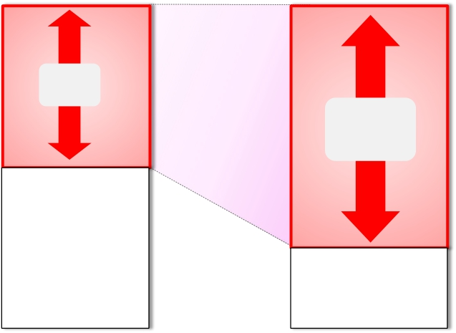
Transforming Our Business Portfolio (Transformation)
Revenue: ¥10.7 trillion
Broadband,
Applications*
&
52%
System
Integration
75%
Voice
48%
25%
2013/3
（Fiscal year
ended March 31）
2008/3
*including IP related revenue and new business
IR Presentation (December, 2013)
‐8‐
Copyright©2013 Nippon Telegraph and Telephone Corporation

Slide 10
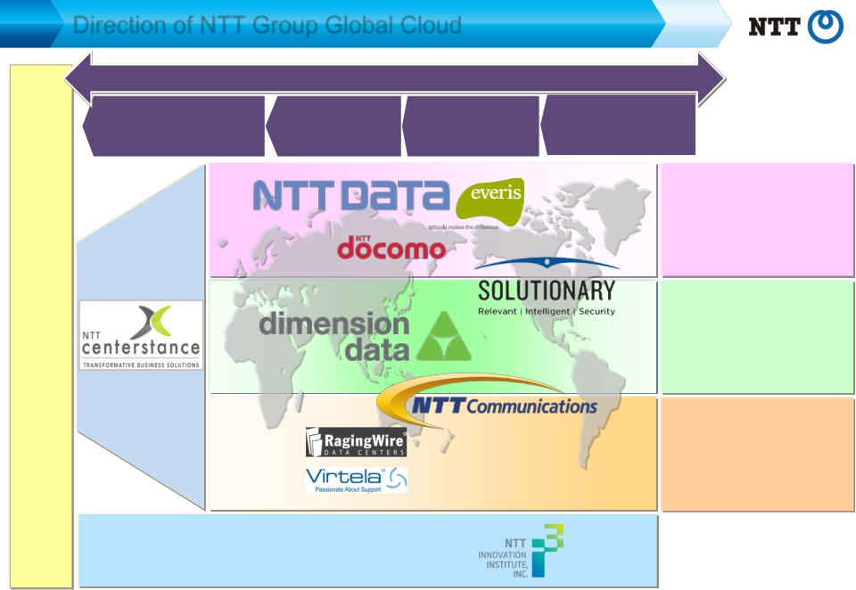
Direction of NTT Group Global Cloud
Cloud Services
Advisory
Services
Migration
Services
Operation
Services
Management
Services
Applications
Solutions
Managed ICT
Data Centers
Networks
Corporate Customers
R&D
※ In October 2013, NTT entered an agreement with the shareholders to acquire 80 % shares of RagingWire Data Centers,
100% shares of Virtela Technology Services Incorporated and Everis Participaciones, S.L.
IR Presentation (December, 2013)
‐9‐
Copyright©2013 Nippon Telegraph and Telephone Corporation

Slide 11
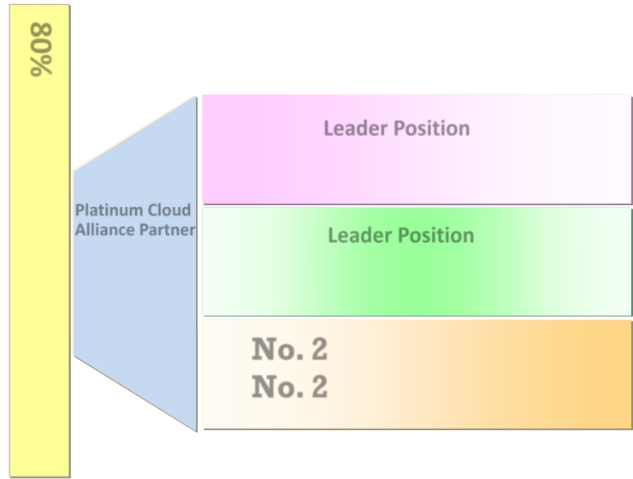

Our Strengths in Global Cloud Services
Leader Position （SOLUTIONARY）
Gartner Magic Quadrant
MSSPs※ （North America）
※Managed Security Service Providers
Platinum Cloud
Applications
Solutions
Alliance Partner
of
Salesforce.com
（Centerstance）
Leader Position （dimension data）
Gartner’s Magic Quadrant
Communications Outsourcing
and Professional Services
No. 2 *
（NTT Group）
No. 2 *
80% Fortune Global 100 choose NTT Group*
Managed ICT
Data Centers
Networks
（*As of March 31, 2013）
inDataCenter
inGlobalIPBackbone
（NTT Communications）
Source: Gartner, " Magic Quadrant for MSSPs, North America " Kelly M. Kavanagh, 15 November 2012
Source: Gartner, " Magic Quadrant for Communications Outsourcing and Professional Services " Eric Goodness, et al. 21 October 2013
This report was published by Gartner, Inc. as part of a larger research document and should be evaluated in the context of the entire document.
The Gartner document is available upon request from Nippon Telegraph and Telephone corporation. Gartner does not endorse any vendor, product or service depicted in its research publications, and does not advise technology users to select only those vendors with the highest ratings.
Gartner research publications consist of the opinions of Gartner's research organization and should not be construed as statements of fact.
Gartner disclaims all warranties, expressed or implied, with respect to this research, including any warranties of merchantability or fitness for a particular purpose.
IR Presentation (December, 2013)
‐10‐
Copyright©2013 Nippon Telegraph and Telephone Corporation

Slide 12
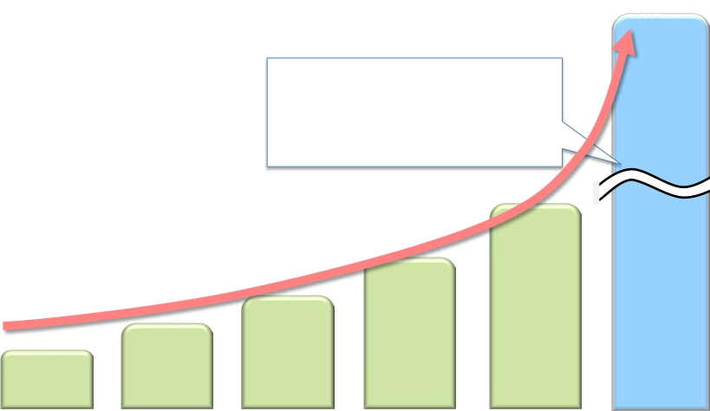
Cross-Selling Contract Value
From April to Sep, 2013
Big-size Cloud projects originated in
“North America” : $450M
（Yum! Brands Inc, TxDOT, etc）
＜Accumulated Contract Value＞
From Oct 2010
290M
790M
USD
200M
USD
～Sep. 2012
USD
～Mar. 2013
147M
USD
～Mar. 2012
62M
～Mar. 2011
112M
USD
～Sep. 2011
USD
～Sep. 2013
IR Presentation (December, 2013)
‐11‐
Copyright©2013 Nippon Telegraph and Telephone Corporation

Slide 13





Cases of Cross-Selling Contract
① Yum！Brands, Inc
Customer
One of the world’s largest restaurant operating company
including KFC and Pizza Hut
Contract Summary
Migration of common information systems to Cloud
Provision of outsourcing service
- Business Process Outsourcing (BPO)
(eg. Accounting, General Affairs, Personnel Affairs)
- Information Technology Outsourcing (ITO)
② Texas Department of Transportation
Customer
Government agency responsible for maintaining
aviation/rail/public transportation infrastructure
Contract Summary
Provision of core system for public transportation
management on highly secure Could platform
Advisory
Service
Application/
Managed ICT
Data Center
· Assessment of cloud
migration by originally
developed tools
· Customization and
implementation of Oracle
ERP application
· Private Cloud Service
· Data Center
‐12‐
· Application development/
maintenance/quality
assurance
· Provision of Private Cloud
Service
· IT Support for CAD, GIS,
GPS, etc
· Implementation and
operation of unified
communication platform*
· Full-line security service
Application
Managed ICT
Security
‐12‐
*Unified platform of telephone and video conference, etc., provided via network
Copyright©2013 Nippon Telegraph and Telephone Corporation
IR Presentation (December, 2013)

Slide 14
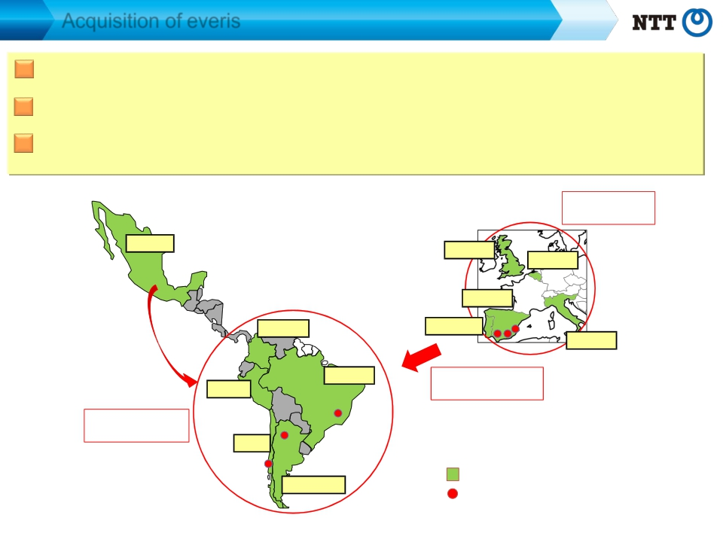
Acquisition of everis
Acquired 100% shares in everis, a full-line IT service provider in Spain
Strengthening our presence in Spain and major Latin American countries
Improving our price competitiveness and service quality by utilizing development
bases in Spain and Latin America
Near-shoring in
European area
Mexico
UK
Mexico
Belgium
Belize
Honduras
Guatemala
Nicaragua
El Salvador
Spain
Panama
Colombia
Portugal
Costa Rica
Guyana
Italy
Venezuela Suriname
Colombia
French Guyana
Ecuador
Brazil
Off-shoring for
Peru
Brazil
Latin American area
Peru
Near-shoring in
Bolivia
Paraguay
Latin American area
Chile
Chile
Argentina
Uruguay
Presence of everis (by country)
Development bases of everis
Argentina
IR Presentation (December, 2013)
‐13‐
Copyright©2013 Nippon Telegraph and Telephone Corporation

Slide 15

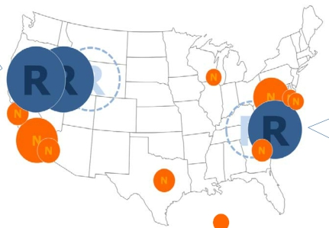


Acquisition of RagingWire
Acquired 80% shares in RagingWire, a Data Center operator in US,
for approx. $350M
Significantly strengthening our ability to provide high-quality and large-scale data
centers, to respond to high demands for data center/cloud services in North America
California Data
Center Campus
（Sacramento）
IR Presentation (December, 2013)
Virginia Data
Center Campus
(Ashburn)
NTT Com‘s Data Centers
RagingWire’s Data Centers
※The size of circles are proportional to server room areas
Copyright©2013 Nippon Telegraph and Telephone Corporation
‐14‐

Slide 16




Acquisition of Virtela
Acquired 100% shares in Virtela, a Virtual Network Operator in US, for approx.
$525M
Aiming to become a leader in the global market through unified delivery of global
network service
① Unified Operation
・ Improvement of business efficiency by integrating operation with Virtela
② Unified Service
・ Upgrade of services by utilizing Virtela’s network function virtualization*
* Technology which enables to virtualize customers' network equipment (such as firewalls and WAN
accelerators) , instead of placing dedicated equipment on customers’ premises
③ Unified Network
・ Expansion of service coverage from 160 to 196 countries/regions
・ Effective usage of IP backbone
IR Presentation (December, 2013)
‐15‐
Copyright©2013 Nippon Telegraph and Telephone Corporation

Slide 17
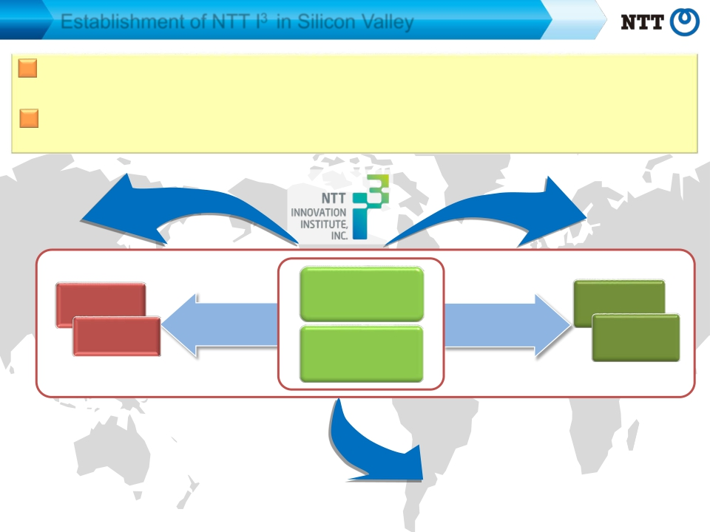
Establishment of NTT I3 in Silicon Valley
Establishment of NTT I3 in Silicon Valley as the base for developing cloud
and security technology
Advancing market-driven development of services originated in North
America
Large
enterprises
Developed
market
(1) Cloud
(2)Security
Mid/small
enterprises
Emerging
market
Deploy
developed IP
Deploy
standardised
service
IR Presentation (December, 2013)
‐16‐
Copyright©2013 Nippon Telegraph and Telephone Corporation

Slide 18

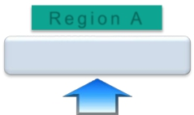
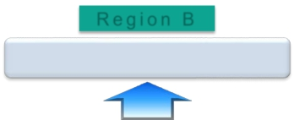
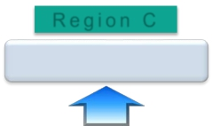

Enhancement of Security Platform
■ One of the world’s largest security integrators
Providing service in over 50 countries
Cutting-edge R&D, world-class communications carrier CSIRT(Computer Security Incident Response Team)
■ Established a permanent position as a frontrunner in security technology
Building a global security platform
Adapting to the legal systems and personal information protection systems of each
country (local platforms)
Promoting M&A and strategic alliances
Region A
Region B
Region C
Local Platform
･･･
Global Security Platform
・Intelligent encryption
Security
Analysis
Engine
Security
Intelligence
Information regarding
threats and vulnerability, etc.
Global
Operation
(NOC / SOC)
・Secure dispersion/
computation technology
・Cloud forensics
・Anti-malware, etc.
IR Presentation (December, 2013)
‐17‐
Copyright©2013 Nippon Telegraph and Telephone Corporation

Slide 19
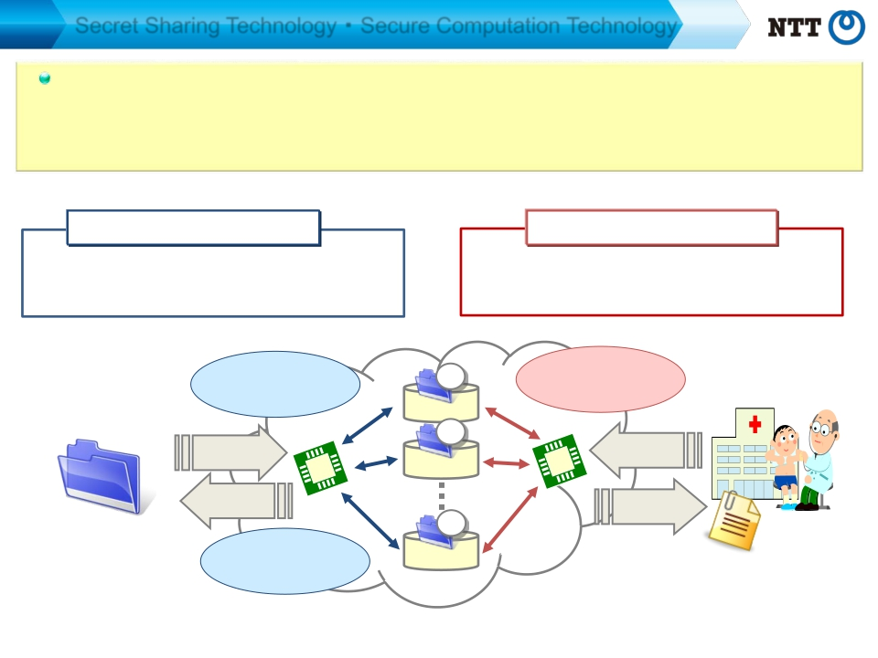
Secret Sharing Technology ･ Secure Computation Technology
NTT’s Secure Computation Technology ranks among the highest level in the world,* which
is highly competitive in expanding our “Global Cloud Service”.
NTT has succeeded in putting it to practical use for medical statistical analysis for the first
time in the world.
Secret Sharing Technology
Enables to encrypting data (dividing into some
meaningless data sets) and stores them in
separate servers among the cloud.
Secret sharing
(data saved in separate servers)
save
Secure Computation Technology
Enables computation of secretly shared data
without decryption.
Enables statistical analyses
without decryption
computing
request
?
?
draw
Restoration of
original file
output
result
?
Original
(Data File)
Use of Data
Cloud
（（Statistic Computing, etc））
* World’s No.1 sorting and multiplication capability
IR Presentation (December, 2013)
‐18‐
Copyright©2013 Nippon Telegraph and Telephone Corporation

Slide 20
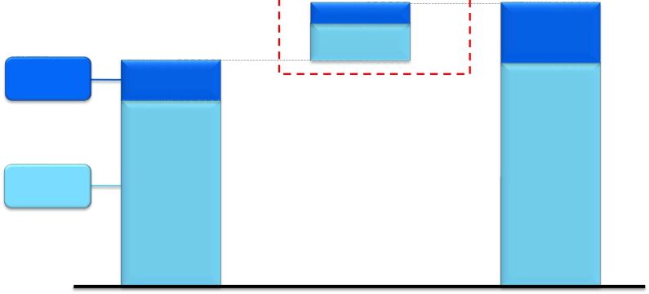
IT Spending ※1 Forecast
$300 billion
$1,750 billion
100
200
（33%）
（67%）
33%）
340
（20%）
$1,450 billion
67%）
30
19
Developing
Countries
Developed
Countries
240
1,210
（17%）
（83%）
20
1,410
114
（80%）
95
2011
Growth
2011-2016
（E）2016
Source: Gartner, "Forecast: Enterprise IT Spending by Vertical Industry Market, Worldwide, 2011-2017, 3Q13 Update" 3 October 2013,
Chart created by NTT based on Gartner data.
※1 IT Spending
: Software, IT Services, Devices (Excluding Internal Services, Telecom Services, and Datacenter.)
※ Developing Countries : Latin America, Emerging Asia/Pacific, Greater China, Eastern Europe, Eurasia, MEA
※ Developed Countries : North America, Western Europe, Mature APAC
IR Presentation (December, 2013)
‐19‐
Copyright©2013 Nippon Telegraph and Telephone Corporation

Slide 21
Broadband Services

Slide 22
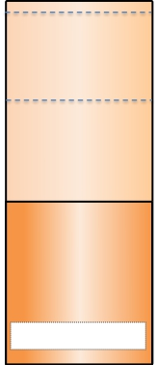



Broadband Access Services in Japan
Mobile
Fixed
Mobile
137.6M subs
E-mobile
SoftBank
Mobile
ａｕ
NTT DOCOMO
61.6M subs
NTT market share
Approx. 45％
～150Mbps
150B
100B
50B
Access
speed
Approx.
30.0M
20.0M
10.0M
Access
speed
FTTH
24.3M subs
NTTEAST and
NTT WEST
17.5M subs
NTT market share
Approx. 72％
～1Gbps
Approx.
DSL
CATV
6.0M subs
～160Mbps
Approx.
Approx.
5.2M subs
NTT EAST and NTT WEST
Approx.1.75M subs
NTT market share
Approx. 34％
～50Mbps
（Note） Access speeds shown are numbers used for commercial purposes, and are the maximum output speeds achievable within the framework of the respective best effort services.
（Source）Fixed accesses are MIC data, Mobile is TCA data. (Some figures are based on financial results materials of the companies.) (As of the end of June 2013)
IR Presentation (December, 2013)
‐21‐
Copyright©2013 Nippon Telegraph and Telephone Corporation

Slide 23




Mobile Broadband Business
DOCOMO Smartphone Users
(Million subs)
“Xi” LTE Subscriptions
(Million subs)
27.00
30
30
3,000
2,500
3,000
2,500
25.00
25
25
21.57
20
20
2,000
1,500
1,000
500
2,000
1,500
1,000
500
16.40
15
15
10
10
0
0
00
2013/3 2014/3
1Q 2Q 3Q 4Q 1Q 2Q
Full-year
-forecast
2013/3
1Q 2Q 3Q 4Q 1Q 2Q
Full-year
-forecast
2014/3
・・・
年度末
・・・
年度末
（予想）
（予想）
IR Presentation (December, 2013)
‐22‐
Copyright©2013 Nippon Telegraph and Telephone Corporation

Slide 24











Aggregate ARPU of Mobile Broadband Business
： Smart ARPU
： Packet ARPU
： Voice ARPU
： “Monthly Support” Impact
（（Yen））
４,５３０
５１０
２,９７０
１,７７０
ｰ７２０
full-year
５,２２０
３５０
２,５３０
２,３５０
ｰ１０
2012/3
1Ｑ
５,２４０
３５０
２,６１０
２,３２０
ｰ４０
2Ｑ
５,１５０
３６０
２,６００
２,２５０
ｰ６０
3Ｑ
４,９６０
３６０
２,６４０
２，０７０
ｰ１１０
4Ｑ
４,９３０
３７０
２,７００
２，０４０
ｰ１８０
2013/3
1Ｑ
４,８７０
３９０
２,７５０
２，０２０
ｰ２９０
2Ｑ
４,８５０
４２０
２,８３０
１，９９０
ｰ３９０
3Ｑ
４,６７０
４６０
２,８６０
１,８６０
ｰ５１０
4Ｑ
４,６１０
４６０
２,８９０
１,８４０
ｰ５８０
2014/3
1Ｑ
４,５９０
４９０
２,９１０
１,８４０
ｰ６５０
2Ｑ
・Smart ARPU : A part of other operating revenues (revenues from content services, proxy bill collection commissions,
mobile phone insurance service, advertising and others) / No. of active subscriptions (*)
forecast
(*) Sum of No. of active subscriptions for each month : ((No. of subscriptions at the end of previous month + No. of subscriptions at the
end of current month) / 2) during the relevant period
・Fiscal year ended 2012/3 Aggregate ARPU 5,140 ( Voice ARPU 2,250, Packet ARPU 2,600, Smart ARPU 350, “Monthly Support” Impact -60 )
・Fiscal year ended 2013/3 Aggregate ARPU 4,840 ( Voice ARPU 1,970, Packet ARPU 2,790, Smart ARPU 420, “Monthly Support” Impact -340 )
IR Presentation (December, 2013)
‐23‐
Copyright©2013 Nippon Telegraph and Telephone Corporation

Slide 25


Expansion of dmarket
Total subscriptions to
“dvideo”, “dhits”, “danime store”
“dvideo”
※Video/movie webcast service
4.46 million subs
(Million subs)
７.０１
６.５３
“dhits”
※Music webcast service
1.55 million subs
“danime store”
※“Anime” webcast service
1.01 million subs
Total “dmarket”
transactions
(FY2013/1H):
¥27 billion
2012/3 2013/3
2014/3
3Q
4Q
1Q
2Q
3Q
4Q
1Q
2Q
IR Presentation (December, 2013)
‐24‐
Copyright©2013 Nippon Telegraph and Telephone Corporation

Slide 26
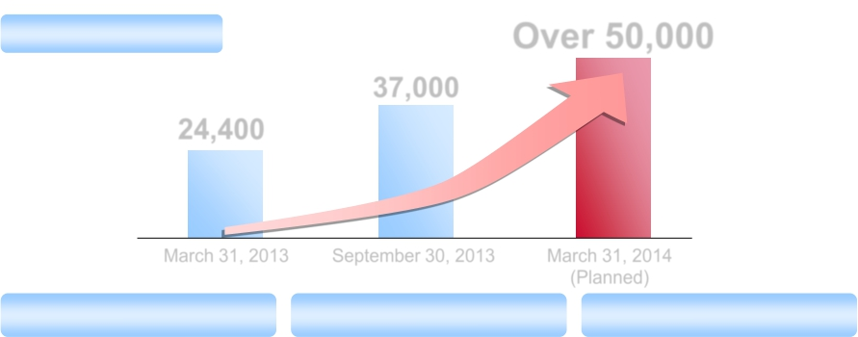
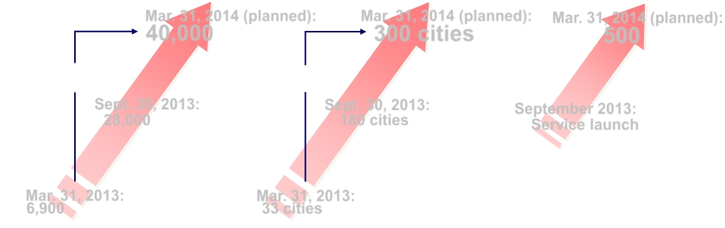
LTE Base Station Roll-Out and Speed Enhancements
No. of LTE base stations
Over 50,000
37,000
24,400
March 31, 2013
September 30, 2013
March 31, 2014
(Planned)
Base stations compatible with
75Mbps or higher rates
Cities where 112.5Mbps service
is introduced
Base stations compatible
with 150Mbps
Mar. 31, 2014 (planned):
Mar. 31, 2014 (planned):
Mar. 31, 2014 (planned):
40,000
300 cities
500
6-fold
Sept. 30, 2013:
28,000
Mar. 31, 2013:
IR Presentation (December, 2013)
9-fold
Sept. 30, 2013:
180 cities
Mar. 31, 2013:
‐25‐
September 2013:
Service launch
Copyright©2013 Nippon Telegraph and Telephone Corporation
6,900
33 cities

Slide 27







Fixed Broadband Business FTTH Subscriptions
FTTH Subscriptions (Sum of NTT East and NTT West））
（thousands subs)
FTTH Churn Rate (Sum of NTT EAST and NTT WEST））
Churn rate is
improving
1.37%
1.34%
1.31%
1.24%
1.21%
1.19%
16,564
17,300
18,300
1.07%
15,059
13,251
1.05%
1.03%
1.05%
11,134
2009/3
2010/3
2011/3
2012/3
2013/3
2014/3E
2012/3
2013/3
2014/3
（Fiscal year ended/ing March 31）
1Q
2Q
3Q
4Q
1Q
2Q
3Q
4Q
1Q
2Q
IR Presentation (December, 2013)
‐26‐
Copyright©2013 Nippon Telegraph and Telephone Corporation

Slide 28







Fixed Broadband Business ARPU
ARPU
（Yen）
<Hikari Denwa>
Percentage of
90%
Basic Rate
Additional Services
FTTH users
80%
84%
88%
5,740
5,880
5,920
5,860
5,700
16.42
5,580
15.17
1,320
1,450
1,570
1,640
1,720
1,790
Million
channels
12.11
13.90
NTT
500 yen/month～
East
11/3
12/3
13/3
14/3E
4,260
4,290
4,310
4,280
4,140
3,910
<FLET’S TV>
Million
subscriptions
1.19
1.00
0.86
5,620
5,780
5,890
5,940
5,880
5,770
0.59
1,330
1,460
1,580
1,650
1,730
1,750
650 yen/month～
11/3
12/3
13/3
14/3E
<Remote Support>
Million
subscriptions
4.53
NTT
West
4.66
4,290
4,320
4,310
4,290
4,150
4,020
4.30
3.34
500 yen/month～
（Fiscal year
2009/3
2010/3
2011/3
2012/3
2013/3
2014/3E
11/3
12/3
13/3
14/3E
ended/ing
March 31）
IR Presentation (December, 2013)
‐27‐
Copyright©2013 Nippon Telegraph and Telephone Corporation

Slide 29
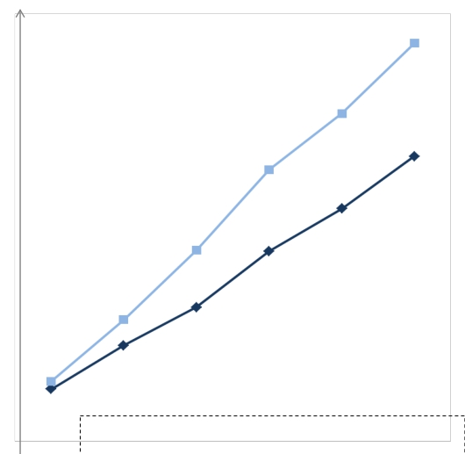
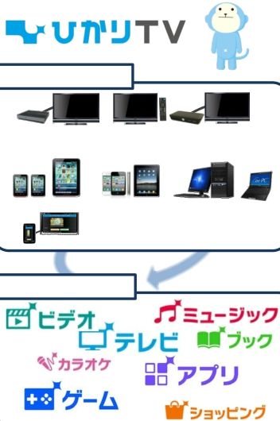
Penetration of Video Services
Million
subscriptions
4.19
3.45
Multi-Device
Hikari TV＋FLET’S TV
2.86
Tuner
(STB)
TV
TV with
Built-in tuner
New STB for Smart TV
3.00
2.01
2.45
Smartphones, tablet PCs
PC/NotePC
2.00
Hikari TV
Car Navigation
Multi-Service
1.28
1.41
0.63
1.01
video
music
TV
book
0.55
Hikari TV ：IPTV service which distributes VOD, terrestrial digital broadcasting,
BS digital broadcasting, and multi-channel broadcasting
FLET’S TV ：Service which distributes terrestrial digital broadcasting, BS digital
broadcasting, and multi-channel broadcasting(optional), by Radio
Frequency system
karaoke
game
application
shopping
2009/3
2010/3
2011/3
2012/3
2013/3
2014/3E
（End of Year/month）
IR Presentation (December, 2013)
‐28‐
Copyright©2013 Nippon Telegraph and Telephone Corporation

Slide 30


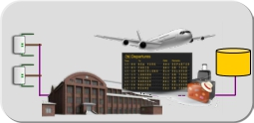



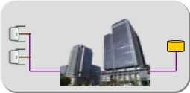



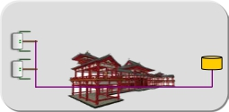


Expansion of Wi-Fi Solution Business
Enterprises and local government provide information service through Wi-Fi,
together with free Internet access
NTT Group (NTT-BP) builds the Wi-Fi network and provides the platform for
Information service
Users
Area Owners
Airports・Railway Stations
server
ＡＰ
NTT
Internet
access
（free of charge）
＋
Information
service
（charged）
Office buildings
Tourist spots, Art galleries,
City halls,etc.
Information
service
platform
（including cloud）
＋
Wi-Fi network
※ Started provision of “Japan Connected-free Wi-Fi”, which inter-connects the Wi-Fi
services provided by enterprises and local governments
IR Presentation (December, 2013)
‐29‐
Copyright©2013 Nippon Telegraph and Telephone Corporation

Slide 31
NTT Group Overview

Slide 32

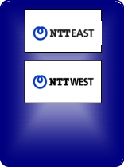
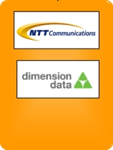



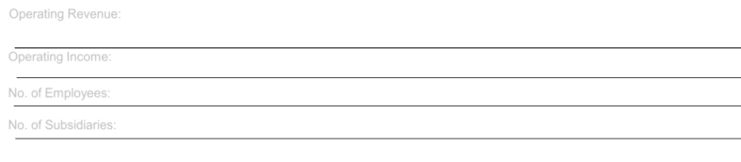
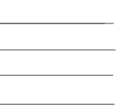
NTT Group Overview
· Operating revenues (consolidated) :10,700.7 billion yen
· Operating income (consolidated)
· No. of employees
· No. of subsidiary companies
: 1,202.0 billion yen
: 227,150
: 827
* Percentage figures show the percentage of voting rights
(March 31, 2013)
54.2％
Other
group
companies
100％**
100％**
66.6％**
**
Regional
communications
business
Operating Revenue:
3,658.2 billion yen
Operating Income:
92.5 billion yen
Long distance and
international
communications
business
1,657.9 billion yen
121.3 billion yen
Mobile
communications
business
4,470.1 billion yen
836.4 billion yen
Data
communications
business
1,303.5 billion yen
85.8 billion yen
Other businesses
real estate, finance,
construction
and power business
1,257.6 billion yen
53.6 billion yen
No. of Employees:
No. of Subsidiaries:
81,300
80
33,450
270
23,900
181
61,350
217
27,150
79
(Note) Fiscal year ended March 2013. Operating revenue and operating income of each segment include intersegment transactions.
IR Presentation (December, 2013)
‐31‐
Copyright©2013 Nippon Telegraph and Telephone Corporation

Slide 33
Trend in Consolidated Financial Results
11.0
■ Operating
Revenues
（（Trillion yen））
■ Operating
Income
（（Trillion yen））
■ Net Income
（（Trillion yen））
10.7
1.20
0.52
10.4
1.11
0.54
10.5
1.22
0.47
10.2
1.12
0.49
10.3
1.21
0.51
1.23
0.59
■ Operating FCF
1.41
（（Trillion yen））
1.25
1.27
1.35
503
1.22
1.24
■ EPS
（（yen））
Fiscal year ended/ing
March 31
400
2009/3
385
2011/3
432
2013/3
372
2010/3
367
2012/3
2014/3E *
*Includes influence of 60 billion yen of non-operating revenues by The Otemachi 2-Chome Area Redevelopment Project .
(Note1) Due to the January 2009 stock split of one share of common stock into 100 shares, figures for 2008/3 have been retroactively adjusted.
(Note2) Operating FCF＝EBITDA-Capex
IR Presentation (December, 2013)
‐32‐
Copyright©2013 Nippon Telegraph and Telephone Corporation

Slide 34
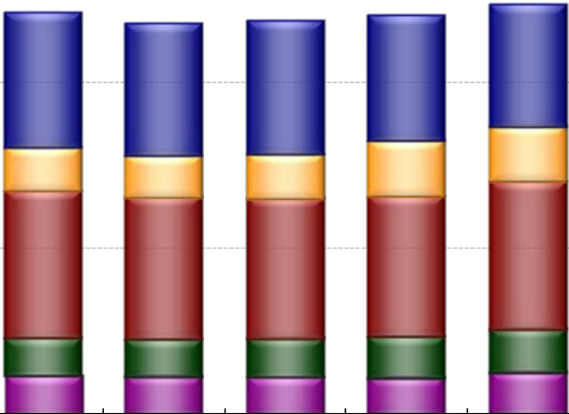

Changes in Consolidated Operating Revenues
：Regional communications business
：Data communications business
Consolidated
Operating Revenues
（billion yen）
：Long distance and international
communications business
：Mobile communications business
：Other business
10,700.7
3,658.2
11,000.0
10,416.3
10,305.0
10,507.4
10,181.4
10,000
4,064.8
3,964.3
4,027.2
3,764.8
1,657.9
1,315.5
1,259.6
1,332.7
1,678.7
5,000
4,448.0
1,127.2
1,165.2
4,284.4
1,132.5
1,132.6
4,224.3
1,163.2
1,120.3
4,240.0
1,251.8
1,089.0
4,470.1
1,303.5
1,257.6
0
(Fiscal year
2009/3
2010/3
2011/3
2012/3
2013/3
2014/3E
ended/ing March 31)
(Note) Business segment operating revenues include intersegment transactions
IR Presentation (December, 2013)
‐33‐
Copyright©2013 Nippon Telegraph and Telephone Corporation

Slide 35
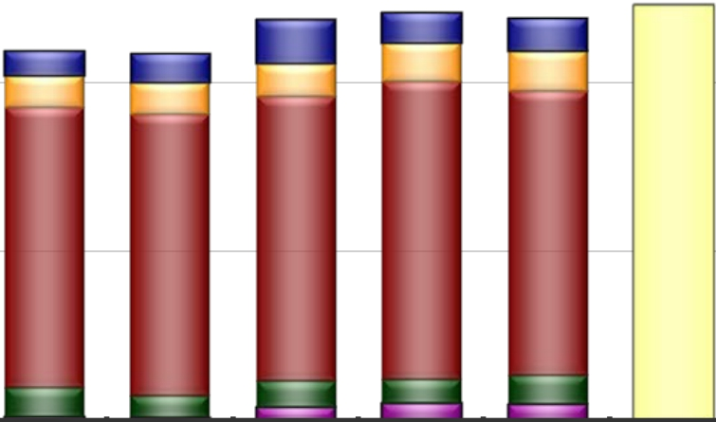
Changes in Consolidated Operating Income
：Regional communications business
：Data communications business
Consolidated
Operating Income
（billion yen）
：Long distance and international
communications business
：Mobile communications business
：Other business
1,223.0
1,202.0
1,230.0
1,214.9
1,109.8
70.5
96.9
825.4
86.8
15.2
2009/3
1,117.7
82.1
98.2
828.4
64.9
2010/3
86.9
116.7
876.4
71.5
56.9
2012/3
92.5
121.3
836.4
85.8
53.6
2013/3
127.3
97.1
839.1
77.0
44.9
2011/3
1,000
500
0
(Fiscal year
13.3
2014/3E
ended/ing March 31)
(Note) Business segment operating income include intersegment transactions
IR Presentation (December, 2013)
‐34‐
Copyright©2013 Nippon Telegraph and Telephone Corporation

Slide 36
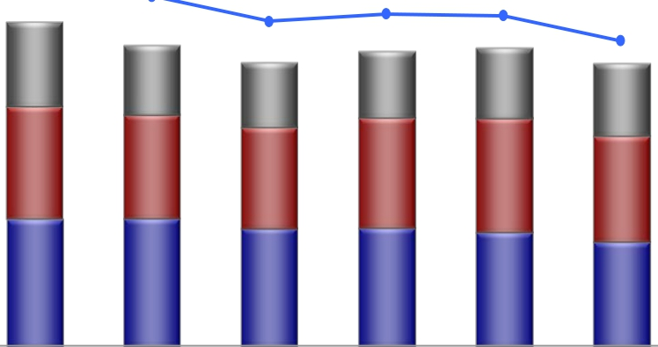
Changes in CAPEX
CAPEX / Sales
（Billions of yen）
2,500
20.6%
19.5%
20.0%
18.1%
1,870.1
422.0
668.5
779.6
2011/3
18.5%
1,946.6
435.6
726.8
784.2
2012/3
18.4%
1,970.0
461.3
753.7
755.0
2013/3
2,145.1
560.2
737.6
847.3
2009/3
1,987.1
454.6
686.5
846.0
2010/3
17.0%
1,870.0
480.0
700.0
690.0
2014/3E
2,000
1,500
1,000
500
0
Fiscal year
ended/ing
March 31
Others
NTT
DOCOMO
NTT EAST
＋
NTT WEST
15.0%
10.0%
5.0%
0.0%
IR Presentation (December, 2013)
‐35‐
Copyright©2013 Nippon Telegraph and Telephone Corporation

Slide 37
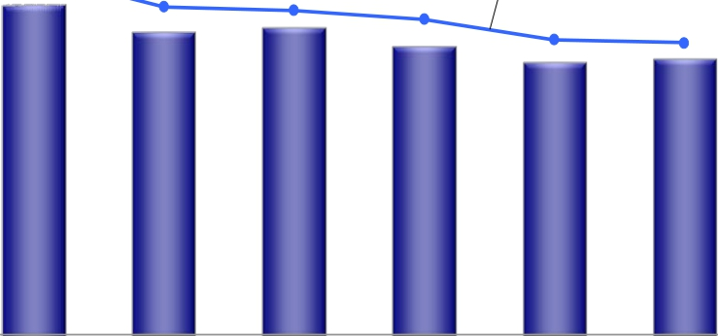
Changes in Interest-bearing Debt
Interest-bearing
Debt
（billion yen）
6,000
40.2%
Debt ratio*
40.0%
5,000
36.6%
36.2%
35.2%
32.9%
32.6%
4,000
3,000
30.0%
4,899.3
4,553.5
20.0%
4,491.7
4,274.0
4,036.0
4,100.0
2,000
10.0%
1,000
0
0.0%
2009/3
2010/3
2011/3
2012/3
2013/3
2014/3E
(Fiscal year
ended/ing March 31)
* Debt ratio = Interest-bearing debt / (Interest-bearing debt + Shareholders’ equity) x 100
IR Presentation (December, 2013)
‐36‐
Copyright©2013 Nippon Telegraph and Telephone Corporation

Slide 38
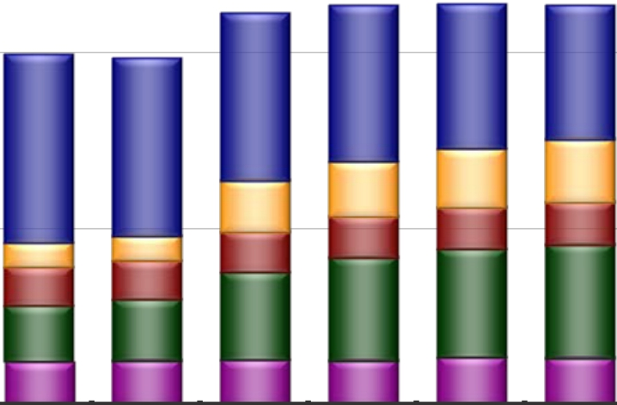
Changes in Number of Employees
：Regional communications business
：Long distance and international
communications business
：Mobile communications business
：Data communications business
：Other business
Consolidated No. of
employees
222,150
226,650
227,150
226,750
200,000
198,550
196,900
88,300
81,300
75,550
94,350
106,500
100,600
33,450
35,900
31,150
29,350
22,950
50,000
25,500
2011/3
100,000
0
（End of Year/month）
23,300
58,650
25,250
2012/3
23,900
61,350
27,150
2013/3
24,150
64,350
26,800
2014/3E
13,900
21,850
31,250
25,050
2009/3
14,200
22,300
34,550
25,250
2010/3
IR Presentation (December, 2013)
‐37‐
Copyright©2013 Nippon Telegraph and Telephone Corporation

Slide 39
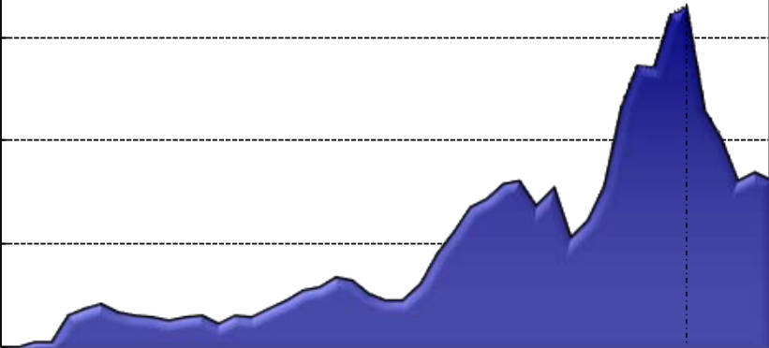


Age Distribution of Employees at NTT East, NTT West and
“Outsourcing Companies” (As of March 31, 2013）
8,000
6,000
4,000
2,000
0
Number of Employees
20
30
40
50
60
65
Age
(Note) Figures for East Outsourcing Companies include the consolidated prefectural outsourcing companies (NTT EAST-TOKYO and others), NTT-ME and NTT EAST
SOLUTIONS, while figures for West Outsourcing Companies include the consolidated regional outsourcing companies (NTT WEST-KANSAI and others), NTT MARKETING
ACT, NTT NEOMEIT and NTT WEST-HOMETECHNO. Figures for those companies include the number of more than 60-year-old contracted employees.
38
Copyright©2013 Nippon Telegraph and Telephone Corporation
IR Presentation (December, 2013)
‐ ‐

Slide 40
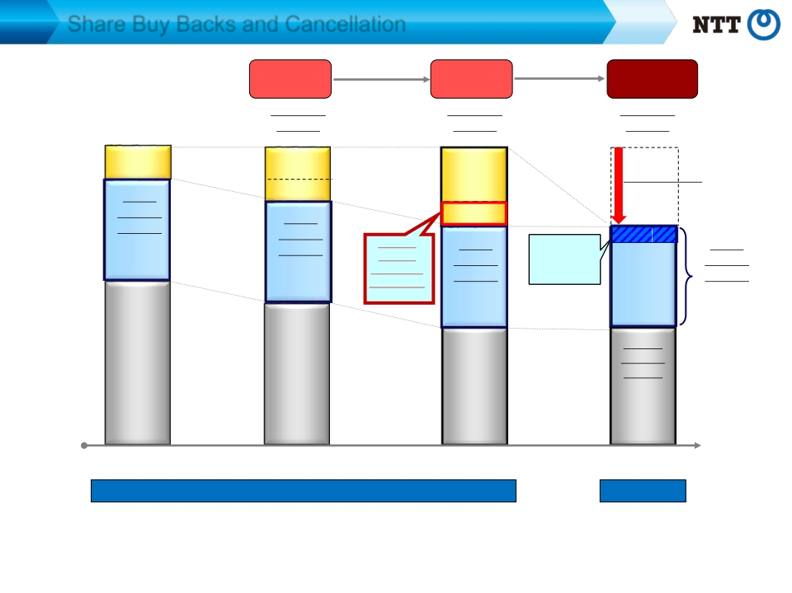
Share Buy Backs and Cancellation
Buy back
from market
Treasury
Buy back
from market
Treasury
Cancellation
Treasury
＜＞：share holding ratio
99mil. shares
Gov’t
Stocks
<10.4%>
99mil. shares
38mil. shares
Stocks
<14.1%>
138mil. shares
Stocks
<0.0%>
Cancellation
-187 mil. shares
Owned
Shares
※
431mil. shares
<33％>
Gov’t
Owned
Shares
431mil. shares
<33％>
50mil. shares
Gov’t
Owned
Shares
431mil. shares
<33％>
Portion
bought
back from
the market
Excess
Holdings
62mil. shares
Gov’t
Owned
Shares
431mil. shares
<39％>
Market
floating
shares
793mil. shares
755mil. shares
705mil. shares
Oct. 31, 2013
705mil. shares
Nov. 30, 2013
Mar. 31, 2012
Mar. 31, 2013
Total number of shares issued (million shares)
1,323
※ Mandatory (minimum) number of shares to be held by the Government under the NTT Law
= （total number of shares issued－30 million shares issued at the IPO in 2000) ×1/3
1,137
*The number of shares issued after the initial listing are not to be included in the calculations. (NTT Law, supplementary provision 13)
IR Presentation (December, 2013)
‐39‐
Copyright©2013 Nippon Telegraph and Telephone Corporation

Slide 41

Next V alue P artner
T ransformation
T rusted S olutions
andFull-lineICT services
Copyright©2013 Nippon Telegraph and Telephone Corporation
for
of BusinessmodelsandLifestyle
by
ofGlobal,Secure,End-to-end,
Copyright©2013 Nippon Telegraph and Telephone Corporation

