Slide 1

Joe Kaeser, President and CEO – Ralf P. Thomas, CFO
Siemens – Vision 2020
Q2 FY 2014, Analyst and Press Conference
Berlin, May 7, 2014
© Siemens AG 2014. All rights reserved.

Slide 2
Safe Harbour Statement
This document contains statements related to our future business and financial performance and future events or developments involving Siemens that may
constitute forward-looking statements. These statements may be identified by words such as “expect,” “look forward to,” “anticipate,” “intend,” “plan,” “believe,”
“seek,” estimate ” “will,” project” or words of similar meaning. We may also make forward-looking statements in other reports in presentations, in material
delivered to shareholders and in press releases. In addition, our representatives may from time to time make oral forward-looking statements. Such statements
are based on the current expectations and certain assumptions of Siemens’ management, and are, therefore, subject to certain risks and uncertainties. A variety
of factors, many of which are beyond Siemens’ control, affect Siemens’ operations, performance, business strategy and results and could cause the actual results,
performance or achievements of Siemens to be materially different from any future results, performance or achievements that may be expressed or implied by
such forward-looking statements or anticipated on the basis of historical trends. These factors include in particular, but are not limited to, the matters described in
Item 3: Key information—Risk factors of our most recent annual report on Form 20-F filed with the SEC, in the chapter C.9.3 Risks of our most recent annual
report prepared in accordance with the German Commercial Code, and in the chapter C.7 Risks and opportunities of our most recent interim report.
Further information about risks and uncertainties affecting Siemens is included throughout our most recent annual and interim reports, as well as our most recent
earnings release, which are available on the Siemens website, www.siemens.com, and throughout our most recent annual report on Form 20-F and in our other
filings with the SEC, which are available on the Siemens website, www.siemens.com, and on the SEC’s website, www.sec.gov. Should one or more of these risks
or uncertainties materialize, or should underlying assumptions prove incorrect, actual results, performance or achievements of Siemens may vary materially from
those described in the relevant forward-looking statement as being expected, anticipated, intended, planned, believed, sought, estimated or projected. Siemens
neither intends, nor assumes any obligation, to update or revise these forward-looking statements in light of developments which differ from those anticipated.
All underlying margins are calculated by adjusting margins for the effects reported for the respective businesses in the relevant period. These effects are provided
to assist in the analysis of the businesses' results year-over-year and may vary from period to period. Underlying margins are not necessarily indicative of future
performance. Other companies may calculate similar measures differently.
Due to rounding, numbers presented throughout this and other documents may not add up precisely to the totals provided and percentages may not precisely
reflect the absolute figures.
The financial measures identified in this document are in part transitional figures attained by comparison, classification, appreciation and rounding of historical
financial measures; these financial measures and their transitional basis must be regarded as preliminary.
© Siemens AG 2014. All rights reserved.
g ,
p j
Page 2
Berlin, May 7, 2014
Q2 FY 2014, Analyst and Press Conference

Slide 3
Q2 FY 2014 – Key figuresKey figures
Siemens (continuing operations, in €m)
Orders
Revenue
Book-to-bill ratio
Total Sectors profit
Net income
Basic earnings per share net income (in €)
Free cash flow
1) Change is adjusted for portfolio and currency translation effects
© Siemens AG 2014. All rights reserved.
Q2 FY 13
21,235
17,779
1.19x
1,348
1,030
1.20
1,360
Q2 FY 14
18,430
17,449
1.06x
1,566
1,153
1.33
1,390
Change
-10%1)
1%1)
16%
12%
11%
2%
Page 3
Berlin, May 7, 2014
Q2 FY 2014, Analyst and Press Conference

Slide 4
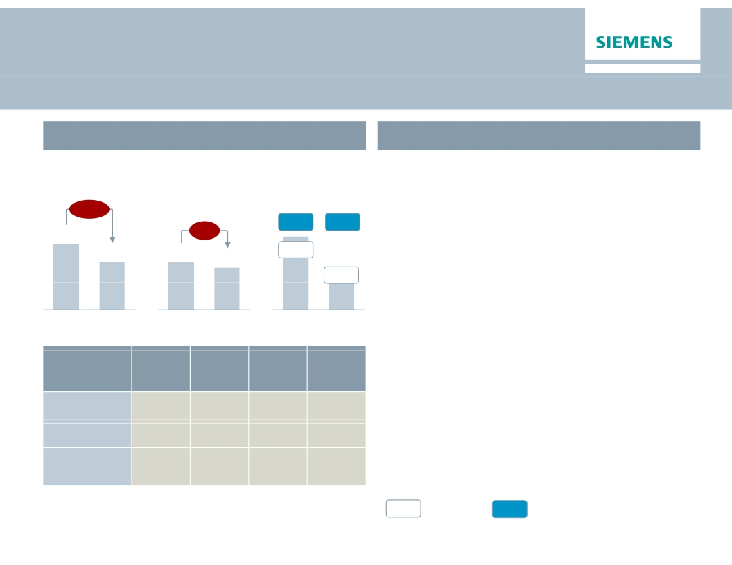
Energy – Performance held back by lower revenues and
execution challenges
Key Figures Energy
€bn
Main developments in Q2
· Book-to-bill at 1.09 despite sharp order decline
€m
Orders 1)
Revenue 1)
Profit 2)
in Europe/CAME region
-23%
8.5
6.1
· Market environment remains challenging
· Power Generation – Positive gains
overcompensate lower contribution due to
decreasing revenue mainly from gas turbine
business
-6%
10.5%
8.8%
551
8.6%
4.6%
255
6.3
5.6
Q2 13
Q2 14
Q2 13
Q2 14
Q2 13
Q2 14
· Wind – Significantly lower contribution from
offshore business and charges related to
Orders
y-o-y 1)
-14%
-46%
7%
Revenue
y-o-y 1)
-8%
13%
-14%
Profit
margin
18.4%
-4.3%
-24.2%
Underl.l
profit
margin
14.4%
-0.2%
1.1%
defective components
· Transmission – Substantial execution
challenges at two Canadian turnkey projects
result in charges of €287m; further low margin
projects
Division
Power
Generation
Wind Power
Power
Transmission
1) Comparable, i.e. adjusted for currency translation and portfolio effects
%
Profit margin
%
Underlying Profit margin
© Siemens AG 2014. All rights reserved.
2) for underlying margin calculation please refer to Flashlight document
Page 4
Berlin, May 7, 2014
Q2 FY 2014, Analyst and Press Conference

Slide 5
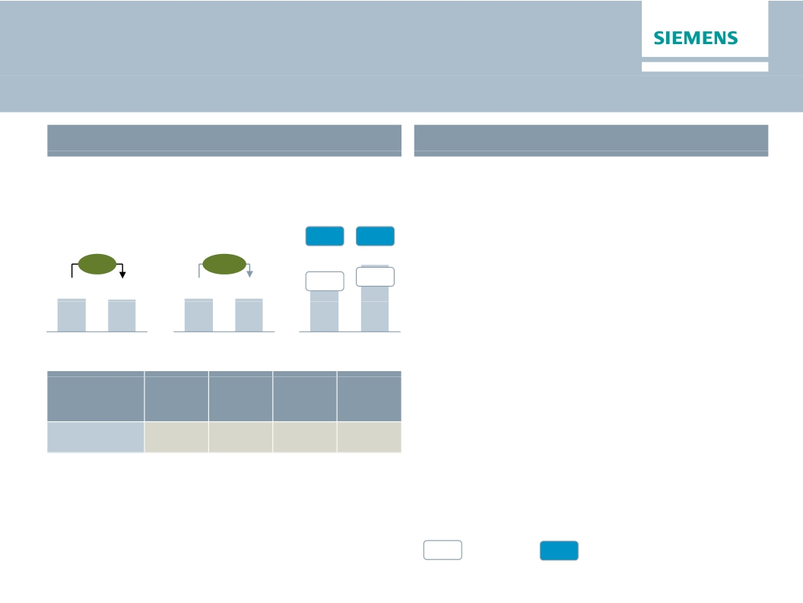
Healthcare – Continued excellent performance on high
level despite currency headwinds
Key Figures Healthcare
€bn
Main developments in Q2
· Order growth supported by strong service
€m
Orders 1)
Revenue 1)
Profit 2)
business and improvement in Europe while
revenue growth is broad based
15.3%
15.5%
· Strong profit margin – €66m gain from
+1%
+5%
expected sale of particle therapy installation
3.3
Q2 13
3.3
Q2 13
3.3
Q2 14
13.6%
445
Q2 13
16.3%
531
Q2 14
compensates for strongly adverse FX effects
· Diagnostics – Solid growth and profit
development
3.2
Q2 14
Orders
y-o-y 1)
3%
Revenue
y-o-y 1)
3%
Profit
margin
10.8%
Underl.l
profit
margin
15.2%
Division
Diagnostics
1) Comparable, i.e. adjusted for currency translation and portfolio effects
%
Profit margin
%
Underlying Profit margin
© Siemens AG 2014. All rights reserved.
2) for underlying margin calculation please refer to Flashlight document
Page 5
Berlin, May 7, 2014
Q2 FY 2014, Analyst and Press Conference

Slide 6
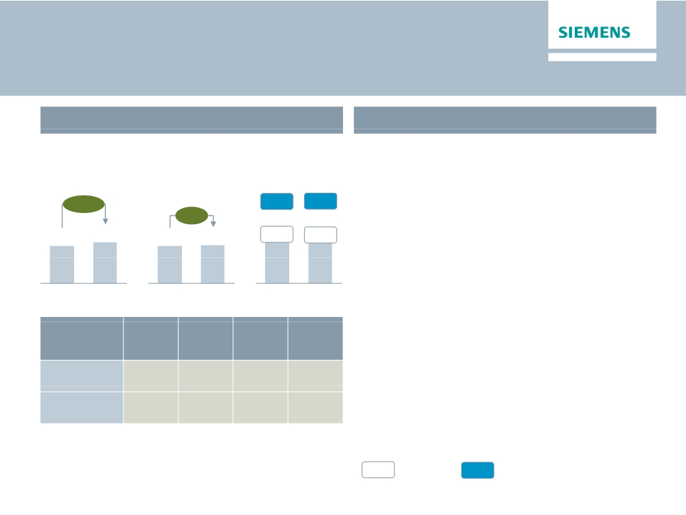
Industry – Profit climbs as short cycle businesses
continue stabilizing
Key Figures Industry
€bn
Main developments in Q2
· Short cycle markets show continuing
€m
Orders 1)
Revenue 1)
Profit 2)
stabilization, with positive order growth
particularly in Germany and China
+12%
4.4
10.5%
7.9%
345
13.2%
10.3%
456
· Industry Automation – Margin improvement
due to higher capacity utilization
· Drive Technologies – Improved cost position
and volume growth support gross margins
+5%
4.8
4.4
4.4
Q2 13
Q2 14
Q2 13
Q2 14
Q2 13
Q2 14
· Metals Technologies burdened by a project in
the US; Joint venture with Mitsubishi-Hitachi
Orders
y-o-y 1)
11%
14%
Revenue
y-o-y 1)
6%
5%
Profit
margin
15.8%
9.5%
Underl.l
profit
margin
18.1%
9.9%
Heavy Machinery signed
Division
Industry
Automation
Drive
Technologies
1) Comparable, i.e. adjusted for currency translation and portfolio effects
%
Profit margin
%
Underlying Profit margin
© Siemens AG 2014. All rights reserved.
2) for underlying margin calculation please refer to Flashlight document
Page 6
Berlin, May 7, 2014
Q2 FY 2014, Analyst and Press Conference

Slide 7
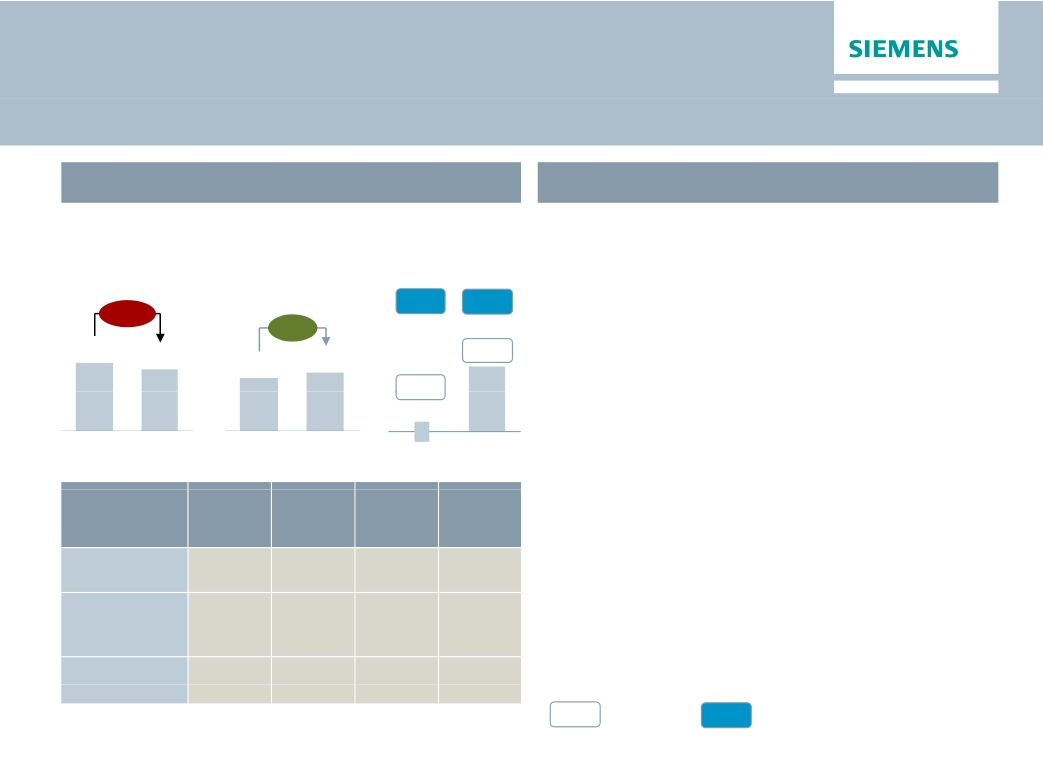
Infrastructure & Cities – Higher profit on improvements
in execution, mix and productivity
Key Figures Infrastructure & Cities
Main developments in Q2
€bn
Orders 1)
-12%
€m
Profit 2)
4.7%
· Positive book-to-bill of 1.05 on tough comps
due to major rail orders
· Transportation & Logistics – Improved projectImproved project
execution of large rolling stock orders
Revenue 1)
+7%
7.2%
5.2
4.7
4.1
4.4
7.3%
· Power Grid Solutions & Products – Mainly
0.2%
6
Q2 13
benefitting from favourable mix and ‘Siemens
2014’ related productivity improvements
· Building Technologies – Continued
improvement from successful implementation
325
Q2 14
Q2 13
Q2 14
Q2 13
Q2 14
Orders
y-o-y 1)
-29%
9%
-6%
Revenue
y-o-y 1)
21%
1%
-1%
Profit
margin
7.0%
8.2%
6.9%
Underl.l
profit
margin
8.3%
8.2%
6.9%
of 'Siemens 2014' measures
Division
Transportation
& Logistics
Power Grid
Solutions
& Products
Building
Technologies
1) Comparable, i.e. adjusted for currency translation and portfolio effects
%
Profit margin
%
Underlying Profit margin
© Siemens AG 2014. All rights reserved.
2) for underlying margin calculation please refer to Flashlight document
Page 7
Berlin, May 7, 2014
Q2 FY 2014, Analyst and Press Conference

Slide 8
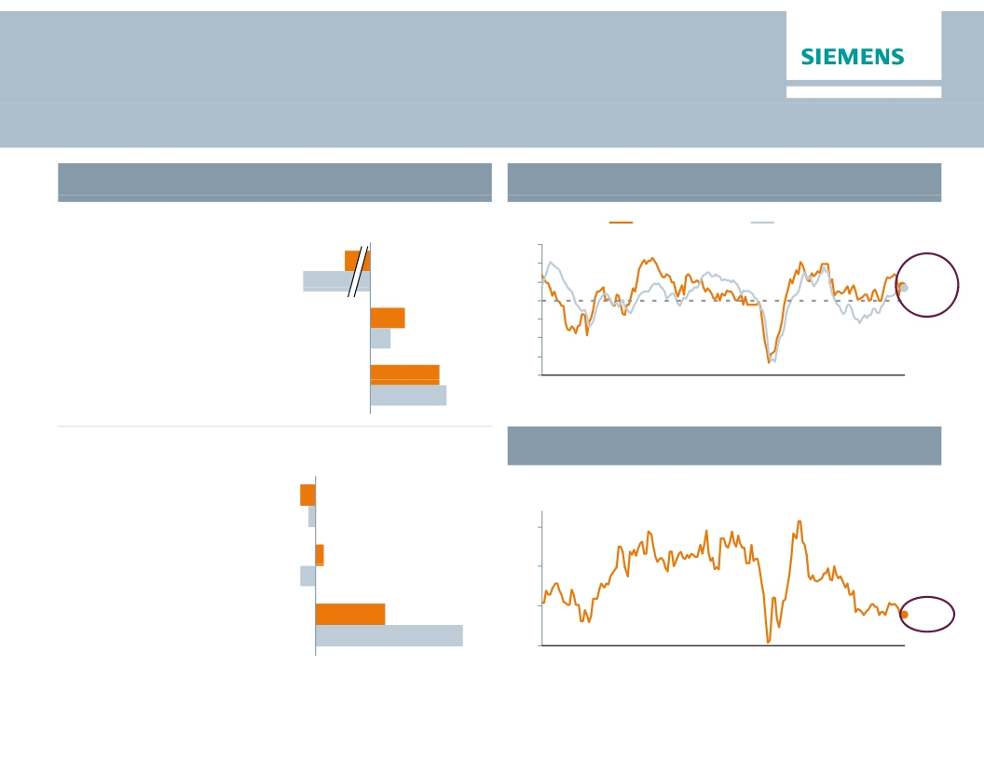
Lower volume from large orders in Europe while
China shows strength
Regional business split
Purchasing Managers Index
Q2 FY 14 Order growth y-o-y1)
Index
US ISM Mfg PMI
Eurozone Mfg PMI
65
60
Expanding economy
Europe/C.I.S./Africa/ME
-26%
(therein Germany)
-38%
55
50
53.72)
53.3
Americas
(therein USA)
Asia/Australia
+10%
+6%
+20%
45
40
35
30
Contracting economy
(therein China)
+22%
00
01
02
03
04
05
06
07
08
09
10
11
12
13
14 (Apr)
2) US as of March; flash reading for EZ in April
China Industry Value Added
Q2 FY 14 Revenue growth y-o-y1)
Europe/C.I.S./Africa/ME
(therein Germany)
Americas
(therein USA)
-2%
-1%
-2%
In %
20
15
1%
Asia/Australia
9%
10
8.8%
(therein China)
19%
5
00
01
02
03
04
05
06
07
08
09
10
11
12
13
14 (Mar)
1) Change is adjusted for currency translation and portfolio effects
© Siemens AG 2014. All rights reserved.
Page 8
Berlin, May 7, 2014
Q2 FY 2014, Analyst and Press Conference

Slide 9

Outlook Fiscal 2014
Basic earnings per share (Net income)
In €
At least 15%
growth
6.55
5.08
4.74
·
·
·
·
·
·
We expect our markets to remain
challenging in Fiscal 2014
Our short cycle businesses are not
anticipating a sustainable recovery until
late in the fiscal year
We expect orders to exceed revenue,
for a book-to-bill ratio above 1
Assuming that revenue on an organic basis
remains level year-over-year, we expect
basic earnings per share (Net Income) for
Fiscal 2014 to grow by at least 15% from
€5.08 in Fiscal 2013l 2013
This outlook is based on shares outstanding
of 843 million as of September 30, 2013
Furthermore it excludes impacts related
to legal and regulatory matters
th t
i b
FY 2011
FY 2012
FY 2013
FY 2014e
© Siemens AG 2014. All rights reserved.
Page 9
Berlin, May 7, 2014
Q2 FY 2014, Analyst and Press Conference

Slide 10
Siemens – Vision 2020: Strategic focus
1
2
3
Long-term growth agenda in attractive fields
Align portfolio along strategic imperatives
Cost reduction and business excellence
Ownership culture and leadership based on common values
© Siemens AG 2014. All rights reserved.
Page 10
Berlin, May 7, 2014
Q2 FY 2014, Analyst and Press Conference

Slide 11




Siemens – Innovating the Electrical World
Global trends
Digital
Market development (illustrative)
transformation
Networked world of
Market growth: ~7-9%
complex and hetero-
geneous systems
Digitalization
Globalization
Market growth: ~4-6%
Global competition
driving productivity &
localization
Urbanization
Infrastructure invest-
ment needs of urban
agglomerations
Demographic
change
Decentralized
demand of a growing
and aging population
Automation
Electrification
Today
Market growth: ~2-3%
Mid term-2020
l ti
Climate
change
Higher resource
efficiency in an all-
electric world
Power
Transmission,
Distribution &
Smart Grid
Imaging
& In-Vitro
Diagnos-
tics
Power
Generation
Efficient Energy
Application
© Siemens AG 2014. All rights reserved.
Page 11
Berlin, May 7, 2014
Q2 FY 2014, Analyst and Press Conference

Slide 12
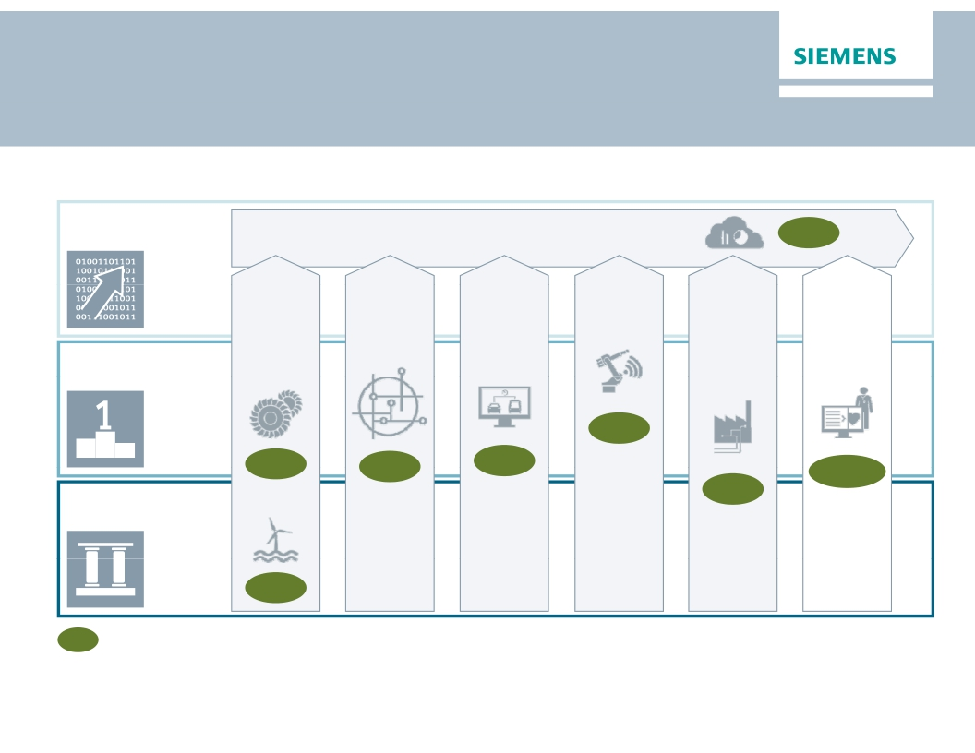
Stringent resource allocation for growth fields in
Electrification, Automation and Digitalization
Selected growth fields
Digitalization
Business Analytics & Data-driven Services
Software & IT solutions
8%
'Digital twin'
Software
7%
Image
guided
Therapy,
Molecular
Diagnostics,
etc.
8-10%
Distribution
Grid
Automation
& Software
7%
Road & City
Mobility,
tolling
6%
Key
Verticals
e.g.
O&G, F&B
6%
Automation
Electrification
Flexible &
Small GT
8%
Offshore
18%
x%
Est. market growth
2013-2020 (CAGR)
Power to
last
Drive energy
management
Efficient
urban
mobility
Shape
Industrie
4.0
Grow in
Process
Industries
Next
Generation
Healthcare
© Siemens AG 2014. All rights reserved.
Page 12
Berlin, May 7, 2014
Q2 FY 2014, Analyst and Press Conference

Slide 13

Acquisition of Rolls-Royce's Aero Derivative Gas
Turbine business offers great value
Transaction scope
Transaction rationale 3)
·
·
Acquisition of 100% of Rolls-Royce's aero-derivative gas
turbine (ADGT) and compressor business including
related services business
Only part of Rolls-Royce's Energy Business
ADGT's are an attractive power
supply option e.g. for offshore
oil & gas and for decentralized
power generation
1
2
3
4
5
Excellent fit – complementary technologies
Strengthens focus area Oil & Gas and
Decentralized Power
Innovation leader with ''best in breed'' gas turbines
supported by access to aero-technology
World-class global service platform
Significant synergies and enabling business
Transaction facts
Selected Rolls-Royce ADGT business financials
(2013)
·
·
·
·
·
Purchase price of £785m 1)
Additional £200m for 25 years exclusive access to future
Rolls-Royce aero-technology developments and
preferred access to supply and engineering services
Ramp up to £50m+ annual gross cost synergies until
FY2017 2) (~2/3 of long-term run-rate gross cost synergies)
EVA accretive in FY2020
Closing expected by end of December 2014 subject to
regulatory approvals
·
·
·
·
Sales:
Installed fleet:
EBIT:
Employees:
£871m, thereof ~60% service
~2,500 ADGT
£72m (~8.3% EBIT margin)
~2,400
Portfolio completion with key aero-derivative gas turbine technology for growth
in the oil & gas industry and in decentralized power supply
1) On a cash-and-debt-free basis; 2) Pre integration & transformation cost 3) Transaction rationale details – see slides in appendix
© Siemens AG 2014. All rights reserved.
Page 13
Berlin, May 7, 2014
Q2 FY 2014, Analyst and Press Conference

Slide 14
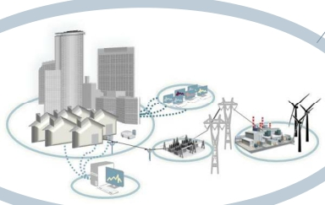
Automation is key to success
Nano grids
Intelligent grid
in one building
Decentral generation
e.g Wind,
Photovoltaics
Industrial,
Micro grids
Campus with island
function (generation &
consumption)
Grid automation
Transmission and
distribution
Grid stabilization
Voltage regulation
Data centers, etc.
Utilities
Grid operators
Grid storage
e.g. batteries
Controllable
transformers
Grid coupling
Connect grids with
different operating
parameters
Commercial &
Public
While power electronics is a key enabler, integration and automation make the difference
· Integration of renewables such as PV, Wind and storage systems
· Mitigation of negative effects on power quality by mass renewable integration
· Enabling semi/full autonomous prosumers ranging from large campuses to buildings
· Better utilization of existing power grid infrastructure
© Siemens AG 2014. All rights reserved.
Page 14
Berlin, May 7, 2014
Q2 FY 2014, Analyst and Press Conference

Slide 15
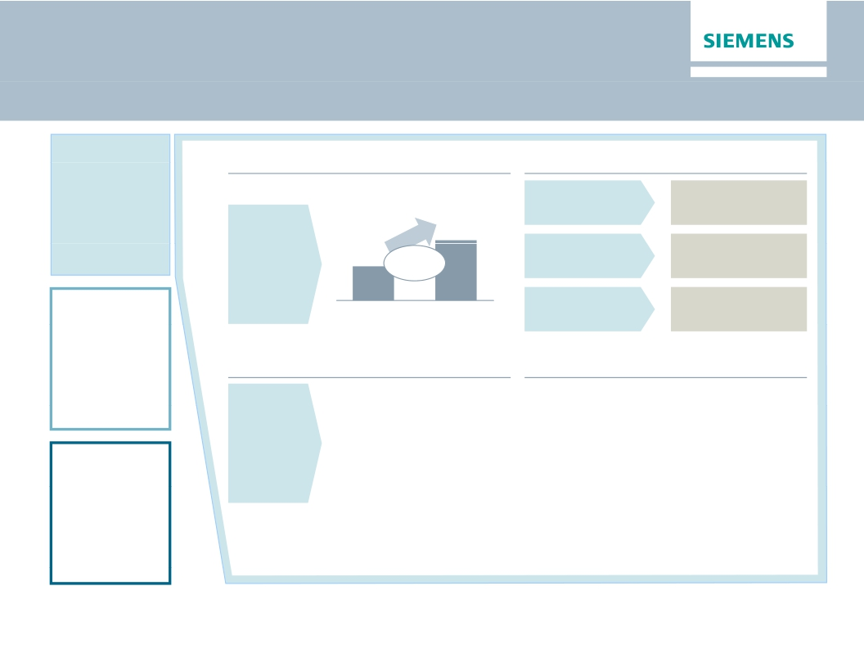
Digitalization: From data to business
Digitalization
Attractive market in Siemens verticals
Market (€bn)1
Substantial profit margins achievable
IT enhanced
>30%
Services
So t a e
100
Software
&
Vertical IT
Software
products
56
CAGR
+8%
>20%
Automation
Solutions
Combined SW
& HW solutions
2012
2020
>15%
Innovative business models
· Meter data management
Key enablers
· Cloud strategy
in the cloud
· Data Analytics enriched
plant control
· Siemens remote service
platform across divisions
i th
· Data analytics platform
· Applications on top of platforms
· Strong partnerships
Business
model
innovation
Electrification
1) Source internal: Siemens market for vertical IT
© Siemens AG 2014. All rights reserved.
Page 15
Berlin, May 7, 2014
Q2 FY 2014, Analyst and Press Conference

Slide 16
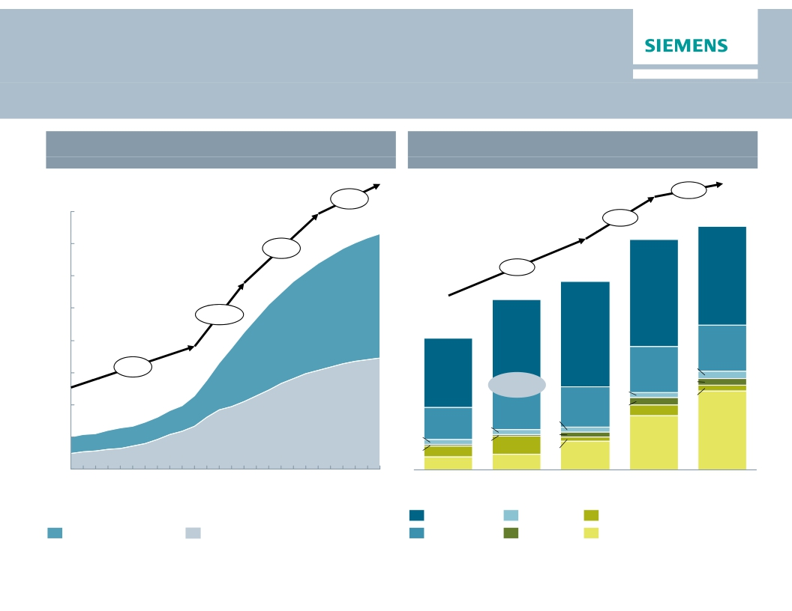
Unconventional Oil & Gas opportunities in North
America remain very attractive
Global unconventional O&G supply development
Production, in Mbbl/d
Regional capex split for unconventionals,
top 5 countries in 2025, USD billion
+3%
1.1%
40
4.1%
272
257
35
+7%
30
9.3%
210
110
190
119
25
+17%
20
147
118
99
51
15
+9%
78
52
8
7
7
75%
5
10
46
45
8
13
36
12
15
6
2
6
5
5
88
5
0
5
2
20
17
60
32
2000
2005
2010
2015
2020
2025
2011
United States
2013
China
2015
2020
Australia
2025
Unconventional liquids
Source: Rystad Ucube 2014
Unconventional gas
Canada
Venezuela
Sum Others
© Siemens AG 2014. All rights reserved.
Page 16
Berlin, May 7, 2014
Q2 FY 2014, Analyst and Press Conference

Slide 17
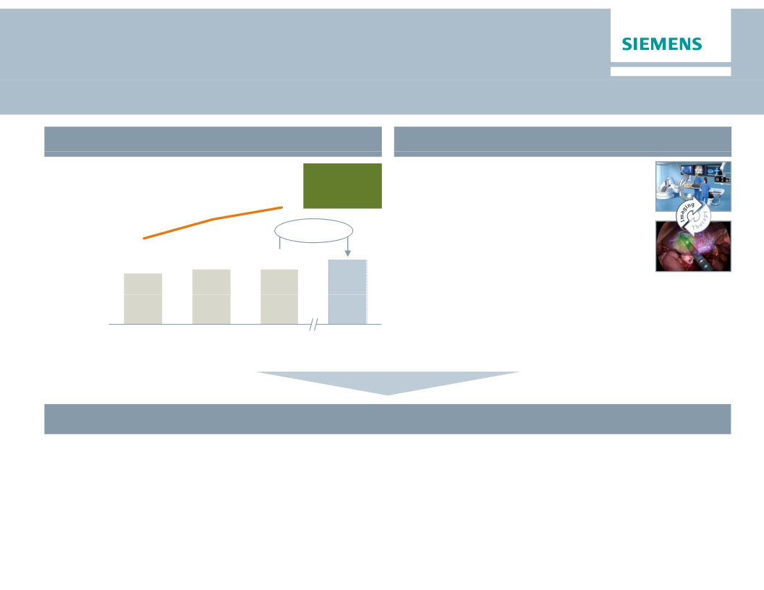
Healthcare with higher entrepreneurial flexibility –
separately managed under the Siemens umbrella
Strong position, resilient performance
Distinct trends at work
Margin
range
15-19%
· Customer & market structures in tran-
sition (e.g. value-based reimbursement,
convergence of diagnosis & therapy)
Profit
excl. ppa
16.3%
14.6%
in % of
revenue
12.0%
3-5% p.a.
· Long-term paradigm shifts:
· Potential disruptive technological
12.5
13.6
13.6
changes (e.g. Big data analytics,
knowledge based HC, molecular DX)
Revenue
in €bn
· Point of Care/Mobile HC
FY 2011
FY 2012
FY 2013
FY 2020e
Healthcare with individual set-up to succeed in changing environment
· Focus flexibly on market requirements
· Invest in growth opportunities to respond to paradigm shifts in the system
· Focus resource allocation to address distinct Healthcare industry characteristics
· Going public of Audiology
© Siemens AG 2014. All rights reserved.
Page 17
Berlin, May 7, 2014
Q2 FY 2014, Analyst and Press Conference

Slide 18
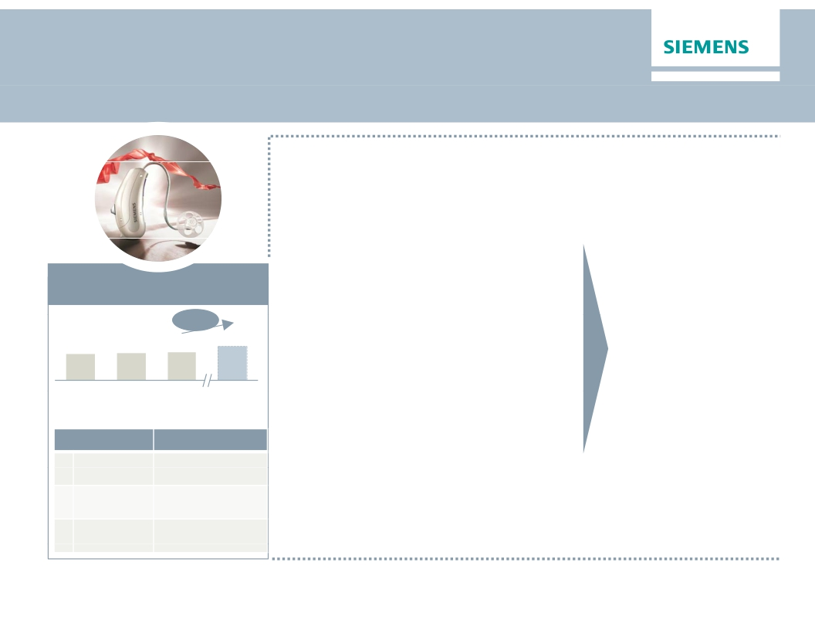
Going public of Hearing Aids business
creates an opportunity
· Attractive market:
Secular growth, good margins
k t
· Strong Siemens performance
· Competitive technological basis
· Highly respected brand
· However, no synergetic value –
business can better realize full
Success factors
in place
Timing is right:
Receptive stock
markets, com-
✓
Attractive market
€bn
3.1
CAGR
3.2
4%
3.3
industry po ential outside oft t ti l t id f
Siemens
· Distinct customers and go-to-market
· Hearing aids growth areas far from
petitive position
Story is right:
Leading global
pure-play hearing
✓
4.0
FY2012 FY2013 FY2014e FY2020e
Profit Pool 17-22% EBIT
Main competitors Revenue reported1)
1 Sonova CHF 1.8bn
≈ €1.5bn
Siemens core: Implants, retail,
consumer electronics
· Independently listed company
· Build on strengths of the business
✓aids player
Execution
is right:
Siemens experience,
2
3
WDH
GN Resound
DKK 7.9bn
≈ €1.0bn
DKK 4.2bn
≈ €0.6bn
· Focus management attention
· Raise capital dedicated to build
business
determined to succeed
1) WDH and GN ReSound-Hearing Aids CY2013; Sonova as of FY12/13
© Siemens AG 2014. All rights reserved.
Page 18
Berlin, May 7, 2014
Q2 FY 2014, Analyst and Press Conference

Slide 19
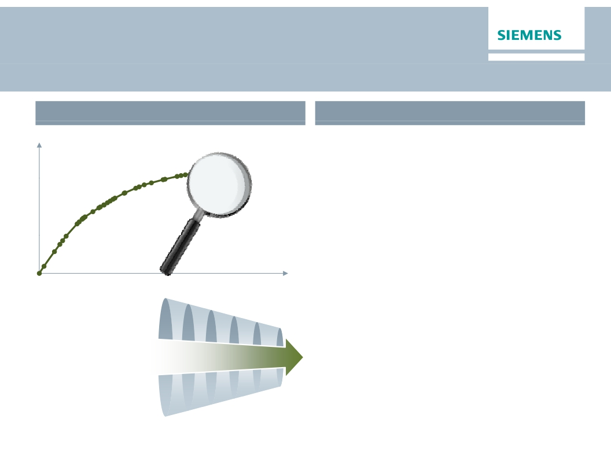
In depth analysis of businesses
has led to specific conclusions
Portfolio analysis
Conclusions
Cumulated
Profit
1. Areas of growth?
2. Potential profit pool?
3. Why Siemens??
4. Synergetic value?
5. Paradigm shifts in
technology/markets?
Focus
Cumulated
Revenue
'Siemens – Vision 2020'
· Fix underperforming businesses
starting with 'bottom 10' businesses
· Decide along the Strategic Imperatives
· Organic structural realignment
· Strategic partnerships
· Divestment (best owner concept)
· Stringent resource allocation supported by
performance culture and One Siemens
framework
© Siemens AG 2014. All rights reserved.
Page 19
Berlin, May 7, 2014
Q2 FY 2014, Analyst and Press Conference

Slide 20
JV with Mitsubishi-Hitachi Heavy Machinery creates
a global prime supplier of metals technologies
Siemens Metals Technologies
Transaction Structure
·
One of the world's leading life-cycle partners to the
metallurgical industry, headquartered in Linz (Austria)
Siemens
MHI
Hitachi
IHI
·
·
·
FY 2013 revenues of €2bn and ~8,900 employees
Business mainly acq ired b Siemens as part of
VA Technologie AG in 2005
Siemens contributes whole business unit MT excl.
the services business for Electrics/Automation
56%
Board:
2 Siemens/3 MHMM
34%
10%
MHMM
HoldCo
The Joint Venture
49%
NewCo
51%
·
Mitsubishi Heavy Industry (MHI), Hitachi and IHI Metaltech
contribute their metals machinery JV MHMM
(HQ in England)
·
·
MHMM focuses on the hot and cold rolling mills and
processing lines metals machinery business with
revenues of ~€550m in 2013
MT and MHMM with complementary regional footprint
MT
MHMM
and product portfolio
The JV will become a full-line supplier of metals
technologies products and services on a global scale
Strategic supply agreements between JV and Siemens
(e.g Components, automation)
·
·
·
Siemens to receive 49% ownership in the JV
51% of the JV shares to be held by the HoldCo MHMM
Closing expected by the end of calendar year 2014
·
·
© Siemens AG 2014. All rights reserved.
Page 20
Berlin, May 7, 2014
Q2 FY 2014, Analyst and Press Conference

Slide 21
Simplification leads to reduction
of overhead and support function cost by ~€1bn
Target
Functional cost reduction
~€1bn
FY 2014e
Target
© Siemens AG 2014. All rights reserved.
Key actions
· Remove additional layers (Cluster, Sectors)
· Combine certain Divisions and Businesses
· Stringent management governance through
all levels of the organization (Corporate Core)
· Optimization of Corporate Services on
highest possible level
· Full savings to mainly materialize in FY 2016
Page 21
Berlin, May 7, 2014
Q2 FY 2014, Analyst and Press Conference

Slide 22
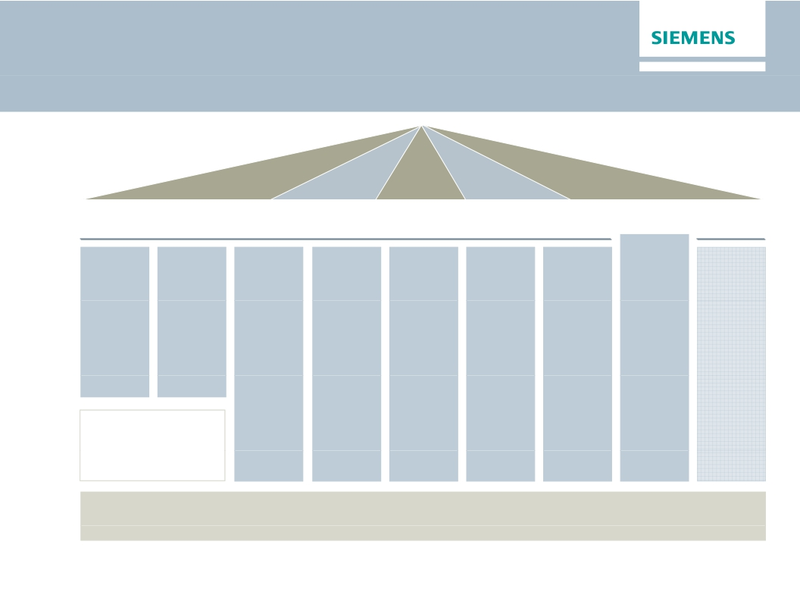
Flat and market driven organization along the value
chain will capture growth opportunities
rket
Go-to-mar
Americas
Middle
East, CIS1)
Europe,
Africa
Asia,
Australia
Global
Healthcare
Market
Separately
managed
Healthcare
Power
Wind
and Gas
Power and
Renewables
PG
WP
Power Generation
Services
PS
Energy
Manage-
ment
EM
Building
Techno-
logies
BT
Mobility
MO
Digital
Factory
DF
Process
Industries
and Drives
PD
Financial
Services
SFS
GlobalP&L)
(G
ivisions
Di
HC
Corporate Services
1) Commonwealth of Independent States
© Siemens AG 2014. All rights reserved.
Page 22
Berlin, May 7, 2014
Managing Board
Corporate Core
Q2 FY 2014, Analyst and Press Conference

Slide 23
The Management model drives resource allocation
and Ownership culture makes the difference
Customer and business focus
People and leadership
Ownership
culture
Management model
One Siemens
Financial framework
Operating system – Corporate Memory
Governance
Customer
proximity
Innovation
Business
excellence
People
excellence
and care
Sustainability and Citizenship
© Siemens AG 2014. All rights reserved.
Page 23
Berlin, May 7, 2014
Q2 FY 2014, Analyst and Press Conference

Slide 24
One Siemens Financial Framework
sets the aspiration
One Siemens
Financial Framework
Siemens
Capital efficiency
Capital structure
Growth:
Siemens > most
relevant competitors1)
(Comparable revenue growth)
(ROCE2))
15-20%
Total cost productivity3)
3-5% p.a.
(Industrial net debt/EBITDA)
up to 1.0x
Dividend payout ratio
40-60%4)
Profit Margin ranges of businesses (excl. PPA)5)
PG
11-15%
WP
5-8%
EM
7-10%
BT
8-11%
MO
6-9%
DF
14-20%
PD
8-12%
HC
15-19%
SFS6)
15-20%
1) ABB, ALSTOM, GE, Rockwell and Schneider, weighted 2) Based on continuing and discontinued operations 3) Productivity measures divided by functional costs (cost of sales,
R&D-, SG&A-expenses) of the group 4) Of net income excluding exceptional non-cash items 5) excl. acquisition related amortization on intangibles
6) SFS based on Return on equity after tax
© Siemens AG 2014. All rights reserved.
Page 24
Berlin, May 7, 2014
Q2 FY 2014, Analyst and Press Conference

Slide 25
Rigorous Operating System reinforces
business excellence
Enabler
Customer proximity
Innovation
Business excellence
People excellence
and care
© Siemens AG 2014. All rights reserved.
Priorities & Results (by metrics)
· Key account management
· Market development boards
· Software architecture and platforms
· New technology driven growth areas
· Mandatory elements of top+ framework
(Benchmarking, productivity programs)
· Lean management
· Project risk management
· Service platforms
· Ownership culture
· Continuous development & learning,
employability
· Integrity & compliance
g y
Page 25
Berlin, May 7, 2014
Q2 FY 2014, Analyst and Press Conference

Slide 26
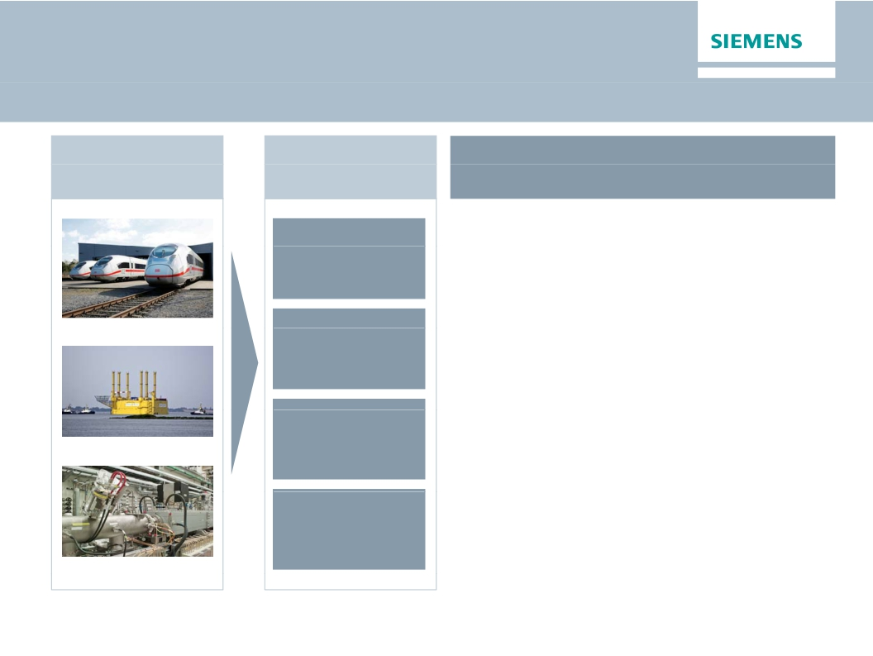
Corporate Memory for Project Management
Lessons
learned from
legacy projects
Actions for
project bid &
execution phase
Learnings applied: BORWIN 3
Offshore grid-connection platform
·
·
·
·
·
Extended project duration (5 years)
Focus on HVDC grid – not a steel
platform
Partner accountable for platform;
cable separately tendered
Experience based pricing and
contract design
Avoid the 'resource trap'
Q2 FY 2014, Analyst and Press Conference
Typical risks and
root causes
identified
Early warning
mechanisms
defined
Mitigation
measures
identified
Concept for
Corporate Memory
High Speed Trains
Offshore Grid conn.
Particle Therapy
© Siemens AG 2014. All rights reserved.
Page 26
Berlin, May 7, 2014

Slide 27
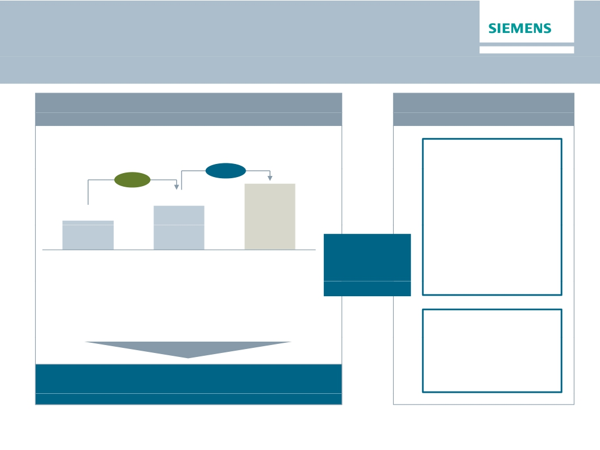
Foster ownership culture through equity ownership
and leadership based on shared values
Foster equity ownership
Employees owning shares from Siemens Share plans
(in thousand)
Leadership based
on shared values
“It is not the
strategy which
52%
>50%
140
makes the
92
FY 2009
difference, but the
culture of a
company, its
values and what it
stands for"
Ownership
culture
FY 2013
Target
· >3% of shares are held by current employees
· ~107k employees participated in share matching
plan 2014, up 5% from 2013
Broad implementation of a Siemens Profit Sharing
Pool (share based) planned
© Siemens AG 2014. All rights reserved.
"Always act as
if it were your
own company"
Page 27
Berlin, May 7, 2014
Q2 FY 2014, Analyst and Press Conference

Slide 28
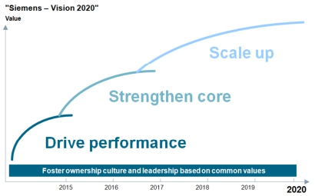
Siemens – Vision 2020
Value creation & Cultural change
Siemens – Vision 2020
1. Stringent company governance with effective
support functions (cost reduction ~€1bn)
2. 'Underperforming' businesses fixed
3. Solid execution of our financial target system
· Capital efficiency: ROCE 15-20%
· Growth > most relevant competitors
4. Global and decentralized management
structures: more than 30% of Division and BU
management outside Germany
5. Partner of choice for customers (NPS up ≥20%)
6. Employer of choice (Siemens Engagement
Survey: Employee Engagement Index,
Leadership and Diversity Index: >75%)
7. Ownership culture: Increase number of
employee shareholders by at least 50%
Innovating the electrical world
NPS: Net Promoter Score
P t
f h i
© Siemens AG 2014. All rights reserved.
Page 28
Berlin, May 7, 2014
Q2 FY 2014, Analyst and Press Conference

Slide 29
Siemens – Vision 2020
Clear milestones until 2016
Until
Q4 2014
Q2 2015
Q4 2015
Q4 2016
Execution steps
Execution of ‘Siemens 2014’ measures
Implementation of new organization, start in new structure on Oct 1
Introduction of Incentive System 2015
Sharpening brand message starting in Oct 2014
Update on cost reduction (stringent governance, efficient support functions)
Progress update on portfolio optimization
Update on cost reduction (stringent governance, efficient support functions)
Update on performance in growth fields
Share buy-back executed (up to €4bn)
Update on portfolio optimization and cost reduction
og ess update o po t o o opt
at o
© Siemens AG 2014. All rights reserved.
Page 29
Berlin, May 7, 2014
Q2 FY 2014, Analyst and Press Conference

Slide 30
Appendix
© Siemens AG 2014. All rights reserved.
Page 30
Berlin, May 7, 2014
Q2 FY 2014, Analyst and Press Conference

Slide 31


Overview of businesses (I)
~€14bn1)
~€5bn1)
Power and Gas
CEO: Roland Fischer
Strongly positioned in core markets:
Wind Power and Renewables
CEO: Markus Tacke
Unique competitive position:
Gas Turbines, Generators,
Products
Clear #1 position in fast growing Offshore Wind
Steam Turbines, Solutions,
Compressors,
40%
40%
Onshore Wind with selective approach on
profitable projects
Instrumentation & Electrical
Priorities
Service
20%
Solutions
(Split estimated base onti t d b d
FY 2013 revenues)
Priorities
·
·
·
·
·
Maintain leading position with superior business model
Strengthen competitiveness through operational excellence
and cost out programs
Technology leadership throughout portfolio via focused
innovation and selective M&A
Strong local presence to secure market proximity and
customer care
High market share and solid profit margin
·
·
·
·
Remain world leader in sustainable offshore business through
innovation and industrialization (e.g., new offshore facility in
Hull/GB)
In offshore further drive down Levelized Cost of Energy
(LCoE) to reach <0.1 EUR/kWh by 2020; onshore to reach
grid parity
Onshore: Margin improvement and consecutive growth
Manage backlog execution thoroughly across value chain
1) Estimated revenue based on FY 2013 financials (incl. Service)
© Siemens AG 2014. All rights reserved.
Page 31
Berlin, May 7, 2014
Q2 FY 2014, Analyst and Press Conference

Slide 32


Overview of businesses (II)
~€12bn1)
Power Generation Service
CEO: Randy Zwirn
High margin/constant flow of revenue:
Service, modernization and upgrades of
Large Gas Turbines, Large Steam Turbines,
Generators, Industrial Turbines (e.g. Oil&Gas)
and Wind Turbines (onshore/offshore)
Priorities
Energy Management
CEO: Ralf Christian, Jan Mrosik
Seamless offering
Transmission (High Voltage Products, Solutions) (T)
Transformers (T)
Low and Medium Voltage (LMV)
Energy Automation (SG)
Software Solutions & Services (SG)
Priorities
·
·
·
·
Continuously building up highly profitable backlog by strong
increase in growth regions (e.g., Middle East, South Korea)
Grow footprint in Oil & Gas industry
R&D investment to make fleet more valuable for customers
(e. g., condition based maintenance through data analytics)
Expand flexible value added service portfolio for
Wind Power
·
·
·
·
·
Optimized go-to-market addressing all types of customers
seamlessly
Extend leadership in digitalization
‘Transform to win’ productivity program until 2015:
Stabilize execution of legacy projects
Continue optimization of LMV
Expand power electronics business to distribution grid
applications
1) Estimated revenue based on FY 2013 financials
© Siemens AG 2014. All rights reserved.
( ) Organizational home division of business until Sep 2014
Page 32
Berlin, May 7, 2014
Q2 FY 2014, Analyst and Press Conference

Slide 33


Overview of businesses (III)
~€6bn1)
~€7bn1)
Building Technologies
Mobility
CEO: Johannes Milde
Strong technology base and integrated solutions
Products & Systems
Solutions & Services
Building Performance & Business Continuity
Priorities
CEO: Jochen Eickholt
Strengthened portfolio
Mobility Management (Rail Automation, Road and
City Mobility) (MOL)
Turnkey Projects (MOL) and Electrification (SG)
Mainline Transport (High Speed, Commuter Rail,
Locomotives) (RL)
Urban Transport (RL)
Priorities
·
·
·
·
Selective country approach (products in emerging countries
to solutions/services in mature markets)
Focus on organic growth in China
Advanced Services through IT and SW-based analytics
Expand joint go-to-market with Energy Management
(e.g., LMV for Data Centers)
·
·
·
·
Ensure stringent project execution of order backlog
Expand on market leadership in Rail Automation,
deliver on synergies of €100m until 2018
Integrated turnkey projects with high Siemens product
content
Grow services e.g., remote monitoring
1) Estimated revenue based on FY 2013 financials
© Siemens AG 2014. All rights reserved.
( ) Organizational home division of business until Sep 2014
Page 33
Berlin, May 7, 2014
Q2 FY 2014, Analyst and Press Conference

Slide 34


Overview of businesses (IV)
~€9bn1)
~€11bn1)
Digital Factory
CEO: Anton Huber
Shaping future of manufacturing
Factory Automation (IA)
Motion Control (DT)
Product Life-cycle Management (IA)
Services (CS)
Priorities
Process Industries and Drives
CEO: Peter Herweck
Bundling process know-how
Large Drives, Mechanical Drives (DT)
Process Automation (IA)
Upstream and Midstream (P)
Metals Technologies (MT)
Services (CS)
Priorities
·
·
·
·
Digital Revolution changes product development and
manufacturing process (‘Industrie 4.0’)
Secure customer retention by leveraging PLM software
and automation product offering
Ongoing expansion of the product portfolio and
installed base
Develop business in data-driven services
·
·
·
·
Growth momentum due to focused approach on strong
growing key verticals such as O&G, F&B, chemicals
Invest in growth with life-cycle business –
service capabilities and local set-up
Expand software offering for digital engineering and
operations
Further optimize efficiency and cost position
(field devices and drive train)
1) Estimated revenue based on FY 2013 financials
© Siemens AG 2014. All rights reserved.
( ) Organizational home division of business until Sep 2014
Page 34
Berlin, May 7, 2014
Q2 FY 2014, Analyst and Press Conference

Slide 35


Overview of businesses (V)
~€13.6bn1)
€18.7bn2)
Healthcare
Financial Services
CEO: Hermann Requardt
Personalized and affordable Healthcare
Imaging
Clinical Products
Diagnostics
Customer Solutions
Audiology
Priorities
CEO: Roland Chalons-Browne
Combine industrial and financial logic
Commercial Finance
Project & Structured Finance
Insurance
Financing & Investment Management
Venture Capital
Treasury
Priorities
·
·
Individual set-up to succeed in changing environment
React more flexibly to customers' requirements and
·
improve market penetration
Invest in growth opportunities to respond to paradigm
·
shifts
Focus resource allocation to address distinct
·
Healthcare industry characteristics
Going public of Audiology
·
·
·
·
Financing as strategic differentiator and earnings
contributor
Close alignment with Divisions to offer a joint customer
and market approach
Sound financial risk management and portfolio diversity
Respected partner to the financial markets
1) Revenue FY 2013; 2) Total Assets Sep 30, 2013
© Siemens AG 2014. All rights reserved.
( ) Organizational home division of business until Sep 2014
Page 35
Berlin, May 7, 2014
Q2 FY 2014, Analyst and Press Conference

Slide 36
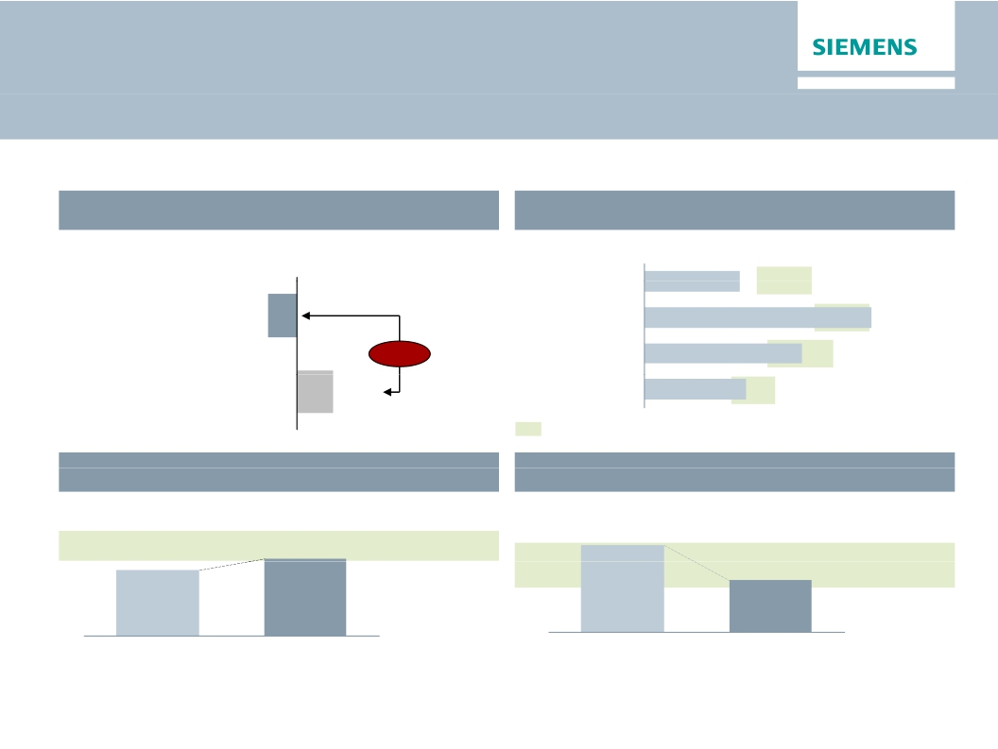
One Siemens cockpit – H1 FY 2014
ROCE in target corridor despite impact on Energy margins
Financial target system
Growth1)
Revenue growth (rolling 4 quarters Q2 FY 14)
Margins compared to industry benchmarks
EBITDA Margins (H1 FY 2014)
Energy
8.5%
10-15%
Siemens
-1.9%
Healthcare
20.2%
15-20%
-4.3%
Industry
14.0%
11-17%
Competitors
2.4%
Infrastr. & Cities
9.0%
8-12%
EBITDA margins of respective markets throughout business cycles
Capital structure
Adjusted industrial net debt/EBITDA
Capital efficiency
ROCE adjusted (continuing operations)
it l ffi i
it l t
16.4%
H1 FY 14
15-20%
1.0x
Q2 FY 13
13.9%
H1 FY 13
1) As reported
0.6x
Q2 FY 14
0.5-1 0x
© Siemens AG 2014. All rights reserved.
Page 36
Berlin, May 7, 2014
Q2 FY 2014, Analyst and Press Conference

Slide 37
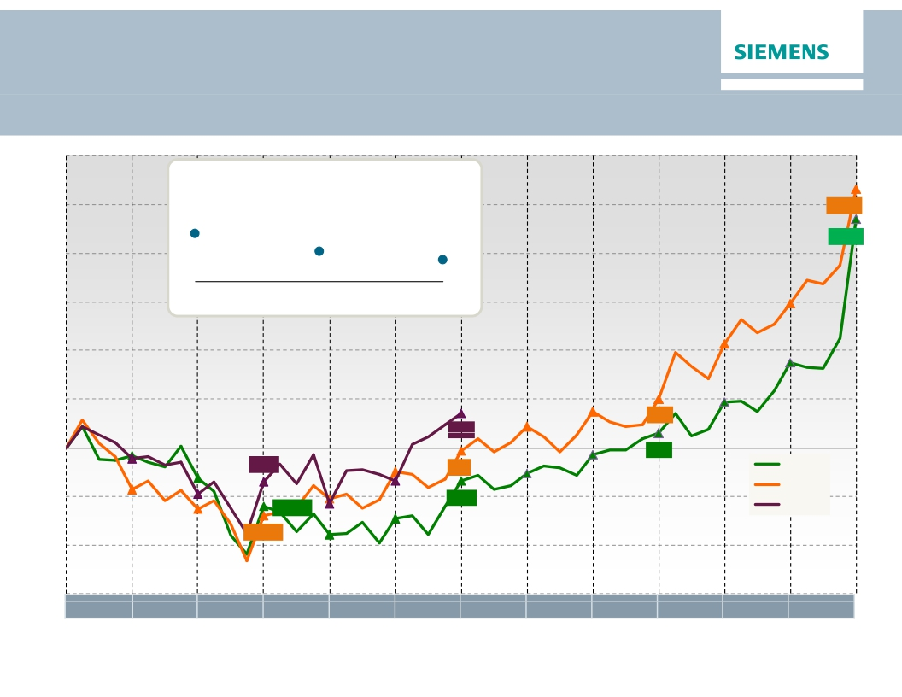
Free Cash Flow
Decent performance in Q2 after a weak start in Q1
€m
Operating Working Capital (OWC) turns
Total Sector
9.0
5,328
7.7
7.1
4,700
FY 2012
FY 2013
Q2 FY 2014
992
703
291
-699
-61
FY 2012
FY 2013
-1,204
-1,395
-676
FY 2014
Oct
Nov
Dec
Jan
Feb
Mar
Apr
May
Jun
Jul
Aug
Sep
© Siemens AG 2014. All rights reserved.
Page 37
Berlin, May 7, 2014
Q2 FY 2014, Analyst and Press Conference

Slide 38
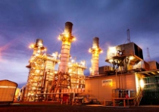


1 Excellent fit – complementary technologies
Product portfolio with full power output range
for both technologies
Complementary technology strengths
MW
0
20
40
60
✓ Only on-site service possible
✓ Good gas fuel flexibilityd f l fl ibilit
✓ Stable proven DLE systems
SGT-
100
SGT-
300
SGT-
500
SGT-700
SGT-800
IGT
(Siemens)
SGT-
200
SGT-
400
✓ Designed for efficient
combined cycle power plants
SGT-600
SGT-750
Main application:
Industrial power generation
✓ Light cores and fast core
change for service
(changeable within 24h)
✓ Quality level inherited from
aero engines
✓ Designed for high number
ADGT
(Rolls-
Royce)
501
RB211 G62
RB211 GT61
TRENT 60
of cycles with high efficiency
· Customers can choose from different technologies in the full output range
Main application:
Offshore production platforms
· Joint portfolio will be strong alternative for customers compared to other players in the sector
DLE = Dry Low Emissions: Emissions combustion system to minimize the emissions to atmosphere
© Siemens AG 2014. All rights reserved.
Page 38
Berlin, May 7, 2014
Q2 FY 2014, Analyst and Press Conference

Slide 39
2
Strengthens focus area Oil & Gas and
Decentralized Power
Rolls-Royce ADGT Business
Siemens
Siemens new equipment revenue by sector
Rolls-Royce ADGT Business' new equipment1)
revenue by sector
Industrial
Power
Generation
Oil & Gas
· Improved access for
~1/4
Siemens to the Oil &
Gas sector and the
field of decentralized
power generation
· Improved
~1/3
opportunities to sell
into industrial power
generation sector
~2/3
~3/4
Industrial
Oil & Gas
Power
Generation
➔Rolls-Royce acting mainly in the Oil & Gas sector
· Complementary strengths in different sectors
➔Siemens acting mainly in the IPG sector
· Improved coverage to both Oil & Gas and industrial power generation sectors
1) Excluding aftermarket services business
© Siemens AG 2014. All rights reserved.
Page 39
Berlin, May 7, 2014
Q2 FY 2014, Analyst and Press Conference

Slide 40
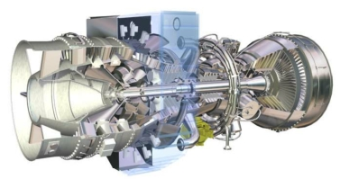
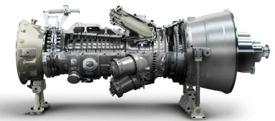
3
Innovation leader with ''best in breed'' gas turbines
supported by access to aero technology
Rolls-Royce: ADGTs
Industrialisation
of ADGTs:
Improved competitiveness
through industrial instead
of aero parts
Significant innovation
potential through
combined technology
know-how to develop
'best in breed' hybrid
gas turbines
Siemens: IGTs
Application of aero
technology to IGTs:
Improved competitiveness
through increased efficiency
Access to aero derivative technology for Siemens and significant innovation potential
of combining leading technologies
© Siemens AG 2014. All rights reserved.
Page 40
Berlin, May 7, 2014
Q2 FY 2014, Analyst and Press Conference

Slide 41
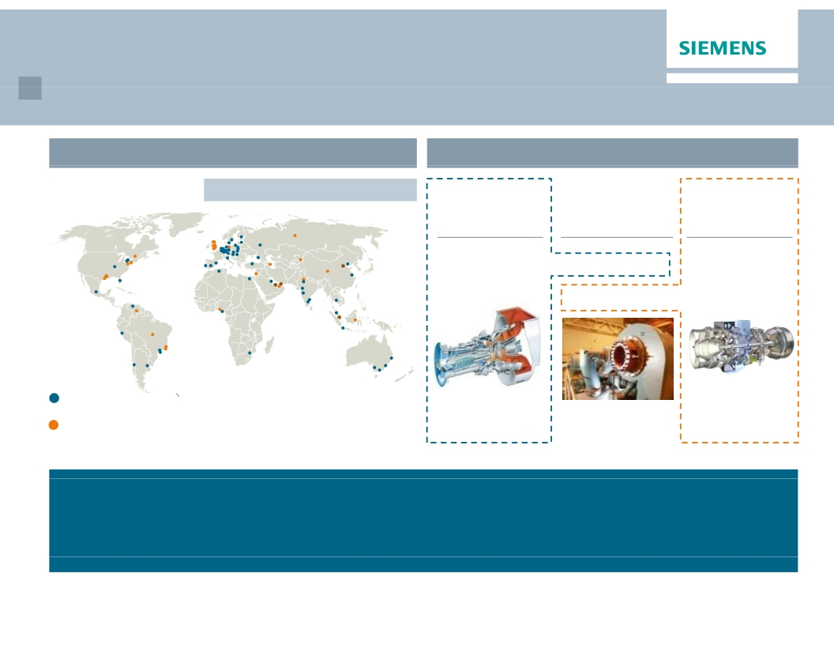
4 World-class global service platform
World class global service platform
Strong combined service platform
Large installed fleet
Sites over 5 FTEs
~5,600 employees in total
Small & medium
industrial gas
turbines
~2,250 units
Aero derivative
gas turbines
~2,500 units
Compressors
>10,000 units
>1,700 units
Siemens
Rolls-Royce
ADGT Business
~4,600 service employees (Siemens Oil and Gas Service),
thereof ~1,700 employees within transaction scope
~1,000 service employees
Siemens fleet
Rolls-Royce fleet
· Transaction strongly utilizes Siemens' world-class sales and service organization
· Customers benefit from powerful global platform with further improved customer proximity
· Focus on long-term relationship with customers regarding service benefits both customers
and service business
© Siemens AG 2014. All rights reserved.
Page 41
Berlin, May 7, 2014
Q2 FY 2014, Analyst and Press Conference

Slide 42
5
Significant synergies and enabling business
Cost
synergies
Sales
synergies
· Purchasing synergies: Savings through higher
purchase volume and broader supplier base
· Process optimisation & design to cost: Industrialisation
of ADGT parts
· Manufacturing synergies: Implementing operational
excellence
· Integration of sales force and service sites
· Siemens' sales force and industrial power generation
sector access to place ADGT products
· Siemens to improve access to Oil & Gas sector
through comprehensive product range and the Rolls-
Royce ADGT Business' sector access
· New equipment sales synergies will drive
corresponding service synergies
£50m+ annual gross
cost synergies in
FY2017 with further
upside thereafter 1)
(in FY2017 ~2/3 of
long-term run-rate
gross cost synergies
reached)
Significant
additional upside
from sales synergies
The scope and scale of Siemens' Energy business will enable the acquired business
to realize significant profit potential
1) Pre integration & transformation cost, synergy investments and allocations
© Siemens AG 2014. All rights reserved.
Page 42
Berlin, May 7, 2014
Q2 FY 2014, Analyst and Press Conference

Slide 43

Financial calendar
May
June
July
May 7, 2014
Q2 Earnings Release and Strategy Update (Berlin)
May 21, 2014
Roadshow France (Paris)
May 22, 2014
Roadshow Germany (Frankfurt)
May 28, 2014
Roadshow Canada (Montreal)
May 29, 2014
Bernstein Conference (New York)
June 12, 2014
JP Morgan Conference (London)
July 31, 2014
Q3 Earnings Release and Analyst Call
© Siemens AG 2014. All rights reserved.
Page 43
Berlin, May 7, 2014
Q2 FY 2014, Analyst and Press Conference

Slide 44

Siemens press contacts
Marc Langendorf
Alexander Becker
Ivonne Junghänel
Wolfram Trost
+49 89 636-41360
+49 89 636-36558
+49 89 636-33929
+49 89 636-34794
49 89 636 33929
Internet:
Email:
Phone:
Fax:
www.siemens.com/press
press@siemens.com
+49 89 636-33443
+49 89 636-35260
© Siemens AG 2014. All rights reserved.
Page 44
Berlin, May 7, 2014
Q2 FY 2014, Analyst and Press Conference

Slide 45

Siemens Investor Relations contact data
IR-Hotline:
Fax:
Internet:
+49-89 636-32474
+49-89-636-32830
http://www.siemens.com/investorrelations
Email: investorrelations@siemens.com
© Siemens AG 2014. All rights reserved.
Page 45
Berlin, May 7, 2014
Q2 FY 2014, Analyst and Press Conference

Slide 46
Reconciliation and Definitions for
Non-GAAP Measures
This document includes supplemental financial measures that are or may be non-GAAP financial measures.
Orders and order backlog; adjusted or organic growth rates of revenue and orders; book-to-bill ratio; Total Sectors profit; return on equity (after tax), or ROE (after
tax); return on capital employed (adjusted), or ROCE (adjusted); Free cash flow, or FCF; adjusted EBITDA; adjusted EBIT; adjusted EBITDA margins, earnings
effects from purchase price allocation, or PPA effects; net debt and adjusted industrial net debt are or may be such non-GAAP financial measures.
These supplemental financial measures should not be viewed in isolation or as alternatives to measures of Siemens’ net assets and financial positions or results of
operations as presented in accordance with IFRS in its Consolidated Financial Statements. Other companies that report or describe similarly titled financial
measures may calculate them differently.
Definitions of these supplemental financial measures, a discussion of the most directly comparable IFRS financial measures, information regarding the usefulness
of Siemens’ supplemental financial measures, the limitations associated with these measures and reconciliations to the most comparable IFRS financial measures
are available on Siemens’ Investor Relations website at www.siemens.com/nonGAAP. For additional information, see supplemental financial measures and the
related discussion in Siemens’ most recent annual report on Form 20-F, which can be found on our Investor Relations website or via the EDGAR system on the
website of the United States Securities and Exchange Commission.
Revenue growth - Performance against competition (Fiscal 2014)
To illustrate management’s perspective on the Company s performance against competition, Siemens compares its own revenue growth rate with the weighted
average revenue growth rate of its Sectors’ most relevant competitors, including, among others, ABB, GE, Philips, Rockwell and Schneider. Revenue growth for
Siemens and its competitors is calculated as the actual growth rate over a rolling four quarter period compared to the same period a year earlier. Siemens
competitors revenue growth is derived as the weighted average growth rate of dedicated competitor baskets defined for each Siemens Sector. Each Sector
basket's growth rate is based upon the most recent reported competitor revenues publicly available at the time of calculation. The Sector competitor baskets
revenue growth rates are weighted by the revenue of the respective Siemens Sector.
This measure may provide seful information to in estors with respect to management’s vie on Siemens’ growth compared competitor . Howe er,ith respect to management’s ie on Siemens’ gro th compared to competitor gro th Ho e er e
caution investors, that this measure is subject to certain limitations, which include the following: The metric is defined by Siemens and, as such, is not based on a
generally accepted framework that is also relevant for other companies; accordingly, other companies may define a similarly titled measure differently. In
calculating this measure, Siemens relies on data published by its competitors for which Siemens assumes no responsibility. In addition, the data may not be
directly comparable as a result of differing presentation currencies and reporting standards being used by our competitors in the data’s presentation. Furthermore,
subject to limited exceptions, no adjustments are made for currency translation effects, portfolio changes and changes in reporting structure for either the Siemens
or the competitor data. Because the public availability of relevant competitors’ data at the time of calculation may not coincide with the availability of Siemens data,
some competitor data used may relate to a different time period than the Siemens data.
© Siemens AG 2014. All rights reserved.
Page 46
Berlin, May 7, 2014
Q2 FY 2014, Analyst and Press Conference

