Slide 1

Financial Results for the Fiscal Year
Ended March 31, 2015
and
Financial Forecasts for the Fiscal Year
Ending March 31, 2016
May 15, 2015

Slide 2


The forward-looking statements and projected figures concerning the future performance of NTT
and its subsidiaries and affiliates contained or referred to herein are based on a series of
assumptions, projections, estimates, judgments and beliefs of the management of NTT in light of
information currently available to it regarding NTT and its subsidiaries and affiliates, the economy
and telecommunications industry in Japan and overseas, and other factors. These projections
and estimates may be affected by the future business operations of NTT and its subsidiaries and
affiliates, the state of the economy in Japan and abroad, possible fluctuations in the securities
markets, the pricing of services, the effects of competition, the performance of new products,
services and new businesses, changes to laws and regulations affecting the telecommunications
industry in Japan and elsewhere, other changes in circumstances that could cause actual results
to differ materially from the forecasts contained or referred to herein, as well as other risks
included in NTT’s most recent Annual Report on Form 20-F and other filings and submissions
with the United States Securities and Exchange Commission.
* “E” in this material represents that the figure is a plan or projection for operation.
** “FY” in this material indicates the fiscal year ending March 31 of the succeeding year.
Financial Results for the Fiscal Year Ended March 31, 2015
and Financial Forecasts for the Fiscal Year Ending March 31, 2016
－1－
Copyright (c) 2015 Nippon Telegraph and Telephone Corporation

Slide 3
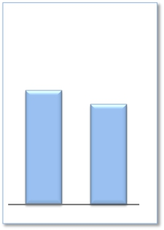

FY2014 Highlights
Operating Income
(Billions of yen)
1,213.7
1,084.6
Operating Revenues increased for the fifth consecutive year;
Operating Income decreased
Expansion of global cloud services
➢Promoting M&A
· NTT Communications acquired e-shelter, a Europe-based data center provider
➢Cross-selling order volume was approximately US$200 million
➢Overseas sales increased to ¥1,585.4 billion (a ¥389.4 billion increase year-
on-year)
➢Percentage of corporate sales represented by overseas sales: 44%
Enhanced competitiveness of network services
➢Expansion of NTT’s user base
FY2013
FY2014
Overseas Sales
Overseas Sales in billions of yen
Overseas Sales in billions of USD
1,585.4
1,196.0
15.0
12.2
· 17.83 million new billing plan subscribers
· 66.60 million mobile phone subscribers (net increase of 3.49 million subscribers)
· 18.72 million FLET’S Hikari subscribers (net increase of 0.67 million subscribers),
including 0.27 million subscribers to the “Hikari Collaboration Model”
· Number of subscribers to Hikari TV and FLET’S TV: 4.36 million (net increase of 0.37
million subscribers)
➢Fixed-line and mobile access cost reductions
· Reduction of ¥239.0 billion year-over-year, and a total ¥651.0 billion in reductions
compared to FY2011
➢Capex to Sales
· 15.6% as a result of enhanced efficiency in capital investments
Shareholder returns
➢Completed ¥338.1 billion of share buybacks (mainly from the Japanese government)
FY2013
FY2014
➢Dividends of ¥180 per share for FY2014, a ¥10 increase year-on-year
Financial Results for the Fiscal Year Ended March 31, 2015
and Financial Forecasts for the Fiscal Year Ending March 31, 2016
－2－
Copyright (c) 2015 Nippon Telegraph and Telephone Corporation

Slide 4

Consolidated Results and Forecasts (U.S. GAAP)
Operating Revenues increased, spurred by the continued growth of our overseas businesses
Operating Income decreased due to a decrease in income in the Mobile communications segment,
despite increased revenues in other segments; fell short of the FY2014 Forecast by ¥10.4 billion
Earnings Per Share (EPS) was ¥473.69, a 29.2% increase compared to FY2011
(Billions of yen)
FY2014 Highlights
FY2014
Change
year-on-year
+170.1
+299.2
FY2014
Forecasts
11,010.0
9,915.0
FY2013
10,925.2
9,711.5
Change from the
Revised
Forecasts
+85.3
+95.8
[%]
+1.6%
+3.1%
Operating
Revenues
Operating
Expenses
11,095.3
10,010.8
Operating
Income
Net Income*
※
EPS
(yen)
1,084.6
518.1
473.69
(129.1)
(67.4)
(35.52)
(10.6)%
(11.5)%
(7.0)%
(10.4)
(10.9)
(5.31)
1,213.7
585.5
509.21
1,095.0
529.0
479.00
*
Net Income represents net income attributable to NTT, excluding noncontrolling interests.
Financial Results for the Fiscal Year Ended March 31, 2015
and Financial Forecasts for the Fiscal Year Ending March 31, 2016
－3－
Copyright (c) 2015 Nippon Telegraph and Telephone Corporation

Slide 5
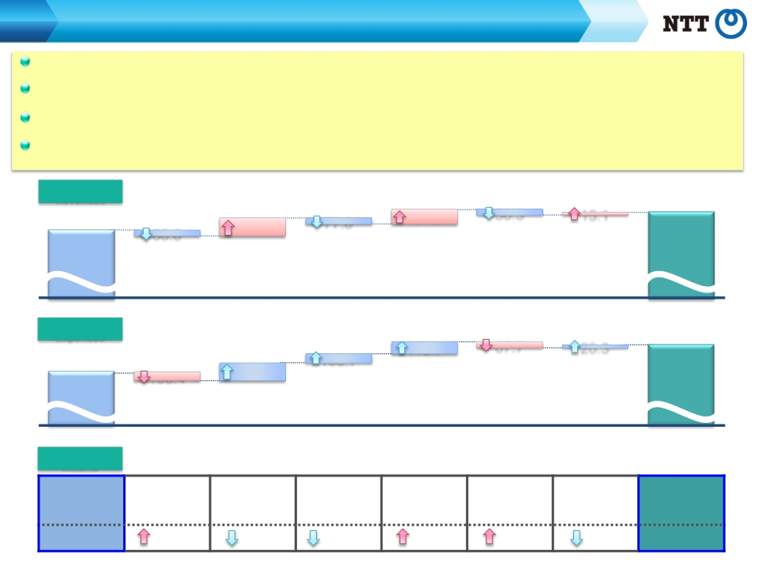
Consolidated Results and Forecasts (U.S. GAAP)
FY2014 Contributing Factors by Segment
Regional communications business: Operating Income increased as a result of vastly improved operational efficiency as well as the
reduction of marketing costs.
Long distance and international communications business: Although intensifying domestic competition led to a decrease in Operating
Income, overseas businesses experienced steady growth.
Mobile communications business: Operating Revenues decreased due to the increased impact of “Monthly Support” discount programs
and the effect of new rate plans, which also resulted in a decrease in Operating Income.
Data communications business: Operating Income increased due to an improvement in gross margins resulting from increased sales, as
well as a reduction in unprofitable transactions, among other factors.
Operating
[year-on-year：+170.1]
(Billions of yen)
11,095.3
FY2014
Revenues
10,925.2
FY2013
77.8
Mobile
communications
business
167.2
Data
communications
business
56.3
Other
business
15.1
Elimination of
intersegment/Others
66.8
Regional
communications
business
188.7
Long distance and
international
communications
business
Operating
[year-on-year：+299.2]
Expenses
9,711.5
FY2013
148.7
Data
communications
business
67.7
Other
business
20.3
Elimination of
intersegment/Others
103.7
Mobile
communications
business
10,010.8
FY2014
108.4
Regional
communications
business
202.6
Long distance and
international
communications
business
Operating
Income
[year-on-year：(129.1)]
Regional
Long-distance and
Mobile
Data
Other business
Elimination of
FY2013
1,213.7
communications
business
41.6
international
communications
business
13.9
communications
business
181.5
communications
business
18.4
intersegment/
Others
5.1
FY2014
1,084.6
11.4
Financial Results for the Fiscal Year Ended March 31, 2015
and Financial Forecasts for the Fiscal Year Ending March 31, 2016
－4－
Copyright (c) 2015 Nippon Telegraph and Telephone Corporation

Slide 6

Consolidated Results and Forecasts (U.S. GAAP)
FY2015 Forecast Summary
Operating Revenues are expected to increase for the sixth consecutive year, to reach a record ¥11,350.0 billion
Operating Income is expected to recover and reach ¥1,200.0 billion, a ¥115.4 billion increase year-over-year
EPS is expected to reach ¥595, a 62.3% increase compared to FY2011
(Billions of yen)
FY2015 Forecasts
FY2014
Change
year-on-year
[%]
Operating
Revenues
Operating
Expenses
Operating
Income
Net Income
※
EPS
(yen)
11,095.3
10,010.8
1,084.6
518.1
473.69
11,350.0
10,150.0
1,200.0
630.0
595.00
+254.7
+139.2
+115.4
+111.9
+121.31
+2.3%
+1.4%
+10.6%
+21.6%
+25.6%
※Net income represents net income attributable to NTT, excluding noncontrolling interests.
Financial Results for the Fiscal Year Ended March 31, 2015
and Financial Forecasts for the Fiscal Year Ending March 31, 2016
－5－
Copyright (c) 2015 Nippon Telegraph and Telephone Corporation

Slide 7







Consolidated Results and Forecasts (U.S. GAAP)
FY2015 Forecast Summary by Segment
Regional communications business: Operating Income is expected to increase due to, among other factors, decreased marketing costs as the
“Hikari Collaboration Model” becomes fully established, despite an expected continued decrease in Operating Revenues
Long distance and international communications business: Although intensifying domestic competition is expected to lead to a decrease in
Operating Income, Operating Revenues are expected to increase due to the steady growth of overseas businesses.
Mobile communications business: Operating Revenues and Operating Income are both expected to increase due to a softening of the adverse
impact of the new billing plans, increased revenues from the “docomo Hikari” and “Smart Life” business areas, and cost reductions.
Data communications business: Operating Income and Operating Revenues are expected to increase due to an improvement in gross margins
resulting from increased sales and a reduction in unprofitable transactions, among other factors.
（Billion yen）
Operating Revenue
Operating Income
11,095.3*
1,272.2
1,511.0
4,383.4
1,998.6
3,505.5
FY2014
+254.7
(12.2)
+29.0
+126.6
+241.4
(105.5)
11,350.0*
1,260.0
1,540.0
4,510.0
2,240.0
3,400.0
FY2015E
1,200.0*
45.0
110.0
675.0
100.0
220.0
FY2015E
Other business
Data
communications
business
Mobile
Communications
business
Long
distance and
international
communications
business
Regional
communications
business
+115.4
(22.5)
+23.6
+39.2
(13.6)
+51.1
1,084.6*
67.5
86.4
635.8
113.6
168.9
FY2014
Financial Results for the Fiscal Year Ended March 31, 2015
and Financial Forecasts for the Fiscal Year Ending March 31, 2016
－6－
*including adjustments such as Elimination
Copyright (c) 2015 Nippon Telegraph and Telephone Corporation

Slide 8

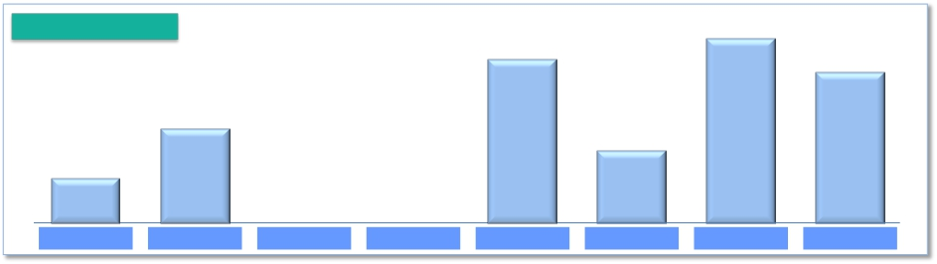
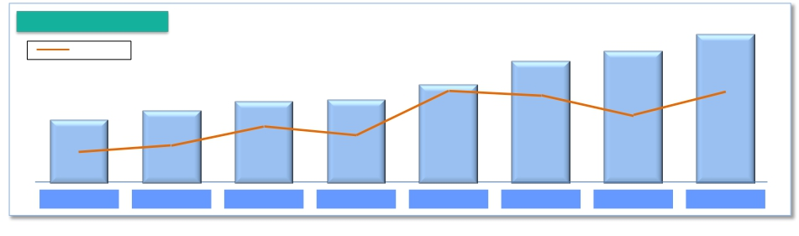
Shareholder Returns
Share buybacks:
Dividends:
Completed ¥338.1 billion of share buybacks (mainly from the Japanese government) in FY2014
Dividends of ¥180 per share for FY2014, a ¥10 increase year-on-year
Share buybacks
406.5
(Billions of yen)
338.1
381.7
200.0
150.0
94.4
FY 2007
FY 2008
FY 2009
FY 2010
FY 2011
FY 2012
FY 2013
FY 2014
Dividends per share
180
(yen)
160
●
37.2%
FY 2012
170
●
33.4%
FY 2013
● Pay-out ratio
90
●
19.5%
FY 2007
140
●
38.2%
FY 2011
120
●
32.3%
FY 2009
120
●
31.2%
FY 2010
110
●
27.5%
FY 2008
●
38.0%
FY 2014
Financial Results for the Fiscal Year Ended March 31, 2015
and Financial Forecasts for the Fiscal Year Ending March 31, 2016
－7－
Copyright (c) 2015 Nippon Telegraph and Telephone Corporation

Slide 9


Shareholder Returns
Dividends:
Dividends of ¥200 per share planned for FY2015,
a ¥10 increase in interim and year-end dividends and
a ¥20 increase in total from FY2014.
Two-for-one stock split of NTT’s common stock:
The objective of the two-for-one stock split* is to lower NTT’s minimum investment
cost per unit, thereby improving the investment environment for its shares and
expanding its investor base.
* Effective date: July 1, 2015
Note 1: The dividend forecasts for the fiscal year ending March 31, 2016, taking the stock split into account, are as follows:
Interim dividends are ¥50 per share,
Year-end dividends are ¥50 per share,
Annual Dividends (total of the above two items) are ¥100 per share.
Note 2: EPS for the fiscal year ending March 31, 2016, taking the stock split into account, is expected to be ¥297.50.
Financial Results for the Fiscal Year Ended March 31, 2015
and Financial Forecasts for the Fiscal Year Ending March 31, 2016
－8－
Copyright (c) 2015 Nippon Telegraph and Telephone Corporation

Slide 10


Progress of Broadband Services

Slide 11
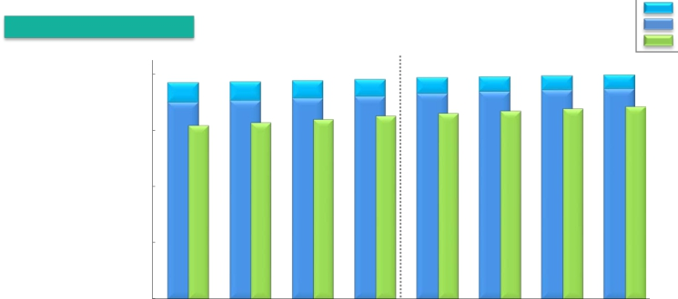


Progress of Broadband Services
Number of Subscribers for Fixed Broadband Services
FLET’S ADSL
FLET’S Hikari
Hikari Denwa
Number of subscribers
*1*2
(Thousands)
20,000
15,000
10,000
5,000
0
19,788
1,333
18,455
16,705
2014.9
19,892
1,275
18,617
16,910
2014.12
19,935
1,219
18,716
[270]
17,108
2015.3
20,317
1,001
19,316
17,108
2016.3E
19,271
1,751
17,521
15,412
2013.6
19,335
1,663
17,672
15,664
2013.9
19,444
1,572
17,873
15,950
2013.12
19,534
1,483
18,050
16,256
2014.3
19,717
1,398
18,319
16,507
2014.6
Changes from the preceding quarter
4-6
(Thousands)
FY2015E
FY2013
10-12
FY2014
10-12
FY2014
FLET’S Hikari *1
Number of
opened
*3connections
FLET’S ADSL
* 5Hikari Denwa
7-9
1-3
4-6
7-9
1-3
220
870
(98)
242
152
707
(88)
252
200
743
(91)
287
178
811
(89)
305
269
879
(85)
251
136
683
(65)
199
162
684
(58)
204
99
720
(56)
198
665
2,966
(264)
852
600
2,750
(218)
0
4
*1 Number of FLET’S Hikari subscribers includes B FLET’S, FLET’S Hikari Next, FLET’S Hikari Light and FLET’S Hikari WiFi Access provided by NTT East, B FLET’S, FLET’S Hikari Premium,
FLET’S Hikari Mytown, FLET’S Hikari Next, FLET’S Hikari Light and FLET’S Hikari WiFi Access provided by NTT West, and wholesale Hikari Access (Hikari Collaboration Model) FTTH
(fiber-to-the-home) access services provided to service providers by NTT East and NTT West.
*2 Figures in [ ] represent FTTH access services which NTT East and NTT West provide to service providers.
*3 Number of opened connections excludes openings due to relocations.
*4 Numbers for Hikari Denwa include wholesale services provided to service providers by NTT East and NTT West.
*5 Numbers of Hikari Denwa subscribers are presented in thousands of channels.
Financial Results for the Fiscal Year Ended March 31, 2015
and Financial Forecasts for the Fiscal Year Ending March 31, 2016
－9－
Copyright (c) 2015 Nippon Telegraph and Telephone Corporation

Slide 12



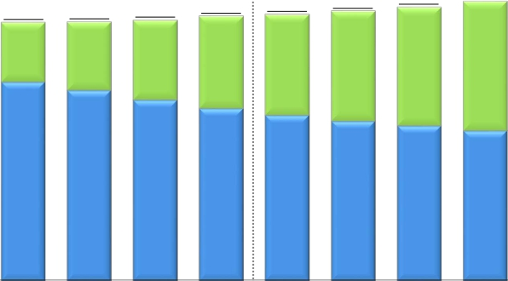

Progress of Broadband Services
Number of Subscribers for Mobile Broadband Services
*Number of subscribers
(Thousands)
LTE(“Xi”)
FOMA
70,000
60,000
50,000
40,000
30,000
20,000
10,000
0
69,900
37,000
32,900
2016.3E
64,295
26,215
38,080
2014.9
65,274
28,298
36,976
2014.12
66,595
30,744
35,851
2015.3
61,623
14,198
47,425
2013.6
61,772
16,398
45,374
2013.9
62,182
19,021
43,160
2013.12
63,105
21,965
41,140
2014.3
63,566
24,043
39,523
2014.6
Changes from the preceding quarter
FY2013
10-12
FY2014
10-12
(Thousands)
FY2015E
4-6
7-9
1-3
4-6
7-9
1-3
FY2014
LTE("Xi")+FOMA
87
149
410
924
461
729
979
1,322
3,490
3,300
*
The number of FOMA subscribers includes communications module service subscribers
Financial Results for the Fiscal Year Ended March 31, 2015
and Financial Forecasts for the Fiscal Year Ending March 31, 2016
－10－
Copyright (c) 2015 Nippon Telegraph and Telephone Corporation

Slide 13
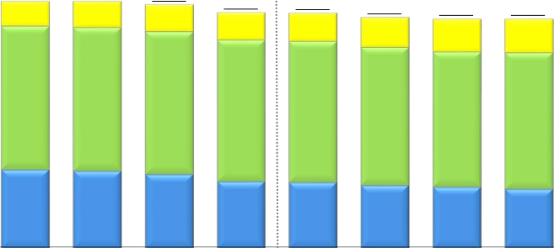

Progress of Broadband Services
ARPU of Mobile Broadband Services (LTE(“Xi”), FOMA)
*
Smart ARPU
Packet ARPU
Voice ARPU
(Yen)
5,000
4,000
3,000
2,000
1,000
0
4,680
470
2,720
1,490
4,680
500
2,720
1,460
4,610
510
2,700
1,400
4,460
520
2,680
1,260
4,450
530
2,670
1,250
4,370
560
2,620
1,190
4,340
620
2,560
1,160
4,340
640
2,580
1,120
4,370
590
2,600
1,180
4,310
680
2,540
1,090
FY2013
10-12
FY2014
10-12
FY2014
FY2015E
4-6
7-9
1-3
4-6
7-9
1-3
*
NTT DOCOMO’s ARPU calculation methods have been changed from the second quarter of the fiscal year ending March 31, 2015. Accordingly, the ARPU data for the results
for the three months ended Jun. 30, 2013 (from Apr. to Jun., 2013), the three months ended Sep. 30, 2013 (from Jul. to Sep., 2013), the three months ended Dec. 31, 2013
(from Oct. to Dec., 2013), the three months ended Mar. 31, 2014 (from Jan. to Mar., 2014), the year ended Mar. 31, 2014 and the three months ended Jun. 30, 2014 (from
Apr. to Jun., 2014) presented above have also been changed.
Please see page 17 regarding the calculation of ARPU.
Financial Results for the Fiscal Year Ended March 31, 2015
and Financial Forecasts for the Fiscal Year Ending March 31, 2016
－11－
Copyright (c) 2015 Nippon Telegraph and Telephone Corporation

Slide 14

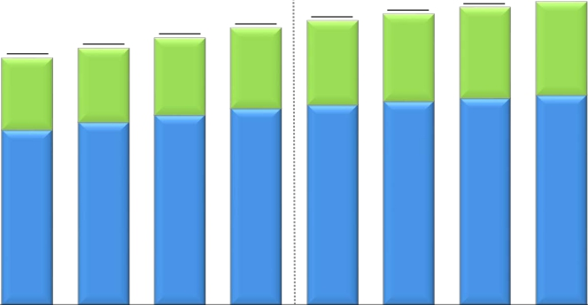
Progress of Broadband Services
Number of Subscribers for Video Services
FLET'S TV
Hikari TV
*1 *2
(Thousands)
5,000
4,000
3,000
2,000
1,000
0
4,275
1,304
2,971
2014.12
4,359
1,345
3,014
2015.3
4,522
1,372
3,150
FY2015E
4,086
1,209
2,877
2014.6
4,183
1,256
2,927
2014.9
3,841
1,113
2,727
2013.12
3,984
1,161
2,823
2014.3
3,552
1,032
2,520
2013.6
3,692
1,067
2,625
2013.9
*1
*2
“FLET’S TV” requires a subscription to “FLET’S TV Transmission Services,” provided by NTT East and NTT West, and a subscription to SKY Perfect JSAT’s “SKY Perfect JSAT
Facility Use Services” broadcast service.
Numbers of subscribers for “FLET’S TV Transmission Services” include wholesale services provided to service providers by NTT East and NTT West.
Financial Results for the Fiscal Year Ended March 31, 2015
and Financial Forecasts for the Fiscal Year Ending March 31, 2016
－12－
Copyright (c) 2015 Nippon Telegraph and Telephone Corporation

Slide 15
Financial Information

Slide 16

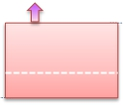









Details of Consolidated Statement of Income
Operating
Revenues
Fixed IP/packet: (2.2)
Mobile IP/packet: (37.6)
(Billions of yen)
[year-on-year：+170.1]
Fixed voice: (137.6)
Mobile voice: (180.6)
Other: +0.1
SI revenues and sales
of telecommunications
equipment
444.1
IP/packet
communications
services revenues
39.7
Voice-related
services revenues
Other revenues
83.9
318.1
Fixed voice
11,095.3
Systems Integration
10,925.2
Mobile voice
Telecommunications
equipment
Systems Integration:
+416.7
Telecommunications equipment (Fixed-line): (5.4)
Telecommunications equipment (Mobile): +32.7
FY2013
FY2014
Operating
Expenses
[year-on-year：+299.2]
Depreciation
expenses and loss on
disposal of assets
44.8
121.6
Personnel expenses
30.4
Other expenses
192.1
10,010.8
9,711.5
Expenses for purchase
of goods and services
and other expenses
FY2013
Financial Results for the Fiscal Year Ended March 31, 2015
and Financial Forecasts for the Fiscal Year Ending March 31, 2016
FY2014
Copyright (c) 2015 Nippon Telegraph and Telephone Corporation
－13－

Slide 17





Details of Consolidated Balance Sheet
March 31, 2014
(Billions of yen)
20,284.9
March 31, 2015
20,702.4
Liabilities
9,624.3
[+290.1]
Interest-Bearing
Debt
4,406.7
[+206.8]
Liability for Employees’
Retirement Benefits
1,388.0
[+60.1]
Other
28.3[+2.4]
Equity
11,049.8
[+125.0]
Treasury Stock
(497.7)
[(340.8)]
Liabilities
Interest-Bearing
Debt
4,200.0
Liability for Employees’
Retirement Benefits
1,327.9
Other
25.9
Equity
10,924.8
Treasury Stock
(156.9)
Assets
20,702.4
[+417.5]
Depreciable Assets
(property, plant and
equipment)
8,097.7
[(144.2)]
Deferred Tax Assets
(non-current)
589.9
[(71.6)]
Assets
20,284.9
Depreciable Assets
(property, plant and
equipment)
8,241.9
Deferred Tax
Assets
(non-current)
661.5
9,334.2
Financial Results for the Fiscal Year Ended March 31, 2015
and Financial Forecasts for the Fiscal Year Ending March 31, 2016
－14－
Copyright (c) 2015 Nippon Telegraph and Telephone Corporation

Slide 18




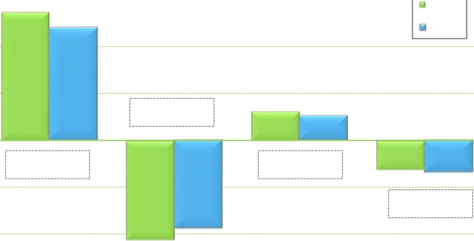

Details of Consolidated Cash Flows
Cash flows from
operating
activities
(A)
Cash flows from
investing
activities
(B)
FCF
(A) + (B)
Cash flows from
financing
activities
Interest-bearing debt
（Billions of yen）
4,500.0
3,000
2,727.9
FY2013
4,406.7
2,391.8
FY2014
4,200.0
4,200.0
2,000
4,000.0
1,000
621.1
+238.2
523.2
0
(1,000)
(336.1)
(97.9)
3,500.0
(622.4)
(678.0)
(55.6)
(2,000)
(1,868.6)
(2,106.8)
3,000.0
FY2013
FY2014
FY2015E
Increase/Decrease from the same period of the previous fiscal year
(3,000)
Financial Results for the Fiscal Year Ended March 31, 2015
and Financial Forecasts for the Fiscal Year Ending March 31, 2016
－15－
Copyright (c) 2015 Nippon Telegraph and Telephone Corporation

Slide 19

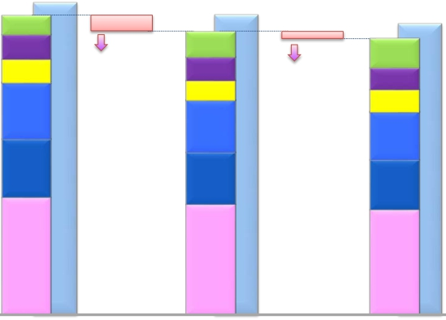



Capital Investment
Capital Investment
(Billions of yen)
1,892.8
1,795.7
112.4
147.7
141.8
339.4
351.3
703.1
FY2013
Capex to Sales Ratio
Capex to Sales
* (includes real estate-related amounts)
Includes consolidated
capital investments real
estate-related amounts
Other
NTT DATA (Consolidated)
NTT Communications
NTT West
NTT East
NTT DOCOMO (Consolidated)
* Amounts include sales and
investments related to real estate and
solar power generation operations
1,817.5
1,702.9
152.2
140.9
121.4
314.5
312.1
661.8
FY2014
15.6%
16.4%
1,760.0
1,660.0
175.0
130.0
135.0
290.0
300.0
630.0
FY2015E
14.9%
15.5%
92.9
(5.2)%
42.9
(2.5)%
16.7%
17.3%
Financial Results for the Fiscal Year Ended March 31, 2015
and Financial Forecasts for the Fiscal Year Ending March 31, 2016
－16－
Copyright (c) 2015 Nippon Telegraph and Telephone Corporation

Slide 20

Calculation of ARPU
Average monthly revenue per unit, or ARPU, is used to measure average monthly operating revenues attributable to each designated service on a per user
basis. In the case of NTT Group’s mobile communications business, ARPU is calculated by dividing revenue items included in operating revenues from its
mobile communications business segment, such as revenues from FOMA mobile phone services and Xi mobile phone services, that are incurred consistently
each month (i.e., basic monthly charges and voice/packet transmission charges), by the number of Active Subscribers to the relevant services. The calculation
of these figures excludes revenues that are not representative of monthly average usage, such as telecommunications equipment sales, activation fees and
universal service charges.
NTT believes that its ARPU figures calculated in this way provide useful information regarding the monthly average usage of its subscribers. The revenue items
included in the numerators of NTT Group’s ARPU figures are based on its financial results comprising its U.S. GAAP results of operations.
For a complete discussion on the calculation of APRU, please see the “Supplementary Data for the Annual Results for the Fiscal Year Ended March 31, 2015.”
Notes:
(1) The following is the formula we use to compute ARPU for mobile business conducted by NTT DOCOMO.
·
Mobile Aggregate ARPU (“LTE(‘Xi’)”+“FOMA”) = Voice ARPU (“LTE(‘Xi’)”+“FOMA”) + Packet ARPU (“LTE(‘Xi’)”+“FOMA”) + Smart ARPU
(“LTE(‘Xi’)”+“FOMA”).
·
NTT DOCOMO’s Voice ARPU (“LTE(‘Xi’)”+“FOMA”) is based on operating revenues related to voice services, such as basic monthly
charges and voice communication charges attributable to our “FOMA” and “LTE(‘Xi’)” services, and Packet ARPU (“LTE(‘Xi’)”+“FOMA”) is
based on operating revenues related to packet services, such as flat monthly fees and packet communication charges attributable to
“FOMA” and “LTE(‘Xi’)” services, and Smart ARPU (“LTE(‘Xi’)”+“FOMA”) is based on operating revenues from a part of Other Operating
Revenues attributable to “FOMA” and “LTE(‘Xi’)” wireless communications services (revenues from content, collection of charges, mobile
phone insurance service, advertising and others).
(2) NTT DOCOMO's ARPU calculation does not include subscriptions for and revenues from communication module services, “Phone Number Storage,” “Mail
Address Storage,” “docomo Business Transceiver” and wholesale telecommunications services and interconnecting telecommunications facilities that are
provided to Mobile Virtual Network Operators (MVNOs).
(3) Number of active subscribers used in the ARPU calculation of NTT DOCOMO are as below.
1Q Results: Sum of number of active subscribers** for each month from April to June.
2Q Results: Sum of number of active subscribers** for each month from July to September.
3Q Results: Sum of number of active subscribers** for each month from October to December.
4Q Results: Sum of number of active subscribers** for each month from January to March.
FY Results/FY Forecast: Sum of number of active subscribers**/ expected number of active subscribers** for each month from April to March.
** Active subscribers = (number of subscribers at end of previous month + number of subscribers at end of the current month)/2
Financial Results for the Fiscal Year Ended March 31, 2015
and Financial Forecasts for the Fiscal Year Ending March 31, 2016
－17－
Copyright (c) 2015 Nippon Telegraph and Telephone Corporation

