Slide 1

Joe Kaeser, President and CEO – Ralf P. Thomas, CFO
Q1 – A sound start to Fiscal 2014
Q1 FY 2014, Analyst Call
Munich, January 28, 2014
© Siemens AG 2014. All rights reserved.

Slide 2
Safe Harbour Statement
This document contains statements related to our future business and financial performance and future events or developments involving Siemens that may
constitute forward-looking statements. These statements may be identified by words such as “expects,” “looks forward to,” “anticipates,” “intends,” “plans,”
“believes,” seeks ” “estimates,” will ” “project” or words of similar meaning. We may also make forward-looking statements in other reports, in presentations in
material delivered to shareholders and in press releases. In addition, our representatives may from time to time make oral forward-looking statements. Such
statements are based on the current expectations and certain assumptions of Siemens’ management, and are, therefore, subject to certain risks and uncertainties.
A variety of factors, many of which are beyond Siemens’ control, affect Siemens’ operations, performance, business strategy and results and could cause the
actual results, performance or achievements of Siemens to be materially different from any future results, performance or achievements that may be expressed or
implied by such forward-looking statements or anticipated on the basis of historical trends. These factors include in particular, but are not limited to, the matters
described in Item 3: Key information—Risk factors of our most recent annual report on Form 20-F filed with the SEC, in the chapter “Risks” of our most recent
annual report prepared in accordance with the German Commercial Code, and in the chapter “Report on risks and opportunities” of our most recent interim report.
Further information about risks and uncertainties affecting Siemens is included throughout our most recent annual and interim reports, as well as our most recent
earnings release, which are available on the Siemens website, www.siemens.com, and throughout our most recent annual report on Form 20-F and in our other
filings with the SEC, which are available on the Siemens website, www.siemens.com, and on the SEC’s website, www.sec.gov. Should one or more of these risks
or uncertainties materialize, or should underlying assumptions prove incorrect, actual results, performance or achievements of Siemens may vary materially from
those described in the relevant forward-looking statement as being expected, anticipated, intended, planned, believed, sought, estimated or projected. Siemens
neither intends, nor assumes any obligation, to update or revise these forward-looking statements in light of developments which differ from those anticipated.
All underlying margins are calculated by adjusting margins for the effects reported for the respective businesses in the relevant period. These effects are provided
to assist in the analysis of the businesses' results year-over-year and may vary from period to period. Underlying margins are not necessarily indicative of future
performance. Other companies may calculate similar measures differently.
Due to rounding, numbers presented throughout this and other documents may not add up precisely to the totals provided and percentages may not precisely
reflect the absolute figures.
© Siemens AG 2014. All rights reserved.
g ,
p j
Page 2
Munich, January 28, 2014
Q1 FY 2014, Analyst Call

Slide 3
Q1 FY 2014 – Key figuresKey figures
Siemens (continuing operations, in €m)
Orders
Revenue
Book-to-bill ratio
Total Sectors profit
Net income
Basic earnings per share net income (in €)
Free cash flow
1) Change is adjusted for portfolio and currency translation effects
© Siemens AG 2014. All rights reserved.
Page 3
Munich, January 28, 2014
Q1 FY 13
19,173
17,925
1.07x
1,560
1,214
1.42
-1,416
Q1 FY 14
20,836
17,325
1.20x
1,789
1,457
1.70
-658
Change
12%1)
-1%1)
15%
20%
20%
54%
Q1 FY 2014, Analyst Call

Slide 4
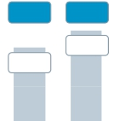
Energy – Improved Sector performance
Challenges in Transmission remain
Key Figures Energy
Main developments in Q1
€bn
Orders 1)
€m
Profit 2)
· Strong book-to-bill at 1.25 mainly driven by
large orders in Wind
Revenue 1)
+3%
8.0%
9.9%
· Largest on-shore order ever from
MidAmerican Energy (1050 MW)
7.4
7.2
-4%
6.3
Q1 13
5.8
Q1 14
8.8%
506
Q1 14
· Two offshore orders for Godewind 1 + 2
projects from Dong Energy (582 MW)
· Market environment remains highly competitive
· Power Generation – Higher profit from service
6.5%
410
Q1 13
Q1 13
Q1 14
business compensates for lower contribution
from gas turbine and solution business
· Wind – Solid performance, seasonal lower
offshore revenue share
· Transmission – Continuing project execution
challenges and higher proportion of low margin
projects
Orders
y-o-y 1)
-12%
100%
-9%
Revenue
y-o-y 1)
-11%
20%
-3%
Profit
margin
16.6%
4.8%
-6.6%
Underl.l
profit
margin
16.6%
4.8%
-1.3%
t ib ti
Division
Power
Generation
Wind Power
Power
Transmission
1) Comparable, i.e. adjusted for currency translation and portfolio effects
%
Profit margin
%
Underlying Profit margin
© Siemens AG 2014. All rights reserved.
2) for underlying margin calculation please refer to Flashlight document
Page 4
Munich, January 28, 2014
Q1 FY 2014, Analyst Call

Slide 5
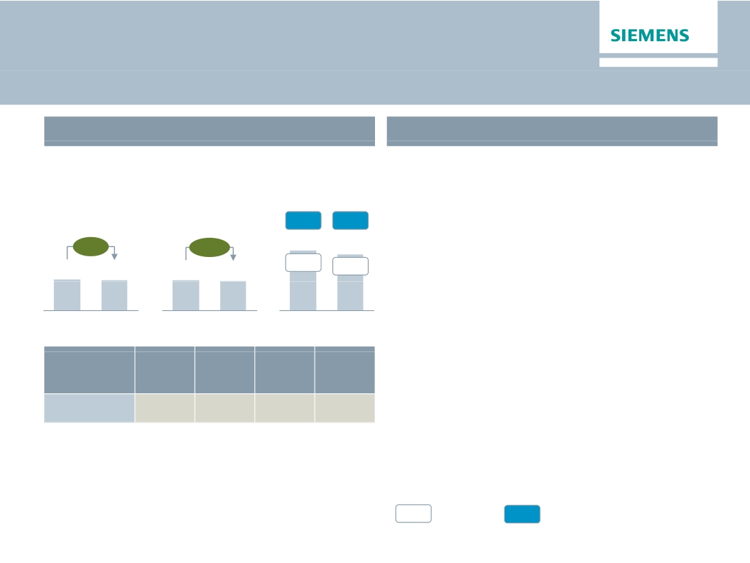
Healthcare – Strong performance on high level despite
currency headwinds
Key Figures Healthcare
€m
Revenue 1)
Profit 2)
Main developments in Q1
· Strength in innovation reinforced at RSNA:
· Somatom Force – Low dose high end CT
€bn
Orders 1)
16.8%
16.5%
further opens new patient groups
+4%
+1%
· Artis One – Highly flexible, efficient angio-
3.3
Q1 13
3.2
Q1 14
3.3
Q1 13
3.1
Q1 14
15.5%
503
Q1 13
15.2%
471
Q1 14
graphy system for routine interventions
· Order growth balanced between advanced and
emerging markets in still challenging
Underl.l
profit
margin
15.5%
environment
· Strong profit margin despite significant
headwinds from U. S. medical device tax
(~30bps) and FX effects) d FX ff t
· Diagnostics – Solid profit development
Division
Diagnostics
Orders
y-o-y 1)
1%
Revenue
y-o-y 1)
1%
Profit
margin
11.0%
1) Comparable, i.e. adjusted for currency translation and portfolio effects
%
Profit margin
%
Underlying Profit margin
© Siemens AG 2014. All rights reserved.
2) for underlying margin calculation please refer to Flashlight document
Page 5
Munich, January 28, 2014
Q1 FY 2014, Analyst Call

Slide 6
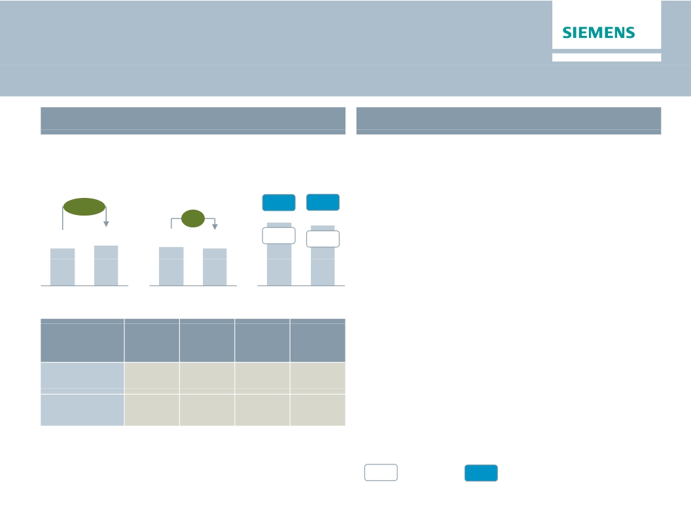
Industry – Improving orders and stable profitability
Key Figures Industry
€m
Main developments in Q1
· Short cycle markets only with few pockets of
€bn
Orders 1)
Revenue 1)
Profit 2)
growth, order growth mainly driven by long-
12.4%
cycle business and PLM Software
+10%
12.7%
0%
· Industry Automation – Margin improvement on
4.3
Q1 13
4.6
Q1 14
4.4
Q1 13
4.3
Q1 14
11.5%
506
Q1 13
11.2%
482
Q1 14
better business mix due to higher share of
product business
· Drive Technologies – Less favorable revenue
mix held back profit on lower portion of higher
Orders
y-o-y 1)
7%
6%
Revenue
y-o-y 1)
2%
1%
Profit
margin
16.8%
6.5%
Underl.l
profit
margin
19.0%
6.8%
margin short cycle offerings
· Divestment of Water Technologies closed in
January 2014; preliminary consideration of
€0.6bn, net cash inflow in the second quarter
Division
Industry
Automation
Drive
Technologies
1) Comparable, i.e. adjusted for currency translation and portfolio effects
%
Profit margin
%
Underlying Profit margin
© Siemens AG 2014. All rights reserved.
2) for underlying margin calculation please refer to Flashlight document
Page 6
Munich, January 28, 2014
Q1 FY 2014, Analyst Call

Slide 7
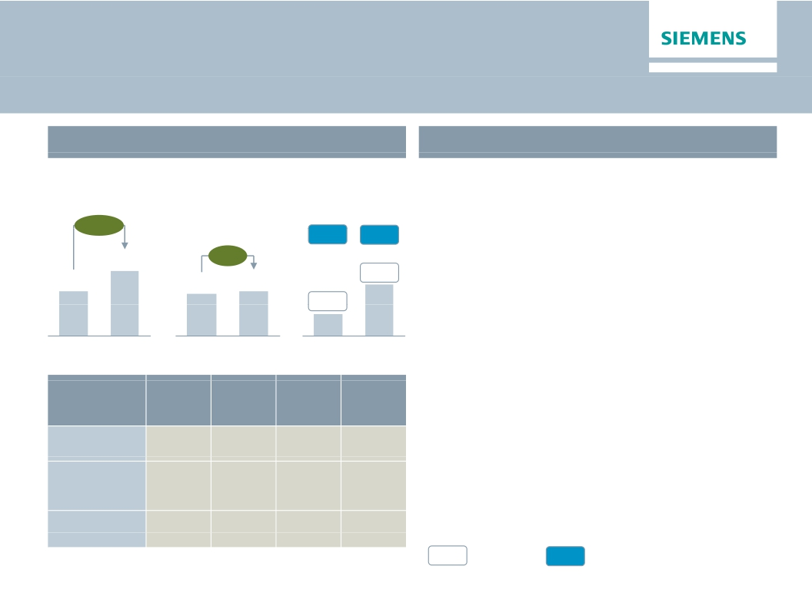
Infrastructure & Cities – Transformation measures and
progress in execution drive margin improvement
Key Figures Infrastructure & Cities
€m
Main developments in Q1
· Order growth driven by Riyadh turnkey metro
€bn
Orders 1)
Revenue 1)
Profit 2)
project (€1.6bn) and further large transportation
+45%
6.4%
8.0%
orders
6.3
+4%
· Transportation & Logistics – Progress in
executing large rolling stock projects; regulatory
approval for Velaro D high speed trains in
Germany
4.4
4.1
4.4
7.6%
330
3.4%
141
Q1 13
Q1 14
Q1 13
Q1 14
Q1 13
Q1 14
· Power Grid Solutions & Products – Mainly
benefitting from favorable mix in LMV
· Building Technologies – Exit of lower margin
business and ‘Siemens 2014’ related productivity
improvement drive profitability
Underl.l
profit
margin
6.0%
9.0%
8.6%
Power Grid Solutions & Products Mainly
Division
Transportation
& Logistics
Power Grid
Solutions
& Products
Building
Technologies
Orders
y-o-y 1)
129%
12%
1%
Revenue
y-o-y 1)
10%
4%
-2%
Profit
margin
5.0%
9.0%
8.6%
1) Comparable, i.e. adjusted for currency translation and portfolio effects
%
Profit margin
%
Underlying Profit margin
© Siemens AG 2014. All rights reserved.
2) for underlying margin calculation please refer to Flashlight document
Page 7
Munich, January 28, 2014
Q1 FY 2014, Analyst Call

Slide 8
Appendix
© Siemens AG 2014. All rights reserved.
Page 8
Munich, January 28, 2014
Q1 FY 2014, Analyst Call

Slide 9
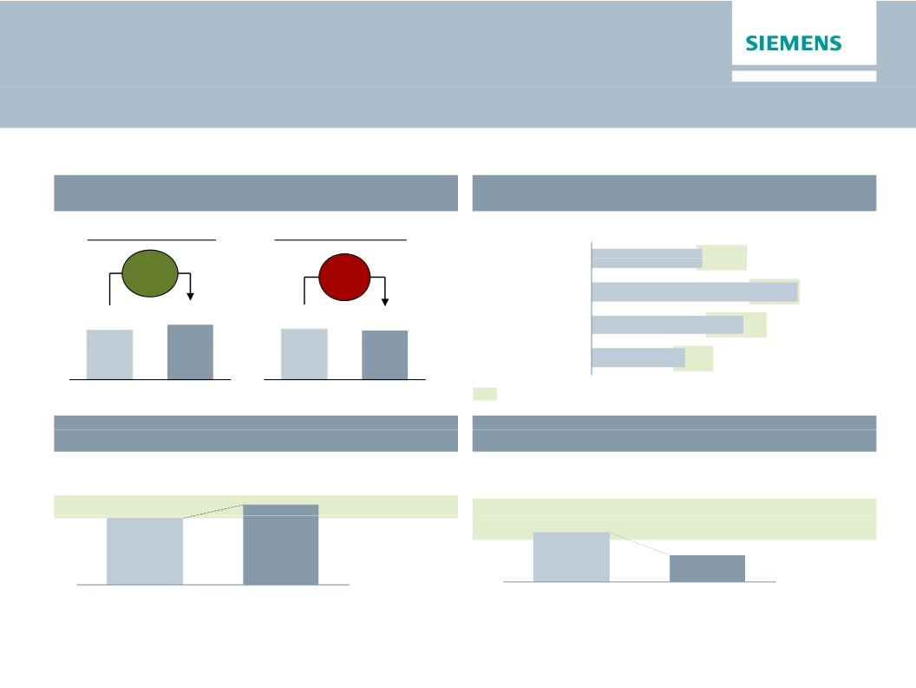
One Siemens cockpit – Q1 FY 2014
All Sectors have reached EBITDA Margin Range
Financial target system
Growth1)
Margins compared to industry benchmarks
Orders
Revenue
EBITDA Margins (Q1 FY 14)
9%
12%2)
-3%
-1%2)
Energy
Healthcare
10.6%
10-15%
15-20%
19.8%
19.2
20.8
17.9
17.3
Industry
14.6%
11-17%
Infrastr. & Cities
9.0%
8-12%
EBITDA margins of respective markets throughout business cycles
Q1 FY 13
Q1 FY 14
Q1 FY 13
Q1 FY 14
Capital efficiency
ROCE adjusted (continuing operations)
it l ffi i
Capital structure
Adjusted industrial net debt/EBITDA
it l t
14.9%
18.0%
15-20%
0.6x
0.5-1 0x
0.3x
Q1 FY 14
Q1 FY 13
Q1 FY 14
Q1 FY 13
1) As reported, cont. operations 2) Comparable, i.e. adjusted for currency translation and portfolio effects
© Siemens AG 2014. All rights reserved.
Page 9
Munich, January 28, 2014
Q1 FY 2014, Analyst Call

Slide 10

Outlook Fiscal 2014
Basic earnings per share (Net income)
In €
·
We expect our markets to remain
challenging in Fiscal 2014.
At least 15%
growth
·
Our short-cycle businesses are not
anticipating a recovery until late in the fiscal
year.
6.55
5.08
·
·
·
·
We expect orders to exceed revenue, for a
book-to bill ratio above 1.
Assuming that revenue on an organic basis
remains level year-over-year, we expect
basic earnings per share (Net Income) for
Fiscal 2014 to grow by at least 15% from
€5.08 in Fiscal 2013.
This outlook is based on shares outstanding
of 843 million as of September 30, 2013.
Furthermore it excludes impacts related to
4.74
FY 2011
FY 2012
FY 2013
FY 2014e
legal and regulatory matters.
© Siemens AG 2014. All rights reserved.
Page 10
Munich, January 28, 2014
Q1 FY 2014, Analyst Call

Slide 11

Financial calendar
January
February
March
January 28, 2014
Q1 Earnings Release; Annual General Meeting
February 11, 2014
Roadshow Switzerland (Zurich)
March 20, 2014
Bank of America Merrill Lynch Conference (London)
© Siemens AG 2014. All rights reserved.
Page 11
Munich, January 28, 2014
Q1 FY 2014, Analyst Call

Slide 12

Siemens Investor Relations contact data
IR-Hotline:
Fax:
Internet:
+49-89 636-32474
+49-89-636-32830
http://www.siemens.com/investorrelations
Email: investorrelations@siemens.com
© Siemens AG 2014. All rights reserved.
Page 12
Munich, January 28, 2014
Q1 FY 2014, Analyst Call

Slide 13
Reconciliation and Definitions for
Non-GAAP Measures
This document includes supplemental financial measures that are or may be non-GAAP financial measures.
Orders and order backlog; adjusted or organic growth rates of revenue and orders; book-to-bill ratio; Total Sectors profit; return on equity (after tax), or ROE (after
tax); return on capital employed (adjusted), or ROCE (adjusted); Free cash flow, or FCF; adjusted EBITDA; adjusted EBIT; adjusted EBITDA margins, earnings
effects from purchase price allocation, or PPA effects; net debt and adjusted industrial net debt are or may be such non-GAAP financial measures.
These supplemental financial measures should not be viewed in isolation or as alternatives to measures of Siemens’ net assets and financial positions or results of
operations as presented in accordance with IFRS in its Consolidated Financial Statements. Other companies that report or describe similarly titled financial
measures may calculate them differently.
Definitions of these supplemental financial measures, a discussion of the most directly comparable IFRS financial measures information regarding the usefulness
of Siemens’ supplemental financial measures, the limitations associated with these measures and reconciliations to the most comparable IFRS financial measures
are available on Siemens’ Investor Relations website at www.siemens.com/nonGAAP. For additional information, see supplemental financial measures and the
related discussion in Siemens’ most recent annual report on Form 20-F, which can be found on our Investor Relations website or via the EDGAR system on the
website of the United States Securities and Exchange Commission.
© Siemens AG 2014. All rights reserved.
Page 13
Munich, January 28, 2014
Q1 FY 2014, Analyst Call

