Slide 1

Joe Kaeser, President and CEO
Ralf P. Thomas, CFO
Q1 – Overall performance as expected
Q1 FY 2015, Analyst Call
Munich, January 27, 2015
© Siemens AG 2015

Slide 2
Notes and forward-looking statements
This document contains statements related to our future business and financial performance and future events or developments involving Siemens that may
constitute forward-looking statements. These statements may be identified by words such as “expect,” “look forward to,” “anticipate” “intend,” “plan,” “believe,”
“seek,” estimate ” “will,” project” or words of similar meaning. We may also make forward-looking statements in other reports in presentations, in material
delivered to shareholders and in press releases. In addition, our representatives may from time to time make oral forward-looking statements. Such statements
are based on the current expectations and certain assumptions of Siemens’ management, of which many are beyond Siemens’ control. These are subject to a
number of risks, uncertainties and factors, including, but not limited to those described in disclosures, in particular in the chapter Risks in the Annual Report.
Should one or more of these risks or uncertainties materialize, or should underlying expectations not occur or assumptions prove incorrect, actual results,
performance or achievements of Siemens may (negatively or positively) vary materially from those described explicitly or implicitly in the relevant forward-looking
statement. Siemens neither intends, nor assumes any obligation, to update or revise these forward-looking statements in light of developments which differ from
those anticipated.
This document includes – in IFRS not clearly defined – supplemental financial measures that are or may be non-GAAP financial measures. These supplemental
financial measures should not be viewed in isolation or as alternatives to measures of Siemens’ net assets and financial positions or results of operations as
presented in accordance with IFRS in its Consolidated Financial Statements. Other companies that report or describe similarly titled financial measures may
calculate them differently.
Due to rounding, numbers presented throughout this and other documents may not add up precisely to the totals provided and percentages may not precisely
reflect the absolute figures.
© Siemens AG 2015
l t fi
Page 2
Munich, January 27, 2015
Q1 FY 2015, Analyst Call

Slide 3
Key developments
· Continued volatile economic and market environment
· Orders below prior year (-13%) due to tough comps in large orders
· Moderate organic revenue growth (+3%) driven by Mobility, Wind Power and
Digital Factory
· Industrial business margin with 10.2% within expected range
· Net Income of €1.1bn (-25%) and basic EPS of €1.30 burdened by factors
outside Industrial Business mainly due to lower interest rate environment
· Strong Free Cash Flow from Industrial Business
· Significant progress on portfolio optimization: Closing of Rolls-Royce
acquisition and divestment of BSH and Audiology, Primetals Technologies joint
venture starts operation
© Siemens AG 2015
l til
k t
M d
th (+3%) d i
b M bilit
Wi d P
Page 3
Munich, January 27, 2015
Q1 FY 2015, Analyst Call

Slide 4
PG: Margin decline as expected, actions in place
WP: Focus on execution to strengthen profitability
Power and Gas (PG)
Wind Power and Renewables (WP)
Orders
Revenue
Orders
Revenue
€bn
€bn
+6%1)
-3%1)
3.7
-44%1)
+8%1)
3.5
2.9
2.9
2.3
1.5
1.3
1.3
Q1 FY 14
Q1 FY 15
Q1 FY 14
Q1 FY 15
Q1 FY 14
Q1 FY 15
Q1 FY 14
Q1 FY 15
Profit & Margin
Profit & Margin
€m
536
18.2%
Q1 FY 14
Target
margin
11-15%
€m
80
5.4%
Q1 FY 15
Target
margin
5-8%
325
11.3%
11.4%
Q1 FY 15
66
5.0%
Q1 FY 14
· Lower margins across the businesses,
higher OPEX & lower service contribution
· Continuing challenges resulting in price
pressure and overcapacities
· Sharply lower large order volume in
Germany and the U.S.
· Increased profit contribution from service
· Expenses for new turbine offering ramp up
1) Comparable, i.e. adjusted for currency translation and portfolio effects
© Siemens AG 2015
Page 4
Munich, January 27, 2015
x.x% Margin as reported
x.x% Margin excl. severance
Q1 FY 2015, Analyst Call

Slide 5
EM: Gradual profitability improvement
BT: Solid start, CHF appreciation as short-term impact
Energy Management (EM)
Building Technologies (BT)
Orders
Revenue
Orders
Revenue
€bn
€bn
+17%1)
+3%1)
+3% )
+3%1)
+0% )
+0%1)
2.6
Q1 FY 14
3.1
Q1 FY 15
2.5
Q1 FY 14
2.7
Q1 FY 15
1.3
Q1 FY 14
1.4
Q1 FY 15
1.3
Q1 FY 14
1.4
Q1 FY 15
Profit & Margin
Profit & Margin
€m
109
Target
margin
€m
120
117
Target
margin
43
1.7%
Q1 FY 14
4.1%
4.2%
Q1 FY 15
7-10%
8.9%
Q1 FY 14
8.5%
8.7%
Q1 FY 15
8-11%
· Broad based regional order growth; large
HVDC-order in Canada
· Execution of legacy projects as planned
· Order growth driven by the U.S. and the
Middle East
· Adverse impact of significant Swiss Franc
appreciation expected
1) Comparable, i.e. adjusted for currency translation and portfolio effects
© Siemens AG 2015
Page 5
Munich, January 27, 2015
x.x% Margin as reported
x.x% Margin excl. severance
Q1 FY 2015, Analyst Call

Slide 6
DF: Broad based growth drives margin
PD: Higher investment in opex weigh on margin
Digital Factory (DF)
Process Industries and Drives (PD)
Orders
Revenue
Orders
Revenue
€bn
€bn
+2%1)
+8%1)
-8%1)
+3%1)
2.3
Q1 FY 14
2.4
Q1 FY 15
2.2
Q1 FY 14
2.4
Q1 FY 15
2.5
Q1 FY 14
2.3
Q1 FY 15
2.2
Q1 FY 14
2.3
Q1 FY 15
Profit & Margin
Profit & Margin
€m
463
19.4%
19.8%
Q1 FY 15
Target
margin
14-20%
€m
163
7.4%
Q1 FY 14
155
6.7%
6.8%
Q1 FY 15
Target
margin
8-12%
386
17.8%
Q1 FY 14
· Revenue growth led by China and the U.S.
· Volume driven margin expansion on
strong product and industrial software
business
· Lower large order volume and weaker
demand from commodity related
industries
· Higher R&D and selling expenses
1) Comparable, i.e. adjusted for currency translation and portfolio effects
© Siemens AG 2015
Page 6
Munich, January 27, 2015
x.x% Margin as reported
x.x% Margin excl. severance
Q1 FY 2015, Analyst Call

Slide 7
MO: Positive mix effects drive margin expansion
HC: Unfavourable mix with negative margin impact
Mobility (MO)
Orders
€bn
-64%1)
Healthcare (HC)
Orders
€bn
+2%1)
Revenue
+15%1)
Revenue
+2%1)
3.4
Q1 FY 14
1.6
Q1 FY 14
1.9
Q1 FY 15
2.8
Q1 FY 14
3.0
Q1 FY 15
2.7
Q1 FY 14
2.9
Q1 FY 15
1.3
Q1 FY 15
Profit & Margin
Profit & Margin
€m
155
8.4%
Q1 FY 15
Target
margin
6-9%
€m
473
17.6%
Q1 FY 14
Target
margin
15-19%
109
6.9%
Q1 FY 14
413
14.5%
14.8%
Q1 FY 15
· Lower order volume on tough
comparables
· Positive mix effect from high margin
business
· Strong orders in Europe & US, Asia weak
· Unfavorable business mix in Imaging &
Therapy and FX tailwinds not yet evident
1) Comparable, i.e. adjusted for currency translation and portfolio effects
© Siemens AG 2015
Page 7
Munich, January 27, 2015
x.x% Margin as reported
x.x% Margin excl. severance
Q1 FY 2015, Analyst Call

Slide 8
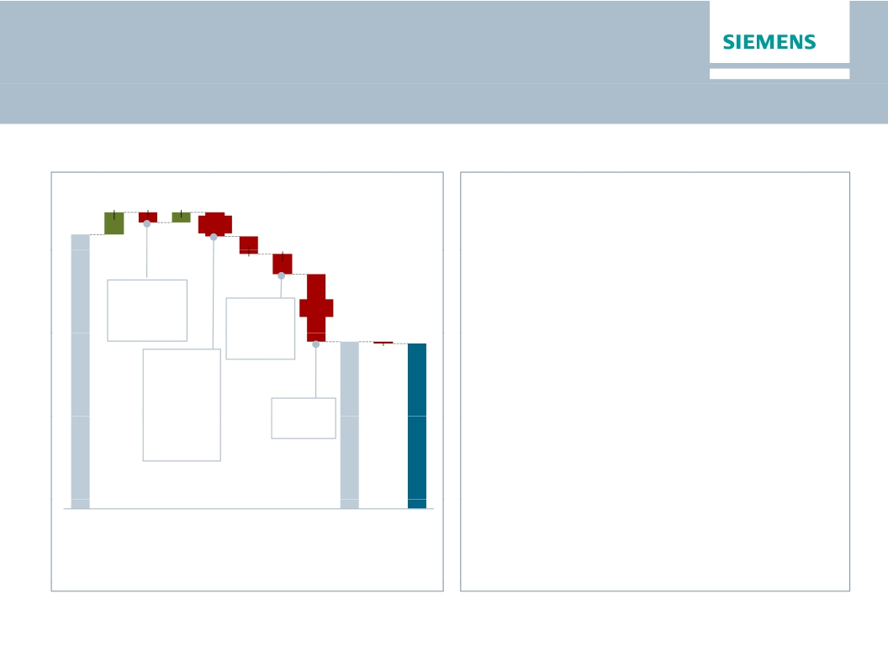
Below Industrial Business negatively impacted by
unfavourable interest rate development
Below Industrial Business (Q1 FY 2015)
in €m
146 -69
67
Key topics
1,819
-156
· CMPA:
-131
· Q1: Missing BSH equity income and impact
-117
from revaluation of Hanau obligation due to
lower interest rates
· Q2e: Gain from BSH divestment (~€1.4bn
pre tax) and negative impact related to
Therein:
-€53m
Hanau
-451
1,106
Therein:
-€123m
1,095
Treasury
Tax rate
@29%
-11
Unify of close to €300m
· Corporate Treasury: Substantial negative
effect from derivatives not qualifying for
hedge accounting
· Discontinued Operations:
· Q1: Loss of €56m due to Metals
Technologies
· Q2e: Gain from divestment of Audiology
Therein:
-€97m
Pensions
-€59m
Corp. Items
Ind.
Bus.
SFS
CMPA
SRE
Corp.
Items
&
Pen.
PPA
Corp.
Elim,
Tre &
other
Tax
Inc.
cont.
Ops
NetDisc.
IncomeOps.
all in
(~€1.6bn pre tax)
© Siemens AG 2015
Page 8
Munich, January 27, 2015
Q1 FY 2015, Analyst Call

Slide 9

Outlook Fiscal 2015
Basic earnings per share (Net income)
In €
6.55
6.37
5.08
4.74
At least 15%
growth
· We believe that our business environment will
be complex in fiscal 2015, among other things
due to geopolitical tensions.
· We expect revenue on an organic basis to
remain flat year-over-year, and orders to
exceed revenue for a book-to-bill ratio above 1.
· Furthermore, we expect that gains from
divestments will enable us to increase basic
earnings per share (EPS) from net income by
at least 15% from €6.37 in fiscal 2014.
· For our Industrial Business, we expect a profit
margin* of 10–11%.
· This outlook excludes impacts from legal and
regulatory matters.
l d
t f
FY 2011
FY 2012
FY 2013
FY 2014
FY 2015e
*Effective with fiscal 2015, our enhanced profit definition excludes
amortization of intangible assets acquired in business combinations.
fit d fi iti
l d
© Siemens AG 2015
Page 9
Munich, January 27, 2015
Q1 FY 2015, Analyst Call

Slide 10
Questions and Answers
Thank you for your attention –
your questions, please!
© Siemens AG 2015
Page 10
Munich, January 27, 2015
Q1 FY 2015, Analyst Call

Slide 11
Appendix
© Siemens AG 2015
Page 11
Munich, January 27, 2015
Q1 FY 2015, Analyst Call

Slide 12
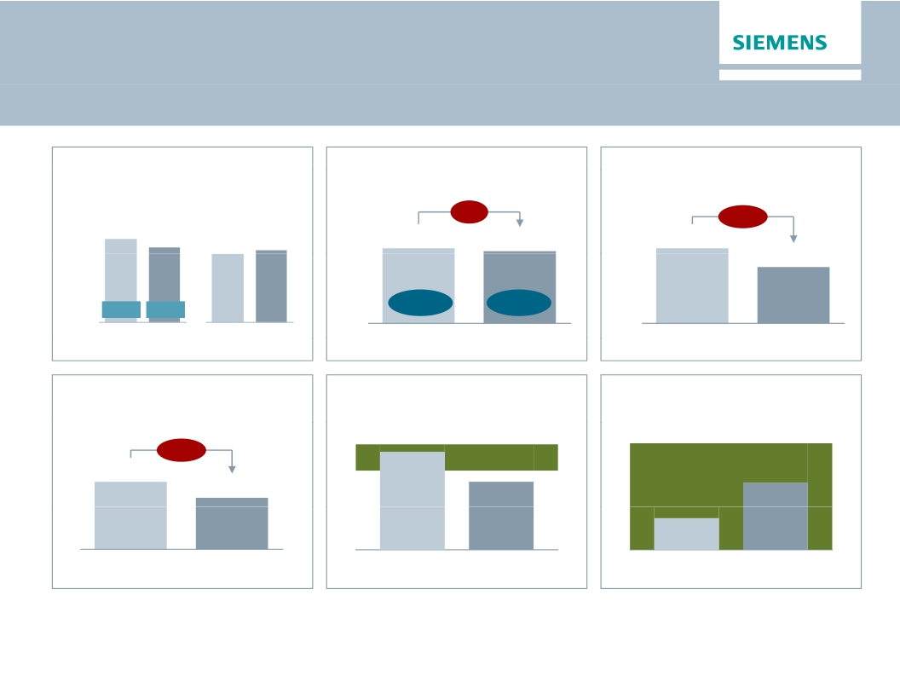
Financial Cockpit
Orders
Revenue
Profit Industrial Business (IB)
Net Income
in €bn
-13%
Comp.
+3%
in €bn
in €bn
(nom.)(-11%)
20.1
(+5%)
17.4
-4%
-25%
18.0
16.6
1.9
1.8
1.5
1.1
B-t-B
1.22
1.03
Margin
11.3%
10.2%
Q1 14
Q1 15
Q1 14
Q1 15
Q1 FY 14
Q1 FY 15
Q1 FY 14
Q1 FY 15
EPS (“all-in”)
ROCE (“all-in”)
Capital structure1)
in €
15-20%
≤1
-23%
1.70
1.30
18.6%
12.9%
0.6x
0.3x
Q1 FY 14
Q1 FY 14
Q1 FY 15
Q1 FY 14
Q1 FY 15
Q1 FY 15
1) Industrial Net Debt/EBITDA; EBITDA is without the elimination of income or loss from investments accounted for using the equity method
© Siemens AG 2015
Page 12
Munich, January 27, 2015
Q1 FY 2015, Analyst Call

Slide 13
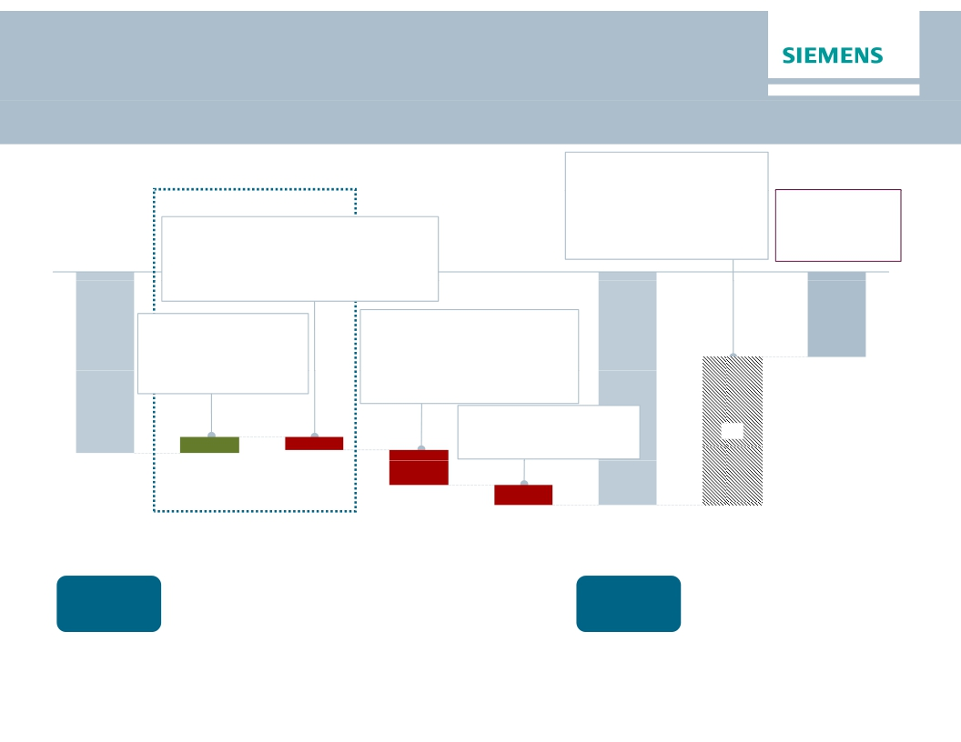
Net Debt Bridge as of Q1 FY 2015
€bn
Q1 ∆Q4
· SFS Debt
+19.3
· Post emp. Benefits -10 610 6
· Credit guarantees -0.8
+0.6
-1.3
- 0.1
Operating Activities
1 3
Adj. ind. Net Debt/
therein:
· ∆ Inventories net of advance payments -0.4
· ∆ Trade and other receivables -0.1
· ∆ Trade payables
-1.1
· ∆ Billings in excess
+0.8
therein a.o.:
· Hybrid adjustments
· Fair value adj.
(hedge accounting)
+0.9
+1.1
-0.0
- 0.0
EBITDA
0.6x
(Q4 FY14: 0.1x)
p y
therein a.o.:
· CAPEX
-0.3
· Income (C/O)
+1.1
· D&A & Impairments +0.6
· Income taxes paid -0.3
· Change in receivables from
financing activities (SFS)
· Acquisition of businesses,
net of cash acquired
therein a.o.:
-0.4
-1.5
-5.6
1.1
-0.8
· Interest paid
-0.1
9.8
· Share Buyback
-0.7
-12.0
12 0
-2.3
-1.3
-15.4
Net Debt
Q1 2015
Cash &
cash equiv.
€7.8bn2)
Net Debt
Q4 2014
Cash &
cash equiv.
€8.9bn2)
Cash flows from
op. activities
(w/o ∆ working
capital)
∆ Working
Capital1)
Cash flows
from investing
activities
Financing
topics
Net Debt adj.
Adj. ind.
Net Debt
Q1 2015
1)
2)
Includes cash flows from inventories net of advanced payments received, cash flows provided by trade and other receivables, cash flows provided by trade payables
Including available-for-sale financial assets
and cash flows used in billings in excess of cost and in estimated earnings on uncompleted contracts and related advances
© Siemens AG 2015
Page 13
Munich, January 27, 2015
Q1 FY 2015, Analyst Call

Slide 14
SFS Key Figures Q1 FY15
Key Financial Data SFS
· Assets
· Profit before Tax
· Return on Equity after tax
· Operating and Investing Cash Flow
€22.7bn
€146m
20.5%
- €178m
Assets
€bn
Liabilities and Equity
€bn
0.9
1.4
0.2
22.7
22.7
2.2
20.3
19.3
1.3
Accruals
& Other
Liabilities
Leases &
Loans1)
Equity
Investments
Other Assets
& Inventory2)
Cash
Total Assets
Total
Liabilities
& Equity
Allocated
Equity
Total Debt
1) Operating and finance leases, loans, asset-based lending loans, factoring and forfeiting receivables
2) Intercompany receivables, securities, (positive) fair values of derivatives, tax receivables, fixed assets, intangible assets, land and building, prepaid expenses and inventories
© Siemens AG 2015
Page 14
Munich, January 27, 2015
Q1 FY 2015, Analyst Call

Slide 15
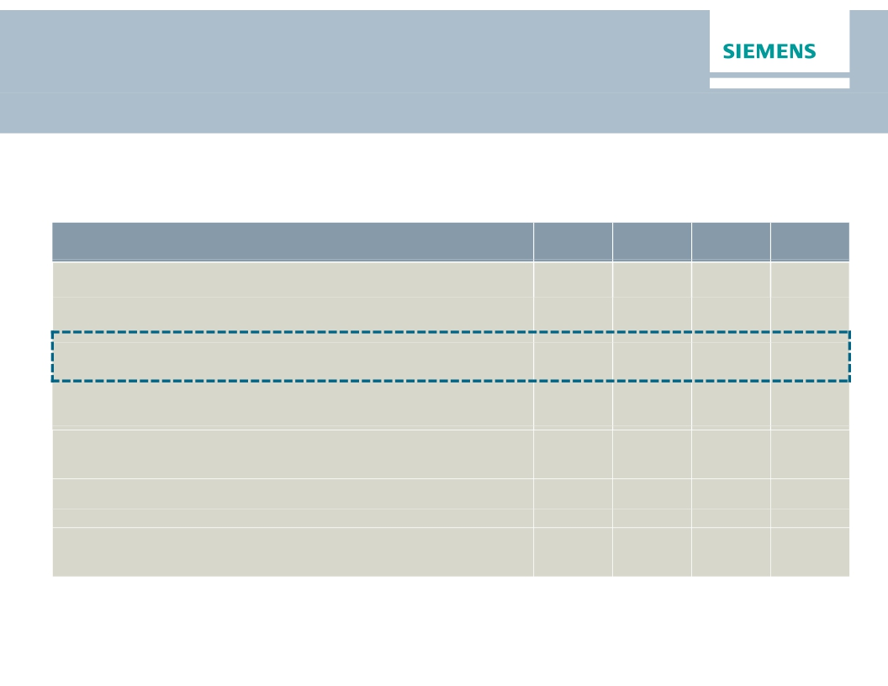
Underfunding for Siemens’ pension plans increased
to € -9.6 bn in Q1
Deficit for Siemens pension plans increased in Q1, mainly due to decreased discount rate
assumptions.
in €bn1)
Defined benefit obligation (DBO) on pension benefit plans
Fair value of plan assets
Funded status of pension benefits
DBO on other post-employment benefit plans (mainly unfunded)
Discount rate2)
Interest Income2)
Actual return on plan assets2)
1) All figures a e repo ted on co tinu g basis and accor in to IAS 9 ( vised 2011)
2) As of Q1 FY2015 figures are based on total post-employment benefits
© Siemens AG 2015
FY 2012
-33.0
24.1
-8.9
0.7
3.2%
0.9
3.2
FY 2013
-32.6
24.1
-8.5
0.6
3.4%
0.8
1.3
FY 2014
-35.0
26.5
-8.5
0.5
3.0%
0.8
2.9
Q1
FY 2015
-36.8
27.3
-9.6
0.6
2.6%
0.2
0.8
gu es a e epo ted o a co t u g bas s a d acco d g to
S 9 ( e sed 0
Page 15
Munich, January 27, 2015
Q1 FY 2015, Analyst Call

Slide 16

Financial calendar
January
January 27, 2015
Q1 Earnings Release; Annual General Meeting
Februaryy
March
© Siemens AG 2015
March 11, 2015
Citi West Coast Symposium (San Francisco)
March 19, 2015
Bank of America Merrill Lynch Conference (London)
Page 16
Munich, January 27, 2015
Q1 FY 2015, Analyst Call

Slide 17

Siemens Investor Relations contacts
Investor Relations
www.siemens.com/investorrelations
investorrelations@siemens.com
+49 89 636-32474
+49 89 636-32830
Internet:
Email:
IR-
Hotline:
Fax:
© Siemens AG 2015
Page 17
Munich, January 27, 2015
Q1 FY 2015, Analyst Call

