Slide 1

Photovoltaic Power Systems Business
and Data Center Facility Business
Kiyoshi Tsutsui,
President and CEO,
NTT Facilities, Inc.
September 26, 2014

Slide 2

The forward-looking statements and projected figures concerning the future performance
of NTT and its subsidiaries and affiliates contained or referred to herein are based on a
series of assumptions, projections, estimates, judgments and beliefs of the management
of NTT in light of information currently available to it regarding NTT and its subsidiaries
and affiliates, the economy and telecommunications industry in Japan and overseas, and
other factors. These projections and estimates may be affected by the future business
operations of NTT and its subsidiaries and affiliates, the state of the economy in Japan
and abroad, possible fluctuations in the securities markets, the pricing of services, the
effects of competition, the performance of new products, services and new businesses,
changes to laws and regulations affecting the telecommunications industry in Japan and
elsewhere, other changes in circumstances that could cause actual results to differ
materially from the forecasts contained or referred to herein, as well as other risks
included in NTT’s most recent Annual Report on Form 20-F and other filings and
submissions with the United States Securities and Exchange Commission.

Slide 3
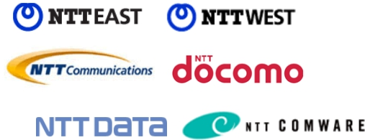
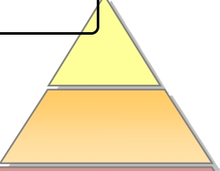


Our Mission
Maximize profit in the field of building and energy business
as a member of the NTT Group
Ensuring non-stop
telecommunications
service
Telecommunications
business
Service
Platform
Optimizing
facility cost
Infra-
structure
Energy
Net Work
Building
NTT FACILITIES, INC. All Rights Reserved.
2

Slide 4
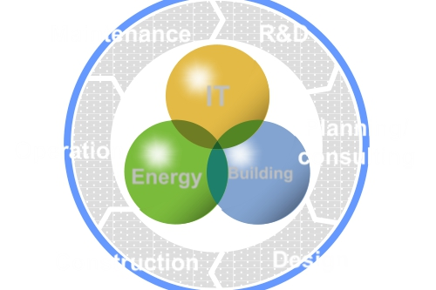
NTT Facilities: Profile
Operation started
December 1, 1992
Maintenance
R&D
IT
Building
Capital
¥12.4 billion
Operating revenues
Planning/
consulting
Operation
Energy
¥276.1 billion
(Fiscal year 2013; consolidated)
Construction
Design
Employees
About 5,000
(as of Mar 31, 2014)
Service Centers
About 200
Monitoring systems
About 200,000 systems
Building management
About 22,000 buildings
3
NTT FACILITIES, INC. All Rights Reserved.

Slide 5
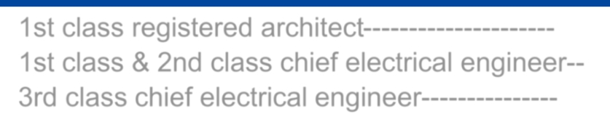
Licensee
5,000 specialists, with more than 28,000 licenses play the
important role in NTT facilities group.
1st class registered architect---------------------
1st class & 2nd class chief electrical engineer--
700
92
3rd class chief electrical engineer---------------
1,689
1st class electric work specialist……………
1,509
1st class construction foreman……………………
174
Class 1 technical engineer for private power
Building mechanical and electrical engineer…….
155
generating facilities…………………………….
395
1st class piping works execution managing
Special electrical worker……………………….605
engineer …………………………………………….
206
Qualified person for energy management of
Interior planner……………………………………….
55
1st class designed factory…………………….
425
379CASBEE Accredited Professional………………..
Chief telecommunications engineer…………...
Certificate of qualification for managing
89
Professional engineer………………………………. 44
Facility manager…………………………………….754
engineer…………………………………………
509
Real estate transaction authorized sales staff….
257
Hazardous materials engineer (Classes I, ll
165CompTIA …………………………………………….
and lll)………………………………………….2,752
Certified fire defense equipment officers
(Classes l and ll)………………………………...903
1st grade boiler operator………………….…...492
SCNA/SCSA …………………………………………
24
NTT FACILITIES, INC. All Rights Reserved.
4

Slide 6
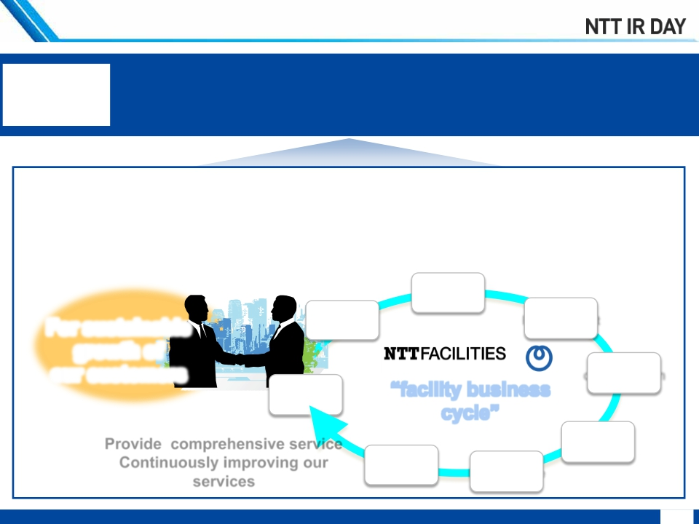
Value Creation
Your best value partner in the field of
environmentally friendly integrated facility services
We are
Retain long-lasting customer relationship by providing and
improving our comprehensive services in facility business cycle.
Design
For sustainable
growth of
Planning
Procurement
our customers
construction
Consulting
“facility business
cycle”
Provide comprehensive service
Operation
Continuously improving our
services
R&D
Maintenance
NTT FACILITIES, INC. All Rights Reserved.
5

Slide 7




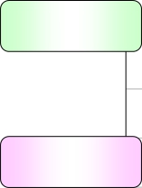
NTT Facilities: Mid-term Business Plan
Recorded high operating revenue in FY 2013,
Non-NTT group customers reached 40%;
Planning to exceed 50% in FY 2015
[billions of yen]
Operating
revenue
Non-
NTT group
NTT group
276.1
116.7
2013
result
280.0
1,300
2014
plan
300.0
1,555
2015
plan
254.9
87.8
2012
result
878
1,167
130.0
155.5
NTT FACILITIES, INC. All Rights Reserved.
6

Slide 8
Photovoltaic (PV) Power Generation
Business

Slide 9



Our Strengths as a System Integrator
We make investment feasible even after the revision of Feed-
in-tariff program in Japan with our comprehensive services in
system design, construction, and operation
System Integrator
System
design
Planning
Construction Operation
· Support business planning
· Power generation simulation
· Feasibility assessment
· Support of applications for
ministries and other
organizations
· Optimal system design
ü Power generation
maximization
ü Cost reduction
· Monitoring system
configuration design
· Management of
construction schedule
and safety
· Consultation with
electric utility on
behalf of customer
· Testing and
commissioning
· Operation support
(by licensees)
· Maintenance
· Environmental education
support
Our cost-competitiveness coming from
bargaining power
and strict quality control of procurement
Manufacturer
Our abundant construction
track record
Subcontractor
(PV modules, Inverter, etc.)
(electrical work and mounting
structure installation)
NTT FACILITIES, INC. All Rights Reserved.
8

Slide 10
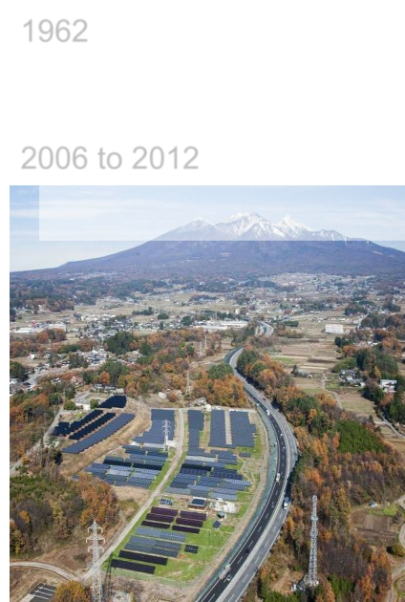
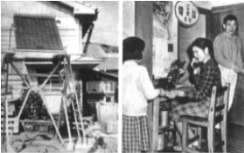
History of NTT Group’s PV System Installations
1962 Installed the first PV System as stand-alone
Oronoshima island, Fukuoka
2006 to 2012
Demonstrative Project for Large-Scale Photovoltaic Power Generation
System subsidized by NEDO (Grid Stabilization Technology, etc.)
Pursue high return on investment
through demonstration study of
cost reduction, power generation
maximization, monitoring and power
generation diagnosis
Ø Comparative evaluation of 27 types of PV systems
(Characteristics of power generation and deterioration)
Ø Evaluation of wiring and capacity designing of
Equipment
(Maximization power generation performance in lifecycle)
Ø Upgrading system design and maintenance
technology
(Cost optimization, power generation maximization)
power supply source for public telephones in
NTT FACILITIES, INC. All Rights Reserved.
9

Slide 11
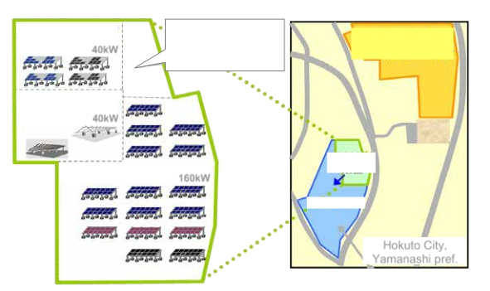
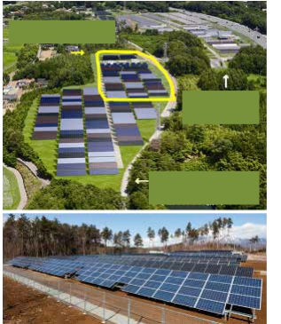
Continuous Demonstration Study
(F Solar Research Park)
Obtain know-how by evaluating the latest promising
technologies at NTT Facilities’ demonstration PV site
Module evaluation area
Mounting structure
evaluation area
Design technology
evaluation area
Evaluation of system using various types of latest PV modules
Evaluation of advanced mounting structures
Evaluation of technology for optimal system design
Area built in FY2011
(3) Design technology
evaluation area
40kW
Building for facility
tour and monitoring,
power receiving
equipment
Area completed in
Phase 1
NEDO Hokuto Site
(Solar Power Plant)
(2) Mounting structure
evaluation area
40kW
(1) Module evaluation area
160kW
NEDO
Hokuto Site
Perspective Image
(2MW )
Installed in
FY2011
Expanding area
Hokuto City,
Yamanashi pref.
Ｆソーラーリサーチパーク』
『Ｆソーラーリサーチパーク
F Solar Research Park
NTT FACILITIES, INC. All Rights Reserved.
10

Slide 12
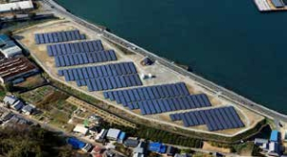
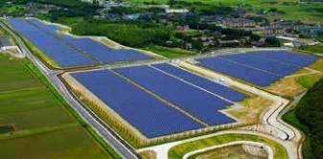
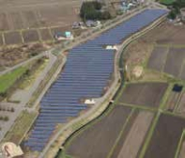
Our Installation Track Record and Shares
We hold more than 8% in PV system installation market
above 1MW class
F Onomichi Solar Power Plant
(Hiroshima pref.)
Yoshinogari Mega Solar Power Plant
(Saga pref.)
Solar Garden Himekami
(Iwate pref.)
NTT Facilities’ share in mega watt class PV system market
(System Integration [SI] & investment as an independent power producer [IPP] above 1MW; as of April 30, 2014)
Capacity
201MW
(Our track record [SI: 138MW; IPP: 63MW])
2,458MW
(source: The Agency for Natural Resources and Energy, the Ministry of
Economy, Trade and Industry)*
448MW
(Our track record [SI: 312MW; IPP: 136MW])
37,694MW
(source: The Agency for Natural Resources and Energy, the Ministry of
Economy, Trade and Industry)*
NTT Facilities
8%
1%
NTT Facilities
Japan
NTT Facilities
Japan
Construction
(as of April 30, 2014)
Certification
(as of April 30, 2014)
* Source: Reusable energy facilities authorization status, webpage of The Agency for Natural Resources and Energy, the Ministry of Economy, Trade and Industry
http://www.enecho.meti.go.jp/category/saving_and_new/saiene/kaitori/index.html
NTT FACILITIES, INC. All Rights Reserved.
11

Slide 13
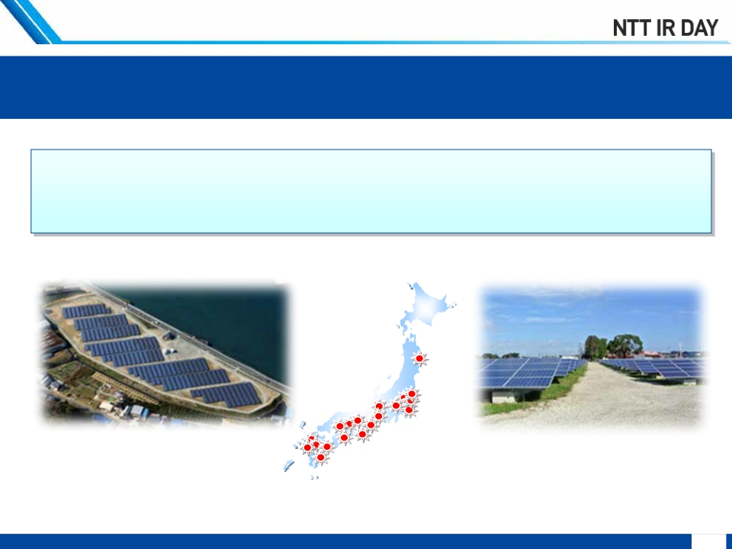
Investment Plan
Planning to investment ¥80 billion(350MW) by FY2016
<IPP>
168MW across 60 locations nationwide
(Based on lease contracts of site signed as of September 26, 2014)
F solar power plants are in
operation at 31 locations
nationwide
F Onomichi Solar Power Plant
(Hiroshima pref.)
F Sakura Solar Power Plant
(Chiba pref.)
In-service F solar power plants
NTT FACILITIES, INC. All Rights Reserved.
12

Slide 14
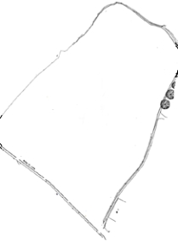
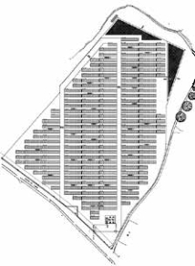
Simulation for Overall System Optimization
Simulation technology that can optimize about 40 variables
in order to maximize its output in the site area
Site Information
Location information N.Lat. XXº, E.long. XXº
Site area XX,000㎡
Optimization through simulation
<Major variables>
· Number and capacity of
Inverter
· PV module capacity per
Inverter
· Number of PV modules
connected in series
· Distance between PV modules,
tilt angle
· Wiring voltage drop
· wind speed, wind flow in the
site etc.
Maximum
power generation
Optimal system
design
NTT FACILITIES, INC. All Rights Reserved.
13

Slide 15




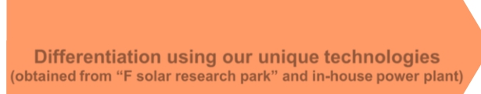
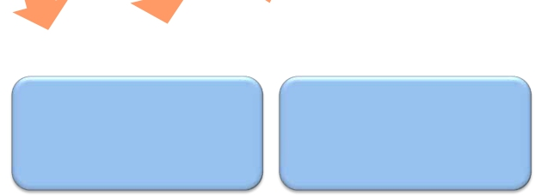

Technological Capability based on Demonstration
(1) Power Generation Efficiency
Maximize power generation efficiency leveraging 20 techniques
based on demonstration study and abundant track record
Utility Grid
Inverter
メガソーラーの躍進
Idealoutput(100)
Overall system
efficiency
at most 90％
*Generally it is
around 65 to 80%
％
Energy flow of PV Systems
Differentiation using our unique technologies
(obtained from “F solar research park” and in-house power plant)
Inverter loss
Increased power generation through
optimal PV module selection
PV loss
Wiring loss
PV module selection
leveraging our data base of
field data and taking into
account regional features
(geographical features, etc.)
Wiring design that minimizes
wiring loss
(cable specification,
wiring plan)
Equipment capacity design
aimed at efficient operation
of inverter
NTT FACILITIES, INC. All Rights Reserved.
14

Slide 16
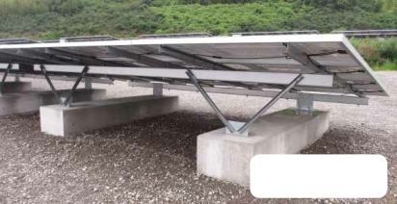
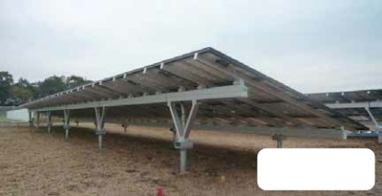
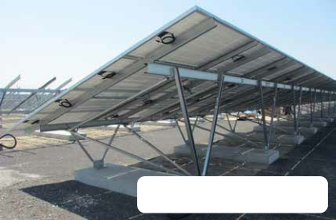
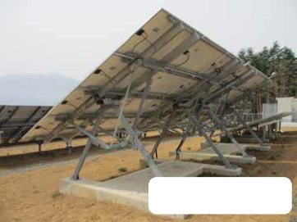
Technological Capability based on Demonstration
(2) Mounting Structure Development
Maximize power generation and minimize construction cost
by our mounting structure development using our technologies
integrated with electrical and structural design
Steel type
Designed for regions
with snowfall
Aluminum
type
Manually-angle-
changeable type
NTT FACILITIES, INC. All Rights Reserved.
15

Slide 17
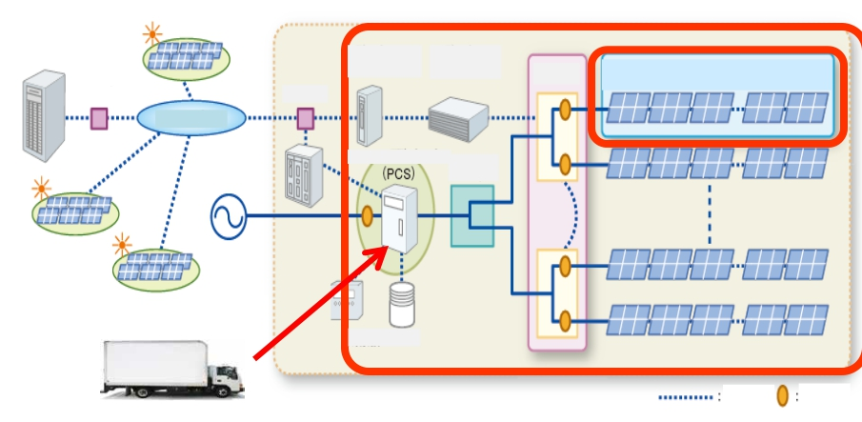
Technological Capability based on Demonstration
(3) Maintenance and Monitoring Service
Minimize the decline of power generation by monitoring each string,
inverter and restoration service using temporary inverter
Monitoring each Inverter
Remoni
server
Data transfer
Data collection
equipment
equipment
Connection
box
Monitoring each string
Router
Router
Internet
Inverter
Junction box
Weather station
Communication
line
Measuring
point
Restoration service using temporary Inverter
NTT FACILITIES, INC. All Rights Reserved.
16

Slide 18
Data Center Facility Business

Slide 19
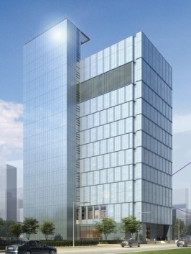
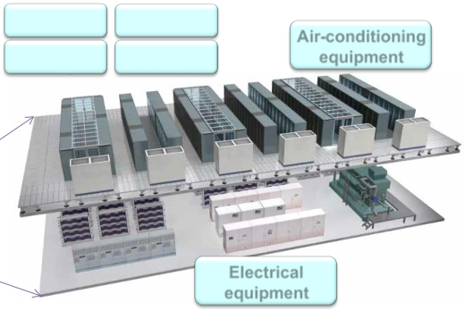

Roles of NTT Facilities in NTT Group
Specializes in one stop service in consultation, design,
installation and maintenance of air-conditioning and electrical
equipment of mission critical facilities,
e.g., datacenter and telecom buildings.
Monitoring
devices
Anti-disaster
facility
Servers, etc..
Disaster-
resistant facility
Air-conditioning
equipment
Electrical
equipment
Osaka No.5 Data Center, NTT Communications
Building
Contributing to NTT Group’s cloud service through
installation and maintenance of data center facility
NTT FACILITIES, INC. All Rights Reserved.
18

Slide 20







Our Strength in Data Center Facility Business
We can provide wide range of services to our customer,
based on 100 years of experience as a in-house engineering company
of a telecommunications career
Covering
Comprehensive
Services
Strengthening of
each service
LCC
Lifecycle cost
Facility
management
Consulting
Facility
business cycle
Maintenance/
operation
R&D
Energy savings
Safety and
Security
Design
Construction
Procurement
Non-stop
Cost & quality
NTT FACILITIES, INC. All Rights Reserved.
19

Slide 21
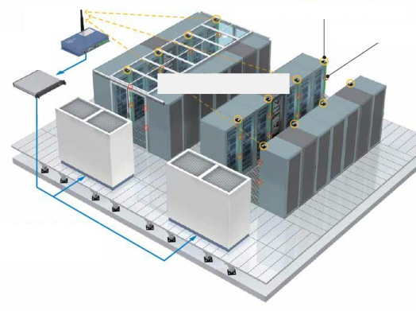
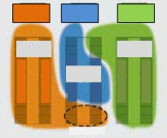
Smart DASH
Smart control system enabling optimal air condition and energy saving,
by self learning and automatic sensing &control
(1) Measurement
and collection of
server suction
temperature
using wireless
temperature
sensors
Wireless
gateway
DASH server
(1U)
Wireless temperature sensor module
Temperature
sensor
Wireless collection of temperature
sensor information
Air-
conditioner
A
Area covered
by air-
conditioner A
Air-
conditioner
B
Area covered
by air-
conditioner B
Zone A
Air-
conditioner
C
Area covered
by air-
conditioner C
Server rack
Server rack
Server rack
Server rack
Server rack
Server rack
(2) Analysis of area covered by each
air-conditioning equipment
Automatic control of the
air-conditioner based on
the collected data
(3) Continuous improvement of air flow
by the maintenance worker and the
air-conditioner’s automatic control
NTT FACILITIES, INC. All Rights Reserved.
20

Slide 22

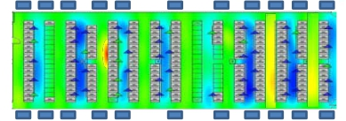
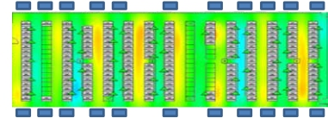




Smart DASH: Improvement of Thermal Environment
Achieve energy saving and optimal temperature distribution
through airflow improvement
and automated air-conditioning system
Before improvement
Excessive cooling to avoid partial hotspots
Waste of air-conditioner energy due to
excessive cooling
ICT device suction temperature Target
temperature achievement rate: 77%
After improvement
Optimal temperature distribution without
deviating from the upper limit of ICT device
temperature
Easing of air-conditioner operation by
maintaining uniform distribution of
temperature
More than 30% of energy saving has
been achieved
ICT device suction temperature
Target temperature achievement rate:
99％
21
NTT FACILITIES, INC. All Rights Reserved.
Room
condition
Energy save
Reliability

Slide 23
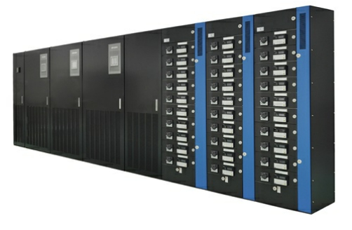
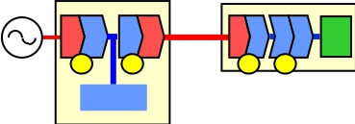
High Voltage Direct Current (HVDC) Power Supply System
AC200V àà DC380V
Alternate current power supply (AC)
Uninterruptible
Power-supply System
ICT equipment
AC DC
DCAC
ACDC
DCDC
CPU
1
2
Battery
AC
100 to
200V
3 4
4 conversion steps is
AC
too many
500kW system example
Compared to AC
High Voltage DC power supply(HVDC)
HVDC
Power-supply System
ICT equipment
Power consumption 20% reduction
AC
DC
DC
DC
CPU
1
DC
380V
2
Supply reliability improved 10 times
AC
Battery
Installation space 50% reduction
NTT FACILITIES, INC. All Rights Reserved.
22

Slide 24
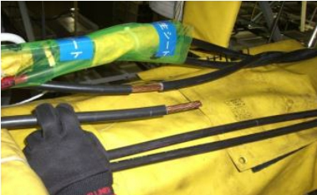
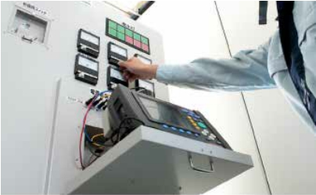
Facility Renovation/Expansion Work
Without Disconnecting Power
We offer non-stop service based on abundant experience
and proven technologies
While other companies carry out renovation after stopping the system,
we do it without stopping the system using our uninterruptible switching technology
Old UPS
New UPS
Uninterruptible
Switching
Device
ICT System
(servers, etc.)
Non-stop
NTT FACILITIES, INC. All Rights Reserved.
23

Slide 25
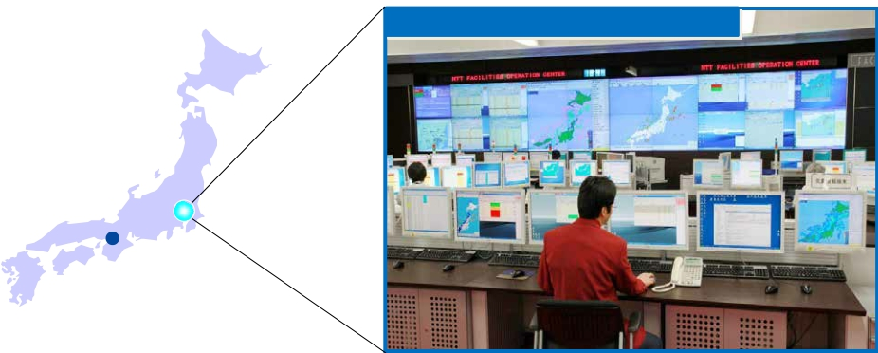
Back-up site for DC Facility Enables One-stop Service
Buildings and energy facilities are monitored and maintained
through collaboration between the eastern and western operation
centers and the nationwide maintenance bases
24-hour, 365-day monitoring
Monitoring 200,000 systems, 8,000 buildings, etc.
2 operation centers in eastern and western Japan
ＦOperation Center
Back-up site
West Japan Operation Center
NTT FACILITIES, INC. All Rights Reserved.
24

Slide 26
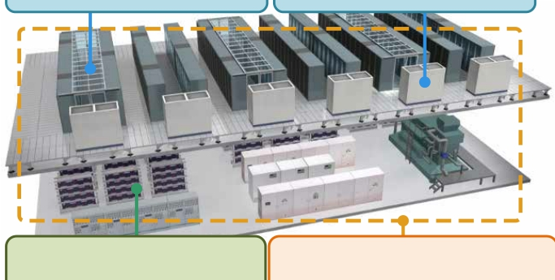
2013 Environment Minister’s Award
for Global Warming Prevention Activities
Received award for our power saving technologies:
air-conditioning, power supply technologies and
technological linking between these and ICT equipment
that help to achieve power saving in datacenters
Electric flow design,
Highly efficient
気流設計・制御技術
HDVC Power Supply System
高効率空調装置
control technology
air-conditioning equipment
Technological linking of ICT
equipment, air-conditioning
equipment and power supply
ICT 装置－空調装置・
ICT 装置－空調装置・
ICT 装置－空調装置・
HV DC給電システム
ICT 装置－空調装置・
電源装置連係技術
電源装置連係技術
電源装置連係技術
電源装置連係技術
《３つの省電力技術 》
<<3 power saving technologies>>
NTT FACILITIES, INC. All Rights Reserved.
25

Slide 27
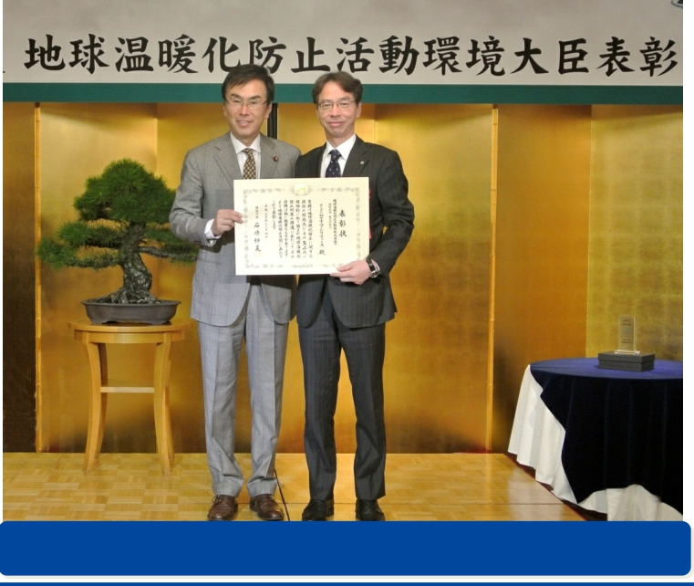
2013 Environment Minister’s Award
for Global Warming Prevention Activities
Environment Minister’s Award for Global Warming Prevention Activities
Technological development and commercialization section
NTT FACILITIES, INC. All Rights Reserved.
26

Slide 28
Global DC Facility Market
Market size expanding significantly led by the 3 major
markets of North America, APAC and Western Europe
Global DC facility market and growth rate (CAGR)*1
(unit: million USD)
5,000
4,500
4,000
3,500
9.1%
3,000
2,500
2,000
11.4%
6.6%
2012
2015
1,500
1,000
500
0
1.8%
North America
APAC
Western Europe
Japan
北米
西欧
日本
*1 Compound Average Growth Rate from 2013 to 2015 (NTT Facilities’ study). Figures for Japan are calculated by NTT Facilities using data from 2013 to 2015.
North America comprises USA and Canada. APAC includes Australia, New Zealand, Indonesia, Cambodia, Malaysia, Myanmar, Philippines, Thailand, Laos, Vietnam,
Singapore, Brunei, China, Hong Kong, Taiwan, South Korea and Mongolia. Western Europe comprises the Netherlands, France, Spain, Sweden, Switzerland, the U.K.,
Germany, Ireland and Italy
NTT FACILITIES, INC. All Rights Reserved.
27

Slide 29
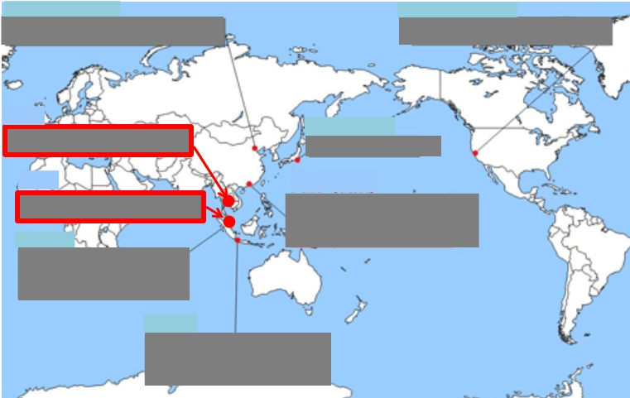
Global Expansion
We expand global business mainly in the construction and maintenance business
with our key strengths: high reliability and efficiency technologies.
We acquire service base complementing elements of our business cycle
and customer base which become the foundation for our efficient growth
Local subsidiary
NTT Facilities China
M&A
Unitrio Technology
M&A
Pro-Matrix
Branch
NTT Facilities
Singapore Branch
Office
NTT Facilities
Local subsidiary
NTT Facilities USA
Head Quarter
NTT Facilities
NTT Facilities
Hong Kong Branch
Indonesia Office
NTT FACILITIES, INC. All Rights Reserved.
28

Slide 30


