Slide 1

Solid start to fiscal 2013
Peter Löscher, President and CEO
Joe Kaeser, CFO
Q1 FY 2013, Analyst Call
January 23, 2013
Page 1
Q1 FY 2013, Analyst Call, January 23, 2013
Copyright © Siemens AG 2013. All rights reserved.

Slide 2
Agenda
1
2
3
HSBC today
Transformation 2011-13 and drivers of growth
Strategic priorities and outlook
12

Slide 3
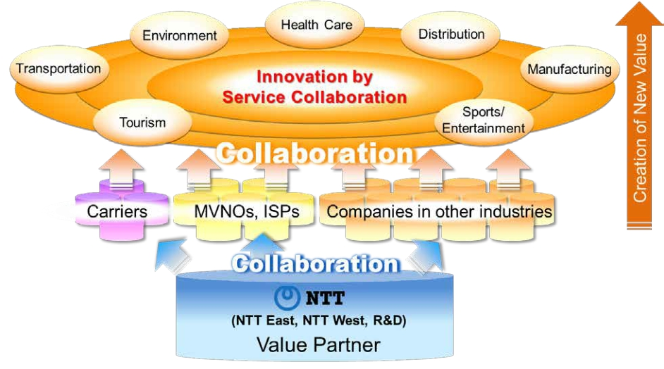
Creation of Value through Collaboration
IR Presentation (December, 2014)
‐ 18‐
Copyright©2014 Nippon Telegraph and Telephone Corporation

Slide 4
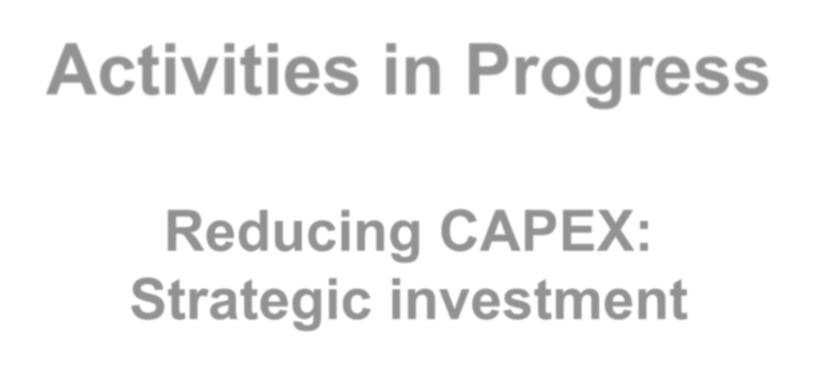
Activities in Progress
Reducing CAPEX:
Strategic investment
Copyright©2014 Nippon Telegraph and Telephone Corporation
1

