Slide 1
Computer Networking Devices
Components used to connect computers as well as other electrical devices together in order to share resources such as printers and fax machines.

Slide 2
Repeaters
Signal attenuation or signal loss – signal degrades over distance
Repeaters clean, amplify, and resend signals that are weakened by long cable length.
Built-in to hubs or switches

Slide 3
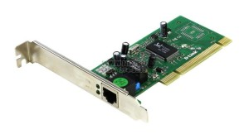
NETWORK INTERFACE CARD
Network cards also known as Network Interface Cards (NICs) are hardware devices that connect a computer with the network.
They are installed on the mother board.
They are responsible for developing a physical connection between the network and the computer.
Computer data is translated into electrical signals send to the network via Network Interface Cards.
These days network cards are software configured unlike in olden days when drivers were needed to configure them.
Even if the NIC doesn’t come up with the software then the latest drivers or the associated software can be downloaded from the internet as well.

Slide 4
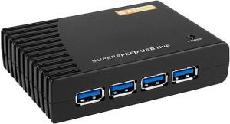
HUB
Hub works at physical layer and hence connect networking devices physically together.
Hubs are fundamentally used in networks that use twisted pair cabling to connect devices.
They are designed to transmit the packets to the other appended devices without altering any of the transmitted packets received.
They act as pathways to direct electrical signals to travel along. They transmit the information regardless of the fact if data packet is destined for the device connected or not.
HUB is used to connect multiple computers in a single workgroup LAN network. Typically HUBs are available with 4,8,12,24,48 ports
HUBs generally have LED (light-emitting diode) indicator lights on each port to indicate the status of link, collisions, and other information.

Slide 5
Hub falls in two categories:
Active Hub: They are smarter than the passive hubs. They not only provide the path for the data signals infact they regenerate, concentrate and strengthen the signals before sending them to their destinations. Active hubs are also termed as ‘repeaters’.
Passive Hub: It forwards the data signal from all ports except the port on which signal arrived. They have nothing to do with modifying the signals.
Logically HUB creates a star topology where it sits in the center of the topology and all connected systems stays at the points of the star.
Physically HUB creates a bus topology where all connected systems share the same bus connection.

Slide 6
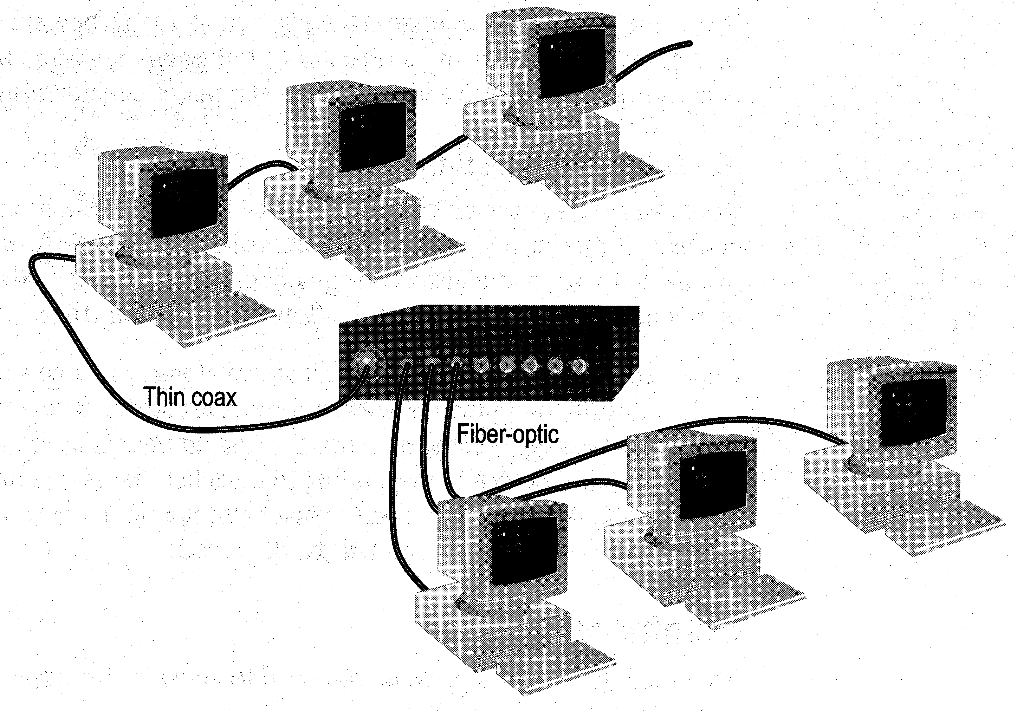
Limitations and Features of a HUB
Cannot link unlike segments
Cannot join segments with different access methods (e.g. CSMA/CD and token passing)
Do not isolate and filter packets
Can connect different types of media
The most economic way of expanding networks

Slide 7
Bridges
A bridge is a computer networking device that builds the connection with the other bridge networks which use the same protocol.
It works at the Data Link layer of the OSI Model and connects the different networks together and develops communication between them.
It connects two local-area networks; two physical LANs into larger logical LAN or two segments of the same LAN that use the same protocol.
Bridges are also used to segment larger networks into smaller portions. The bridge does so by placing itself between the two portions of two physical networks and controlling the flow of the data between them.
Bridges nominate to forward the data after inspecting into the MAC address of the devices connected to every segment. The forwarding of the data is dependent on the acknowledgement of the fact that the destination address resides on some other interface.
It has the capacity to block the incoming flow of data as well.

Slide 8
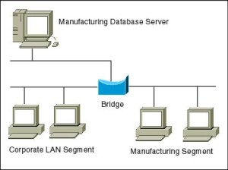
Types of Bridges:
There are mainly three types in which bridges can be characterized:
Transparent Bridge: As the name signifies, it appears to be transparent for the other devices on the network. The other devices are ignorant of its existence. It only blocks or forwards the data as per the MAC address.
Source Route Bridge: It derives its name from the fact that the path which packet takes through the network is implanted within the packet. It is mainly used in Token ring networks.
Translational Bridge: The process of conversion takes place via Translational Bridge. It converts the data format of one networking to another. For instance Token ring to Ethernet and vice versa

Slide 9
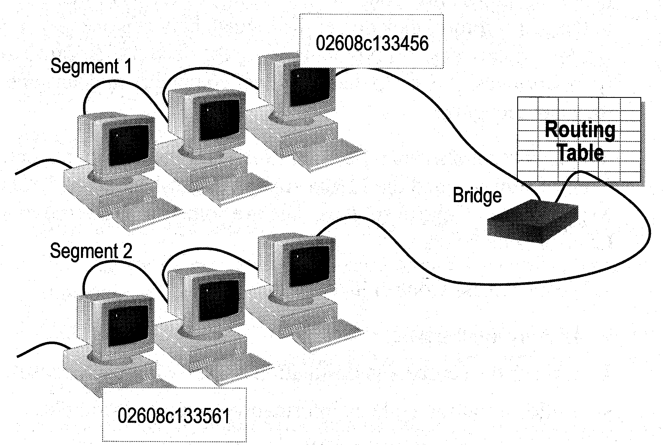
How Bridges Work
Bridges work at the Media Access Control Sub-layer of the OSI model
Routing table is built to record the segment no. of address
If destination address is in the same segment as the source address, stop transmit
Otherwise, forward to the other segment

Slide 10
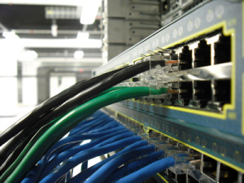
Switches
Switches are the linkage points of an Ethernet network. Just as in hub, devices in switches are connected to them through twisted pair cabling. But the difference shows up in the manner both the devices; hub and a switch treat the data they receive.
Hub works by sending the data to all the ports on the device whereas a switch transfers it only to that port which is connected to the destination device. A switch does so by having an in-built learning of the MAC address of the devices connected to it.
Since the transmission of data signals are well defined in a switch hence the network performance is consequently enhanced. Switches operate in full-duplex mode where devices can send and receive data from the switch at the simultaneously unlike in half-duplex mode.
Performance improvements are observed in networking with the extensive usage of switches in the modern days

Slide 11
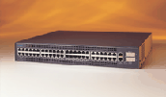
Switches
Switches operate at the Data Link layer (layer 2) of the OSI model
Can interpret address information
Switches resemble bridges and can be considered as multiport bridges
By having multiports, can better use limited bandwidth and prove more cost-effective than bridge

Slide 12
Switches divide a network into several isolated channels
Packets sending from 1 channel will not go to another if not specify
Each channel has its own capacity and need not be shared with other channels
Hub
3.3Mbps
10Mbps
Switch
3.3Mbps
3.3Mbps
10Mbps
10Mbps
10Mbps

Slide 13
Advantages of Switches
Switches divide a network into several isolated channels (or collision domains)
Reduce the possibility of collision
Collision only occurs when two devices try to get access to one channel
Can be solved by buffering one of them for later access
Each channel has its own network capacity
Suitable for real-time applications, e.g. video conferencing
Since isolated, hence secure
Data will only go to the destination, but not others

Slide 14
Limitations of Switches
Although contains buffers to accommodate bursts of traffic, can become overwhelmed by heavy traffic
Device cannot detect collision when buffer full
CSMA/CD scheme will not work since the data channels are isolated, not the case as in Ethernet
Some higher level protocols do not detect error
E.g. UDP
Those data packets are continuously pumped to the switch and introduce more problems

Slide 15
Method of Switching - Cut Through Mode
It allows the packets to be forwarded as soon as they are received. The method is prompt and quick but the possibility of error checking gets overlooked in such kind of packet data transmission
Much faster
Cannot detect corrupt packets
Can propagate the corrupt packets to the network
Best suited to small workgroups

Slide 16
Method of Switching - Store and Forward Mode
Read the whole packet before transmit
Slower than the cut-through mode
More accurate since corrupt packets can be detected .
More suit to large LAN since they will not propagate error packets
Facilitate data transfer between segments of different speed
DB
100Mbps
10Mbps

Slide 17
Method of switching-Fragment free
Combines speed of cut through switch with error checking functionality
Forwards all frames initially, but determines that if a particular port is receiving too many bad frames, it reconfigures the port to store and forward mode
Preferred switching solution

Slide 18
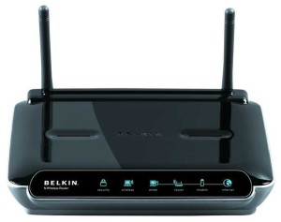
Routers
Routers are network layer devices and are particularly identified as Layer- 3 devices of the OSI Model.
They process logical addressing information in the Network header of a packet such as IP Addresses.
Router is used to create larger complex networks by complex traffic routing. It has the ability to connect dissimilar LANs on the same protocol.
It also has the ability to limit the flow of broadcasts. A router primarily comprises of a hardware device or a system of the computer which has more than one network interface and routing software.
Functionality:
When a router receives the data, it determines the destination address by reading the header of the packet. Once the address is determined, it searches in its routing table to get know how to reach the destination and then forwards the packet to the higher hop on the route. The hop could be the final destination or another router.

Slide 19
Routing tables play a very pivotal role in letting the router makes a decision. Thus a routing table is ought to be updated and complete. The two ways through which a router can receive information are:
Static Routing: In static routing, the routing information is fed into the routing tables manually. It does not only become a time-taking task but gets prone to errors as well. The manual updating is also required in case of statically configured routers when change in the topology of the network or in the layout takes place. Thus static routing is feasible for tinniest environments with minimum of one or two routers.
Dynamic Routing: For larger environment dynamic routing proves to be the practical solution. The process involves use of peculiar routing protocols to hold communication. The purpose of these protocols is to enable the other routers to transfer information about to other routers, so that the other routers can build their own routing tables.

Slide 20
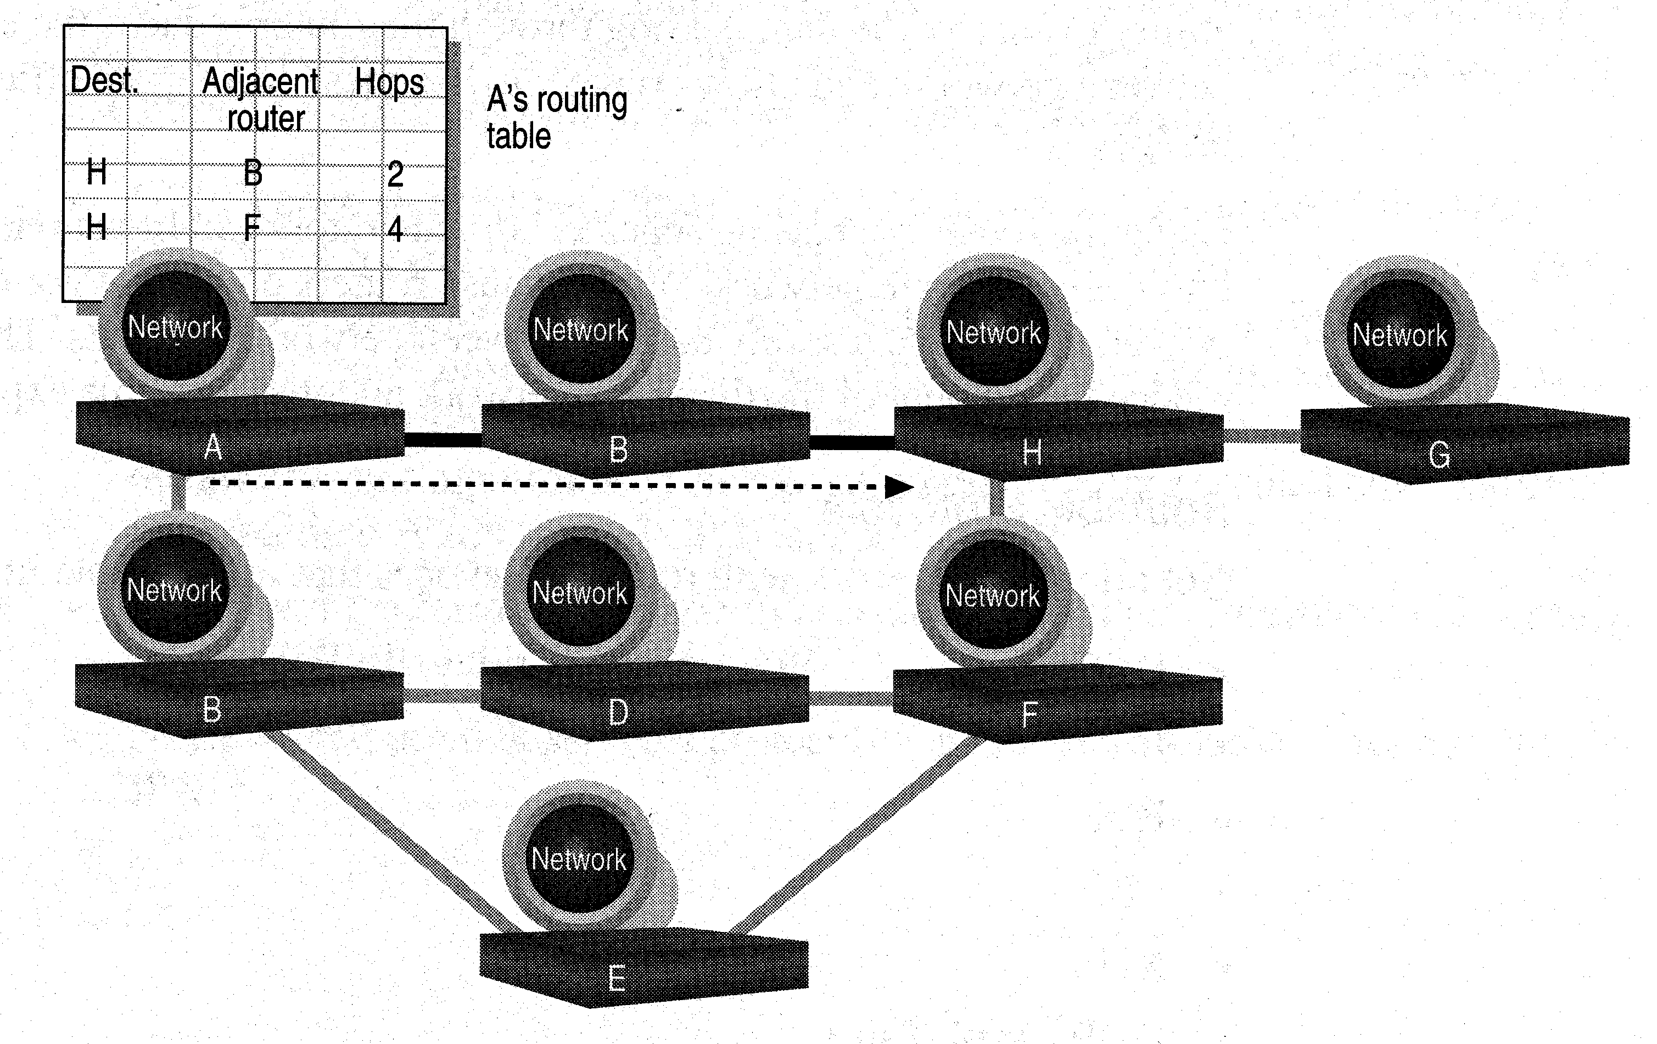
Routers
Layer 2 Switches cannot take advantage of multiple paths
Routers work at the OSI layer 3 (network layer)
They use the “logical address” of packets and routing tables to determine the best path for data delivery

Slide 21
How Routers Work
As packets are passed from routers to routers, Data Link layer source and destination addresses are stripped off and then recreated
Enables a router to route a packet from a TCP/IP Ethernet network to a TCP/IP token ring network
Only packets with known network addresses will be passed - hence reduce traffic
Routers can listen to a network and identify its busiest part
Will select the most cost effective path for transmitting packets

Slide 22
How Routing Table is formed
Routing table is formed based on communications between routers using “Routing Protocols”
Routing Protocols collect data about current network status and contribute to selection of the best path
Routers communicate within themselves

Slide 23
Routing Protocol Example - RIP for IP Routing
RIP (Routing Information Protocol) ― the oldest one
Use no. of hops between nodes to determine best path
Does not consider the network congestion condition
Broadcast every 30 sec the routing table to neighbouring routers to convey routing information
RIP is limited to interpreting a maximum of 16 hops
Not suitable for large network (e.g. Internet)
Can create excessive network traffic due to broadcasting
May take a long time to reach the far reaches

Slide 24
Routing Protocol Example - OSPF for IP
OSPF - Open Shortest Path First
Make up the limitations of RIP - can coexist with RIP
In general case, best path refers to the shortest path
In case of traffic congestion, can go a longer path
Each router maintains a database of other router’s links
If link failure notice is received, router can rapidly compute an alternate path
Require more memory and CPU power

Slide 25
Routing tables play a very pivotal role in letting the router makes a decision. Thus a routing table is ought to be updated and complete. The two ways through which a router can receive information are:
Static Routing: In static routing, the routing information is fed into the routing tables manually. It does not only become a time-taking task but gets prone to errors as well. The manual updating is also required in case of statically configured routers when change in the topology of the network or in the layout takes place. Thus static routing is feasible for tinniest environments with minimum of one or two routers.
Dynamic Routing: For larger environment dynamic routing proves to be the practical solution. The process involves use of peculiar routing protocols to hold communication. The purpose of these protocols is to enable the other routers to transfer information about to other routers, so that the other routers can build their own routing tables.

Slide 26
Static and Dynamic Routers

Slide 27
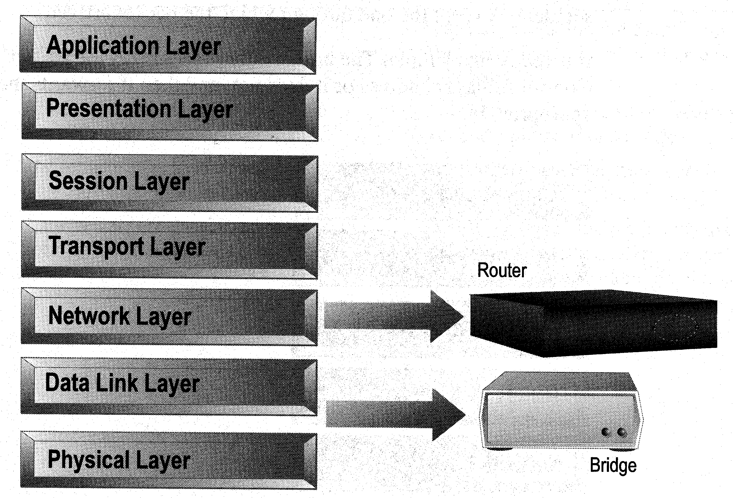
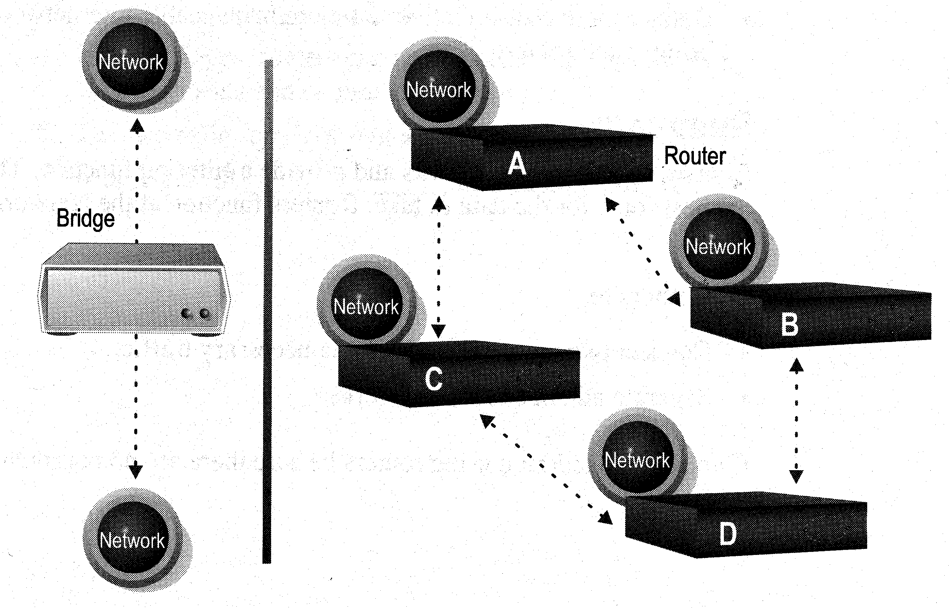
Distinguishing Between Bridges and Routers
Bridges forward everything they don’t recognize
Routers select the best path
Routers are layer 3 devices which recognize network address
Bridges are layer 2 devices which look at the MAC sublayer node address

Slide 28
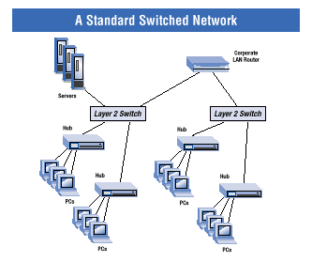
Layer-3 Switches
Layer-3 switches operate in both layer 2 (data link layer) and 3 (network layer)
Can perform both MAC switching and IP routing
A combination of switch and router but much faster and easier to configure than router
Why Layer-3 switches?
Traffic of LAN is no longer local
Speed of LAN is much faster
Need a much faster router, however, very expensive
Excerpt from www.intel.com

Slide 29
Summary
Repeaters are the least expensive way to expand a network, but they are limited to connecting two segments
Bridges function similar to repeaters, but can understand the node addresses
Switches can be considered as multiport bridges, can divide a network into some logical channels
Routers interconnect networks and provide filtering functions. They can determine the best route

Slide 30
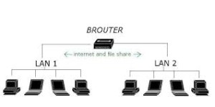
Brouters
Brouters are the combination of both the bridge and routers. They take up the functionality of the both networking devices serving as a bridge when forwarding data between networks, and serving as a router when routing data to individual systems. Brouter functions as a filter that allows some data into the local network and redirects unknown data to the other network.
Brouters are rare and their functionality is embedded into the routers functioned to act as bridge as well

Slide 31
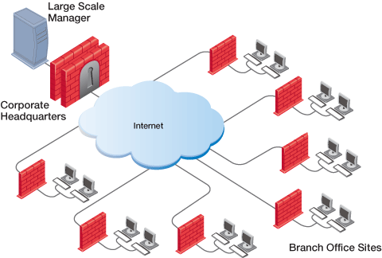
Gateways
Gateway is a device which is used to connect multiple networks and passes packets from one packet to the other network. Acting as the ‘gateway’ between different networking systems or computer programs, a gateway is a device which forms a link between them. It allows the computer programs, either on the same computer or on different computers to share information across the network through protocols. A router is also a gateway, since it interprets data from one network protocol to another.

Slide 32
Others such as bridge converts the data into different forms between two networking systems. Then a software application converts the data from one format into another. Gateway is a viable tool to translate the data format, although the data itself remains unchanged. Gateway might be installed in some other device to add its functionality into another

Slide 33
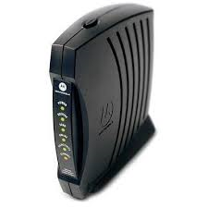
Modems
Modem is a device which converts the computer-generated digital signals of a computer into analog signals to enable their travelling via phone lines. The ‘modulator-demodulator’ or modem can be used as a dial up for LAN or to connect to an ISP. Modems can be both external, as in the device which connects to the USB or the serial port of a computer, or proprietary devices for handheld gadgets and other devices, as well as internal; in the form of add-in expansion cards for computers and PCMCIA cards for laptops.

Slide 34
Configuration of a modem differs for both the external and internal modem. For internal modems, IRQ – Interrupt request is used to configure the modem along with I/O, which is a memory address. Typically before the installation of built-in modem, integrated serial interfaces are disabled, simultaneously assigning them the COM2 resources.
For external connection of a modem, the modem assigns and uses the resources itself. This is especially useful for the USB port and laptop users as the non-complex and simpler nature of the process renders it far much more beneficial for daily usage.
Upon installation, the second step to ensure the proper working of a modem is the installation of drivers. The modem working speed and processing is dependent on two factors:
Speed of UART – Universal Asynchronous Receiver or Transmitter chip (installed in the computer to which the modem connection is made)
Speed of the modem itself

Slide 35
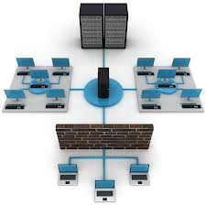
Firewall?
Hardware or software device that protects a computer network from unauthorized access.
Firewall Sling Secure Smartphone. [online image]. Available www.slingsecure.com

Slide 36
How a Firewall works
Firewalls filters the information coming through the Internet connection into a user private network.
To control traffic in and out of the network firewalls one or more of the three methods are used including:
Packet filtering
Proxy service
Stateful inspection

Slide 37
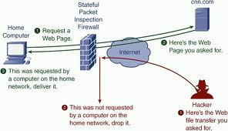
Diagram of Firewall

Slide 38
Additional Information about Firewalls
Most home network routers have built in firewall.
The term “firewall” originated from firefighting, where a firewall is a barrier established to prevent the spread of a fire.
A firewall works with the proxy server making request on behalf of workstation users.
There are a number of features firewalls can include from logging and reporting to setting alarms of an attack.
Costs for host based firewalls usually costs around $100 or less. Some may costs more depending on different things such as features included or if its an enterprise based system.

Slide 39
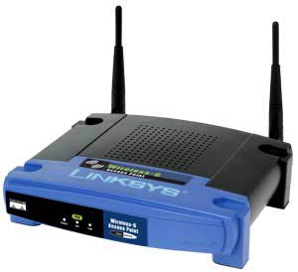
Wireless Access Point
A small hardware device featuring built-in network adapter, antenna, and radio signals.
Configured nodes on a WLAN.
Wireless Access Points, Page 2. [online image]. Available compnetworking.about.com

Slide 40
How a Wireless Access Point works?
Operates using radio frequency technology
Broadcast wireless signals computers can detect and use
A wireless network adapter is implemented while using a wireless access point, most computers today already have network adapters built into the computer.

Slide 41
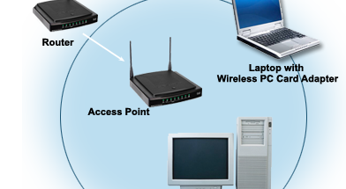
Diagram of Wireless Access Point
RxNT – The eprescribing System. [online image]. Available www.rxnt.com

Slide 42
Additional Information about Access Points
The access point usually connects to the router
A hotspot is a application wireless users can connect to the Internet.
Aps are used throughout a home network, usually through only one AP.
Wireless access points can cost anywhere from $30 and up depending on the type purchased.

Slide 43
Server
A network server or server is a computer that offers its services and/or its resources to clients, workstations, and other servers over a computer network.
A server commonly has multiple processors, large hard drives, and large amounts of RAM.
A server provides centralized management of resources, security, and expanded access to networked resources in a network.

