Slide 1
Layered Network Architecture Models and Protocals

Slide 2
Complexity of networks
Networks are complex !!!
Parts of a network:
  Hosts
  Routers
  Media
  Applications
  Hardware
  Software
  Different OS
  Different protocols
Is there a Solution?
Organize all the elements under a same agreement
Better yet, use a divide and conquer approach
Result: the concept of a communications protocol
Notes:
The problems mentioned before are more technical. They are not particular to any network, and they do not specify how the elements of a network can be a problem.
On this slide we show the different elements a network might have. We also show what the solution might be. The idea here is to have some basis as why the idea of protocol is used.
Next we go to show the concept of protocol.

Slide 3
Protocol
Agreement about communication
Specifies
  Format of messages
  Meaning of messages
  Rules for exchange
  Procedures for handling problems
Protocols allow to specify or understand communication without knowing the details of a particular hardware
Notes:
This is a more technical definition of protocol. This establishes what a protocol must have in order to cope with the networks problems showed before.
Protocols allow one to specify or understand communication without knowing the details of a particular hardware

Slide 4
Need for Protocols
Hardware is low level
Many problems can occur
  Bits corrupted or destroyed
  Entire packet lost
  Packet duplicated
  Packets delivered out of order
Need mechanisms to distinguish among
  Multiple computers on a network
  Multiple applications on a computer
  Multiple copies of a single application on a computer
  Different Operating Systems (OS)
Notes:
We have seen this before, but this is a little more general and focused in the definition of the concept.
We have seen all this problems before in detail, we say that hardware is low level but at the same time is essential to out explanation, because at the end we will see that all of this is focused on hardware.

Slide 5
Set of Protocols
Work together
Each protocol solves part of a communication problem
Known as
  Protocol suite
  Protocol family
Designed in layers
Notes:
Before we showed the problems of a network more than once (general and technical). What we have here is one general way to cope with the problem. It would not be impossible to come with just one protocol for a network, but it would be very difficult to generalize it.
Protocol suite: structured communication software to handle all transmission tasks
The divide and conquer approach tells us that we have specific tasks and we need to solve them separately.
We define protocols and we stack them up in layers according to the service they provide. How do they do that we will see in the following slide

Slide 6
What is layering?
A technique to organize a network system into a succession of logically distinct entities, such that the service provided by one entity is solely based on the service provided by the previous entity.
Main benefits of layered network are given below:
Complex systems can be broken down into understandable subsystems.
Any facility implemented in one layer can be made visible to all other layers.
Services offered at a particular level may share the services of lower level.
Each layer may be analyzed and tested independently.
Layers can be simplified, extended or deleted at any time.
Increase the interoperability and compatibility of various components build by different vendors.
Notes:
Here goes the analogy showed in the book.
Compiler, assembler, link editor, and loader.
Compiler->assembler->link editor->loader

Slide 7
Conceptual Layers of Protocol Software
Sender
Layer n
…
Layer 2
Layer 1
Layer n
…
Layer 2
Layer 1
Receiver
The modules of Protocol SW are on each machine stacked vertically into layers
Network
Notes:
Conceptually: sending a message from an application program on one machine to an application program on one machine to an application program in another means transferring the message down though successive layers of protocol software on the sender’s machine, forwarding the message across the network, and transferring the message up through successive layers of protocol software on the receiver’s machine.

Slide 8
Layers and packet headers
Each layer
  Appends header to outgoing packet
  Removes header from incoming packet
Receiver uses header as demultiplexing key
  Sender Multiplexes among several layers.
  This process is called Encapsulation
H
H
H
M
Notes:
This process is called encapsulation

Slide 9
Design Issues
Some issues affect many layers, e.g:
  need to address data (say who it’s for),
  possible need for setting up connections,
  data transfer rules (simplex, half-duplex, ...),
  error management,
  deal with message component re-ordering,
  flow control,
  routing
  security

Slide 10
Multi-layer Network Models
The two most important such layer network models: OSI and Internet
Open Systems Interconnection Model
  Created by International Standards Organization (ISO) as a framework for computer network standards.
  Based on 7 layers
Internet Model
  Created by DARPA originally in early 70’s
  Developed to solve to the problem of internetworking
  Based on 5 layers
  Based on Transmission Control Protocol/ Internet Protocol (TCP/IP) suite

Slide 11
THE OSI MODEL
Established in 1947, the International Standards Organization (ISO) is a multinational body dedicated to worldwide agreement on international standards. An ISO standard that covers all aspects of network communications is the Open Systems Interconnection (OSI) model. It was first introduced in the late 1970s.
OSI Model Concepts:
Service –says what a layer does
Interface –says how to access the service
Protocol –says how the service is implemented
  A set of rules and formats that govern the communications between two peers

Slide 12

Figure 2.3 The interaction between layers in the OSI model
2.<number>

Slide 13
Lower/Upper Layers
Layers 1-4 often referred to as lower layers.
Layers 5-7 are the upper layers.
Lower layers relate more closely to the communications technology.
Layers 1 – 3 manage the communications subnet.
  the entire set of communications nodes required to manage massages between a pair of machines.
Layers 4 – 7 are true ‘end-to-end’ protocols.
Upper layers relate to application.
In OSI model, each layer provide services to layer above, and ‘consumes’ services provided by layer below.

Slide 14
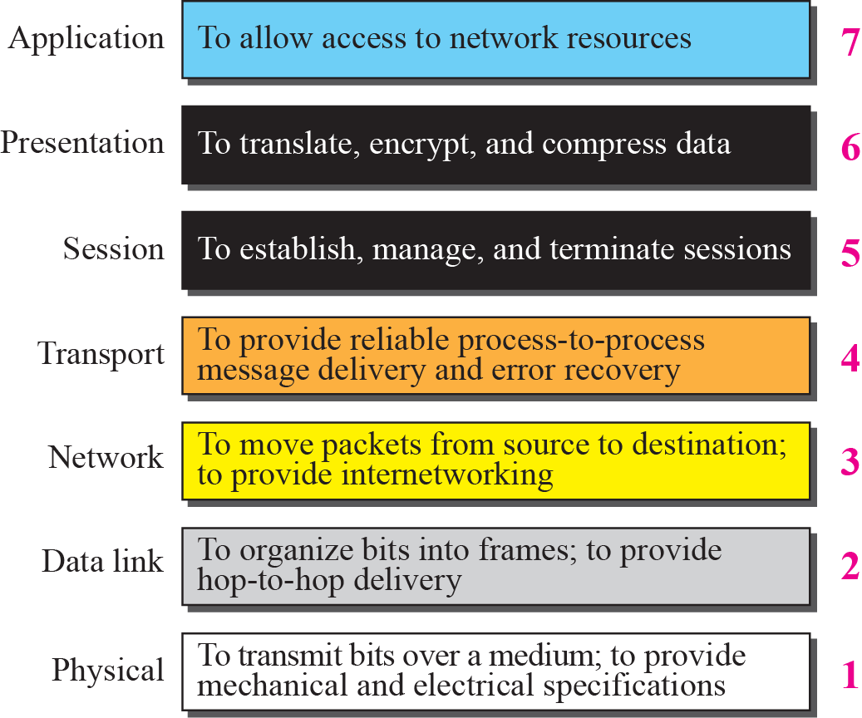
Functions of OSI Layers

Slide 15

Physical layer
The physical layer is responsible for movements of
individual bits from one hop (node) to the next.

Slide 16
Physical Layer
The physical layer is concerned with transmission of raw bits over a communication channel. It specifies the mechanical, electrical and procedural network interface specifications and the physical transmission of bit streams over a transmission medium connecting two pieces of communication equipment. In simple terns, the physical layer decides the following:
Number of pins and functions of each pin of the network connector (Mechanical)
Signal Level, Data rate (Electrical)
Whether simultaneous transmission in both directions
Establishing and breaking of connection
Deals with physical transmission
There exist a variety of physical layer protocols such as RS-232C, Rs-449 standards developed by Electronics Industries Association (EIA).

Slide 17

Data link layer
The data link layer is responsible for moving
frames from one hop (node) to the next.

Slide 18

Hop-to-hop delivery

Slide 19
Data Link Layer
The goal of the data link layer is to provide reliable, efficient communication between adjacent machines connected by a single communication channel. Specifically:
1. Group the physical layer bit stream into units called frames. Note that frames are nothing more than ``packets'' or ``messages''.
2. Sender calculates the checksum and sends checksum together with data. The checksum allows the receiver to determine when a frame has been damaged in transit or received correctly.
3. Receiver re-computes the checksum and compares it with the received value. If they differ, an error has occurred and the frame is discarded.

Slide 20
4. Error control protocol returns a positive or negative acknowledgment to the sender. A positive acknowledgment indicates the frame was received without errors, while a negative acknowledgment indicates the opposite.
5. Flow control prevents a fast sender from overwhelming a slower receiver. For example, a supercomputer can easily generate data faster than a PC can consume it.
6. In general, data link layer provides service to the network layer. The network layer wants to be able to send packets to its neighbours without worrying about the details of getting it there in one piece.

Slide 21
Below are the some of the important design issues of the data link layer:
a). Reliable Delivery:
Frames are delivered to the receiver reliably and in the same order as generated by the sender. Connection state keeps track of sending order and which frames require retransmission. For example, receiver state includes which frames have been received, which ones have not, etc.
b). Best Effort: The receiver does not return acknowledgments to the sender, so the sender has no way of knowing if a frame has been successfully delivered.
When would such a service be appropriate?
1. When higher layers can recover from errors with little loss in performance. That is, when errors are so infrequent that there is little to be gained by the data link layer performing the recovery. It is just as easy to have higher layers deal with occasional loss of packet.
2. For real-time applications requiring ``better never than late'' semantics. Old data may be worse than no data.

Slide 22
c). Acknowledged Delivery
The receiver returns an acknowledgment frame to the sender indicating that a data frame was properly received. This sits somewhere between the other two in that the sender keeps connection state, but may not necessarily retransmit unacknowledged frames. Likewise, the receiver may hand over received packets to higher layer in the order in which they arrive, regardless of the original sending order. Typically, each frame is assigned a unique sequence number, which the receiver returns in an acknowledgment frame to indicate which frame the ACK refers to. The sender must retransmit unacknowledged (e.g., lost or damaged) frames.

Slide 23
d). Framing
The DLL translates the physical layer's raw bit stream into discrete units (messages) called frames. How can the receiver detect frame boundaries? Various techniques are used for this: Length Count, Bit Stuffing, and Character stuffing.
e). Error Control
Error control is concerned with insuring that all frames are eventually delivered (possibly in order) to a destination. To achieve this, three items are required: Acknowledgements, Timers, and Sequence Numbers.
f). Flow Control
Flow control deals with throttling the speed of the sender to match that of the receiver. Usually, this is a dynamic process, as the receiving speed depends on such changing factors as the load, and availability of buffer space.

Slide 24
In some cases, the data link layer service must be ``opened'' before use:
The data link layer uses open operations for allocating buffer space, control blocks, agreeing on the maximum message size, etc.
Synchronize and initialize send and receive sequence numbers with its peer at the other end of the communications channel.
g. Error Detection and Correction
In data communication, error may occur because of various reasons including attenuation, noise. Moreover, error usually occurs as bursts rather than independent, single bit errors. For example, a burst of lightning will affect a set of bits for a short time after the lightning strike. Detecting and correcting errors requires redundancy (i.e., sending additional information along with the data).
There are two types of attacks against errors:
Error Detecting Codes: Include enough redundancy bits to detect errors and use ACKs and retransmissions to recover from the errors. Example: parity encoding.
Error Correcting Codes: Include enough redundancy to detect and correct errors. Examples: CRC checksum.

Slide 25

Network layer
The network layer is responsible for the
delivery of individual packets from
the source host to the destination host.

Slide 26

Source-to-destination delivery

Slide 27
Network Layer
The basic purpose of the network layer is to provide an end-to-end communication capability in contrast to machine-to-machine communication provided by the data link layer. This end-to-end is performed using two basic approaches known as connection-oriented or connectionless network-layer services.
Four issues:
Interface between the host and the network (the network layer is typically the boundary between the host and subnet)
Routing
Congestion and deadlock
Internetworking (A path

Slide 28
Routing
The routing algorithm must deal with the following issues:
Correctness and simplicity: networks are never taken down; individual parts (e.g., links, routers) may fail, but the whole network should not.
Stability: if a link or router fails, how much time elapses before the remaining routers recognize the topology change? (Some never do.)
Fairness and optimality: an inherently intractable problem. Definition of optimality usually doesn't consider fairness. Do we want to maximize channel usage? Minimize average delay?

Slide 29
Congestion
The network layer also must deal with congestion:
When more packets enter an area than can be processed, delays increase and performance decreases. If the situation continues, the subnet may have no alternative but to discard packets.
If the delay increases, the sender may (incorrectly) retransmit, making a bad situation even worse.
Overall, performance degrades because the network is using (wasting) resources processing packets that eventually get discarded.

Slide 30
Internetworking
Finally, when we consider internetworking -- connecting different network technologies together -- one finds the same problems, only worse:
Packets may travel through many different networks
Each network may have a different frame format
Some networks may be connectionless, other connection oriented

Slide 31

Transport layer
The transport layer is responsible for the delivery
of a message from one process to another.

Slide 32

Reliable process-to-process delivery of a message

Slide 33
Transport Layer
The transport level provides end-to-end communication between processes executing on different machines. Although the services provided by a transport protocol are similar to those provided by a data link layer protocol, there are several important differences between the transport and lower layers:
1. User Oriented. Application programmers interact directly with the transport layer, and from the programmers perspective, the transport layer is the ``network''. Thus, the transport layer should be oriented more towards user services than simply reflect what the underlying layers happen to provide.
2. Negotiation of Quality and Type of Services. The user and transport protocol may need to negotiate as to the quality or type of service to be provided. Examples? A user may want to negotiate such options as: throughput, delay, protection, priority, reliability, etc.
3. Guarantee Service. The transport layer may have to overcome service deficiencies of the lower layers (e.g. providing reliable service over an unreliable network layer).
4. Addressing becomes a significant issue. That is, now the user must deal with it; before it was buried in lower levels.

Slide 34
5. Storage capacity of the subnet.
Assumptions valid at the data link layer do not necessarily hold at the transport Layer. Specifically, the subnet may buffer messages for a potentially long time, and an ``old'' packet may arrive at a destination at unexpected times.
6. We need a dynamic flow control mechanism.
The data link layer solution of reallocating buffers is inappropriate because a machine may have hundreds of connections sharing a single physical link. In addition, appropriate settings for the flow control parameters depend on the communicating end points (e.g., Cray supercomputers vs. PCs), not on the protocol used.
Don't send data unless there is room. Also, the network layer/data link layer solution of simply not acknowledging frames for which the receiver has no space is unacceptable. Why? In the data link case, the line is not being used for anything else; thus retransmissions are inexpensive. At the transport level, end-to-end retransmissions are needed, which wastes resources by sending the same packet over the same links multiple times. If the receiver has no buffer space, the sender should be prevented from sending data.
7. Deal with congestion control.
In connectionless Internets, transport protocols must exercise congestion control. When the network becomes congested, they must reduce rate at which they insert packets into the subnet, because the subnet has no way to prevent itself from becoming overloaded.
8. Connection establishment.
Transport level protocols go through three phases: establishing, using, and terminating a connection. For data gram-oriented protocols, opening a connection simply allocates and initializes data structures in the operating system kernel.
Connection oriented protocols often exchanges messages that negotiate options with the remote peer at the time a connection are opened. Establishing a connection may be tricky because of the possibility of old or duplicate packets.
Finally, although not as difficult as establishing a connection, terminating a connection presents subtleties too. For instance, both ends of the connection must be sure that all the data in their queues have been delivered to the remote application.

Slide 35
Session Layer
This layer allows users on different machines to establish session between them. A session allows ordinary data transport but it also provides enhanced services useful in some applications. A session may be used to allow a user to log into a remote time-
sharing machine or to transfer a file between two machines. Some of the session related services are:
1. This layer manages Dialogue Control. Session can allow traffic to go in both direction at the same time, or in only one direction at one time.
2. Token management. For some protocols, it is required that both sides don't attempt same operation at the same time. To manage these activities, the session layer provides tokens that can be exchanged. Only one side that is holding token can perform the critical operation. This concept can be seen as entering into a critical section in operating system using semaphores.
3. Synchronization. Consider the problem that might occur when trying to transfer a 4-hour file transfer with a 2-hour mean time between crashes. After each transfer was aborted, the whole transfer has to start again and again would probably fail. To Eliminate this problem, Session layer provides a way to insert checkpoints into data streams, so that after a crash, only the data transferred after the last checkpoint have to be repeated.

Slide 36
Presentation Layer
This layer is concerned with Syntax and Semantics of the information transmitted, unlike other layers, which are interested in moving data reliably from one machine to other. Few of the services that Presentation layer provides are:
Encoding data in a standard agreed upon way.
It manages the abstract data structures and converts from representation used inside computer to network standard representation and back.
data encryption and decryption.
Deals with data compression and decompression

Slide 37
Application Layer
The application layer consists of what most users think of as programs. The application does the actual work at hand. Manipulation of data (information) in various ways is done in this layer which enables user or software to get access to the network. Some services provided by this layer includes: E-Mail, transferring of files, distributing the results to user, directory services, network resource etc.
Mail Services : This layer provides the basis for E-mail forwarding and storage.
Network Virtual Terminal : It allows a user to log on to a remote host. The application creates software emulation of a terminal at the remote host. User’s computer talks to the software terminal which in turn talks to the host and vice versa. Then the remote host believes it is communicating with one of its own terminals and allows user to log on.
Directory Services : This layer provides access for global information about various services.
File Transfer, Access and Management (FTAM) : It is a standard mechanism to access files and manages it. Users can access files in a remote computer and manage it. They can also retrieve files from a remote computer.

Slide 38
Q-1. Why it is necessary to have layering in a network?
Ans: A computer network is a very complex system. It becomes very difficult to implement as a single entity. The layered approach divides a very complex task into small pieces each of which is independent of others and it allow a structured approach in implementing a network. The basic idea of a layered architecture is to divide the design into small pieces. Each layer adds to the services provided by the lower layers in such a manner that the highest layer is provided a full set of services to manage communications and run the applications.

Slide 39
TCP/IP PROTOCOL SUITE
The layers in the TCP/IP protocol suite do not exactly match those in the OSI model. The original TCP/IP protocol suite was defined as having four layers: host-to-network, internet, transport, and application. However, when TCP/IP is compared to OSI, we can say that the TCP/IP protocol suite is made of five layers: physical, data link, network, transport, and application.

Slide 40

TCP/IP and OSI model

Slide 41
Layer 1: Host-to-network Layer
Lowest layer of the all.
Protocol is used to connect to the host, so that the packets can be sent over it.
Varies from host to host and network to network.
Layer 2: Internet layer
Selection of a packet switching network which is based on a connectionless internetwork layer is called a internet layer.
It is the layer which holds the whole architecture together.
It helps the packet to travel independently to the destination.
Order in which packets are received is different from the way they are sent.
IP (Internet Protocol) is used in this layer.

Slide 42
Layer 3: Transport Layer
It decides if data transmission should be on parallel path or
single path.
Functions such as multiplexing, segmenting or splitting on the data is done by transport layer.
The applications can read and write to the transport layer.
Transport layer adds header information to the data.
Transport layer breaks the message (data) into small units so that they are handled more efficiently by the network layer.
Transport layer also arrange the packets to be sent,
in sequence.

Slide 43
Layer 4: Application Layer
The TCP/IP specifications described a lot of applications that were at the top of the protocol stack. Some of them were TELNET, FTP, SMTP, DNS etc.
TELNET is a two-way communication protocol which allows connecting to a remote machine and run applications on it.
FTP(File Transfer Protocol) is a protocol, that allows File transfer amongst computer users connected over a network. It is reliable, simple and efficient.
SMTP(Simple Mail Transport Protocol) is a protocol, which is used to transport electronic mail between a source and destination, directed via a route.
DNS(Domain Name Server) resolves an IP address into a textual address for Hosts connected over a network.
Web (HTTP): Base protocol for communication on the World Wide Web.

Slide 44
Merits of TCP/IP model
It operated independently.
It is scalable.
Client/server architecture.
Supports a number of routing protocols.
Can be used to establish a connection between two computers.
Demerits of TCP/IP
In this, the transport layer does not guarantee delivery of packets.
The model cannot be used in any other application.
Replacing protocol is not easy.
It has not clearly separated its services, interfaces and protocols.

Slide 45
some major differences between OSI Reference Model and TCP/IP Reference Model,
OSI(Open System Interconnection) | TCP/IP(Transmission Control Protocol / Internet Protocol)
1. OSI is a generic, protocol independent standard, acting as a communication gateway between the network and end user. | 1. TCP/IP model is based on standard protocols around which the Internet has developed. It is a communication protocol, which allows connection of hosts over a network.
2. In OSI model the transport layer guarantees the delivery of packets. | 2. In TCP/IP model the transport layer does not guarantees delivery of packets. Still the TCP/IP model is more reliable.
3. Follows vertical approach. | 3. Follows horizontal approach.
4. OSI model has a separate Presentation layer and Session layer. | 4. TCP/IP does not have a separate Presentation layer or Session layer.
5. OSI is a reference model around which the networks are built. Generally it is used as a guidance tool. | 5. TCP/IP model is, in a way implementation of the OSI model.
6. Network layer of OSI model provides bothconnection oriented and connectionless service. | 6. The Network layer in TCP/IP model provides connectionless service.
7. OSI model has a problem of fitting the protocols into the model. | 7. TCP/IP model does not fit any protocol
8. Protocols are hidden in OSI model and are easily replaced as the technology changes. | 8. In TCP/IP replacing protocol is not easy.
9. OSI model defines services, interfaces and protocols very clearly and makes clear distinction between them. It is protocol independent. | 9. In TCP/IP, services, interfaces and protocols are not clearly separated. It is also protocol dependent.
10. It has 7 layers | 10. It has 4 layers

Slide 46
ADDRESSING
Four levels of addresses are used in an internet employing the TCP/IP protocols: physical address, logical address, port address, and application-specific address. Each address is related to a one layer in the TCP/IP architecture.

Slide 47
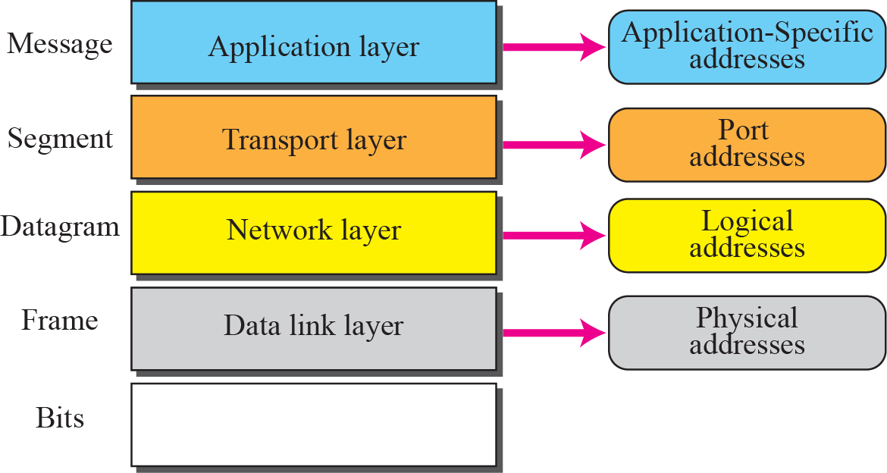
Addresses in the TCP/IP protocol suite

Slide 48
Example 1
In Figure 1, a node with physical address 10 sends a frame to a node with physical address 87. The two nodes are connected by a link (a LAN). At the data link layer, this frame contains physical (link) addresses in the header. These are the only addresses needed. The rest of the header contains other information needed at this level. As the figure shows, the computer with physical address 10 is the sender, and the computer with physical address 87 is the receiver. The data link layer at the sender receives data from an upper layer. It encapsulates the data in a frame. The frame is propagated through the LAN. Each station with a physical address other than 87 drops the frame because the destination address in the frame does not match its own physical address. The intended destination computer, however, finds a match between the destination address in the frame and its own physical address.

Slide 49
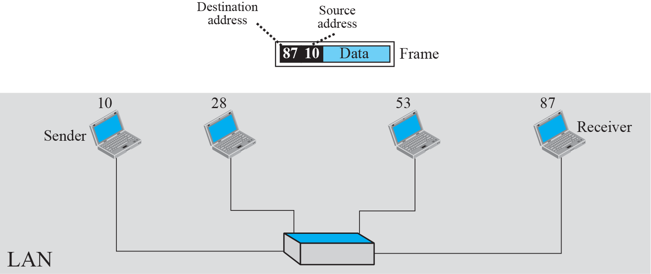
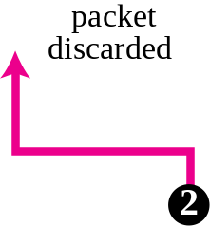
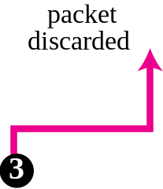
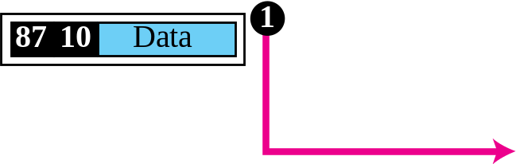
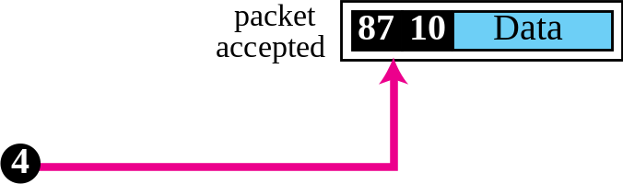
Figure 1 Example 1: physical addresses

Slide 50
Example 2
most local area networks use a 48-bit (6-byte) physical address written as 12 hexadecimal digits; every byte (2 hexadecimal digits) is separated by a colon, as shown below:
07:01:02:01:2C:4B
A 6-byte (12 hexadecimal digits) physical address

Slide 51
Example 3
Figure 2. shows a part of an internet with two routers connecting three LANs. Each device (computer or router) has a pair of addresses (logical and physical) for each connection. In this case, each computer is connected to only one link and therefore has only one pair of addresses. Each router, however, is connected to three networks. So each router has three pairs of addresses, one for each connection. Although it may be obvious that each router must have a separate physical address for each connection, it may not be obvious why it needs a logical address for each connection.The computer with logical address A and physical address 10 needs to send a packet to the computer with logical address P and physical address 95. We use letters to show the logical addresses and numbers for physical addresses, but note that both are actually numbers, as we will see in later chapters.

Slide 52
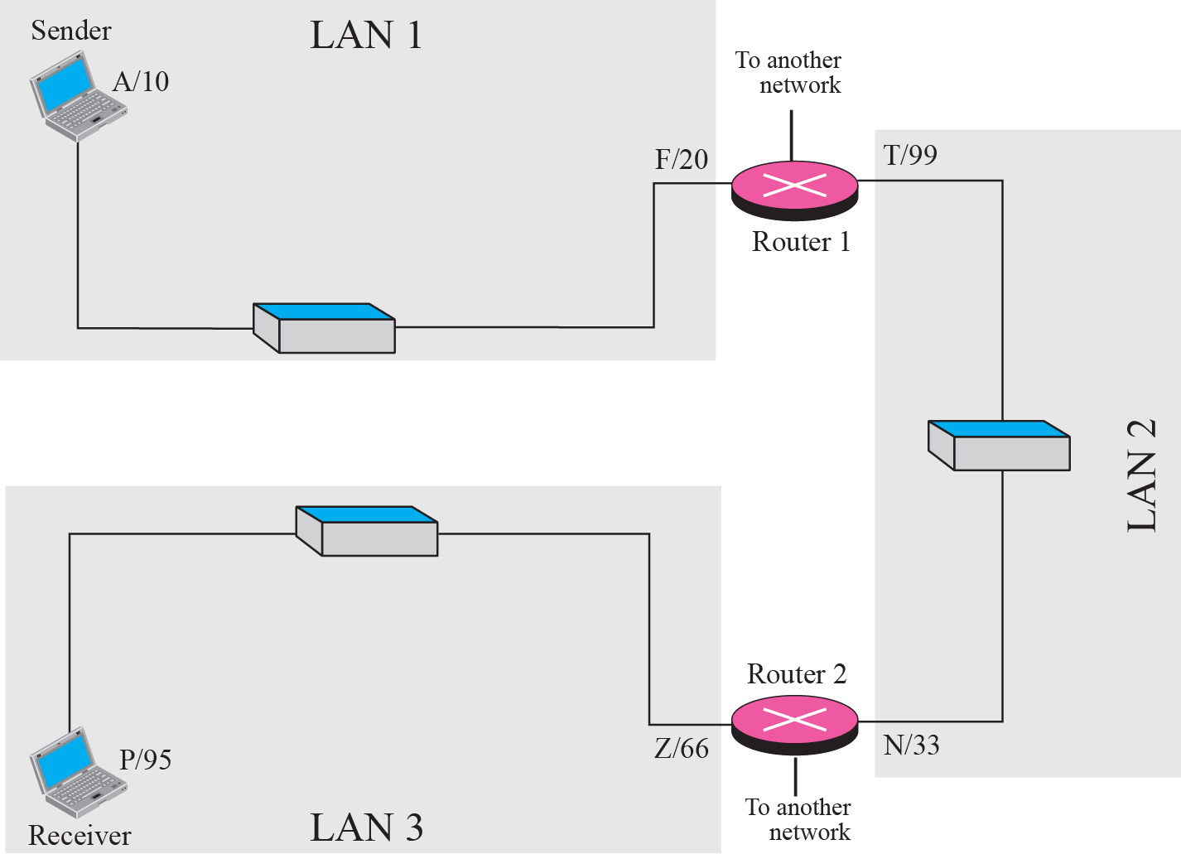
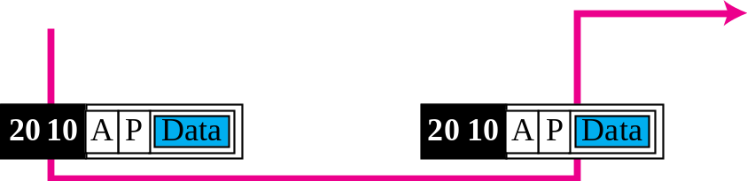
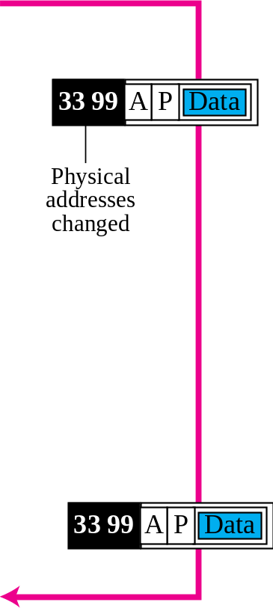
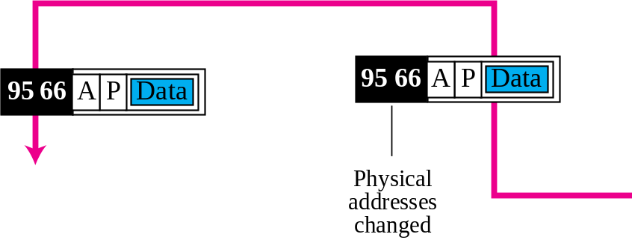
Figure 2. Example 3: logical addresses

Slide 53
Example 4
Figure 3, shows two computers communicating via the Internet. The sending computer is running three processes at this time with port addresses a, b, and c. The receiving computer is running two processes at this time with port addresses j and k. Process a in the sending computer needs to communicate with process j in the receiving computer. Note that although both computers are using the same application, FTP, for example, the port addresses are different because one is a client program and the other is a server program.

Slide 54

Figure 3 Port addresses

Slide 55
N.B: The physical addresses change from hop to hop, but the logical and port addresses usually remain the same.
A port address is a 16-bit address represented by one decimal number as shown. I,e 753
753
A 16-bit port address represented
as one single number.

Slide 56
A Critique of the TCP/IP Reference Model
Problems:
Service, interface, and protocol not distinguished
Not a general model
Host-to-network “layer” not really a layer
No mention of physical and data link layers
Minor protocols deeply entrenched, hard to replace

Slide 57
A Critique of the OSI Model and Protocols
Why OSI did not take over the world
Bad timing
Bad technology
Bad implementations
Bad politics

Slide 58
Example Networks
The Internet
Connection-Oriented Networks:
X.25, Frame Relay, and ATM
Ethernet
Wireless LANs: 802:11

Slide 59
Design Issues for the Layers
Addressing
Error Control
Flow Control
Multiplexing
Routing

