Slide 1
Transmission Media
In a data transmission system, the transmission medium is the physical path between transmitter and receiver.
Guided medium
  Electromagnetic waves are guided along a solid medium.
Unguided media
  Wireless transmission occurs through the atmosphere, outer space, or water.
The characteristics and quality of a data transmission are determined both by the medium and the signal.
  For guided media, the medium itself is more important in determining the limitations of transmission.
  For unguided media, the bandwidth of the signal produced by the transmitting antenna is more important. One key property of signals transmitted by antenna is directionality.
Key concerns are data rate and distance: the greater the data rate and distance, the better.

Slide 2
Quality of Transmission Media
A good transmission medium should provide communication with good quality at long distance.
For voice communication, quality of communication is determined by the voice quality.
For data communication, however, the quality of communication is mainly determined by the effective data rate of communication.

Slide 3
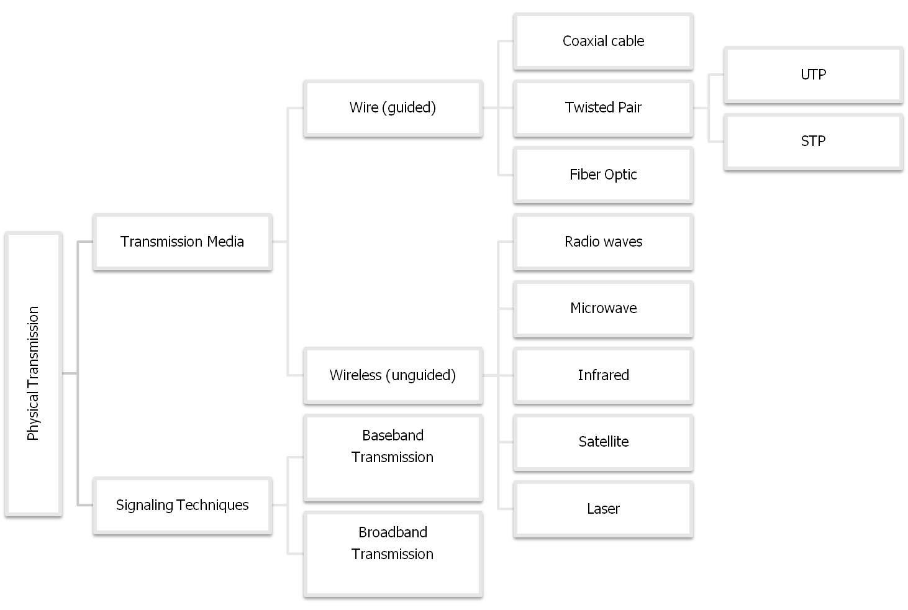
Physical Transmission

Slide 4
Design Factors for Transmission Media
Bandwidth: Communication capacity of a transmission media
  All other factors remaining constant, the greater the bandwidth of a signal, the higher the data rate that can be achieved.
Transmission impairments: Limit the distance a signal can travel.
Interference: Competing signals in overlapping frequency bands can distort or wipe out a signal.
Number of receivers: Each attachment introduces some attenuation and distortion, limiting distance and/or data rate.

Slide 5
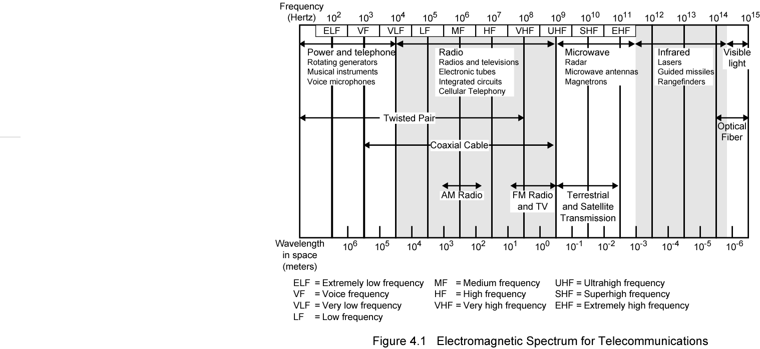
Electromagnetic Spectrum

Slide 6
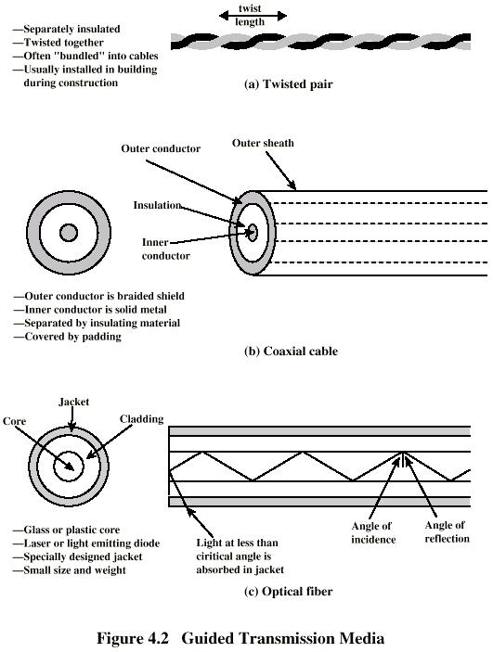
Twisted Pair
Consists of two insulated copper wires arranged in a regular spiral pattern to minimize the electromagnetic (cross talk) interference between adjacent pairs ie the noise produced by adjacent cables.
Low frequency transmission medium (traditionl phone wires, 10 or 100 Mbps Ethernet, enhanced Cat 5 and 6 can handle gigabit+ Ethernet)
There are 2 types of twisted pair : UTP and STP

Slide 7
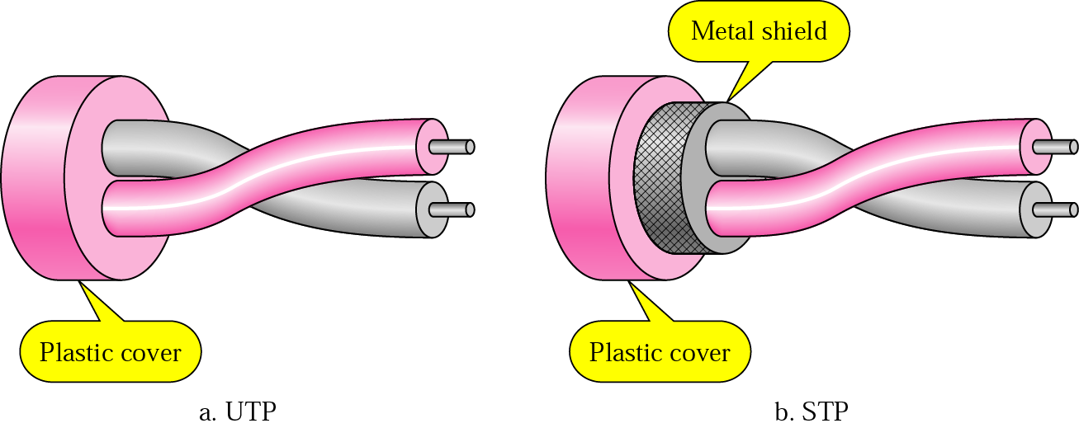
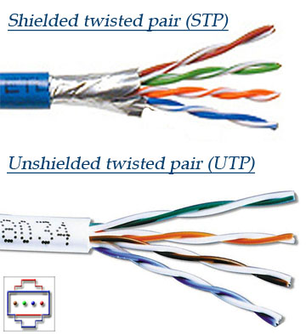
UTP and STP

Slide 8
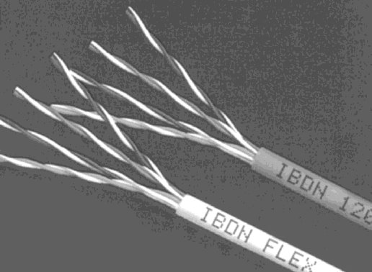
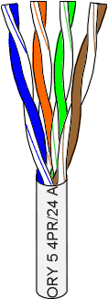
Unshielded Twisted Pair (UTP)
Consists of 4 pairs (8 wires) of insulated copper wires typically about 1 mm thick.
The wires are twisted together in a helical form.
Twisting reduces the interference between pairs of wires.
High bandwidth and High attenuation channel.
Flexible and cheap cable.
Category rating based on number of twists per inch and the material used
CAT 3, CAT 4, CAT 5, Enhanced CAT 5 and now CAT 6.

Slide 9
Types of Twisted Pair
UTP (Unshielded Twisted Pair)
  Each wire is insulated with plastic wrap, but the pair is encased in an outer covering
  Category 3 UTP (16MHz Bandwidth; 10BASE-T/100BASE-T4)
  Category 5 UTP (100MHz Bandwidth; 100BASE-T/1GBASE-T with Cat 5e)
    More tightly twisted than Category 3 cables
  Category 6 UTP (250MHz Bandwidth; 10GBASE-T up to 55 meters)
STP (Shielded Twisted Pair)
  The pair is wrapped with metallic foil or braid to insulate the pair from electromagnetic interference
  Category 6a STP (500MHz Bandwidth; 10GBASE-T up to 100 meters)
  It is more expensive and hard to handle(thick)

Slide 10
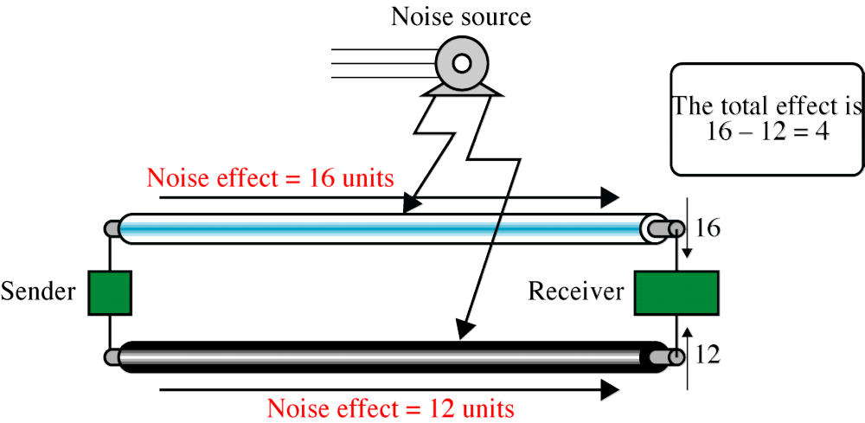
Effect of Noise on Parallel Lines

Slide 11
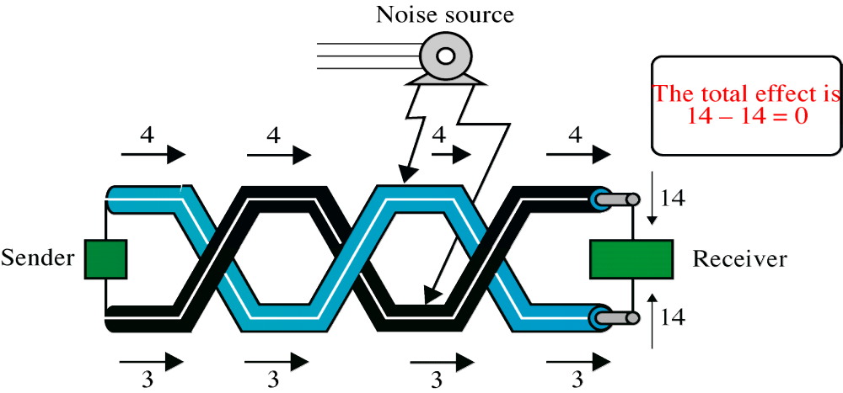
Noise on Twisted-Pair Lines

Slide 12
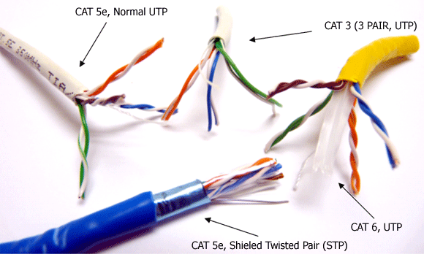
Types of Twisted Pair

Slide 13

Categories of unshielded twisted-pair cables (EIA)

Slide 14
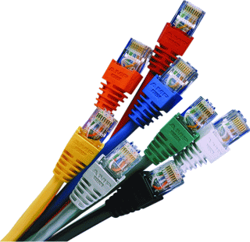
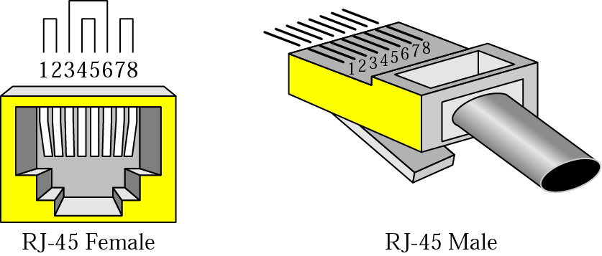
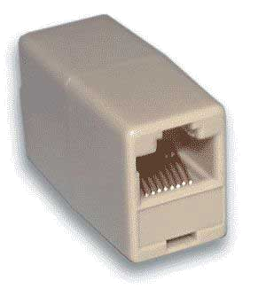

Figure 7.5 UTP connector

Slide 15
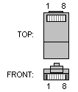
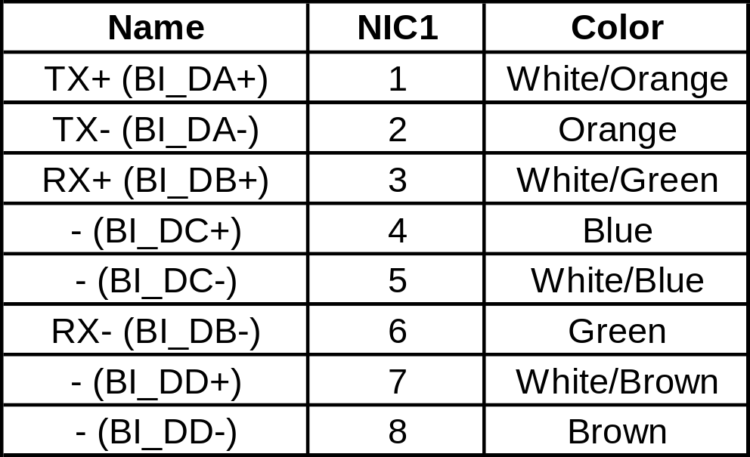
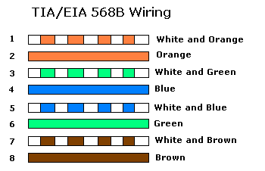
UTP Pin Assignment (Normal UTP cable)
PC
Hub or Switch
Both sides of Cable

Slide 16
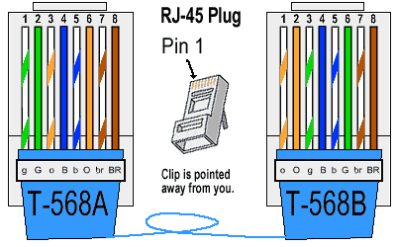
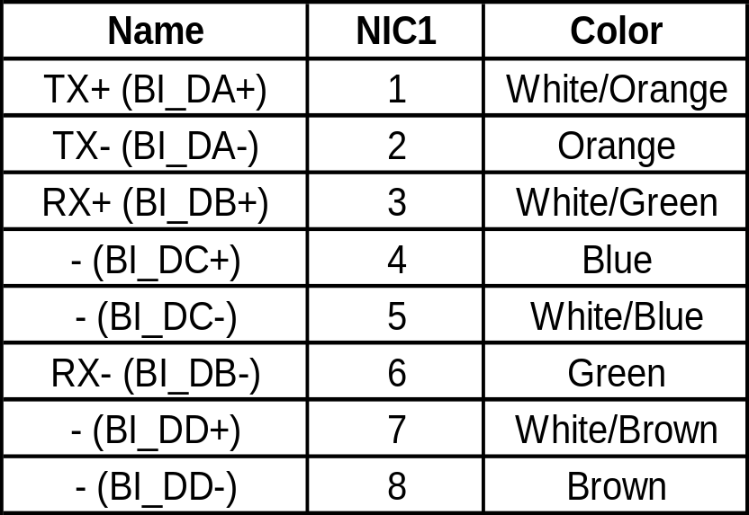
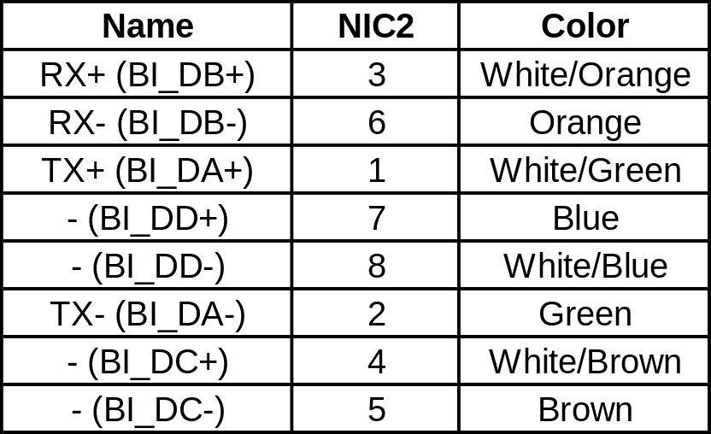
UTP Pin Assignment (Cross UTP cable)
PC
PC
One side of Cable
The other side of Cable

Slide 17
Twisted Pair: Pros and Cons
Advantages:
  Inexpensive and readily available
  Flexible and light weight
  Easy to work with and install
Disadvantages:
  Susceptibility to interference and noise
  Attenuation problem
  For analog, repeaters needed every 5-6km
  For digital, repeaters needed every 2-3km
  Relatively low bandwidth

Slide 18
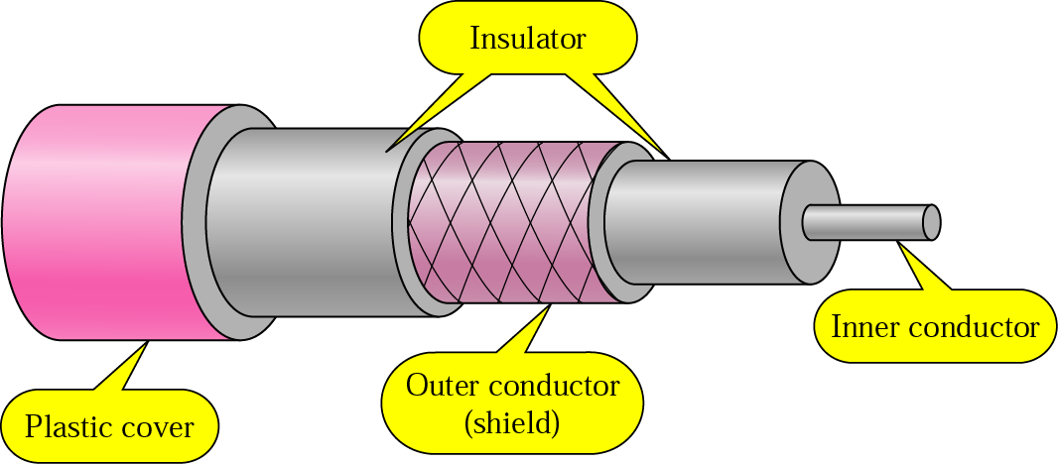
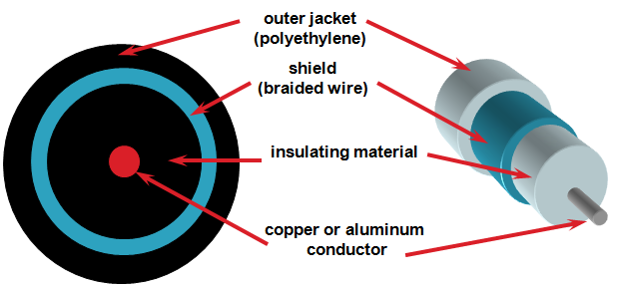
Copper Media: Coaxial Cable
Coaxial cable is a copper-cored cable surrounded by a heavy shielding and is used to connect computers in a network.
Outer conductor shields the inner conductor from picking up stray signal from the air.
High bandwidth but lossy channel.
Repeater is used to regenerate the weakened signals.

Slide 19

Coaxial Cable Standards
Coaxial cables are categorized by their radio government (RG) ratings
Each RG number denotes a unique set of physical specifications
  Wire gauge of the inner conductor
  Thickness and type of the inner insulator
  Construction of the shield
  Size and type of the outer casing
Each RG ratings is adapted for a specialized function

Slide 20

Coaxial Cable Connectors
Coaxial cable connector is BNC (Bayone-Neill-Concelman)
Figure shows the BNC connector, the BNC T connector, and the BNC terminator

Slide 21
Coaxial Cable - Transmission Characteristics
Transmission Characteristics
  Analog signal
    Amplifiers every few km
    Closer if higher frequency
    Up to 500MHz (about 4MHz for each TV channel)
  Digital signal
    Repeater every 1km or so
    Closer for higher data rates
Applications
  Television distribution
    Cable TV
  Long distance telephone transmission
    Can carry 10,000 voice calls simultaneously
    Being replaced by fiber optic
  Local area networks
  Short-range connections between devices such as high-speed I/O channels on computer systems

Slide 22
Coax Advantages & Disadvantages
Advantages
Disadvantages
Higher bandwidth
  400 to 600Mhz
Much less susceptible to interference than twisted pair
It will not cause a toxic gas when its burned. That’s why they use it in some buildings.
High attenuation rate makes it expensive over long distance
It’s not used anymore due to high cost and other technical factors.

Slide 23
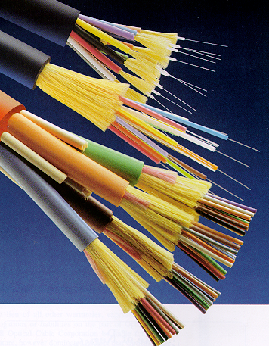

Fiber Media
Optical fibers use light to send information through the optical medium.
It uses the principal of total internal reflection.
Modulated light transmissions are used to transmit the signal.
Require a light source with injection laser diode (ILD) or light-emitting diodes (LED)

Slide 24
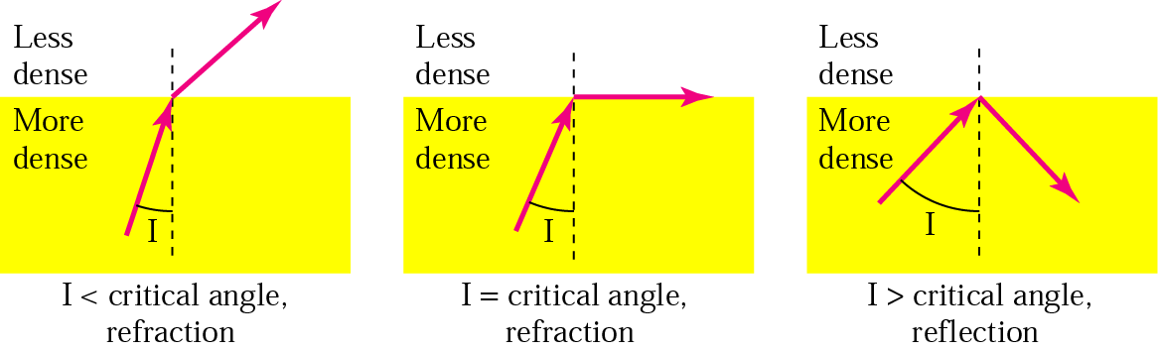
Total Internal Reflection
Physical Media
Fiber Optic works on the properties of light. When light ray hits at critical angle it tends to refracts at 90 degree. This property has been used in fiber optic. The core of fiber optic cable is made of high quality glass or plastic. From one end of it light is emitted, it travels through it and at the other end light detector detects light stream and converts it to electric data form

Slide 25
Fiber Media
Physical Media
Light travels through the optical media by the way of total internal reflection.
Modulation scheme used is intensity modulation.
Two types of Fiber media :
  Multimode
  Singlemode
Multimode Fiber can support less bandwidth than Singlemode Fiber.
Singlemode Fiber has a very small core and carry only one beam of light. It can support Gbps data rates over > 100 Km without using repeaters.

Slide 26
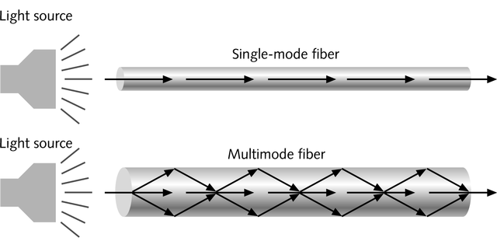
Single and Multimode Fiber
Physical Media
Single-mode fiber
  Carries light pulses along single path
  Uses Laser Light Source
Multimode fiber
  Many pulses of light generated by LED travel at different angles

Slide 27
Fiber Media
Physical Media
The bandwidth of the fiber is limited due to the dispersion effect.
Distance Bandwidth product of a fiber is almost a constant.
Fiber optic cables consist of multiple fibers packed inside protective covering.
62.5/125 µm (850/1310 nm) multimode fiber
50/125 µm (850/1310 nm) multimode fiber
10 µm (1310 nm) single-mode fiber

Slide 28
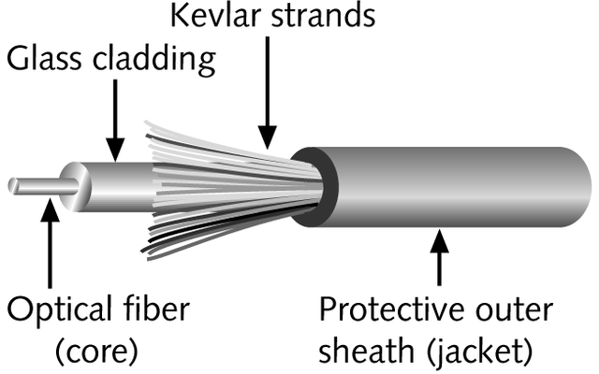
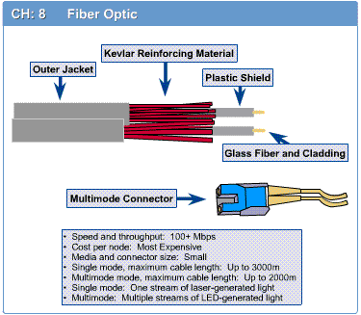
Fiber-Optic Cable
Physical Media
Contains one or several glass fibers at its core
Surrounding the fibers is a layer called cladding

Slide 29

Fiber Optic Cable
Optical fiber is made of glass or plastic and transmits signals in the form of light.
The cable consists of a strand of glass (core) surrounded by a glass tube (cladding).
Its surrounded by a plastic isolation layer for protection
Greater capacity
  high-speed point-to-point transmission (10’s-100’s Gbps)
Smaller size and lighter weight
Lower attenuation (fewer repeaters)
Low error rate (immune to electromagnetic noise)
Hard to tap
plastic jacket
glass or plastic
cladding
fiber core

Slide 30
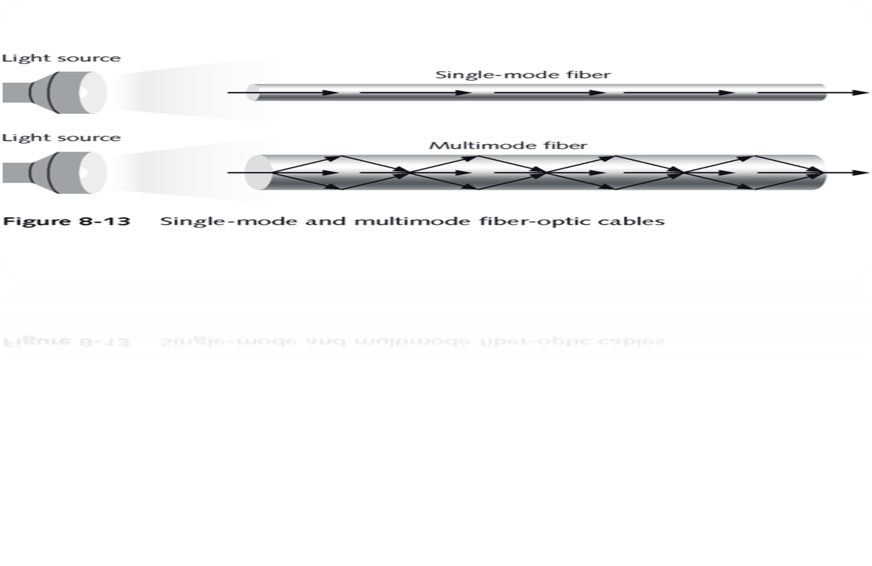
Fiber Optic Types
Digital data is converted to light
Single mode - one light source flashes a light down the cable.
  can carries single ray of light
Multimode - supports many simultaneous light transmissions.
  capable of carrying multiple beams of light.

Slide 31
Fiber Optic Types
Multimode step-index fiber
  The reflective walls of the fiber move the light pulses to the receiver
Multimode graded-index fiber
  Acts to refract the light toward the center of the fiber by variations in the density
Single mode fiber
  the light is guided down the center of an extremely narrow core

Slide 32

Fiber-Optic Connections
Fiber-optic use three different type of connectors
  Subscriber Channel (SC) connector
    Used in cable TV and it uses a push/pull locking system
  The Straight-Tip (ST) connector
    Used for connecting cable to networking devices
  MT-RJ in new connector with the same size as RJ45

Slide 33
Optical Fiber - Benefits
Benefits
  Greater capacity
    Available bandwidth: about 50THz
    Data rates of hundreds of Gbps
  Smaller size & weight
  Lower attenuation
  Electromagnetic isolation
  Greater repeater (or amplifier) spacing
    10s of km at least
Applications
  Long-haul trunks
    thousands of km
  Metropolitan trunks
    tens of km
  Rural exchange trunks
    hundreds of km
  Subscriber loops
    To replace twisted pair and coaxial cable
  LANs: very high data rate, 100Mbps to 10Gbps

Slide 34
Fiber Optic Advantages & Disadvantages
Advantages
Disadvantages
greater capacity (bandwidth of up to 2 Gbps)
Speed (100 - 500 mbps)
smaller size and lighter weight
lower attenuation
immunity to environmental interference
highly secure
expensive over short distance
requires highly skilled installers
adding additional nodes is difficult

Slide 35
Type of Cable depends on:
Transmission speed.
Maximum cable length.
Shielded requirements.
Price.

Slide 36

UNGUIDED MEDIA: WIRELESS
Unguided media: transport electromagnetic waves without using a physical conductor (wireless communication)
  Signal broadcast through air

Slide 37
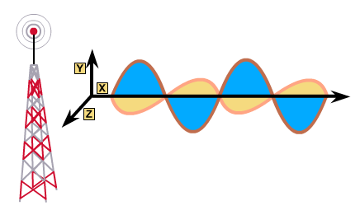
Wireless Media
Physical Media
Very useful in difficult terrain where cable laying is not possible.
Provides mobility to communication nodes.
Right of way and cable laying costs can be reduced.
Susceptible to rain, atmospheric variations and Objects in transmission path.

Slide 38
Wireless Media
Physical Media
Indoor : 10 – 50m : BlueTooth, WLAN
Short range Outdoor : 50 – 200m: WLAN
Mid Range Outdoor : 200m – 5 Km : GSM, CDMA, WLAN Point-to-Point, Wi-Max
Long Range Outdoor : 5 Km – 100 Km : Microwave Point-to-Point
Long Distance Communication : Across Continents : Satellite Communication

Slide 39
Wireless Transmission Frequencies
Radio is a general term for frequencies in the range of 3kHz to 300GHz. The properties of radio waves are frequency dependent.
30MHz to 1GHz
  Suitable for omnidirectional applications
  E.g., broadcast radio
1GHz to 40GHz
  Referred to as microwave frequencies
  Can be highly directional
  Suitable for point-to-point transmission
  Microwave is also used for satellite communications
3 x 10¹¹ Hz to 2 x 10¹⁴ Hz
  Infrared
  Local applications, such as in a single room
There are national and international agreements about who gets to use which frequencies.
  AM & FM radio, television, mobile phones, telephone companies, police, maritime, navigation, military, government, etc.
  ISM band (Industrial, Scientific, Medical): unlicensed usage
    E.g., Cordless phone, radio-controlled toys, bluetooth, wireless LAN

Slide 40
Antennas
For unguided media, transmission and reception are achieved by means of an antenna.
An antenna is an electrical conductor or system of conductors used either for radiating electromagnetic energy or for collecting electromagnetic energy.
An antenna will radiate power in all directions but does not perform equally well in all directions.
  isotropic antenna: an idealized antenna that radiates power in all directions equally
  antenna gain: a measure of the directionality of an antenna, which is defined as the power output in a particular direction, compared to that produced in any direction by a perfect isotropic antenna.
  Usually, the increased power radiated in a given direction is at the expense of other directions.

Slide 41
Wireless Propagation
Signal radiated from an antenna travels along one of three routes:
  Ground wave
    Follows contour of earth
    Up to about 2MHz
    E.g., AM radio
  Sky wave
    2 to 30 MHz
    Signal reflected from ionosphere layer of upper atmosphere
    Signals can travel thousands of km
    E.g. BBC world service, Voice of America
  Line of sight
    Above 30MHz
    The transmitting and receiving antennas must be within an effective line of sight of each other

Slide 42
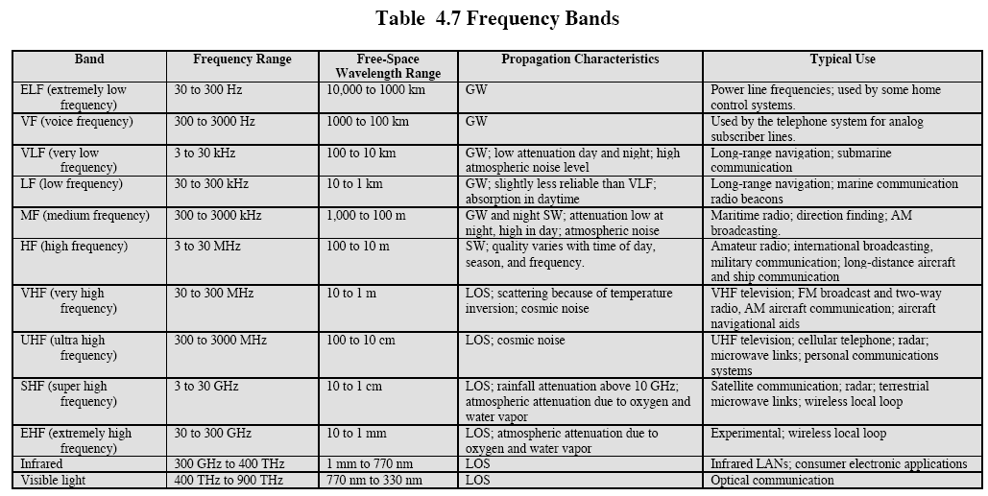
Frequency Bands

Slide 43
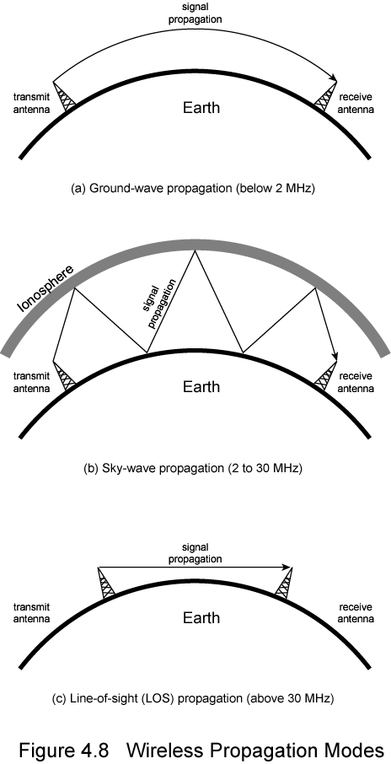
Ground Wave Propagation

Slide 44
Sky Wave Propagation

Slide 45
Line of Sight Propagation

Slide 46
Line of Sight Transmission
Free space loss
  Signal disperses with distance
  Greater for lower frequencies (longer wavelengths)
Atmospheric Absorption
  Water vapour and oxygen absorb radio signals
  Water greatest at 22GHz, less below 15GHz
  Oxygen greater at 60GHz, less below 30GHz
  Rain and fog scatter radio waves
Multipath
  Better to get line of sight if possible
  Signal can be reflected causing multiple copies to be received
  May be no direct signal at all
  May reinforce or cancel direct signal
Refraction
  May result in partial or total loss of signal at receiver

Slide 47
Microwaves
  Microwaves are unidirectional
  Antenna need to be aligned
  Advantage: pair of antenna can be aligned without interfering with another pair
  Microwave propagation is line-of-sight
  For long distance communication
    Very tall towers
    Repeater
  Very high-frequency microwaves cannot penetrate walls
    Disadvantage if receiver inside a building
    -Applied in Cellular phones, Satellite networks, Wireles LANs

Slide 48
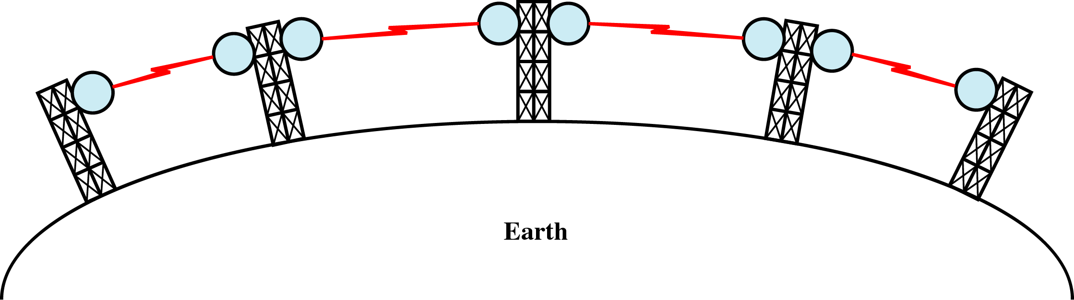
Terrestrial Microwave
Physical Media
Microwaves do not follow the curvature of earth
Line-of-Sight transmission
Height allows the signal to travel farther
Two frequencies for two way communication
Repeater is used to increase the distance Hop-by-Hop

Slide 49
Satellite Microwave
Satellite is relay station
Satellite receives on one frequency, amplifies or repeats signal and transmits on another frequency
Requires geo-stationary orbit
  Height of 35,784km
Television
Long distance telephone
Private business networks

Slide 50
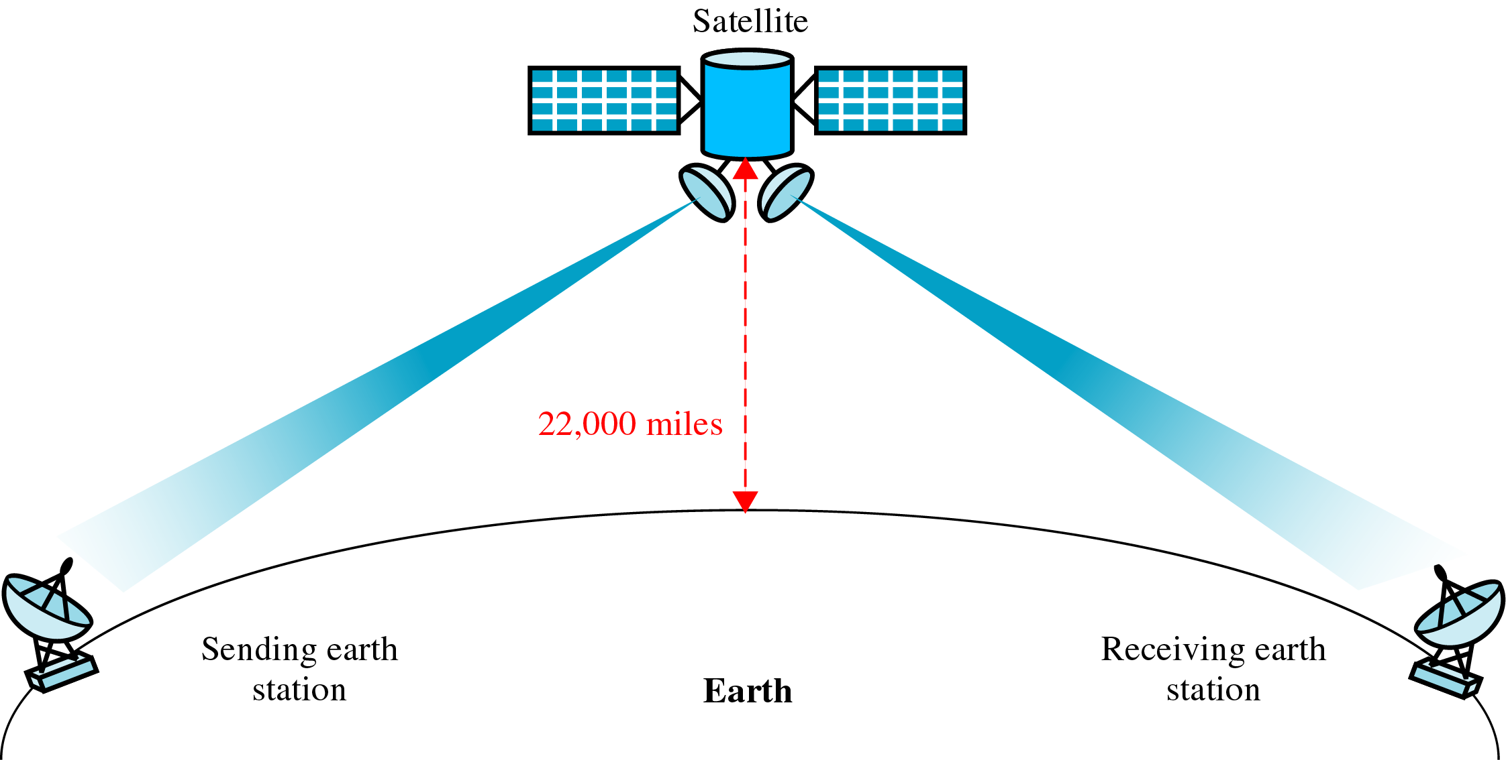
Satellite Communication
Physical Media

Slide 51
Radio waves
  - Radio waves: waves range in frequencies between 3 KHz and 1 GHz
  Microwaves: waves ranging in frequencies between 1 and 300 GHz
  Radio waves are omnidirectional (propagated in all directions)
  The sending and receiving antennas do not have to be aligned
  Disadvantage
    One antenna interferences another antenna when they using same frequency
  Radio waves that propagate in the sky mode, can travel long distance [AM radio]
  Radio waves [low and medium frequencies] can penetrate walls inside a building
    Advantage: an AM radio can be received inside a building
    Disadvantage: we cannot isolate a communication to just inside or outside a building and suffers from multipath interferences due to reflections.
Applications
  Useful for multicasting: Radio, television. Cordless phones and paging system

Slide 52
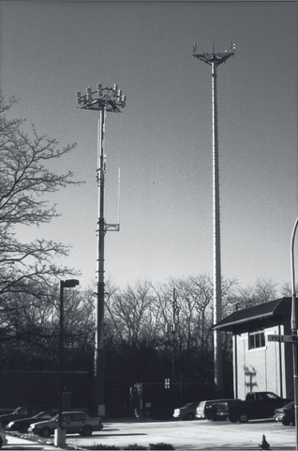
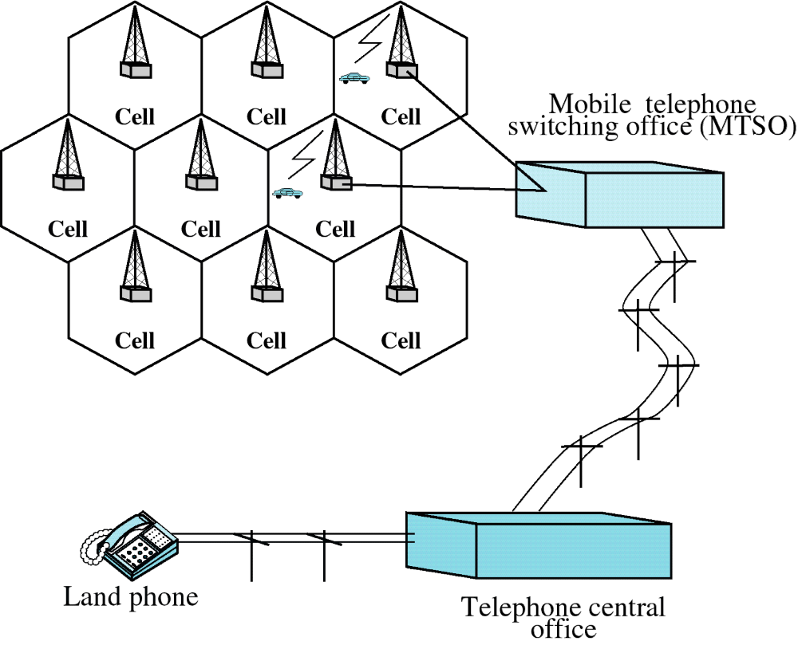
Cellular System

Slide 53
Infrared
  From 300 GHz to 400 THz (wavelengths from 1 mm to 770 nm)
  Use for short-range communication
  It has high frequency, cannot penetrate walls
    Prevents interference between one system and another
      Remote control not interfere with our neighbors
  Can not be used outside because sun’s rays contain infrared waves (interference)
  (IrDA) Infrared Data Association established standards for communicating between devices:
    Keyboards, mice, PCs and printers

Slide 54
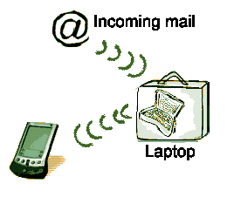
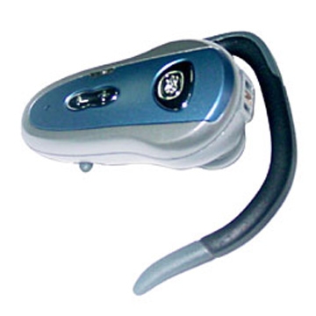

Bluetooth

Slide 55
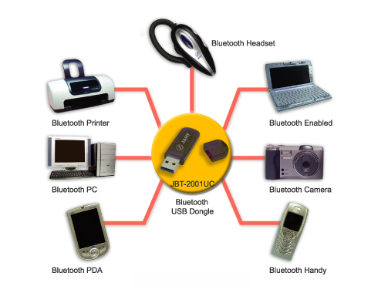

Slide 56
Bluetooth
Operate in noisy radio frequency environments
  2.402 GHz - 2.480 GHz
  omni-directional
  Point-to-multipoint
frequency-hopping scheme
  79 hops (RF channels) 1 MHz apart.
    bandwidth is reduced in Japan, France and Spain
  The maximum frequency hopping rate is 1600 hops/s
link range
  Usually 10 centimeters to 10 meters
  Can be extended to more than 100 meters by increasing the transmit power
Small amounts of data
  1Mbps over short distances (up to 10 meters).

Slide 57
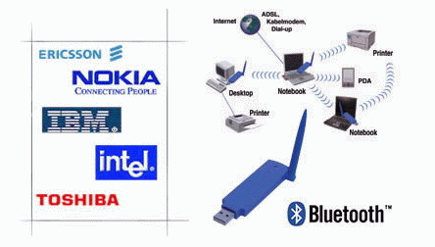
Bluetooth
Very Low power device
Based on the IEEE 802.11 standard
Not designed to carry heavy traffic loads
Fast acknowledgement

Slide 58
Media Selection Criteria
Cost
Speed
Distance
Delay
Expandability
Environment
Security

Slide 59
Transmission Impairments in Wireless Transmission
Free Space Loss
  Signal dispersion is a function of distance
  Ratio between power-radiated to power-received
  Greater for lower wavelength
  Antenna gain can be used to compensate the losses
  Also known as near far problem
Refraction
  Each wireless medium has its own density
  Propagation speed is a function of density of the medium
  When medium changes, the result is refraction
  Refraction means change of direction

