Slide 1
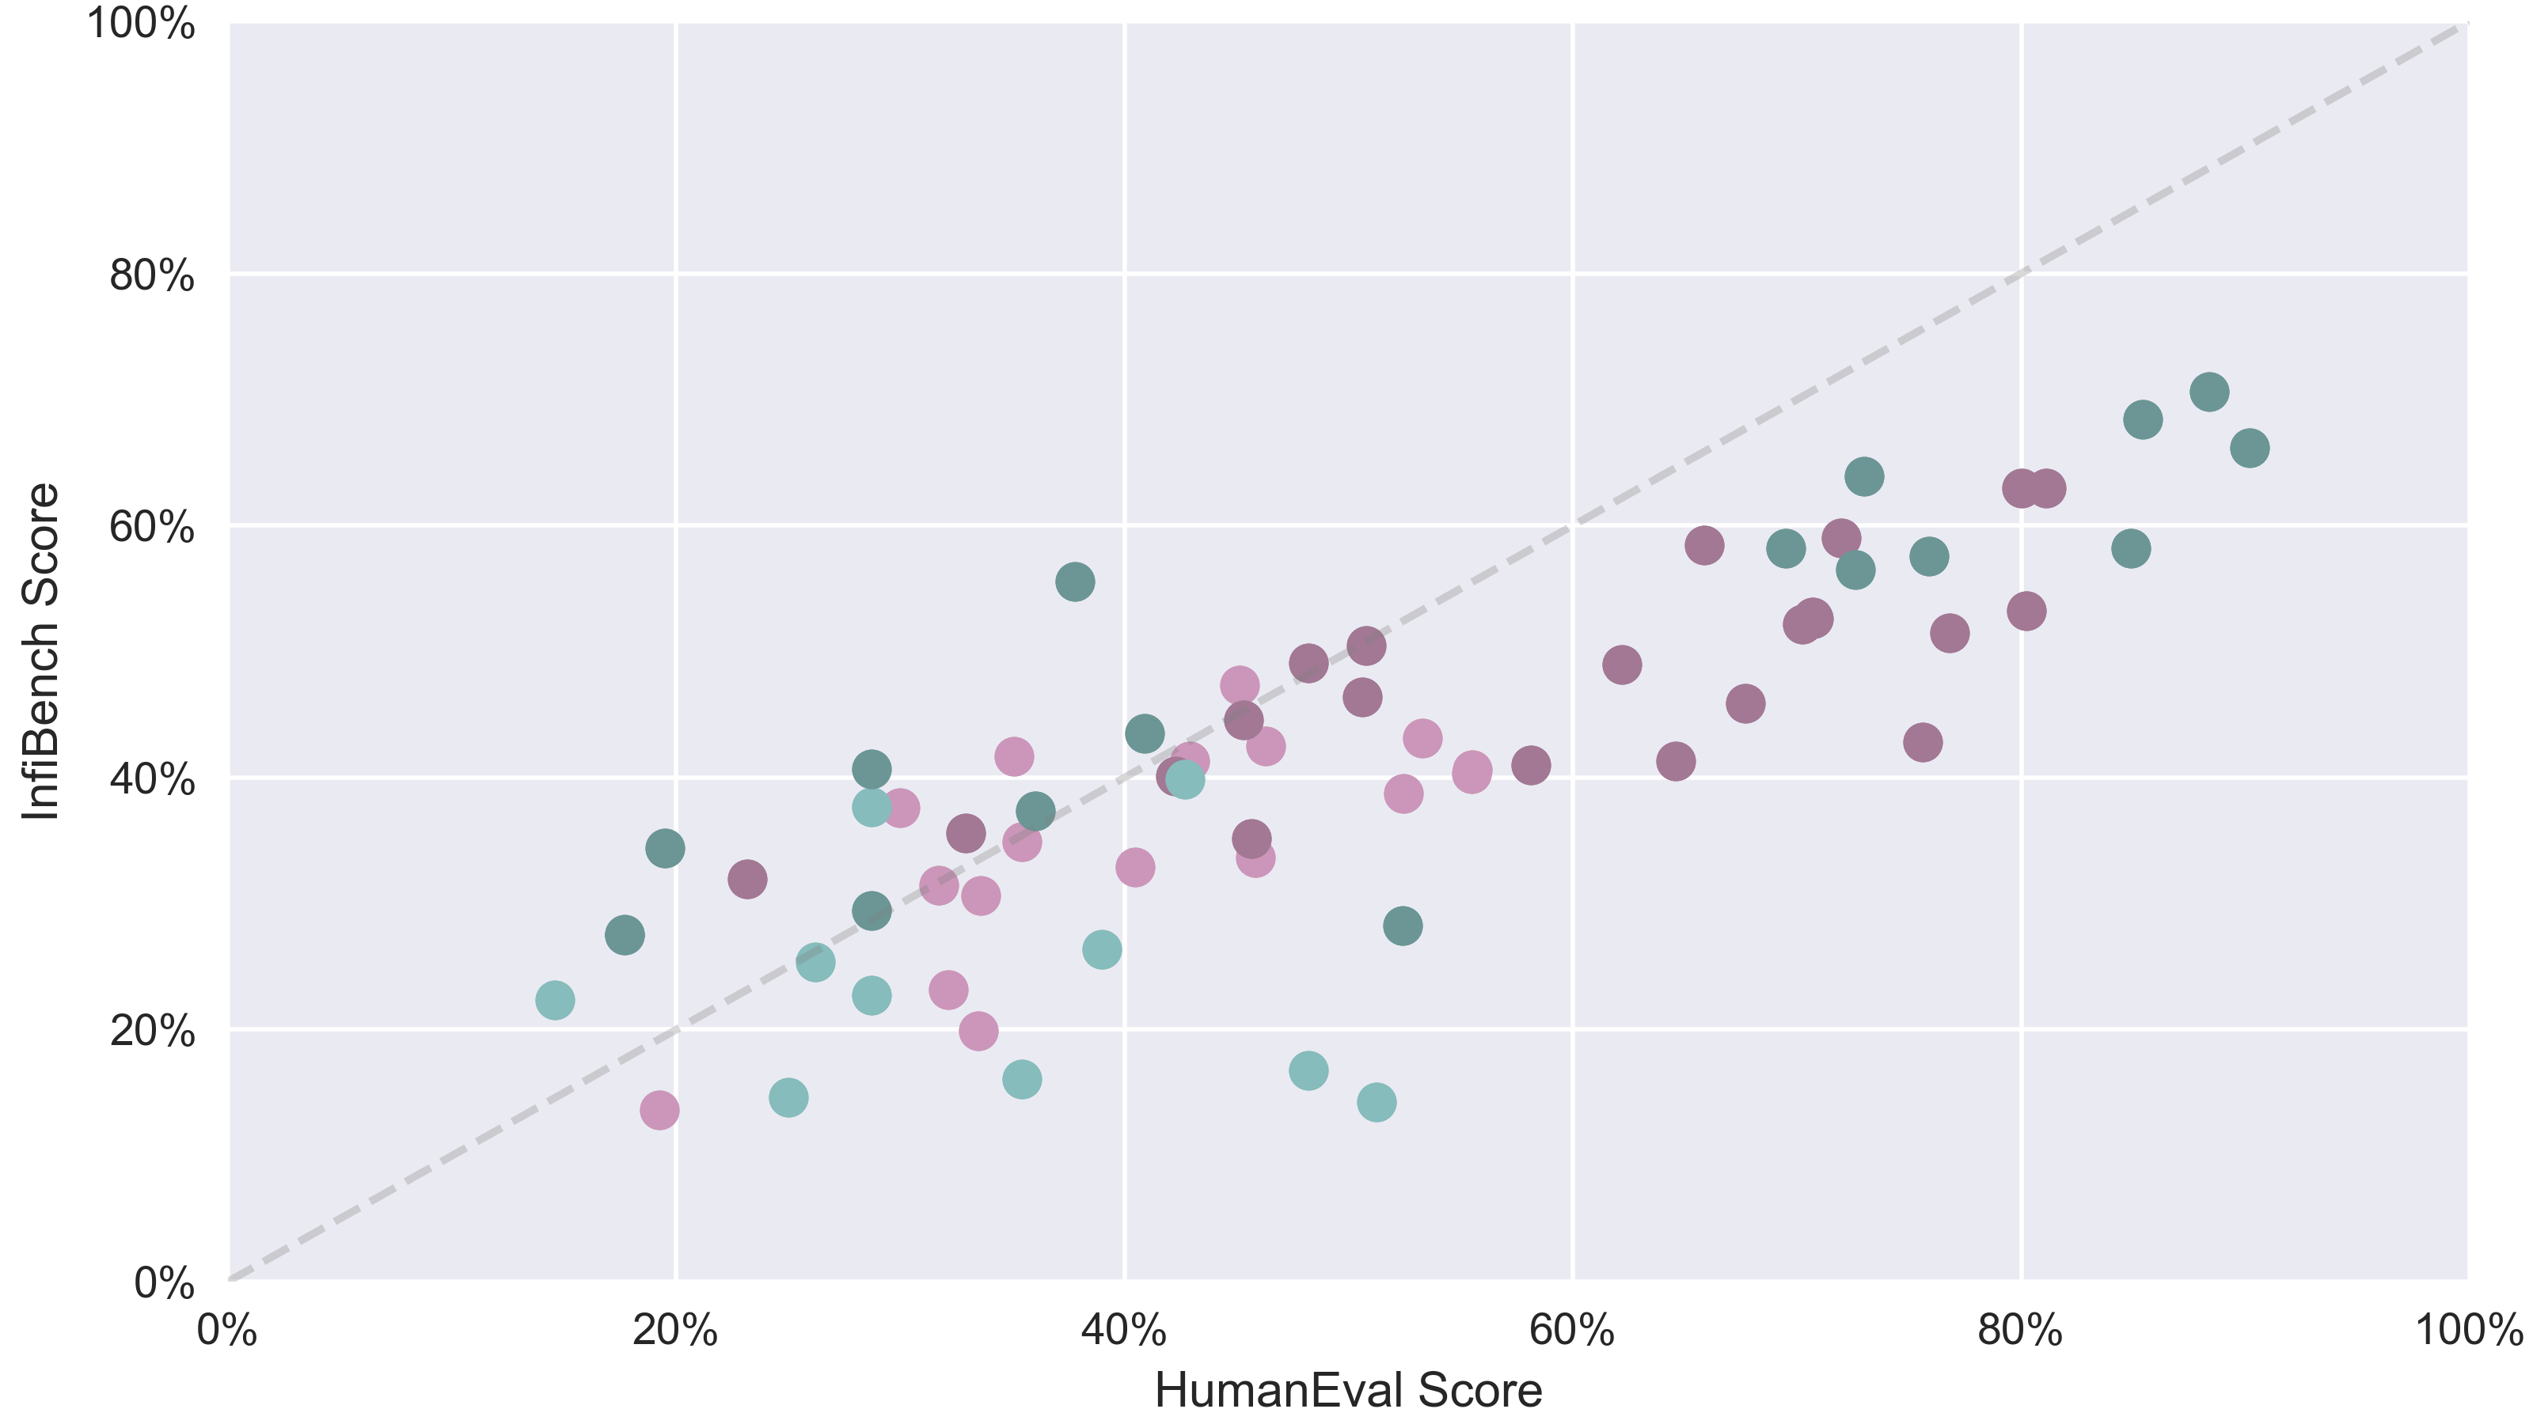
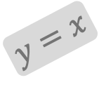
$$y=x$$
Better on
InfiBench
Better on
HumanEval
Mixtral-8x7B-Instruct
ChatGLM3-6B
General Finetuned Model
General Base Model
gemma-2b
gemma-7b
Code Finetuned Model
Phi2
Phi1
CodeGen-16B-multi
Code Base Model

