Slide 1
Code Model
Scaling
GPT4-0613
70.64%±0.82%
GPT-4o-2024-05-13
66.19%
Codestral-22b
62.98%
deepseek-coder-33b-instruct 62.96%
Claude 3 Opus
63.89%
mistral-large
58.22%
General Model
Scaling
deepseek-moe-16b-chat 45.18%
Phind-CodeLlama-34B-v2 59.00%
deepseek-coder-1.3b-instruct 41.32%
deepseek-llm-67b-chat
57.41%
Mixtral-8x7B-Instruct 55.55%
CodeLlama-70b-Instruct
42.82%
Qwen-1.8B-Chat
26.84%
Phi1.5
20.56%
Phi2 16.74%
General Finetuned Model
Phi1 14.28%
General Base Model
Code Finetuned Model
Code Base Model

Slide 2
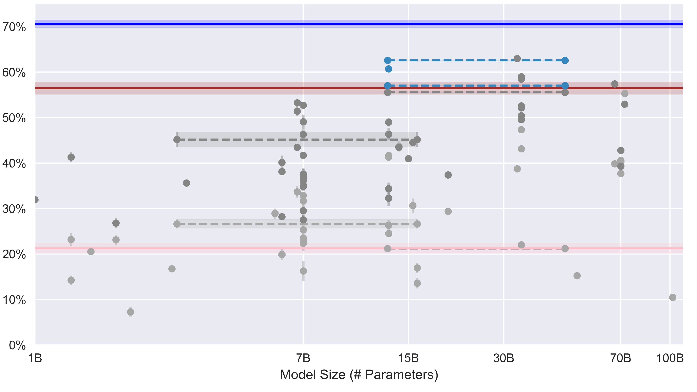
GPT4-0613
70.64%±0.82%
62.61%
GPT3.5-turbo-0613
56.47%±1.34%
davinci-002
21.25%±1.17%
60.74%
57.04%
Other Open-Source Models
Our Models
Our MoE Models

