Slide 1

On Notions of Independence …. And how they apply to F#
@dsyme, researcher at microsoft, f# community contributor

Slide 2
What is Independence?

Slide 3
What is Independence? Theoretical Independence Cognitive Independence Memetic Independence Technical Independence Social Independence Legal Independence

Slide 4
What is Dependence? Existential Dependence Cognitive Dependence ….

Slide 5
First, a little about F#

Slide 6
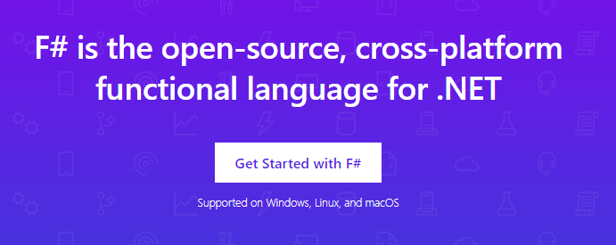
www.microsoft.com/net/

Slide 7
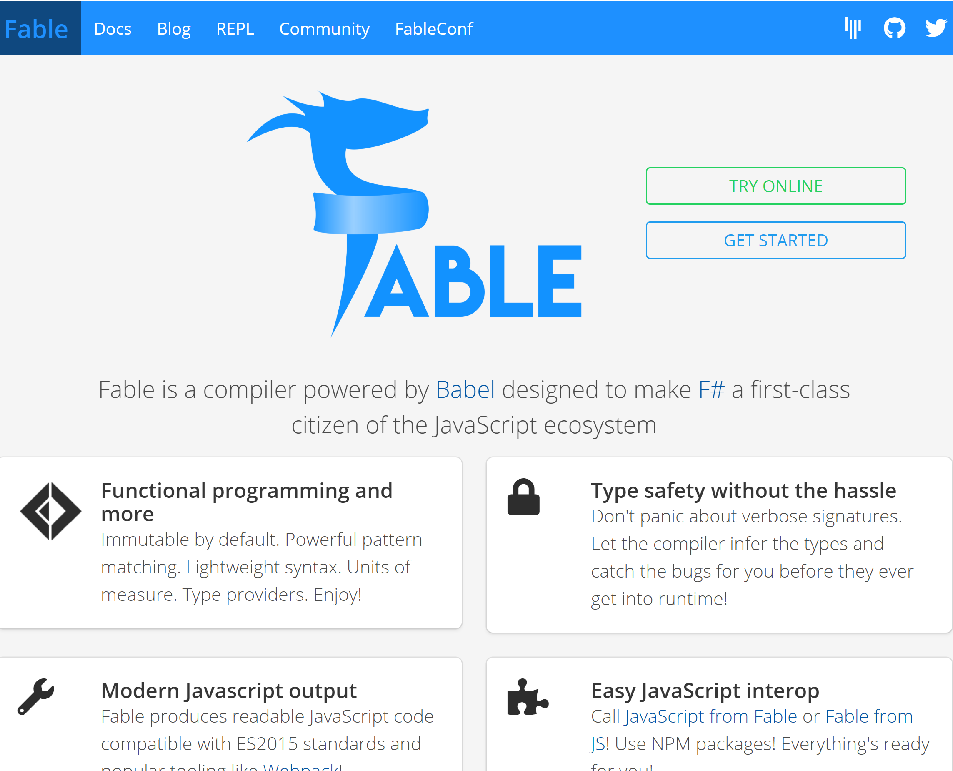

Slide 8
F# and .NET Core (Linux, OSX, Windows) dotnet new -lang F# dotnet build docs.microsoft.com/dotnet/core/

Slide 9
But how did we get here? How did the F# community get created and how does it work?

Slide 10
The Early History of F# - HOPL IV (2020) fsharp.org/history

Slide 11
Technique #1 The Community at the Centre of the Technology The F# Pivot of 2013 - From Proprietary to Open

Slide 12
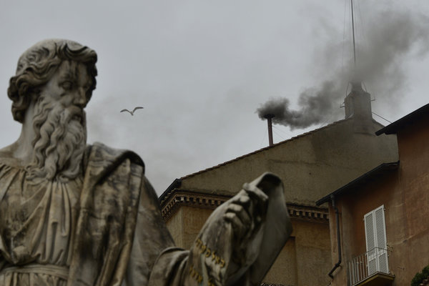
Old think…

Slide 13
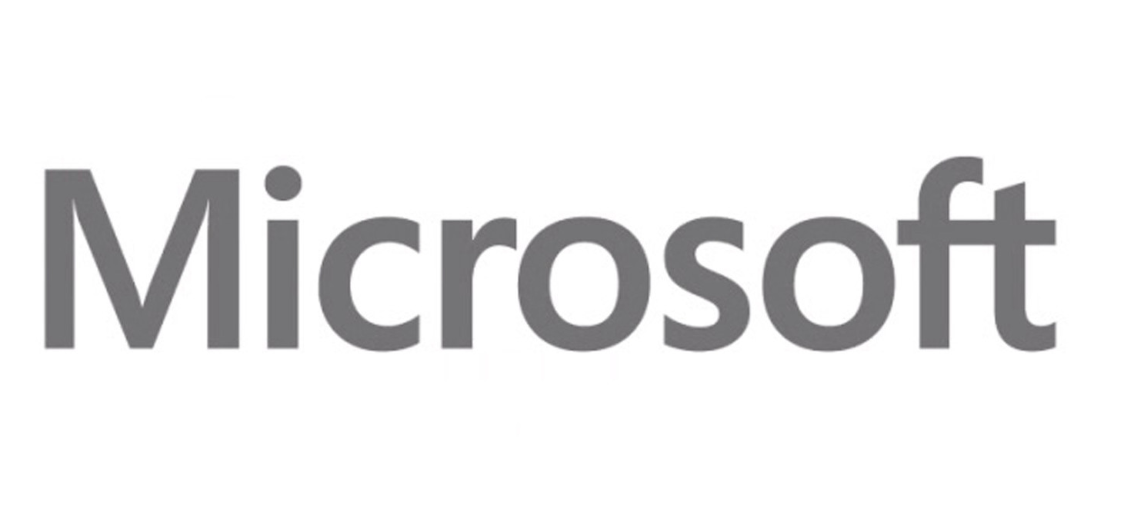


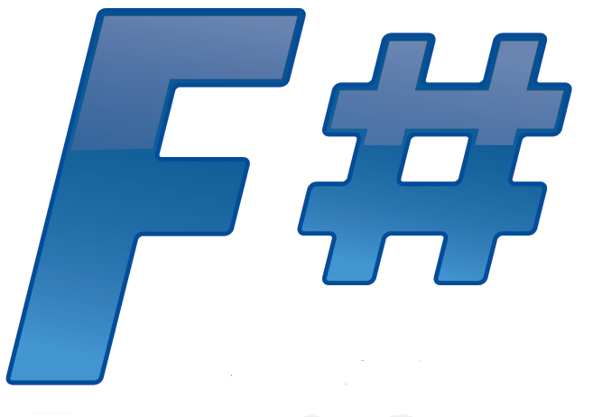





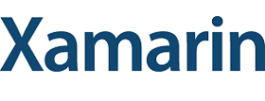



New think…
Visual Studio, .
.NET, SDKs, Tools
…
Visual F# Tools
F# Language
F# Open Source
Group
tryfsharp.org
F# Software
Foundation
F# Community
Groups
fpish.net
tryfs.org
fssnip.net
tryfs.org
fsharpforfunandprofit.com
Xamarin Studio

Slide 14
Technique #2 The Community at the Centre of Design & Implementation Suggestions: github.com/fsharp/fslang-design Designs github.com/fsharp/fslang-suggestions Implementation github.com/dotnet/fsharp

Slide 15
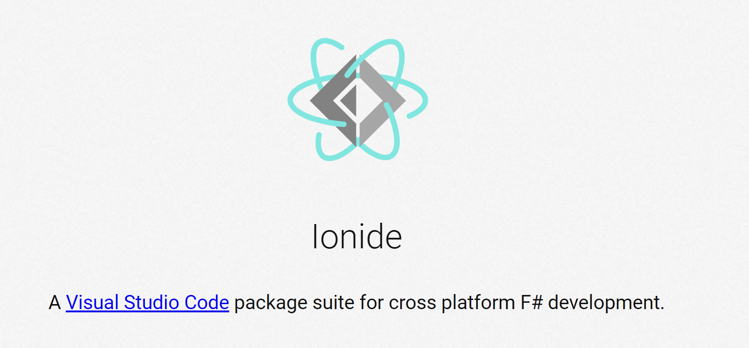
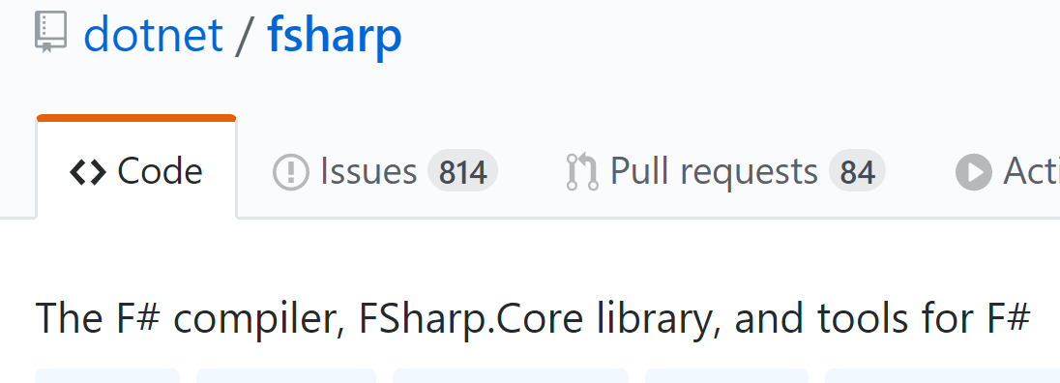
Technique #3 The Community at the Centre of Tooling

Slide 16
Technique #4 A Foundation at the Centre of the Community… …that embodies the ethics and spirit of the community and represents its interests positively http://foundation.fsharp.org

Slide 17
The Genesis of the F# Software Foundation, 2014 Houston, we have a problem. But what sort of problem exactly? And what would a solution look like?

Slide 18
The principles of founding the FSSF
Open, worldwide, free membership, social media, education focus
Every base technology needs a social organization that acts in its interests.
Companies struggle to provide a voice strong enough for a base technology today. They can contribute but won’t succeed alone.
Let’s shift F# to where we want to be, not where we are.
Let’s embrace both commercial and non-commercial. Be a DMZ.
Let’s solve our weaknesses (e.g. cross-platform, open-source). If we’re not perfectly XYZ, work on it. It’s painful, but do it.
Self-consistency and an empowered user base are more valuable than sheer size in the long run.

Slide 19
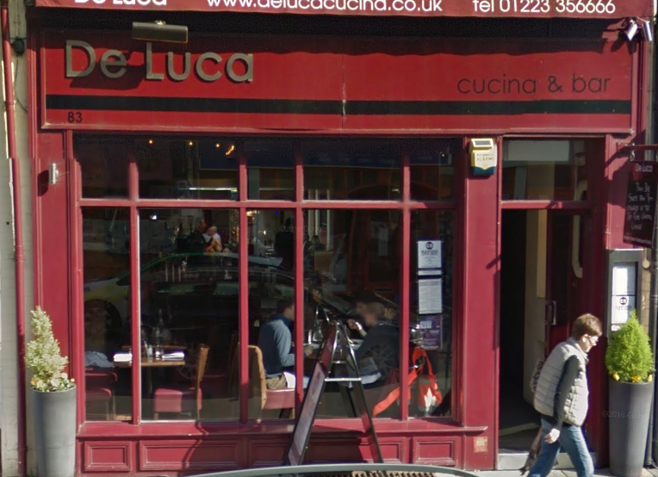
The Genesis of the F# Software Foundation, 2014 Houston, we have a problem. But what sort of problem exactly? And what would a solution look like?

Slide 20
Technique #5 The Community at the Centre of Incubation http://fsprojects.github.io and much more Balancing trust, consistency and innovation

Slide 21
Technique #6 The Community owns the Message The core message about F# is decided by the community Microsoft is part of the community, so are many other interests F# Conferences are F# Events run by the F# Community

Slide 22
Marketing Matters! You can help “market” F# every day. Social Proof really, really matters. Write a testimonial today for fsharp.org/testimonials. Spread positive, authentic, honest messages When spreading negative messages, be constructive. Please don’t do it for the clicks and likes.

Slide 23
Technique #7 Balance the Forces in the Community Communities are a balance of interests and forces There need to be truly neutral zones Commercial interests are important but must not dominate Respect the “neutrality” of F# community zones Understand the many points of view. Ask to understand.

Slide 24
What is Independence? What kind of independence should we seek for F#? What should we avoid? What kind of dependence should we accept for F#? What should we avoid?

Slide 25
What is Independence? Existential Independence Cognitive Independence Memetic Independence Technical Independence Social Independence Complete Independence

Slide 26
Cognitive Independence When a technology A can be understood and used without knowing technology B Example: ASP.NET Core and Giraffe

Slide 27
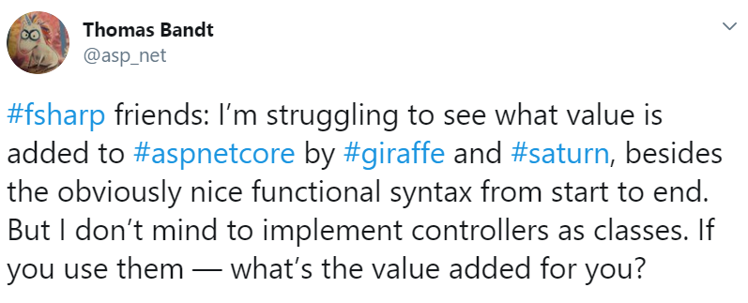
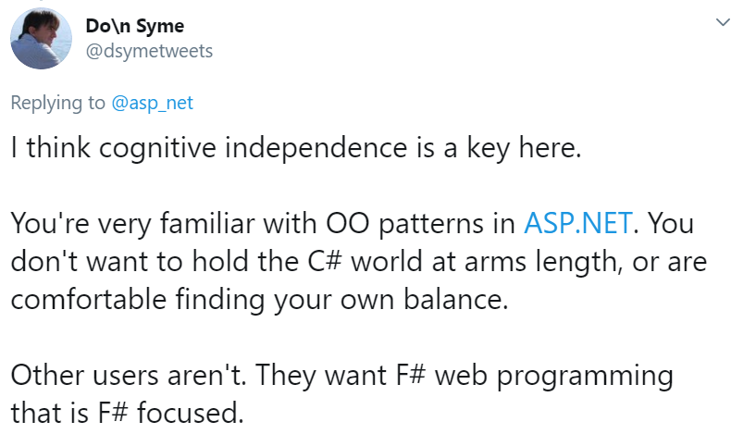

Slide 28
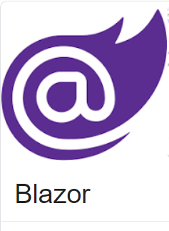
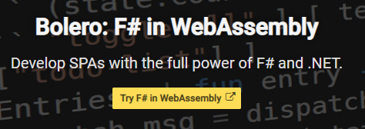
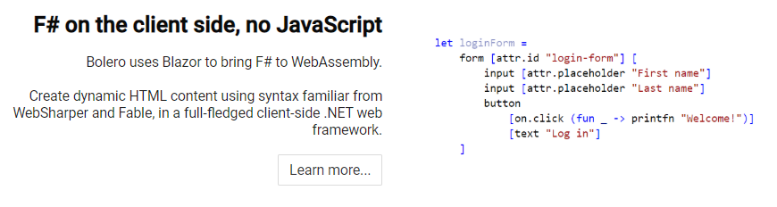
Example: I love F# Bolero, but dislike C# Blazor. How can that be?

Slide 29
I am guilty here. F# 2.0 was too cognitively dependent on .NET, Visual Studio etc. Please help me correct this

Slide 30
Cognitive independence does NOT mean using only functional programming everywhere F# is functional-first, not functional. F# has object programming and dot notation for a reason. Use it!!!!

Slide 31
F# users thrive on programming experiences which offer “sweet spot” of cognitive independence and interoperabilit - do not need to think in C# - do not drive you into corners that don’t work - good examples in F#, not C#

Slide 32
Memetic Independence When a technology can be virally communicated as an idea independently of other technologies, associations or vested interests

Slide 33
Does Visual Basic have memetic independence? No Does F# have memetic independence? It comes and goes!!!! Do .NET and C# have memetic independence? Your challenge

Slide 34
.NET, C# and F# need…
Memetic independence.
A community(ies) that is worth being a part of.
A community(ies) with strong, positive voices of their own.
A community(ies) that can include people and companies who are not aligned to Microsoft's interests.
A community(ies) with generational renewal. A place for 20-year olds. 18 year olds. 16 year olds.
A Technology Creators Conference open to all .NET tech creators

Slide 35
Warning Signs…
When searching for .NET/C#/F# leads you straight to one company
When the first sentence explaining .NET includes “Windows”, “Microsoft” or “Visual Studio” 100% of the time.
When you can only reasonably contribute to a technology on Windows
When all major community contributors are MVPs from one company.
When everyone giving talks or attending is using Windows or VS.
When inspirational upstack frameworks, languages and creative tooling are not encouraged, but extinguished.
When community are unkind, unwelcoming or negative. Amplify positivity.

Slide 36
The Great Challenge for .NET, C# and F# = Social Independence + Memetic Independence + “Enough” Cognitive Independence + Enterprise-Ready Contribution = Goodness
Dependence
Independence

Slide 37
Please, get involved in the core technologies programming languages runtimes frameworks Invent, Create, Initiate, Lead, Contribute, Collaborate, Govern, Sustain

Slide 38
F# 4.0 ✔ True shift to cross-platform open engineering ✔ Long laundry list of language items ✔ Normalized core library ✔ Type providers more powerful ✔ Better debugging, tooling, performance ✔ ~20% compiler perf improvement
https://github.com/fsharp/fslang-design/tree/master/FSharp-4.0

Slide 39
F# 4.1 ✔ Optional large scope cycles more on this later) ✔ Result<T,Error> in standard library ✔ Unboxed (struct) tuples ✔ Unboxed (struct) records ✔ Unboxed (struct) unions ✔ More bits and pieces
https://github.com/fsharp/fslang-design/tree/master/FSharp-4.1

Slide 40
F# 4.5 ✔ Span<T> high perf type-safe non-allocating code ✔ Improved async debugging ✔ More bits and pieces
https://github.com/fsharp/fslang-design/tree/master/FSharp-4.5

Slide 41
F# 4.6 ✔ Anonymous records ✔ More bits and pieces
https://github.com/fsharp/fslang-design/tree/master/FSharp-4.5

Slide 42
F# 4.7 ✔ Wildcard self identifiers ✔ Implicit yields ✔ Indentation syntax relaxations
https://github.com/fsharp/fslang-design/tree/master/FSharp-4.7

Slide 43
F# 5.x (preview) ✔ nameof operator ✔ support let! … and! for applicatives ✔ open static classes ✔ witness passing for quotations ✔ default interface members ✔ nullable interop ✔ slicing improvements ✔ string interpolation ✔ extension members for constraints
https://github.com/fsharp/fslang-design/tree/master/preview

Slide 44
Questions?

