Slide 1

On Independence
@dsymetweets, researcher, community contributor

Slide 2
What is Independence? What do we mean when we say a technology is independent? How does this play out for F# and its associated technologies?

Slide 3
Independence means many things Existential Independence Cognitive Independence Memetic Independence Technical Independence Social Independence Legal Independence

Slide 4
What is Dependence? Existential Dependence Cognitive Dependence ….

Slide 5
First, let’s look at how I talk about F#

Slide 6
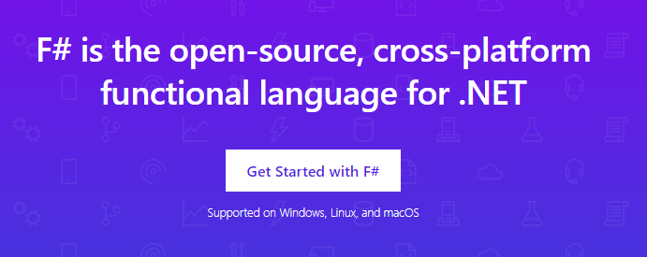
www.microsoft.com/net/

Slide 7
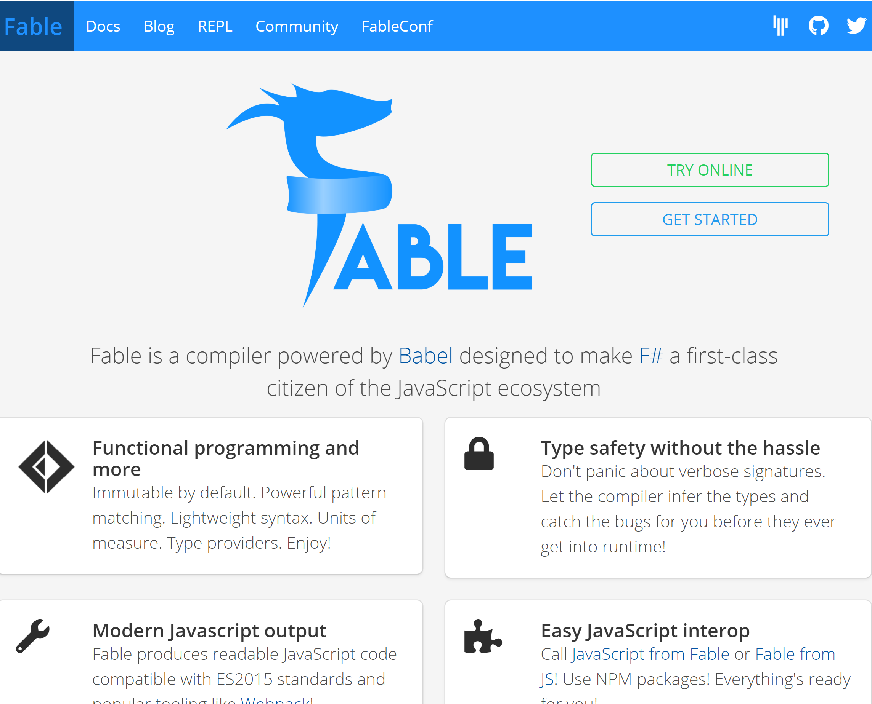

Slide 8
F# and .NET Core (Linux, OSX, Windows) dotnet new -lang F# dotnet build docs.microsoft.com/dotnet/core/

Slide 9
But how did we get here? How did the F# community get created and how does it work?

Slide 10
The Early History of F# - HOPL IV (2020) fsharp.org/history

Slide 11
Technique #1 The Community at the Centre of the Technology The F# Pivot of 2013 - From Proprietary to Open

Slide 12

Old think…

Slide 13



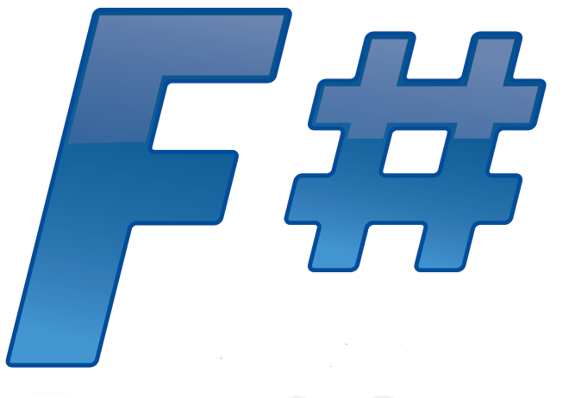





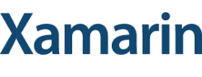



New think…
Visual Studio, .
.NET, SDKs, Tools
…
Visual F# Tools
F# Language
F# Open Source
Group
tryfsharp.org
F# Software
Foundation
F# Community
Groups
fpish.net
tryfs.org
fssnip.net
tryfs.org
fsharpforfunandprofit.com
Xamarin Studio

Slide 14
Technique #2 The Community at the Centre of Design & Implementation Suggestions: github.com/fsharp/fslang-design Designs github.com/fsharp/fslang-suggestions Implementation github.com/dotnet/fsharp

Slide 15
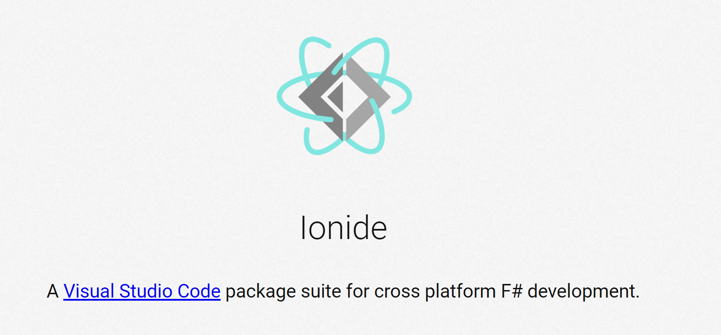
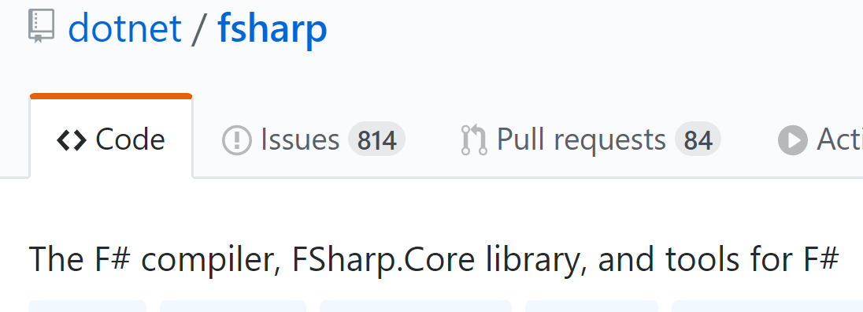
Technique #3 The Community at the Centre of Tooling

Slide 16
Technique #4 A Foundation at the Centre of the Community… …that embodies the ethics and spirit of the community and represents its interests positively http://foundation.fsharp.org

Slide 17
The Genesis of the F# Software Foundation, 2014 Houston, we have a problem. But what sort of problem exactly? And what would a solution look like?

Slide 18
The principles of founding the FSSF
Open, worldwide, free membership, social media, education focus
Every base technology needs a social organization that acts in its interests.
Companies struggle to provide a voice strong enough for a base technology today. They can contribute but won’t succeed alone.
Let’s shift F# to where we want to be, not where we are.
Let’s embrace both commercial and non-commercial. Be a DMZ.
Let’s solve our weaknesses (e.g. cross-platform, open-source). If we’re not perfectly XYZ, work on it. It’s painful, but do it.
Self-consistency and an empowered user base are more valuable than sheer size in the long run.

Slide 19

The Genesis of the F# Software Foundation, 2014 Houston, we have a problem. But what sort of problem exactly? And what would a solution look like?

Slide 20
Technique #5 The Community at the Centre of Incubation http://fsprojects.github.io and much more Balancing trust, consistency and innovation

Slide 21
Technique #6 The Community owns the Message The core message about F# is decided by the community Microsoft is part of the community, so are many other interests F# Conferences are F# Events run by the F# Community

Slide 22
Marketing Matters! You can help “market” F# every day. Social Proof really, really matters. Write a testimonial today for fsharp.org/testimonials. Spread positive, authentic, honest messages When spreading negative messages, be constructive. Please don’t do it for the clicks and likes.

Slide 23
Technique #7 Balance the Forces in the Community Communities are a balance of interests and forces There need to be truly neutral zones Commercial interests are important but must not dominate Respect the “neutrality” of F# community zones Understand the many points of view. Ask to understand.

Slide 24
So, what is Independence? What kind of independence should we seek for F#? What should we avoid? What kind of dependence should we accept for F#? What should we avoid?

Slide 25
What is Independence? Existential Independence Cognitive Independence Memetic Independence Technical Independence Social Independence Complete Independence

Slide 26
Cognitive Independence When a technology A can be understood and used without knowing technology B Example: ASP.NET Core and Giraffe

Slide 27
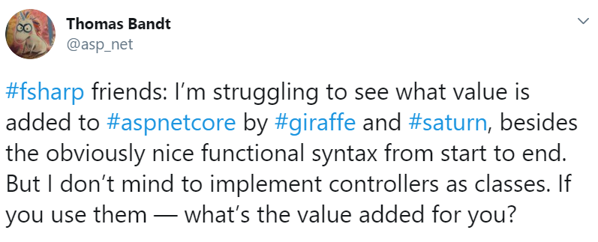
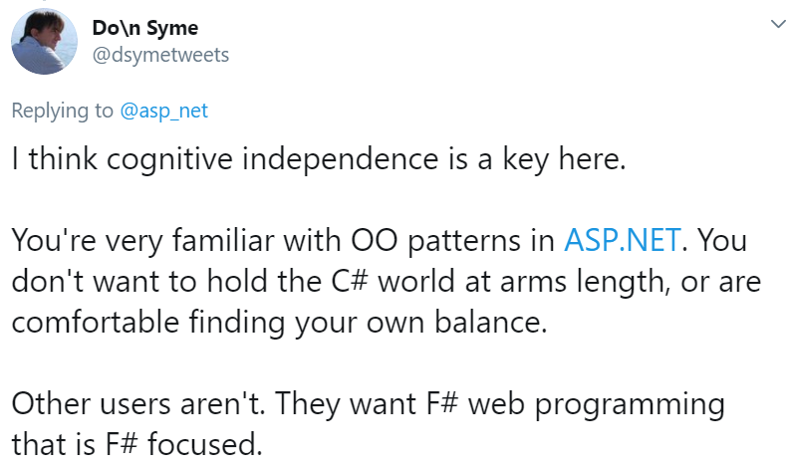

Slide 28
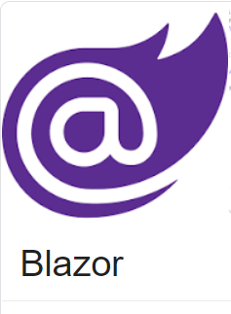
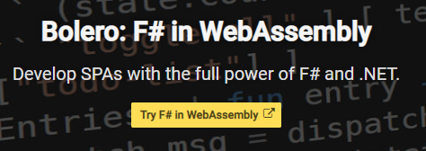
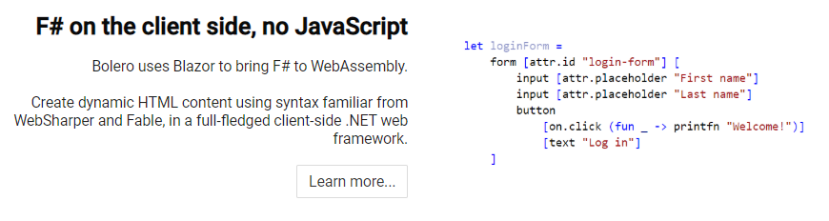
Example: I love F# Bolero, but dislike C# Blazor. How can that be?

Slide 29
Cognitive independence does NOT mean using only functional programming everywhere F# is functional-first, not “purely functional”. F# has object programming and dot notation for a reason. Use it!

Slide 30
F# users thrive on programming experiences which offer “sweet spot” of cognitive independence and interoperability - do not need to think in C# - do not drive you into corners that don’t work - good examples in F#, not C#

Slide 31
Examine yourself Am I helping to make F# cognitively independent from C#? Am I helping to make F# cognitively independent from Haskell? Be part of the solution, not part of the problem

Slide 32
Memetic Independence When a technology can be virally communicated as an idea independently of other technologies, associations or vested interests

Slide 33
Does Visual Basic have memetic independence? No Does F# have memetic independence? It comes and goes!!!! Do .NET and C# have memetic independence? Your challenge

Slide 34
.NET, C# and F# need…
Memetic independence.
Communities that are worth being a part of.
Communities with strong, positive voices of their own.
Communities that can include people and companies who are not aligned to commercial interests.
Communities with generational renewal. A place for 20-year olds. 18 year olds. 16 year olds.

Slide 35
Independence and OSS Projects

Slide 36
Ask yourself the hard questions!
My OSS project needs dependencies, but which ones?
Is my project too complex for others to maintain? If so, does it deserve to exist? Can I improve this?
Is my OSS project existentially dependent on me? Am I working to improve this?
2nd maintainers and publishers
Backup maintainers and key holders
Fully documented build+publish processes

Slide 37
The Great Challenge for .NET, C# and F# = The right kinds of independence + Quality engineering = Goodness
Dependence
Independence

Slide 38
Thanks!

Slide 39
Please, get involved in the core technologies programming languages runtimes frameworks Invent, Create, Initiate, Lead, Contribute, Collaborate, Govern, Sustain

Slide 40
F# 4.0 ✔ True shift to cross-platform open engineering ✔ Long laundry list of language items ✔ Normalized core library ✔ Type providers more powerful ✔ Better debugging, tooling, performance ✔ ~20% compiler perf improvement
https://github.com/fsharp/fslang-design/tree/master/FSharp-4.0

Slide 41
F# 4.1 ✔ Optional large scope cycles more on this later) ✔ Result<T,Error> in standard library ✔ Unboxed (struct) tuples ✔ Unboxed (struct) records ✔ Unboxed (struct) unions ✔ More bits and pieces
https://github.com/fsharp/fslang-design/tree/master/FSharp-4.1

Slide 42
F# 4.5 ✔ Span<T> high perf type-safe non-allocating code ✔ Improved async debugging ✔ More bits and pieces
https://github.com/fsharp/fslang-design/tree/master/FSharp-4.5

Slide 43
F# 4.6 ✔ Anonymous records ✔ More bits and pieces
https://github.com/fsharp/fslang-design/tree/master/FSharp-4.5

Slide 44
F# 4.7 ✔ Wildcard self identifiers ✔ Implicit yields ✔ Indentation syntax relaxations
https://github.com/fsharp/fslang-design/tree/master/FSharp-4.7

Slide 45
F# 5.x (preview) ✔ nameof operator ✔ support let! … and! for applicatives ✔ open static classes ✔ witness passing for quotations ✔ default interface members ✔ nullable interop ✔ slicing improvements ✔ string interpolation ✔ extension members for constraints
https://github.com/fsharp/fslang-design/tree/master/preview

