Slide 1
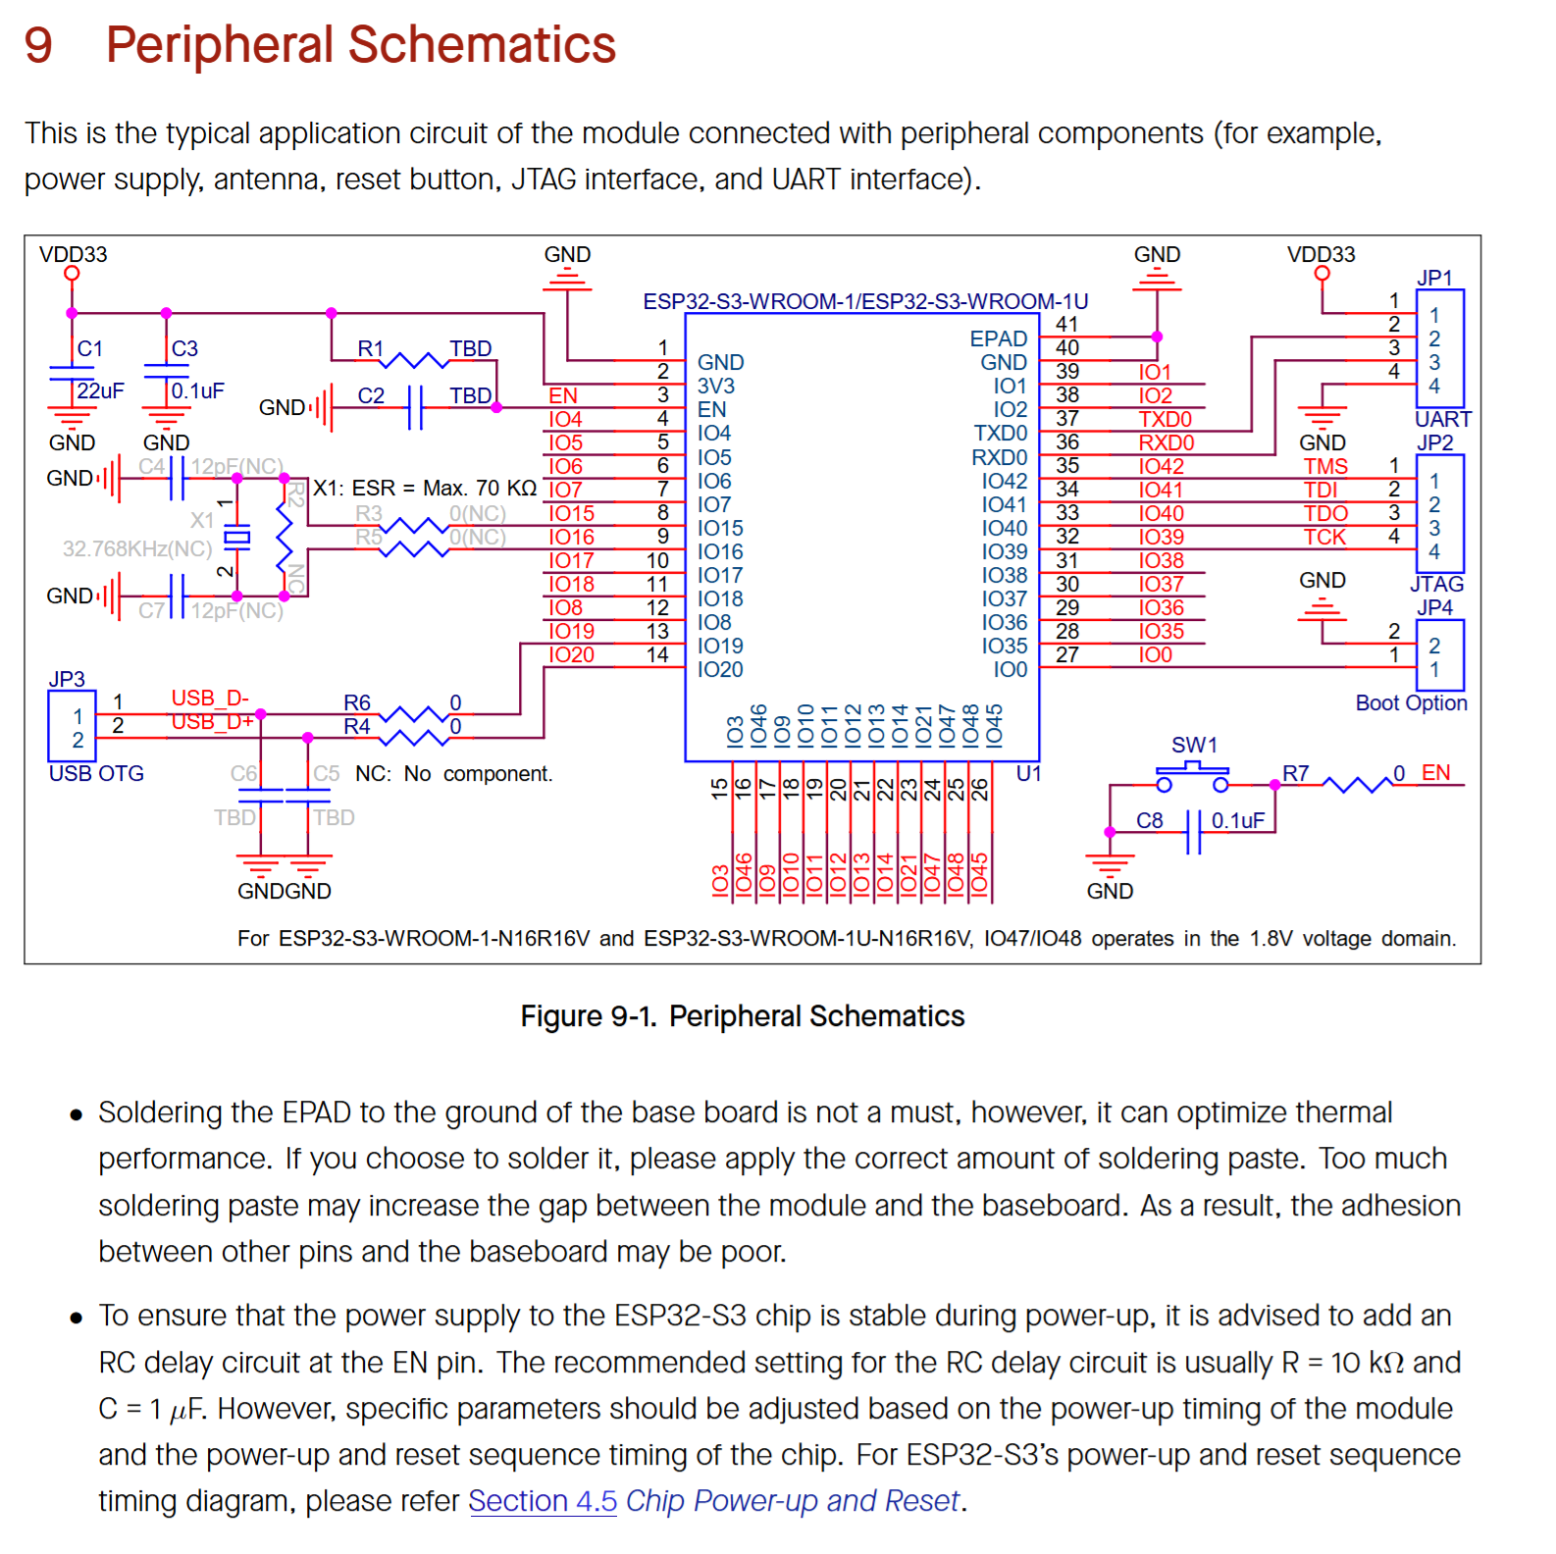
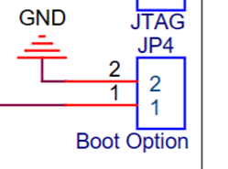
Additional programming interface
USB for programming
Reset Option
Include this circuit to reset the microcontroller via button

