Slide 1
supply CHAIN MANAGEMENT
An Integrated Solution for Product, Order, and Supplier Management

Slide 2
OVERVIEW
Purpose:
Streamline inventory management, order processing, supplier coordination, and demand forecasting.
Key Features:
Supplier Network Management
Product and Inventory Management
Demand Forecasting and Analysis
Order Processing
Delivery Scheduling

Slide 3

supplier network management

Slide 4
overview
Supplier Management
Add Supplier: Allows for adding new suppliers to the system with details such as supplier ID, name, and region.
List Suppliers: Provides a list of all suppliers in the network.
Remove Supplier: Allows removing suppliers from the system
Update Supplier Info: Allows updating Info of a particular supplier
Supplier Relationships
Add Relationship: Establishes relationships between suppliers with a defined weight, representing the cost or distance between them.
List Supplier Hierarchy: Organizes and lists suppliers based on their regions, forming a hierarchical structure.
Finding Suppliers by Region: Lists out all the suppliers in a particular region
List Supplier’s Products: Lists out all the products of a particular supplier
Calculate Supplier Importance : Finds the numbers of connections to a particular supplier

Slide 5
Overview
Graph-Based Analysis
Custom Graph: Utilizes a graph data structure to represent supplier relationships, enabling advanced queries and analyses.
Shortest Path: Finds the shortest path between two suppliers, useful for optimizing logistics and reducing costs.
All Paths: Finds all possible paths between two suppliers, providing insights into multiple routes and redundancies in the supply chain.
Find Nearest Supplier : Finds the nearest supplier for a particular supplier

Slide 6
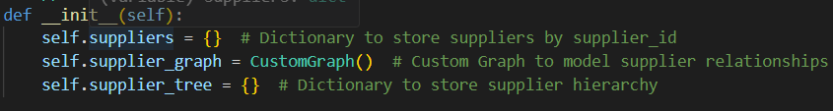
Data Structures used
Hierarchical Dictionary (self.supplier_tree):
Represents the hierarchical structure of suppliers based on their regions.
Allows for quick access to suppliers within a specific region.
Dictionary (self.suppliers):
Used to store suppliers by their unique supplier IDs.
Provides constant-time access to individual suppliers
Custom Graph (self.supplier_graph):
Implemented using an adjacency list representation (self.graph).
Models the relationships and connections between suppliers.
Utilizes efficient algorithms like Dijkstra's algorithm and depth-first search (DFS).

Slide 7
TIME Complexity analysis
O(1) -> Dictionary Lookups has constant time
add_supplier(self, supplier),
add_supplier_relationship(self, supplier_id1, supplier_id2, weight)
list_supplier_hierarchy(self) -> return the ‘supplier_tree’ dictionary
calculate_supplier_importance(self, supplier_id)
list_supplier_hierarchy(self)
O(n) -> Iterating over a list
list_suppliers(self)
remove_supplier(self, supplier_id)
update_supplier_info(self, supplier_id, name=None, region=None)
find_suppliers_by_region(self, region)
list_supplier_products(self, supplier_id)

Slide 8
TIME Complexity Analysis
Find_shortest_path -- O(V + E log V)
where V is the number of vertices (suppliers) and E is the number of edges (relationships) using Dijkstra's algorithm.
Find_all_paths -- O(V!)
O(V!) in the worst case, where V is the number of vertices. This is because the algorithm explores all possible paths between two nodes.
Find_nearest_supplier -- O(V * (V + E log V))
In the worst case if it needs to check all suppliers using Dijkstra's algorithm for each supplier in the specified region.

Slide 9
Space Complexity analysis
O(1) -> As all functions take only a reference to existing lists,dictionary,tuples…
add_supplier(self, supplier),
add_supplier_relationship(self, supplier_id1, supplier_id2, weight)
list_supplier_hierarchy(self)
calculate_supplier_importance(self, supplier_id)
list_supplier_hierarchy(self)
remove_supplier(self, supplier_id)
update_supplier_info(self, supplier_id, name=None, region=None)
find_suppliers_by_region(self, region)
O(n) -> returns a list
list_suppliers(self)
list_supplier_products(self, supplier_id)

Slide 10
space Complexity Analysis
Find_shortest_path -- O(V)
for the min-heap and distance dictionary.
Find_all_paths -- O(V)
for the recursion stack.
Find_nearest_supplier -- O(V )
for the min-heap and distance dictionary for each Dijkstra's run.

Slide 11
Product and inventory management

Slide 12
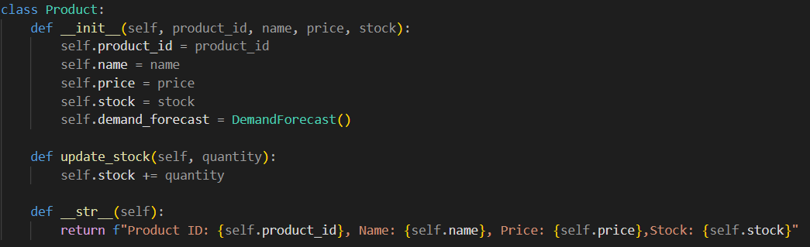
Class product

Slide 13
Class inventory
The Inventory class manages collection of products, tracking their stock levels, handling recent transactions, and provides demand forecasting features. It uses various custom data structures to efficiently manage and track inventory details.
Attributes-
Products
low_stock_heap
transaction_stack
product_list

Slide 14
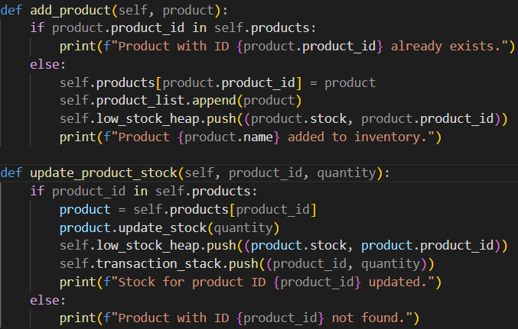
Class inventory
Functions Used-
add_product
Time Complexity-O(log n)
Space Complexity-O(1)
update_product_stock
Time Complexity-O(log n)
Space Complexity-O(1)
get_product_info
Time Complexity-O(1)
Space Complexity-O(1)

Slide 15
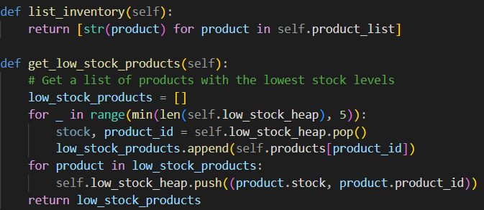
Class inventory
Functions Used(Contd)-
list_inventory
Time Complexity-O(n)
Space Complexity-O(n)
get_low_stock_products
Time Complexity-O(log n)
Space Complexity-O(1)
get_recent_transactions
Time Complexity-O(1)
Space Complexity-O(1)

Slide 16
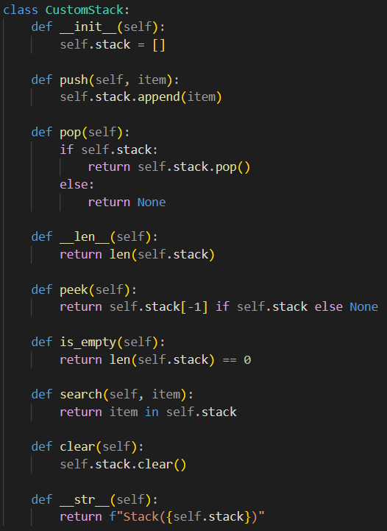
Class inventory-data structures
Data Structures –
Stack
Priority Queue
Double Ended Queue
Stack Functions -
search
Time Complexity-O(n)
Space Complexity-O(1)
__str__
Time Complexity-O(n)
Space Complexity-O(n)

Slide 17
DEMAND FORECASTING AND ANALYSIS

Slide 18
Class inventory
Intialization
Products : This is a dictionary used to store products with key as their product id.
Low_stock_heap: This is a PriorityQueue to track products with low stocks.
Transaction_stack:This is a Stack used for tracking latest transactions.
Product_list:This is a list to store products.
Functions Used
record_demand
forecast_demand
calculate_trend
calculate_moving_average
calculate_exponential_smoothing
calculate_seasonal_index
forecast_with_trend_and_seasonality

Slide 19
Functions and complexities
record_demand
Basically this function is to address the demand of the product
It first checks whether the product exists or not
Then it retrieves that product from products dictioanary
Then it add demands
TIME COMPLEXITY:
It take O(1) time complexity

Slide 20
Functions and complexities
Forecast_demand
This function is basically forecasting the demand
Initially it checks whether the product exists or not
Then it returns the forecast_demand
In forecast_demand we divide total demand by number of entries
Time Complexity:
In this the time complexity is O(1)

Slide 21
Functions and complexities
Calculate_trend
This function basically caluculates the trend of given product
We retrieve product from id
Then we use calculate_trend()
In this calculate trend we subract latest demand history to the oldest one
TIME COMPLEXITY:
Here we don’t iterated through anything , just initializing and subtraction operation
So it takes O(1) time complextity

Slide 22
Functions and complexities
calculate_moving_average
Here we do the same as previous
We retrieve the product from product id
Then we use function moving averger from demand forest
Demand forest uses a division operation,it returns total demand/num of entries
TIME COMPLEXITY:
It takes O(1) time complexity as it is assignment and division operation only
SPACE COMPLEXITY:
O(1) as we are not using any additional space and only division operation happening.

Slide 23
Functions and complexities
calculate_exponential_smoothing
Here we do the same as previous
We retrieve the product from product id
Then we use function exponential smoothing from demand forest

Slide 24
Functions and complexities
calculate_seasonal_index
In this we make find product
Then we use function of demand product
We make a list of length window size
We store recent seasonal indexes
TIME COMPLEXITY:
It takes O(n) time as we are iterationg through the window for seasonal indexes
SPACE COMPLEXITY:
It takes O(n) space complexity

Slide 25
Functions and complexities
forecast_with_trend_and_seasonality
Similar to previous , we find products from products list
Then we use function in demand process forecast_with_trend_and_seasonability()
This function finds forecast trend with seasonability
TIME_COMPLEXITY:
It takes O(n) time complexity
SPACE_COMPLEXITY:
This takes O(n) time complexity as we are using forecast list

Slide 26
ORDER PROCESSING

Slide 27
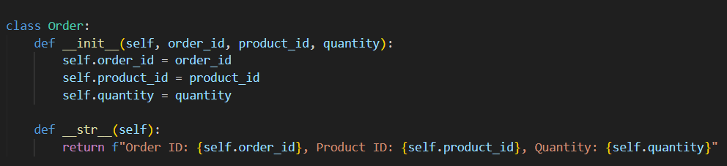
Class order
__init__ Method: This is the constructor method that initializes an order object with three attributes: order_id: A unique identifier for the order. product_id: The identifier for the product being ordered. quantity: The quantity of the product being ordered. __str__ Method: This method provides a string representation of the order object. This is useful for printing the order details in a readable format.

Slide 28
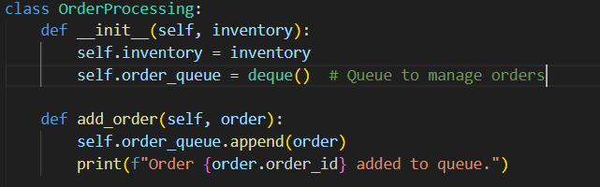
Class order Processing
__init__ Method: Initializes the order processing system with two attributes: inventory: An instance of the Inventory class, which manages product stock. order_queue: A double-ended queue (deque) to store orders in a FIFO (First In, First Out) manner. add_order Method: This method adds an order to the queue. Time Complexity: O(1), as appending to a deque is an O(1) operation.

Slide 29
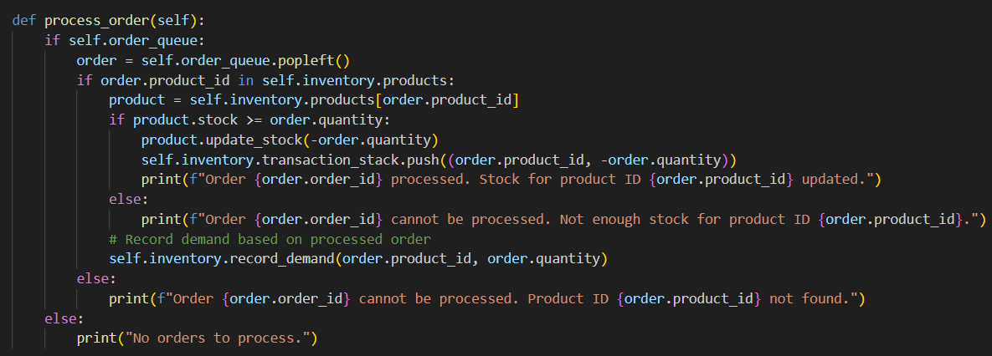
process_order Method: Processes the first order in the queue. Steps: Check if Queue is Not Empty: If the queue is empty, print a message and exit. Dequeue the Order: Remove the first order from the queue. Check Product Availability: If the product ID exists in the inventory: Retrieve the product. Check if the stock is sufficient. If yes, update the stock, log the transaction, and print a success message. If no, print a message indicating insufficient stock. Record the demand for the processed order. If Product Not Found: Print a message indicating that the product ID was not found.

Slide 30
Time Complexity: O(1) for dequeuing and recording demand, but O(n) for updating stock in the heap (where n is the number of products).

Slide 31

list_orders Method: Returns a list of string representations of all orders in the queue. Time Complexity: O(n), where n is the number of orders, as it iterates through the queue.

Slide 32
Data Structures Used deque: Usage: order_queue to manage the order queue. Operations: append(order): O(1) - Add order to the queue. popleft(): O(1) - Remove order from the front of the queue. Benefits: Efficient for FIFO operations, where both appending and popping from the left are O(1). Inventory:

Slide 33
delivery SCHEDULING

Slide 34
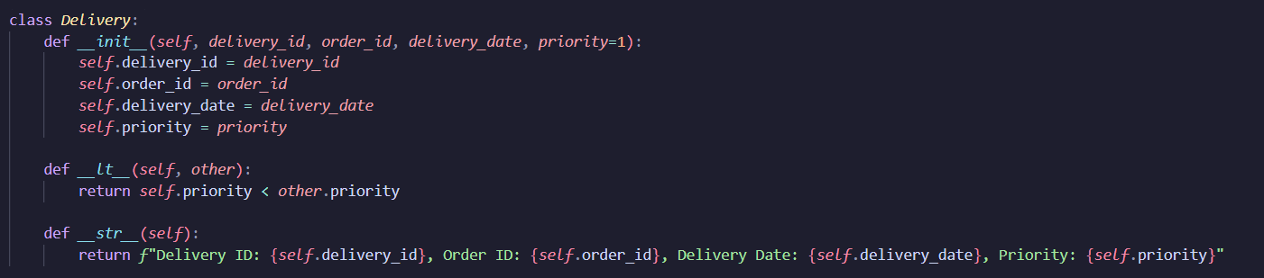
Class delivery
The Delivery class defines individual deliveries with attributes like deliveryid, ordered, delivery date and priority.
Functions used:
__lt__
Time Complexity : O(1)
Space Complexity: O(n)
__str___
Time Complexity : O(1)
Space Complexity: O(n)

Slide 35
Class delivery schedule
The DeliverySchedule class manages a collection of deliveries using a custom priority queue.
Manages delivery schedules using a priority queue.
Supports scheduling deliveries, retrieving the next delivery, removing deliveries, and updating delivery times.
In class Delivery and DeliverySchedule the data structures used are,
Custom Priority Queue: It is the primary data structure used in DeliverySchedule class. It ensures that deliveries are processed based on their priority.
Heapq: The priority queue operations are supported by Python's heapq module, which provides efficient push and pop operations.

Slide 36
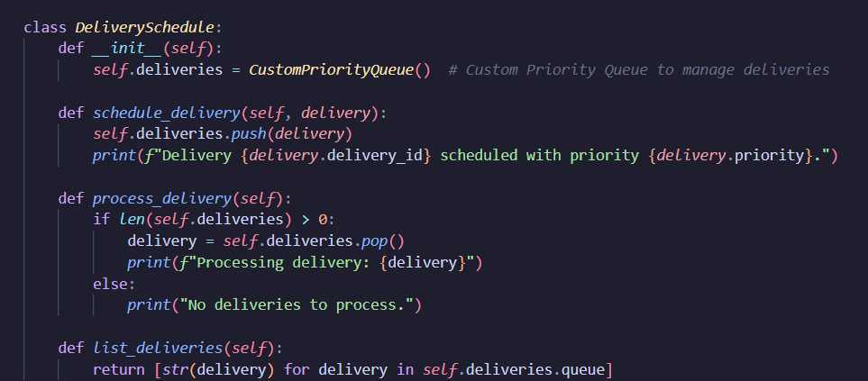
Class delivery schedule
Schedule delivery:
Time Complexity : O(logn)
Space Complexity: O(1)
Process delivery:
Time Complexity : O(logn)
Space Complexity: O(1)
List_deliveries:
Time Complexity : O(n)
Space Complexity: O(n)

Slide 37
Class delivery schedule-Data structures
Custom Priority Queue
Implements a priority queue for efficiently managing elements based on priority. Supports adding, removing, and updating elements, along with standard queue operations.
Attributes:
Push
Pop
Len
Peek
Remove
Getallitems
Update_priority
__str__

Slide 38
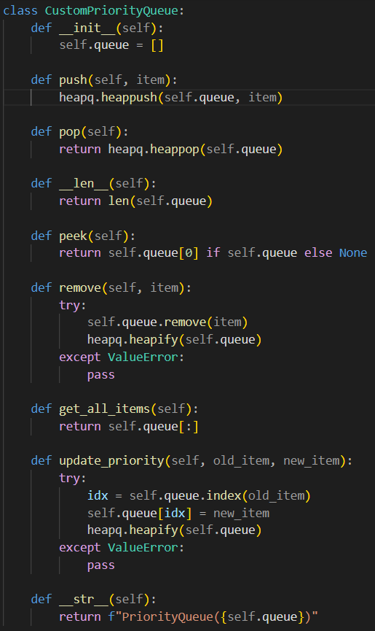
Class delivery schedule-Data structures
Complexities
Push and pop:
Time Complexity : O(logn)
Space Complexity: O(1)
Len and peek:
Time Complexity : O(1)
Space Complexity: O(1)
Remove,getallitems and __str__:
Time Complexity : O(n)
Space Complexity: O(n)

Slide 39

Thank you
Kabilan M D
Hari Prasaath S B
Sai Krishna Digvijay Chowdary
Sai Krishna
Adithyan

