Slide 1
Day 2: VERILOG & AI Acceleration
Skill Integration • FSM Design • Transformer Engine

Slide 2
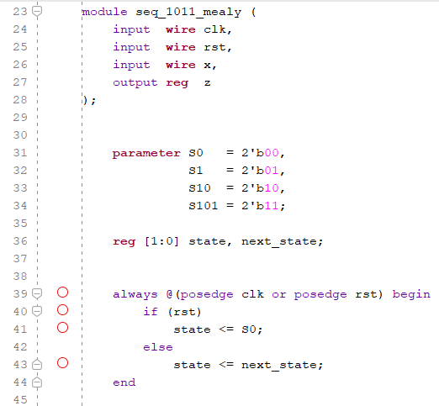
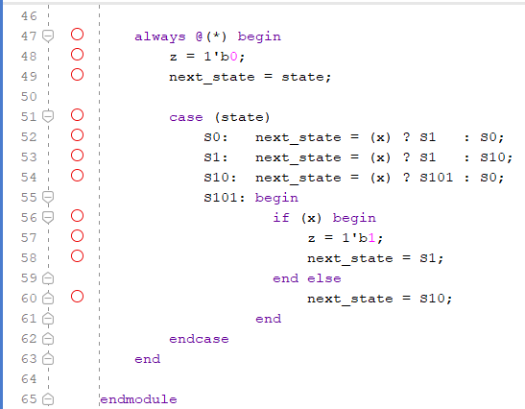
FSM Design: Mealy vs Moore
Code for mealy:

Slide 3
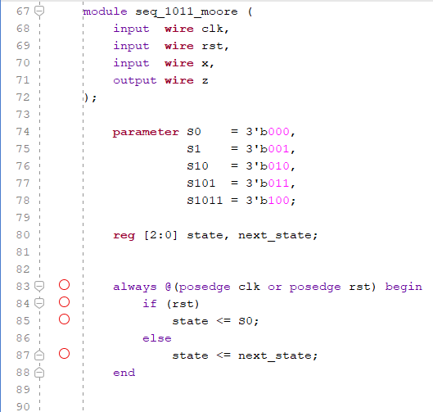
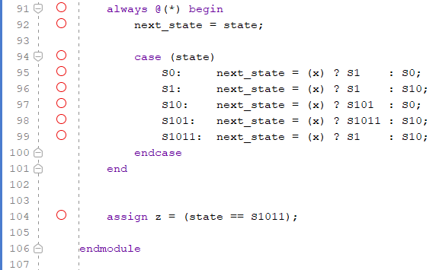
FSM Design: Mealy vs Moore
Code for moore:

Slide 4
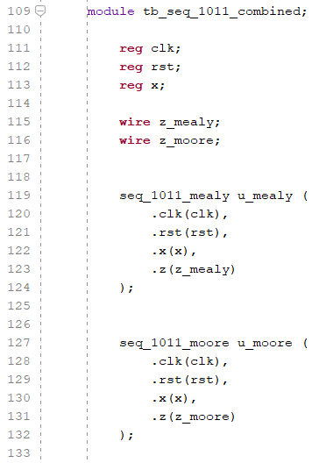
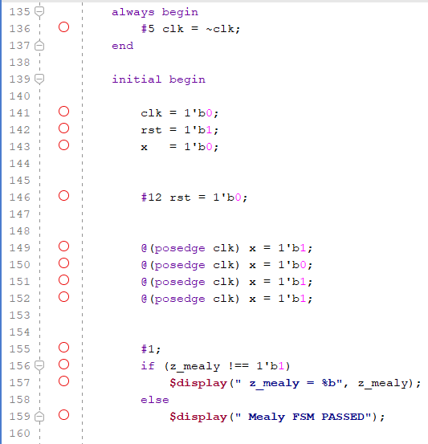
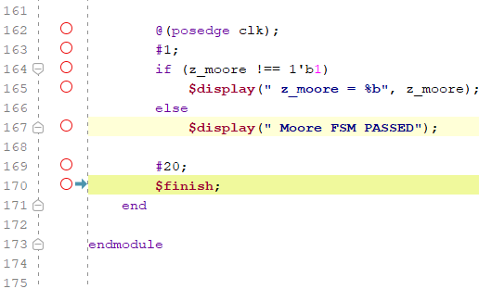
FSM Design: Mealy vs Moore
Testbench:

Slide 5
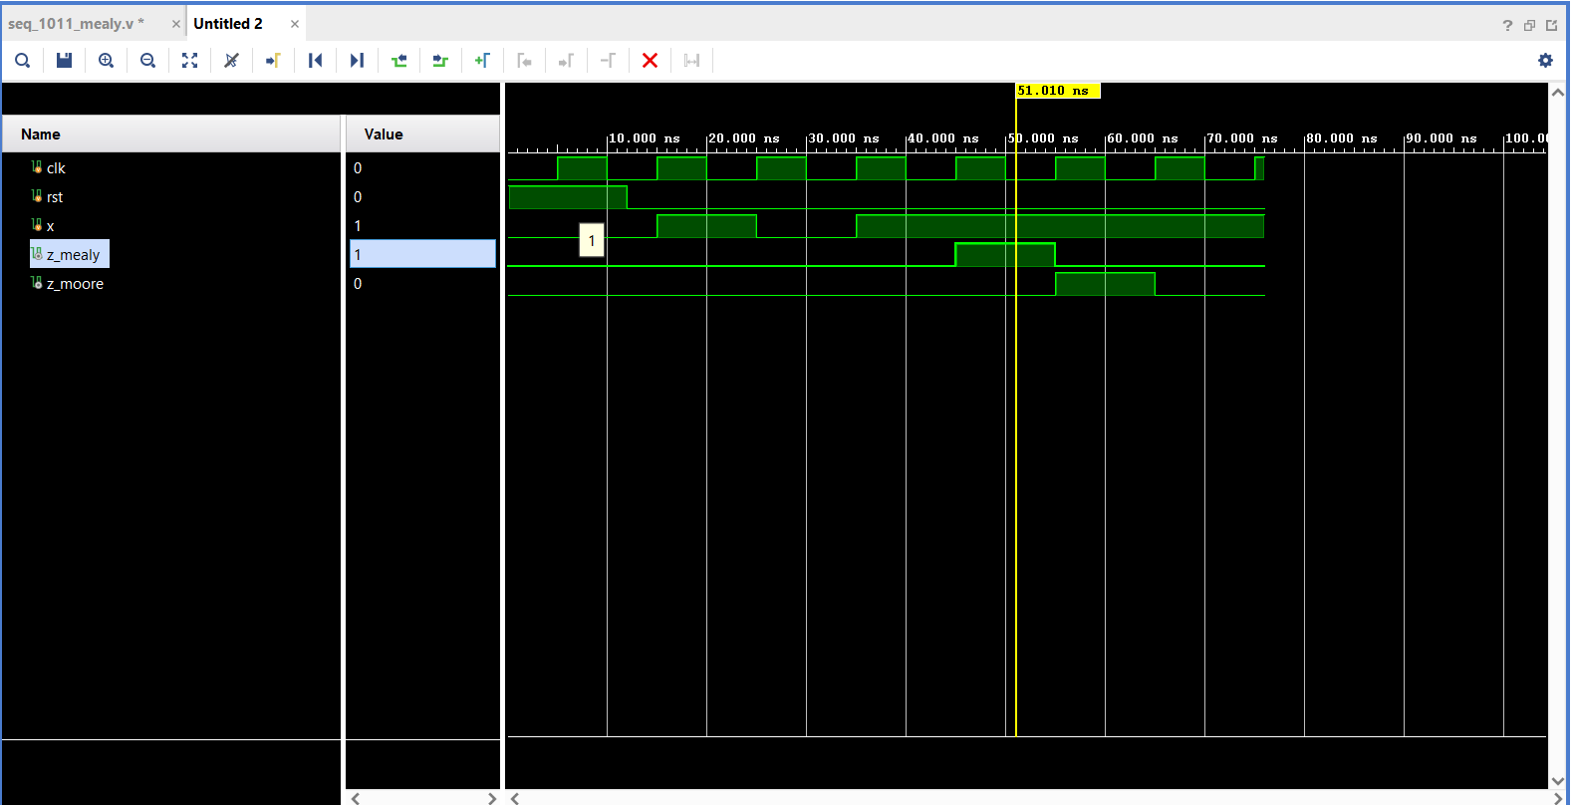
FSM Design: Mealy vs Moore
Simulation result:
In the Mealy FSM, the output depends on the current state and input, so z_mealy is asserted in the same clock cycle when the final 1 arrives.
In the Moore FSM, the output depends only on the state, so z_moore is asserted one clock later, after the FSM enters the final state.
Mealy FSM responds faster but Moore FSM provides cleaner and safer timing.

Slide 6
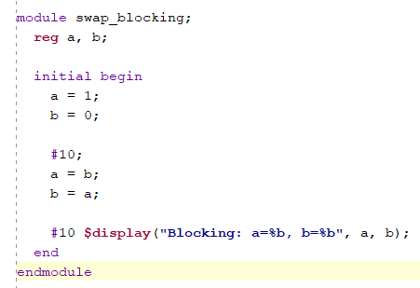
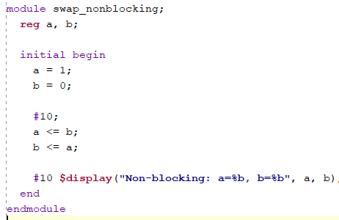
Blocking vs Non‑Blocking
Blocking: in blocking assignment after #10 time units
a becomes 0 immediately and b gets the new value
of a
Non-blocking : in non-blocking assignment after #10 time units
a becomes 0 immediately and b will become 1 that
is the old value of a

Slide 7
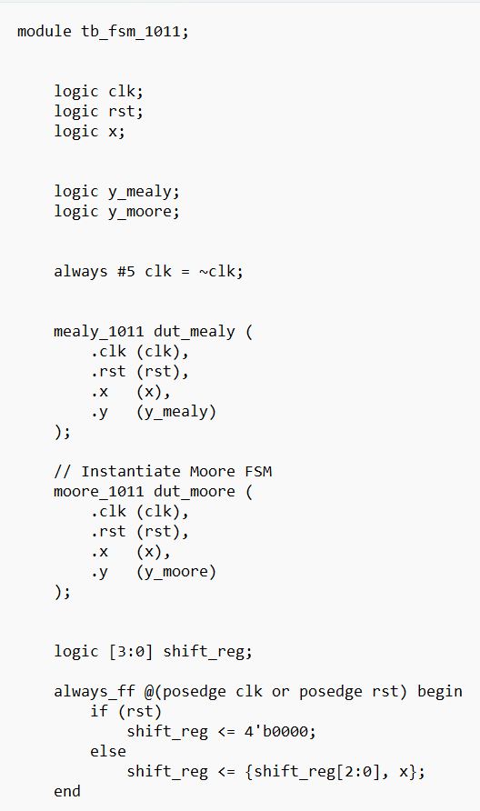
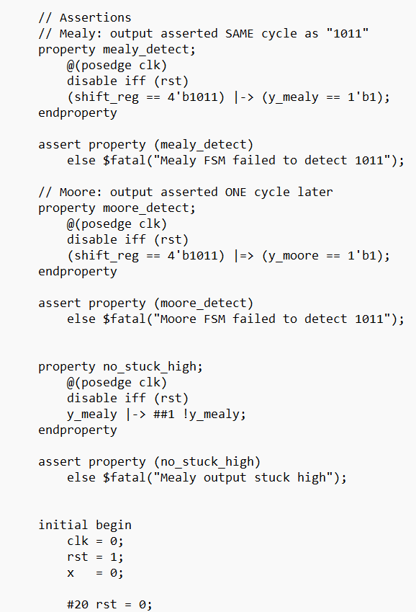
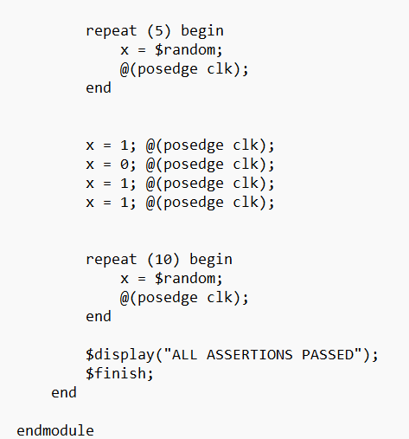
Self Checking Testbench
Systemverilog code : self-checking testbench implemented using concurrent assertions and golden reference model , enabling automatic pass/fail detection without manual waveform inspection

Slide 8
Timing Concepts
Single- cycle path
Entire operation completes in one clock
Fast but limits complexity
Multi- cycle path
Operation spread over multiple cycles
Allows slower logic
False path
Path that never toggles during real operation
Must be constrained to avoid over-optimization
Reducing Critical path delay
Pipelining
Retiming
Logic reconstructing
Register balancing

Slide 9
Transformer Engine
NVIDIA Transformer Engine is a high-performance library designed to accelerate Transformer-based deep learning models using FP8 mixed-precision arithmetic. It dynamically manages precision to improve performance and reduce memory usage while maintaining model accuracy.
Transformers are compute and memory intensive. FP8 significantly reduces bandwidth and storage requirements, enabling faster training and inference on modern GPUs
NVIDIA Transformer Engine
• Full FP8 support on Hopper (H100)
• Enabled using fp8_autocast in PyTorch
• Hardware‑aware software design
• Pipelining vs FP8 precision
• Timing closure vs performance tuning
• Same optimization mindset

Slide 10
Hardware & Software Link
Transformer engine is a hardware-software co-design
Full FP8 support requires NVDIA Hopper architecture GPUs eg:H100
Earlier architecture's (eg:Ampere ) can use parts of TE , does not support native FP8 Tensor core execution
Hopper is essential because Hopper GPUs introduce FP8 Tensor cores without this hardware ,FP8 cannot deliver its promised performance or stability
Te’s exists because Hopper GPUs were explicitly designed to support low-precision AI athematic efficiently

Slide 11
VLSI ↔ AI Optimization Parallel
NVIDIA’s Transformer Engine(TE) and efficient VHDL design pursue the same fundamental goals that is to reduce critical path delay , minimize data movement and use resources only where they add real value
TE achieves this through FP8 precision and hardware-software co-design , while VHDL designers achieve it by reducing critical path delay , optimizing bit-widths , and efficient pipelining .
In both cases performance comes from simplifying Datapath's without compromising functional correctness
One find: Transformer Engine decides between E4M3 and E5M2 by monitoring runtime tensor statistics and dynamically scaling values ;it uses higher-precision format when range is large and switches to precision optimized formats when values are well-bounded ,ensuring performance gains without sacrificing convergence

