Slide 1
DATA ANALYTICS CAPSTONE
Healthcare Infrastructure Gap Index (HIGI)
An AI-Assisted Decision Support Framework for District-Level Healthcare Infrastructure Prioritization in India
Anirudh Harathi
Mentor: Mr. Kartik Umesh Sharma

Slide 2
Executive Summary
OBJ
Objective
Develop a district-level, data-driven framework to measure healthcare infrastructure gaps and support prioritization across India.
DATA
Data
Integrated RHS, Census of India 2011, and NFHS-5 data covering 488 districts and 18 variables.
APP
Approach
Constructed the Healthcare Infrastructure Gap Index (HIGI), profiled districts with K-Means, and built an AI-assisted Random Forest prioritization model.
RES
Key Results
HIGI ranged 0.0861–0.9765; Random Forest achieved R² = 0.7092, MAE = 0.0524; three district profiles identified with moderate cluster separation.
USE
Usage
HIGI, district profiles, and AI-assisted rankings provide complementary evidence for planning, while retaining expert and policy judgement.
The framework converts fragmented district-level data into multiple evidence-based views for healthcare infrastructure prioritization.
Healthcare Infrastructure Gap Index (HIGI)
2

Slide 3
Gap Analysis
Multiple Dimensions
Fragmented Datasets
Challenge
Study Contribution
Healthcare infrastructure
Population & demographics
Health outcomes
RHS
Census 2011
NFHS-5
Different scales/structures
Hard to compare districts
Multidimensional gaps
HIGI
District Profiling
AI-assisted Ranking
IDENTIFIED GAP
Need for an integrated, district-level analytical framework that combines infrastructure measurement with statistical analysis and machine learning to support prioritization.
STUDY CONTRIBUTION
HIGI + District Profiling + AI-Assisted Ranking
The study combines these three complementary perspectives to inform decisions — rather than replacing policy judgement.
Healthcare Infrastructure Gap Index (HIGI)
3

Slide 4
Research Questions
RQ | Research Question | Method | Key Result
RQ1 | Can official district-level datasets be integrated to quantify infrastructure gaps? | Data integration & quality assessment | 488 districts × 18 variables
RQ2 | Can HIGI measure and compare relative infrastructure gaps? | HIGI construction & Spearman correlation | HIGI: 0.0861–0.9765
RQ3 | Can ML identify meaningful district patterns? | K-Means clustering & validation | 3 district profiles
RQ4 | Can AI-assisted prioritization provide a complementary perspective? | Random Forest + OOF predictions + ranking comparison | ρ = 0.653; Top-20 overlap = 10%
Four analytical questions → measurement → district profiling → AI-assisted prioritization
Healthcare Infrastructure Gap Index (HIGI)
4

Slide 5
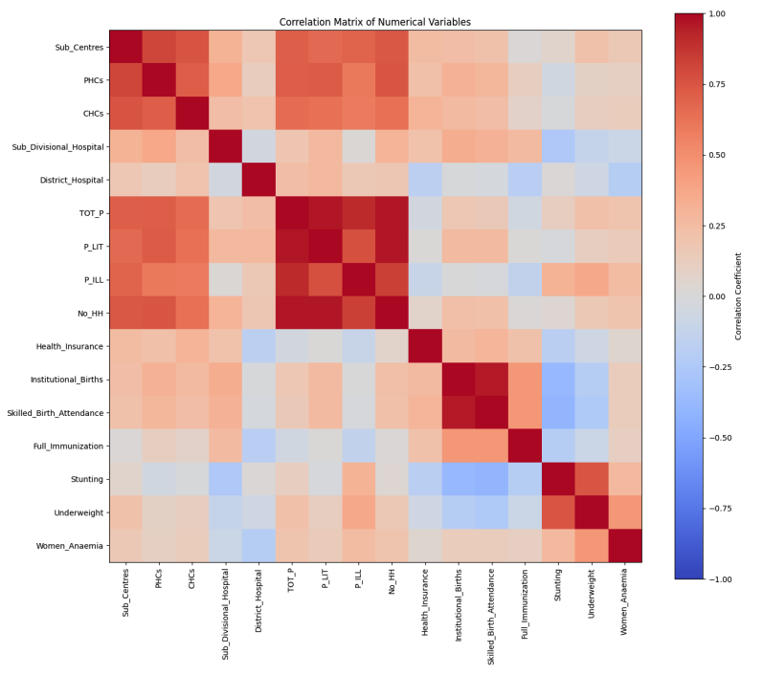
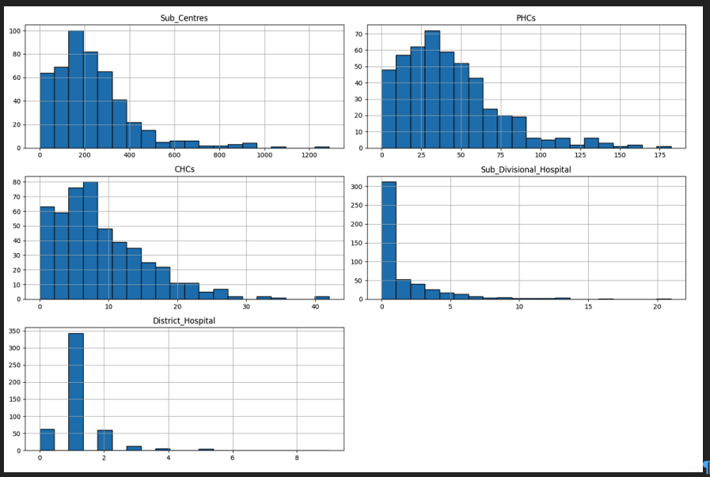
Data Description & EDA
RHS
Census 2011
NFHS-5
488 × 18
Districts × Variables
5 healthcare infrastructure indicators
4 demographic indicators
7 health indicators
Distribution of Healthcare Infrastructure Variables
Correlation Matrix
Infrastructure availability varies substantially across districts, with positively skewed distributions across facility types.
Shading reflects relative association strength.
Infrastructure variables show strong internal relationships and meaningful associations with demographic and health indicators. HIGI ↔ Health Insurance: ρ = −0.348 (moderate negative association).
DATA QUALITY
No missing infrastructure or demographic values
11 missing observations
Full Immunization: 9 · Stunting: 1 · Underweight: 1
KEY TAKEAWAY: Substantial variation in healthcare infrastructure, meaningful cross-variable relationships, and limited missingness support standardized district-level comparison and downstream modelling.
Healthcare Infrastructure Gap Index (HIGI)
5

Slide 6
Architecture diagram/Workflow
RHS
Census 2011
NFHS-5
DATA
INTEGRATION
DATA
CLEANING
EDA
FEATURE
ENGINEERING
3 official data sources
Harmonization • quality checks
Distributions • correlations
Clipping • normalization • HIGI construction
K-MEANS CLUSTERING
RANDOM FOREST
District profiling
HIGI prediction
Cluster Validation
Model Evaluation
Silhouette = 0.2018 • DBI = 1.6442
MAE • RMSE • R²
AI-ASSISTED RANKING
DECISION SUPPORT
Python • Jupyter / Colab • pandas • NumPy • scikit-learn • Matplotlib / Seaborn
Healthcare Infrastructure Gap Index (HIGI)
6

Slide 7
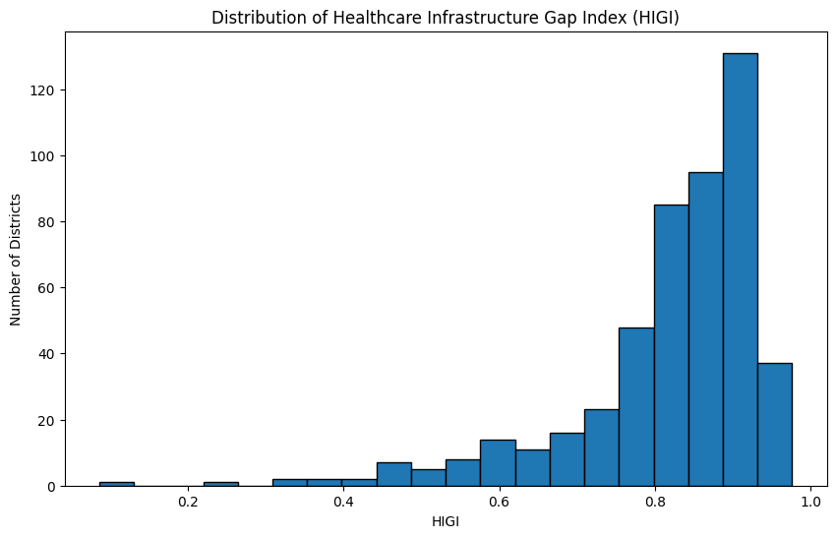
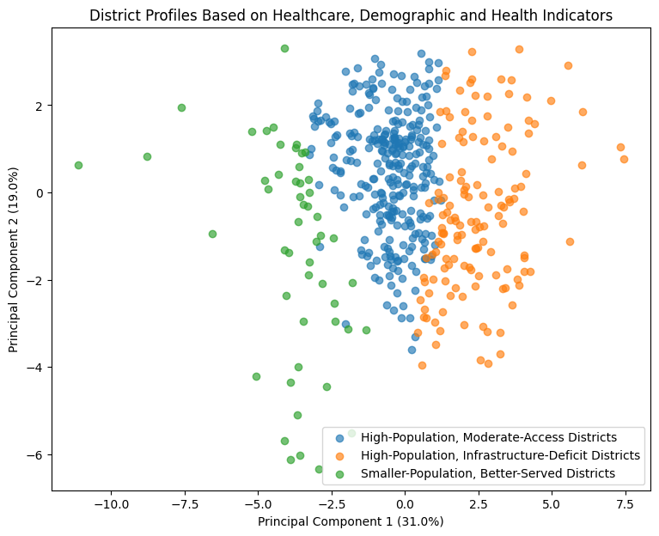
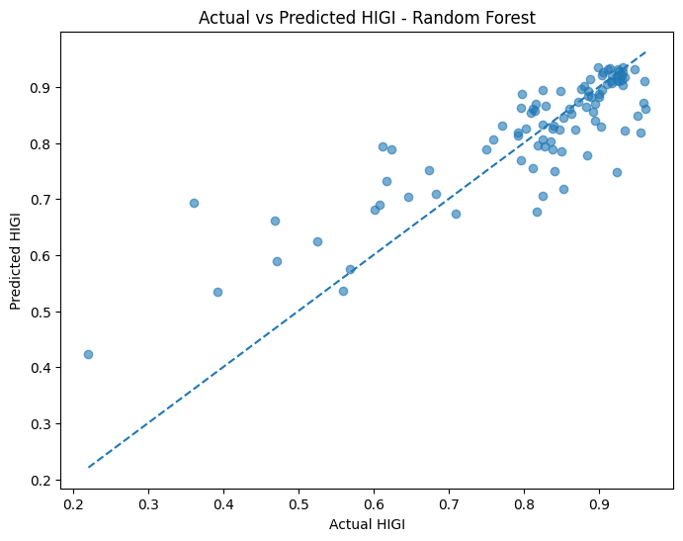
Model Building
1 · HIGI Construction
2 · District Profiling
3 · Predictive Model
Five infrastructure indicators — 20% each:
Sub-Centres / 100k
PHCs / 100k
CHCs / 100k
Sub-Divisional Hospitals / 100k
District Hospitals / 100k
K-Means Clustering
K evaluated: 2–8 → selected K = 3
StandardScaler applied
PCA used only for visualization
Random Forest Regression
Captures non-linear relationships
Handles feature interactions
More robust than a single decision tree
Appropriate for structured/tabular data
1st/99th pct. clipping → Min-Max normalization → Direction reversal → Composite HIGI
Validation
Silhouette = 0.2018
Davies–Bouldin = 1.6442
Higher HIGI = larger relative infrastructure gap
3 interpretable district profiles identified; cluster separation was moderate.
Leakage control: HIGI's five construction indicators excluded from RF predictors.
Why HIGI?
Transparent • Comparable • Population-normalized
Why K-Means?
Unsupervised • Numerical data • Interpretable profiles
Why Random Forest?
Nonlinear relationships • Interaction-aware • Robust for tabular data
Healthcare Infrastructure Gap Index (HIGI)
7

Slide 8
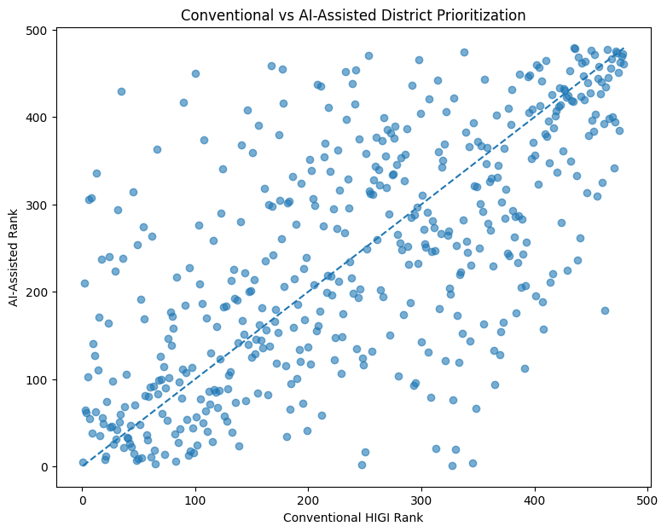
Results
RANDOM FOREST PERFORMANCE
Model | MAE↓ | RMSE↓ | R²↑
Baseline | 0.0990 | 0.1429 | -0.0013
Random Forest | 0.0524 | 0.0770 | 0.7092
Tuned RF | 0.0529 | 0.0773 | 0.7073
ρ = 0.653
Spearman Correlation | Moderate rank agreement
10%
Top-20 overlap
2 / 20
Common top-20 districts
AI-assisted ranking provides a complementary prioritization signal: not a replacement for HIGI.
Healthcare Infrastructure Gap Index (HIGI)
8

Slide 9
Implementation and User Benefit
1
Identify
Use HIGI rankings to identify districts with relatively larger infrastructure gaps.
2
Profile
Use K-Means district profiles to understand differences in population, infrastructure, and health characteristics.
3
Prioritize
Use AI-assisted Random Forest rankings as an additional signal for districts requiring further review.
4
Integrate
Combine analytical outputs with budget, feasibility, local context, and policy priorities.
5
Decide
Provide evidence to policymakers and domain experts while retaining human judgement in final allocation decisions.
EXAMPLE USE CASE
A state health department could screen districts using HIGI, segment them by district profile, and use the AI-assisted ranking to flag districts for deeper feasibility assessment before allocating infrastructure resources.
One District → Multiple Evidence-Based Perspectives → Better-Informed Review
Healthcare Infrastructure Gap Index (HIGI)
9

Slide 10
Conclusion
01
Integration
02
Measurement
Successfully integrated 488 districts × 18 variables from RHS, Census 2011, and NFHS-5.
HIGI provides a standardized measure of relative healthcare infrastructure gaps across districts.
03
Segmentation
04
AI-Assisted Prioritization
K-Means identified 3 district profiles, providing contextual segmentation.
Random Forest achieved R² = 0.7092; AI-assisted ranking showed ρ = 0.653 with only 10% Top-20 overlap.
LIMITATIONS & FUTURE SCOPE
Data are district-level and from different reference periods
Framework excludes real-time and private healthcare infrastructure
Cluster separation is moderate; model shows association, not causation
Future work: newer datasets, HIGI weight sensitivity analysis, feasibility variables, refreshed-data deployment
HIGI should be viewed as a decision-support framework, not an automated allocation system: combining infrastructure gaps, district profiles, and AI-assisted evidence to support expert decision-making.

Slide 11
Bibliography
International Institute for Population Sciences (IIPS), & ICF. (2021). National family health survey (NFHS-5), 2019–21: India. IIPS.
James, G., Witten, D., Hastie, T., & Tibshirani, R. (2021). An introduction to statistical learning: With applications in R (2nd ed.). Springer.
Ministry of Health and Family Welfare. (2022). Rural health statistics 2021–22. Government of India.
Mukherji, A., Rao, M., Desai, S., Subramanian, S. V., Kang, G., & Patel, V. (2024). District-level monitoring of universal health coverage, India. Bulletin of the World Health Organization, 102(9), 630–638B.
Office of the Registrar General & Census Commissioner, India. (2011). Census of India 2011. Government of India.
Organisation for Economic Co-operation and Development, & Joint Research Centre. (2008). Handbook on constructing composite indicators: Methodology and user guide. OECD Publishing.
Russell, S., & Norvig, P. (2021). Artificial intelligence: A modern approach (4th ed.). Pearson.
Sehgal, M., Jatrana, S., & Johnson, L. (2024). A comprehensive health index for India: Development, validation, and spatial variation. Journal of Population Research, 41, Article 21.
Sharda, R., Delen, D., & Turban, E. (2023). Business intelligence, analytics, data science, and AI: A managerial perspective (5th ed.). Pearson.
Sharma, A., Prinja, S., & Aggarwal, A. K. (2017). Measurement of health system performance at district level: A study protocol. Journal of Public Health Research, 6(3), Article 917. https://doi.org/10.4081/jphr.2017.917
Sharma, A., Prinja, S., & Aggarwal, A. K. (2019). Comprehensive measurement of health system performance at district level in India: Generation of a composite index. The International Journal of Health Planning and Management, 34(4), e1783–e1799.
Sivasubramanian, S., & Raval, A. (2025). Artificial intelligence–augmented public health interventions in India. Health Affairs Scholar, 3(5).
Saragadam, S. K., Saragadam, S. H., Kumari, K. S. S., & Kasturi, G. V. K. (2025). Explainable machine learning on health management information system data to unveil health factors affecting maternal mortality ratio of districts in India towards achieving sustainable development goals. Journal of Information Systems Engineering & Management, 10(24s).
Healthcare Infrastructure Gap Index (HIGI)
11

