Slide 1
CENTRALIZATION OF EDUCATIONAL DATA
Student: Haraga Paul-Valentin
Supervisor: Associate Professor Dr. Sanda Avram

Slide 2
Content
Context
The app:
Mobile platform
Web platform
-Future development

Slide 3
Context
The idea behind the whole thesis is to have a digitalized and centralized educational platform. Already most of the educational institutions have done the digitalizing part, but not many have centralized the data.
Here the application developed for this thesis comes in. Through the use of the two platforms developed, there will be always a connection between students and professors, with no further need for other ways of communication, to cover the basic needs of a student, such as schedule, grades or attendance visualization.

Slide 4
Mobile platform
Short description
Workflow

Slide 5
Short description
The mobile platform is targeted at students.
It covers the basic needs of a student, so that it can be up to date with his progress.
Such needs can be: schedule in real-time, grades, attendance, homework and professor info visualization.
For the development of the mobile platform, the following technologies were used: Android Studio and Firebase.

Slide 6
Workflow
When first used, the user is prompted with the sign in window.
After signing in with success, the user information will be saved up and will not be required to sign in again, until logging out.
The menu window will be prompted and from there the user can access the desired need.

Slide 7
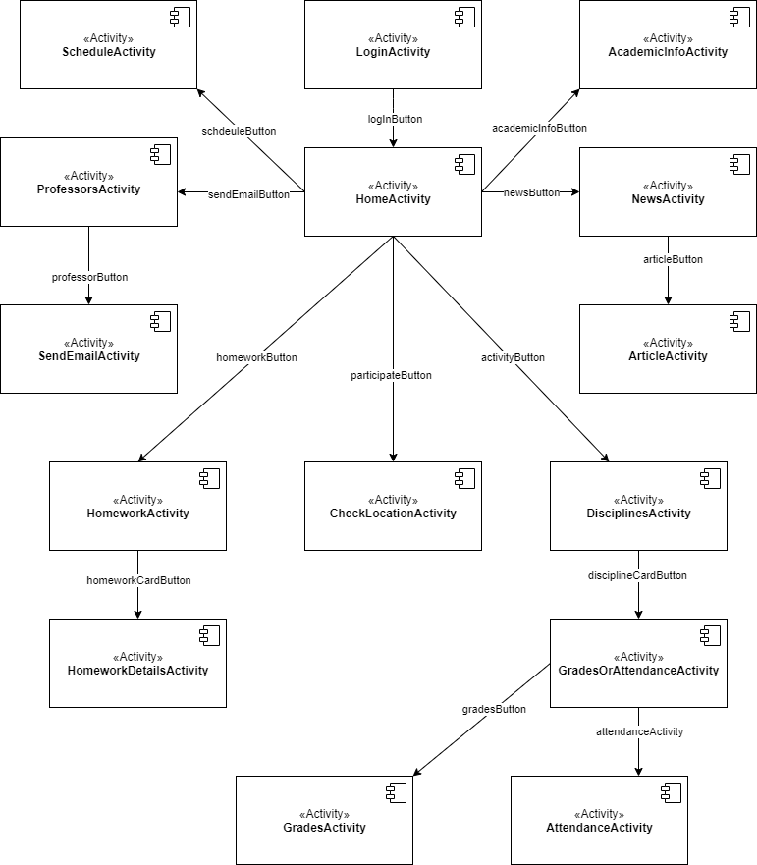

Slide 8
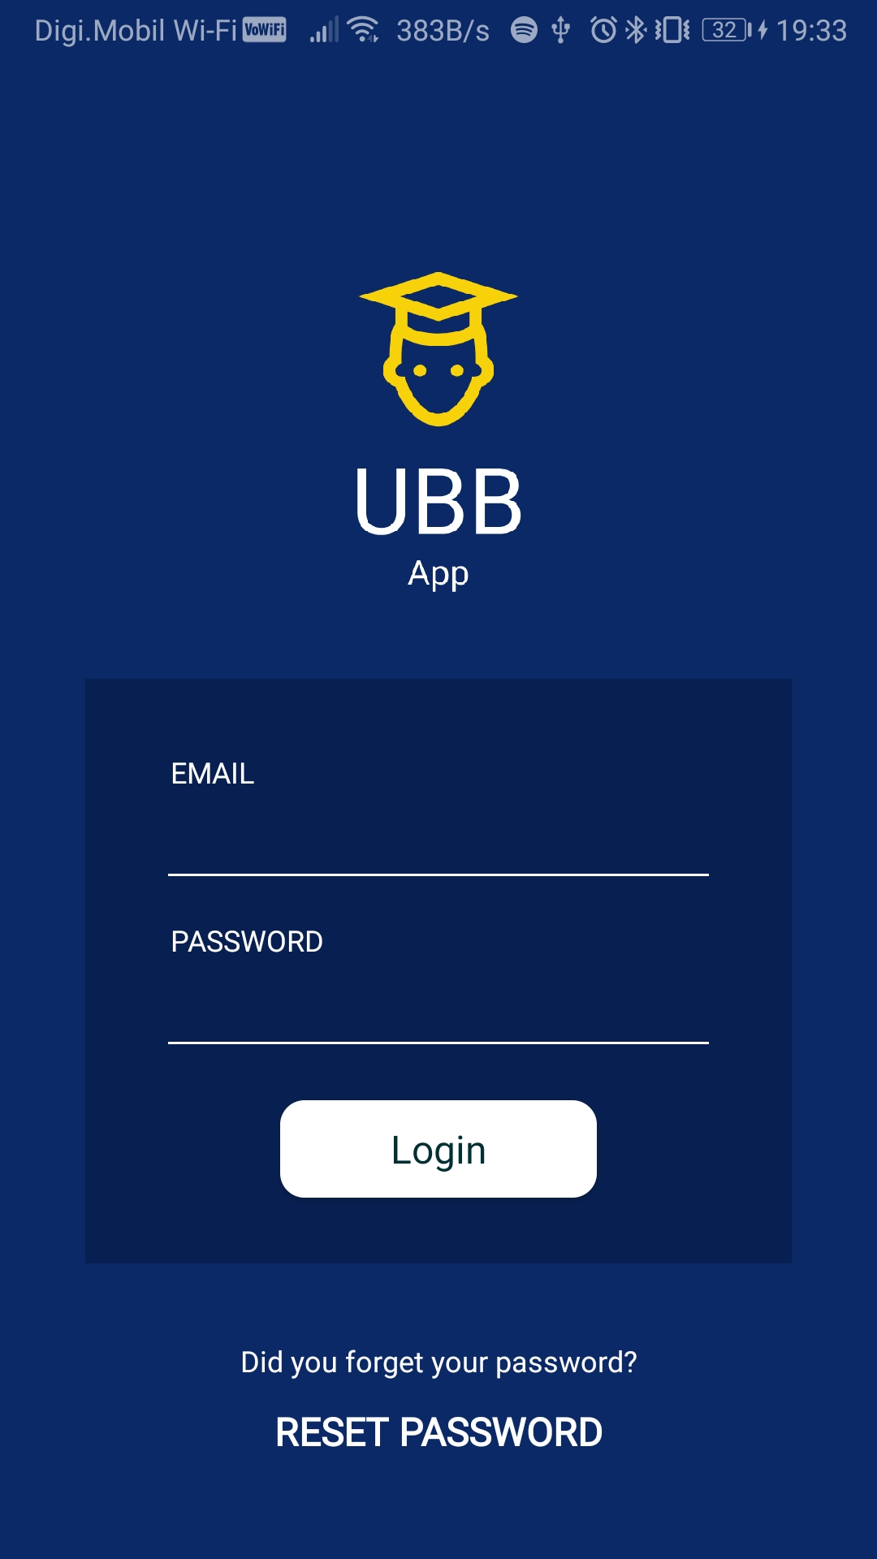
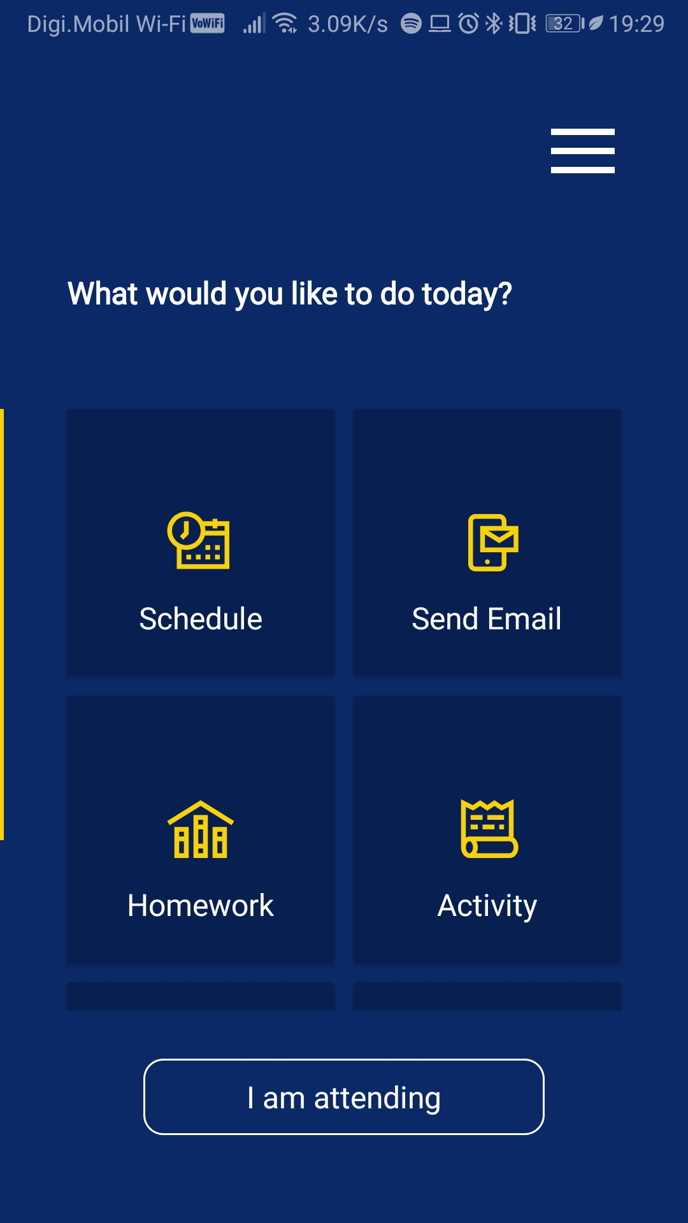
Log in Window
Menu Window

Slide 9
Web platform
Short description
Workflow

Slide 10
Short description
The web platform is targeted at professors.
This platform has an administrative role, which enables the user to add or edit the information that the students will see in the mobile application.
Some of the available options for data manipulation on the platform are: schedule editing or addition, creating attendance sessions and the possibility to mark a student.
For the development of the web platform, the following technologies were used: HTML, CSS, JavaScript, XAMPP and Firebase.

Slide 11
Workflow
The users will be prompted with the sign in page.
After signing in with success, the user will be taken to the main page, there will be a dashboard with a menu, which will contain the available classes of the professor and the administrative tools.
The user will never leave this page, all being done dynamically with the help of the JavaScript, HTML and CSS.
For every tool, there is a small guide at the top of the page
Every time a button is pressed a message will appear to inform the user of the occurred action.

Slide 12
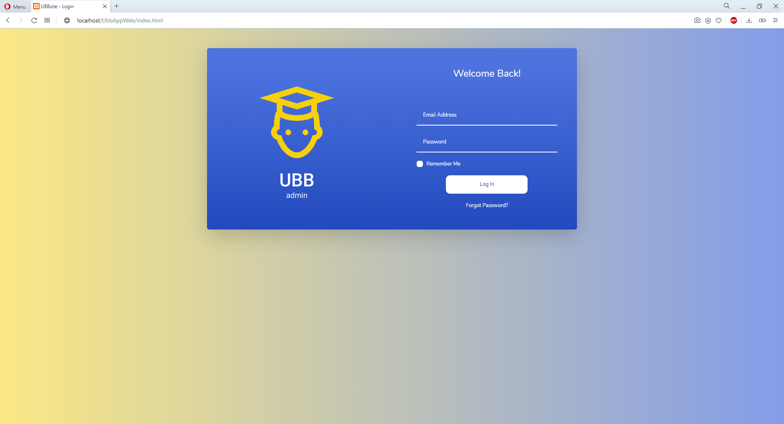
The sign in page

Slide 13
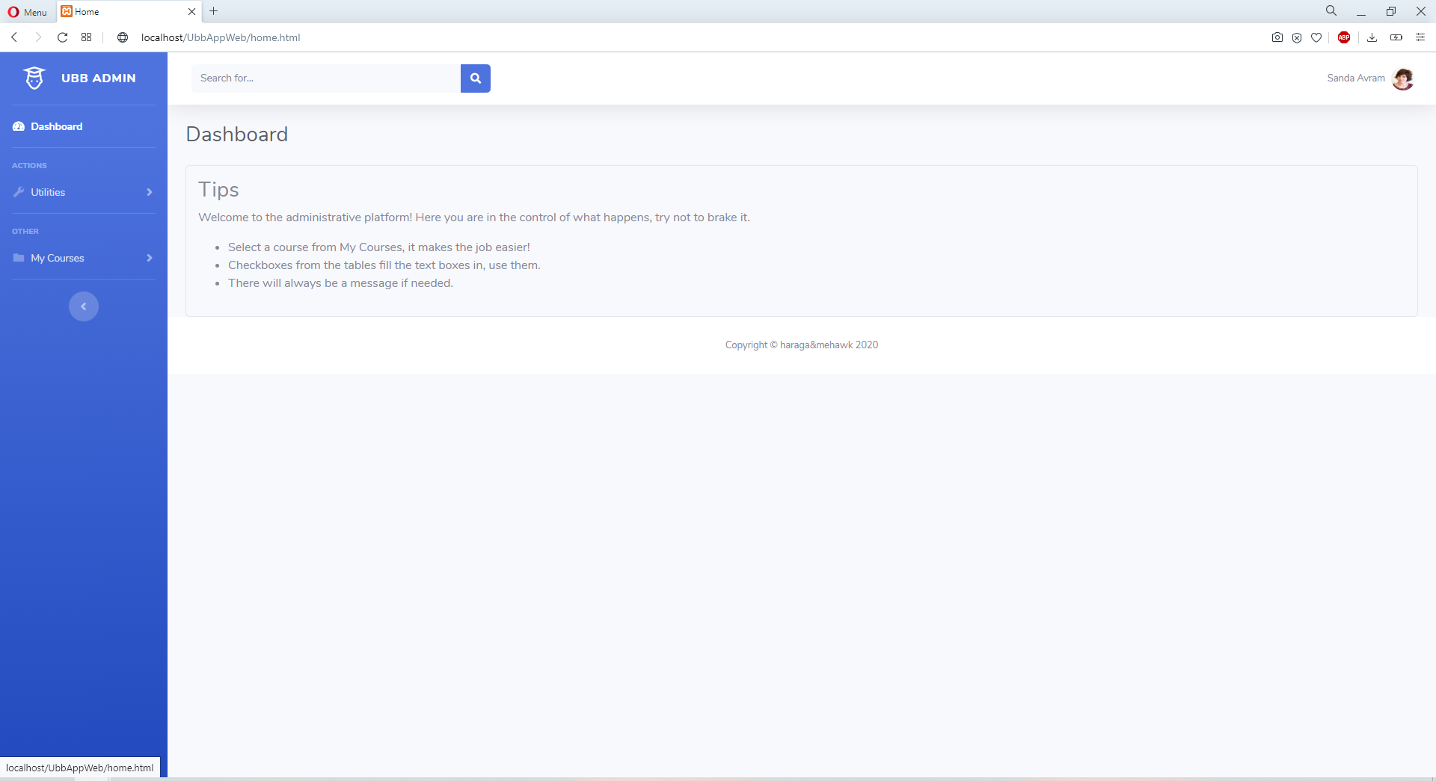
The main page

Slide 14
Future development
The regions where the platforms can be improved are:
Addition of animation and loading screens for a better user experience.
For the mobile platform, the addition of more features such as: buses schedule that pass through the proximity of the places where the classes take place, events organized for students, available sports in the city etc.
Another future development that could be made is the creation of a web platform for students, so that it can be accessed via any device.

Slide 15
Thank you for your attention!

