Slide 1
stereo
out
2x
cinch stereo inputs
DIN
DIN
L
R
L
R
L
R
220V
MIDI in
MIDI through
mix
stereo
out
GT-2
mini
220V
in
MIDI out
channel 1
stereo
out
Ketron
SD-2
power
sensor
Triac
relais
Keyboard Sensor
MIDI
through
power
slaves
MIDI in
DIN
right: channel 1 left: channel 2 foot: channel 3
Tx3
DIN
Display
Rx3
Tx2
ext. switch 1
Keyboard
Controller
ext. switch 2
modulation
exit
pitch bend
enter
Sub-D connector
Foot Pedal

Slide 2
Diodenmatrix Fußpedal
Sub-D Stift-Nr.
G8 violett
8
G7 blau
7
G6 gelb
6
5
G5 braun
4
G4 weiß
G3 grau-rosa
3
G2 grau
2
G1 schwarz
1
1
2
3
4
5
6
7
8
9
10
11
12
13
14
15
A12 rot-
schwarz
A13 rot
11
12
14
15
R12 grün-
braun
R13 grün
13
A14 rosa
A = Arbeitskontakt
R = Ruhekontakt
Reserve:
16
R14 grün-weiß

Slide 3
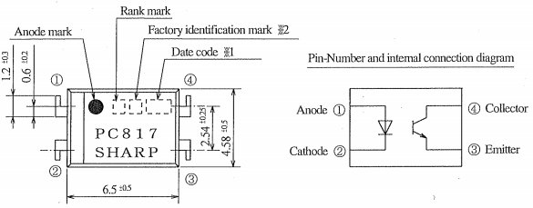
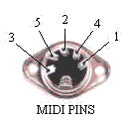
5 4
220
5 4
300
PC817
220
5 4
220
300
PC817
220
5 4
AV2020
LCD
Display
diode matrix rows
A12 red-black
1k
28
40
30
32
42
34
36
44
38
29
31
33
35
37
39
41
43
Arduino
Mega 2560
R12 green-
brown
1k
+5V Gnd
14 15 16 17 18 19
Tx3 Rx3 Tx2 Rx2 Tx1 Rx1
16 LED -
15 LED +
14 D7
13 D6
12 D5
11 D4
10 D3
9 D2
8 D1
7 D0
6 Enable
5 R/W
4 Funct. Select
3 LCD Drive
2 +5V
1 Gnd
220
A13 red
22
23
24
25
26
27
1k
R13 green
1k
A14 light red
1k
R14 green-
white
1k
contrst.
10..20k
G1 black
G2 grey
G3 grey-lght.rd.
G4 white
G5 brown
G6 yellow
G7 blue
G8 violet
diode matrix columns
+5V
Gnd
53
51
52
50
Gnd +5V A0 A1
Gnd
ext. switch 1
Keyboard
Controller
ext. switch 2
internal
wheels
10..20k
10..20k
blue
Gnd
modulat.
yellow
black- white
int. red switch (enter)
orange
pitch bnd.
470n
470n
black
int. black switch (exit)

Slide 4
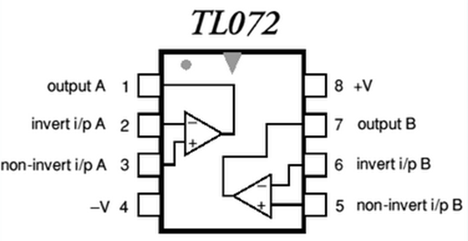
, NE5532, …
7809
Netzteil
mit
Brücken-gleichrichter
+9V
+
1000uF
0,1uF
Gnd
+9V
left
20k
20k
right
x 1
x 2
x 2
+
4,7uF
20k
5k
+
4,7uF
GT2 x 1
ext. x 2
ext. x 2
20k
1/2
NE5532
1/2 NE5532
+
4,7uF
+
4,7uF
10k
-
+
-
+
10k
+
4,7uF
10k
10k
+
4,7uF
+
4,7uF
+
4,7uF
+
4,7uF
+
4,7uF
Audio Mixer
Input fg = 3,4 Hz
5k
Gnd

