Slide 1
USB
Arduino
programming
DIN
MIDI
output
Meter
& LEDs
coding switch
back side
Tx1
MIDI
base
channel
Rx3
Arduino
Keyboard
Matrix
sustain
pedal
push
push

Slide 2
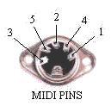
Matrix to MIDI
analog meter
adjust
Key-
board
20k
blue
A5
R4
A4
R3
A3
R2
A2
A1
R1
A7
R7
A8
R8
A9
R9
A10
R10
A11
R11
n.c.
R5
n.c.
n.c.
n.c.
n.c.
n.c.
n.c.
n.c.
n.c.
A6
R6
G1
G2
G3
G4
G5
G6
G7
G8
n.c.
Arduino
Mega 2560
A0 A1 A2 A3
Gnd
52 53
50 51
48 49
46 47
44 45
42 43
40 41
38 39
36 37
34 35
32 33
30 31
28 29
26 27
24 25
22 23
1k
1k
22k
1k
1k
5 4
1k
1k
220
1k
1k
Pin
Hdr.
1k
1k
1k
1k
11
10
9
8
7
6
5
4
3
2
1
+5V
Gnd +9V Vin
1k
1k
1k
1k
150k
1k
1k
n.c.
1k
1k
12k
1k
1k
PW TxRx
13 12 11 10 9 8 7 6 5 4 3 2 1 0
Tx3 Rx3 Tx2 Rx2 Tx1 Rx1
14 15 16 17 18 19
. . . . . .
. . . . . .
G8 G7 G6 G5 G4 G3 G2 G1
13 = G8 connected
to yellow onboard LED
. . . . . .

Slide 3
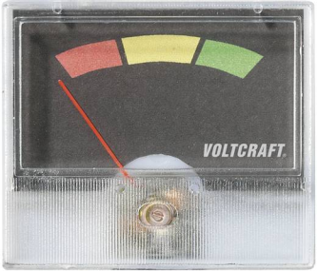

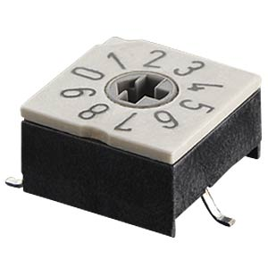
+ 5V 11
white
meter
VOLTCRAFT AM-49X27
orange
keyboard
270 μA
1.66 kΩ
330
180
Arduino A2 8
Arduino A3 7
- +
10 A0
stereo
4 PWM
sustain
pedal
n.c.
3 Gnd
green
push-button
black
push-button
coding
switch
0..9
1 Arduino 23
2 Arduino 22
10k
22k
47k
100k
Arduino A1 9
MIDI base channel
10k

Slide 4
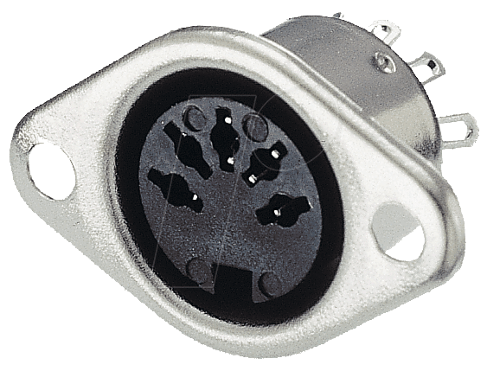
on
display global sensitivity
increment global sens.
meter light on
decrement global sens.
display MIDI velocity
MIDI channel select
global sensitivity
adjust
meter light on
meter light off
meter light off
decrement key sensitivity
playing
increment key sensitivity
meter light on
meter light off
display key sensitivity
half brightness
key sensitivity
adjust
blinking on
clear split point
full brightness
display MIDI velocity
keyboard split point selection
set split point

