Slide 1


Slide 2
Ansible:-Ansible is an open-source IT Configuration Mangement, Deployment and orchestration tools.
It aims to provide large productivity gains to a wide variety of automation Challenges.
AGENTLESS
Ansible written in python and ansible uses a YAML Language.
Win Rm - For connect with windows machine.
ssh - For connect with linux machine.
Chef/Puppet Uses their languages.(Hard to Understand)

Slide 3
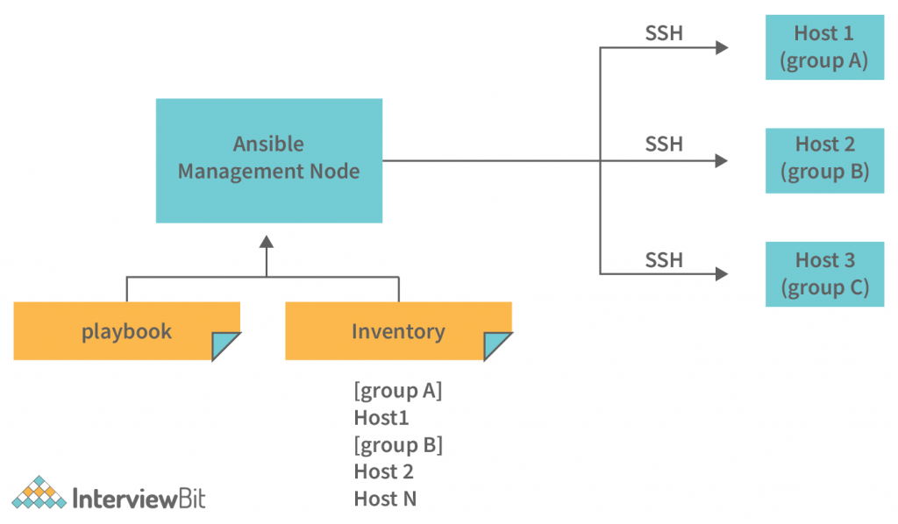
Architecture of Ansible

Slide 4
Have you worked on Ansible
I know how to deploy applications using Ansible.
I know how to install, setup, update any tool using ansible on different server.
IAC- Terraform / Ansible - (way of usage)
If you want to create new resources in cloud then we use Terraform
If you want to update or modify existing resources in cloud then we use Ansible

Slide 5
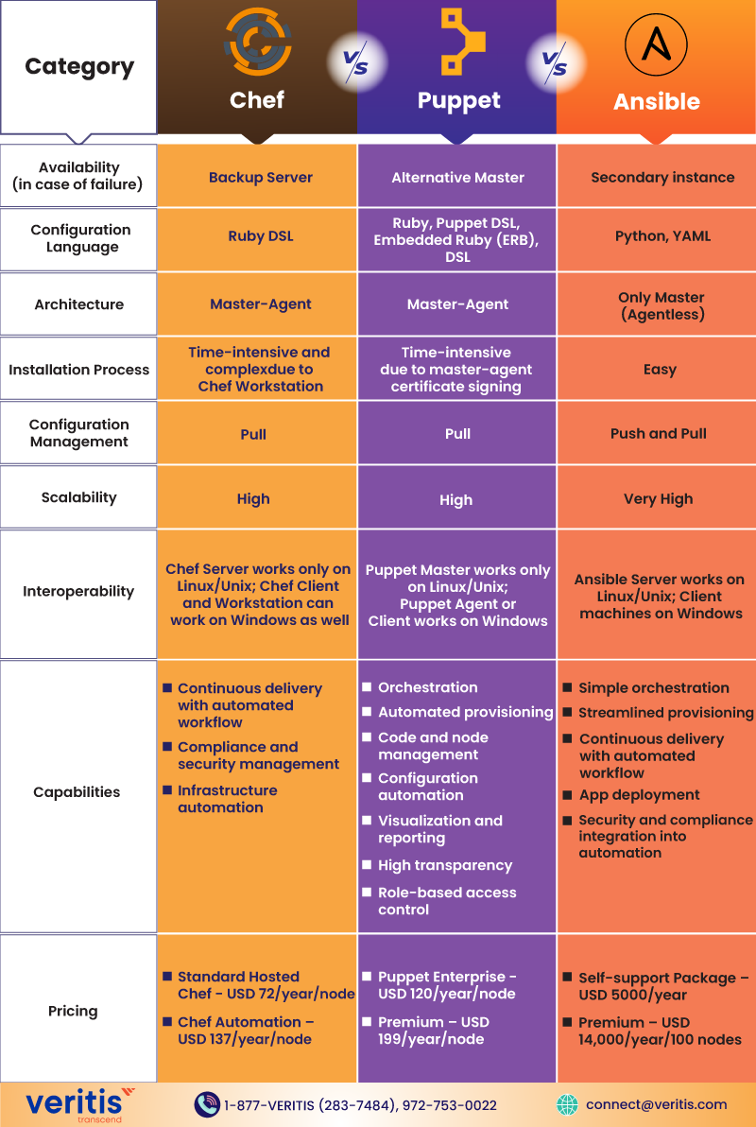
Ansible vs Chef vs Puppet {Pull- chef / Puppet} {Push - Ansible}

Slide 6
ansible-playbook scripts.yml
Inventorys
/etc/ansible/hosts
ubuntu machine
Generate key on all machine (ssh-keygen)
cd /root/.ssh
ls
cat id_rsa_pub
add this public key of control node onto clients authorised key folder(Paste the key in authorised_key)

Slide 7
cd /etc/ansible - vi ansible.cfg
ADD THIS CODE IN ABOVE FILE
[defaults]
host_key_checking = False
CHECK CONNECTIONS
ssh @IP
ansible all -m ping

Slide 8
Ansible Adhoc Commands (we use it for 1 or 2 tasks on your managed nodes) [MODULE]
Que- difference between ansible-adhoc cmds vs ansible playbook.
(Playbook for multiple tasks {like shell-scripting})
ansible -i inventory all -m “shell” -a “touch devopsclass”
ansible -i inventory all -m “shell” -a “nproc”
ansible -i inventory webserver all -m “shell” -a “df” (inventory / hosts) & group of web-servers
ansible -i inventory all -m “copy” -a “src: ” “dest:” “owner”
ansible module- (Look Documentation) ($ ansible-doc -l) {list all the modules}
ansible-doc -l | wc -l (total modules 2000+)
Que-How do you group the servers in ansible/ how can you excute certain no of tasks on certain no of servers of virual machines.
For multiple servers group them and give name to that server(10k-100k webservers or dbservers)
[webserver] [dbserver]....like

Slide 9
The Ad-Hoc command is the one-linear ansible command that performs one task on the target hosts/groups.
ansible -i inventory all -m ping
For multiple inventory or /hosts files use (-i db_inventary or -i hosts)
ansible all -m ping
ansible db:web_server -m ping
ansible db:web_server -m shell -a ‘’uptime”
ansible db:web_server -m shell -a ‘’free -m”
ansible -i prod_inv -m shell -a “uptime”
ansible -i prod_inv -m shell -a “free -m”
ANSIBLE AD-HOC CMD SYNTAX
ansible [-i prod_inv] server_name:group1:group2 -m module [-a argument_value]
Module- Module is a pre-defined programs, that are able to excute task on your managed nodes.
(target - module is very imp in ansible-adhoc cmds)

Slide 10
Playbooks
---
- hosts: all/vm
tasks:
- name: Print message
debug:
msg: Hello Ansible World
- name: Ansible apt install Maven
apt:
name: maven
state: present

Slide 11
---
- hosts: all/vm
vars:
- name: Pooja
tasks:
- name: Print message
debug:
msg: Hello Ansible World
tasks:
- name: Print Varibles
debug:
msg: “Hello {{ name }}”
tasks:
- name: Create directory
file:
path: /home/ubuntu/xyz
state: directory

Slide 12
Playbook-2 (Install and Start Nginx)
---
- name: Install and Start nginx
hosts: all
become: root
tasks:
- name: Install nginx
shell: apt install nginx or (why-- to keep more generic)
apt:
name: nginx
state: present
- name: Start niginx 0r (shell: systemctl start nginx)
service:
name: nginx
state: started
-vvv verbos - it gives what ansible is doing internally.
ex. ansible-playbook -v -i hosts file2.yml
shows the debugs logs here.

Slide 13
Ansible ROLES
Way to generate multiple file structure of any tools you want to install.
way that, it will generate seperate files for variables, tasks and others.
ansible-galaxy role init tomcat
ls
cd ansible-tomcat
https://github.com/jaiswaladi246/tomcat-ansible
https://github.com/jaiswaladi246/Petclinic

Slide 14
---
- hosts: all
tasks:
- name: Print message
debug:
msg: Hello Ansible World
tasks:
- name: Check if folder exist
stat:
path: /home/ubuntu/Petclinic
register: file
- name: Build & Deploy
shell: |
cd /home/ubuntu/
git clone (****url*****)
when: not file.stat.exists
- name: Build & Deploy
shell: |
cd /home/ubuntu/Petclinic
mvn clean package
cp target/petclinic.war /usr/share/tomcat/webapps

Slide 15
Efficient way of writting ansible playbook & that will only increase the efficiency of writting complex playbooks is called Roles
Ansible -Problem
If i want to configure k8s using ansibles then it will have some close to 50-60 tasks & lots of variables, parameters, secrets, certificates to configures while creating this K8s clusters.
For that we use Ansible-Roles
By Using Ansible-Rolls we can segrigrate each&everything in roles / you can properly structure your ansible-playbook.
ex ansible-galaxy role init kubernetes
ls
cd kubernetes
ls -ltr
https://github.com/ansible/ansible-examples (for more example)

Slide 16
Ansible Vault
Ansible Vault is useful to encrypt your playbooks(including roles and variables).
Why we need to encrypt playbooks
We know that: Ansible is being used for automation, there is a possibility that playbooks contains some credentials, SSL certificates info and other sensitive data. Saving such sensitive data as plaintext is a baD idea, because, one wrong commit to github or laptop theft can cause an organization a huge loss.
ex. write a playbook for create/launch a EC2-instance from AWS.
it contains secret_key &access_key info (any one can see and access it)
so, we need a way to store secrets securely.
Ansible-Vault is the answer to this. Ansible vault can encrypt anything inside of a YAML file, using a password of your choice.

Slide 17
Ansible-Vault Cmds - (ansible-vault -h)
ansible-playbook launch_ec2.yml
ansible-vault encrypt launch_ec2.yml (set-passward)
ansible-vault decrypt launch_ec2.yml (removing encrypt/ but you should know passwd)
ansible-playbook launch_ec2.yml (can’t open)
ansible-playbook launch_ec2.yml --ask-vault-pass
CASE-1 : STORE THE CREDENTIALS IN A SEPERATE VARIABLE FILE AND ENCRYPT THAT VARIABLE FILE.....(apply vault on this var files)
so, you don’t need to encrypt entire playbook (cat aws_var.yml)
ansible-vault encrypt aws_var.yml
ansible-playbook launch_ec2_from_a_file.yml (Not running)
ansible-playbook launch_ec2_from_a_file.yml --ask-vault-pass

Slide 18
ansible-vault create demo.yml (It will ask set-passwd at initial stage, before creating a demo file)
(open-writeplaybook-var-save)
cat demo.yml (can’t see because vault is set)
so, To view and edit the content of already encrypted playbook use
ansible-vault view demo.yml
ansible-vault edit demo.yml
ansible-vault rekey demo.yml (To change the vault passwd)
Store the vault passwd in a seperate file instead of giving on cmds.
ansible-playbook launch_ec2_from_a_file.yml --vault-id my_pass (vi my_pass)
ansible-playbook launch_ec2_from_a_file.yml --vault-password-file my_pass (vi my_pass)
Note- In above cmds mension your hosts file path while running playbooks/ansible-vault (-i hosts)
( -i /etc/ansible/hosts) (-i inventory/hosts)
Example of Ansible-Vault - realtime Github secure the github credentials.

Slide 19
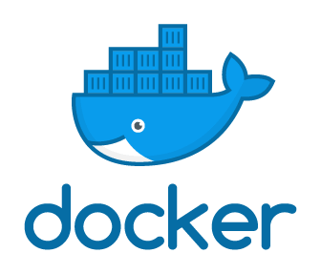

Slide 20
VM vs Containers
After sometimes we realise, even if we use VM we don’t use its full capacity/memory of OS. (Waste of memory/cpu/Resources)
ec2-user /ubuntu
Vm’s are advance to physical-server & Containers are advance to VM.
VM have full OS, isolation is there.
Container’s are not have full OS (mininumal os which refers from its base image)
Container’s are light in weight.
(size- 100MB-500MB)

Slide 21
why docker
In Maven- After building an applications we get .jar/.war files called Artifact (We store that Artifact on the Nexus repo/JFrog artifact store/repo) (jAVA Package application)
CMD--> Java -jar app.jar
Dependencies:- List of jar files that are required for building an applications
Package-->JAR/WAR (SOURCE CODE+DEPENDENCIES)
myapp
How we package the application along with dependencies on which it is building By Using
Dockerfile
we write a Dockerfile for creating a image
jar
java -jar app.jar
port 8080
app.jar
Friend-machine
docker-image
Windows Machine
jdk17
Linux
jdk8
Package the application along with environment called docker image
after runing this image -It create a container

Slide 22
1st Dockerfile
FROM openjdk:alpine --> base image (linux+jdk)
FROM ubuntu:lastet
COPY target/app.jar /app.jar
EXPOSE 8080
CMD [‘java’, ‘-jar’, app.jar]
[CMD VS ENTRYPOINT] Entrypoint is not overideable value
cmd and entrypoint are similar but not same they used to excute the 1st commands in a dockerfile before creating a image.
docker build -t shopping-cart -f docker/Dockerfile
docker tag shopping-cart poojamame/shopping-cart:latest (tag img to push on dockerhub)
docker push poojamame/shopping-cart:latest
docker images
docker ps /docker container
docker run -d --name shopping -p 8070:8070 poojamame/shopping-cart:latest
docker run -d --name container-name1 -p 9000:9000 sonarqube:latest (runnung this application inside this containers)
(Creating-Container)
Host-Port
Container-Port

Slide 23
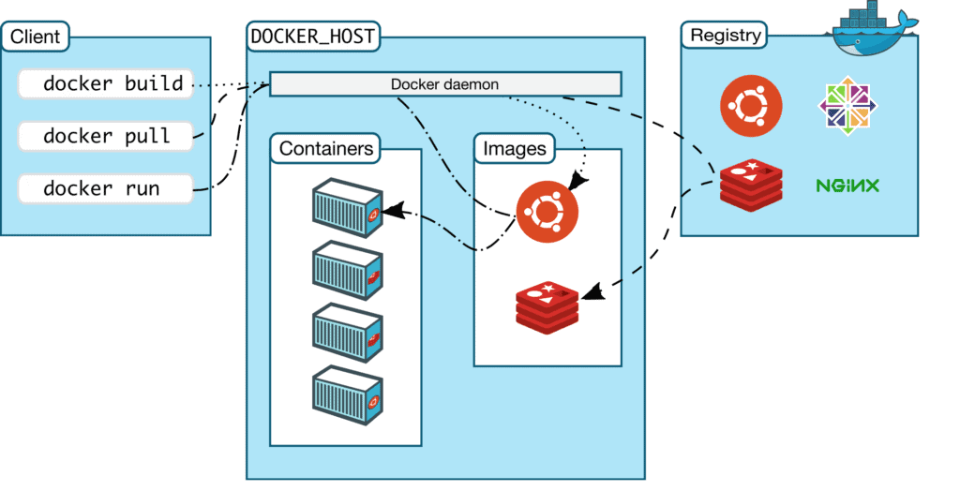
Architecture of Docker

Slide 24
Docker-Client:- Medium to communicate with server {ex.whatup app}
Docker-Host/server {Docker Daemon} :-
Images-
Containers-
Docker-HuB/registry- It is like storage where we were store our images (from that registry we can pull & push the images)
storage and content delivery system for holding docker-images
https://hub.docker.com/
Dockerfile- File which contains cmds to package the applications along with its environment.
image
os
software
Application
run
Container

Slide 26
Remove exsiting containers docker rm -f $(docker ps -aq) (remove all containers forcefully)
Custom Bridge Network:-
docker network create --driver=bridge jhome (Network-name anyname)
docker network ls
docker run -itd --name=alpine1 --network=jhome alpine
docker ps
docker network inspect (Network-Id)
docker run -itd --name=alpine2 --network=jhome alpine
docker ps
docker network inspect (Network-Id)
Lets sign in to 1st container (docker attach alpine1)
/# ping (IP-of-2nd container) or Name
Here both works (container can communicate with IP and Container Name)

Slide 27
Overlay Network:-It is used for orchestration eg. Docker Swarm
Multiple Container Runs On multiple hosts of multiple networks, so the communication not happens because of seperate networks (its difficult to communicate) for that we create overlay network.
This network is mostly use in a production level. because at this level Multiple Container Runs On multiple hosts so, we have to create one overlay network which is common in this hosts.
Multi-host networking on Linux with the native overlay driver.
Ingress-network:- when swarm initiates ingress network automatically created with inbuilt Load-balancer.

Slide 28
docker network ls
docker swarm init
docker node ls
docker network ls
docker network create -d overlay overnet
docker network ls
docker service create --name myservice --network overnet --replicas 2 alpine sleep 1d
docker service ls
docker service ps myservice
docker network inspect overnet (check container IP)
Goto the other node
docker network inspect overnet (again check for container IP)
docker ps
docker exec -it (container-id) sh (togo inside container & check communication)
ping (container-IP of 1st host machine)
see communication happens here

Slide 29
docker network create --driver overlay --attachable myoverlaynet
docker network ls
docker network inspect myoverlaynet
docker service create -d --name mynginxoverlay --network myoverlaynet --replicas 3 -p 8080:80 nginx
docker service ls
docker service ps mynginxoverlay
docker network ls (on node follw below same cmds )
docker container ls
docker container inspect container-id | grep IPAddress
docker container exec -it (container-id) /bin/bash
ping/curl (container-ip)

Slide 30
Host Network- It create network at VPC level.
Use only in some of the cases
container directly attach/connect to VPC CIDIR

Slide 31
Docker Volume:- Manage Data in Docker Container (to persist the container data)
Anyanomus Volumes - creates random hashkey as volume name.
Named Volumes - Giving names to the volume.
Host Volumes - /opt/datao3. (Persist data at host level)
Bind-Mount:-

Slide 33
Docker-Compose:-Docker Compose is a tool that simplifies the process of defining and running multi-container Docker applications. It allows you to use a YAML file to configure the services, networks, and volumes required for a multi-container Docker application, making it easier to manage and deploy complex applications. Docker-Compose is also used to automate the process of deploying your multi containers.
Understanding Docker Compose:
1. YAML Configuration File:
Docker Compose uses a YAML file (usually named docker-compose.yml) to define the services, networks, volumes, and configurations required for your multi-container application.
2. Services:
Each service defined in the YAML file represents a container and its configuration.
Services can be built from images or specified using build instructions to create custom images.
Services can define environment variables, volumes, ports, dependencies, etc.
3. Networking and Volumes:
Docker Compose simplifies the management of networks and volumes among containers.
It automatically creates a default network for your services, allowing them to communicate with each other by service name.

Slide 34
4. Commands:
Docker Compose provides simple commands to manage multi-container applications, such as docker-compose up, docker-compose down, docker-compose build, etc.
Basic Docker Compose Commands:
version: '3'
services:
jenkins:
image: jenkins/jenkins:lts
restart: always
privileged: true
user: root
ports:
- 8080:8080
- 50000:50000
container_name: jenkins
volumes:
- /home/ubuntu/jenkins_compose/jenkins_configuration:/var/jenkins_home
- /var/run/docker.sock:/var/run/docker.sock
version: ‘3’
services:
myapp1:
image: nginx
ports:
- “8090:80”
database:
image: redis
myapp2:
image: ubuntu
sudo docker-compose logs --follow (Cmd to get jenkins password)

Slide 35
Step 1 : install docker compose
sudo curl -L "https://github.com/docker/compose/releases/download/1.29.2/docker-compose-$(uname -s)-$(uname -m)" -o /usr/local/bin/docker-compose
sudo chmod +x /usr/local/bin/docker-compose
docker-compose --version
Step 2 : Create docker compose file at any location on your system
docker-compose.yml
version: '3'
services:
web:
image: nginx
ports:
- 8080:80
database:
image: redis
Step 3 : Check the validity of file by command
docker-compose config
version: '3.7'
services:
web:
image: nginx:alpine
ports:
- "8000:80"
volumes:
- ./app:/usr/share/nginx/index.html

Slide 36
Step 4 : Run docker-compose.yml file by command
docker-compose up -d
Steps 5 : Bring down application by command
docker-compose down
Steps 6 : How to scale services (—scale)
docker-compose up -d --scale database=4
**********************************************
mkdir ~/compose-demo
cd ~/compose-demo
mkdir app OR cd app
vi app/index.html
vi docker-compose
docker-compose up -d
docker-compose ps
docker-compose logs
docker-compose pause
docker-compose unpause
docker-compose stop
docker-compose down (Notice that this won’t remove the base image used by Docker Compose to spin up your environment (in your case, nginx:alpine). This way, whenever you bring your environment up again with a docker-compose up, the process will be much faster since the image is already on your system.)
docker image rm nginx:alpine (In case you want to also remove the base image from your system, you can use:)
<!doctype html>
<html lang="en">
<head>
<meta charset="utf-8">
<title>Docker Compose Demo</title>
<link rel="stylesheet" href="https://cdn.jsdelivr.net/gh/kognise/water.css@latest/dist/dark.min.css">
</head>
<body>
<h1>This is a Docker Compose Demo Page.</h1>
<p>This content is being served by an Nginx container.</p>
</body>
</html>

Slide 37
version: '3' #Version of YML file
services:
db:
image: mysql:5.7
volumes:
- db_data:/var/lib/mysql
restart: always
environment:
MYSQL_ROOT_PASSWORD: mypassword
MYSQL_DATABASE: wordpress
MYSQL_USER: wordpressuser
MYSQL_PASSWORD: wordpress
wordpress:
#depends-on:
#- db
image: wordpress:latest
ports:
- "8080:80"
restart: always
environment:
WORDPRESS_DB_HOST: db:3306
WORDPRESS_DB_USER: wordpressuser
WORDPRESS_DB_PASSWORD: wordpress
volumes:
db_data:

Slide 38
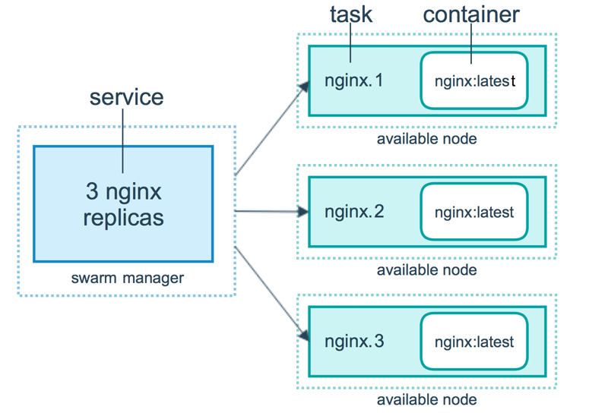
Docker Swarm:- Docker swarm is a group of machines that are running Docker and joined into a cluster. It is a tool for container Orchestration

Slide 39
Today we will learn :
1. What is Docker Swarm
Docker swarm is a container orchestration tool, meaning that it allows the user to manage multiple containers deployed across multiple host machines.
2. Why to use it
3. How to create and manage Docker Swarm
4. Create service on docker swarm
A service is used to deploy an application image
5. Scaling services up and down
A swarm is a group of machines that are running Docker and joined into a cluster.
A cluster is managed by swarm manager.
The machines in a swarm can be physical or virtual. After joining a swarm, they are referred to as nodes.

Slide 40
Lets take an example
You have 100 containers
You need to do
Health check on every container
Ensure all Containers are up on every system
Scaling the containers up or down depending on the load
Adding updates/changes to all the containers
Orchestration- Managing and controlling multiple docker containers as a single service.
Tools available:- Docker Swarm, Kubernetes, Apache Mesos.
Swarm managers are the only machines in a swarm that can execute your commands, or authorise other machines to join the swarm as workers.
Workers are just there to provide capacity and do not have the authority to tell any other machine what it can and cannot do
you can have a node join as a worker or as a manager. At any point in time, there is only one LEADER and the other manager nodes will be as backup in case the current LEADER opts out.

Slide 41
Why do we use Docker Swarm?
Leverage the Power of Containers
Docker Swarm Helps Guarantee High Service Availability
Automated Load-Balancing
When we create docker-swarm, ingress network automatically created.(default ingress network)
step 1: Create 3 ec2-user machine (ubuntu) and install docker on that machine.
sudo apt update
sudo apt install docker.io -y
sudo usermod -aG docker ubuntu
sudo docker --version
sudo docker info
sudo systemctl status docker
step 2: Create one manager machine,other worker machine and Initialize Docker Swarm. (Manager is also a worker it acts like worker node also)
sudo docker swarm init --advertise-addr MANAGER_IP
sudo docker node ls

Slide 42
Step 3 : Join workers in the swarm Get command for joining as worker in manager node run command docker swarm join-token worker this will give command to join swarm as worker.
$ sudo docker swarm join-token manager
This will give command to join swarm as manager
$ docker-machine ssh manager1 0r worker1/worker2
(SSH into worker node (machine) and run command to join swarm as worker)
In Manager Run command,to verify worker is registered and is ready
$ sudo docker node ls
step 4: On manager run standard docker commands
$ sudo docker info
netstat -tulpn | grep LISTEN (apt install net-tools)
Now check docker swarm command options docker swarm
step 5 : Run containers on Docker Swarm and create a service to run on this swarm.
docker service create --name myservice --replicas 3 --publish 80:80 httpd
docker service ls
docker service ps name-of-service (to check where your service is runing)
docker ps

Slide 43
(ON Node if you remove this service)
docker rm -f container-id
docker ps
docker ps
(after sometimes container automatically up an running it create that service again an again if we remove that container, Thats the beauty of docker-swarm)
This is the job of docker-swarm (so-fast)
docker service rm service-name
docker service create --name demo --replicas 6 --publish 80:80 httpd (To check how the load-balancing happens)
docker service inspect --pretty demo (It gives info about service)
docker service rm demo
sudo docker swarm leave (worker-node left the swarm)
docker node rm Node-ID
docker swarm leave --force (Manger-node left the swarm)
docker swarm join-token worker (if token losts)
docker swarm join-token manager

Slide 44
DOCKER STACK DEPLOY:- Docker stack function makes use of .yml files to deploy multiple services at onces.
Vi demo2.yml
version: ‘3.8’
services:
sample1:
image: “nginx:lastest”
ports:
- “8000:8000”
sample2:
image: “ubuntu”
Vi demo.yml
version: ‘3.8’
services:
web:
image: “httpd:lastest”
build: .
ports:
- “8000:8000”
database:
image: “mysql”
docker service update --imagehttpd:latest httpd
(if you want to update the versions of images )
docker stack deploy -c demo.yml demostack --(name of stack)
docker service ls
docker service scale (service-id)=4
docker service ps (service-name)

Slide 45
We have gone through the basics of how to create a service using the command docker service create.
We have seen how to write yaml file to deploy services using docker stack.
We have seen different kinds of attributes like replicas, constraints, labels, environment, restart policy etc used in yaml file.
We have deployed sample nginx, mysql and voting app services on the docker swarm.
we have also seen how to easily make use of play with docker to create docker swarm and deploy the services.

Slide 46
docker service create --replicas 3 -p 80:80 --name serviceName nginx
docker service ls
docker service ps serviceName
(Check the service running on all nodes and Check on the browser by giving ip for all nodes)
docker service scale serviceName=4
docker service ps serviceName
docker node inspect nodename/self/worker/mangaer
docker service update --image imagename:version web
docker service update --image nginx:1.14.0 serviceName
Shutdown node
docker node update --availability drain worker1
docker service rm serviceName

Slide 47
docker service create --replicas 8 alpine ping www.google.com
docker service ls
(when service is created then only containers spinup)
Rolling Update/Upgrade Approch:- Rolling updates are used to update an image in the service while it is being run.
docker service create --replicas 3 --name redisservice redis:3.0.6
docker service update --image redis:3.0.7 redisservice
Draining Nodes:- Prevents the nodes for receiving new tasks.
docker node update --availability drain worker1
(This worker are under the maintance, so check no container are running & load shift to other nodes)
docker node update --availability active worker1

Slide 48
Docker-Compose vs Docker Stack function
Docker Compose is used for defining and running multi-container applications on a single Docker host, while Docker Stack is used for deploying a stack of services to a Docker swarm.
Docker-compose in based on python while docker stack comes with a standard docker installation.
The 'docker stack' is a Docker command to manage Docker stacks. We can use this command to deploy a new stack or update an existing one, list stacks, list the tasks in the stack, remove one or more stacks, and list the services in the stack.

Slide 49
Health-Check of Docker Containers

Slide 50
Docker Swarm vs Kubernets

