Slide 1
Phishing Awareness Training
Presented by [Haram Shahzadi] — CodeAlpha

Slide 2
What is Phishing?
- Cyber-attack tricking users into giving sensitive info
- Uses fake emails, websites, or messages
- Goal: steal passwords, banking info, or identity

Slide 3
Common Types of Phishing
- Email Phishing → Fake bank/PayPal emails
- Spear Phishing → Targeted attacks on specific people
- Smishing → Fraudulent SMS
- Vishing → Fake phone calls
- Website Spoofing → Fake login pages

Slide 4
How to Recognize Phishing
- Suspicious sender address
- Urgent or threatening language (‘Your account will be blocked!’)
- Poor grammar/spelling
- Fake links (hover to check URL)
- Unexpected attachments

Slide 5
Examples

Slide 6
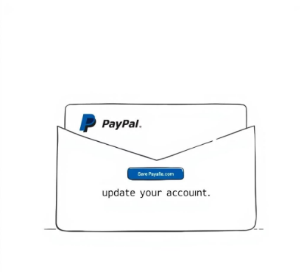
The Lure: An email claiming "Your account is limited" urging urgent action to restore access. It preys on fear and urgency.
Suspicious Sender: The email address looks slightly off (e.g., paypal-secure@xyz.com).
Malicious Link: The embedded link leads to a convincing, yet fake, login page designed to steal your credentials.
Red Flags: Look for generic greetings, obvious spelling or grammatical errors, and threatening language about account closure.
Fake PayPal Email Scam

Slide 7

The Hook: "You've Won Big!" A message claiming you've won a substantial lottery prize, prompting you to click a link to claim it. The Trap: Personal Info Required The link directs you to a phishing site requesting personal and banking details under the guise of prize verification.
WhatsApp ‘Lottery Prize’ Message

Slide 8
Best Practices to Stay Safe
✅ Verify sender before clicking
✅ Don’t share passwords on email
✅ Enable 2FA (Two-Factor Authentication)
✅ Use updated antivirus
✅ Report suspicious emails

Slide 9
Quiz Time! Question 1
What should you do if you suspect a phishing email?
A) Click the link to see what happens
B) Forward it to a friend for advice
C) Verify sender and contact IT before taking action
D) Reply to confront the sender
Remember: A quick verification can prevent a major security incident.

Slide 10
Quiz Time! Question 1
What should you do if you suspect a phishing email?
A) Click the link to see what happens
B) Forward it to a friend for advice
C) Verify sender and contact IT before taking action
D) Reply to confront the sender
Remember: A quick verification can prevent a major security incident.

Slide 11
Quiz Time! Question 2
Which is a common sign of phishing?
A) Email from a known contact with your name
B) Email with urgent request and generic greeting
C) Regular newsletter from a subscribed service
D) Email with no links or attachments
Phishing relies on urgency and anonymity to bypass your skepticism.

Slide 12
Quiz Time! Question 2
Which is a common sign of phishing?
A) Email from a known contact with your name
B) Email with urgent request and generic greeting
C) Regular newsletter from a subscribed service
D) Email with no links or attachments
Phishing relies on urgency and anonymity to bypass your skepticism.

Slide 13

Stay Vigilant, Stay Safe Your Awareness is Our Strongest Defense
Key Takeaways:
Report Immediately: If you spot anything suspicious, report it to IT. Don't engage with the attacker.
Think Before You Click: Always pause and inspect emails, links, and attachments.
Verify Authenticity: If a request seems unusual, confirm it through official channels.

Slide 14
Conclusion
- Phishing is social engineering
- Always think before you click
- Stay alert, stay safe

