Slide 1


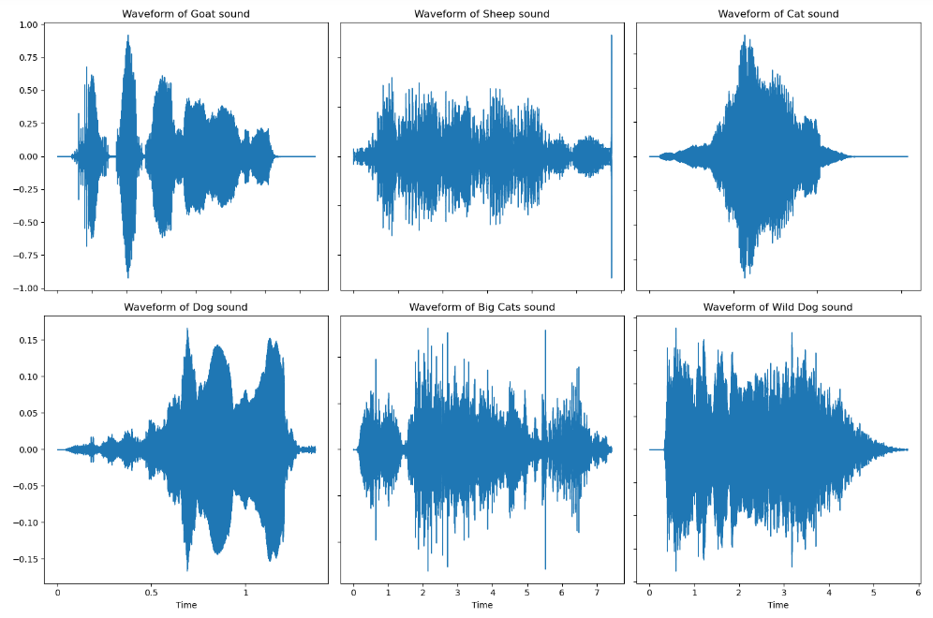
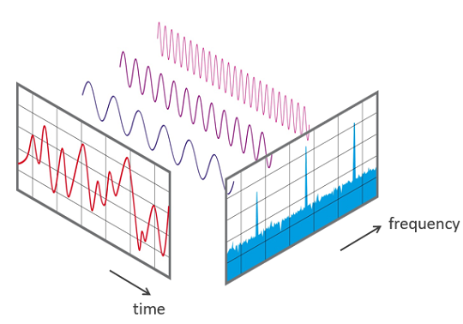
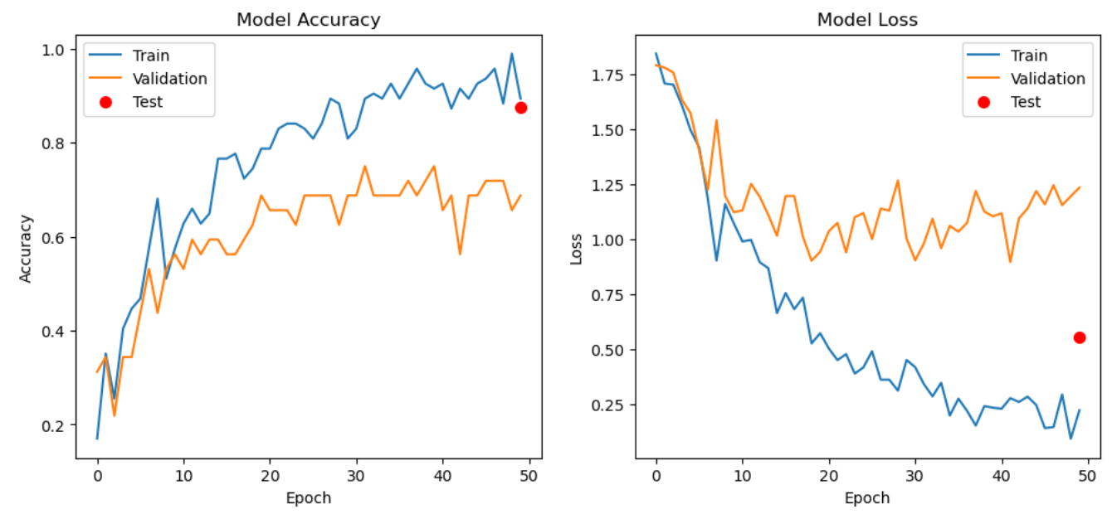
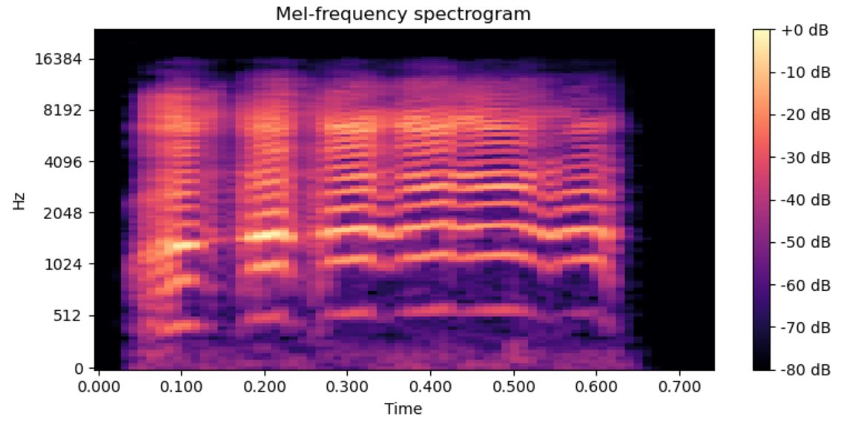
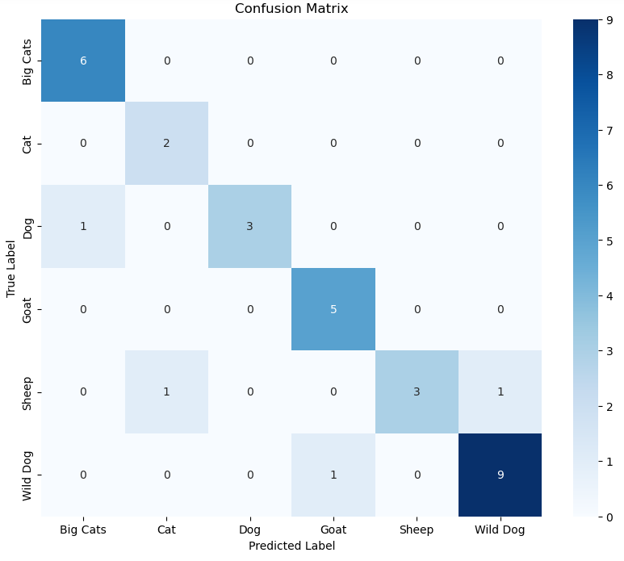
Advanced Classification of Animal Sounds Using Spectrogram Analysis
Group 16: Dallas Grandy, Bhavani Chalamalla, Haranadh Reddy Ravi
Department of Computer Science, Michigan Technological University
Abstract
Methods and Materials
Conclusion and Future Work
This project aims to develop a machine-learning model for classifying animal sounds into distinct categories: Dog, Cat, Goat, Sheep, Big Cats, and Wild Dogs. Utilizing audio feature extraction techniques with the Python library Librosa and advanced signal processing methods, including Fourier Transforms, the study focuses on the analysis of .wav audio files for minimal data loss. Mel Spectrograms and Mel Frequency Cepstral Coefficients (MFCCs) are crucial in representing and quantifying audio features. The project underscores the potential of combining sophisticated audio analysis techniques with machine learning to enhance bioacoustic research and animal sound classification.
Data Collection: The dataset comprises audio recordings of household pets (dogs, cats), farm animals (sheep, goats), and wild animals (canines/wild dogs, big cats). These recordings are sourced from platforms like YouTube, Pixabay, and Google's audio datasets.
Audio Processing Tools: Tools such as MP3 Cutter and Audio Converter are employed to standardize and enhance the audio quality.Librosa for Feature Extraction: Librosa is used for extracting audio features from .wav files. Features like Mel Spectrograms and MFCCs are generated, capturing the essence of the audio files.
Spectrogram Analysis: Fast Fourier Transform (FFT) is applied to create spectrograms, further adjusted to fit into the Mel scale, mimicking the human range of hearing. MFCC Extraction: MFCCs, extracted from the Mel Spectrograms, serve as input features for the machine learning models.
Models tested: Convolutional Neural Networks.
In conclusion, our project aimed at classifying animal sounds through spectrogram analysis. We effectively utilized librosa for feature extraction, with Mel Spectrograms and MFCCs crucially capturing audio characteristics, while Fourier Transforms were key in our precise spectrogram analysis to distinguish between animal sound categories. Our CNN model demonstrated strong classification abilities, especially for 'Big Cats' and 'Wild Dogs'. However, the findings emphasize the importance of a comprehensive and diverse dataset for training robust machine learning models and pave the way for future enhancements that could further improve classification accuracy, ultimately benefiting biodiversity monitoring and conservation efforts.
Future Work: The model exhibited overfitting, reflected in the discrepancy between high training and lower test accuracies, suggesting the refinement of the model with more sophisticated data augmentation, regularization strategies, hyperparameter tuning, and simplification for improved generalization.
We’ll also try to incorporate more Machine learning and deep learning models.
Fig 3: Wave Form of Animal Sounds
Results and Discussion
Introduction
The study and classification of animal sounds play a crucial role in bioacoustic research, offering valuable insights into animal behavior, communication patterns, and ecosystem health. Traditionally, this process has relied heavily on manual effort and subjective interpretation, which can be time-consuming and prone to errors. However, with recent advancements in machine learning and audio processing techniques, there is a growing opportunity to automate and enhance the accuracy of animal sound classification.
This project introduces an automated approach that leverages the power of machine learning algorithms and advanced audio analysis methods to classify animal sounds more efficiently and accurately. By utilizing the Librosa library for feature extraction and employing Fourier Transforms for spectrogram analysis, this study aims to delve into the intricate acoustic characteristics of diverse animal sounds.
Fig 1: Visual of FFT
Test accuracy of 87.5% indicates some overfitting, with the model less effective on unseen data.
We achieved a high training accuracy of 98.94%, showing strong learning capabilities
Discrepancy between training and validation metrics suggests the need for improved generalization.
Plans to enhance generalization include more diverse data augmentation and increased regularization.
References
The model performs very well with 'Big Cats' and 'Wild Dogs’.
Poor performance on 'Cats' indicates a need for more diverse and distinct training samples.
Inconsistent classification across classes highlights the need for enhanced data augmentation and additional tuning to reduce misclassification.
Yagya Raj, K. L., 2018. Domestic Cat Sound Classification Using Learned Features from Deep Neural Nets. Division of Computer Science and Engineering, 8(10). Retrieved from Domestic Cat Sound Classification Using Learned Features from Deep Neural Nets.
Detection and Classification Methods for Animal Sounds | SpringerLink.
Mammal Sound Classification Using Convolution Neural Network.
AudioSet - A sound vocabulary and dataset.
Fig 2: Mel Spectrogram

