Slide 1
EE7510 Course Project
Haranath Manikonda

Slide 2
Aim
To construct an observer based controller using LQR/LTR Control
The control has to be robust
The response should be as quick as possible.

Slide 3
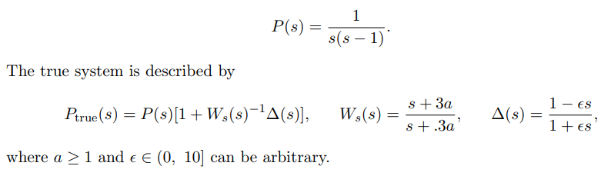
Given system

Slide 4
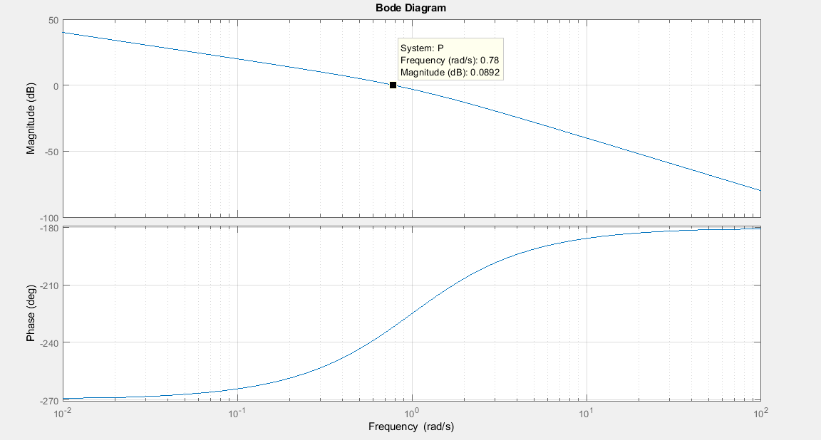
Magnitude Response of the given system

Slide 5
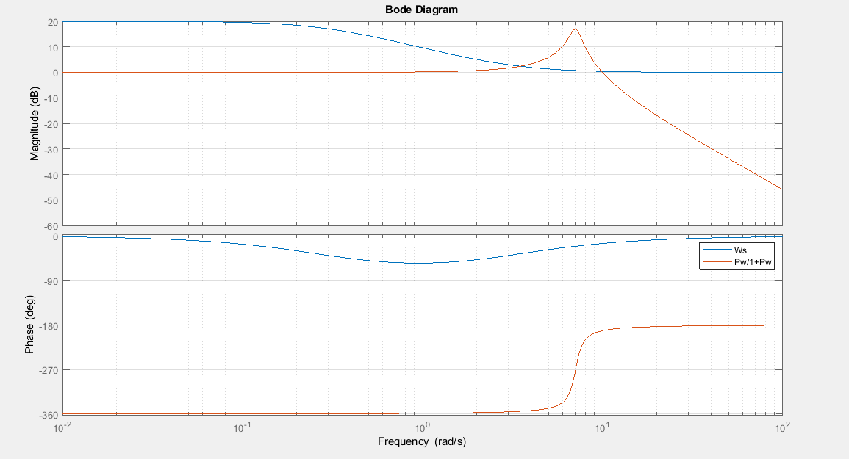
Determination of cut-off Frequency
W = 25

Slide 6
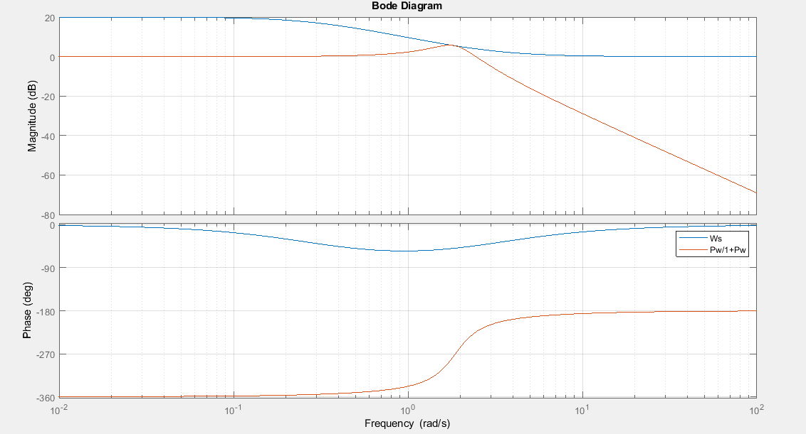
Determination of cut-off Frequency
W = 3.5

Slide 7
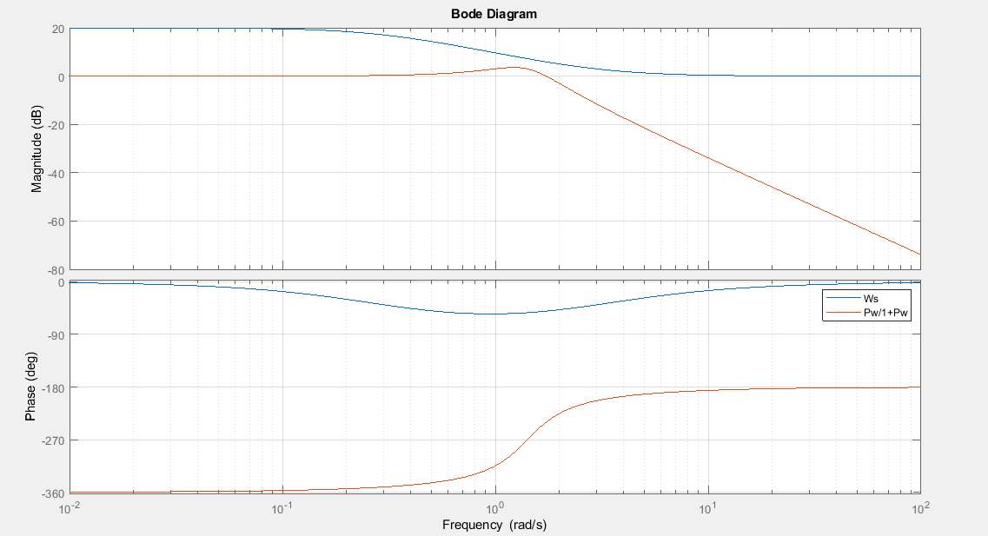
Determination of cut-off Frequency
W = 2

Slide 8
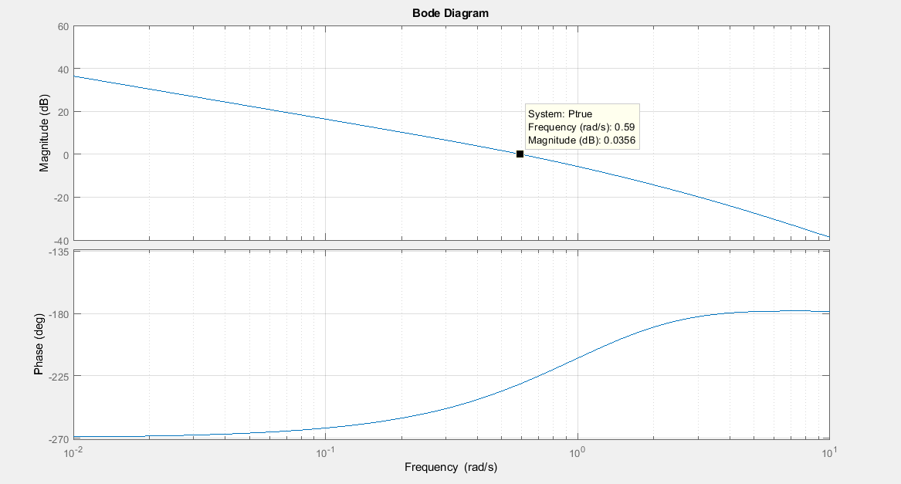
Magnitude Response of True System
W = 0.6

Slide 9
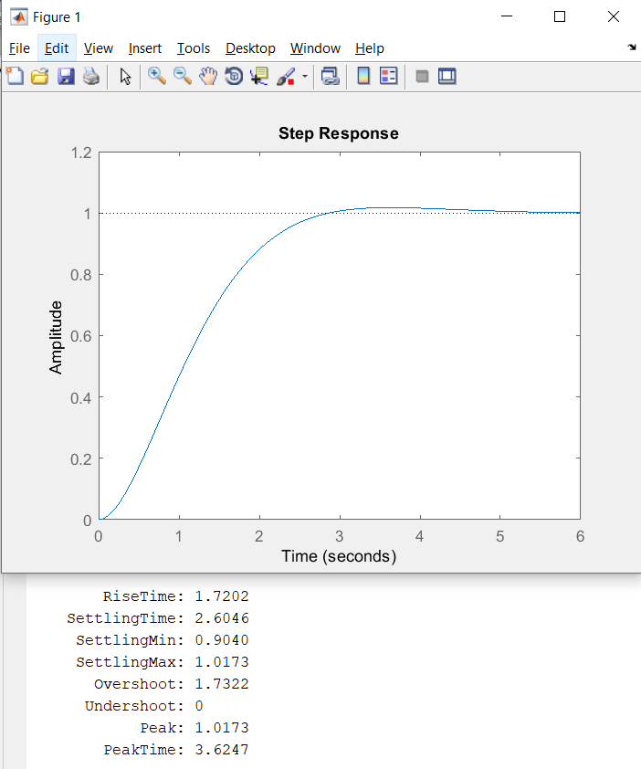
Step Response of the plant model
W = 2.5

Slide 10
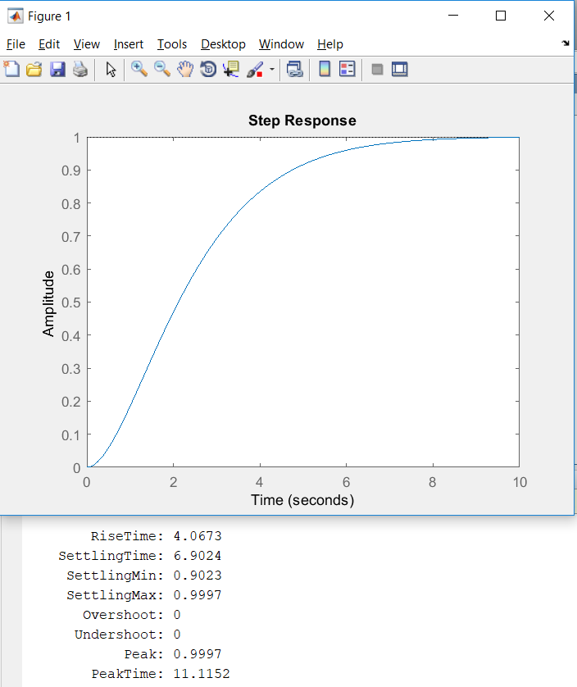
Step Response of the plant model
W = 0.6

Slide 11
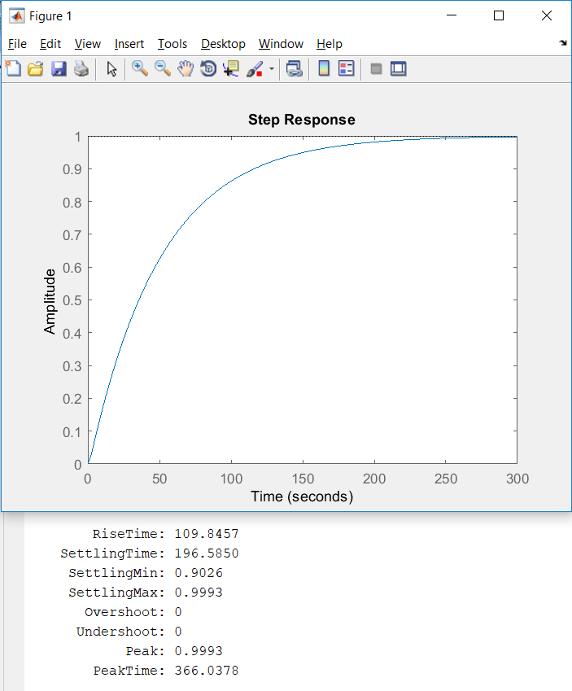
Step Response of the plant model
W = 0.02

Slide 12
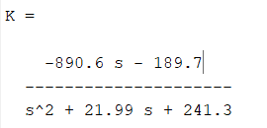
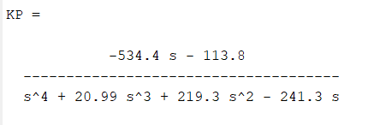
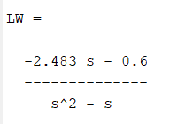
Loop Transfer Recovery
Observer Based Controller Gain
Loop Gain at Output Feedback
Loop Gain at State Feedback
W = 0.02

Slide 13
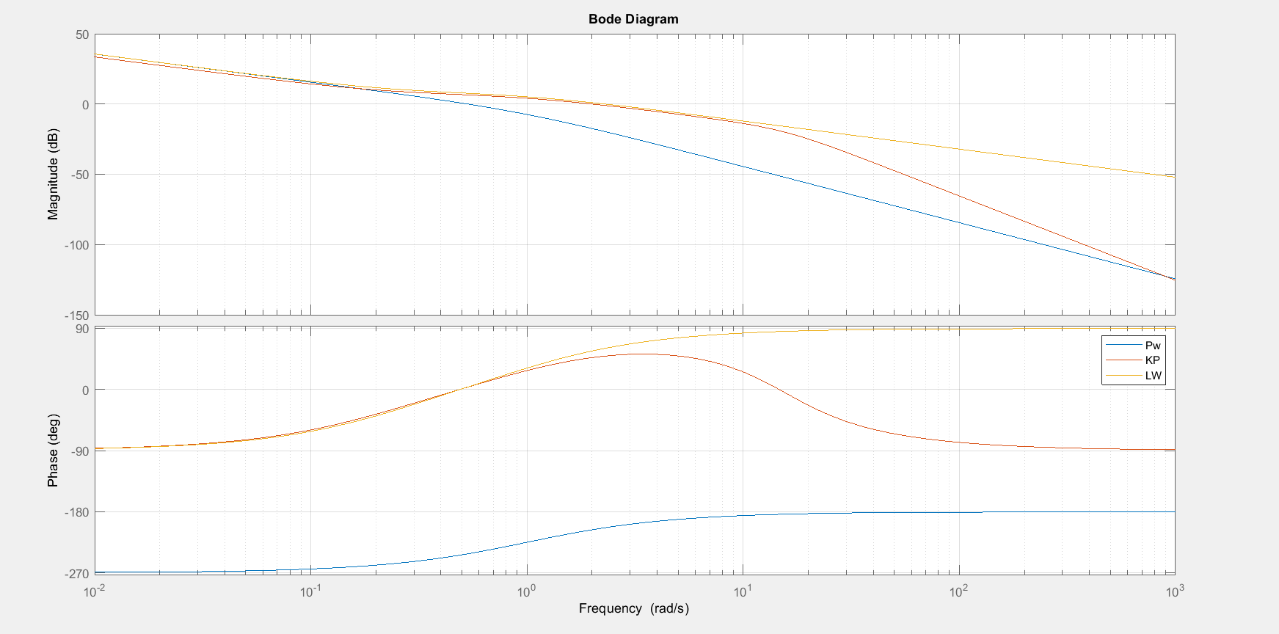
Magnitude Responses
W = 0.6 and q² = 100000.

Slide 14
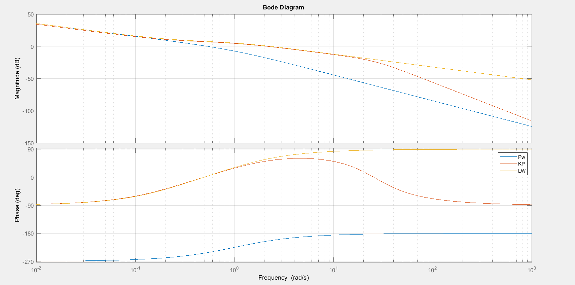
Magnitude Responses
W = 0.6 and q² = 1000000.

Slide 15
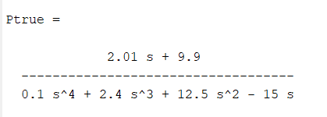
Perturbation Analysis
W = 0.6 and q² = 1000000.

Slide 16
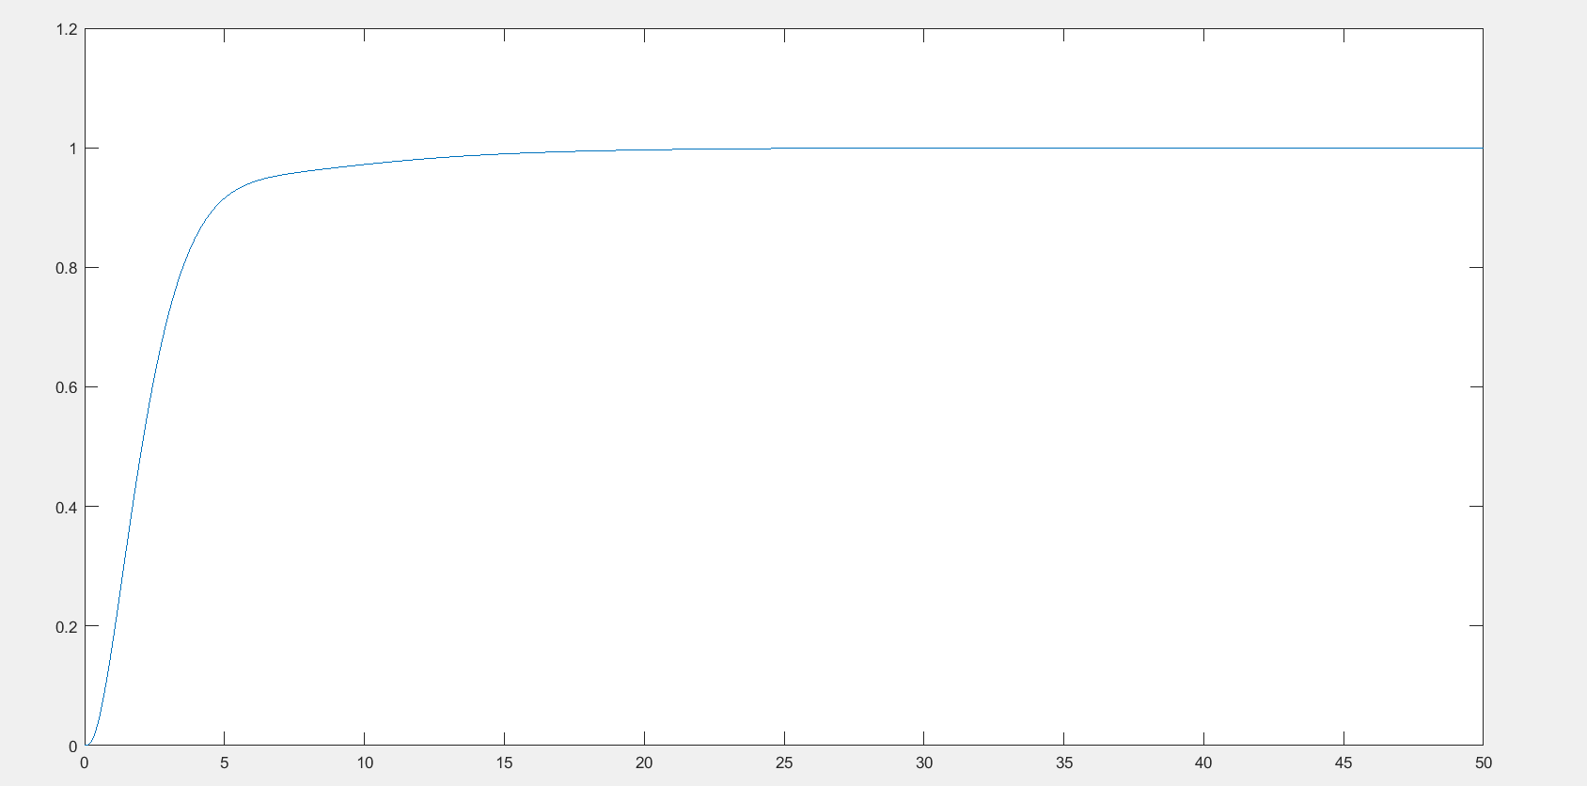
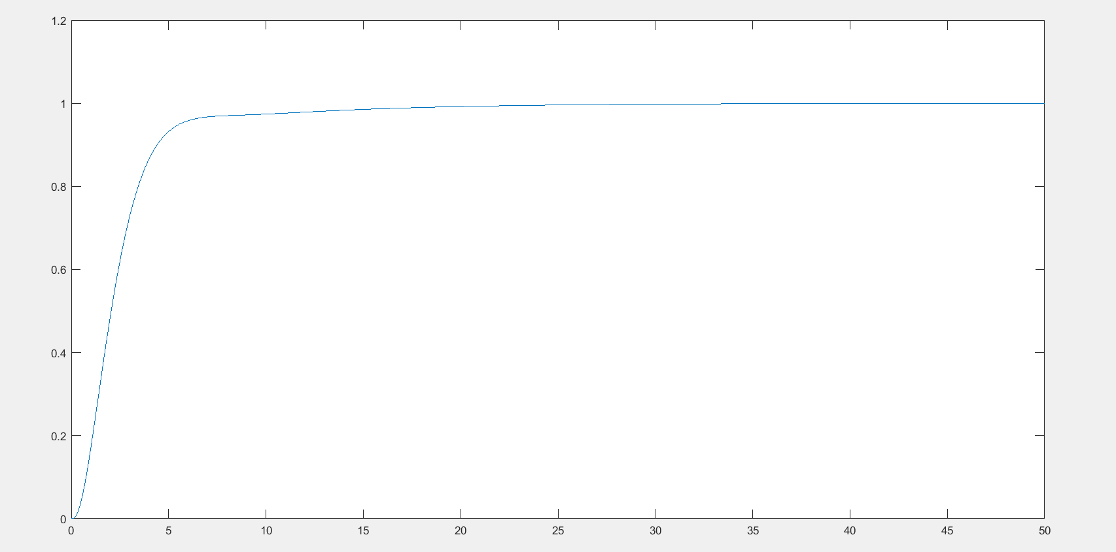
Perturbation Analysis
When ε = 5 and a = 5
When ε = 9 and a = 5

Slide 17
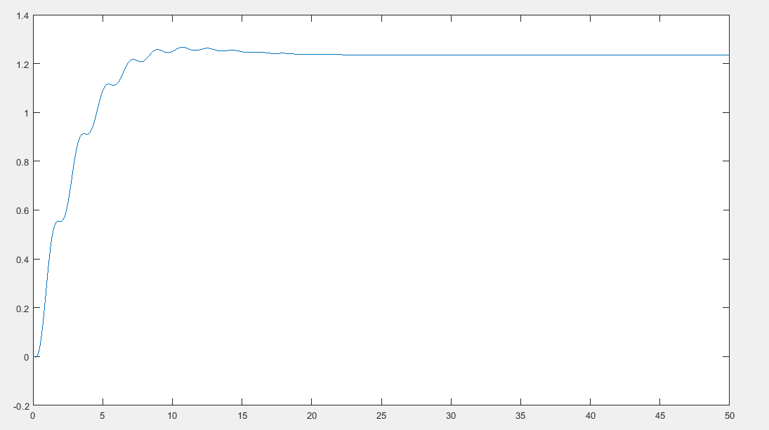
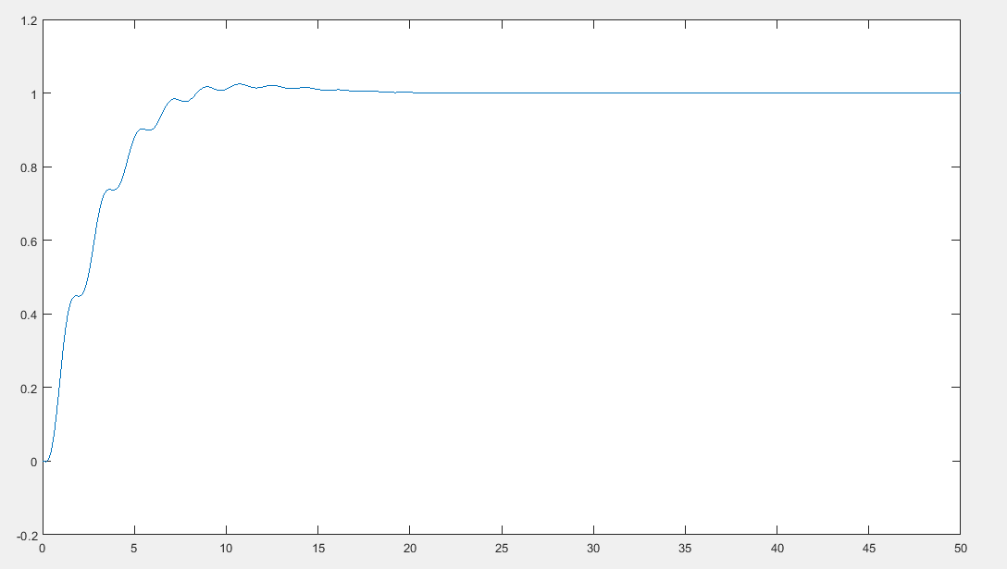
Problems in Design
When ε = 0.5 and a = 5, W=0.65

Slide 18
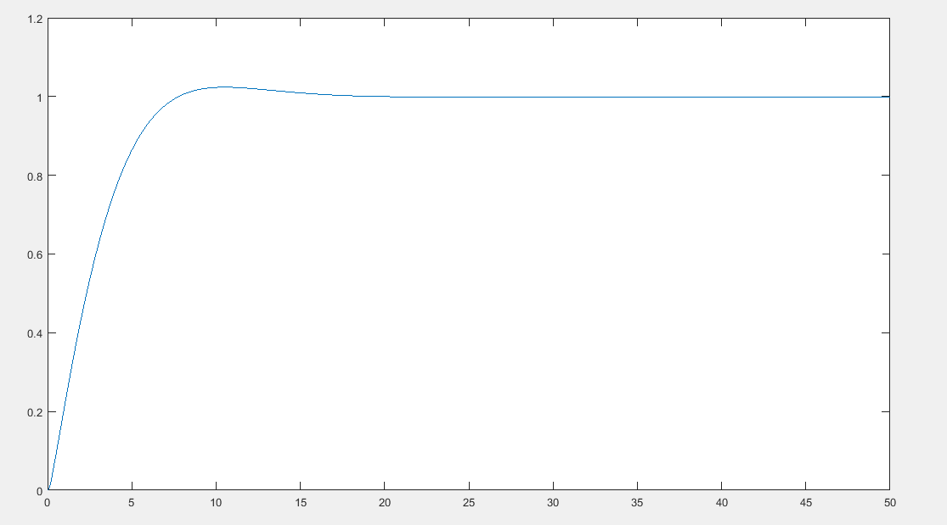
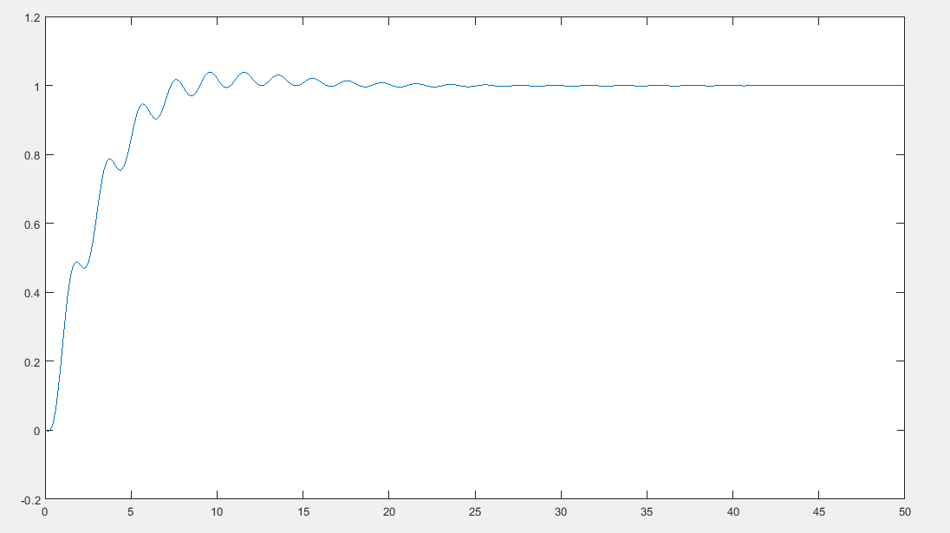
Problems in Design
When ε = 0 and a = 5, W=0.65
When ε = 0.6 and a = 5, W=0.65

Slide 19
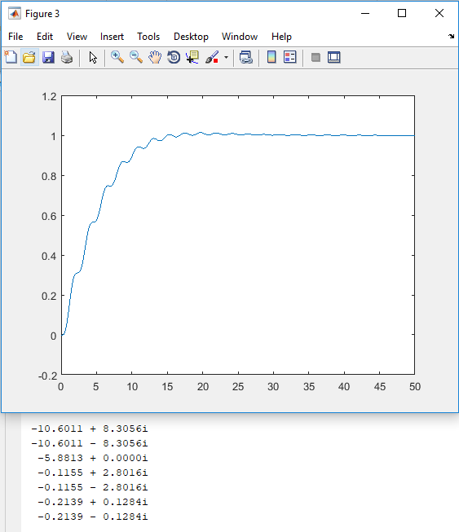
Problems in Design

Slide 20
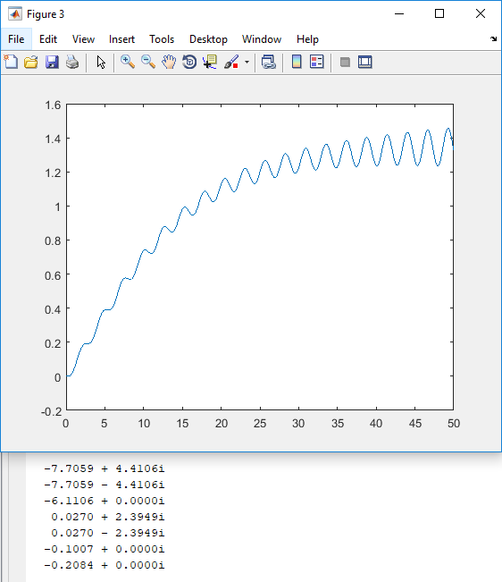
Problems in Design

Slide 21
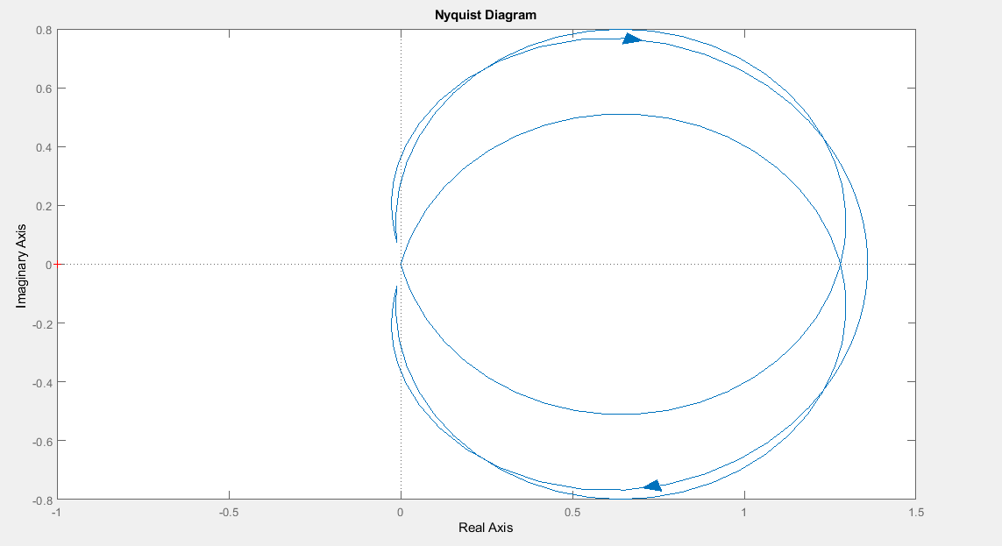
Problems in Design

Slide 22
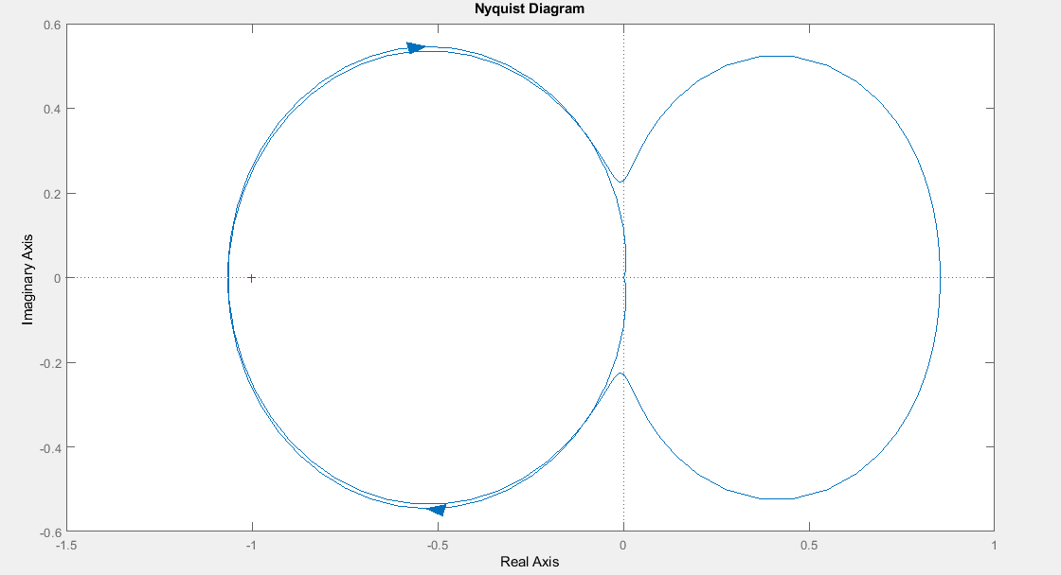
Problems in Design

Slide 23
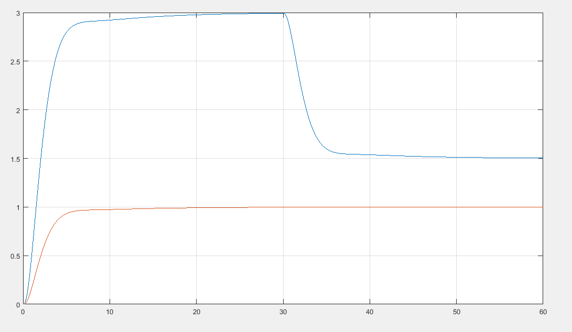
Non – Linear input to increase rise time

Slide 24
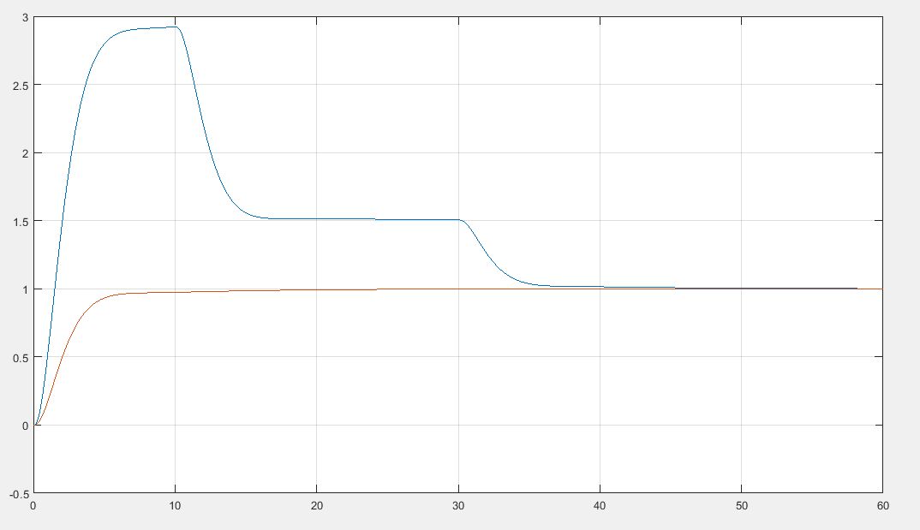
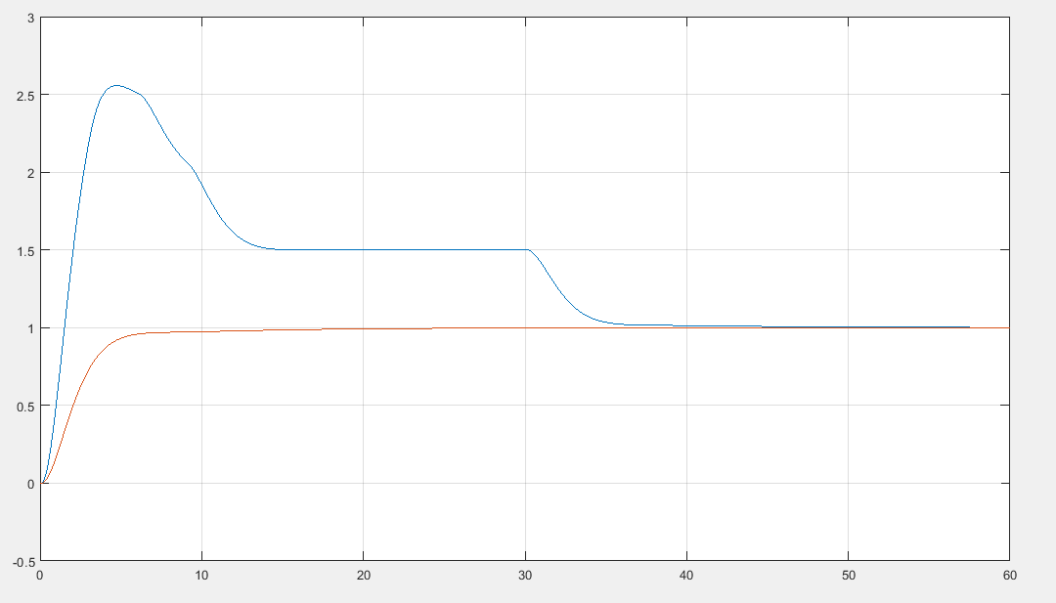
Non – Linear input to increase rise time

Slide 25
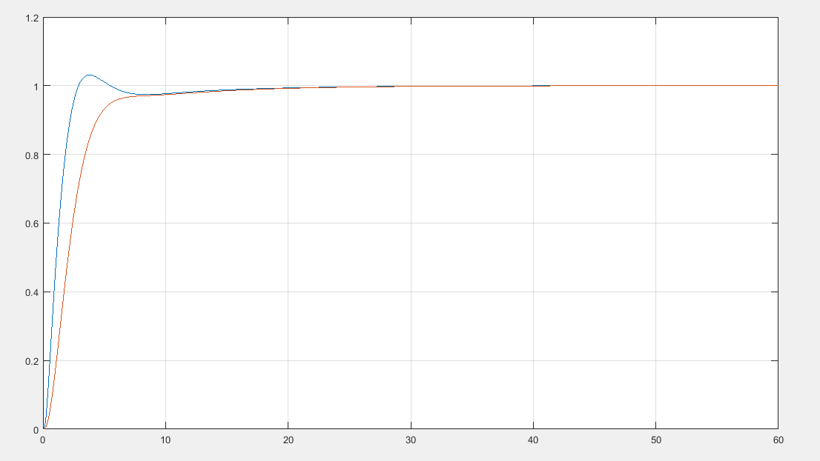
Non – Linear input to increase rise time

Slide 26
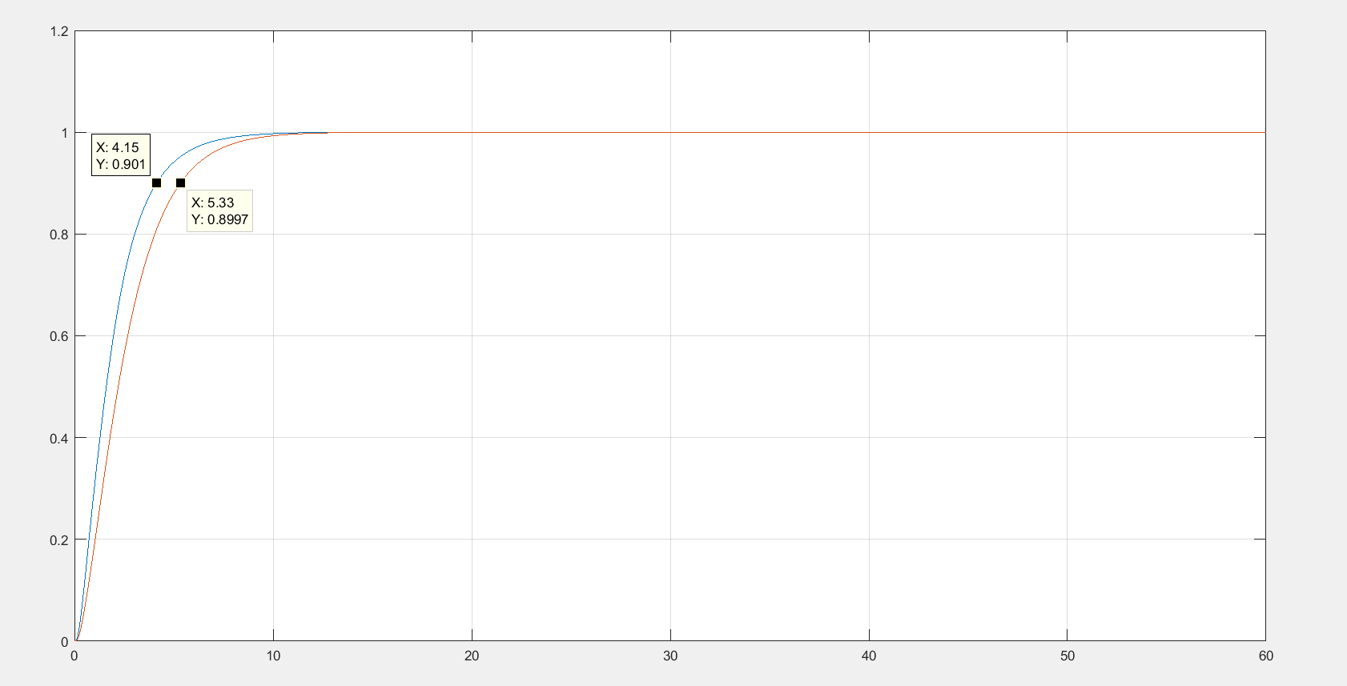
Non – Linear input to increase rise time

Slide 27
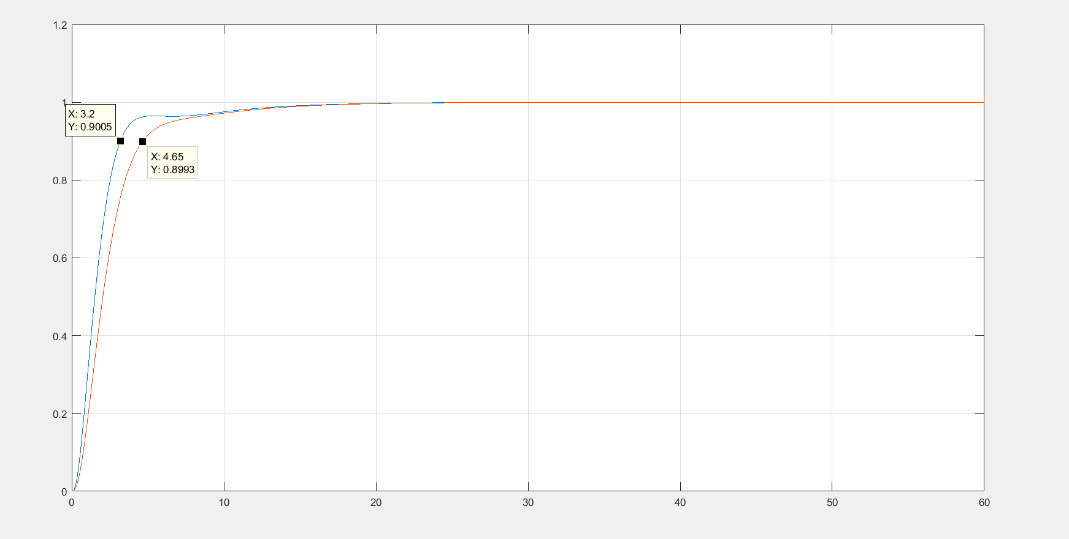
Non – Linear input to increase rise time

Slide 28
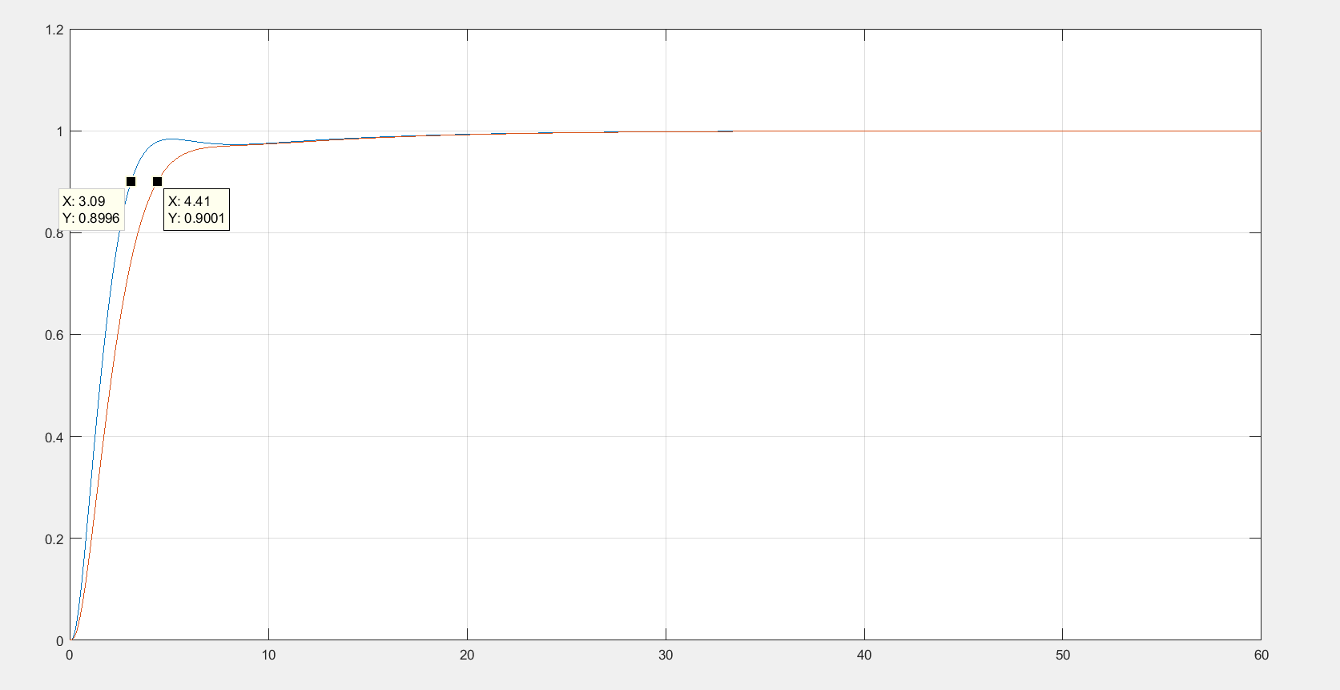
Non – Linear input to increase rise time

Slide 29
THANK YOU

