Slide 1

Project Title: Design and Development of a Loan Lifecycle Management System for Micro-Loans
Team Members:
1. Harapriya Das - 2411021061391
2. Sangameshwar - 2411021061390
3. Sandhyarani - 2411021061361
4. Rakshitha M - 2411021061313
Name of the Mentor: Dr. T. Prasanth
E1CSA313- Design Project -1

Slide 2

Agenda
Introduction
Review of literature
Observations from the literature review
Limitations from the literature review
Problem Definition & Proposed Methodology
  Problem Statement
  Proposed Research / Methodology
  Software Requirements
References

Slide 3

Introduction
The Loan Lifecycle Management System is a web application that manages a micro-loan from application to repayment or default.
A micro-loan is a small loan provided for personal, emergency, educational, or small-business needs.
Borrowers can register, create a profile, apply for a loan, and track its status online.
The system performs rule-based risk evaluation using income, loan amount, existing obligations, and repayment capacity.
Administrators can review applications and approve or reject loans based on borrower details and risk results.
For approved loans, the system creates a repayment schedule, tracks payments and outstanding balances, identifies overdue instalments, and flags potential defaults.
An admin dashboard provides a complete view of applications, active loans, repayments, overdue payments, and default risks.

Slide 4

Review of literature
S.No | Author Name, Journal, Publication Year | Research/ Methodology | Performance Metrics | Advantages | Disadvantages
1 | Bennouna & Tkiouat, Procedia Computer Science, 2019 | Developed a microfinance credit-scoring model using logistic regression and discriminant analysis on 1,500 loans. | Default probability based on borrower details, unpaid debts, loan amount and duration. | Uses financial factors closely related to our rule-based eligibility module. | Requires more historical borrower data for reliable default prediction.
2 | Dubina, Kang & Suh, Credit Scoring for Micro-Loans, 2019 | Developed an interpretable micro-loan credit-scoring system and studied data-quality problems. | ROC-AUC, accuracy, F1-score, Type-I and Type-II errors. | Supports explainable eligibility decisions instead of giving only approval or rejection. | Requires labelled historical loan data; unsuitable for our initial prototype without past records.
3 | Kassim & Rahman, Qualitative Research in Financial Markets, 2018 | Interviewed 40 microfinance borrowers and used content analysis to identify default causes. | Repayment capacity, existing commitments and post-loan monitoring; no prediction accuracy reported. | Supports our overdue tracking and potential-default monitoring modules. | Small sample and qualitative findings from Bangladesh may not apply to every borrower group.
4 | Dorfleitner & Oswald, Review of Financial Economics, 2016 | Used binary regression on Kiva micro-loans to study borrower repayment behaviour. | Default probability based on loan amount, loan term, grace period and borrower screening. | Supports our use of loan amount, repayment period and repayment history in risk monitoring. | Based on Kiva’s lending model and does not provide a complete loan-management application.

Slide 5




Review of literature
Feature | Kreditbee | CASHe | LendingClub | Upstart
User Interface | Simple and loan-focused | Attractive but slightly crowded | Professional and organized | Clean and easy to follow
Platform Support | Android, iOS, website | Android, iOS, website | Android, iOS, website | iOS and website only
App Size (iOS) | 54 MB | 87.2 MB | 136.9 MB | 97.3 MB
Loan Process | Apply, verify, receive and repay | Apply, KYC, approval and repayment | Apply, approval, funding and repayment | Check rate, apply, verify and repay
Technical Features | OTP, digital KYC and UPI | Digital KYC and SSL security | Automated risk checking and autopay | AI-based evaluation and soft credit check
Main Advantage | Flexible loan amount and tenure | Multiple loan categories | Clear loan-progress tracking | Fast automated decisions
Main Drawback | Rejection reasons are unclear | Status updates and support can be slow | Mainly designed for US borrowers | Android application is unavailable
User Rating | 4.4/5 | 4.3/5 | 4.8/5 | 4.9/5

Slide 6




Review of literature
Feature | mPokket | Paytm | Navi | Kiva
User Interface | Simple and student-friendly | Useful but crowded | Modern and polished | Simple and purpose-focused
Platform Support | Android, iOS, website | Android, iOS, website | Android and iOS | iOS and website
App Size (iOS) | 67.6 MB | 345.7 MB | 357.6 MB | 53.9 MB
Loan Process | Apply, KYC, approval and repayment | Apply, select lender, receive and repay | Paperless application and repayment | Select borrower, fund and track repayment
Technical Features | OTP, KYC and bank linking | AI checking, e-sign and autopay | Digital KYC, AI and autopay | Crowd funding and partner verification
Main Advantage | Small loans for students and freshers | Loans, payments and reports in one app | Fast and completely digital process | Supports micro-borrowers through crowdfunding
Main Drawback | Low loan limit and payment-update delays | Large application with too many services | Large application and unclear risk rules | Borrowers cannot apply directly through the app
User Rating | 4.2/5 | 4.7/5 | 4.5/5 | 4.9/5

Slide 7

Observations from the Literature Review
Income, existing obligations, loan amount, and repayment period are important factors in evaluating micro-loan risk.
Accurate and complete borrower data is necessary for consistent eligibility and approval decisions.
Explainable rule-based evaluation is more suitable for our prototype because historical loan data is not yet available for machine learning.
Repayment history and missed instalments are important indicators of increasing default risk.
Post-loan monitoring is necessary to identify overdue payments and potential defaults at an early stage.
Existing studies mainly focus on credit scoring or default prediction, while our project manages the complete loan lifecycle in one system.

Slide 8

Limitations from the Literature Review
Many studies use small or location-specific datasets, so their results may not apply to all micro-loan borrowers.
Most credit-scoring models require large amounts of historical loan and repayment data.
Machine-learning models can produce accurate predictions, but their decisions may be difficult to explain.
Several studies focus mainly on loan eligibility and default prediction, without covering the complete loan lifecycle.
Limited attention is given to repayment scheduling, online payments, notifications, and report generation.
Some models use personal or alternative data, creating concerns related to borrower privacy, security, and consent.

Slide 9

Problem Statement / Scope of the Project
Manual micro-loan processing can cause delays, inconsistent eligibility decisions, and inaccurate repayment tracking.
The proposed web-based application will provide separate registration and login access for borrowers and administrators.
Borrowers can create profiles, enter income and employment details, apply for loans, and track their application status.
The system will perform rule-based eligibility evaluation using income, loan amount, existing obligations, employment, and repayment capacity.
Administrators can review borrower information and risk results before approving or rejecting loan applications.
For approved loans, the system will generate repayment schedules, record payments, and calculate outstanding balances.
The administrative dashboard will monitor active loans, repayment history, overdue instalments, and potential default cases.

Slide 10

Proposed Idea / Solution
Problem Identified | Solution Provided by Our System
Loan details are handled manually or stored in different places. | A centralized MySQL database stores borrower profiles, applications, loans, and repayments.
Borrowers cannot easily track their loan application. | The Borrower Portal displays application status as pending, approved, or rejected.
Eligibility decisions may be inconsistent. | A rule-based evaluation checks income, loan amount, existing obligations, employment, and repayment capacity.
Reviewing applications manually takes time. | The Admin Dashboard displays borrower details and risk results together for faster review.
Repayment dates and remaining amounts are difficult to track. | The system automatically creates a repayment schedule and calculates the outstanding balance.
Missed instalments may not be noticed immediately. | Unpaid instalments are automatically marked as overdue after their due date.
High-risk loans are difficult to identify. | Loans with repeated missed payments are flagged as potential default cases for administrator action.

Slide 11

Proposed Research / Methodology
Research Approach: Follow a design-and-development methodology to create and evaluate a working micro-loan lifecycle management system.
Requirement Definition: Convert findings from the completed literature and application review into clear borrower, administrator, loan, repayment, payment, notification, and reporting requirements.
Rule Formulation: Define eligibility rules using monthly income, employment status, existing obligations, requested amount, loan tenure, and repayment capacity.
System Modelling: Design the system architecture, ER diagram, UML diagrams, database schema, and user-interface flow before implementation.
Prototype Development: Develop the system in stages using React.js, Spring Boot REST APIs, and MySQL, with each module tested after implementation.
Lifecycle Implementation: Connect loan application, evaluation, approval, repayment scheduling, online payment, overdue detection, default flagging, notifications, and report generation.
System Evaluation: Test workflow completion time, eligibility-rule consistency, repayment-calculation accuracy, overdue detection, security, usability, and response performance.

Slide 12

Software Requirements
Frontend: React.js, HTML, CSS, and JavaScript for developing the Borrower Portal and Administrator Dashboard.
Backend: Java with Spring Boot for authentication, loan processing, eligibility evaluation, repayments, and default monitoring.
API Communication: REST APIs for exchanging borrower, loan, approval, and repayment data between the frontend and backend.
Database: MySQL for storing users, borrower profiles, loan applications, risk results, repayment schedules, and payment records.
Development Tools: Visual Studio Code for React development and IntelliJ IDEA or Eclipse for Spring Boot development.
Testing Tools: Postman for testing backend APIs and web browsers for testing the complete user workflow.
Version Control: Git and GitHub for maintaining individual member branches, reviewing changes, and merging approved work into the main branch.

Slide 13

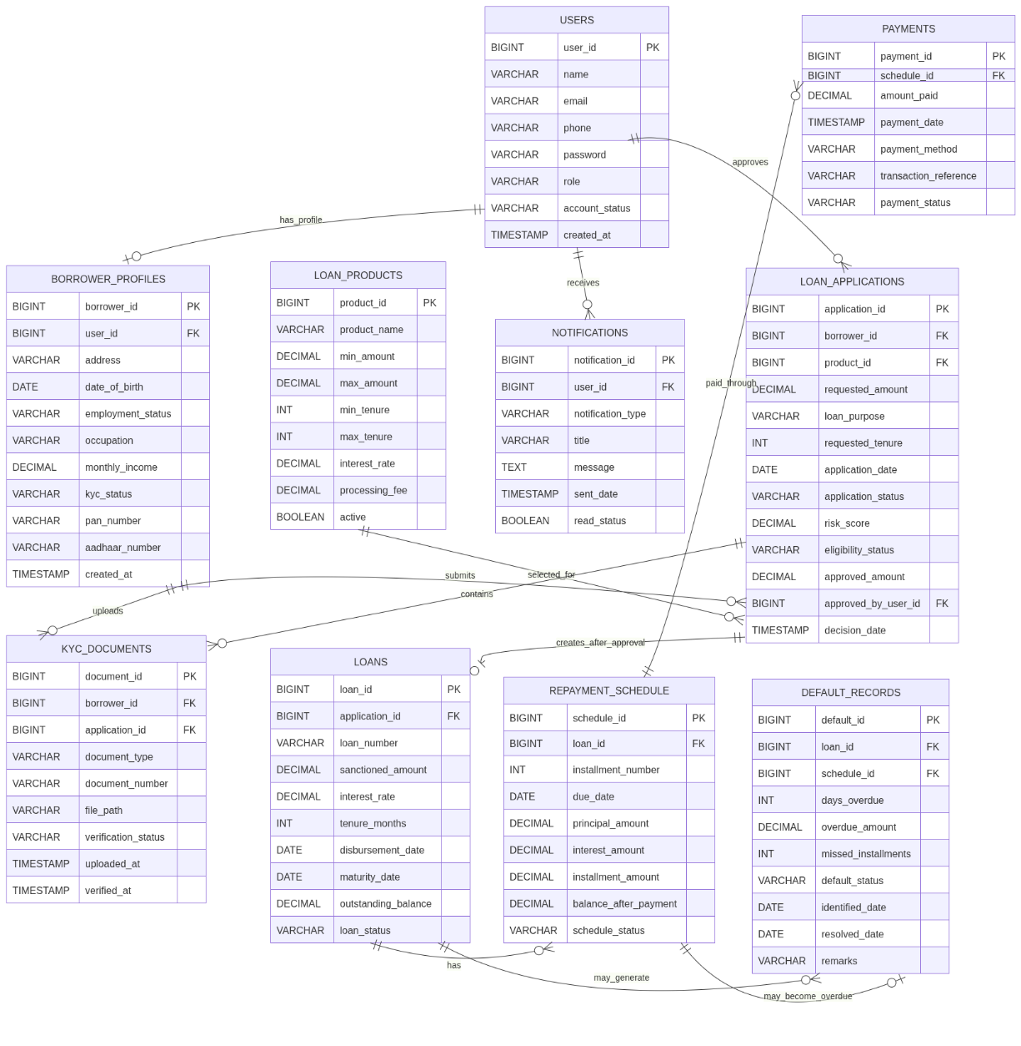
ER Diagram

Slide 14
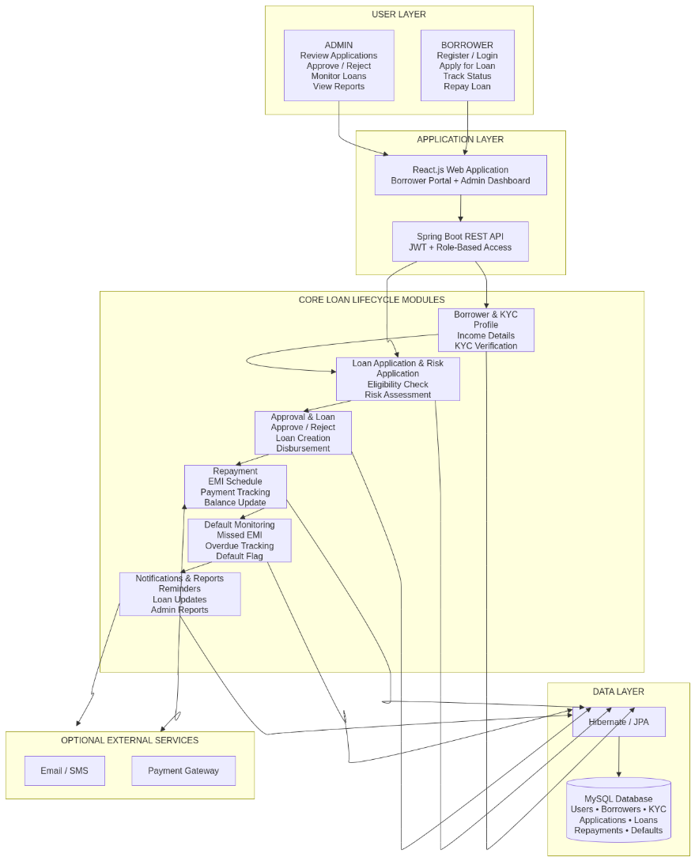
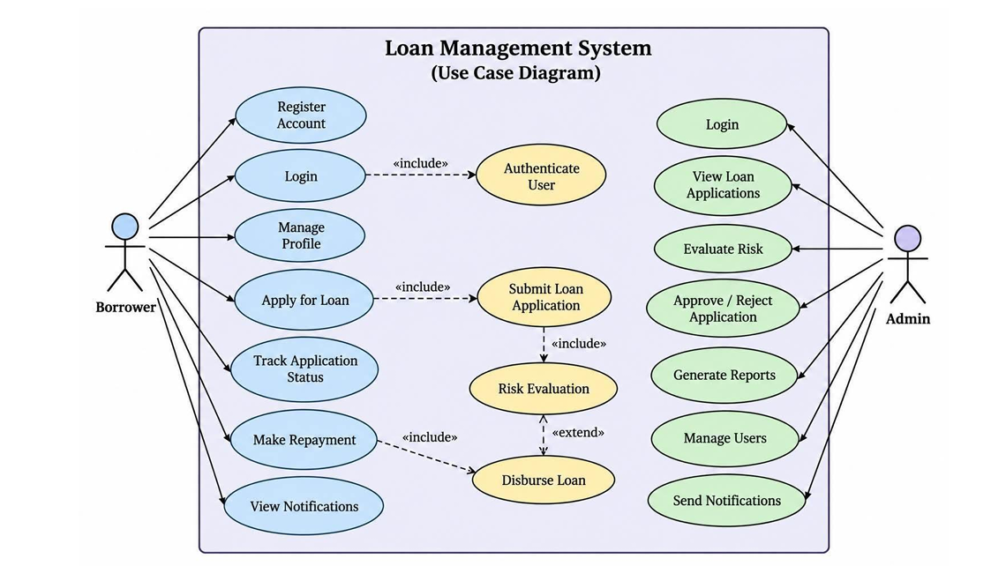
System Architecture And UML Diagram

Slide 15

Proposed Modules
User Access and Session Management: Handles borrower/admin registration, login, logout, role-based access, and active user sessions.
Borrower Profile Management: Maintains personal details, employment information, monthly income, and existing financial obligations.
Loan Application and Tracking: Supports loan submission and displays the application status as pending, approved, or rejected.
Eligibility and Loan Approval: Performs rule-based risk evaluation and allows the administrator to approve or reject applications.
Repayment and Default Management: Generates repayment schedules, updates outstanding balances, detects overdue instalments, and flags potential defaults.
Payment Gateway: Supports loan repayments through UPI, debit/credit cards, and net banking.
Notification Management: Sends application updates, payment confirmations, due-date reminders, and overdue alerts through email, SMS, or WhatsApp.
Dashboard and Report Generation: Displays loan performance and generates borrower, repayment, overdue, and default reports in PDF and Excel formats.

Slide 16

Novelty of the Proposed Idea / Project
What Exists Currently
Digital Loan Application → Existing platforms allow borrowers to apply for loans online.
Eligibility Checking → Many applications evaluate eligibility using internal criteria that are not clearly explained.
Loan Approval → Platforms provide approval or rejection, but the detailed decision process is usually hidden.
Repayment Tracking → Existing applications display instalment dates, payment history, and outstanding amounts.
Payment Reminders → Some platforms notify borrowers about upcoming or missed repayments.

Slide 17

Novelty of the Proposed Idea / Project
What Our Project Proposes
Transparent Rule-Based Evaluation → Clearly evaluates income, obligations, requested amount, and repayment capacity.
Explainable Eligibility Result → Shows which rules affected the borrower’s eligibility instead of providing only a decision.
Complete Loan Lifecycle → Connects application, evaluation, approval, repayment, overdue tracking, and default monitoring.
Borrower and Admin Integration → Provides separate but connected portals for borrowers and administrators.
Early Default Identification → Flags repeated missed instalments as potential defaults for timely administrator action.

Slide 18
Expected Results and Discussion
Functional Loan Management System → Borrowers should be able to register, create profiles, submit applications, and track loan status successfully.
Consistent Eligibility Evaluation → Applications with the same financial conditions should receive the same rule-based eligibility result.
Structured Approval Workflow → Administrators should be able to review borrower details and approve or reject applications efficiently.
Accurate Repayment Management → The system should correctly generate instalment schedules, record payments, and calculate outstanding balances.
Overdue and Default Detection → Missed instalments should be marked as overdue, while repeated missed payments should be flagged as potential defaults.
Improved Loan Monitoring → The dashboard should provide accurate information about pending applications, active loans, repayments, overdue accounts, and default risks.

Slide 19
Conclusion & Future Directions
Conclusion:
The system aims to make micro-loan processing faster, structured, and easier to monitor.
It combines loan application, eligibility evaluation, approval, repayment tracking, and default monitoring in one system.
It helps borrowers track their loans and enables administrators to make consistent decisions and monitor repayments.
Future Directions:
Machine-Learning Credit Scoring: Improve risk prediction using historical borrower and repayment data.
Credit-Bureau Integration: Verify credit history using external credit-information services.
Advanced Fraud Detection: Identify suspicious borrower information, applications, and payment activities.
Mobile and Multilingual Support: Develop a mobile application that supports multiple regional languages.

Slide 20

References
Bennouna, G., & Tkiouat, M. (2019). Scoring in microfinance: Credit risk management tool—Case of Morocco. Procedia Computer Science, 148, 522–531. https://doi.org/10.1016/j.procs.2019.01.025
Cubiles-De-La-Vega, M. D., Blanco-Oliver, A., Pino-Mejías, R., & Lara-Rubio, J. (2013). Improving the management of microfinance institutions by using credit scoring models based on statistical learning techniques. Expert Systems with Applications, 40(17), 6910–6917. https://doi.org/10.1016/j.eswa.2013.06.031
Van Gool, J., Verbeke, W., Sercu, P., & Baesens, B. (2012). Credit scoring for microfinance: Is it worth it? International Journal of Finance & Economics, 17(2), 103–123. https://doi.org/10.1002/ijfe.444
Serrano-Cinca, C., Gutiérrez-Nieto, B., & Reyes, N. M. (2016). A social and environmental approach to microfinance credit scoring. Journal of Cleaner Production, 112, 3504–3513. https://doi.org/10.1016/j.jclepro.2015.09.103
Ruiz, S., Gomes, P., Rodrigues, L., & Gama, J. (2019). Credit scoring for microfinance using behavioral data in emerging markets. Intelligent Data Analysis, 23(6), 1355–1378. https://doi.org/10.3233/IDA-184239
Medina-Olivares, V., Calabrese, R., Dong, Y., & Shi, B. (2022). Spatial dependence in microfinance credit default. International Journal of Forecasting, 38(3), 1071–1085. https://doi.org/10.1016/j.ijforecast.2021.05.009
Kassim, S. H. J., & Rahman, M. (2018). Handling default risks in microfinance: The case of Bangladesh. Qualitative Research in Financial Markets, 10(4), 363–380. https://doi.org/10.1108/QRFM-03-2017-0018
Dorfleitner, G., & Oswald, E. M. (2016). Repayment behavior in peer-to-peer microfinancing: Empirical evidence from Kiva. Review of Financial Economics, 30, 45–59. https://doi.org/10.1016/j.rfe.2016.05.005
Dorfleitner, G., Just-Marx, S., & Priberny, C. (2017). What drives the repayment of agricultural micro loans? Evidence from Nicaragua. The Quarterly Review of Economics and Finance, 63, 89–100. https://doi.org/10.1016/j.qref.2016.02.009
Liu, Y., Yang, M., Wang, Y., Li, Y., Xiong, T., & Li, A. (2022). Applying machine learning algorithms to predict default probability in the online credit market: Evidence from China. International Review of Financial Analysis, 79, 101971. https://doi.org/10.1016/j.irfa.2021.101971
Dong, Y., Gou, Q., & Qiu, H. (2023). Big tech credit score and default risk: Evidence from loan-level data of a representative microfinance company in China. China Economic Review, 81, 102010. https://doi.org/10.1016/j.chieco.2023.102010
Djeundje, V. B., Crook, J., Calabrese, R., & Hamid, M. (2021). Enhancing credit scoring with alternative data. Expert Systems with Applications, 163, 113766. https://doi.org/10.1016/j.eswa.2020.113766

