Slide 1


Hello

Slide 2
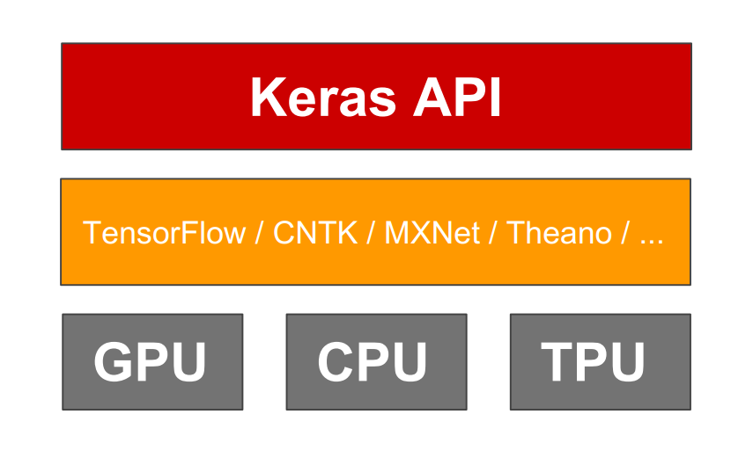
Modular

Slide 3
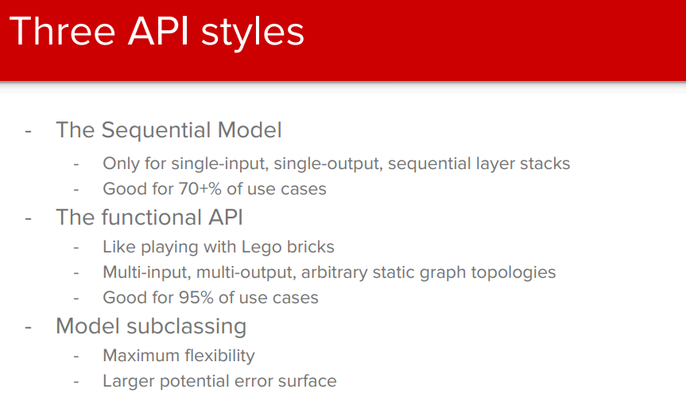
Covers users of all experience types

Slide 4

California House Data set

Slide 5
Learning objectives(Pandas)
Know the basics of DataFrames and Series structures of the pandas library
Access and manipulate data within a DataFrame and Series
Import CSV data into a pandas DataFrame
Reindex a DataFrame to shuffle data

Slide 6
Learning objectives(TensorFlow)
Learn basic TensorFlow concepts
Use the LinearRegressor class
Evaluate the accuracy of a model’s prediction using Root Mean Squared Error
Improve the accuracy of a model by tuning its hyperparameters ”Feature engineering”

Slide 7
Tools(libraries)
Pandas
Numpy
Sklearn
Matplotlib
Math

