Slide 1

ClariQuery
Ask your data in plain English. Accurate across many tables. Private by design.
Multi-table accuracy
No hallucinated answers
HIPAA-safe access control
Buildathon Dallas · Problem Statement 1
Notes:
Business users need answers from their data, but most can't write SQL and can't always wait on a data team. Current AI approaches work at about 80 percent on one or two tables, but hallucinate as more tables are added. And the data often contains PHI and PII, so privacy isn't optional. This is ClariQuery.

Slide 2



The problem
Accuracy breaks at scale
Text-to-SQL works on 1-2 tables, then hallucinates joins as more tables are added.
Answers get invented
Models confidently make up numbers that aren't in the data.
Sensitive data leaks
Tables hold PHI and PII — access control is non-negotiable.
Notes:
Three hard parts: accuracy breaks as you add tables, models invent answers, and the data is sensitive so privacy must be built in. ClariQuery addresses all three.

Slide 3




How it works
→
→
→
→
1.
2.
3.
4.
5.
Plain-English
question
Smart table
selection
Access
control
Generate &
run SQL
Grounded
answer
The key idea: pruning the schema to only relevant tables BEFORE writing SQL keeps accuracy high as the database grows.
Notes:
Five steps: ask in plain English, select relevant tables, apply access control, generate and run SQL, produce a grounded answer. Narrowing the schema first is what keeps accuracy high at scale.

Slide 4


Smart table selection — the accuracy fix
A toggle in the app. It decides how much of the database the AI sees before writing SQL.
Toggle OFF
Toggle ON (default)
AI sees ALL tables at once
More columns = more confusion
Picks wrong joins, invents columns
Accuracy drops as tables grow
AI first picks only relevant tables
Writes SQL on a small, clean schema
Fewer chances to hallucinate joins
Accuracy holds even with 100s of tables
This directly answers the statement: accuracy that breaks past 1-2 tables is fixed by narrowing the schema first.
Notes:
The toggle controls how much of the database the AI sees. Off: it sees every table and is more likely to pick wrong joins or invent columns. On: it first selects only relevant tables, then writes SQL on a small clean schema. That keeps accuracy high as the database grows.

Slide 5
From a question to an answer
"Which plan has the most enrolled members?" — ClariQuery writes the SQL and visualizes the result.
Generated SQL
SELECT plan_name,
COUNT(DISTINCT member_id)
AS members
FROM enrollments
GROUP BY plan_name
ORDER BY members DESC;
Grounded answer
Silver HMO has the most enrolled members, with 733.
Notes:
A real example. The user asks which plan has the most enrolled members. ClariQuery writes correct SQL using COUNT DISTINCT, runs it, answers in plain English, and charts the result. Silver HMO leads with 733.

Slide 6
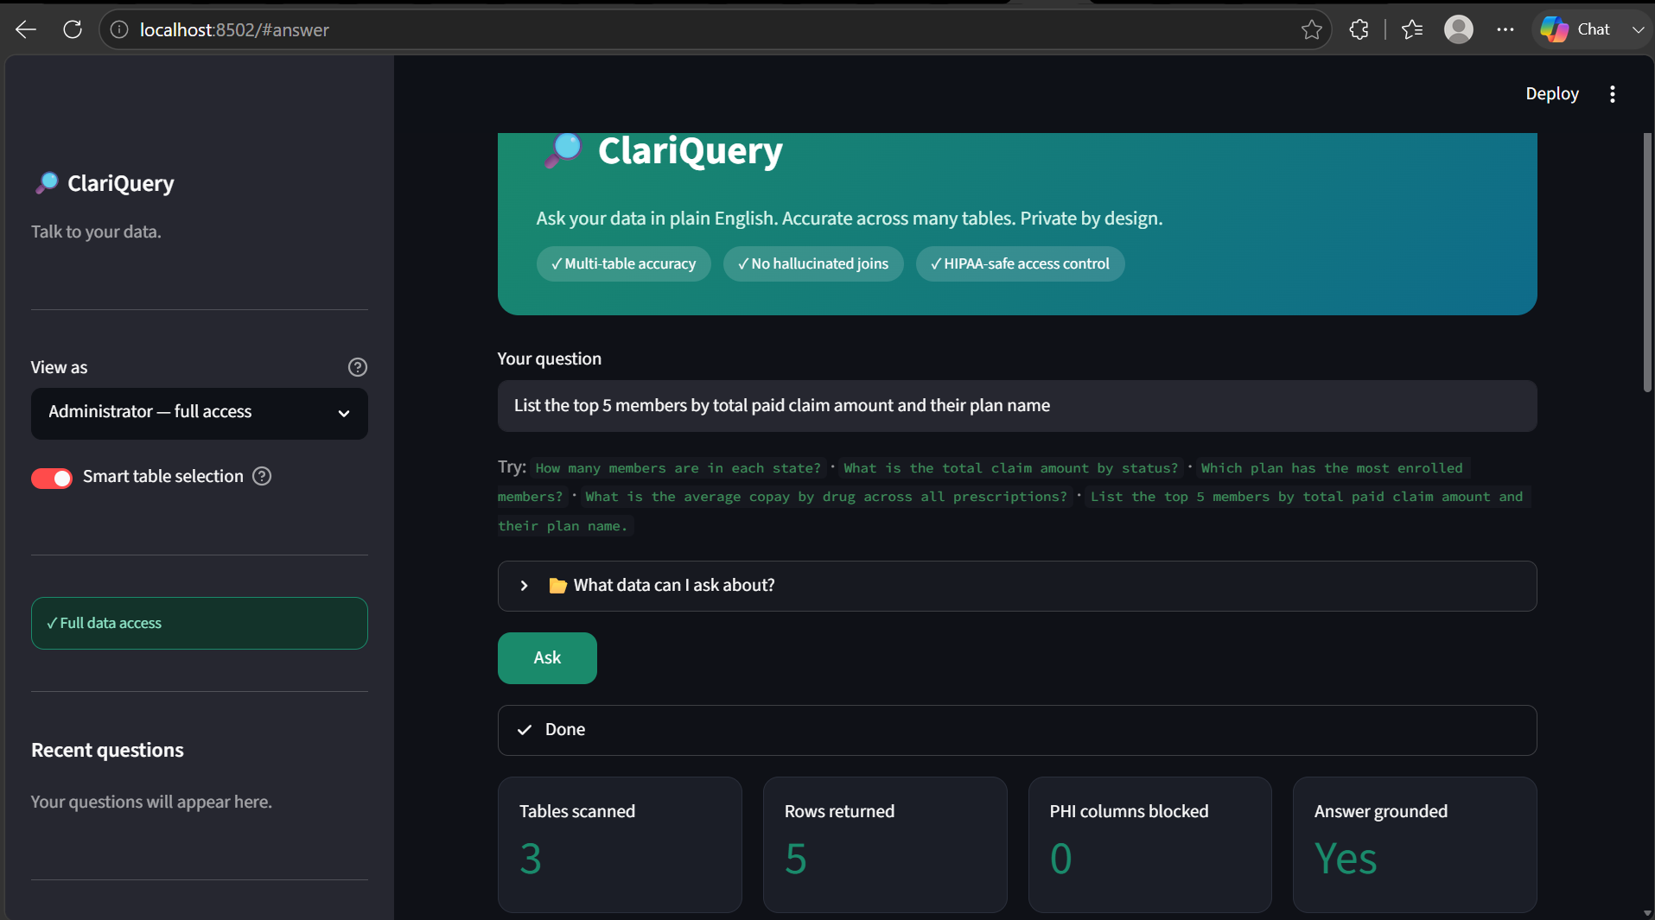
Demo · accuracy across tables
"List the top 5 members by total paid claim amount and their plan name" — a 3-table join.
Notes:
Top five members by total paid claims, with their plan name — a three-table join. The metric cards show tables scanned and that the answer is grounded.

Slide 7
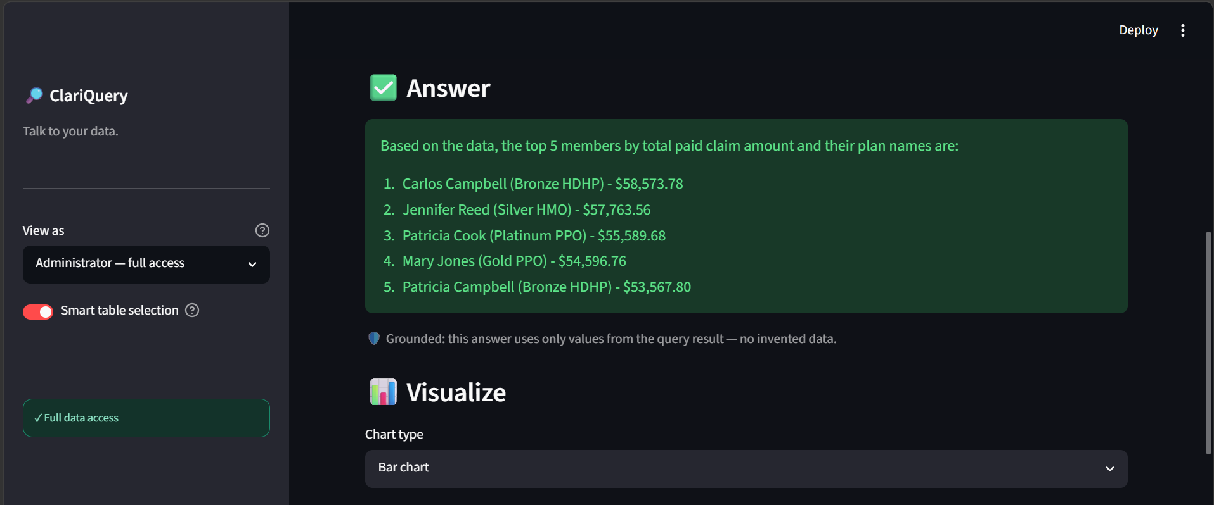
Demo · grounded answer
The answer cites real values from the query result — nothing invented.
Notes:
The answer lists the five members with real dollar amounts pulled directly from the data. The grounded badge confirms no invented values.

Slide 8
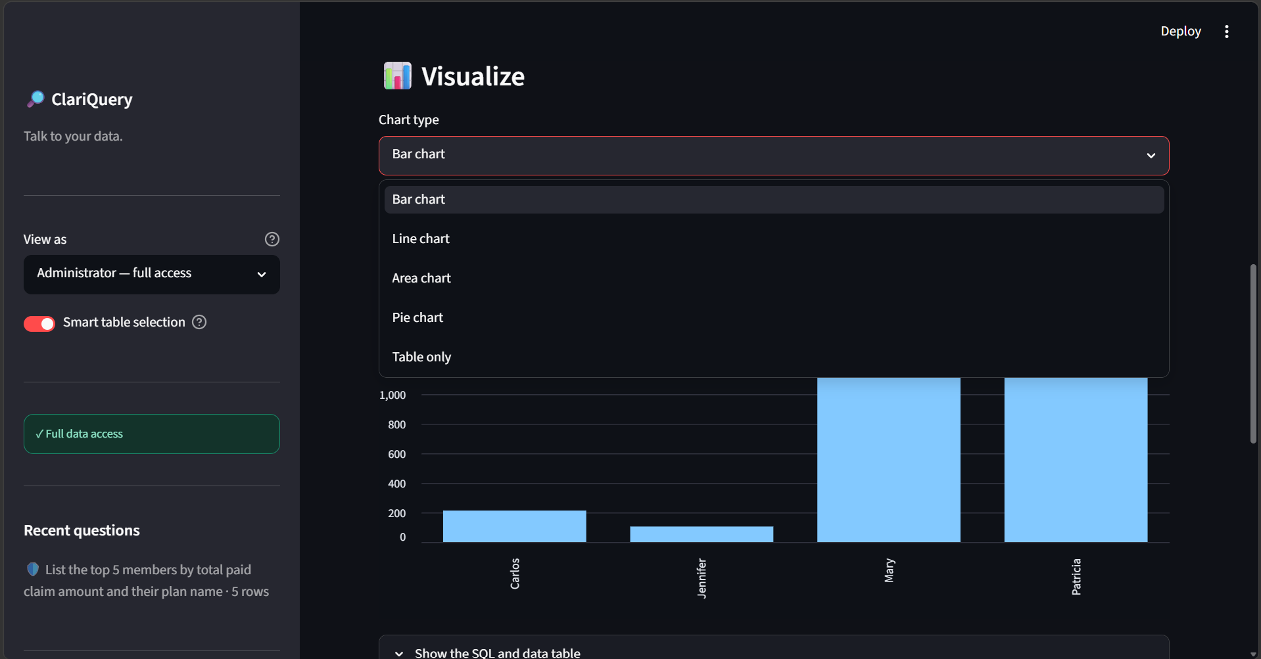
Demo · built-in visualization
Any result can be charted — bar, line, area, pie — from a dropdown.
Notes:
Every answer can be turned into a chart from a dropdown — bar, line, area, or pie — so non-technical users can see the result, not just read it.

Slide 9
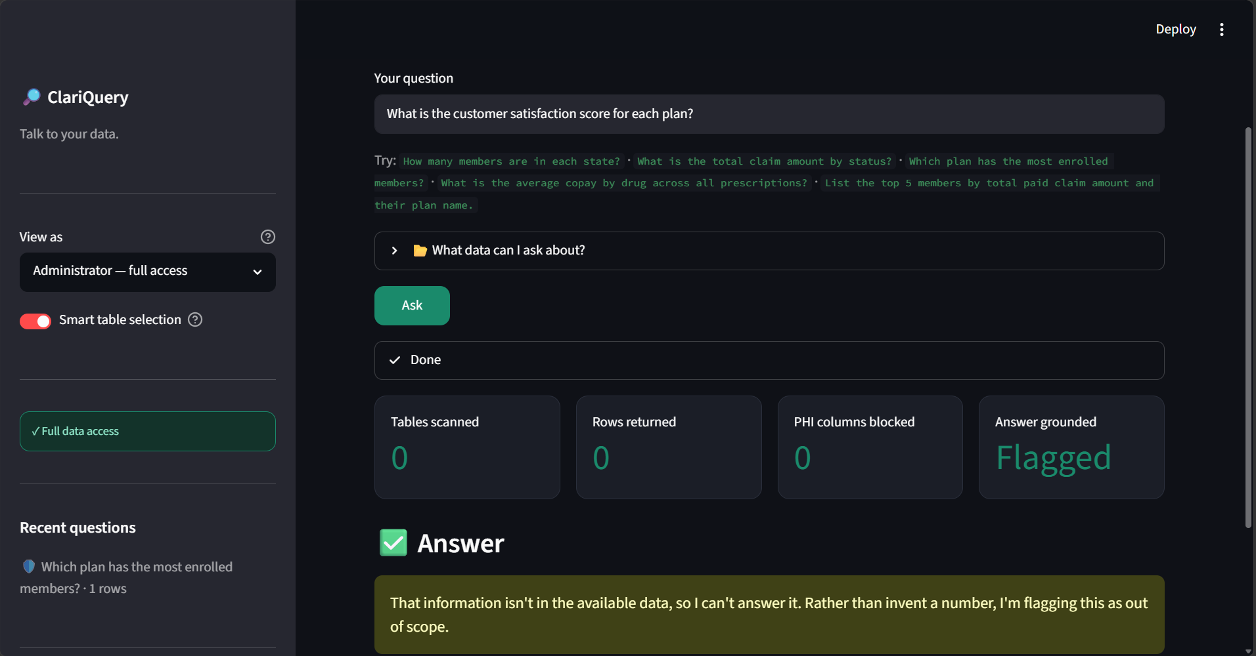
Demo · no hallucination
Ask for data that doesn't exist — "satisfaction score" — and it refuses to guess.
Notes:
When asked for something the data doesn't contain, like a satisfaction score, the answer is Flagged and the system refuses to invent a number. That's the anti-hallucination guardrail.

Slide 10
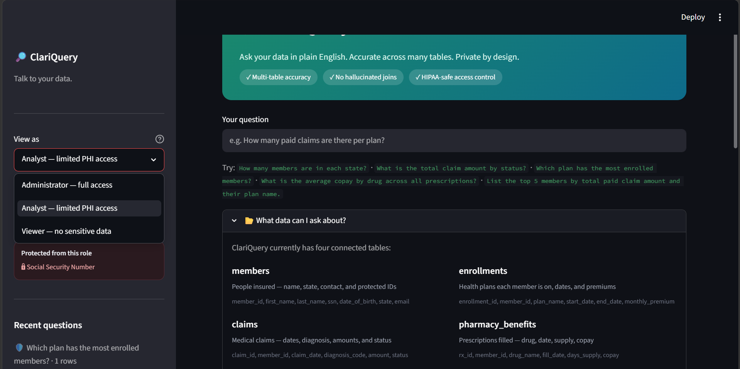
Demo · privacy by design
Each role sees only what it's allowed to — sensitive columns are removed before the AI sees them.
Notes:
Access is controlled by role. Sensitive columns like Social Security Number are removed before the AI ever sees them, so they can't leak. HIPAA-safe by construction.

Slide 11
Under the hood
Schema linking
Before any SQL, the model is asked which tables a question needs. Only those tables, their real column names, and sample values are passed forward.
Access control
Sensitive columns are removed from the schema by role before generation — the model never receives PHI it isn't allowed to use.
Grounding guardrail
The answer must come from the returned rows. If the data can't answer, the model returns IMPOSSIBLE and the app flags it instead of inventing a value.
Notes:
Three mechanisms: schema linking narrows what the model sees, access control removes sensitive columns before the model gets them, and the grounding guardrail forces every answer to come from real rows. Together they cover accuracy, privacy, and hallucination.

Slide 12



Architecture
Streamlit UI
→
Featherless AI
→
Pipeline
→
DuckDB
Python front-end: question box, role selector, charts, metrics
Qwen3-Coder model writes SQL from plain English
Schema linking → access control → SQL → grounding
Fast local SQL engine over the healthcare tables
Backend-agnostic: DuckDB can be swapped for BigQuery — the same pipeline scales to production.
Notes:
A Streamlit front-end takes the question. Featherless AI running Qwen3-Coder writes the SQL. The pipeline applies schema linking, access control, and grounding. DuckDB runs the query. For production, DuckDB swaps to BigQuery without changing the pipeline.

Slide 13


Data model
Four tables, ~2,000 members. All linked by member_id — the multi-table joins this problem is about.
members
2,000 people · PHI/PII
member_id (key)
enrollments
claims
pharmacy_benefits
plans, premiums, dates
diagnosis, amount, status
drugs, copay, supply
member_id (FK)
member_id (FK)
member_id (FK)
Notes:
Four tables linked by member ID. Members is the center and holds the sensitive data. Enrollments, claims, and pharmacy benefits each join back to members — exactly the multi-table reasoning the problem is about.

Slide 14
Requirements met
Accuracy at scale
Prevent hallucination
Data privacy
Smart table selection prunes the schema before SQL — accuracy holds as tables grow.
Answers grounded in real query results; refuses and flags when data can't answer.
Role-based access removes PHI/PII columns before the model sees them.
Built with Python · Streamlit · DuckDB · Featherless AI (Qwen3-Coder)
Notes:
ClariQuery handles the three hard parts: accuracy across multiple tables, no hallucinated answers, and privacy by design. Built with Python, Streamlit, DuckDB, and Featherless AI. Thank you.

