Slide 1
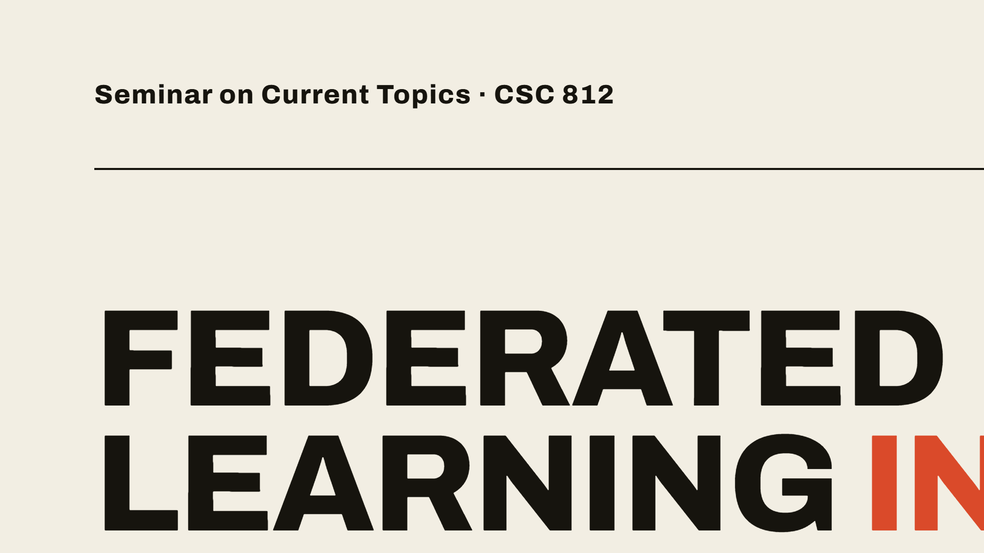

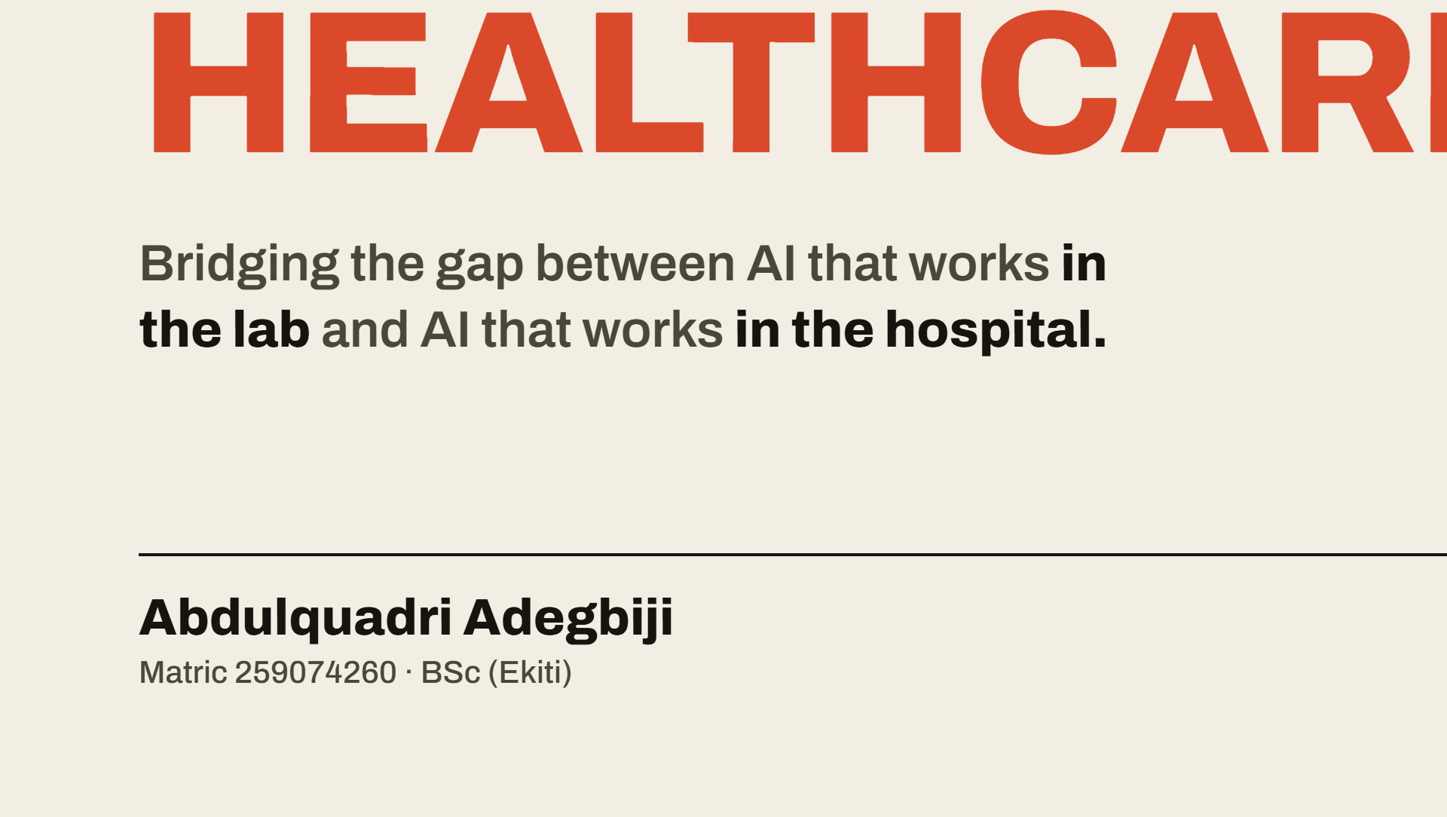
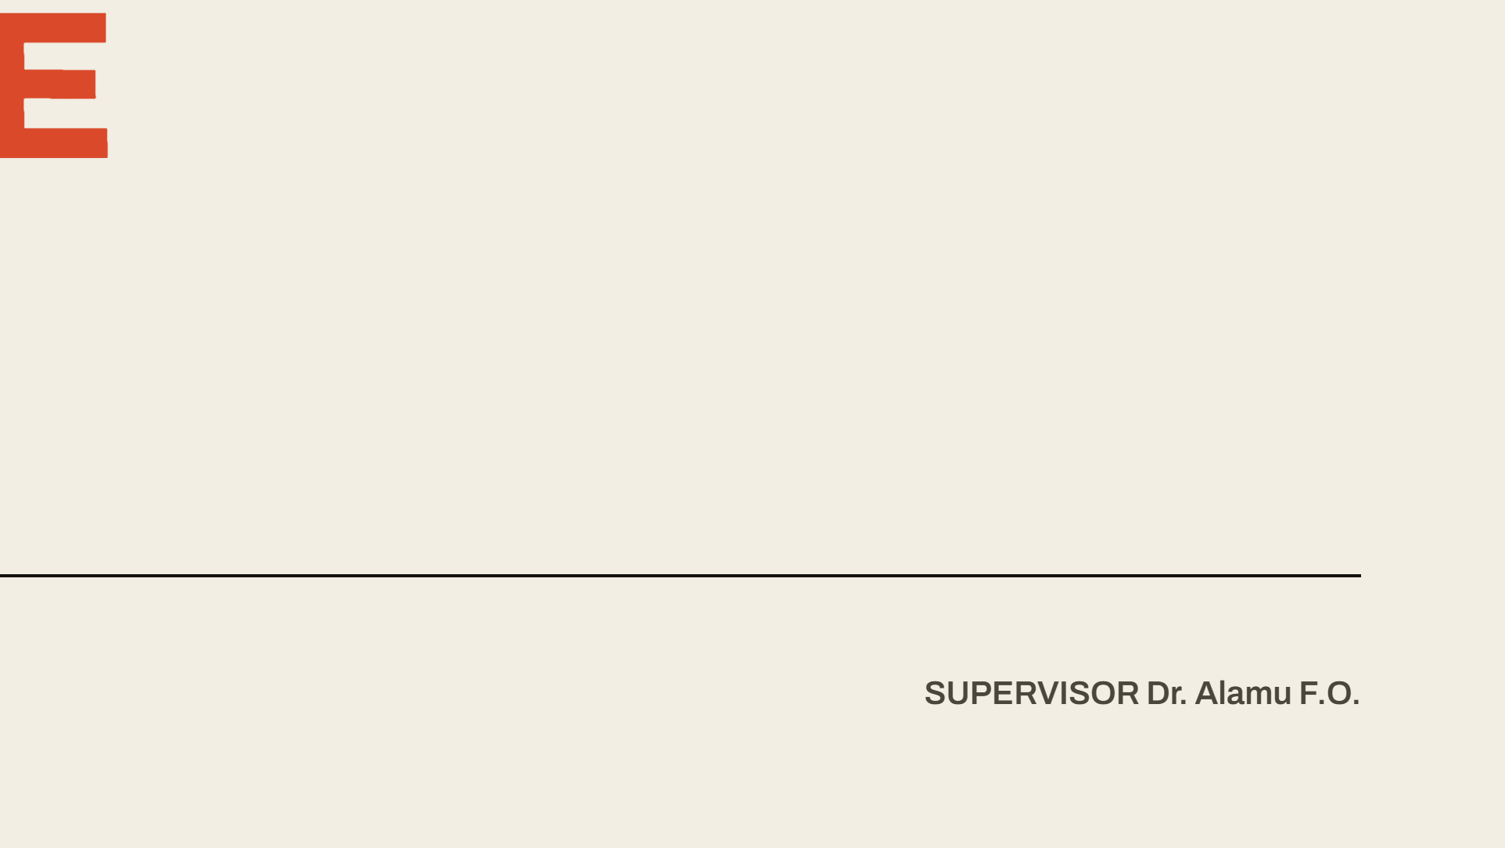
Notes:
Good day, my assessors. My name is Abdulquadri Adegbiji, and I am presenting my research on Federated Learning in Healthcare: Bridging the Deployment Gap. Today I want to take you beyond the theory of AI and into the messy, real-world reality of hospital engineering.

Slide 2
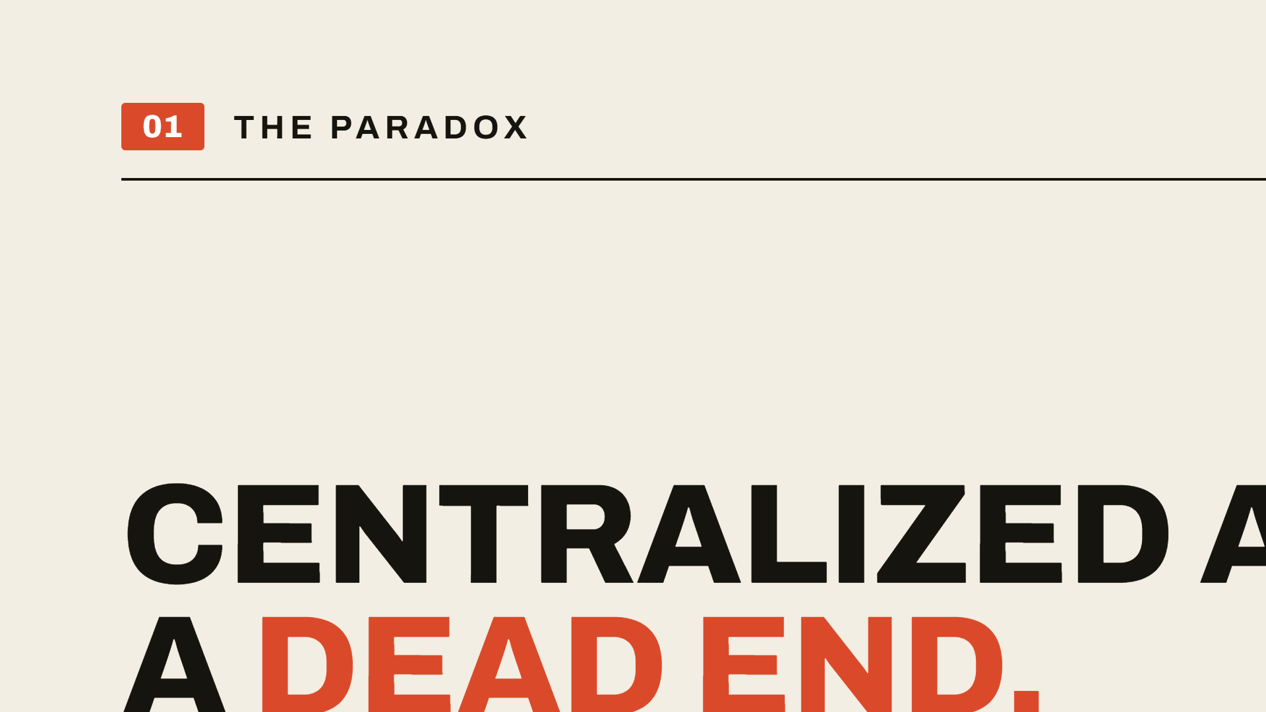
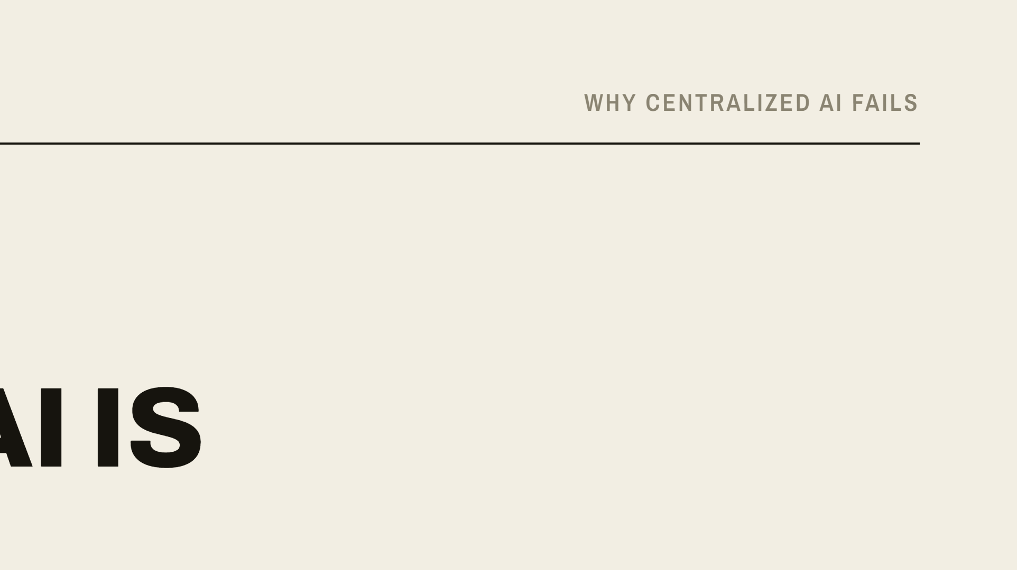
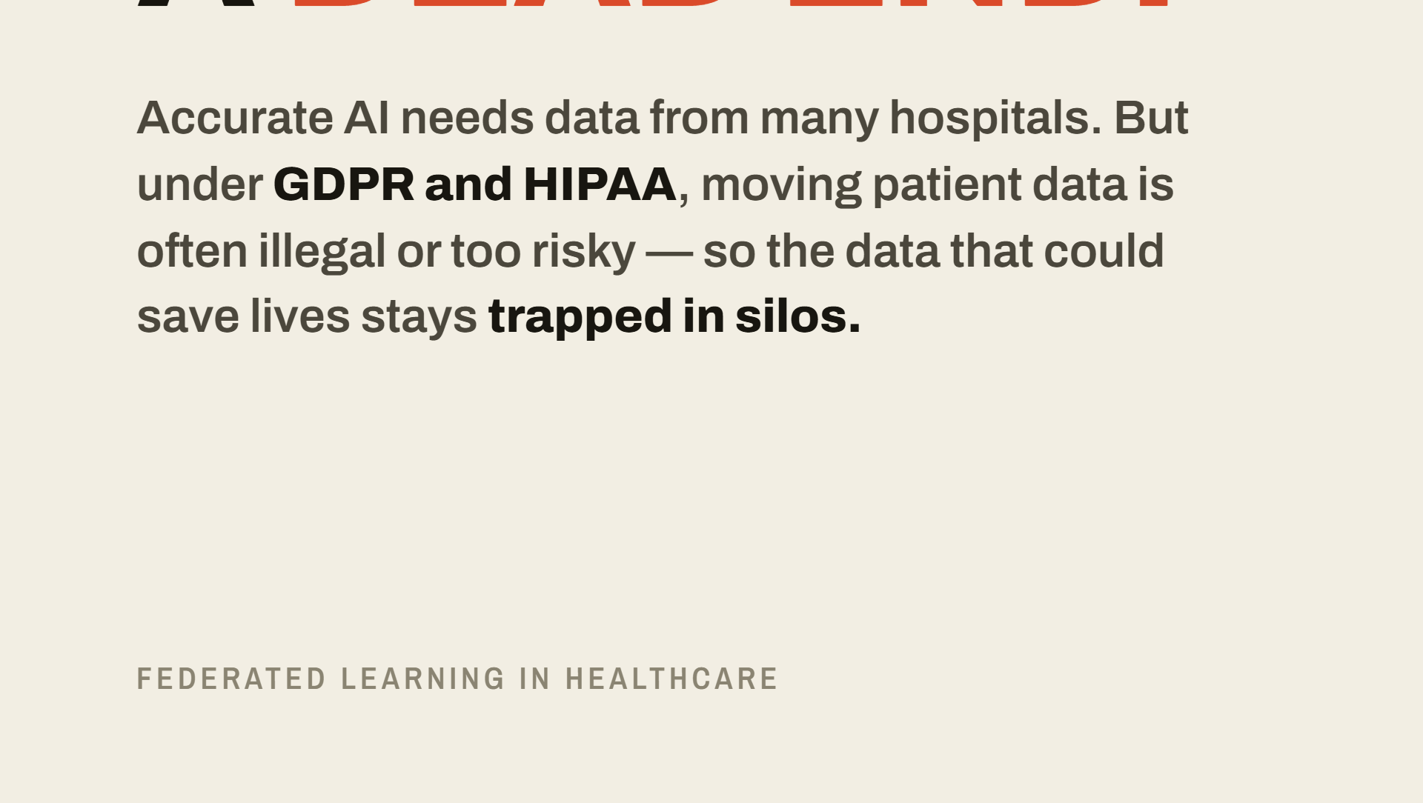

Notes:
We have a paradox in medicine. To build accurate AI, we need massive data from many hospitals. But under laws like GDPR and HIPAA, moving that data is often illegal or too risky. This has turned traditional AI training into a logistical dead end. The data that could save lives is currently trapped in remote silos, and institutions are terrified of the liability of a data breach.

Slide 3
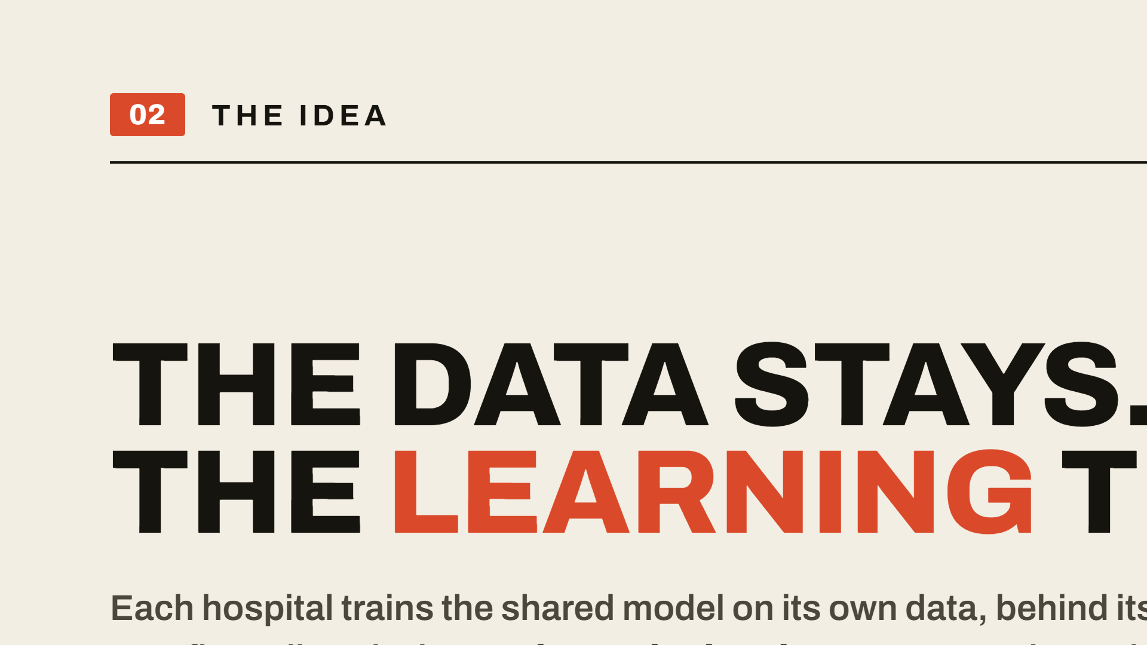

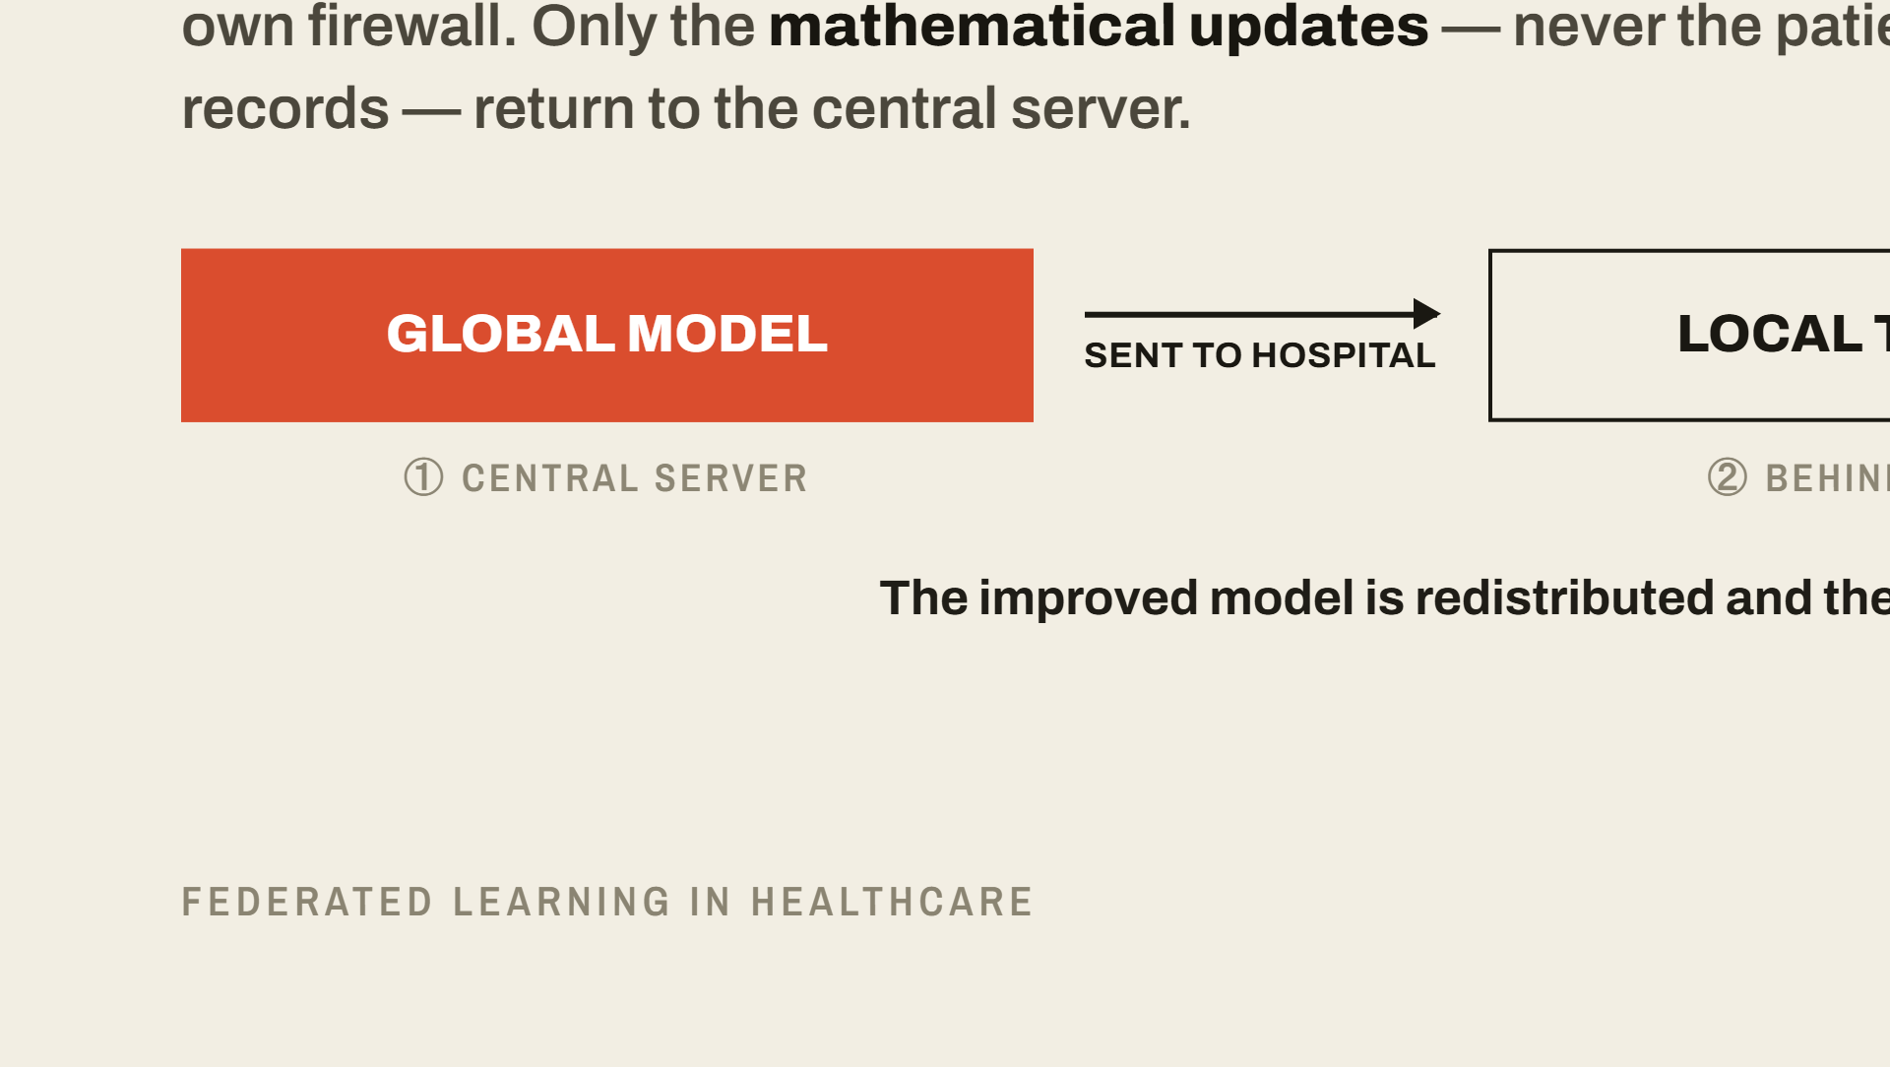
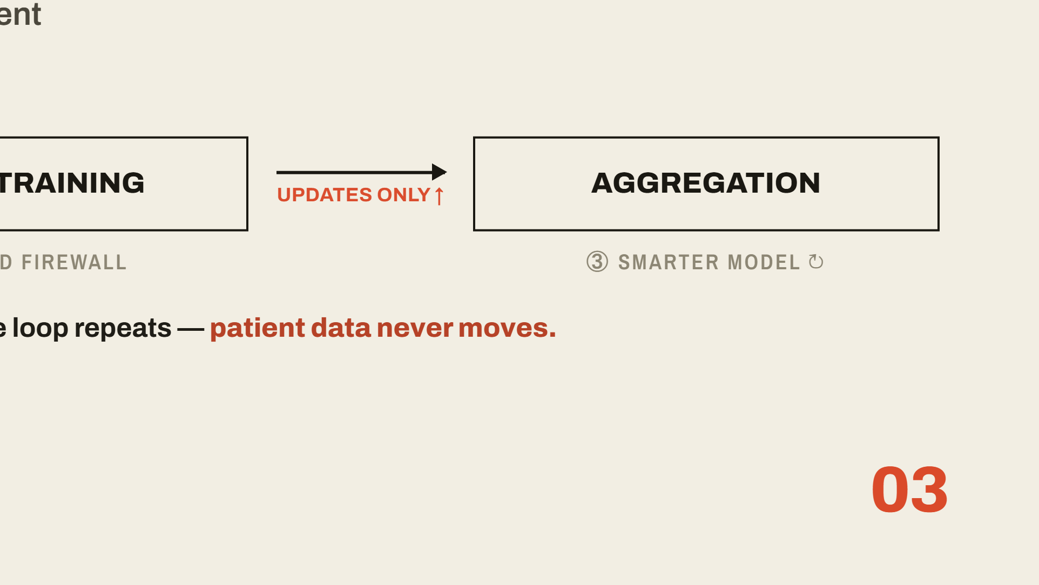
Notes:
Federated learning exists to break this deadlock. Instead of gathering data into one central cloud, we transport the model to the data. A hospital trains a shared global model on its own private data, behind its own firewall, and only sends the mathematical updates — not the patient records — back to a central server. As the saying goes: the data stays, but the learning travels.

Slide 4
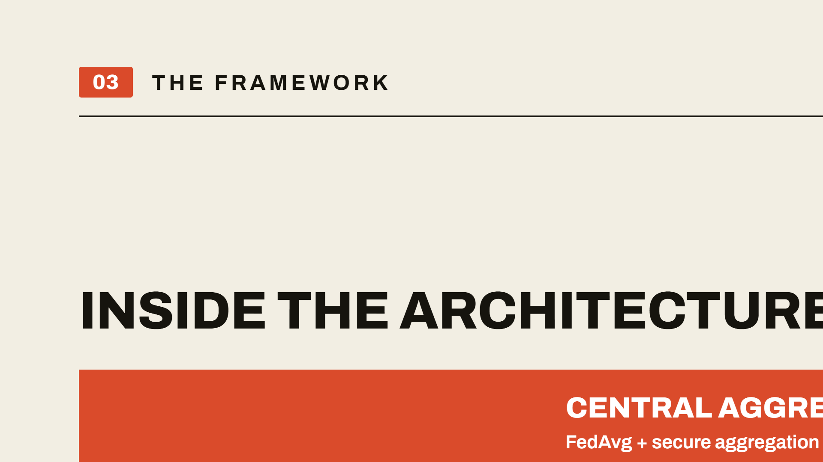
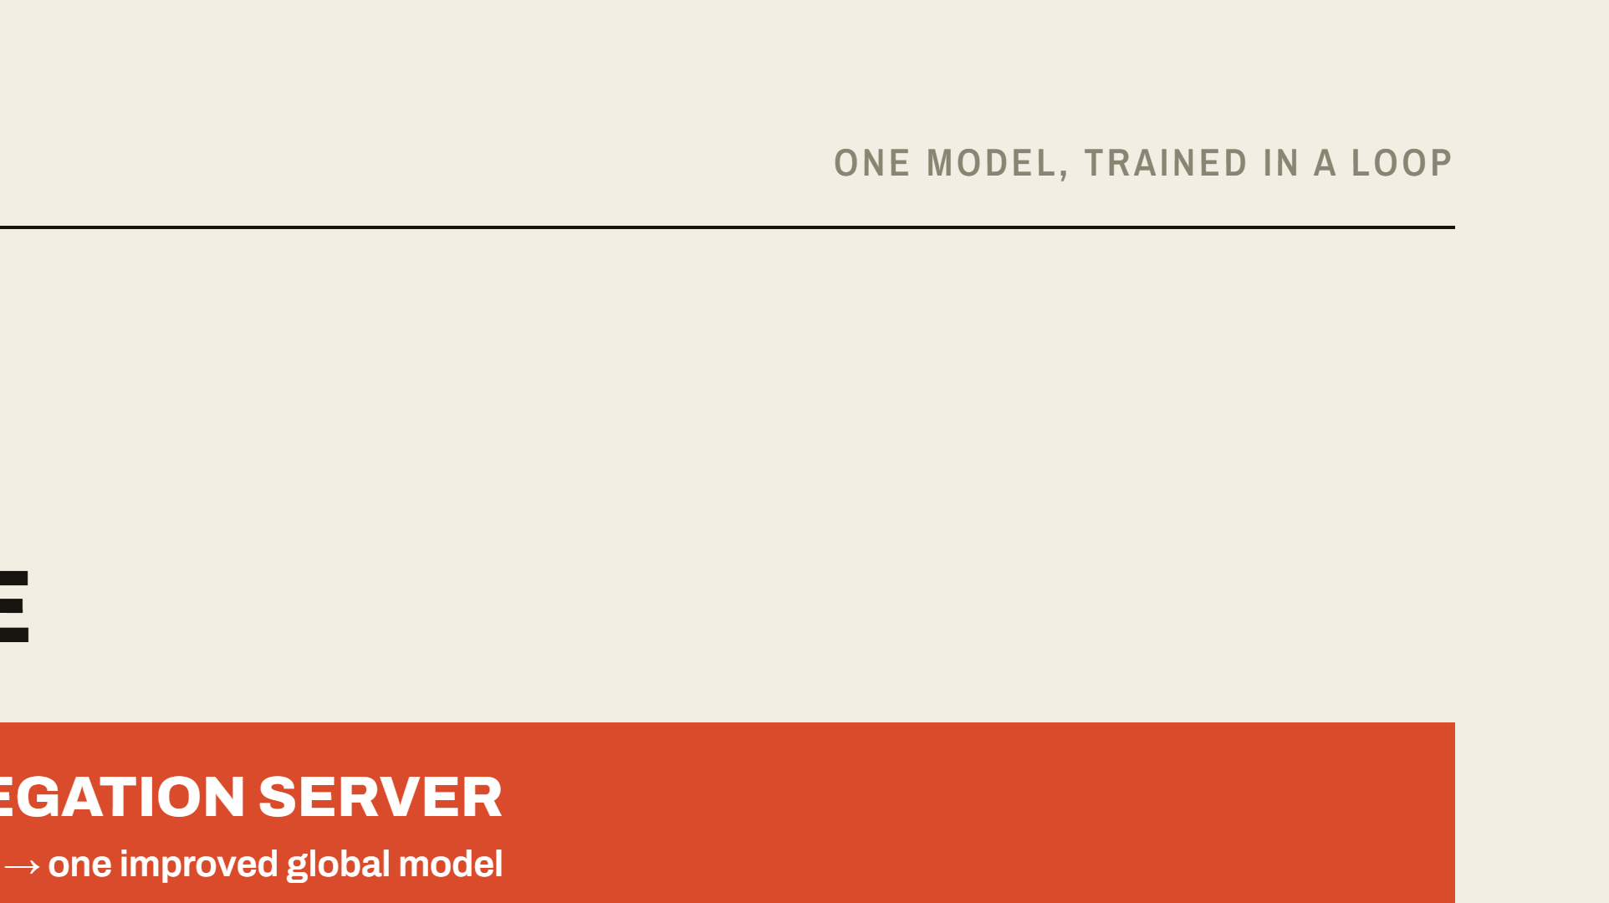
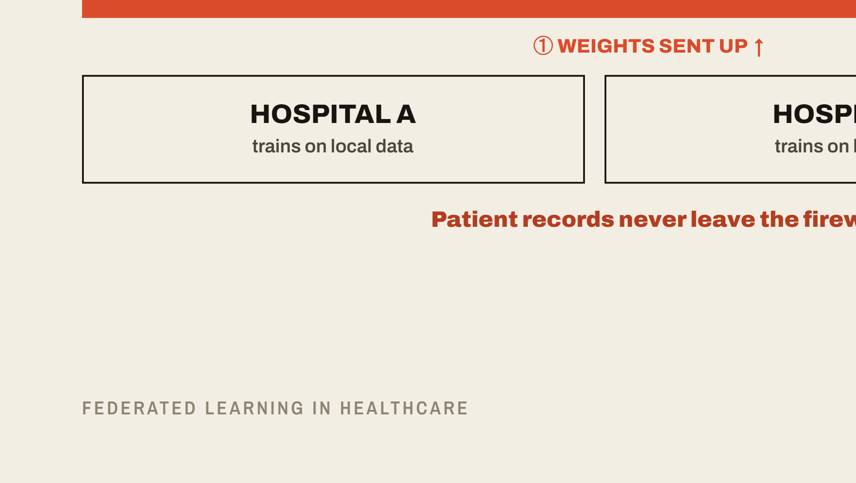
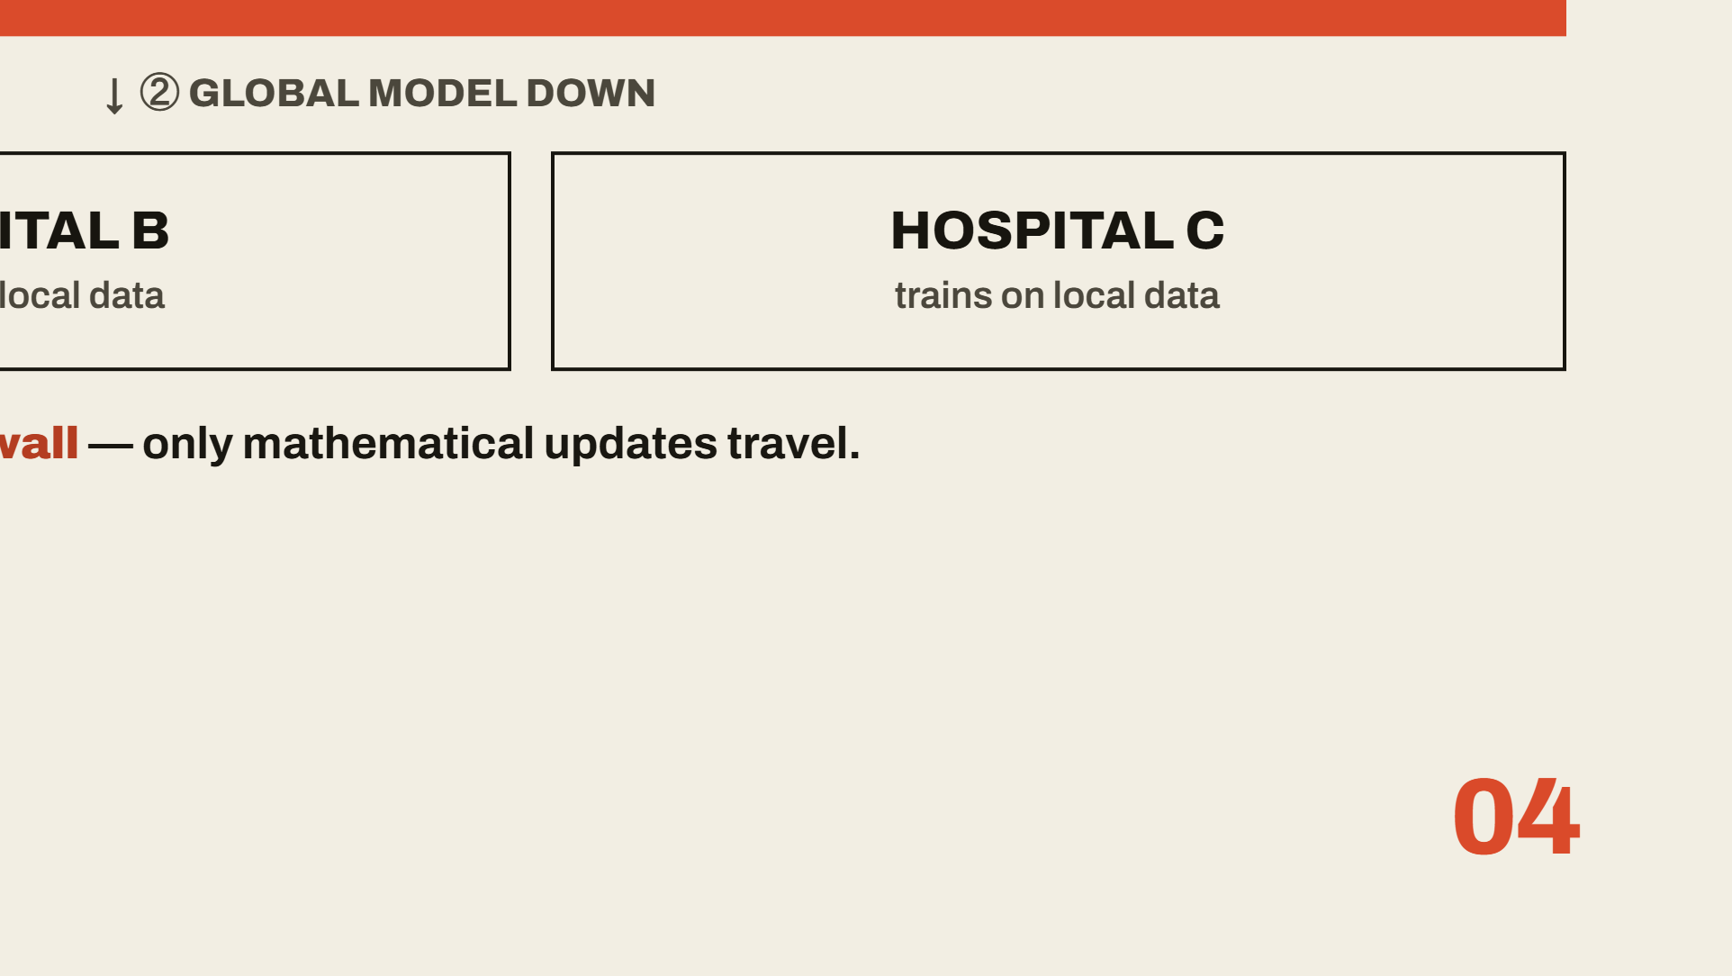
Notes:
So how is this actually built? The architecture is a simple loop. One — a global model is sent out to every participating hospital. Two — each hospital trains it on its own private patient data, locally, behind its own firewall. Three — only the model weights, the mathematical updates, travel back to a central aggregation server; never the patient records. Four — the server combines all those updates using federated averaging and secure aggregation into one improved global model, and the loop repeats. The single point to hold onto: the patient data never moves. Only the learning does.

Slide 5
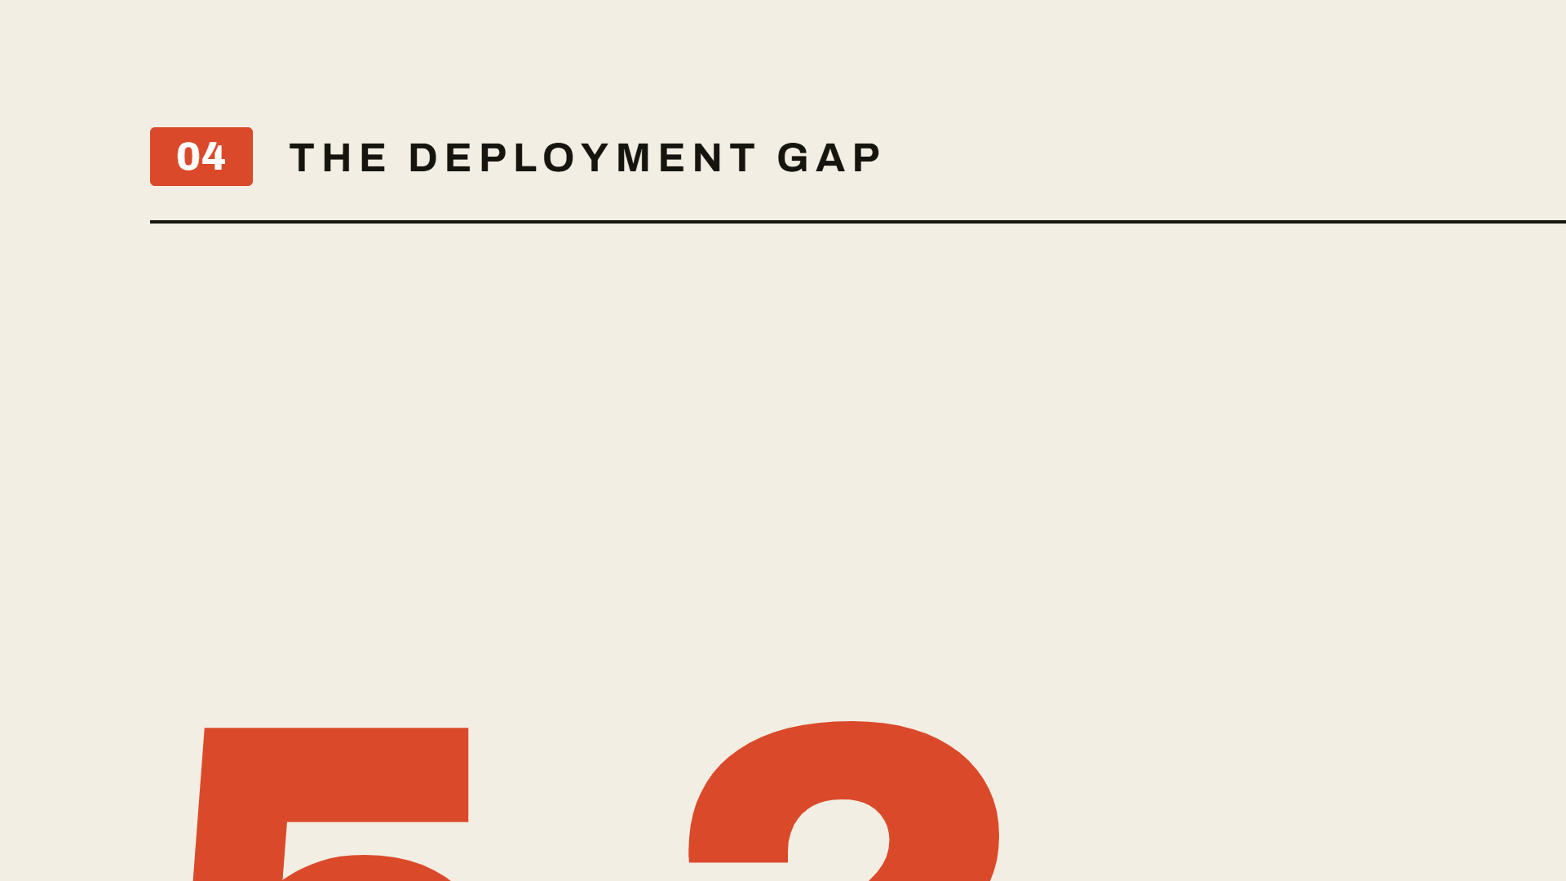
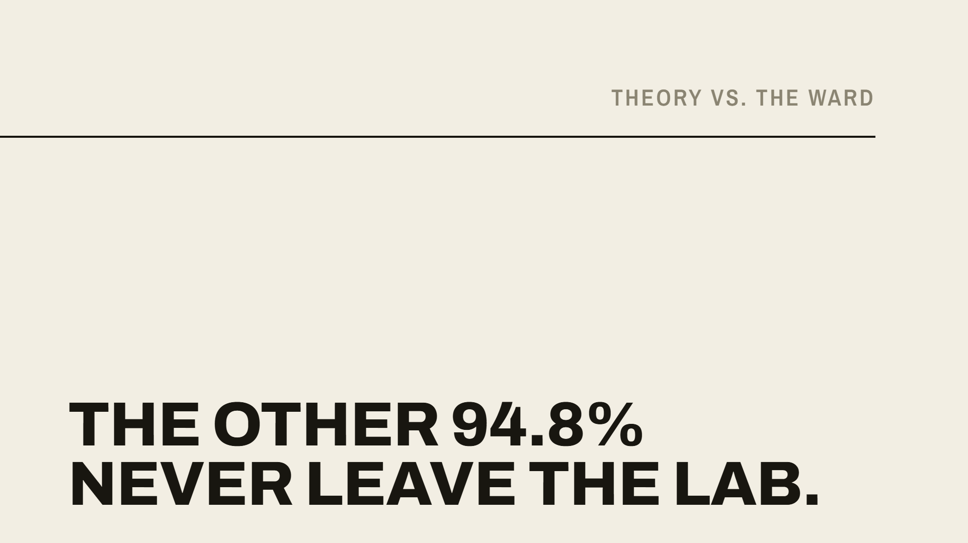
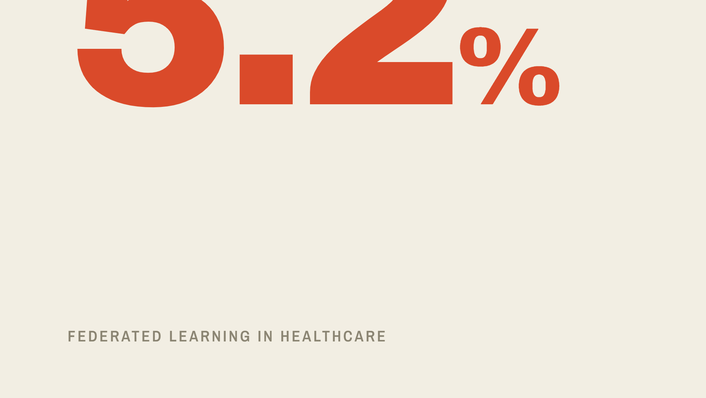
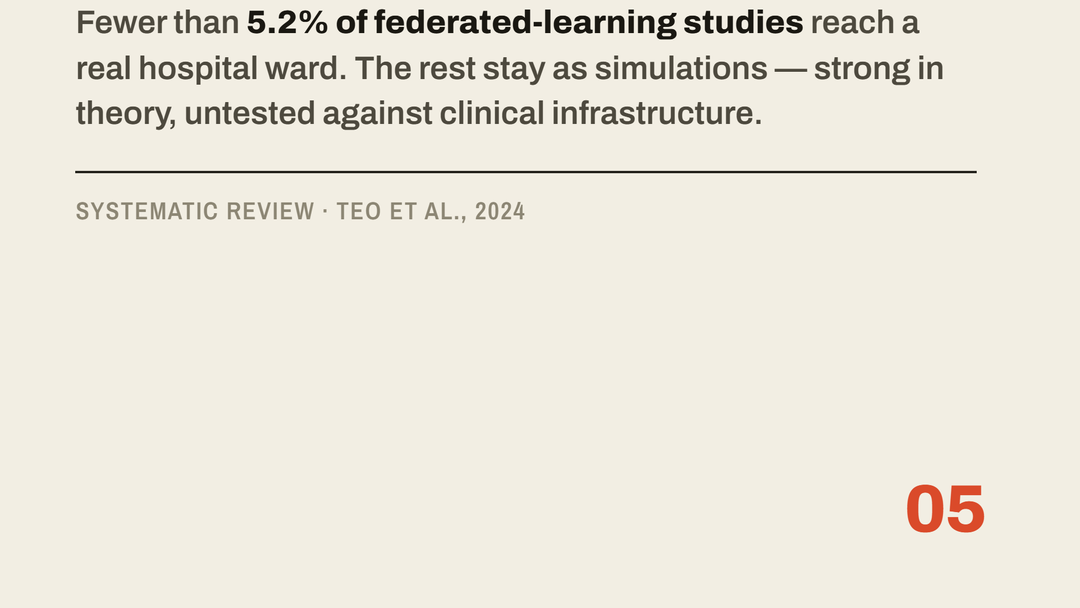
Notes:
In theory, this is perfect. But in practice there is a massive disconnect. A systematic review by Teo and colleagues in 2024 found that fewer than five point two percent of federated learning studies actually reach a hospital ward. The other ninety-five percent stay in the lab as simulations. My research investigates this deployment gap — to understand why these models fail when they meet real clinical infrastructure.

Slide 6
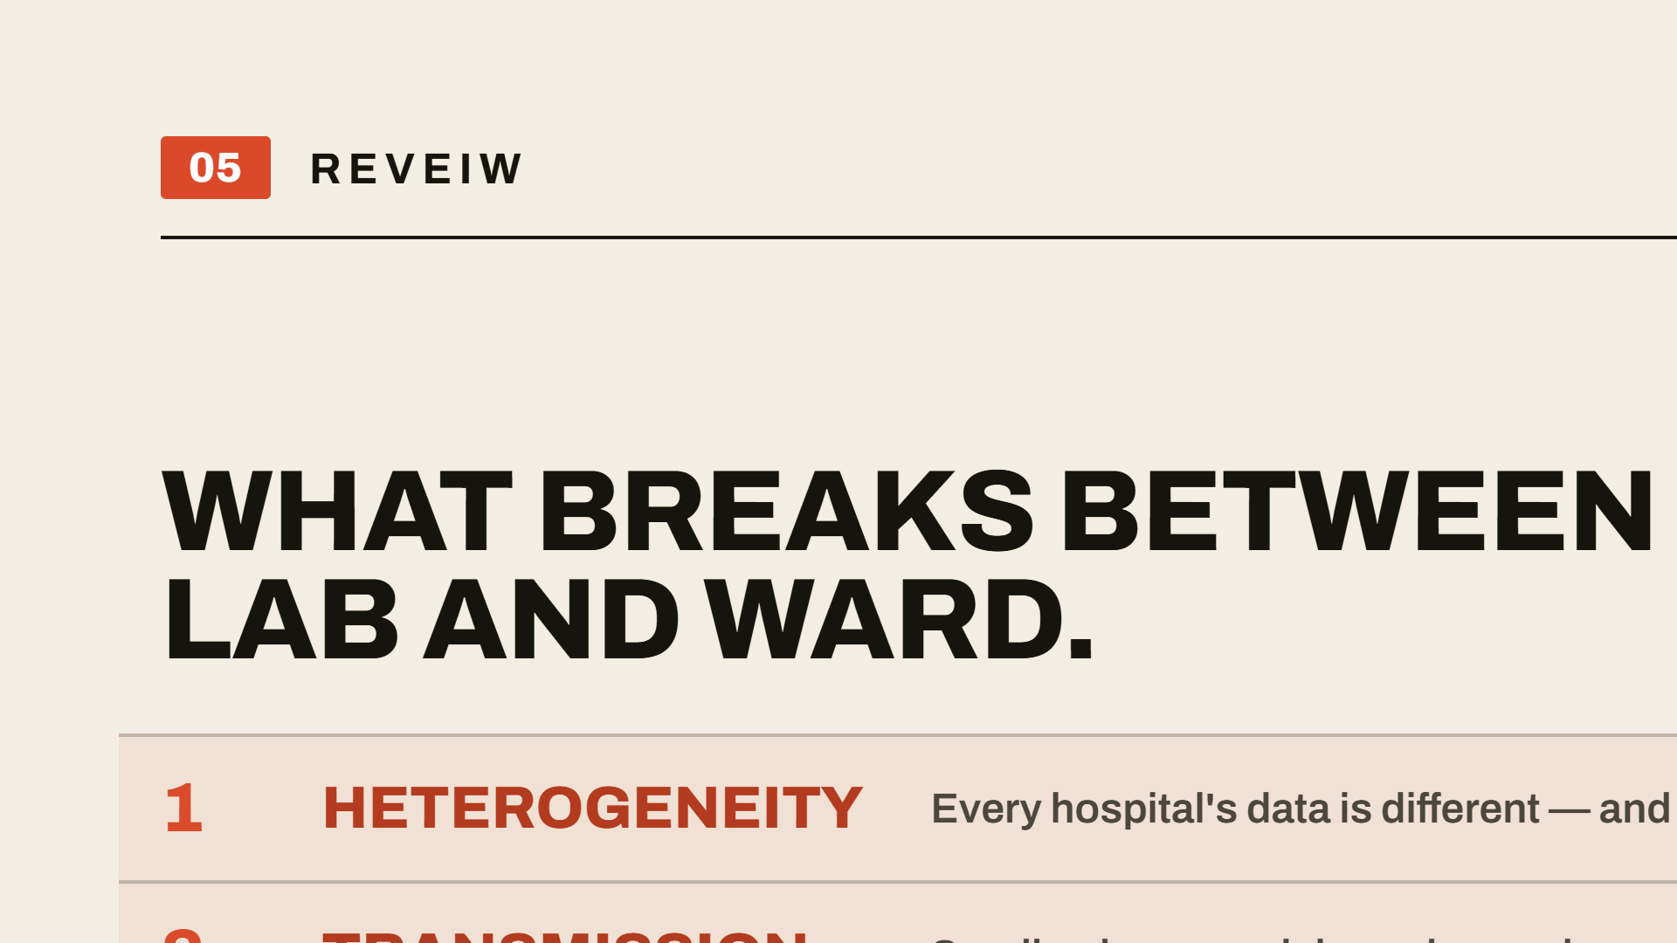
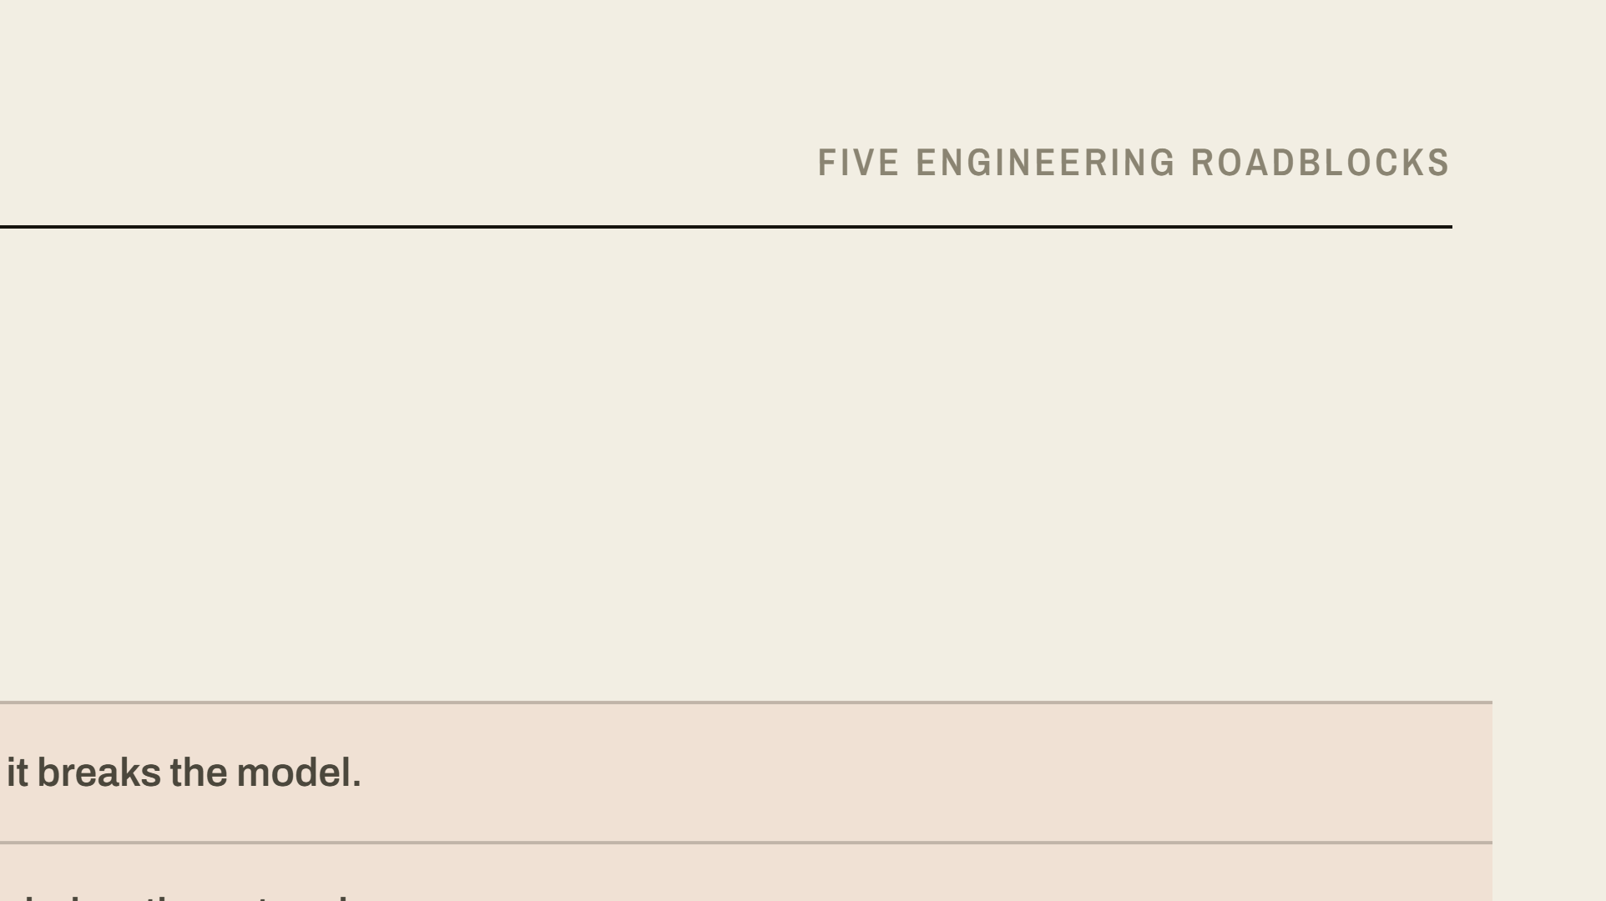
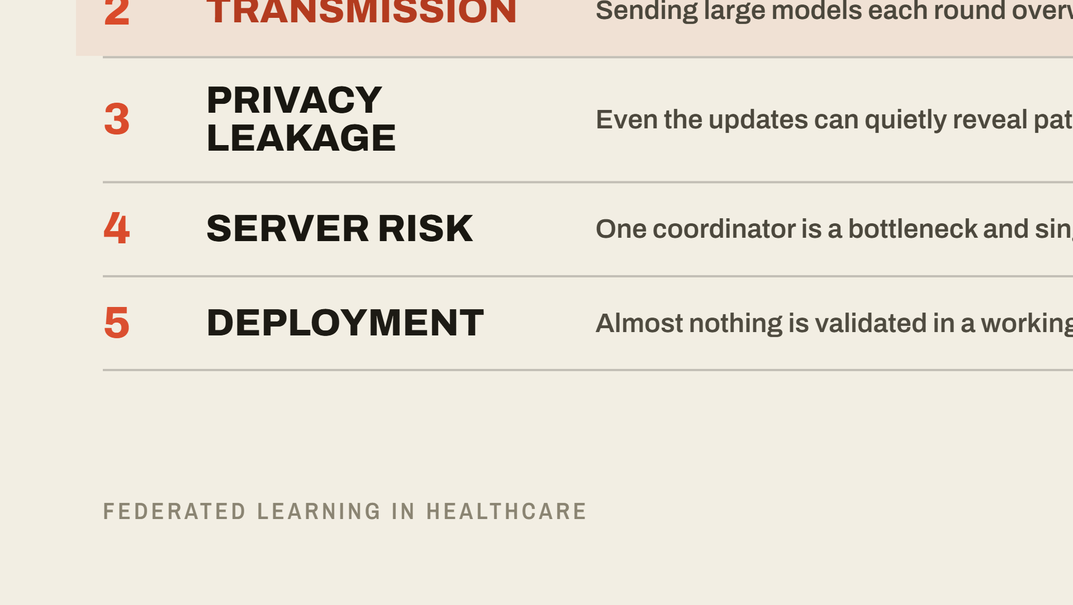
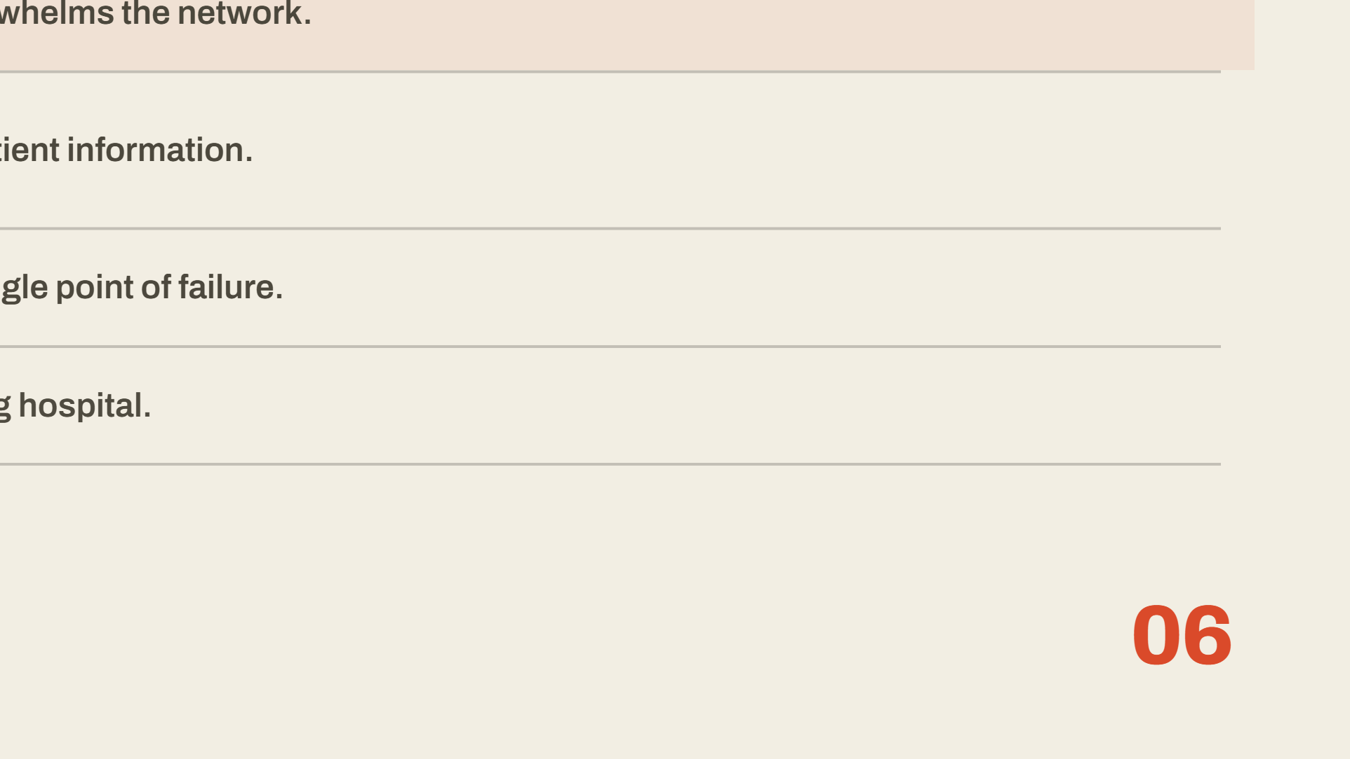
Notes:
To investigate this, this seminar synthesizes the recent literature and groups the obstacles into five recurring engineering roadblocks: data heterogeneity, transmission cost, privacy leakage, central-server risk, and deployment reality. I'll take you through the two that matter most for a setting like Nigeria, and then the very current frontier.

Slide 7
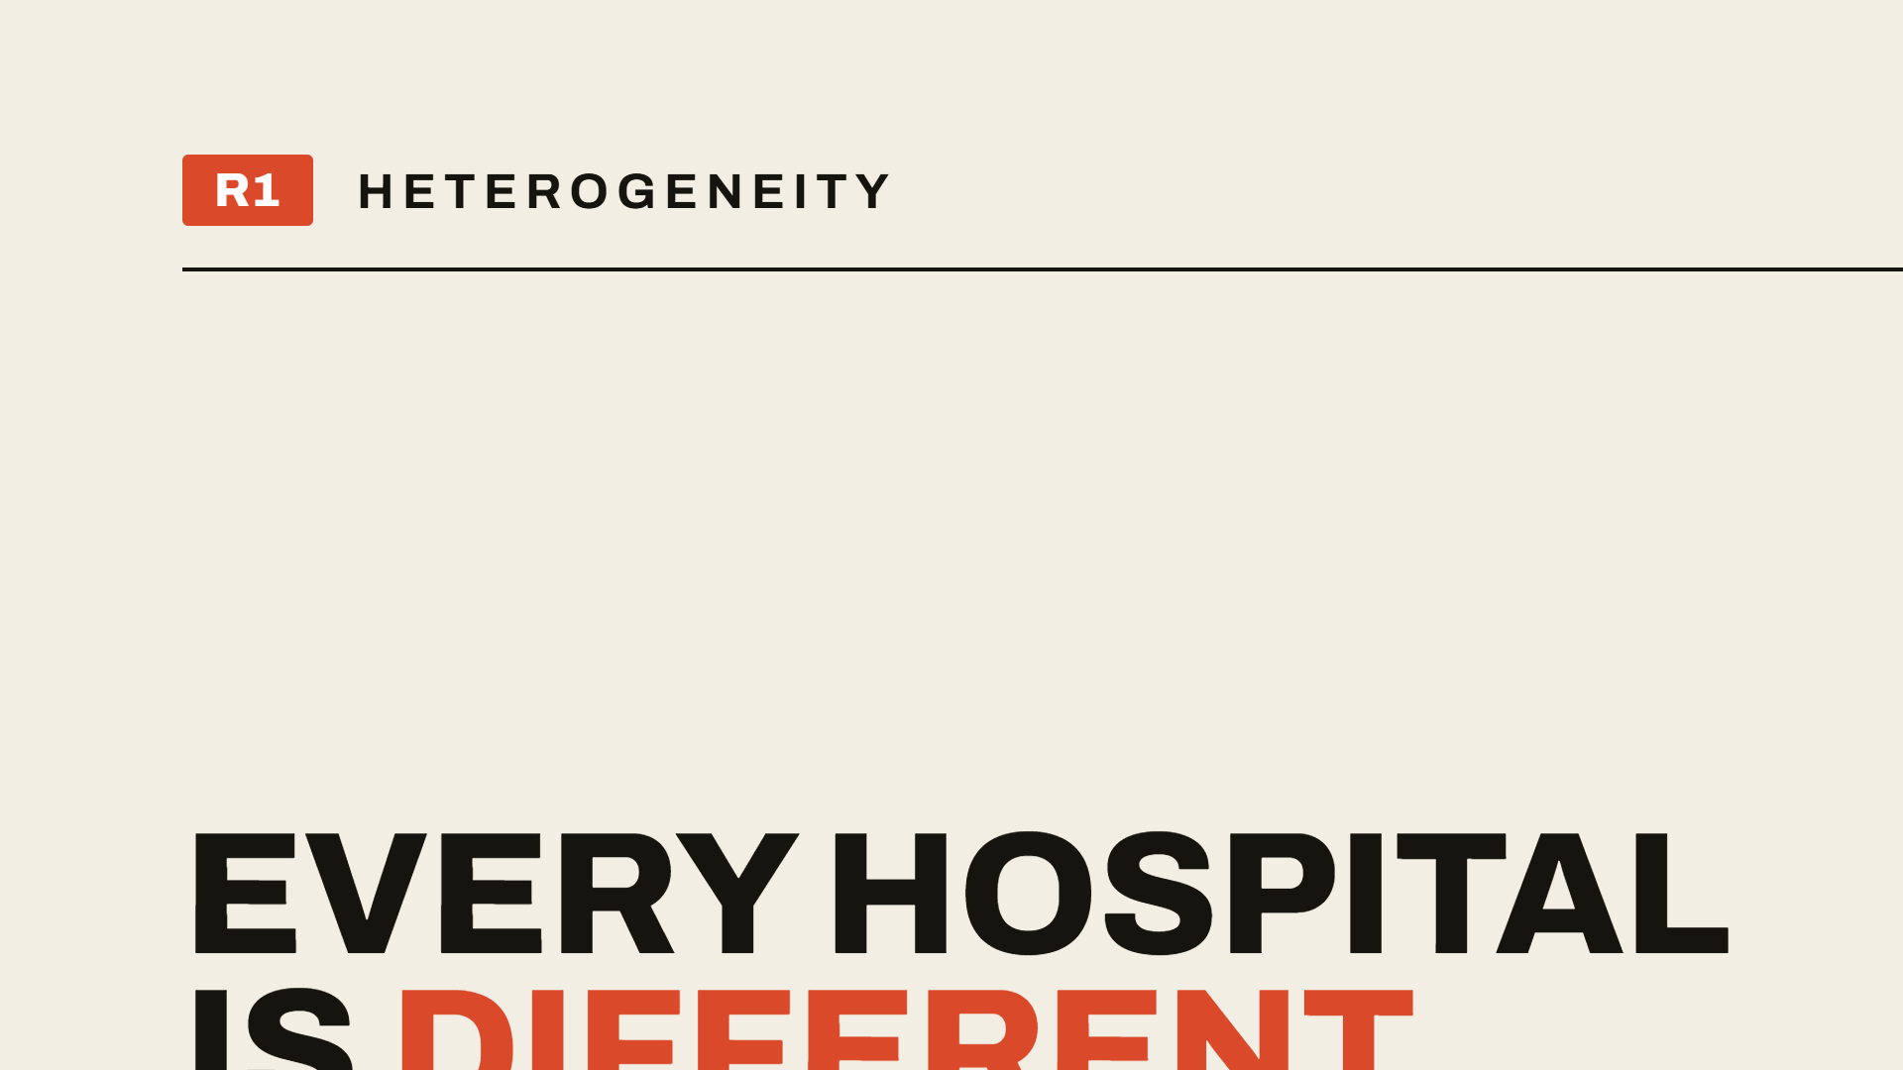
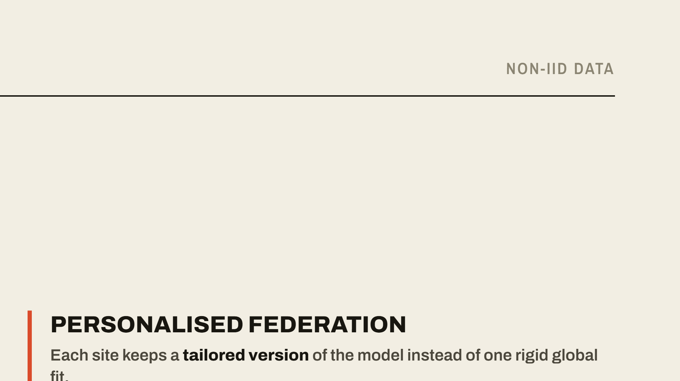
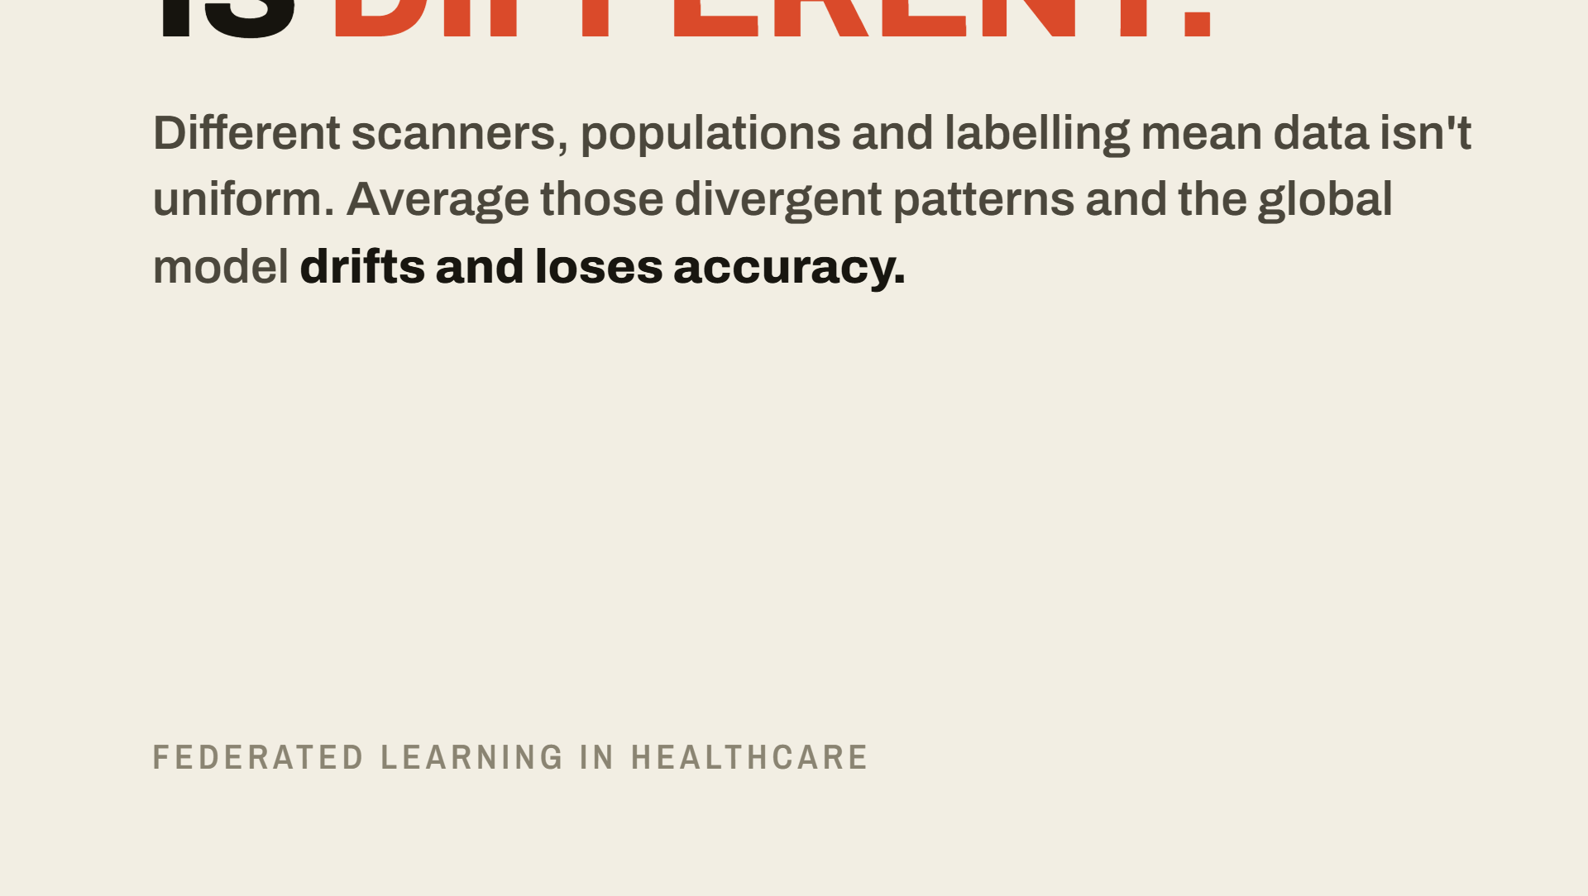
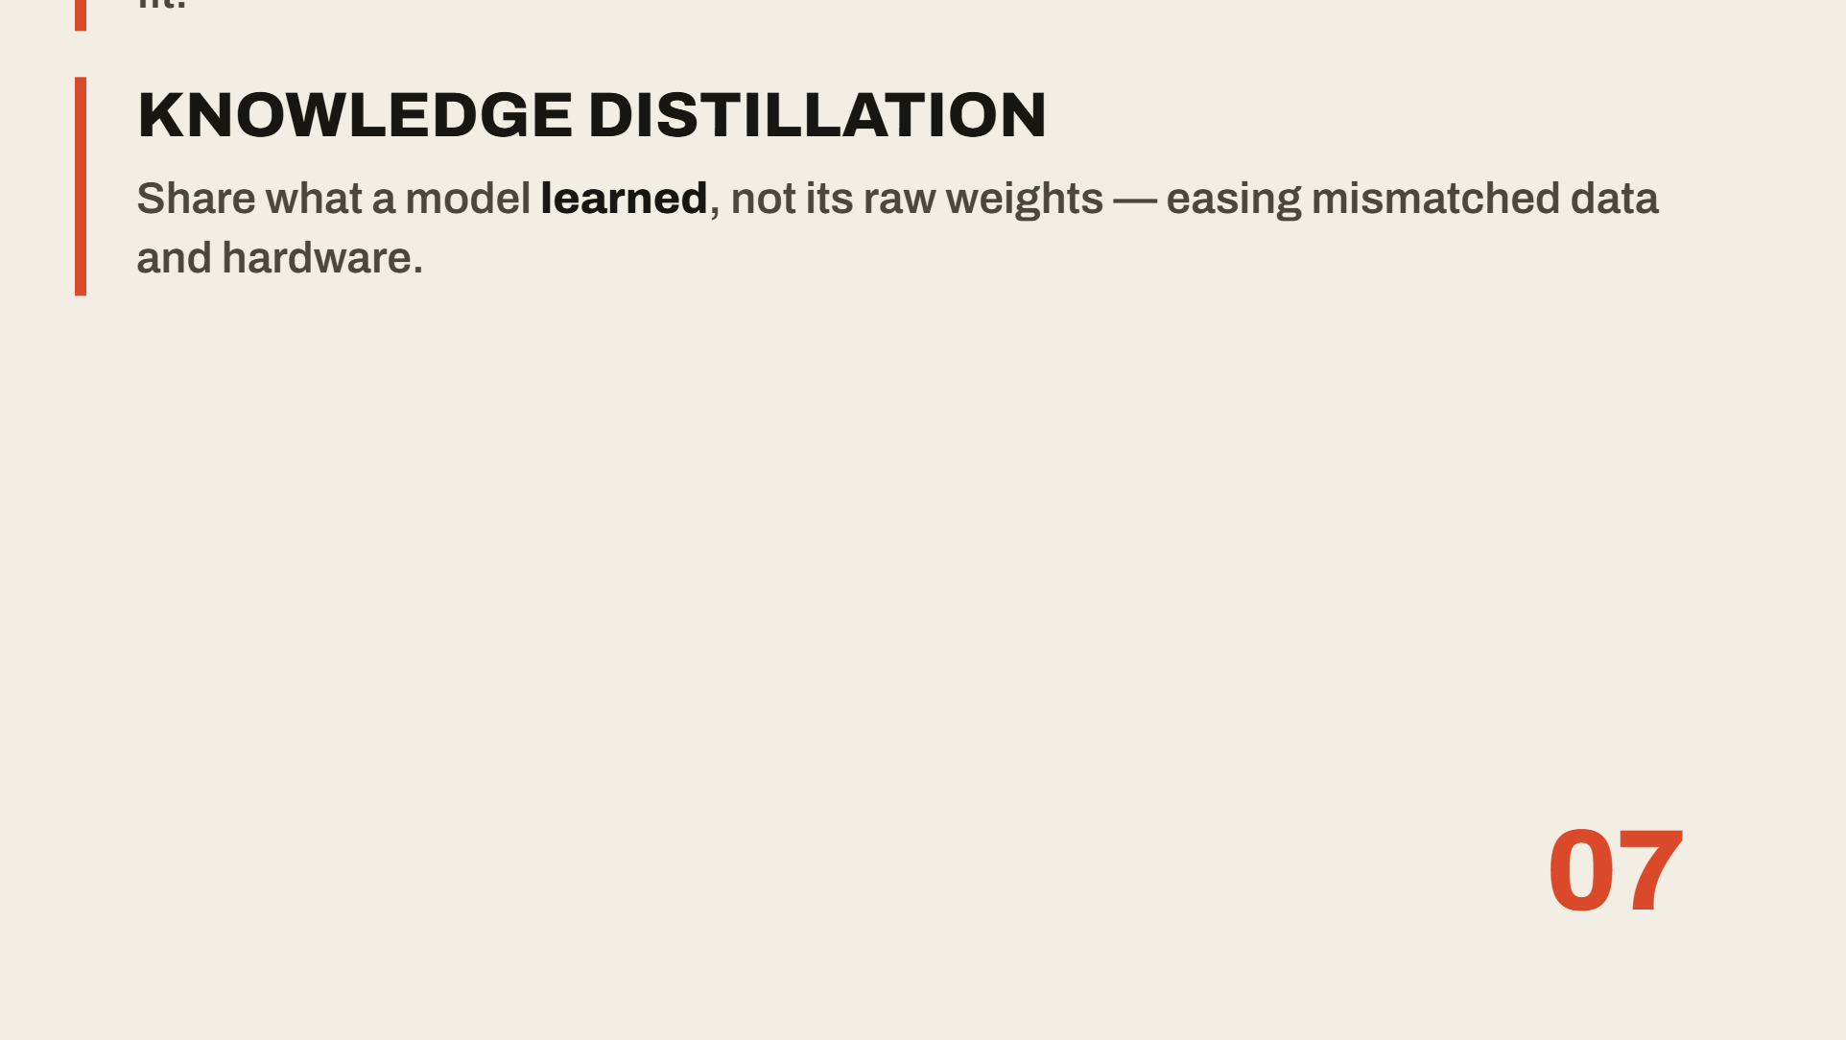
Notes:
The first roadblock: hospital data is not uniform. A rural clinic in Nigeria uses different equipment than a wealthy research center. When a global model averages these divergent patterns, the model drifts and becomes inaccurate. My review highlights solutions like personalized federation and knowledge distillation, which let the AI adapt to each site's specific scanners rather than forcing one rigid global fit.

Slide 8


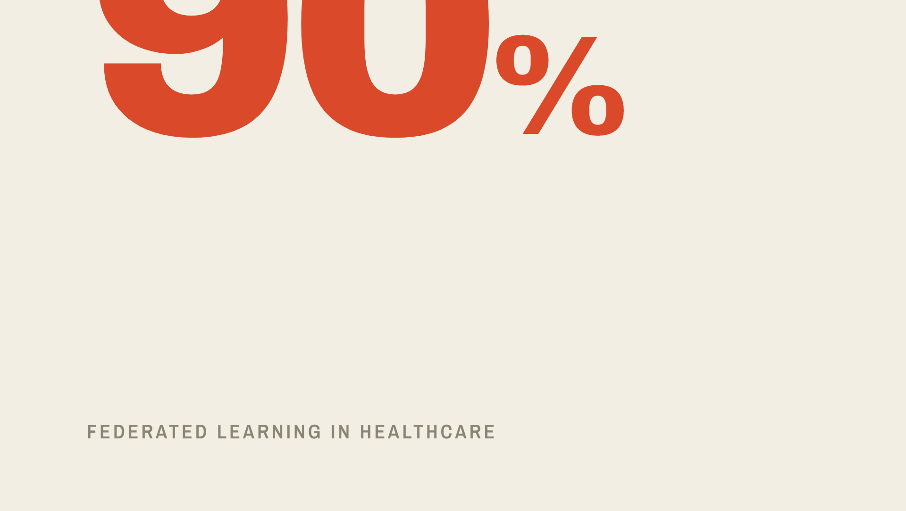
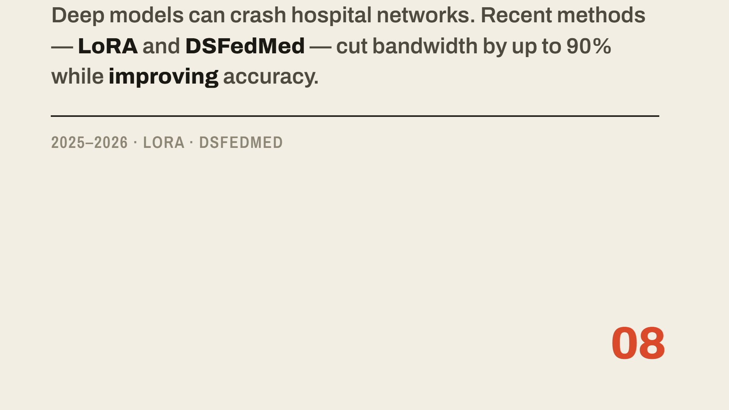
Notes:
The second roadblock is transmission. Deep models are massive, and sending them back and forth can crash hospital networks. But I identified recent breakthroughs from 2025 and 2026 that solve this — specifically LoRA, low-rank adaptation, and a method called DSFedMed. These reduce bandwidth needs by up to ninety percent while actually improving accuracy. That turns a network-killing problem into a solved one.

Slide 9
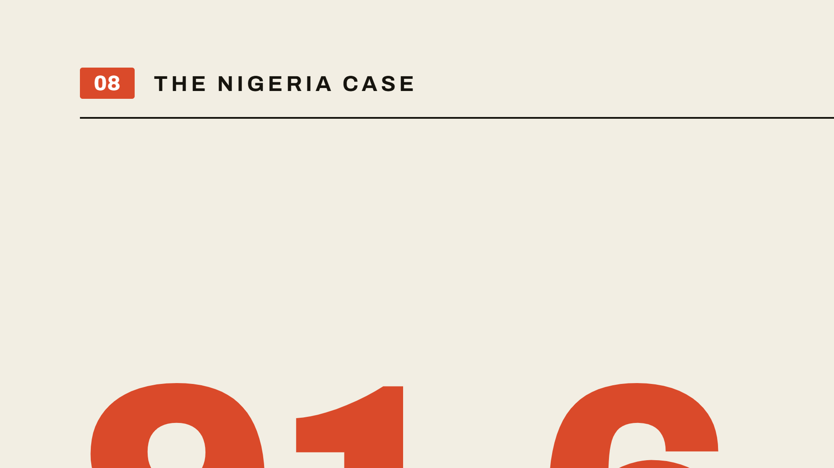

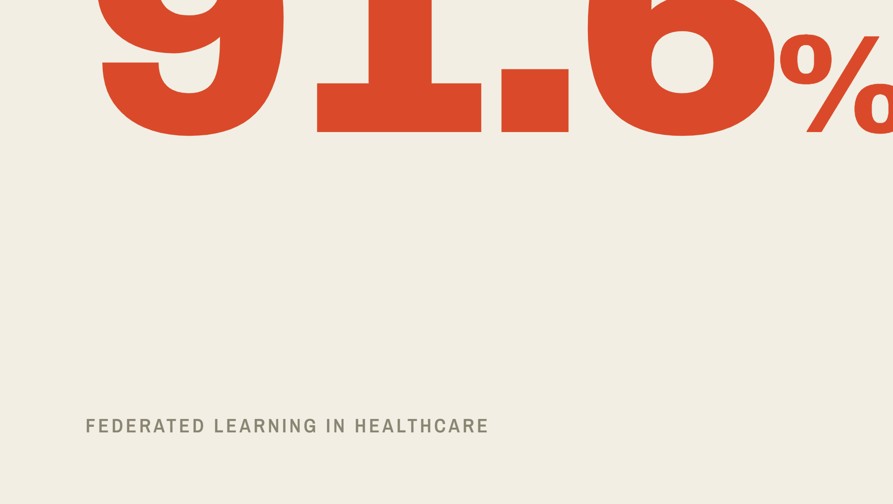
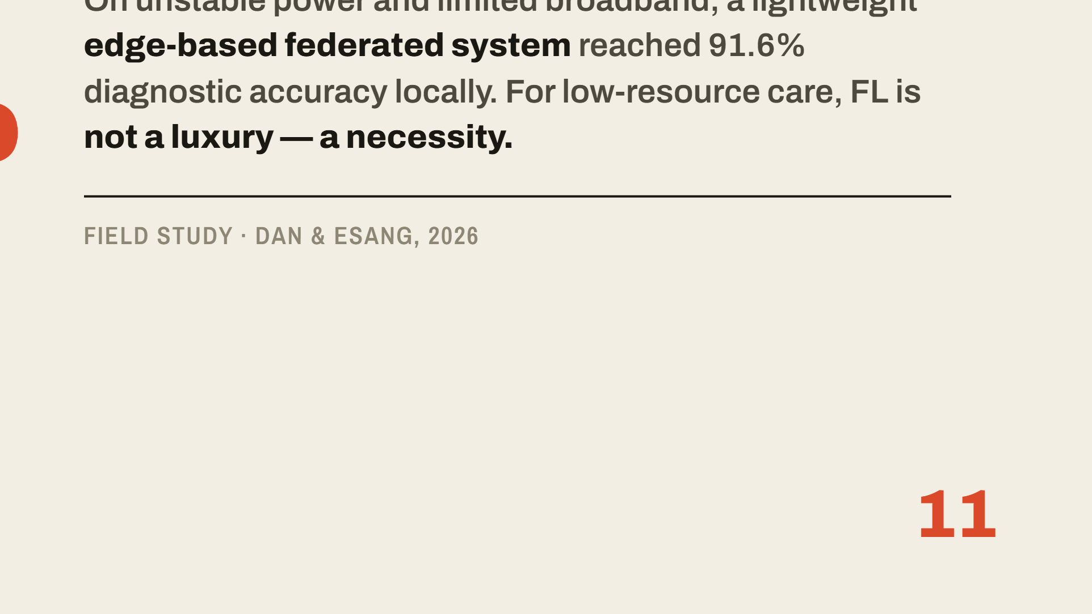
Notes:
Finally, why does this matter for Nigeria? Our infrastructure is often unreliable — unstable power and limited broadband. A 2026 study by Dan and Esang proved that a lightweight, edge-based federated system can achieve ninety-one point six percent diagnostic accuracy in our local cottage hospitals. This proves that for low-resource settings, federated learning is not just a luxury — it is a necessity.

Slide 10
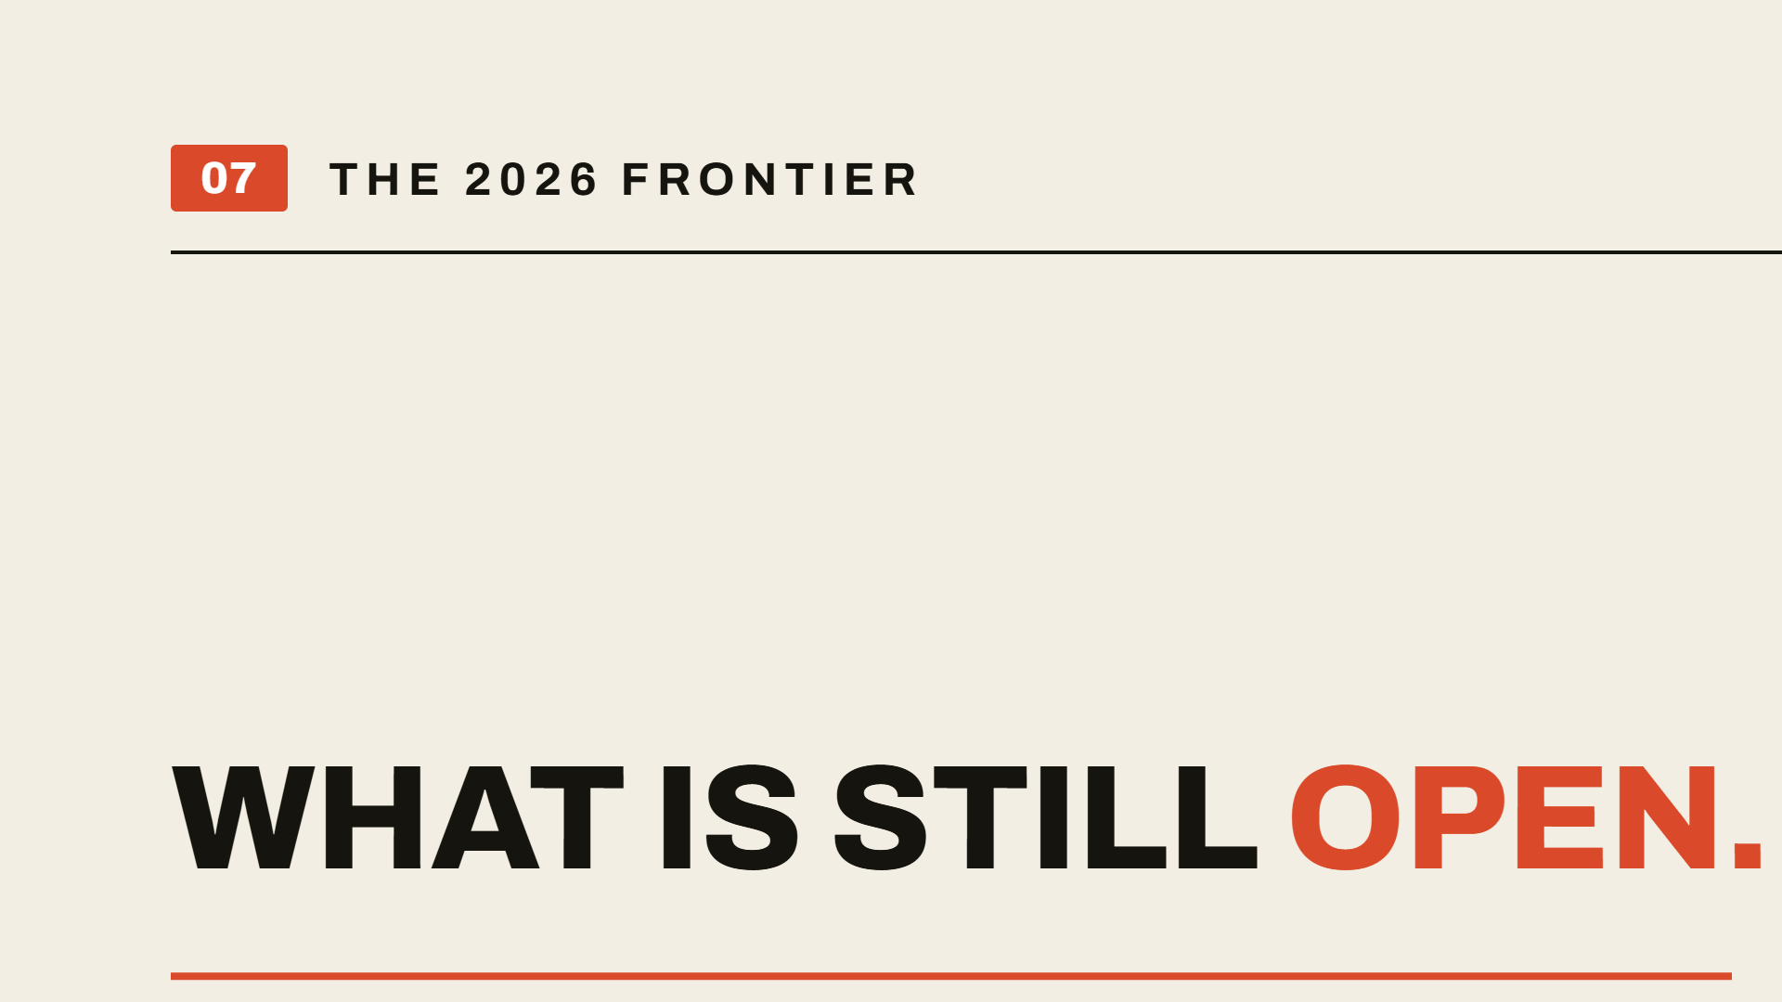

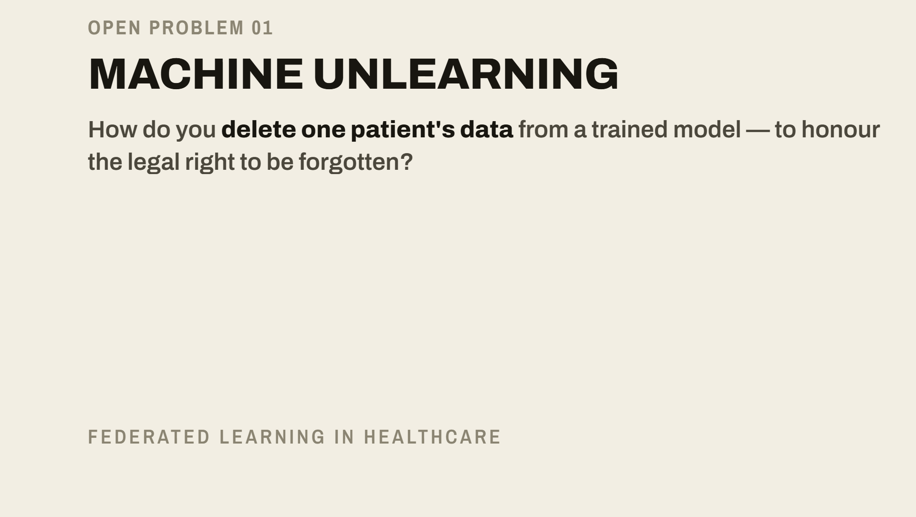
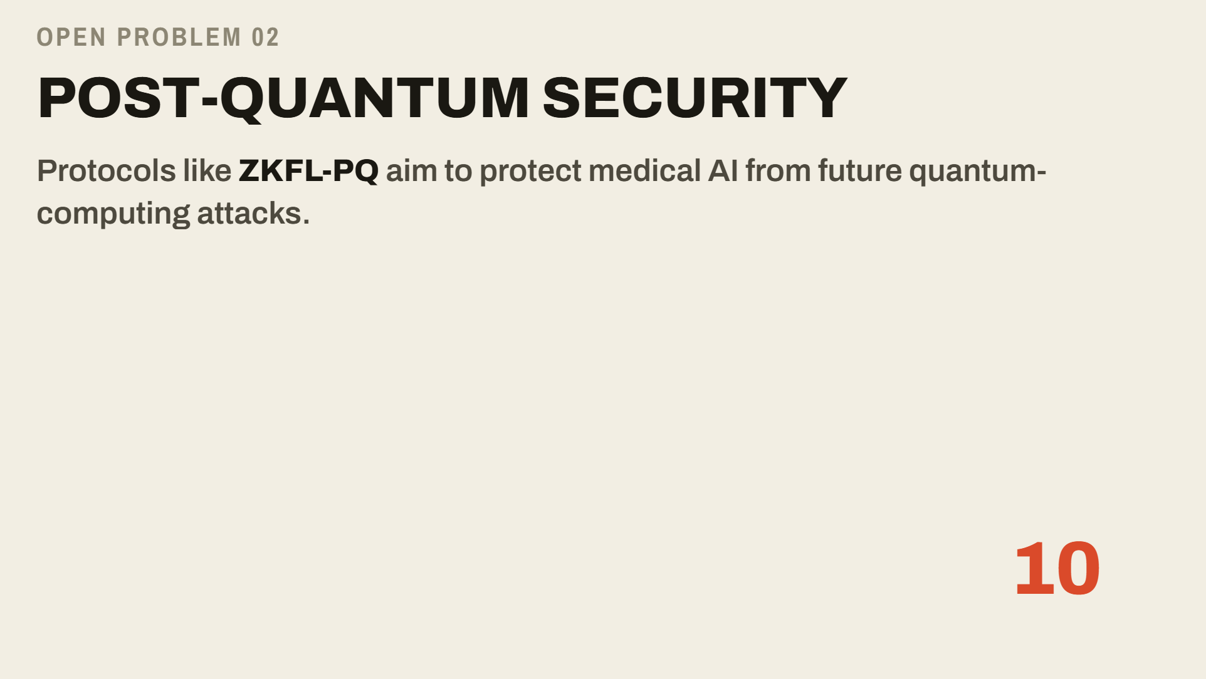
Notes:
To prove this topic is genuinely current, I identified two gaps the field is only now starting to address. First, machine unlearning: how do we delete a single patient's data from a trained model to satisfy the legal right to be forgotten? Second, post-quantum security: we are evaluating protocols like ZKFL-PQ to protect medical AI from future quantum-computing attacks. These define where the research frontier sits in 2026.

Slide 11
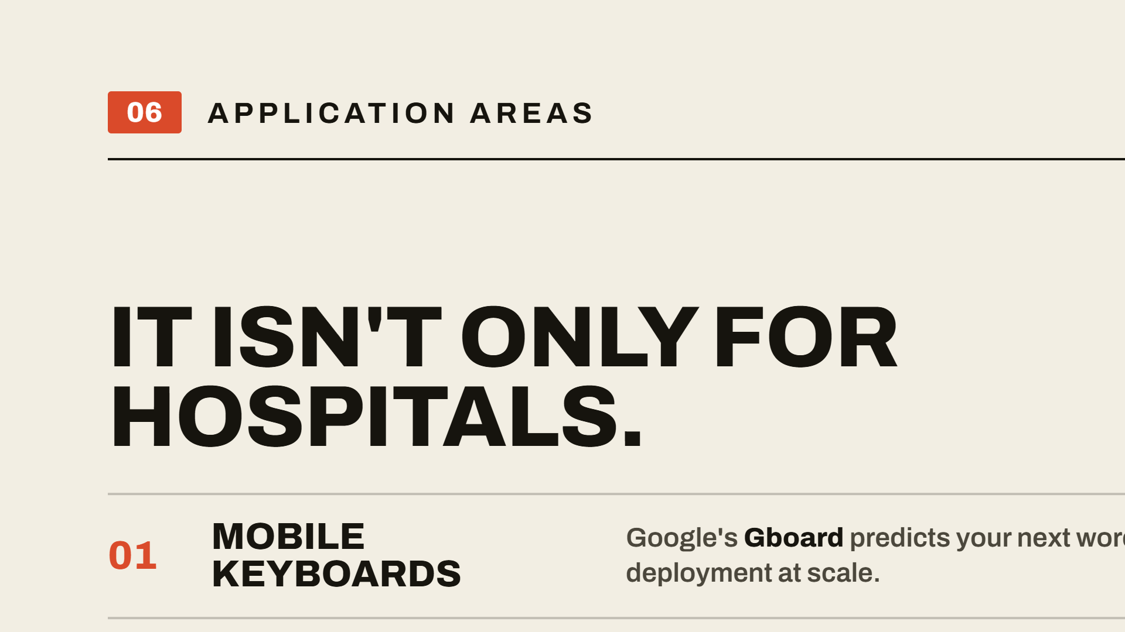
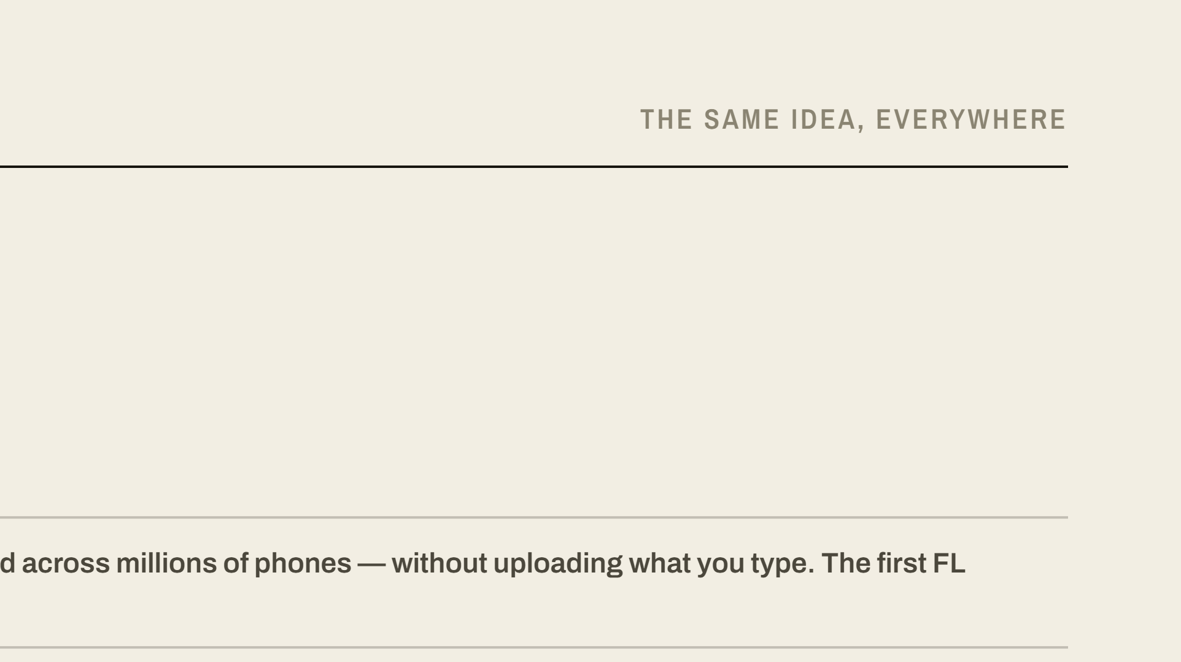
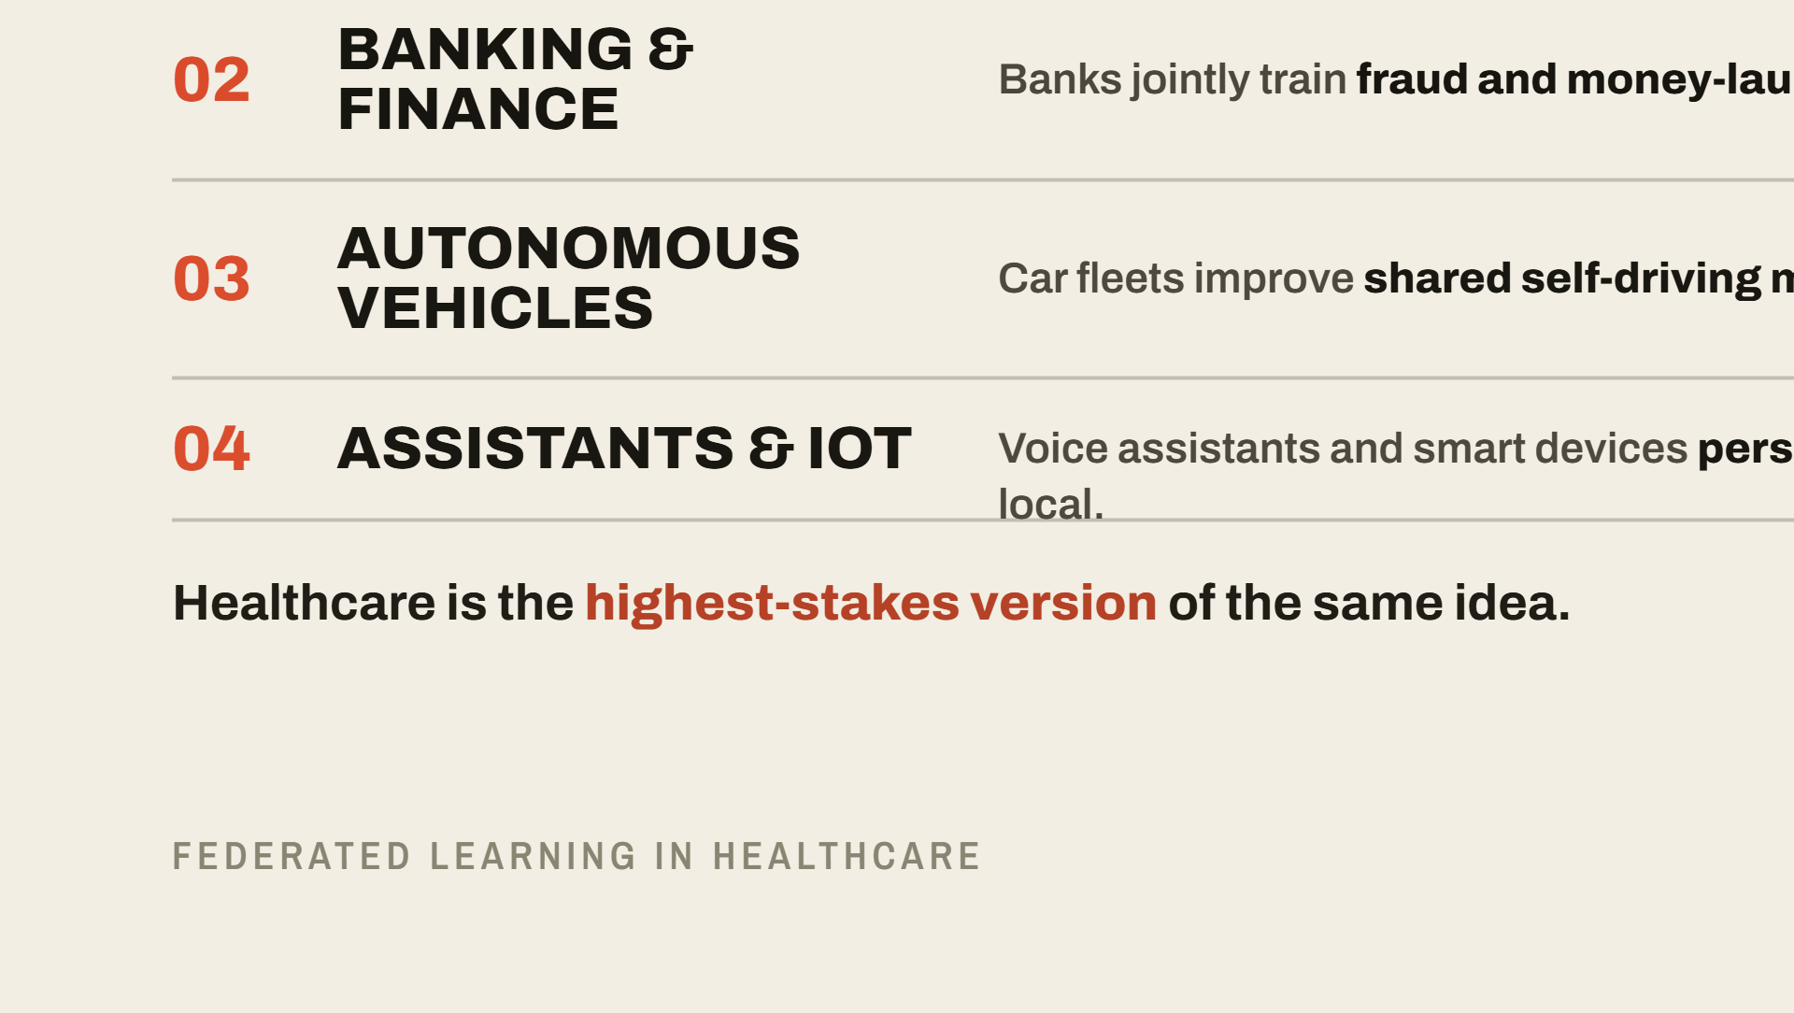
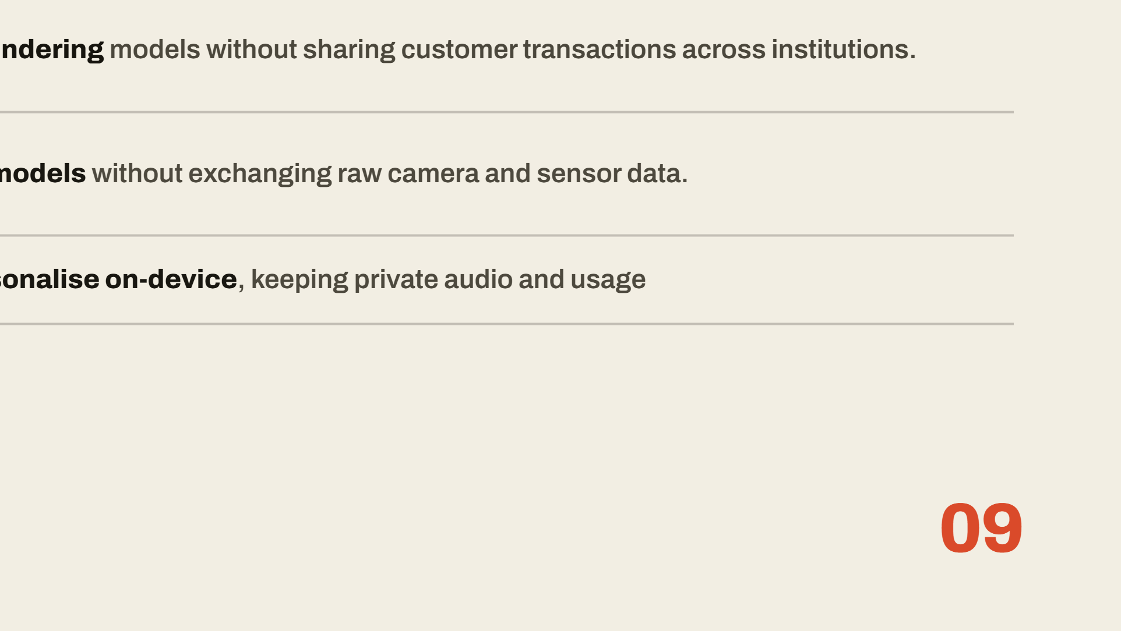
Notes:
It's worth stepping back to see that federated learning is not a healthcare-only idea. It is a general technique, already proven at massive scale in other industries. It began on your phone — Google's Gboard keyboard learns to predict your next word across millions of devices without ever uploading what you type. Banks use it to jointly fight fraud and money laundering without sharing customer transactions. Self-driving car fleets improve shared driving models without exchanging raw camera footage. And voice assistants and smart devices personalize on-device. Healthcare is simply the highest-stakes version of this same idea — which is exactly why getting it right matters so much.

Slide 12
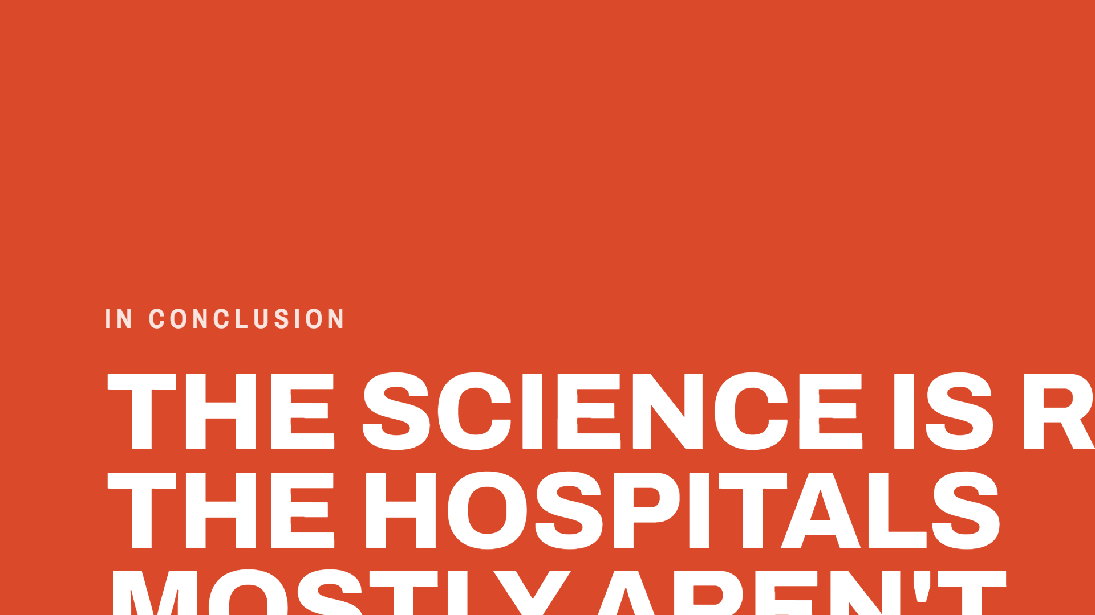

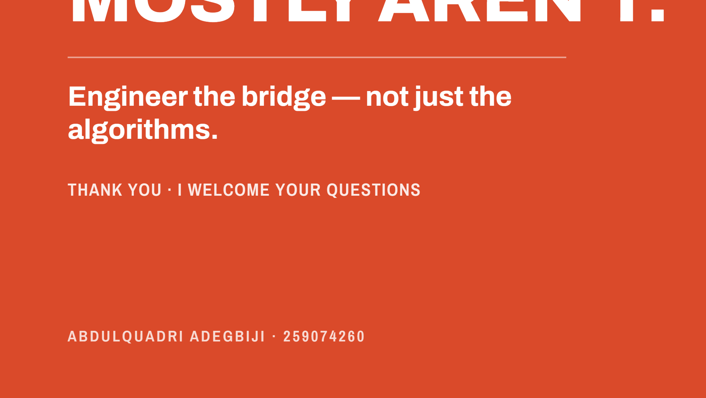

Notes:
In conclusion, the science of federated learning is ready, but the hospitals mostly aren't. We have moved the conversation from simulation to the ward. My research provides a roadmap for the next decade of healthcare AI by focusing on engineering the bridge — not just the algorithms. Thank you, and I am now ready for your questions.

