Slide 1



Where/who app

Slide 2

Our mission:
Our mission:
bringing people together
When help is needed people
▶
don‘t know who to look for
Teams don’t know what other
▶
teams are working on
In-company innovation
▶
Business value:
Business value:
save time = save money

Slide 3
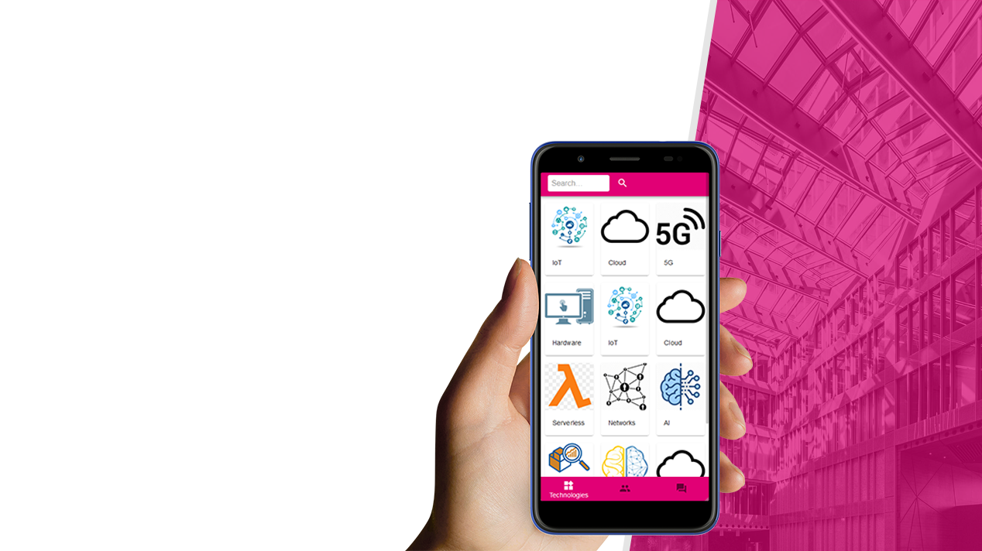
The product:
The product:
Where/who application
Find the person who can help you out
▶
Sort by skills or projects
Availibility check
Instant messages
Ask your question on the forum
Technical details
▶
Easily accessible
Chance to say „Thank You!”
aaa

Slide 4

Thank You!

