Slide 1

Team nexa
A-10 OPEN INNOVATION

Slide 2
PROBLEM STATEMENT
Rural residents often encounter barriers to healthcare that limit their ability to obtain the care they need. Even when an adequate supply of healthcare services exists in a community, there are other factors to be considered in terms of healthcare access and mediums to avail the existing amenity. Also, in pandemic times , access to proper healthcare facilities is the need of the hour.
Healthcare Stakeholders: Patients and Physicians
Why this issue? India has a significant shortage of trained physicians nationwide when compared to the WHO recommended ratio. Additionally, with about 80 percent of the medical workforce concentrated in top 8-10 cities and serving only 28 percent of the total population, access to healthcare still remains an aspiration for many. In rural India, a patient may have to travel even about 122 kms to meet a doctor. The need of the hour is to provide good quality healthcare access to the rural population.

Slide 3
Proposed Solution
Sanjeevani is a medical app that tackles the urban rural divide by helping patients get doctor consultations virtually through app or web-based videos, chats and voice guidance.
It is an Android-IoT based Real-Time Health Monitoring and Medical Consultation System
The IoT systen is connected to the cloud that let’s the users keep real time check on some basic parameters like: Heart-Rate, Blood Pressure, Temperature, ECG Function, Glucose Level, Dissolved Oxygen Level etc. using Bio-Sensors that transmits the data to Firebase for storage in database and henceforth can be accessed by the authenticated person.
The native-android based medical app offers people to have a better access to healthcare resources beyond their boundaries of accessibility and connect them to doctors, specialists and healthcare experts on a digital platform, which provides them access to an online consultant without a physical visit. The app provides one-to-one interaction with doctors with the help of features like text messages and video chats. For the doctors, It also includes the feature to view-track the medical record of the patient regularly and efficiently.

Slide 4
Features of the application
Text Messages : It allows patients to connect to doctors and have a personal consultation over a chat on a digital platform.
Video Conference : It provides its user to avail the option of video conferencing to have a better understanding of the person’s ailment.
Multi-Language Support : It supports multi-language interface for users to have the comfort of communication in their preferred language.
Nearest Pharmacy Location : It also provides an added aid for people to find and locate nearest medical shops along with customer feedbacks.
Patient Profile : It helps doctor check the live health report as generated by the IoT device

Slide 5
Tools and technologies used
Software -
Database – Firebase Database
Android development platform – Native Android
Hardware –
Sensors - EG Module, Pulse Oximeter, Temperature Sensor, Glucometer, Blood Pressure module connected to a Biometric Shield

Slide 6
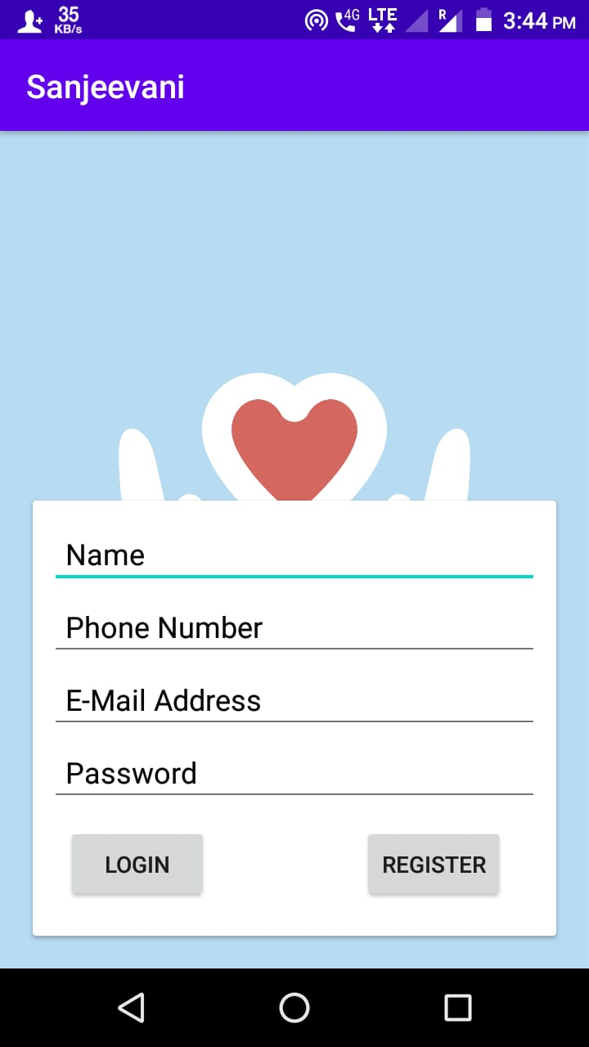
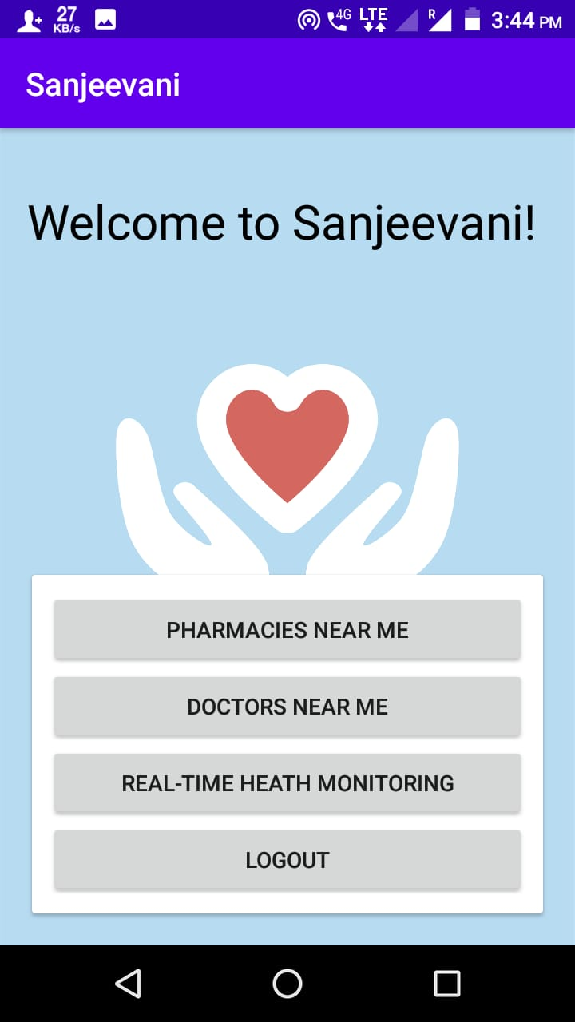
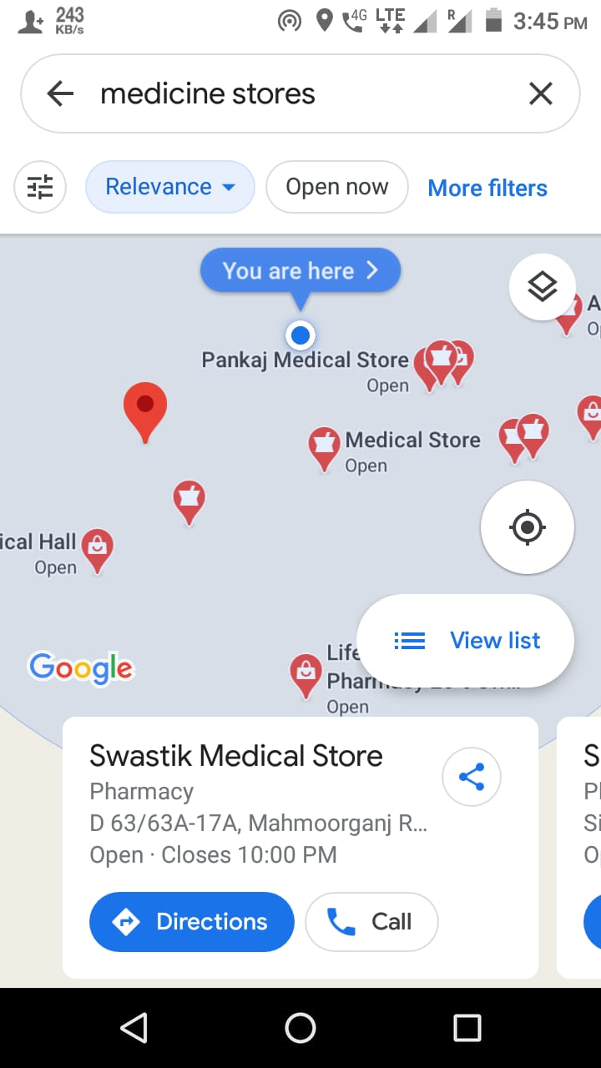
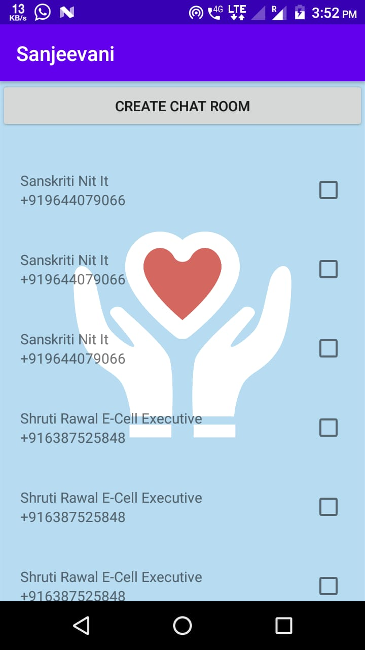
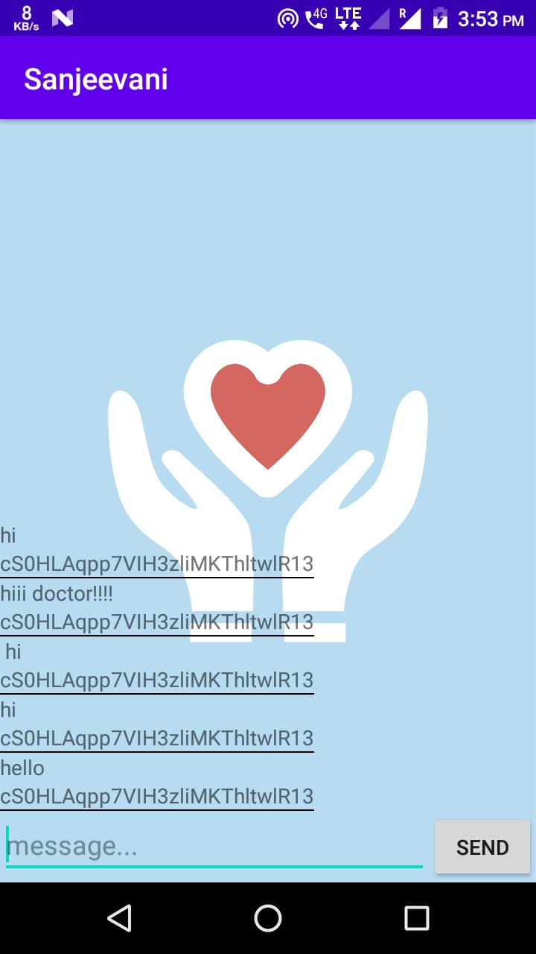
Screenshots of the work in progress application

