Slide 1
OOP WITH JAVA TERM PROJECT 2020-21
Topic – Quiz Management System
Name – Siddharth Mishra
Roll Number – 19115087
Branch – Sem : CSE – 3rd

Slide 2
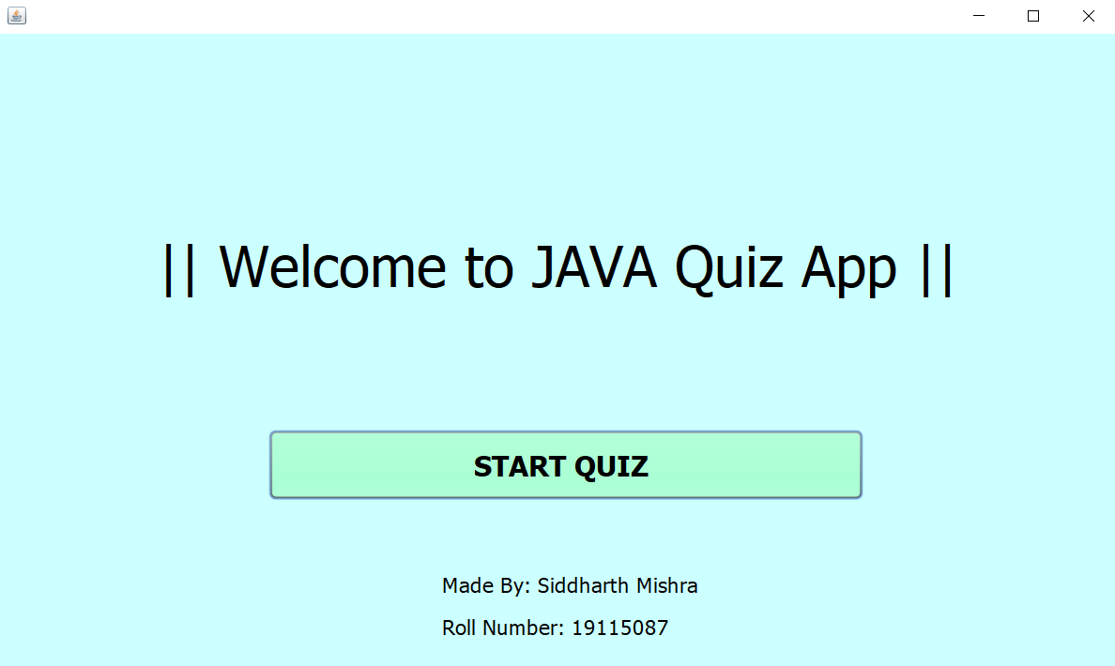
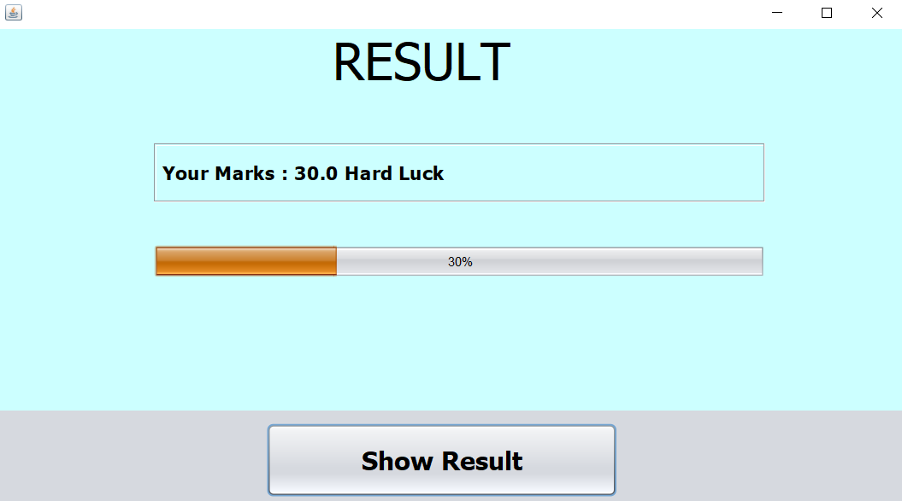
RESULT Screen
User Interface
START Screen

Slide 3
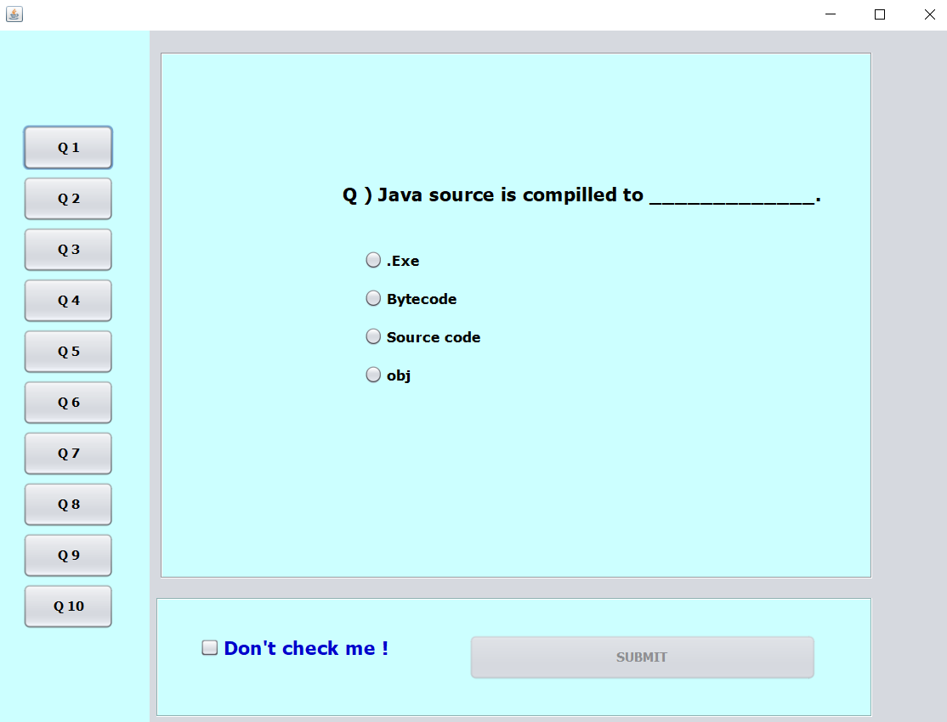
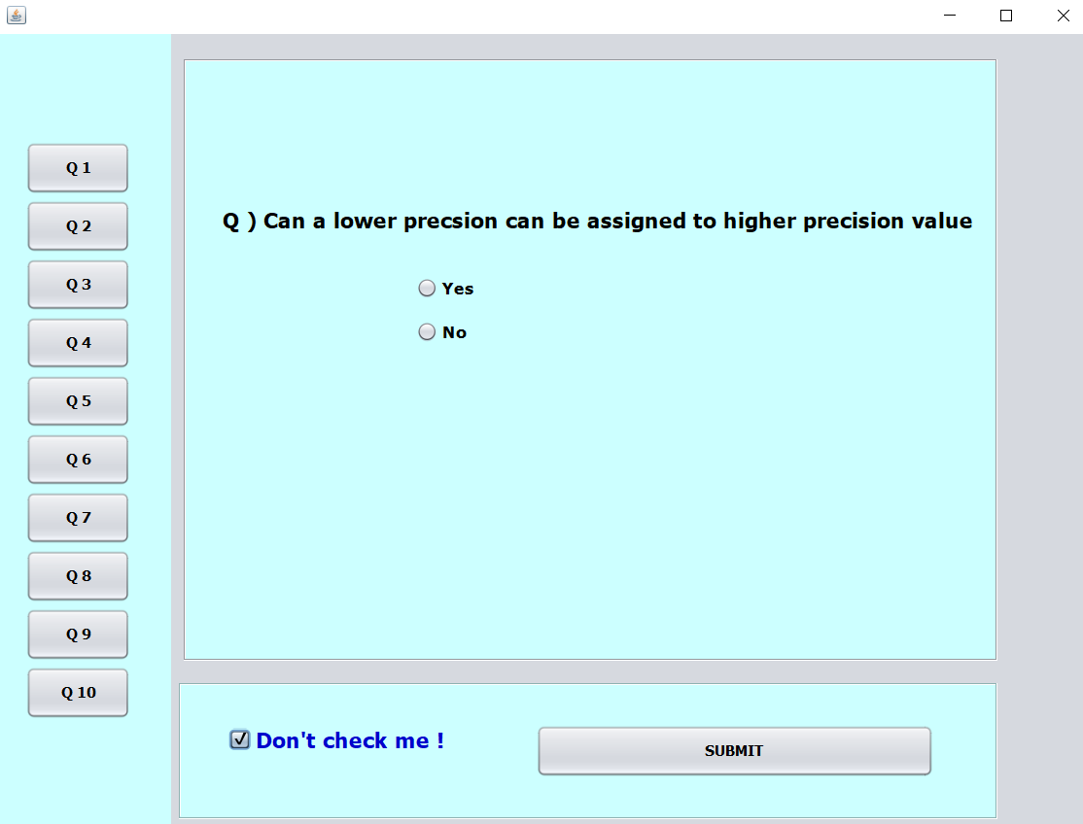
Quiz Screen
User Interface

Slide 4
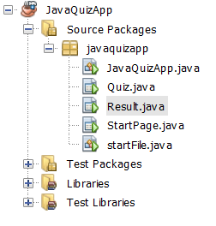
WORKING
This is the general overview of the project. The following files are the JAVA files in the project.
File System for the Project

Slide 5
WORKING
This is a JLabel that contains the welcome note
The user needs to press the “START QUIZ” button to start the quiz

Slide 6
WORKING
Group of radio Buttons that act as options for the MCQ questions.
The JLabel that contains the question of the quiz.
Buttons to change the questions

Slide 7
WORKING
The progress bar that shows the result of the user in percentage
The “Show Result” button to look on the score

