Slide 1
JAVA TERM PROJECT
Topic – Quiz Management System
Name – Siddharth Mishra
Roll Number – 19115087
Branch – Sem : CSE – 3rd

Slide 2
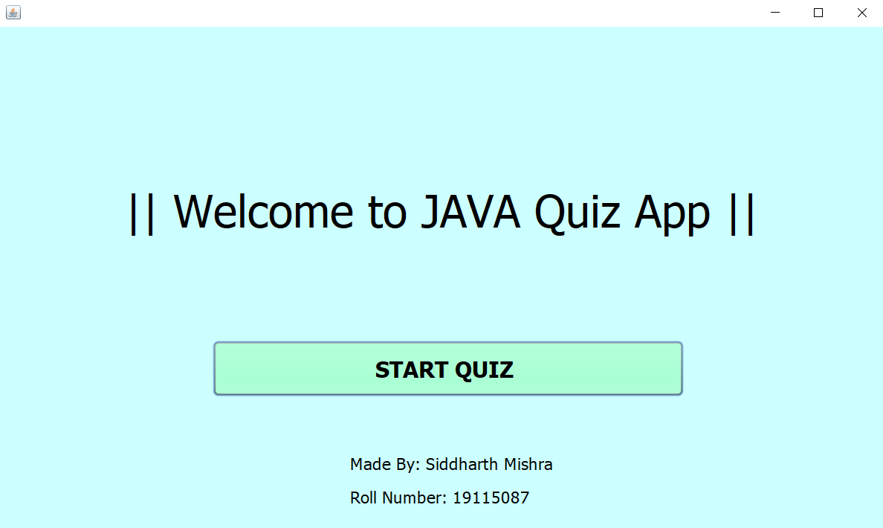
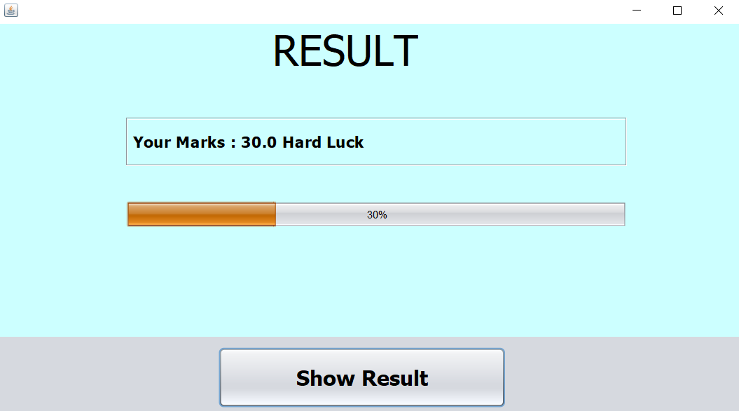
RESULT Screen
User Interface
START Screen

Slide 3
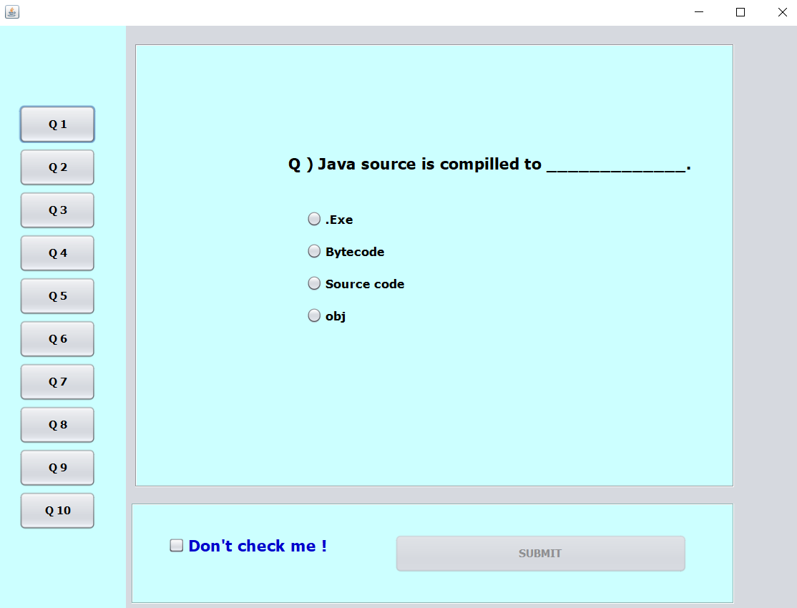
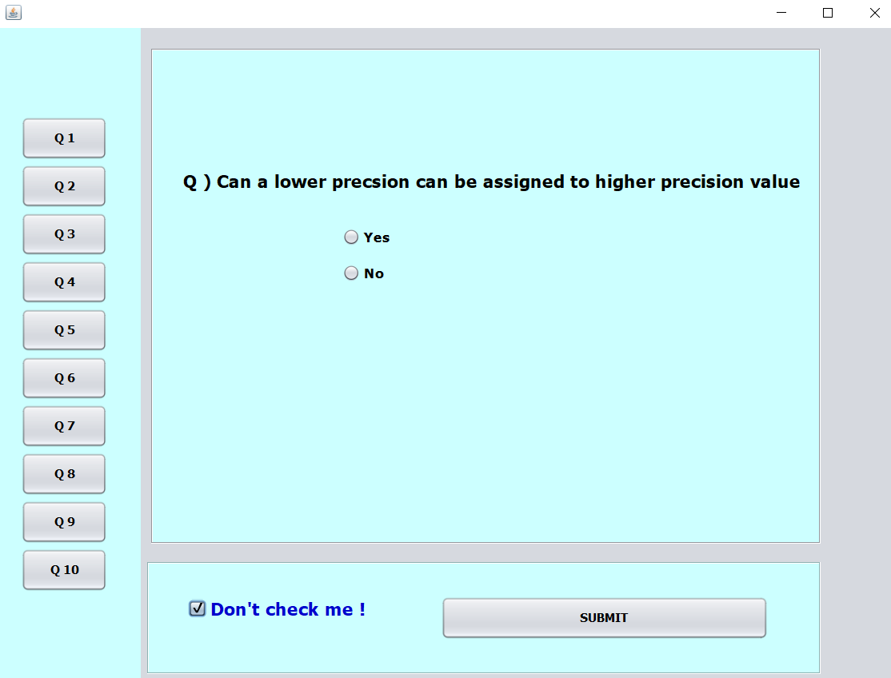
Quiz Screen
User Interface

Slide 4
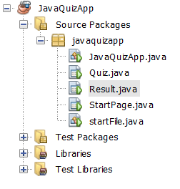
WORKING
File System for the Project

