Slide 1
Predicting House Prices with Machine Learning
December 2 , 2020
Data – Condas : Miren Patel, Hard Thakkar, Kunal Kalra, Hiwot Argaw, Rahwa Asghedom

Slide 2

Agenda
Introduction
Data Exploration
Top correlated features, visualizations, plots, insights
Data Pre-Processing
Missing Value Treatment, Normalization, Outlier Treatment, Features Generation, Feature Encoding
Model Building and Testing
Decision Tree, Random Forest, SVR, Ridge Regression, XGBoost Regression
Conclusion and Next Step

Slide 3
Introduction - Objective
Main Purpose:
To determine which explanatory variables will most positively impact the final price of each home
Predicting the final price of each home by "house id" and "sale price" (Prediction Results)
Evaluation Metric: Calculating Mean Absolute Percentage Error (MAPE), R-Squared
Exploratory Data Analysis:
Analyzing the target variable, "Sale Price"

Slide 4
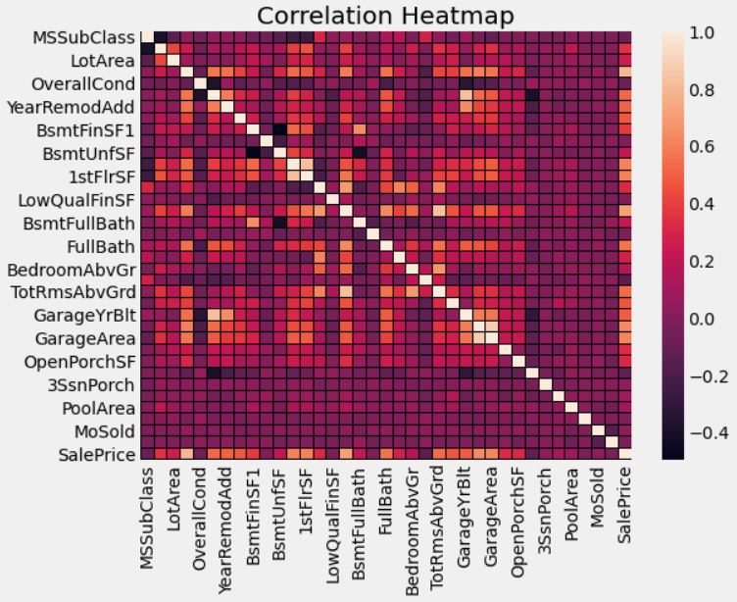
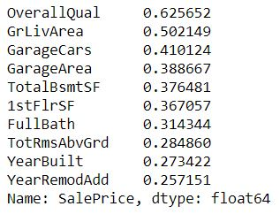
Data Exploration – Visualizations, Insights
Top Correlated Features (against SalePrice)
Visualizations:
SalePrice vs. OverallQual
SalePrice vs. GrLivArea
SalePrice vs. GarageArea
SalePrice vs TotalBsmtSF
SalePrice vs 1stFlrSF
SalePrice vs MasVnrArea

Slide 5
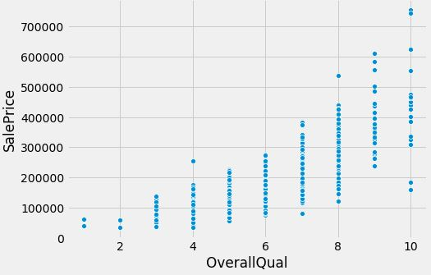
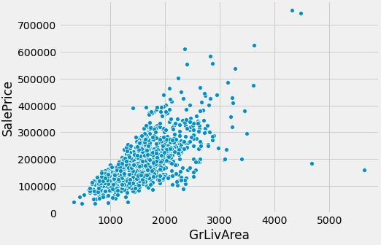
Data Exploration
SalePrice vs. OverallQual
SalePrice vs. GrLivArea
Positive correlation between the variables sales price & overall quality
We see highest population of sales under the 8th quality score
An overall increasing trend; As sales price goes up, quality increases
Moderate positive correlation between above grade (ground) living area square feet & sale price
We also observe some outlier points, a price with much higher ground living area square feet

Slide 6
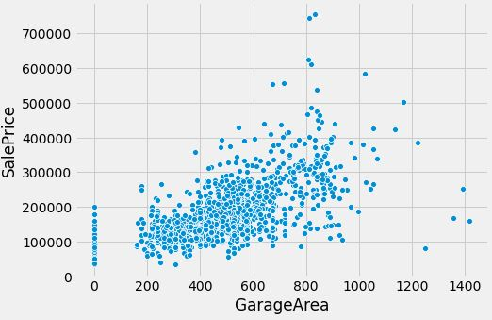
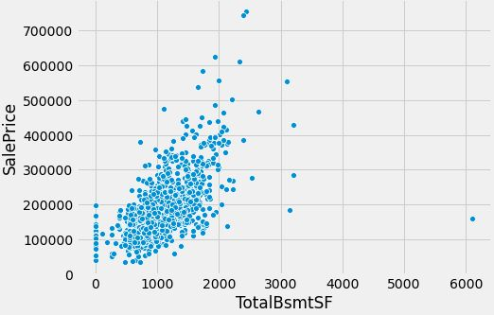
Data Exploration
SalePrice vs. GarageArea
SalePrice vs TotalBsmtSF
Majority of the sales population have a garage area varying from 200 to 800 square feet
A few outlier points is also shown, with low sales price that have much higher garage area
We observe that the total square feet of basement area are mostly below 2000 square feet as the sales price range from 0 – 400000
Very clustered

Slide 7
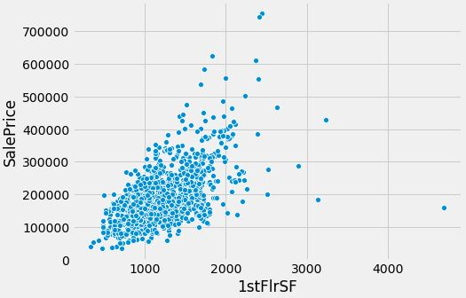
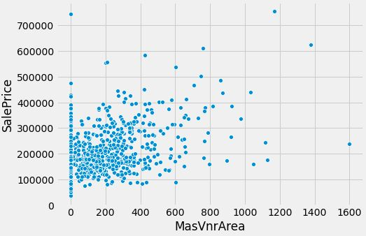
Data Exploration
SalePrice vs 1stFlrSF
SalePrice vs MasVnrArea
The first-floor square feet has a moderate to strong correlation against sale price
Clustered between 0 – 300000 sale price
Weak relationship between the variables points as the scatter plot seems to be widely spread across
The Masonry Veneer area is mainly under 400 square feet, with price ranging from 100000-300000

Slide 8
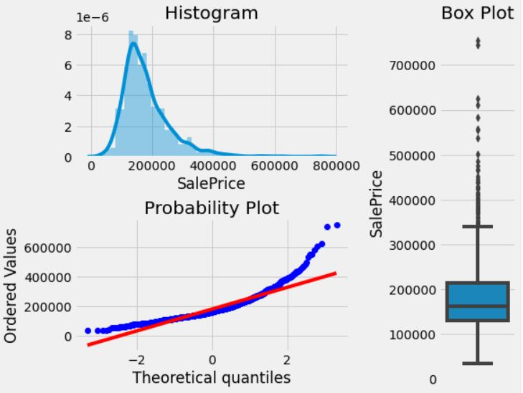
Data Pre-Processing – Features Engineering
Outlier Treatment:
Created a function to identify the outliers
Next, created a function to remove the outliers
Removing extreme outliers as:
Mean +- 3*StdDev
Other Treatments:
Transformed the non-numeric predictors, which are stored as numbers and converted them into strings
Replacing categorical data, Null Values
Our predictor variable is right skewed
There are many outliers, will do treatment later for normalizing data

Slide 9
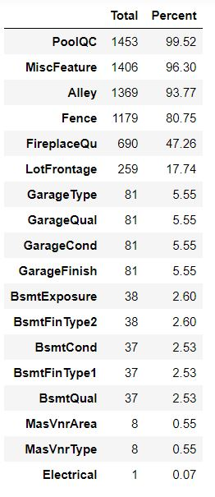
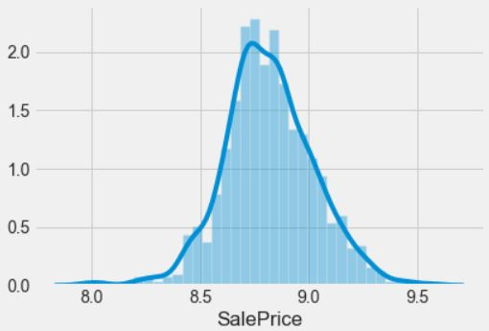
Data Pre-Processing – Features Engineering
Missing Value Treatment:
Created a function that takes a dataframe as input and returns two columns, total missing values and total missing values percentage
Filled null with median mode or 0
Dropped columns with roughly 80% data missing
Normalization:
Transformed the features to remove skew using Box-Cox Transformation
To reduce the skew of SalePrice, we took the log 1+x transform
Normalizing the data

Slide 10
Data Pre-Processing – Feature Encoding/Features Generations
Ordinal Encoding:
Created a function to retain the information about the order in which the values should be ranked
Categorical features have an inherent order in the values, such as Excellent, Average, etc.
Label Encoding:
For all temporal categorical features
One-Hot Encoding:
For remaining categorical features
Features Generations:
Created new numerical features that will help with our model
For example, "TotBathrooms" (Total Bathrooms), "TotalSF" (Total Surface Area), "Total_porch_sf" (Total Porch Surface Area), "hasbsmt" (Has Basement, Yes/No)

Slide 11
Prediction Models
Decision Tree, Random Forest, SVR, RidgeCV Regression, XGBoost Regression

Slide 12
Model Building and Testing
Decision Tree
MAPE (Mean Absolute Percentage Error) : 0.167
R-Squared (R^2) = 0.759
Random Forest
MAPE (Mean Absolute Percentage Error) : 0.110
R-Squared (R^2) = 0.874
SVR
MAPE (Mean Absolute Percentage Error) : 0.140
R-Squared (R^2) = 0.759
RidgeCV Regression (BEST-MODEL)
MAPE (Mean Absolute Percentage Error) : 0.097
R-Squared (R^2) = 0.872
XGBoost Regression
MAPE (Mean Absolute Percentage Error) : 0.099
R-Squared (R^2) = 0.894

Slide 13
Conclusion & Next Steps

Slide 14
Summary
Data Exploration:
Overall Quality and above grade (ground) living area square feet (GrLivArea) were the top correlated features against SalePrice
Data Pre-Processing:
Our predictor variable was right skewed, so did box – cox transformation to normalize our data
Outlier Treatment
Ordinal Encoding
Label Encoding – Temporal Categorical Features
One-Hot Encoding – Remaining Categorical features
Created New Features as well to help with our model
Model Building and Testing:
RidgeCV Regression (BEST – MODEL)
MAPE = 0.097

Slide 15


Next Steps
Study the data better
Hard to do virtual meet-ups, in-person meetings would be more effective
Discover more highly correlated features to help forecast the final price for each home
Add more data related to homes to help improve the model?
Model Tuning
Hyper-parameter Tuning
Dimensionality Reduction by reducing Collinearity

Slide 16
Questions?

