Slide 1
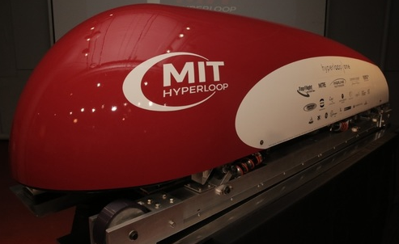
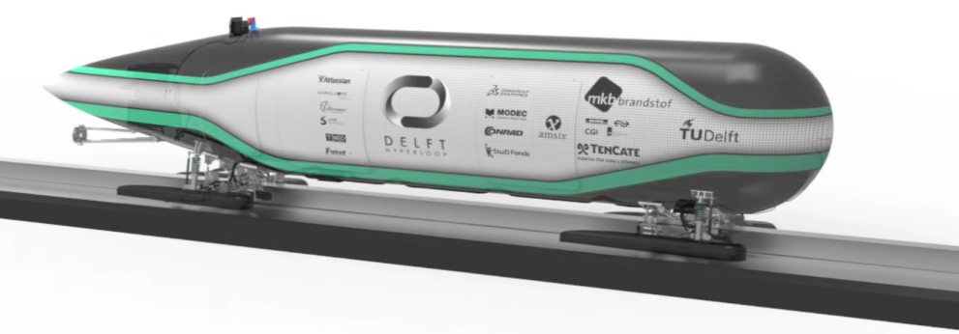
HyperLoop Control System
“An object at rest stays at rest and an object in motion
stays in motion with the same speed and in the same
direction unless acted upon by an unbalanced force.”
Sir Isaac Newton
EE542: Advance Embedded System Design
Lincoln Young & Paul Adams
08/02/2016
Overview
Introduction
HyperLoop Transport System
Electromechanical Control
Electrical & Electronic Control
Summary

Slide 2
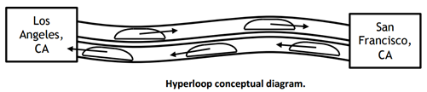
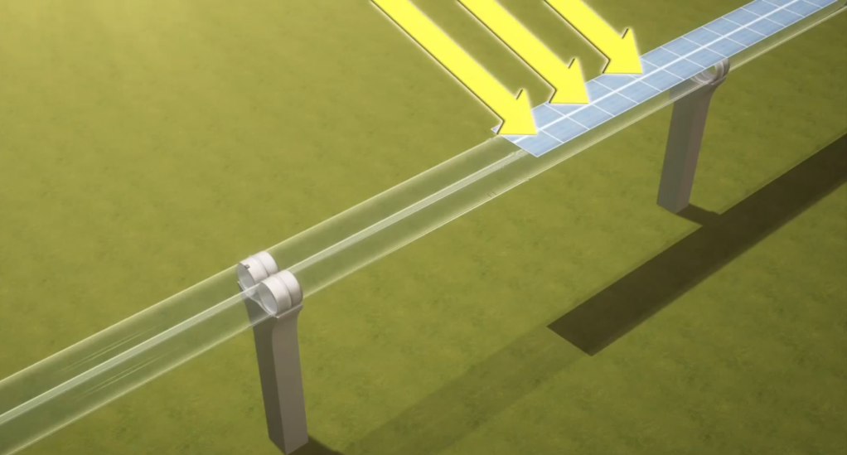
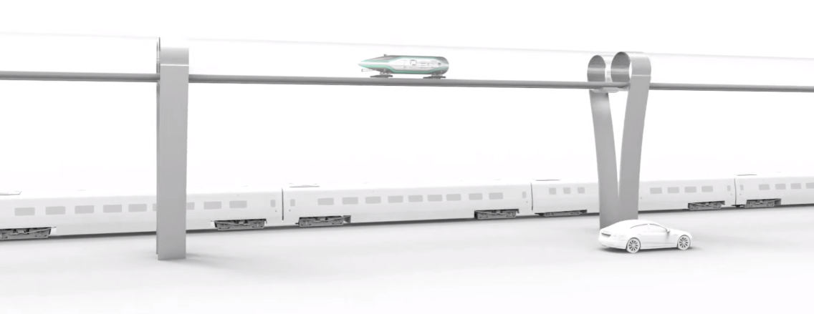
HyperLoop Transport System
A 5th method to transport developed for inter-city travel.
A Low pressure tube (100 Pa)with a capsule/pod traveling at approximately the speed of sound.
The system utilizes Solar Energy and generates more power required for its daily operation
Each Pod levitates 2-10 cm using permanent magnets and an aluminum track.
The journey is a three phase path: 0-300mph, 300mph-750 mph-300 mph, 300-0 mph.
mph
750
300
t
Local City Area
Local City Area
HyperLoop Tube System

Slide 3
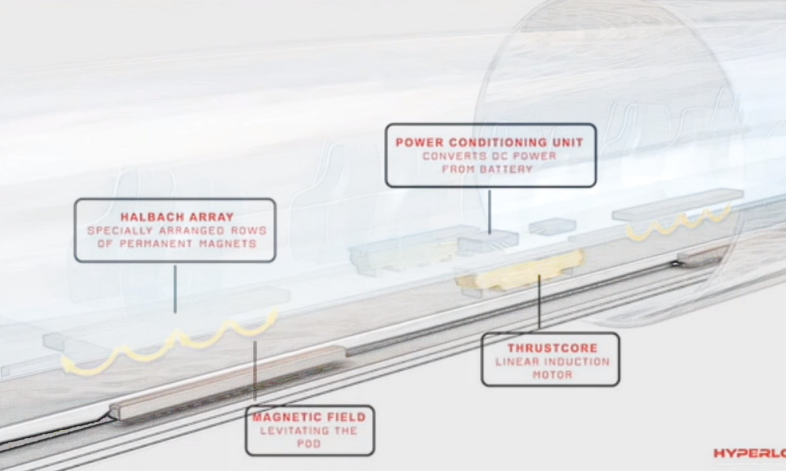
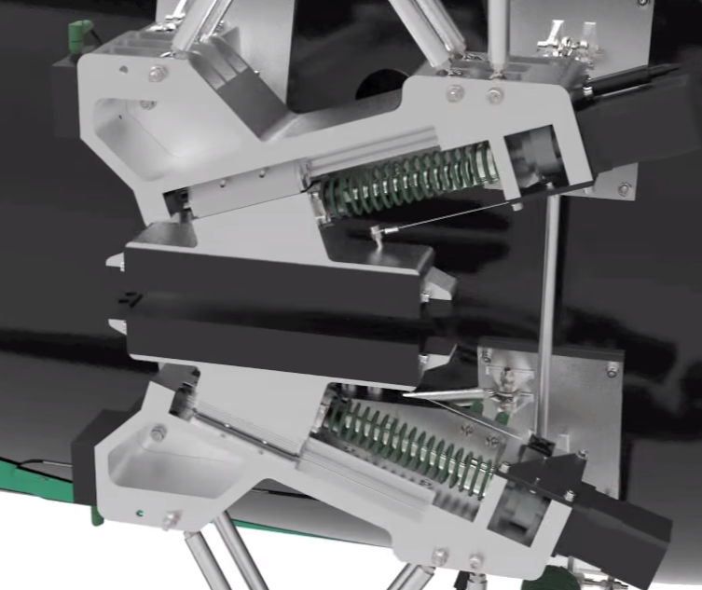
Electromechanical Control
The Levitation of the capsule is achieved with permanent magnets.
This magnetic array augments the magnetic field on a single side of the array and at the same
time cancelling the field to near zero on the opposite side.
The capsule travels on a cushion of air.
The Thrust-core consist of a Linear Induction motor that aids in the acceleration for capsule
The Thrust-force is reversed this recharges the battery - Electrodynamic Suspension brakes
which is a fail safe mechanism.
Levitation & Thrust-core
EDS Brake System

Slide 4
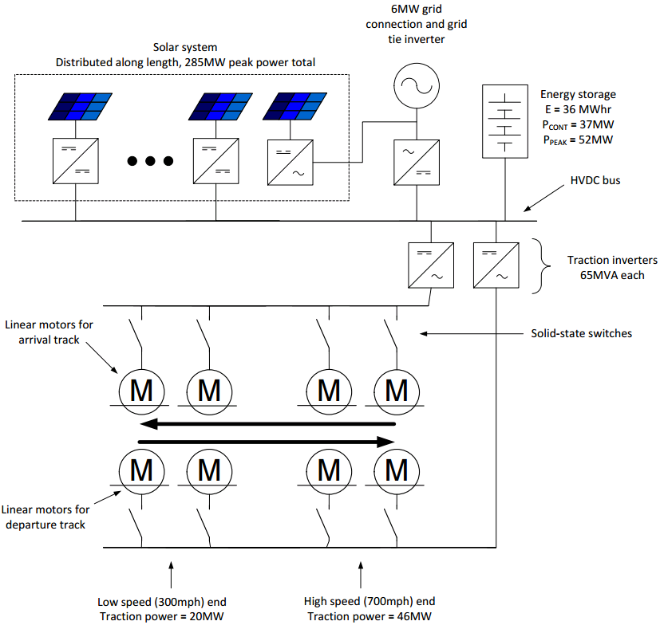
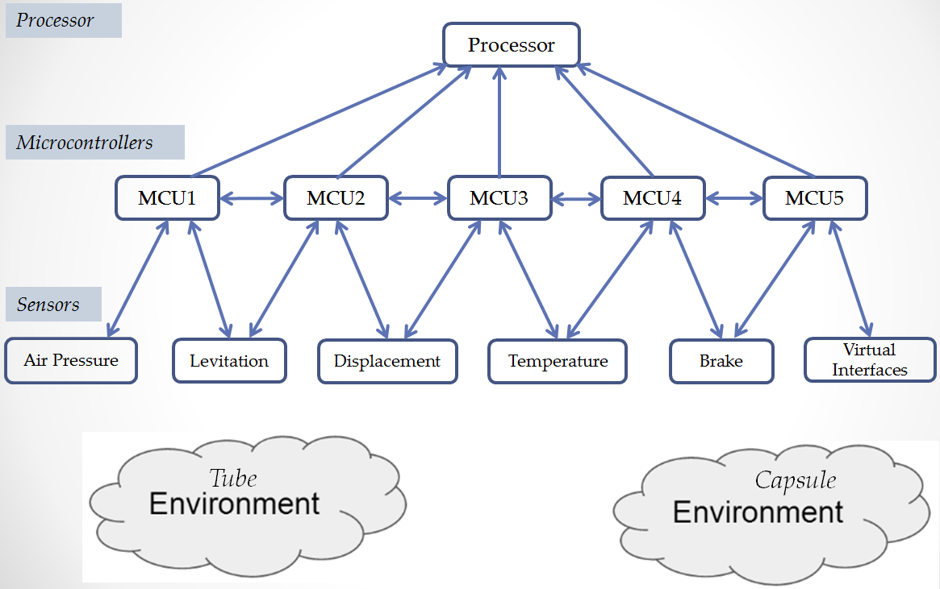
Electrical & Electronic Control
Solar array on the outer surface of the tube will generate approximately 57 MW per year.
The battery array supports the acceleration and deceleration of the capsule.
These arrays provide storage of excess power during nonpeak periods that can be used
during periods of peak usage. Backup power from the grid is required only when solar power
is not available..
A Bottom-Top embedded design employs a wireless communication and state estimation control .
Environment -> Sensors-> Microcontrollers (data is shared) -> Processor -> Wireless communication.
MCU Distributed System using a CAN protocol.

Slide 5
Summary
A Cost effective transport system compared to proposed high speed train from San Francisco to LA .
This transport solution is environmentally sustainable and efficient.
The overall system controls are engineered to innovative robust embedded deisgns.
Compared with High Speed trains, the hyperloop solution requires less maintenance.
MIT and DELF HyperLoop Engineering Student teams designed two capsules we researched.
DELFT HyperLoop Capsule demo: https://www.youtube.com/watch?v=eP8Bz_XCIrk .
Questions?

Slide 6
Back Up

Slide 7
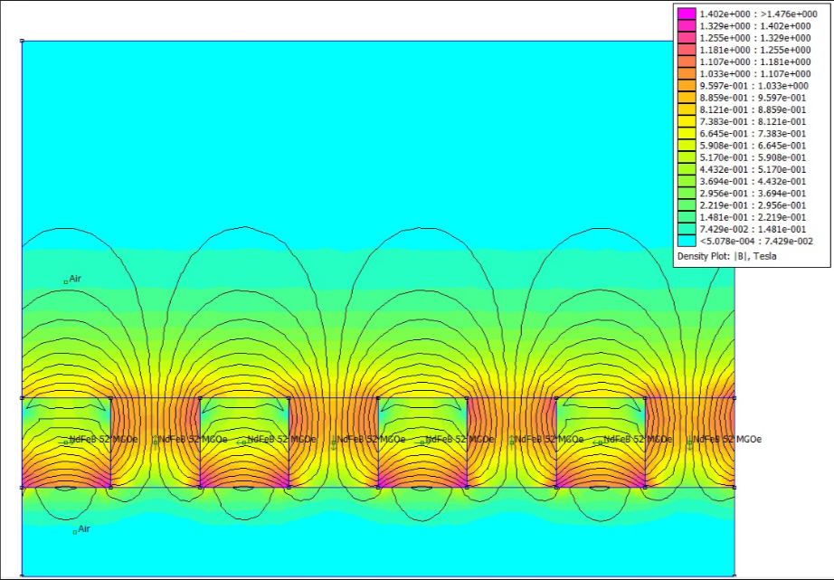
Halbach Array – Permanent Magnets

Slide 8
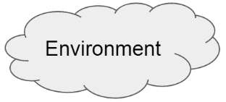
MIT Communication Control
Distributed System
With CAN protocol
Processor
Processor
Microcontrollers
MCU1
MCU2
MCU3
MCU4
MCU5
Sensors
Air Pressure
Levitation
Displacement
Temperature
Brake
Virtual Interfaces
Tube
Capsule

Slide 9
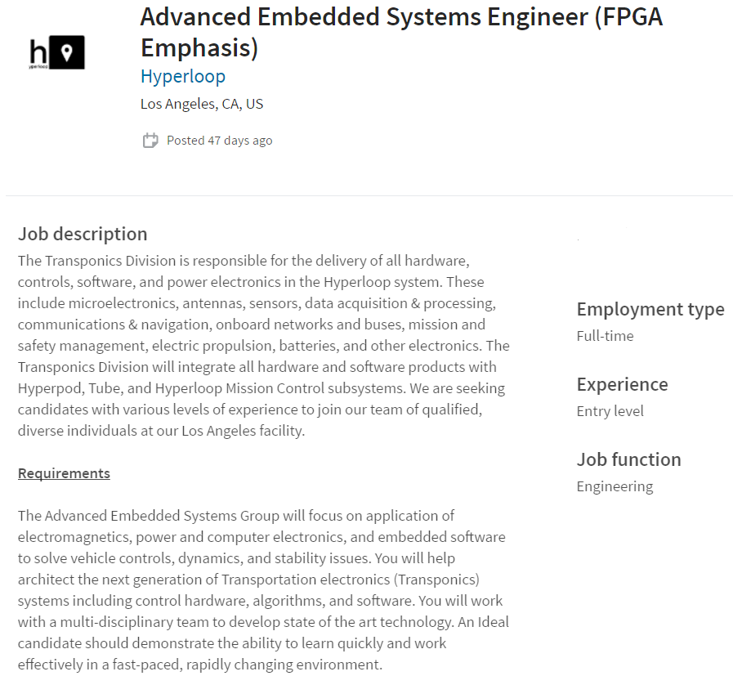
Employment Opportunity

Slide 10
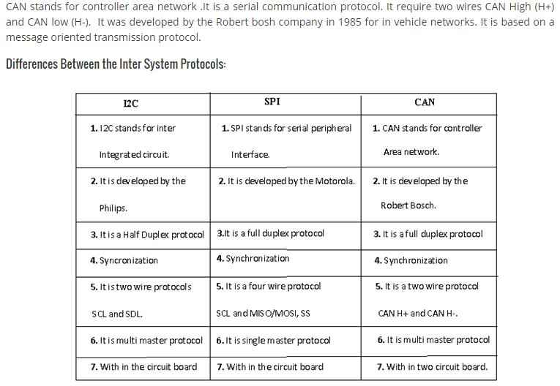
CAN Protocol
The CAN protocol defines packets, checksums, collision handling, retries, etc. Tried, tested protocol and the big
advantage is that it is implemented directly in silicon on many microcontrollers. The firmware interfaces
to the CAN peripheral at the level of sending and receiving packets.
For sending, the hardware does the collision detection, back-off, retry, and CRC checksum generation.
For receiving, it does the packet detection, clock skew adjusting, and CRC checksum validation.
The CAN peripheral will take more firmware to drive than a UART such as is often used with RS-485,
but it takes a lot less code overall since the silicon handles so much of the low level protocol details.

Slide 11
State Estimation
A state estimator is a central part of every control center. The basic motivation
for state estimation is to perform computer analysis of the network under
the conditions characterized by the current set of measurements. Linear least square
Estimation.

