Slide 1
Frequency generator
SoC Tutorial
Louis Aromatario & Alberto Badilini
Louis.AROMATARIO.@student.umons.ac.be – Alberto.BADILINI@student.umons.ac.be

Slide 2
Outline
Introduction before realisation
Platform designer
Top-level file: ghrd.v
Hardware driver: FreqOUT.vhd
Software Development: main.c
Uploading the files to the processor and FPGA

Slide 3
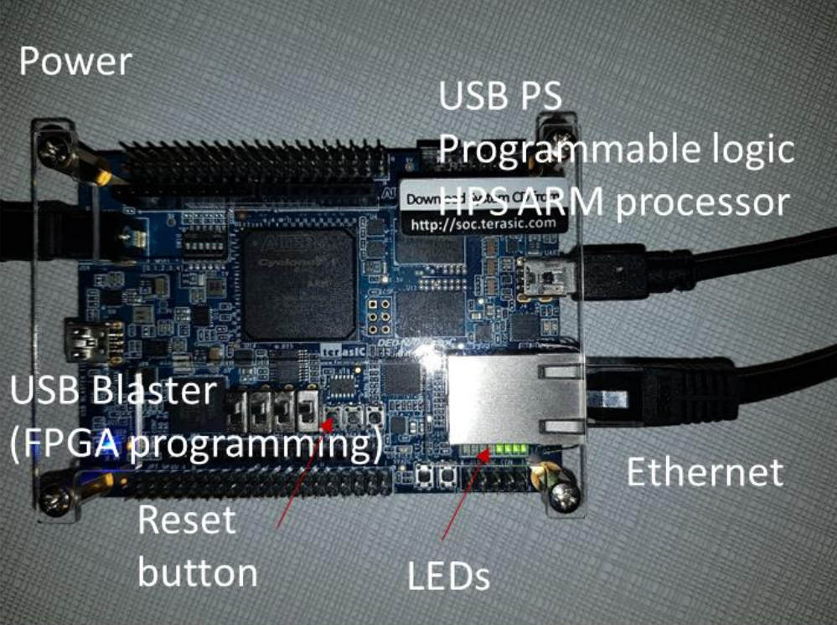
Introduction
DE0-Nano-SoC kit:
Contains a board with FPGA + ARM HPS + USB and alimentation cables
Softwares used:
Intel Quartus Prime Lite edition + ModelSim
Putty

Slide 4
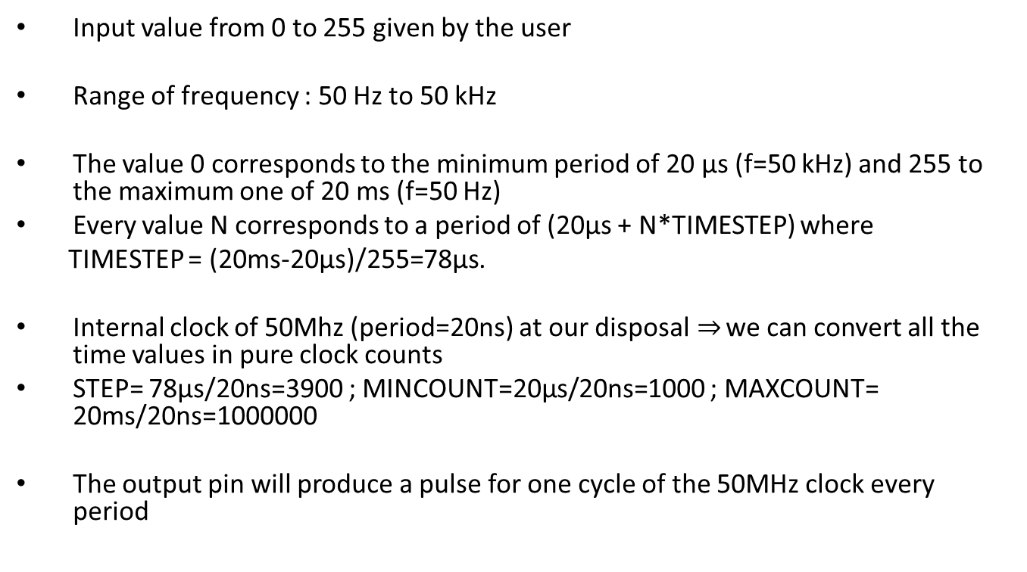
Goal and implementation
Input value from 0 to 255 given by the user
Range of frequency : 50 Hz to 50 kHz
The value 0 corresponds to the minimum period of 20 µs (f=50 kHz) and 255 to the maximum one of 20 ms (f=50 Hz)
Every value N corresponds to a period of (20µs + N*TIMESTEP) where
TIMESTEP = (20ms-20µs)/255=78µs.
Internal clock of 50Mhz (period=20ns) at our disposal$⇒$ we can convert all the time values in pure clock counts
STEP= 78µs/20ns=3900 ; MINCOUNT=20µs/20ns=1000 ; MAXCOUNT= 20ms/20ns=1000000
The output pin will produce a pulse for one cycle of the 50MHz clock every period

Slide 5
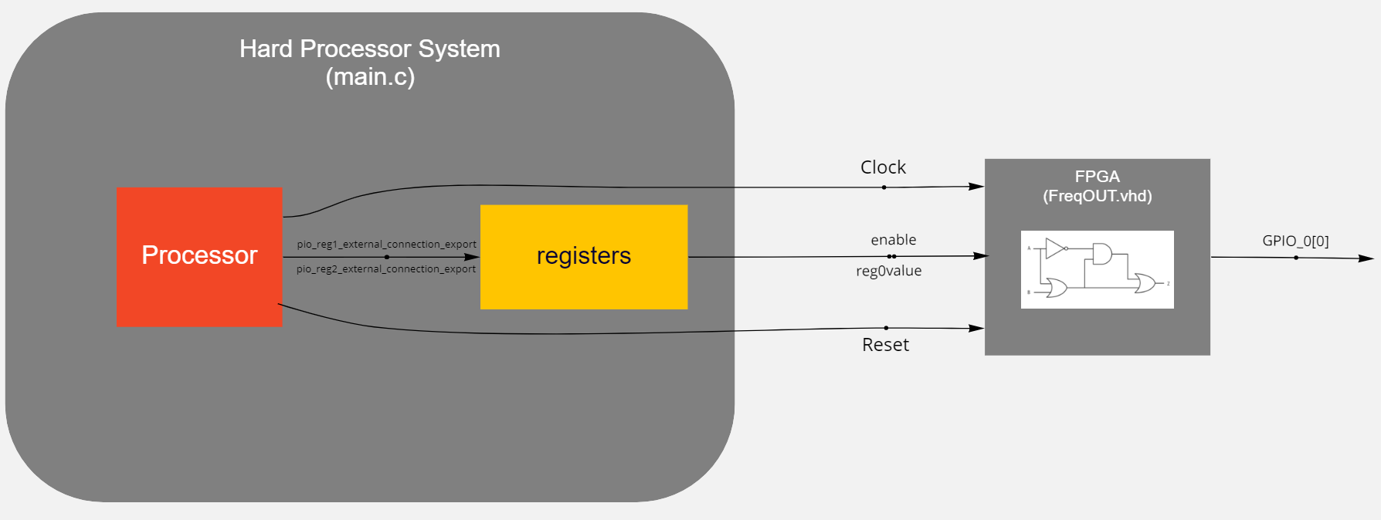
Flowchart of the project

Slide 6
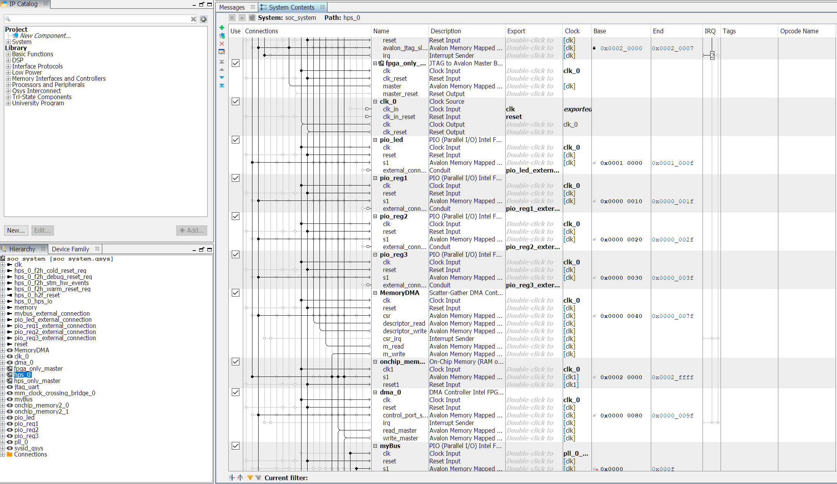
Platform Designer

Slide 7
Top-level file: ghrd.v
Generated from platform designer
Allows to declare internal wires and registers and connect them to processor pins, peripherals (ADC, GPIO pins, Arduino shield pins) and FPGA entities.

Slide 8
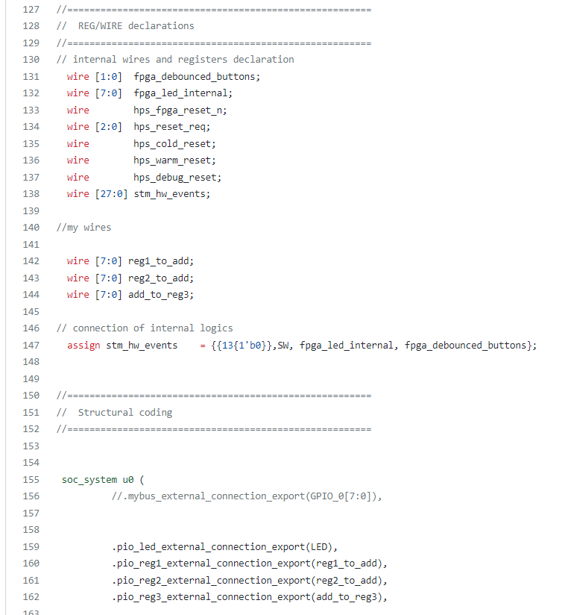
Top-level file: ghrd.v

Slide 9
Hardware driver: FreqOUT.vhd
Description of the logic circuit that will perform the function
4 inputs: clock, reg0value, enable, reset_n
1 output: gpio
2 signals: cnt and gpiobuff
1 variable: max

Slide 10
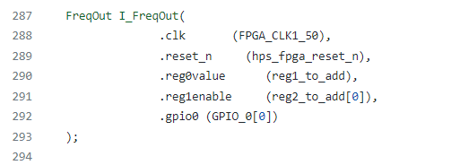
Hardware driver: FreqOUT.vhd
Need to connect the ports of the logic circuit to the registers and GPIO

Slide 11
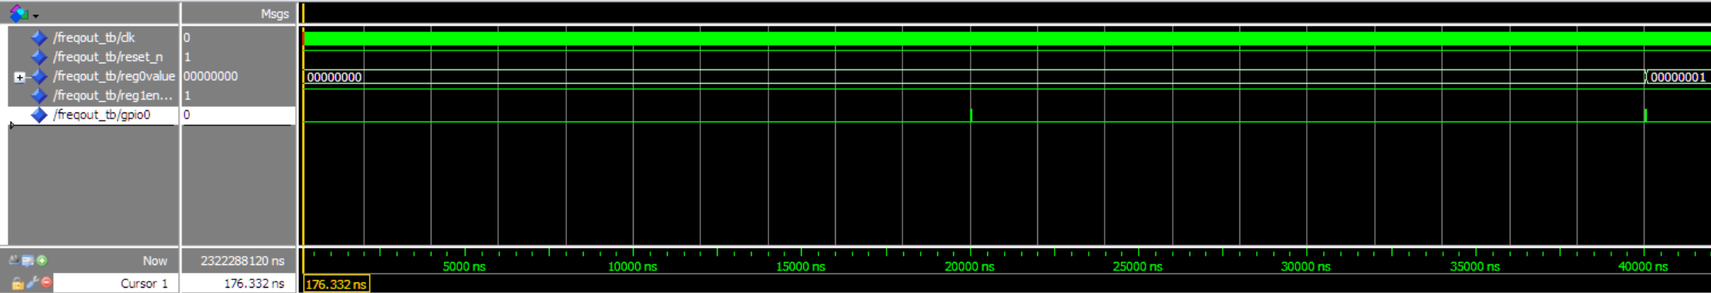
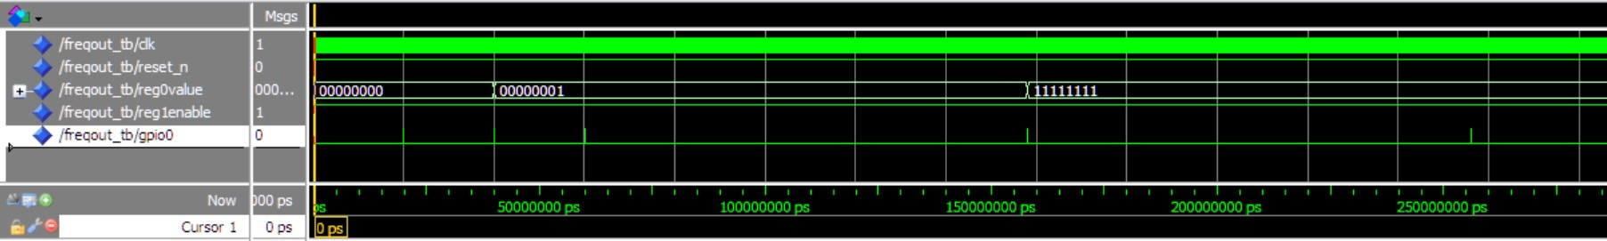
Testbench: FreqOUT_TB.vhd
Describe the way of simulating the behaviour of the FPGA by calling an entity of FreqOut and controlling signals assigned to its ports.

Slide 12

Software Development: main.c
This code manages the values put in the registers according to what the user enters as a 8-bit value.
The main function can accept multiple 8-bit values when it is called with a command line, thanks to « argv » and « argc »

Slide 13

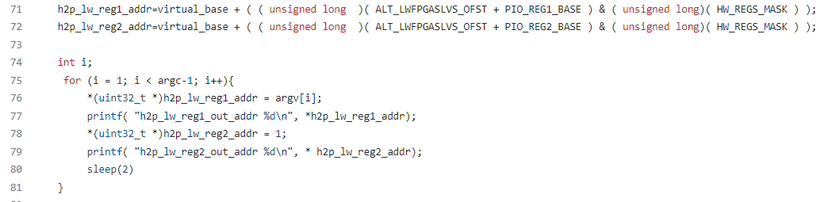
Software Development: main.c
The registers are manipulated with pointers
Pointers are then assigned to the memory address of reg1 and reg2 (using headers files)

Slide 14
Programming the processor and the FPGA
Step-by-step tutorial:
To program the FPGA, connect the board to the PC using the USB blaster (connected on the same side as the power). Go in tools>programmer and click on "harware setup", you'll find the DE-SOC [USB-1], select it and close. Click on "add file" and find the "HPS_CONTROL_FPGA_LED.sof" in the directory of the project. Add it and click on "Start". Your FPGA is now programmed.
Connect now the USB blaster to the other side and connect the board the ethernet. Open your peripherals manager to find the number of the port the board is connected to. Open Putty, select "serial" mode, enter the serial line that you found, put 115200 as baudrate and click open. The linux terminal opens and you can enter "root" as login and type ifcongig to see the IP address of the board.

Slide 15
Programming the processor and the FPGA
Start the SoC EDS Shell and access the directory of your project. You'll find the HPS-FREQOUT file that was generated from the main.c and converted into a file that can be executed in the linux OS of the processor. If you modified the main.c, juste type "makefile" to call the file that will do the conversion.
Finally, to run the genrated file, type
"scp HPS_FREQOUTroot@255.255.255.255:/home/root“
and replace the IP address with the retrieved one.

