Slide 1

Basic Details of the Team and Problem Statement
Ministry/Organization Name/Student Innovation: Student Innovation
PS Code: PK845
Problem Statement Title: Career guidance System
Team Name: Glorious Coders
Team Leader Name: Ayush Upadhyay
Institute Code (AISHE): U-1056
Institute Name: NETAJI SUBHAS UNIVERSITY OF TECHNOLOGY
Theme Name: Miscellaneous

Slide 2
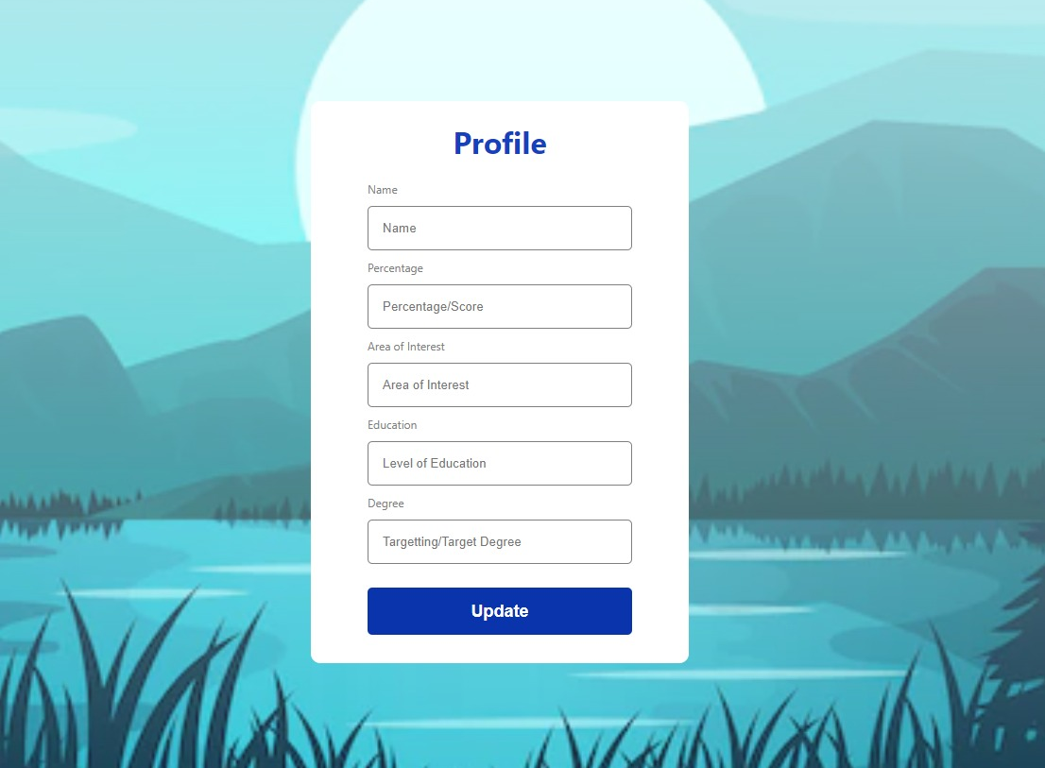
Idea/Approach Details
simulated image of prototype
Idea/Solution:
An AI-Based Website which recommends an individual the career path to choose based upon the factors like their strengths, weakness, age, interest and similar important factors.
The site will use AI for generating a career path suitable for user on the based on the question answer by the user.
The site would provide a platform for experts to comment and reply to the problems and question a student or user is having .
Describe your Technology stack here:
Use of ReactJs.
Use of HTML/ CSS/ JavaScript.
Use of NodeJs, ExpressJs.

Slide 3
Idea/Approach Details
Use Cases
Ask necessary questions regarding User’s interest to generate career path.
Dependencies / Show stopper
User registers to get
career counseling
AI generated career path
Aadhar Verification system database for user login.
Requirement of school/ University database to get more details about student.
DATABASE
Apply to become
career guidance expert
Interview scheduled
Ask academic details and work experience to schedule an interview.

Slide 4
Team Member Details
Team Leader Name: Ayush upadhyay
Branch (Btech) Stream (IT): Year (II):
Team Member 1 Name: Aditya Mehrotra
Branch (Btech) Stream (ICE): Year (II):
Team Member 2 Name: Hardik Chabra
Branch (Btech) Stream (ECAM): Year (II):
Team Member 3 Name: Mayank Dewan
Branch (Btech) Stream (ECE): Year (II):
Team Member 4 Name: Ankit Khurana
Branch (Btech) Stream (ICE): Year (II):
Team Member 5 Name: Aashima Chopra
Branch (Btech) Stream (MEEV): Year (II):
Team Mentor 1 Name: Manu Sheel Gupta
Category (Academic) Expertise (Software Engineering): Domain Experience (15+ years):
Team Mentor 2 Name: Pinaki sir
Category (Academic) Expertise (Agile Software Engineering): Domain Experience (20+ years):

