Slide 1

POV Clock
Prepared by:
-Hazim Emad Ismail
-Mohamed Abd ElMonem Ali

Slide 2
Introduction
Persistence of Vision (POV) refers to the optical illusion in which an afterimage of an object seen by the eye exists for a brief time, usually 1/10th of a second.
We have used this phenomenon to create a POV clock where we display the shape of an analog clock by driving a one dimensional LED array (1 x 17) using precise time delays.
The main idea of the POV display is to flash/blink the LEDs at the exact same location in each revolution.
If the speed of the revolution is fast enough, then the human eye cannot distinguish between two different blinks, and the LEDs appear to be static and constantly glowing.
Usually the motion picture frame rate is 24 frames per second, and this seems to be an ideal condition for smooth POV system. However, anything above 10 updates per second can provide illusion of continuous motion.

Slide 3
Objectives
The main objectives of this project are to implement the following:
Determine the power consumption of the system especially the maximum current requirement, so that it matches with the specified ratings of the battery.
Design hardware system (PCB) which is fairly balanced and as light as possible, so that it can be mounted on the rotating arm of the motor to provide a balanced and stable rotation.
Use precise time delays utilizing timer interrupts to flash the LEDs at precise locations.
Design hardware and algorithm for compensating the change in RPM (to display a stable clock face - avoid rotation/dragging of clock shape) using hall effect sensor.

Slide 4
Components
PCB
12V DC Motor & DC Power Supply
Atmega32
Crystal Oscillator(8MHz) & (2) Ceramic Capacitors 22pF
Universal ZIF Socket 40 Pin
(15) Red LED & (1) White LED & (1) Blue LED
Hall Effect Sensor A3144E
IR Receiver Module 38kHz (KY-22)
Self Locking Switch 6Pin (8X8mm) ON/OFF
Battery 3.7v
Boosting Circuit From (3.7v) To (5v)

Slide 5
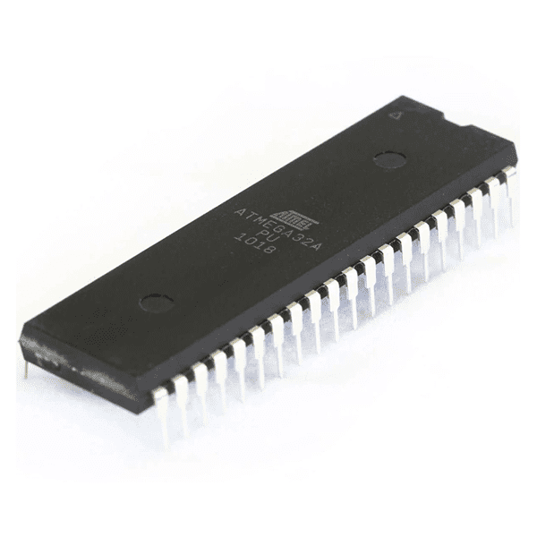
Atmega32
The Atmega32 is an AVR microcontroller that has 32 GPIO pins.
We connected 15 of those pins (from ports A and B) to the LEDs of the propeller.
We connected the IR receiver module to the D6 pin in order to read the IR signals in the ICP interrupt of timer1.
We connected the Hall effect to the D3 pin in order to detect the end of the cycle in the EXT0 interrupt.
We utilized timer0 in the CTC mode for updating the time.
We also tried using timer2 in CTC mode for calculating the motor speed.

Slide 6
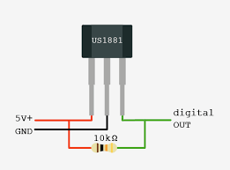
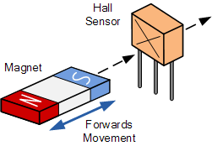
Hall Effect Sensor A3144E
It is a type of sensor which detects the presence and magnitude of a magnetic field using the Hall effect.
4.5V to 24V DC operation voltage.
More efficiency with higher voltage.
Hall sensors are commonly used to time the speed of a revolution.
The hall effect must be connected with a pull-up resistor.
When the hall effect detects a magnet, the LEDs turns on.
When there is no magnet, the LEDs turns off.

Slide 7
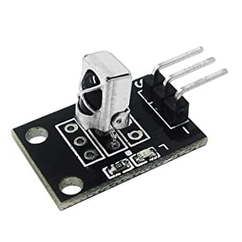
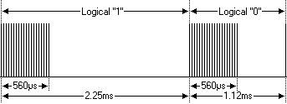
IR Communication
The IR receiver module uses the NEC protocol and operates at a frequency of 38KHz.
The NEC protocol uses pulse distance encoding of the bits. Each pulse is a 560µs long on a 38kHz carrier.
Logical '0' – a 562.5µs pulse burst followed by a 562.5µs space, with a total transmit time of 1.125ms.
Logical '1' – a 562.5µs pulse burst followed by a 1.6875ms space, with a total transmit time of 2.25ms.

Slide 8
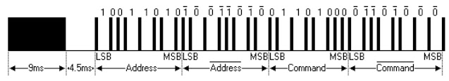
IR Communication
The NEC protocol consists of the following:
A 9ms leading pulse burst
A 4.5ms space
The 8-bit address for the receiving device
The 8-bit logical inverse of the address
The 8-bit command
The 8-bit logical inverse of the command
A final 562.5µs pulse burst to signify the end of message transmission
The address and command are inverted and transmitted twice for reliability. The four bytes of data bits are each sent least significant bit first.

Slide 9
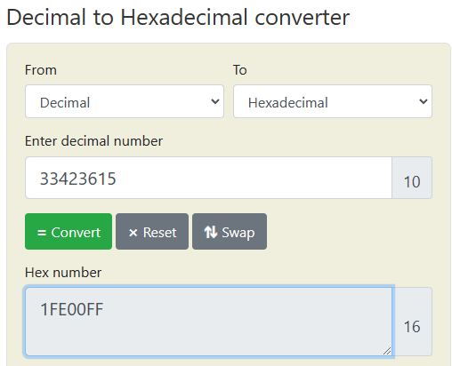
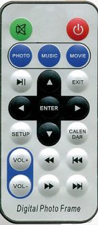
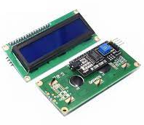
IR Communication
The IR remote outputs a unique code for each button, so we used an I2C LCD which requires only 4 wires to be connected in order to display and note down the codes for all the buttons.

Slide 10
Hardware Design

Slide 11
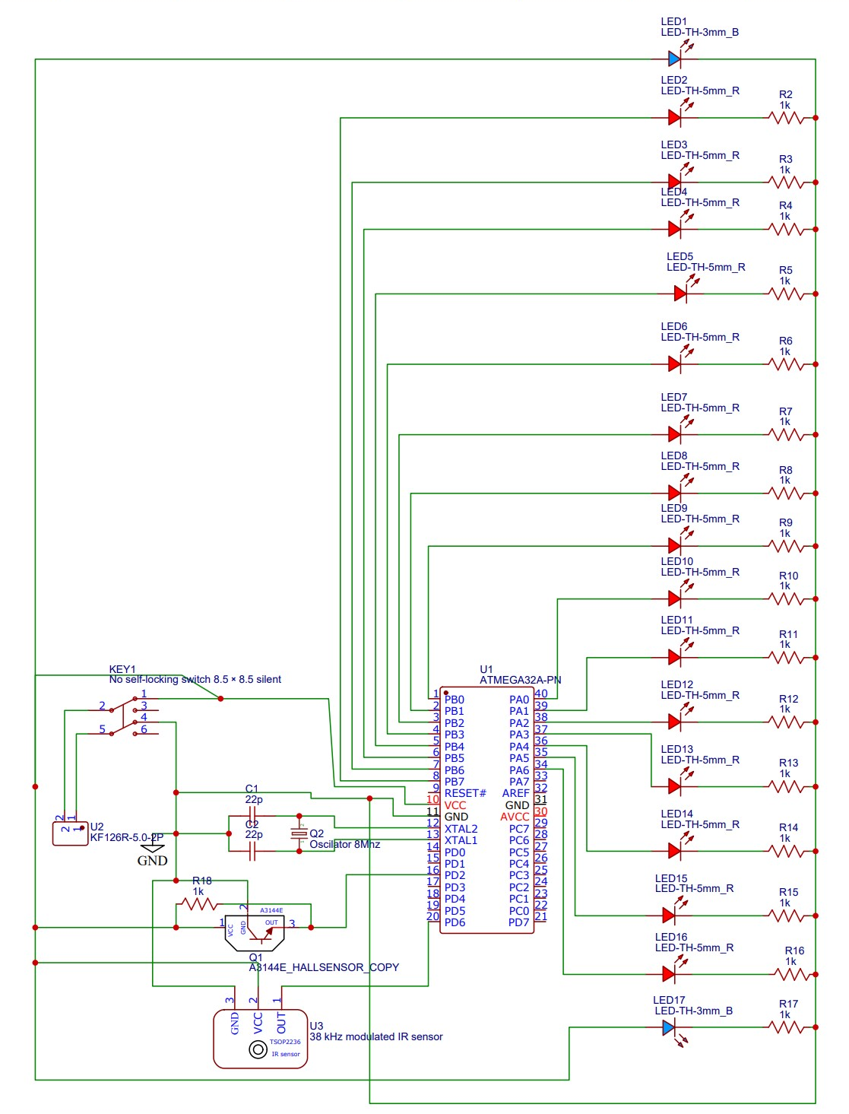
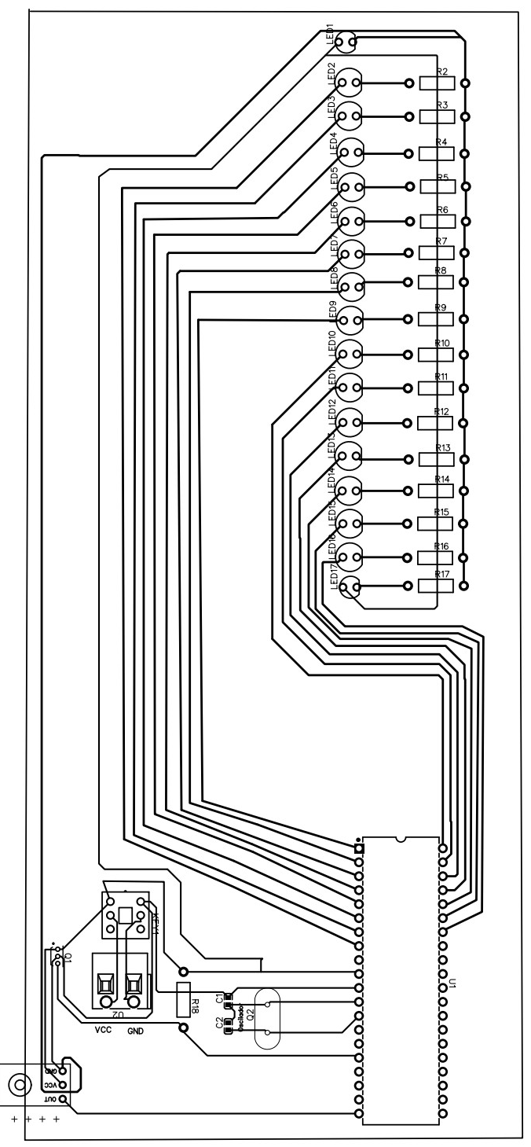
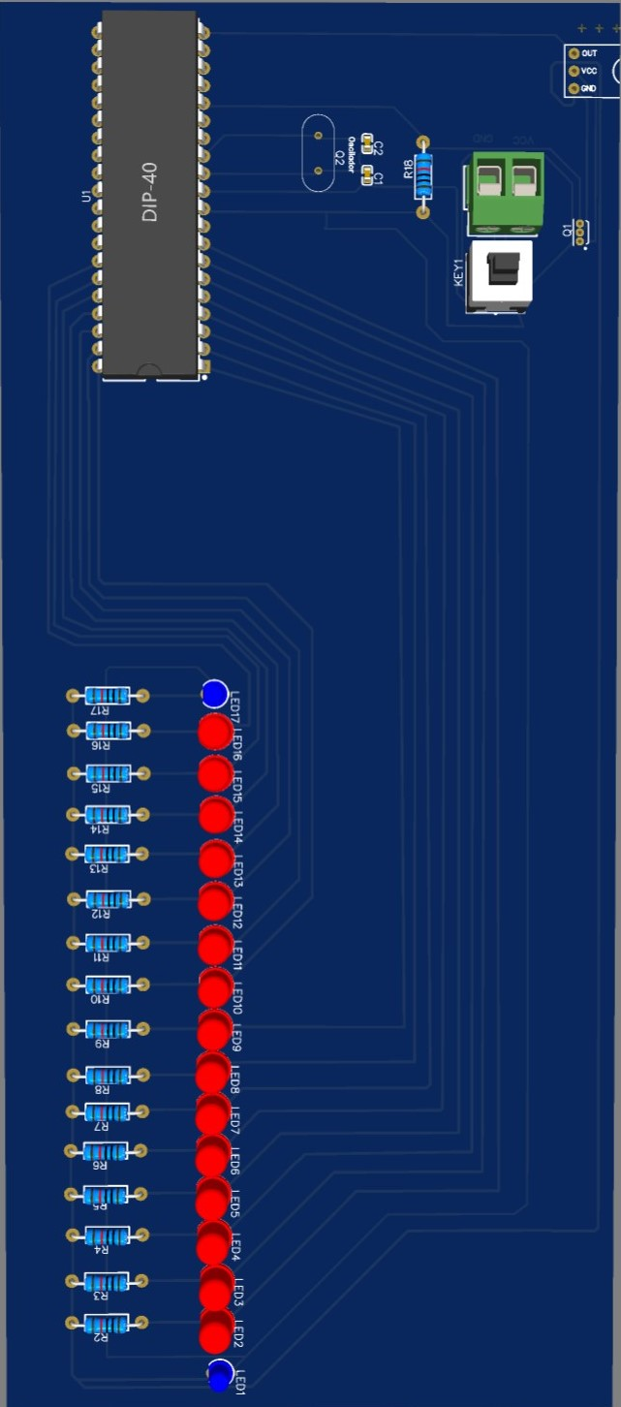
PCB Design

Slide 12
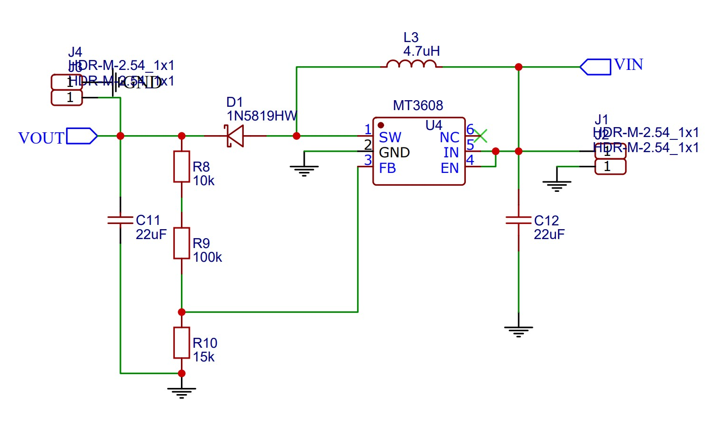
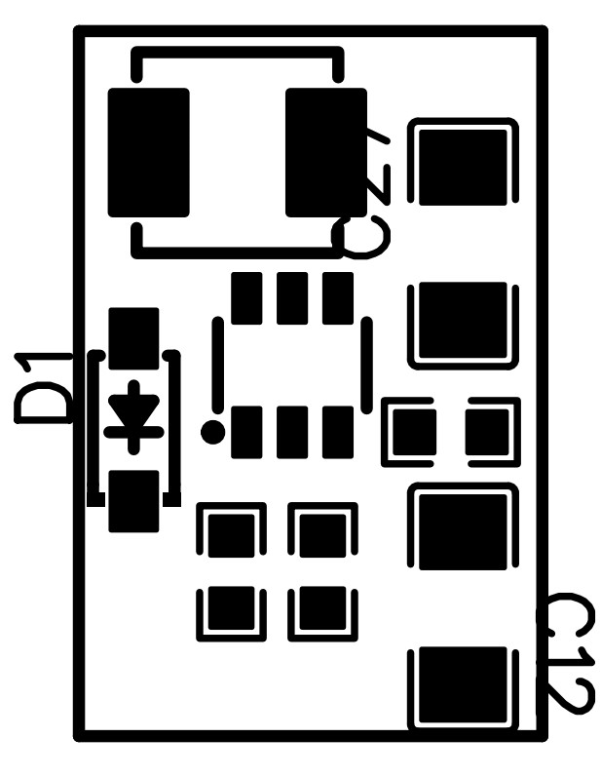
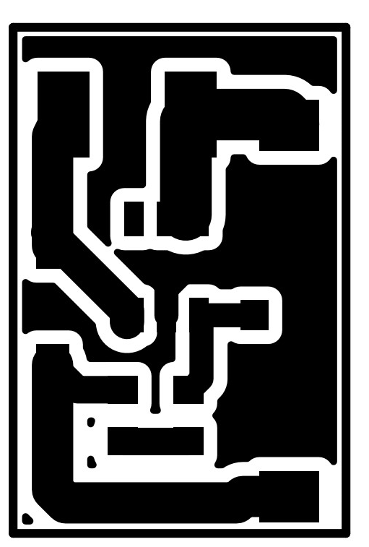
Boosting Circuit From (3.7v) To (5v)

Slide 13
Flowcharts

Slide 14
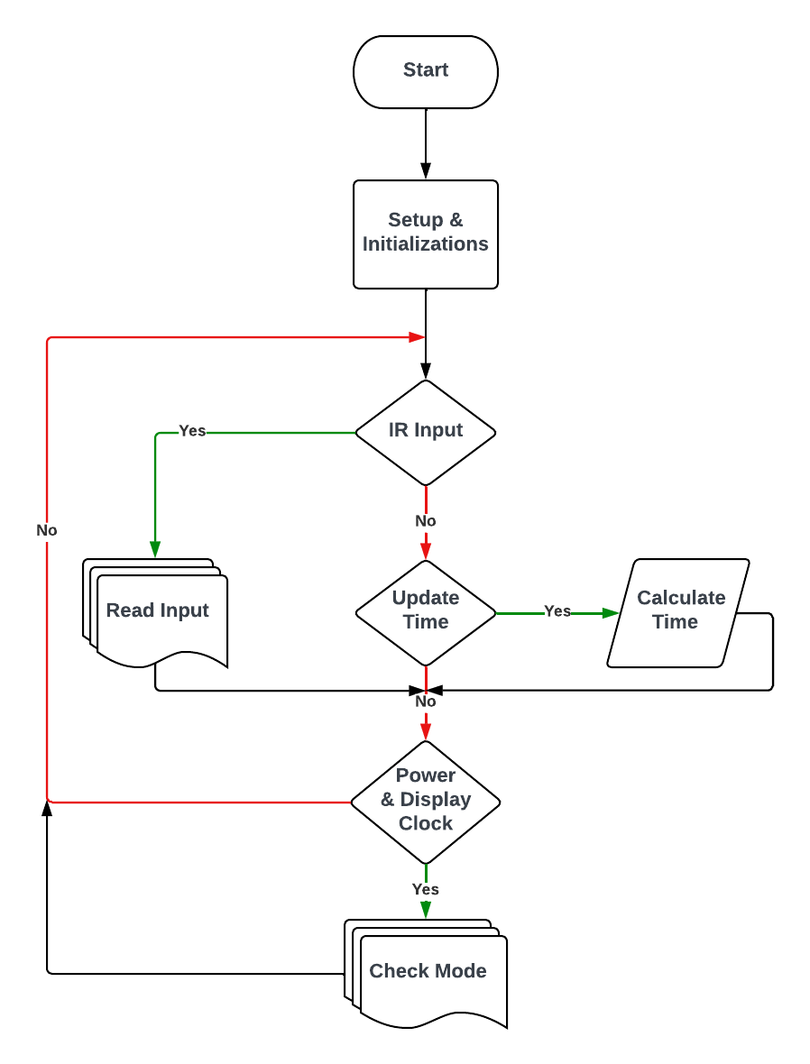

Slide 15
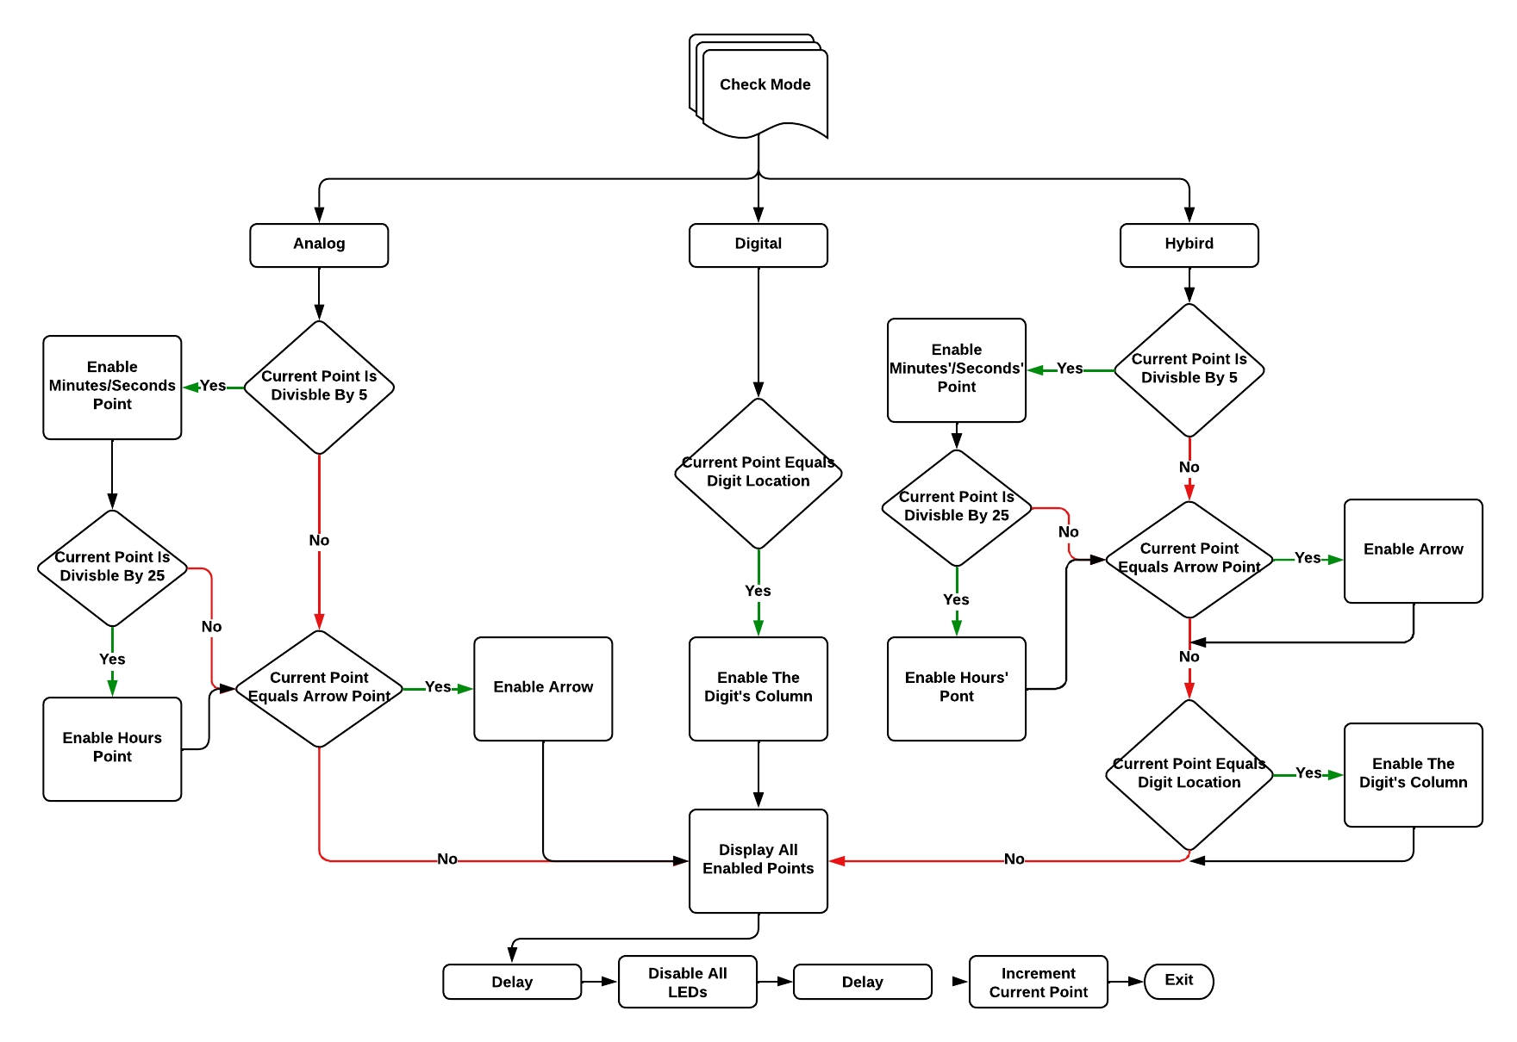

Slide 16
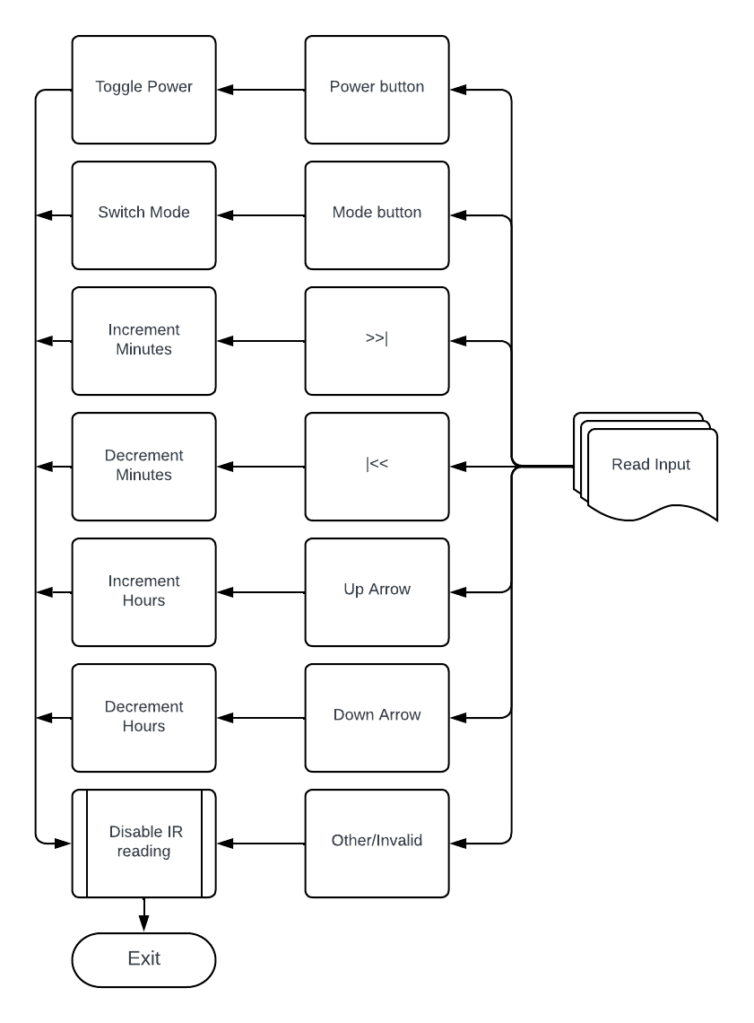

Slide 17
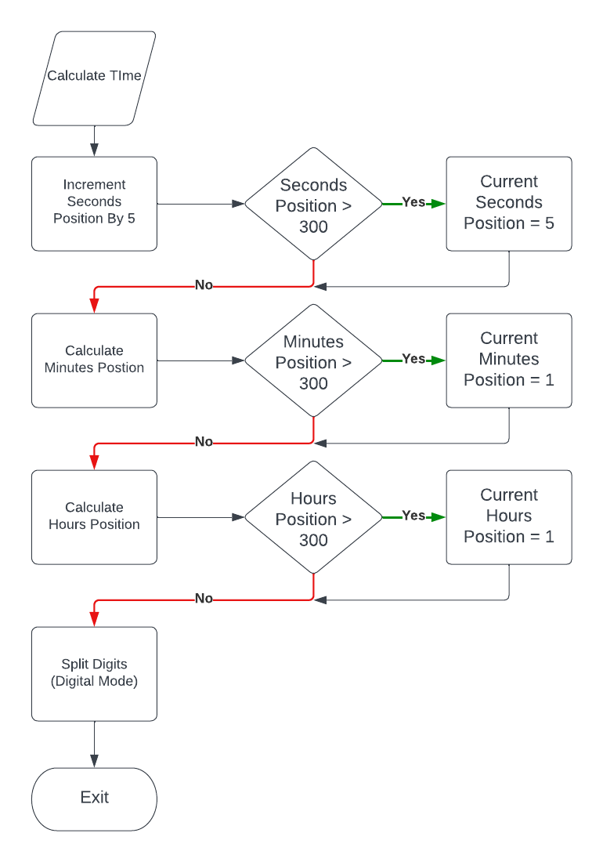

Slide 18
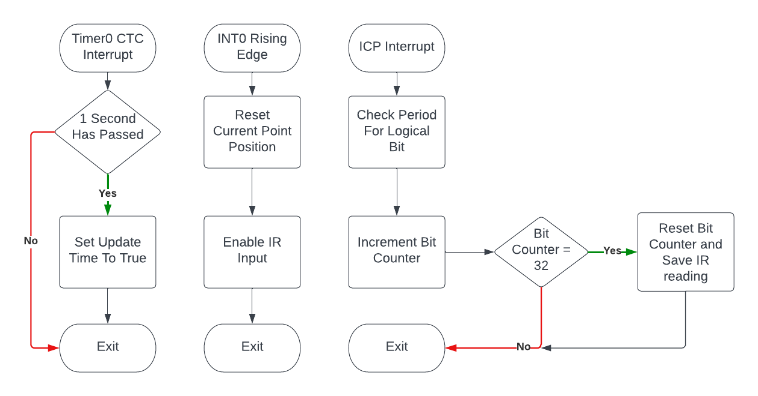

Slide 19
Workflow
We split the clock into 300 virtual points with equal spacing for a full cycle.
This can be achieved by either:
Making the delay constant and changing the motor speed using a power supply.
Making the motor speed constant and calculating the delay using the hall effect sensor and timer2 to calculate the cycle time then dividing it by 300.
The IR remote is used to turn the clock on and off.
Whenever the propeller passes the magnet, the hall effect outputs a low signal which is detected by the INT0 pin (on the signal’s rising edge as the hall effect leaves the magnet‘s area of effect). This signifies that the clock should redisplay its contents again from the beginning achieving the desired POV effect.
Using Timer0, we were able to accurately update the clock every second in the CTC interrupt.

Slide 20
Workflow
We can then decide what to display on each of the 300 points.
The IR remote can also be used to switch between modes:
For the analog mode, we display a minutes’/seconds’ point marker every five points for a total of 60 minutes/seconds, and we display an hours’ marker every 25 points for a total of 12 hours. We also display the arrows for the seconds, minutes, and hours in their appropriate positions.
For the digital mode, we used 11 LEDs for the height of each digit and had full control over the placement of the numbers since they don’t take the full cycle. We decided to add “IMT” as a symbol of appreciation in the empty space at the bottom of the clock.
For the hybrid mode, we combined the principles mentioned above but on a smaller scale to fit everything.
The IR remote can also be used to adjust the time as desired.

Slide 21
Thank You!

