Slide 1

Proud Puppies
Group 14: Brennan Connolly, Austin Echols, Sam Emswiler, and Ashley Findley

Slide 2
Meet the Team!!
Brennan Connolly
Writing and Editing Lead
Usability Consultant
Version Control Lead
Sam Emswiler
Code Integration Specialist
Troubleshooter
GUI Co-Lead
Comedic Relief
Austin Echols
Back End Development Lead
GUI Co-Lead
Sarcasm Supplier
Ashley Findley
Team Manager
Design Lead
Theme Coordinator

Slide 3
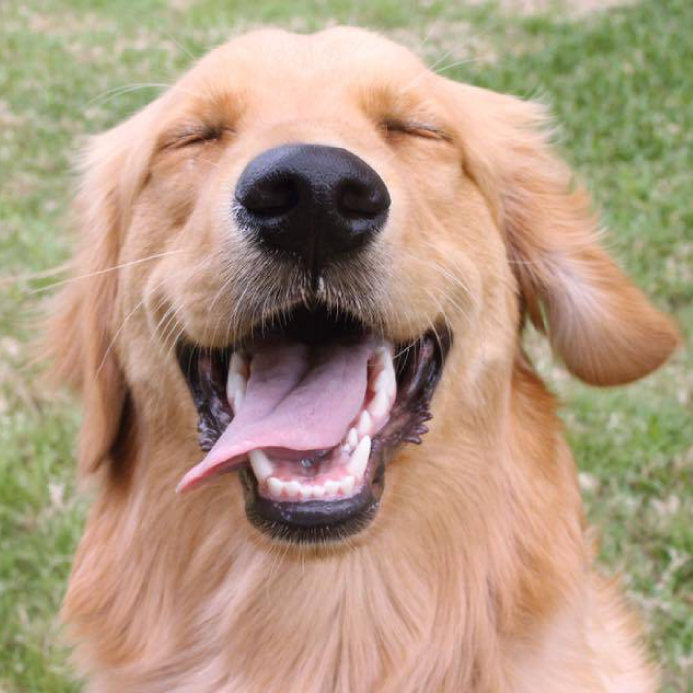
Project Theme
We decided to focus our application on animals, especially pets.
Who doesn’t love photos of cute animals? We figured that this would be a widely appealing, easily agreed-upon theme.
Looking at cute animals is good for your health. Look at this dog. Look. At. Her.

Slide 4
Collections and Data
Our application displays many kinds of information about animals. The fields are:
Name
Species
Breed
Sex
Age
Color
UFA (Up For Adoption)
Vaccinated
Fixed (Neutered/Spayed)
Description
Images

Slide 5
Functionality
Implemented
Import Dataset
Navigate Dataset
Edit Dataset
View “About” Page
Unimplemented
Log In/Log Out
Upload/Delete data
Save an Adorable (Favorite)
Share Adorables
Search and Filter Collection

Slide 6
Demo Time!

Slide 7
Evaluation
Usability Test Tasks:
Find the 3rd image of Georgia and view it in the main display.
Find the age of Snowball.
Locate all team member names.
Half of the users were not told that they needed to load a CSV file to view images.
These users took about 2-3 minutes to figure this out.
Other tasks were completed with relative ease.

Slide 8
Possible Continuation
Complete unimplemented features and remove redundant ones
Logging in and out is especially important, since users with accounts need to have the exclusive ability to manage their uploaded animal data and Adorables.
Searching and filtering are the key functions that would attract users.
Cut, Copy, and Paste functions are near-useless for our purposes.
Develop a marketplace
Pet Stores, pounds, and shelters might be interested in features that let users find pets up for adoption within their locality.
A reputation system could help consumers find good places to buy pets.

